Slide 1
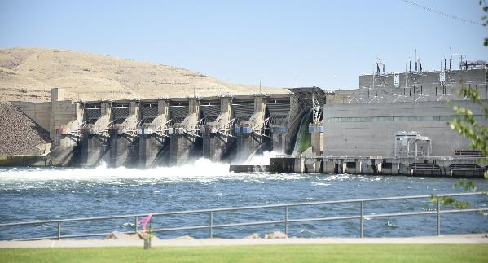

Hydropower Concepts
Background and Basics
How hydropower demands impact ResSim Simulation.

Slide 2
Objective:
To review some basic hydropower concepts and how they affect reservoir system analysis.
  General Energy Concepts
    Definitions
    The Nature of Power Demand and Supply
  Computing Hydropower Releases
  Types of Hydropower Projects
  Reservoir Hydropower Simulation

Slide 3
Definitions
Work = Force × Distance (ft-lbs. or N-m)
Power = Rate of doing work
  Referred to as Capacity (to do work)
  Electric Capacity given in Megawatts*
  1 Kilowatt = 1,000 N-m/sec = 737.56 ft-lbs./sec
  1 Megawatt = 1000 Kilowatts.
Energy = Work = Power * Time
  Electric Energy given in Kilowatt-hours*
  Work accomplished, but not how fast!
Notes:
Kilowatts (KW) and Kilowatt-Hours (KWh) are common units reported to the consumer to describe their power/energy usage.
However, Megawatts, Gigawatts, and Terawatts are all units used in the industry to describe demand and generation at the plant or system level
ResSim works in Megawatts (MW) and Megawatt-Hours (MWh).

Slide 4


The Nature of Power Demand and Supply

Slide 5
Nature of Power Demand
Demand for Power must be exactly met
  Supply == Demand at all times
  Over supply – if not sold, it’s waste.
  Under supply – undesirable consequences…
But, Demand varies…
  Throughout each day
  From day to day
  And from week to week, month to month, year to year…
Notes:
Supply MUST EQUAL Demand – Really? Or is this just an objective? Why would we make this statement?
Because undersupply has undesirable consequences – blackouts, brownouts, damage to infrastructure and equipment
And oversupply goes to waste – if it can’t be sold. Electricity can’t be stored – although it can be converted to other forms of energy – e.g., batteries store electrical energy as chemical energy. What other ways can we “store” energy.

Slide 6
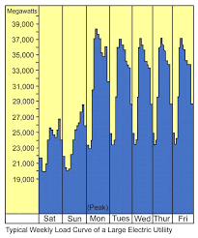
Load Curves
Load = demand for power
Load Curve: Graph of load changing with time
  Hourly, Daily, Weekly,
  Monthly, Seasonally, Annually
Example: Typical Weekly Load
  Weekends low
  Nights low
  Mid-day peak

Slide 7
Load Characterization
Daily Load Curve
Load-Duration Curve
Power Demand
Peak Load
Peak Load
Intermediate
Load
Intermediate
Load
Base Load
Base Load
Time of Day
% of Day
System Capacity is Sized to Meet Maximum Power Demand
Notes:
Baseload sources operate day and night, generating at a constant rate – this is the most efficient use of the turbines and generators and reduces the code of energy production. Nuclear, coal, oil, gas
Intermediate Load sources – not as difficult to ramp up as base load, not as expensive to operate as peak load. Combined cycle thermal plants – gas, oil, biomass, geothermal. Scheduled Hydropower. Solar. Wind.
Peak Load sources – able to ramp up quickly, inefficient and therefore expensive. Gas turbines (simple cycle), peaking hydropower (often with pumpback storage)

Slide 8
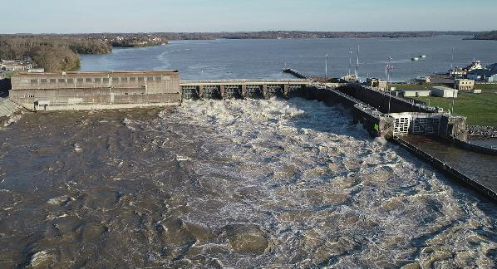
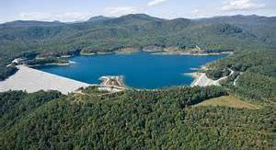
Types of Hydropower Projects
Notes:
Old Hickory Lock & Dam
Bad Creek Lake (a pumpback project)

Slide 9
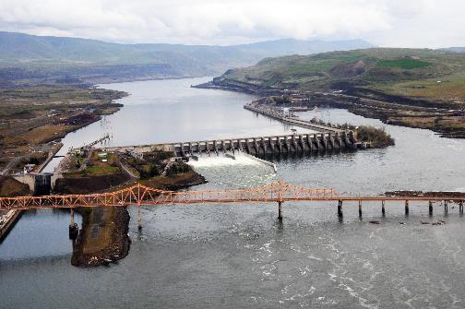
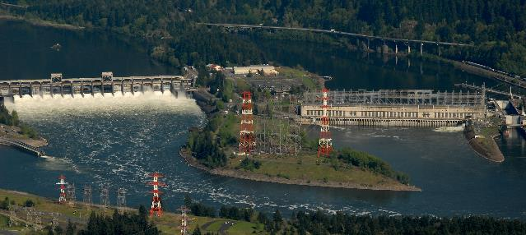
Run-of-River Projects
Headwater essentially constant
Tailwater dependent on flow
Energy computed for flow passage
Energy is Secondary with lower value
Often downstream from storage project
Flow-Duration can estimate energy
Sequential Routing needed to model upstream storage projects
Notes:
The Dalles
Bonneville

Slide 10
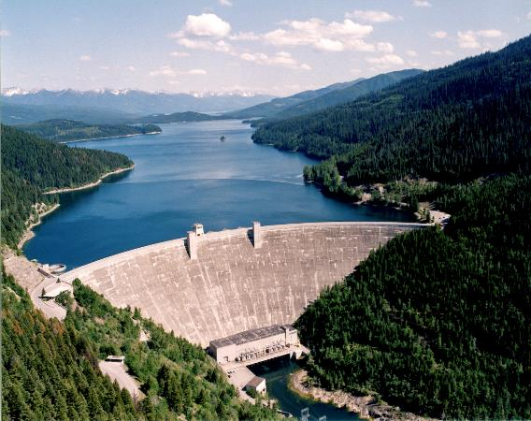
Storage Projects
Specified Power Storage Zone
Operate to meet Energy demand
Storage used when inflow is low
  Headwater varies with pool
  Tailwater dependent on flow
Sequential simulation generally required
Primary and Secondary energy are outputs
Notes:
Hungry Horse

Slide 11
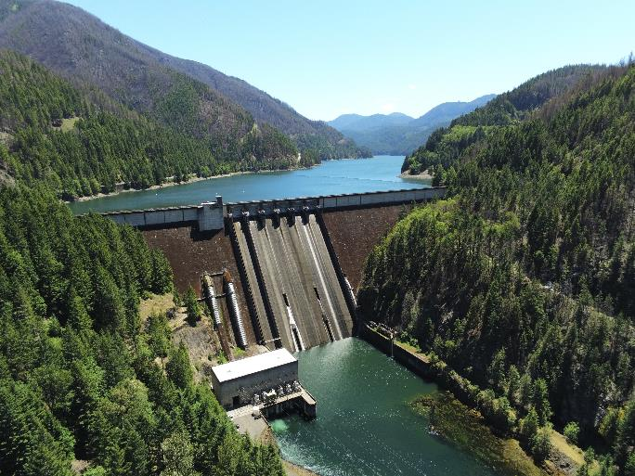
Storage – Peaking Projects
Peaking Power operates for short interval
Short time interval required to evaluate release*
  Maximum timestep = Time plant is generating
  High releases during generation
  Limited Releases when not generating
Downstream Impacts…
Notes:
Hungry Horse
Short Interval Required to “accurately” evaluate release.
However, longer interval can be used when evaluating seasonal operation

Slide 12
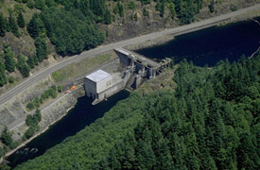
Re-Regulation Projects
Downstream of Peaking Project
Limited Storage
Variable Pool
Steady release
Reduced impact on downstream
Notes:
Big Cliff Dam – Downstream of Detroit

Slide 13
Storage – Power Guide Curve
Power demand expressed as a function of pool level
Firm energy from minimum power pool to power rule curve
Provides more energy when water supply is high
Notes:
Hydropower Storage Projects
Power Guide Curve used to expressed power demand as a function of pool elevation or available storage

Slide 14
Firm Energy
The amount of energy intended to have assured availability to the customer to meet all or any agreed upon portion of his load requirements.
Assured availability usually means that no shortages will be tolerated
Determined for the known or expected Critical Period
Dependable Capacity is the capacity associated with Firm Energy

Slide 15
Dependable Capacity
Load carrying ability of a station under adverse conditions for the time interval and period specified when related to the characteristics of load being applied.
Critical Hydro‑Period when the limitations of hydroelectric power supply due to water conditions are most critical with respect to system load requirements.

Slide 16
Value of Energy and Capacity
Separate benefits for energy & capacity
Primary Power benefits for dependable capacity and firm energy
  Energy based on kW-Hrs on demand
  Capacity based on availability at critical period or time
Secondary Power benefits for energy produced during high flow periods
  Secondary value usually much lower

Slide 17
Computing Hydropower Releases

Slide 18
The Power Equation
Power = weight of a discharge falling a distance
Power (kW) = [Q * w * h * e] / 737.56
  Q = discharge in cfs
  w = weight of water in lbs./ft3
  h = net head in feet (Total h - Hydraulic losses)
  e = efficiency of generator & turbine units
  737.56 ft-lbs./sec = 1 Kilowatt

Slide 19
Calculation of Power Releases
Q = 737.56 (P) / (w * h * e)
  P = power required (in kW)
  e = efficiency
  w = weight of water = 62.4 lbs./ft3
  h = Headwater - Tailwater – Losses (net head)
Q = 11.82 ( P / h * e )
  Efficiency, Headwater, Tailwater, & Losses depend on Q
  Iterative solution is required
Notes:
Rearrange the Power equation to get Q
Simplify the known constants
737.56 / (62.4) = 11.82

Slide 20
Reservoir Hydropower Simulation

Slide 21
Power Release Determination: Instantaneous
Assume net Head
  Initial based on previous period
Compute Q, based on capacity (kW)
  Q_{outflow} = Q_{power} + Q_{losses} + Q_{evaporation}
Determine Tailwater for Q
Calculate net Head, based headwater, tailwater and losses
Compute new discharge using net Head
Repeat until net Head remains same

Slide 22
Power Release Determination: Period Average
Compute Average Q for period
  Q_{outflow} = Q_{power} + Q_{losses} + Q_{evaporation}
Compute ending Storage
Determine ending Elevation
Calculate avg. Head & Efficiency for period
Return and repeat cycle until average Q remains the same

Slide 23
Water Lost to Hydropower
Leakage & Seepage
Evaporation - dependent on release
Fish Ladders, Fish Spill, Other…
Navigation Locks
Station use – cooling, power, water supply
Minimum releases during no-power time
  Missed with large time interval simulation
  Can be estimated and added to leakage

Slide 24
Hydropower Limits
Penstock Flow Capacity - can’t release more than penstock can carry
Penstock Cavitation limits – high and low flow
Generator Overload Capacity - can’t generate more than maximum capacity
Variable efficiency
  maximum efficiency exists in a narrow range of head and discharge
  Low efficiency can waste water…

Slide 25
Take Home Points
Load Curve
Duration Curve
Types of Hydropower Projects
  Storage
  Peaking
  ReReg
  Run of River
  Others?
Firm Energy
Dependable Capacity
Primary vs Secondary Energy
Power Equation:
  Power (kW) = [Q * w * h * e] / 737.56
Iterative Solution – solve for Q
  Q = 737.56 (P) / (w * h * e)

Slide 26
References
Estimate of National Hydroelectric Power Potential at Existing Dams, USACE, July 1977
Hydroelectric Power Evaluation, Federal Power Commission, FPC P-35, March 1968
Hydropower, EM 1110-2-1701, 31 Dec 1985
Potential for Increasing the Output of Existing Hydroelectric Plants, USACE, HEC July 1981

