Slide 1
Analysis of Results
HEC-ResSim Output Options
Notes:
HEC-ResSim
Simulation Module – Use Output Options to:
1. Verify Compute Complete (no errors)
2. Analyze Results (tabular and graphical)
3. Reasonable Operations?
4. Provide Evaluation Data & Reports

Slide 2
Fundamental Questions
How do you review a simulation?
  Viewing Output
  Customizing Output
  Calibration v. Verification
    Testing different scenarios – “Trials”
How do you determine if one alternative is better than another?

Slide 3
Reviewing Results
Revisit Purpose of Model
  Considerations such as Flood Damage Reduction, Water Supply, Environmental, Hydroelectric
Calibration
  Adjusting model parameters to match observed
Refinement
  Adjusting model parameters to produce desired operation
  Trials-Testing Different Scenarios
Verification
  Ascertaining that a model produces desired behavior/results under a variety of expected conditions

Slide 4
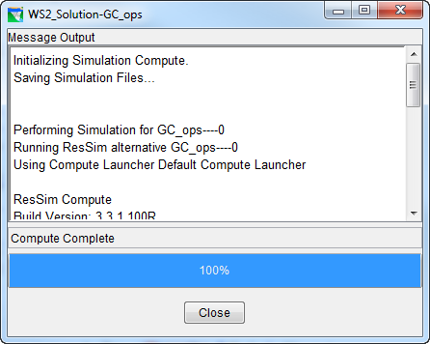
ResSim Compute Complete …
CONGRATULATIONS !!!
Now What?…
Evaluate the simulation
Notes:
Are the computational results “correct”? Just because you have a Successful Compute, that’s not necessarily an indication that the results are what you expected. Did the reservoir operations follow the rules that you input? If so, “great job” (by you and the program). If not, why not? More often than not, something unexpected occurs. The tabular and graphical tools in ResSim are intended to assist you in deciding if the results are “reasonable” (“not perfect”, since that would be unrealistic for “real” reservoir operation).

Slide 5
ResSim Output Options
Informative Text
  Simulation Compute Window
  Compute Log for Alternatives
Summary Reports
  Basic Statistics
  Release Decisions
Time Series
  Plots
  Tables

Slide 6
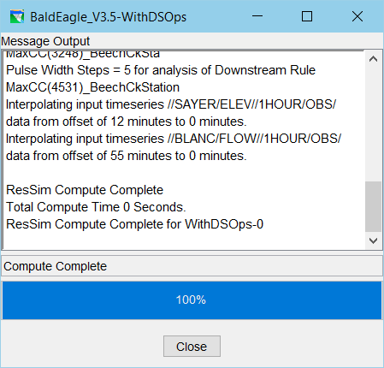
Compute Window

Slide 7
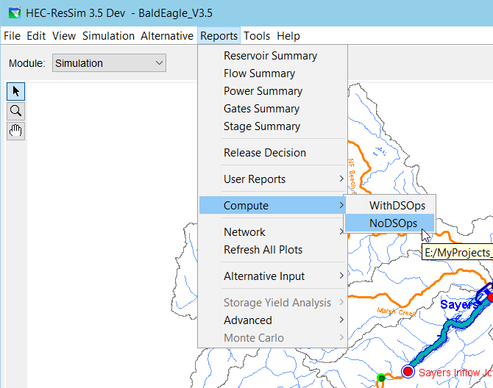
Compute Report (or Log)

Slide 8
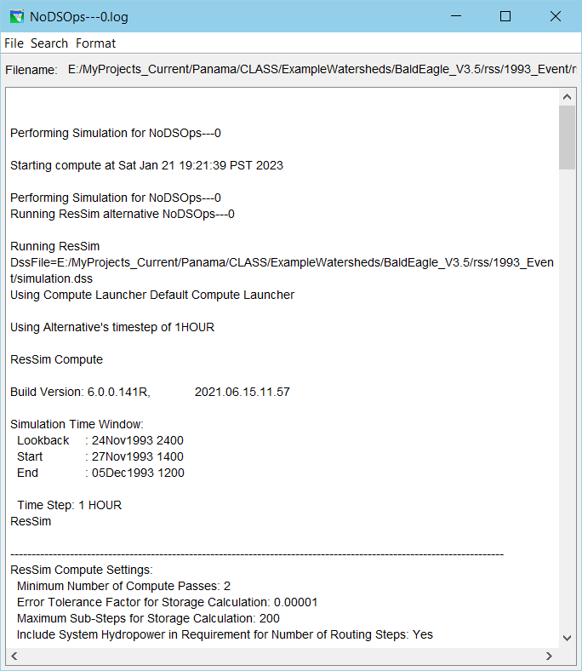
Compute Report (or Log)

Slide 9
Compute Information
Details of Compute
Verify
  Successful completion of Compute
  No Errors or Warnings
  No Exceptions
  Correct Time Window, No time-blocking
  Time Series data loaded correctly
  Proper routing window
  Proper number of passes

Slide 10
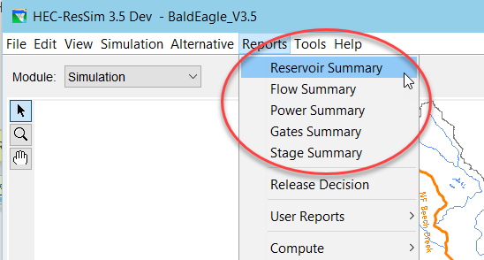
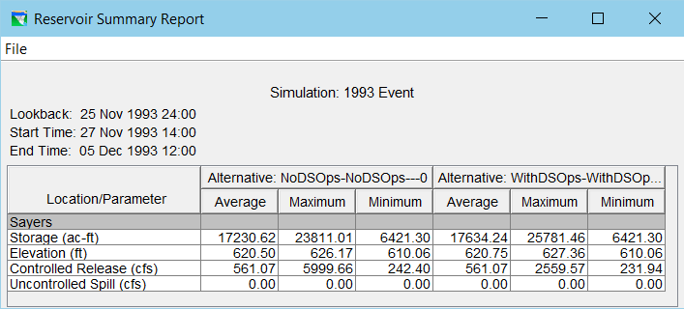
Summary Reports: Reservoirs
Basic Statistics of Reservoir Parameters
  Average
  Maximum
  Minimum

Slide 11
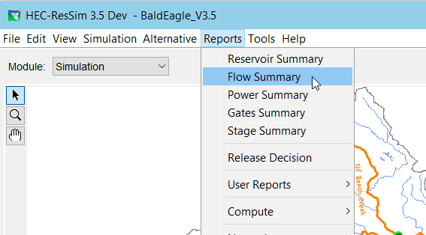
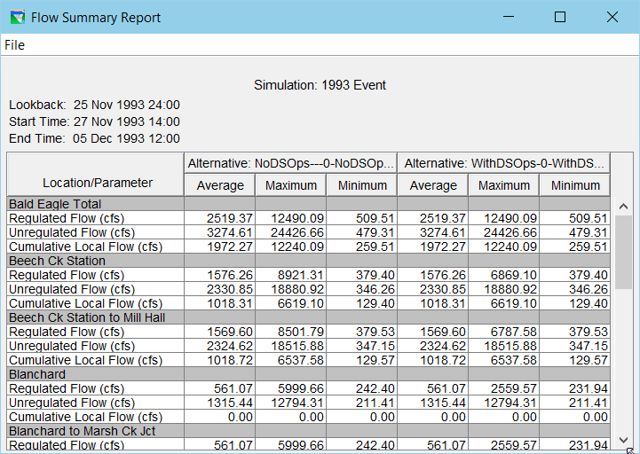
Summary Reports: Flows
Notes:
Basic Statistics for All Locations
Reservoirs
Junctions
Reaches
Flow Types
Regulated
Unregulated
Cumulative Local

Slide 12
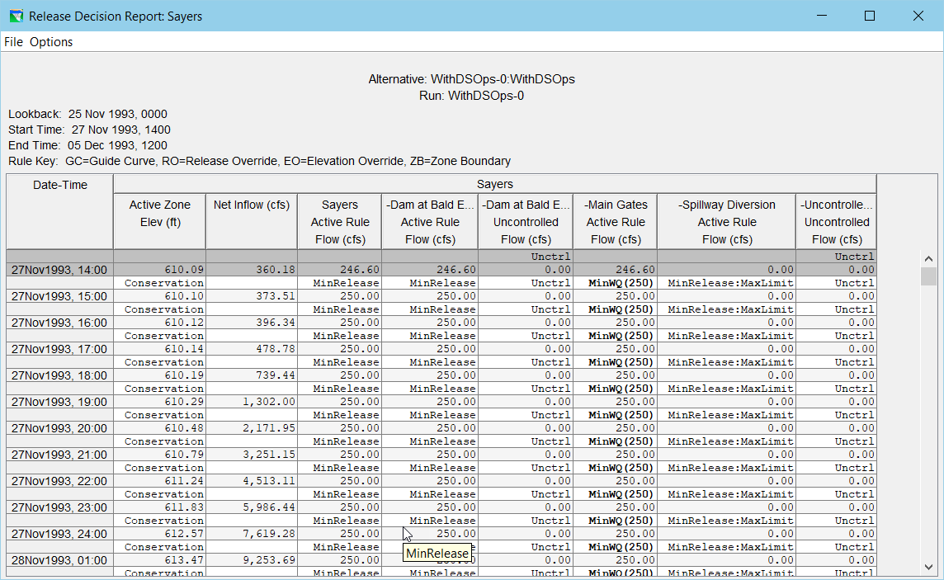
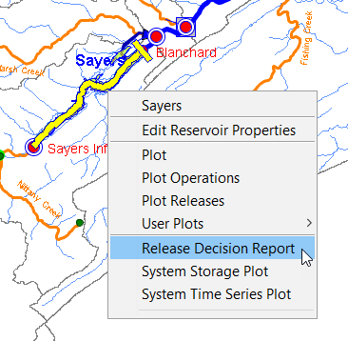
Release Decision Report

Slide 13
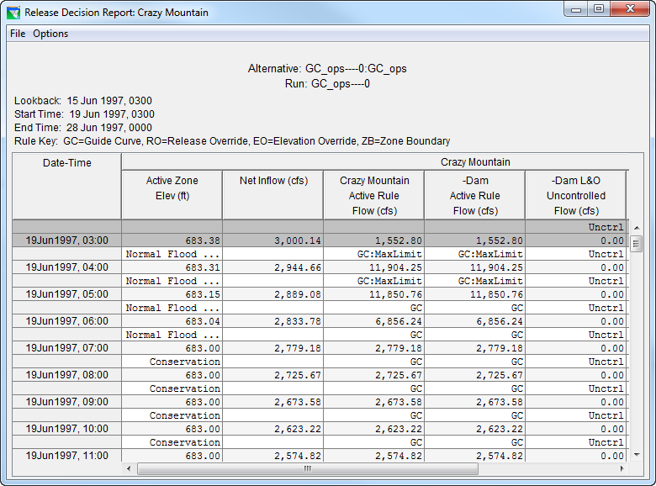
Release Decision Report
  Initial Conditions
  Active Zone
  Release “Rules”
    Objective
    Constraint
  Date & Time
  EOP Elevation
  Net Inflow
  Total Release
  Releases per Outlet

Slide 14
Time Series Output
HEC-ResSim
  Plots & Tables
    Pre-defined (Default)
    User Defined
HEC-DSSVue
  Plots
  Tables
  Computations

Slide 15
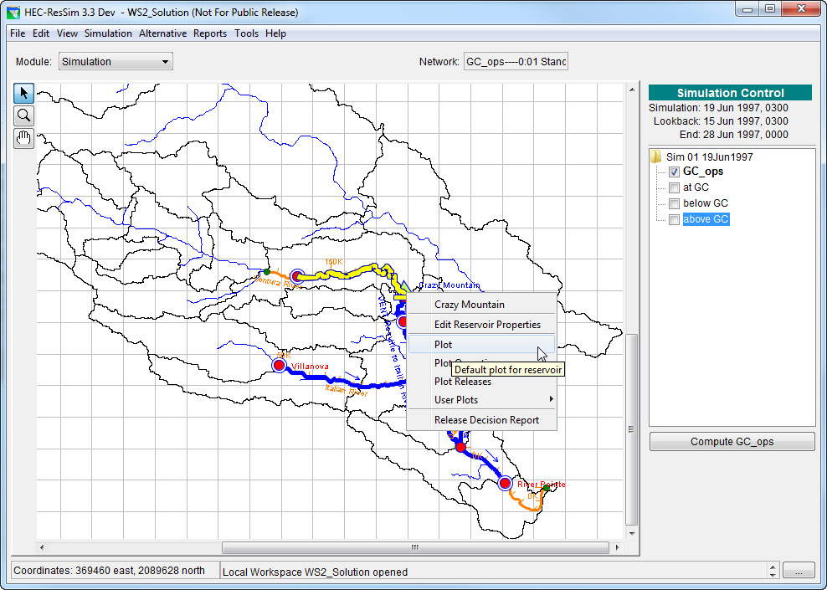
Pre-defined (Default) Plots
Select Location
Select “Plot” from Location Context Menu

Slide 16
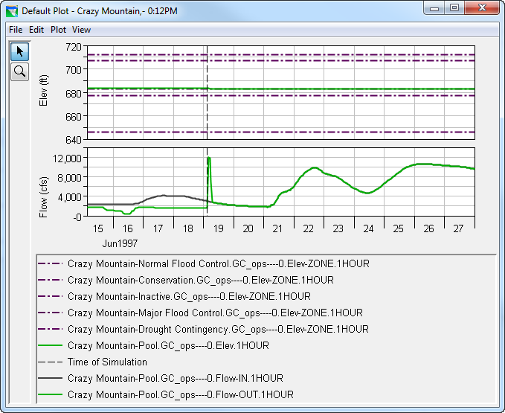
Default Reservoir Plot
Viewports
  Elevation
    Zones
    Computed Elev
  Flow
    Inflow
    Outflow
Start Time Marker
Pointer & Zoom Tools
Menu →Edit → Edit Properties

Slide 17
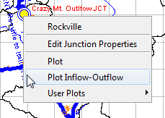
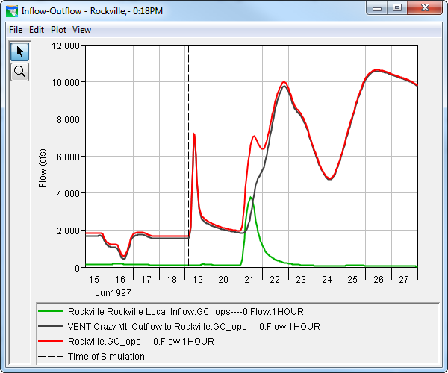
Default Junction Plot
Inflow + Local = Outflow
Verification of Routing Criteria
  Inflow to Reach from upstream
  Local Flow
  Outflow

Slide 18
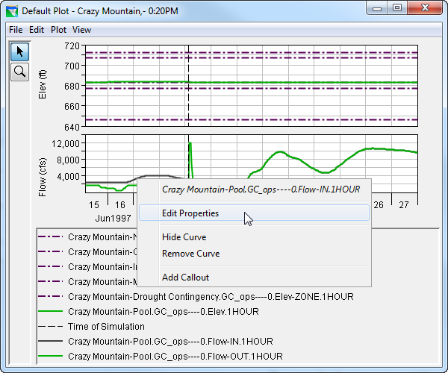
Plot Properties
Context Menu
  Edit Properties
  Callouts
File Menu
  Save Template
  Apply Template
Edit Menu
  Plot Properties
  Default Line Styles
Plot Menu
  User Defined Plots

Slide 19
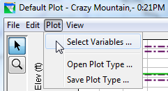
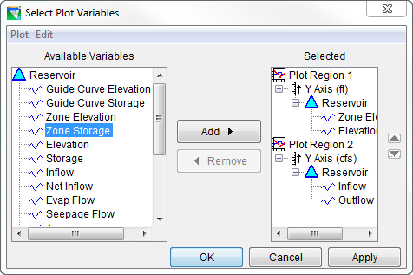
Plot Menu: Select Variables
User Defined Plots
  Variables
  Region
  Axis
    Unit dependent
    Reversible

Slide 20
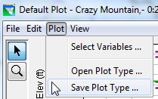
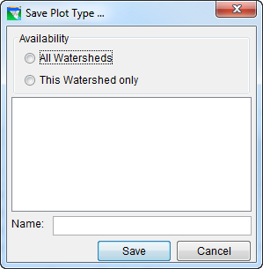
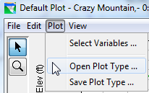
Plot Menu: Open & Save Plot Type
Save Plot Type
Name of Plot
  All Watersheds, or
  Current Watershed
Open Plot Type

Slide 21
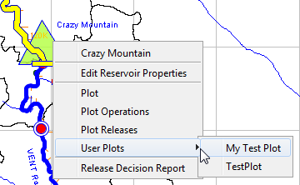
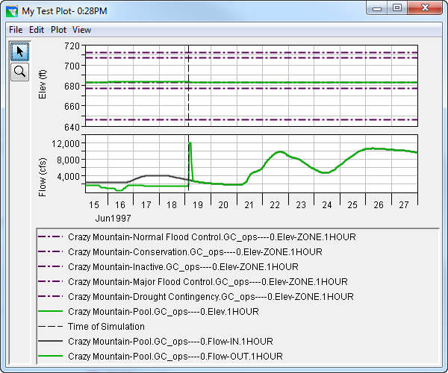
Select and Display User-Defined Plots
Context Menu
  User Plots
    Select Your Plot
    View Your Plot

Slide 22
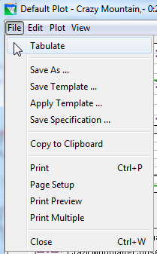
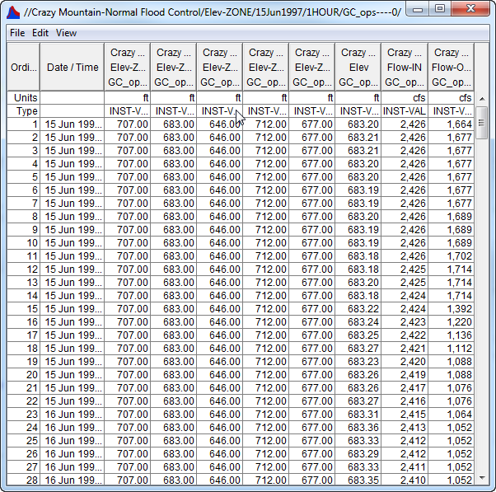
Tabulating Time Series Results
File→Tabulate from a plot’s Menu bar

Slide 23
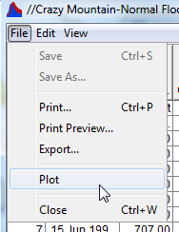
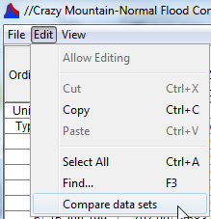
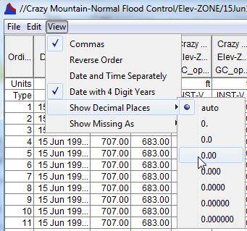
Options for Time Series Tables
File Menu
  Print & Plot
Edit Menu
  Clipboard Copy/Paste
View Menu
  Format Columns

Slide 24
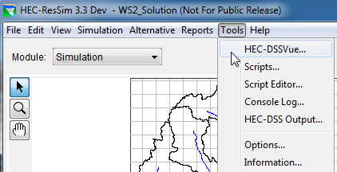
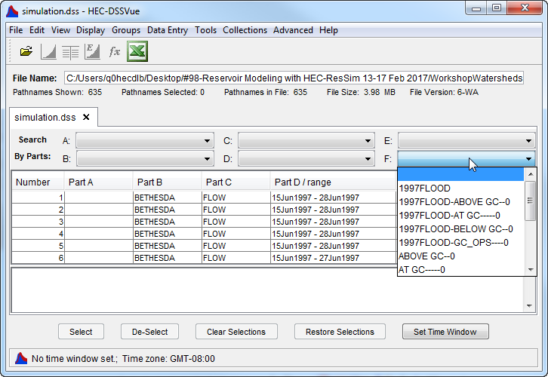
HEC-DSSVue
Tools Menu - HEC-DssVue
  Plots
  Tables
  Utilities
    Math Functions
    Statistics

Slide 25
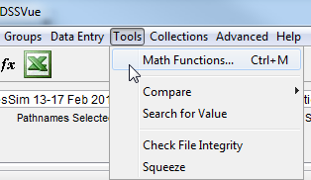
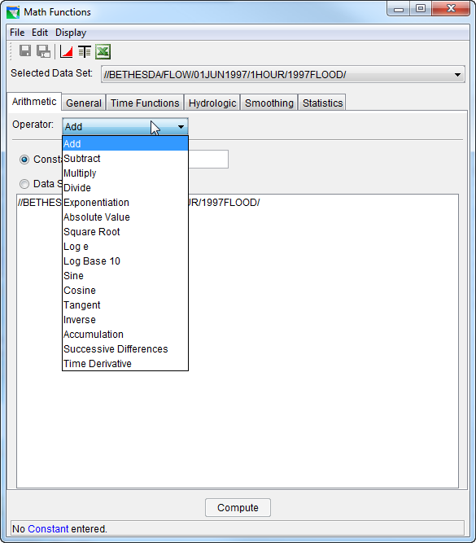
Math Functions: Arithmetic & General

Slide 26
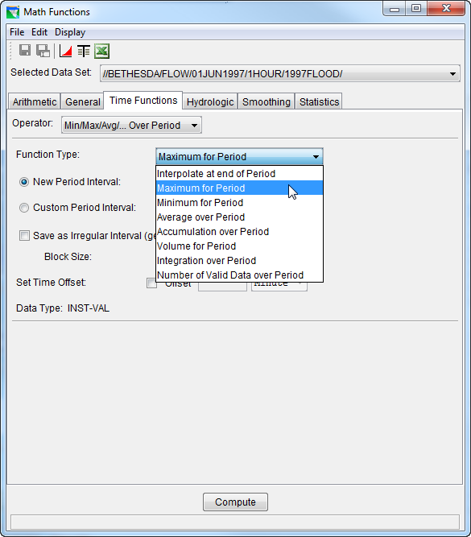
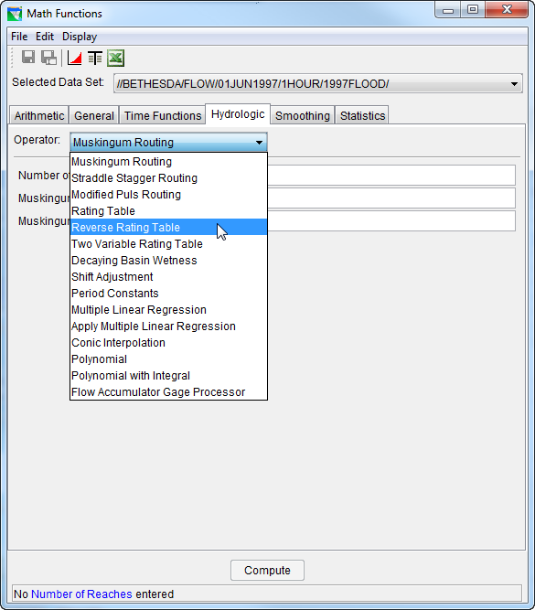
Math Functions: Time Functions & Hydrologic

Slide 27
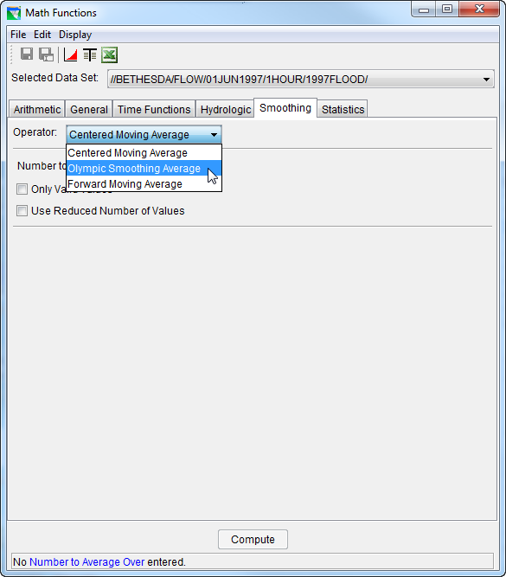
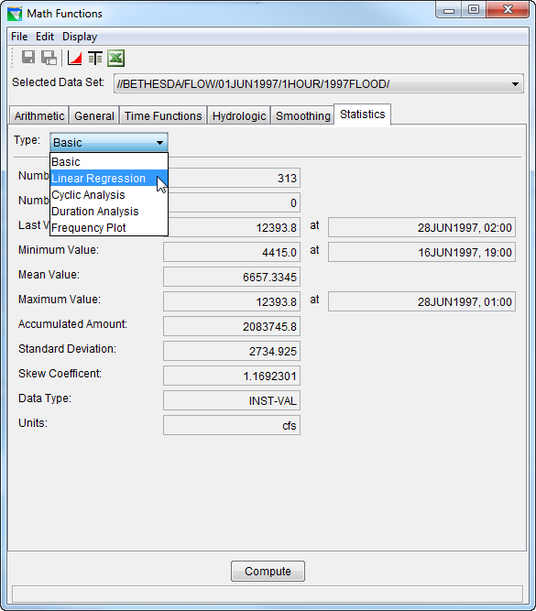
Math Functions: Smoothing & Statistics

Slide 28
Evaluation Criteria
“Columbia River Reservoir System Analysis,” report proposed four indices:
  Penalty, or Value
  Reliability
  Resiliency
  Vulnerability
(HEC, PR-21,1993)
Notes:
HEC, PR-21,1993 - Section 4.4.2 Measure of Performance (Page 34 of the pdf document)
Penalty is the raw economic impact derived from the economic and non-economic penalty functions used in HEC-PRM.
Reliability is the frequency that performance fails to meet a particular purposes' target.
Resiliency is a measure of a system's ability to recover from failure. The resiliency index used here is the number of recoveries divided by the number of failing months, expressed as a percent.
Vulnerability indicates the magnitude of typical failures, when they occur. Here, the average deviation from a performance target is used.

Slide 29
Economic Value
Value or Penalty is the economic impact from the operation
  Flood-damage reduction = Damage without – with project operation
  Power benefits = Capacity value + Energy generated
  Penalty functions in the Prescriptive Reservoir Model
    If functions were in equivalent dollars, the total value can be computed as the sum of all individual values.
    Value functions can be applied to simulation output
  Difficult to put economic value on many objectives

Slide 30
Reliability
Reliability is the frequency that performance is able to meet a particular purpose's target.
  A reliability of 100% implies that the monthly target is always met.
  In simulation, instances of failure to meet target (shortages) imply a reliability less than 100%.

Slide 31
Resiliency
Resiliency is a measure of a system’s ability to recover from failure.
  A resiliency index was defined as the number of recoveries divided by the number of failing months.
  Resiliency of 100% implies that the system always recovers, that is the system does not fail to meet a target in two successive months.

Slide 32
Vulnerability
Vulnerability indicates the magnitude of typical failures.
  The deviation is the difference between the target (e.g., diversion schedule) and the actual value.
  For storage, the average difference between the guide curve and the simulated pool elevation could be an indicator of vulnerability.
  The smaller the average the better, if the guide curve is the ideal.

Slide 33
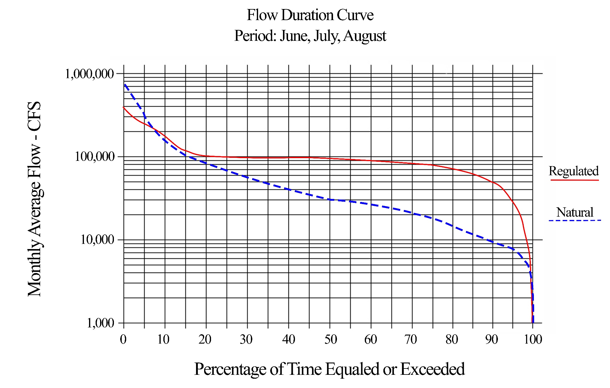
Statistical: Flow-Duration Curve
Water Years 1920-2018
Notes:
Flow-duration for natural & regulated flow shows impact of regulation.
Seasonal duration shown for critical months of operation.
Percent chance of exceeding flow during season

Slide 34
Statistical: Pool Elevation-Duration
The Annual Pool Elevation-Duration for a reservoir provides a summary indicating the percent chance the pool is at or above an elevation during the year.

Slide 35
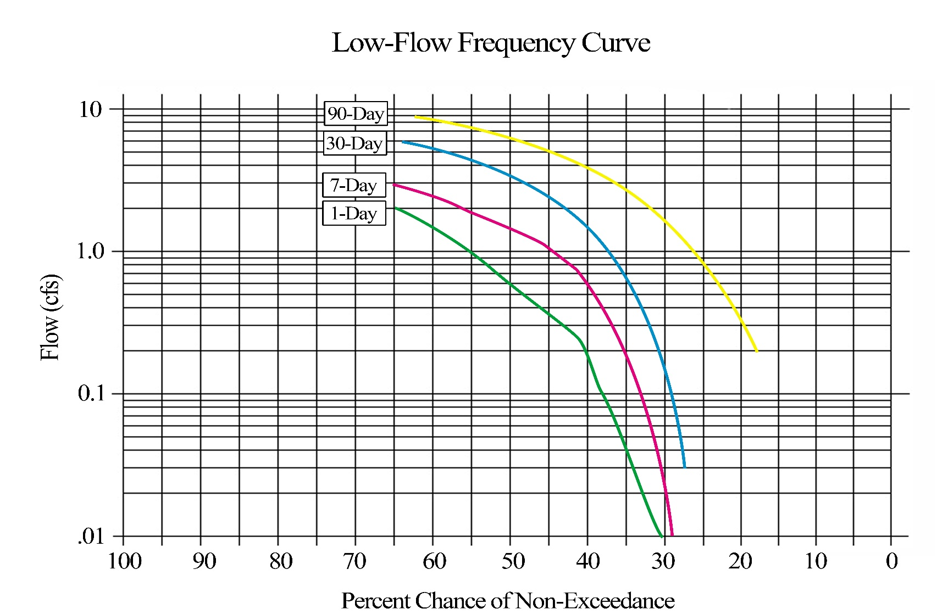
Low-Flow
Frequency
e.g., there is a 55% chance of a 1-day flow not exceeding 1.0 cfs in the year.

Slide 36
Analysis of Results…HEC-ResSim Output Options
Questions?…

Slide 37
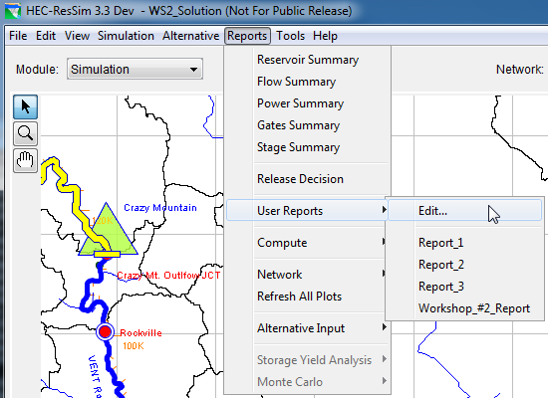
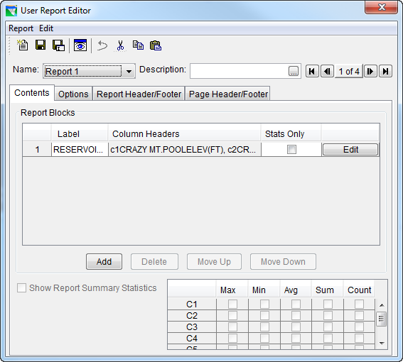
User Defined Reports
Reports→User Reports from Menu bar

Slide 38
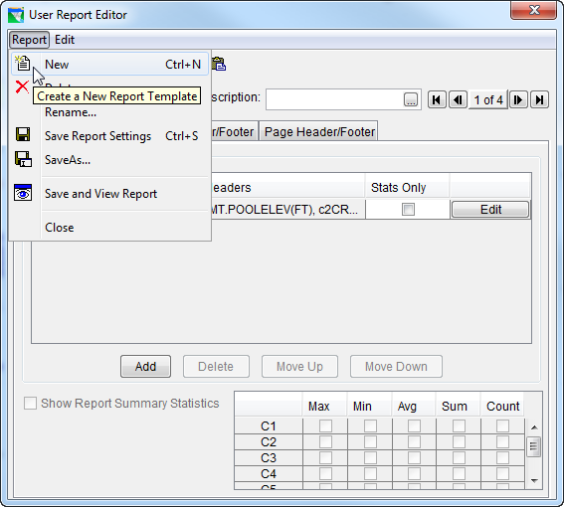
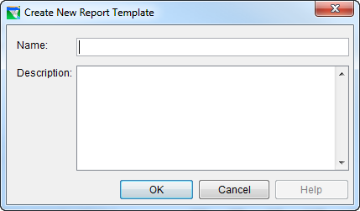
User Report Editor…Creating a Report Template
Notes:
Use File menu to create a New report – Give it a name and description
The Report Header/Footer tab contains the Title block, Report Header block, and Report Footer block. The header and footer on this tab are for the overall report, not the printed pages of the report document. The title, header, and footer blocks are TEXT fields that can include the following special codes:
%R – run name
%A – alternative name
%N – network name
%L – lookback time
%B – simulation time
%E – end time
%V – build version
(yes, the case DOES matter – the codes are all UPPER CASE)
The text can be formatted with different font types and sizes. The text in the title block gets CENTER justified. The text in the header and footer blocks gets left justified.

Slide 39
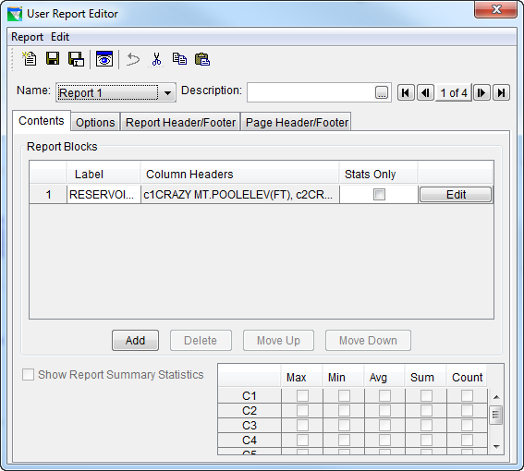
User Report Editor…Defining a Report Block
A report can have multiple tables.
Each table in a Report is a Report Block
Use the Edit button to define the contents of a table
Use the Add button to append more tables to your report.
Notes:
More than one table can be placed in the report. These are called Report Blocks.
To add a table to the report, use the Add button to add a row to the Report blocks list.
To configure a table, select the report block in the list and press its Edit button.
The Label field is editable. Use it to give a title to the report block. The column headers field is not editable; it will fill with information from the data to place in the table when you Edit or configure the report block

Slide 40
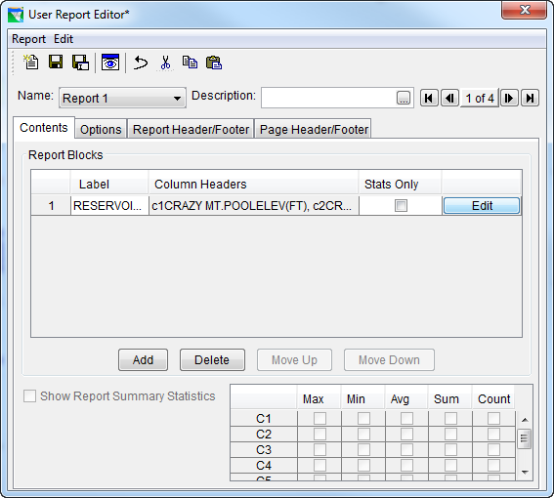
User Report Editor…Defining a Report Block
Options
Report Header/Footer
Page Header/Footer
Notes:
More than one table can be placed in the report. These are called Report Blocks.
To add a table to the report, use the Add button to add a row to the Report blocks list.
To configure a table, select the report block in the list and press its Edit button.
The Label field is editable. Use it to give a title to the report block. The column headers field is not editable; it will fill with information from the data to place in the table when you Edit or configure the report block

Slide 41
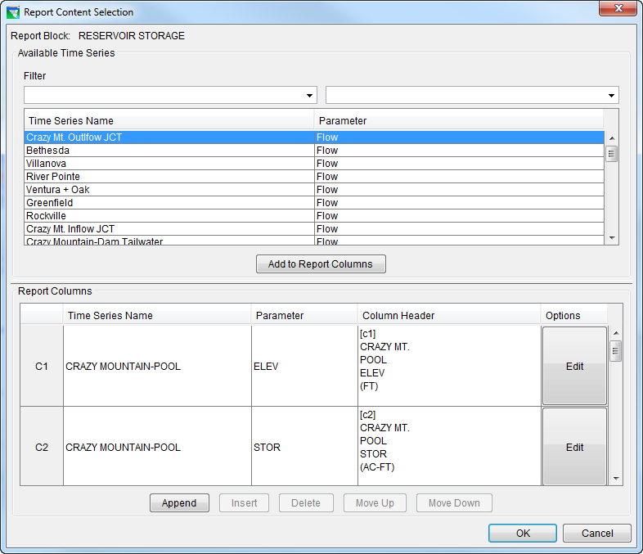
Editing a Report Block…Adding Columns
Select a Time Series
Add to Report Columns
Use Append to add a blank column for math operations

Slide 42
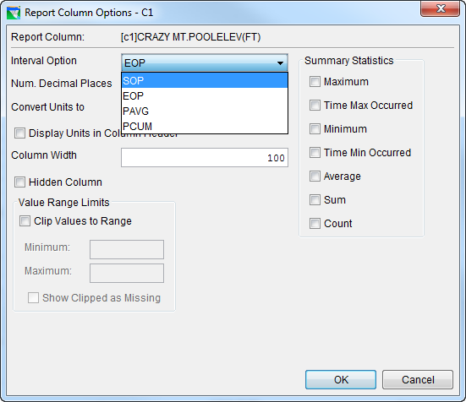
Editing a Report Block…More About Columns
EOP=End of Period
SOP=Start of Period
PAVG=Period Average
PCUM=Period Cumulative
Notes:
The Report Contents Selection editor is used to configure a report block. The basic idea here is to identify the data to place in the columns of the table or report block. The upper half of the editor is a model data browser (very much like the DSS browser except it you only get two fields, the location or “b part” and the parameter or “c part”. There are no other “parts” or filters to identify because the report builder only works on the currently active alternative in the current simulation so – the time window (d part), time step (e part), and alternative id (f part) are “known” (the a part is not used). Use the filters and the scroll bar to locate the time series that you want to include in the report block. When you find one, select it and press the Add to Report Columns button.
The selected time series will appear in the lower half of the editor. It will be identified by a column number and a default header will appear in the Column Header field. If you don’t like the Header that the program used, delete it and type in a new one. The code %S can be used to get the units of the data displayed in the column header of the table.

Slide 43
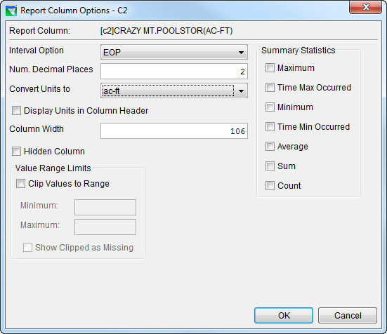
New Columns Using Simple Math
Summary Statistics (Will list at End of Your Report):
  Maximum
  Time Maximum Occurred
  Minimum
  Time Minimum Occurred
  Average
  Sum
  Count

Slide 44
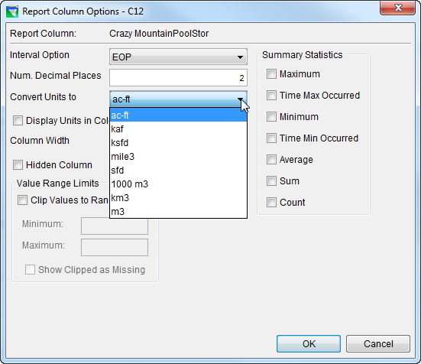
Editing a Report Block… Column Options
Convert Units to (Units Multiplier)
Hidden Column
Notes:
Interval Option – what does the data for each entry in the column represent?
SOP Start of Period
EOP End of Period
PAVG Period Average
PCUM Period Cumulative
Num. Decimal Places – how many digits after the decimal should be displayed?
Units Multiplier
1 – standard compute units: e.g. acre-ft
1000 – (the data is divided by 1000) e.g. Thousand acre-ft
1000000 – (data /1000000) e.g. Million acre-ft
Hidden Column – check this to keep this column from displaying
Value Range Limits – use this to truncate the data. E.g.: If you have negative values but you don’t want them displayed, put a zero in the Minimum box.
Summary Statistics – check the type of information you want added at the bottom of the column. See next slide for an example.

Slide 45
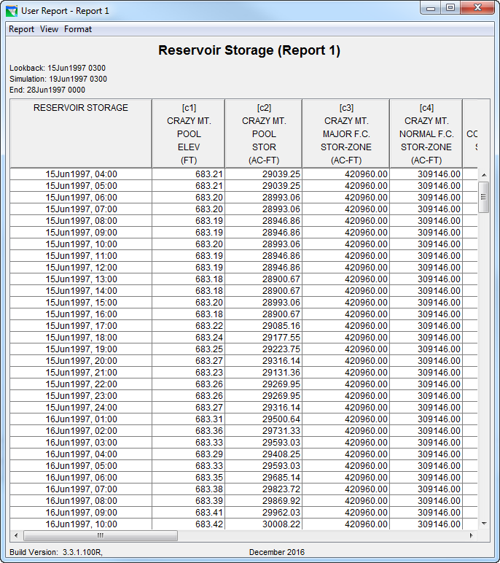
Editing a Report Block…Column Summary Statistics
Notes:
I checked Maximum, Average, and Sum for the Summary Statistics I wanted at each column.

Slide 46
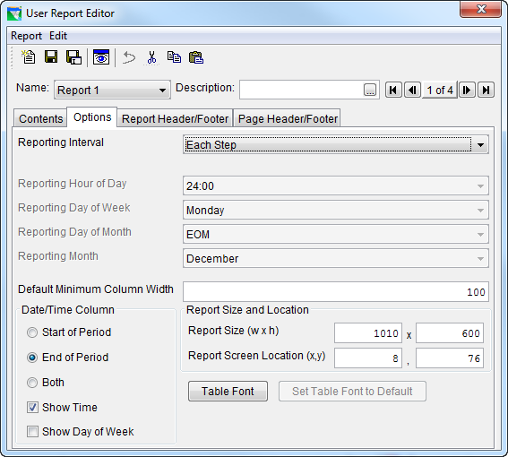
Report Options…The Defaults
Notes:
Reporting Interval
Each Step – produce a row in the report for each compute interval of the simulation
Daily
Weekly
Monthly
Yearly
The relevant entries below become active for each of the above four options
Reporting Hour of Day
Say you picked Daily - At what hour should it report? (what is the “end” of the day?)
Day of Week
Say you picked Weekly – At what day of the week should it report?
Day of Month
Month (of the year)
Minimum Column Width - this is in pixels
Date/Time Column
Display Start of Period
Endo of Period
or Both
Should it include a label for the Day of the Week?
Report Size and Location
This is pretty nit picky stuff – ignore it for now.
Table Font
This should probably say Report Font or just Font. Use this to change the font style you want to be used in your report.

Slide 47


Report Options…Changing a few
Notes:
I picked:
Daily interval (the compute interval was hourly)
Report at 2400 (the end of the clock day)
Show the Day of Week

Slide 48


Report Title…Page Headers & Footers…
Page Number and Date Buttons
Other useful codes:
%R – run name
%A – alternative name
%N – network name
%L – lookback time
%B – simulation time
%E – end time
%V – build version
Notes:
Tables 14.1 and 14.2 in the Users Manual specify the available codes and their purposes.
The Report Header/Footer tab contains the Title block, Report Header block, and Report Footer block. The header and footer on this tab are for the overall report, not the printed pages of the report document. The title, header, and footer blocks are TEXT fields that can include the following special codes:
%R – run name
%A – alternative name
%N – network name
%L – lookback time
%B – simulation time
%E – end time
%V – build version
(yes, the case DOES matter – the codes are all UPPER CASE)
The text can be formatted with different font types and sizes. The text in the title block gets CENTER justified. The text in the header and footer blocks gets left justified.
The Page Header and Footer are only used when the report is printed.
The special codes I added in this example using the buttons:
%d - the date the report was printed
%p – the page number
%n – the number of pages

