Slide 1
IF-Then-Else Blocks
Adding Conditional Logic to the HEC-ResSim Operation Scheme

Slide 2
Need for IF-THEN-ELSE logic
Typically, reservoir operations follow conditional paths for decision-making
Conditions are used to determine the applicability of operational goals and constraints
Using the ResSim IF-BLOCK feature, you can define conditional tests that determine when and which rules apply in the release decision process.
Reservoir Elevation > 610 ft?
No
Min Release Constraint
Yes
In Flood Control Space?
No
Hydropower Release
Yes
Flooding Downstream?
No
New Release = Max Inflow
Yes
Max Release Constraint

Slide 3

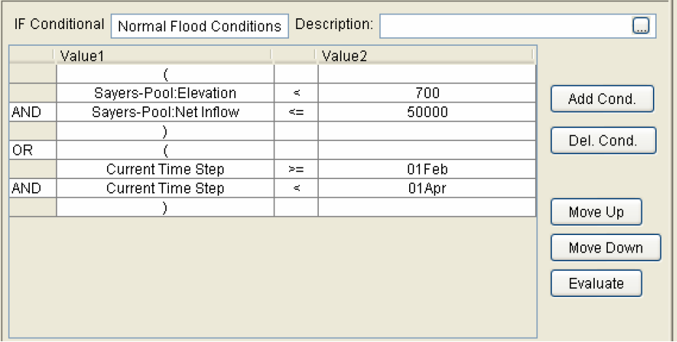
IF-THEN-ELSE in HEC-ResSim
Simple IF statement
IF_Blocks that are as basic as a simple If statement, with its own conditional tests
Compound conditional test
using parentheses and
logical operators
Nested if-then-else
A nested if is an if statement that is the target of another if statement

Slide 4
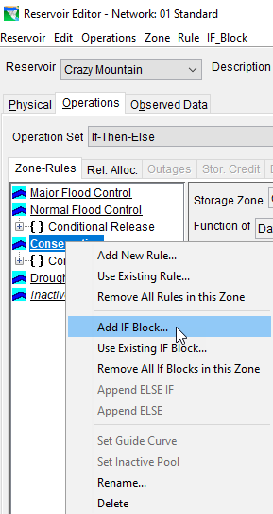

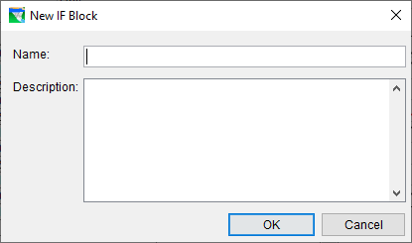
How to…Create an IF block
From the Operations tab of the Reservoir editor, select a zone in your current operation set
Right-click on the zone in the tree and Select Add IF Block…
Under the IF_Block menu Click New
Give the IF Block a name..

Slide 5
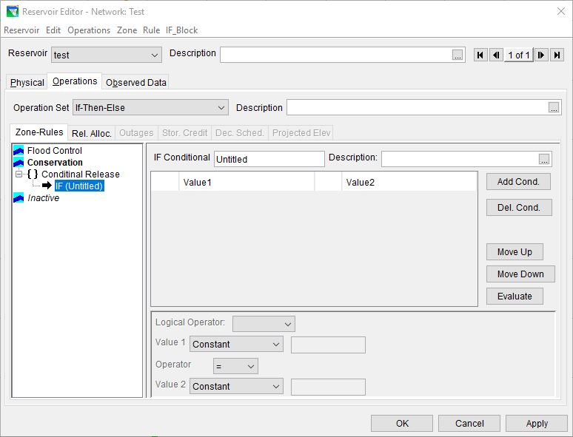
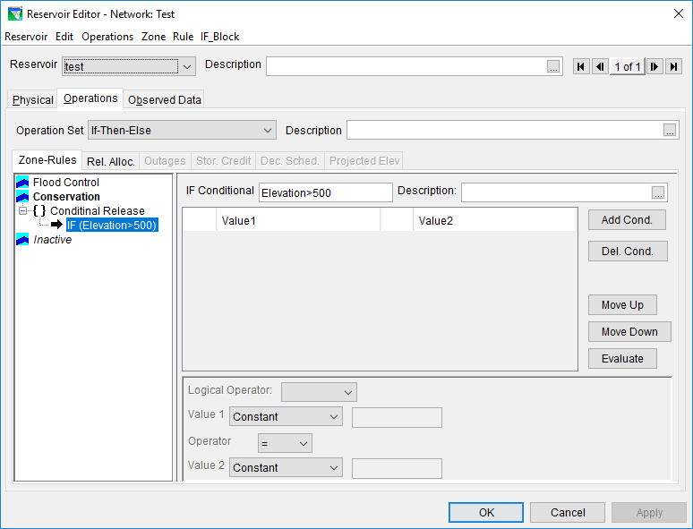
Adding Name

Slide 6
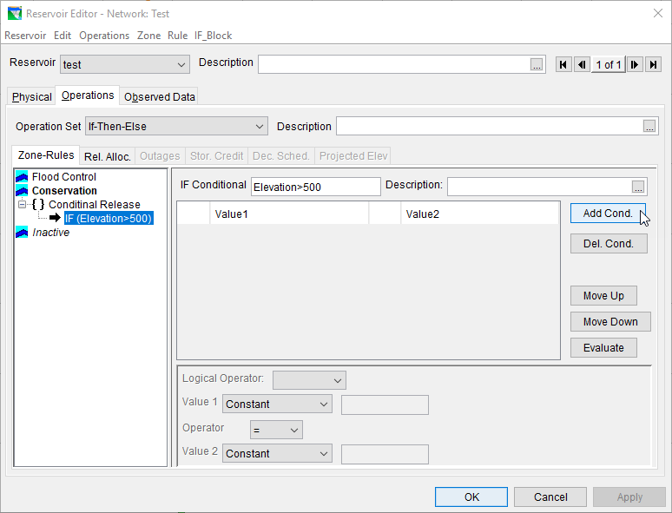
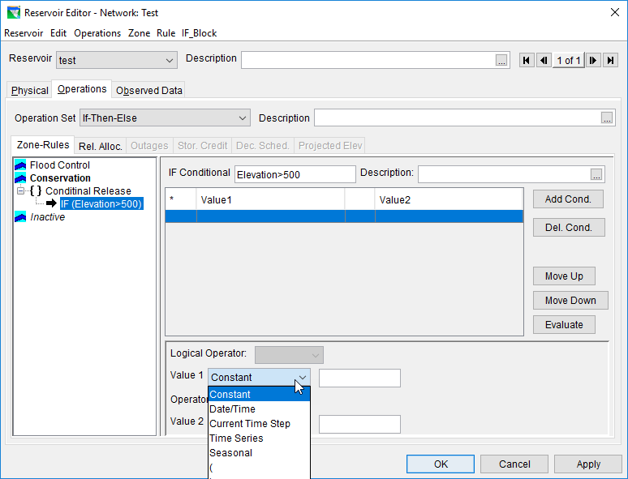
Adding Condition
Constant -> numeric value
Date/Time -> ddmmmyyyy, hh:mm
Current Time Step
Time Series ->
External Variable
Model Variable
State Variable
Seasonal -> ddmmm
( ) -> group conditional tests

Slide 7
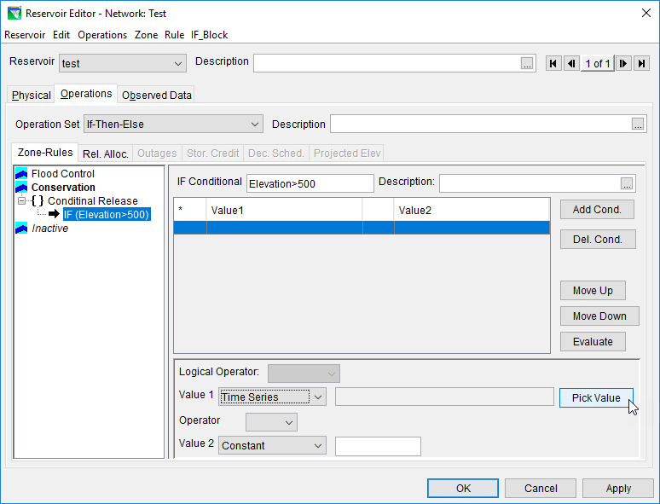
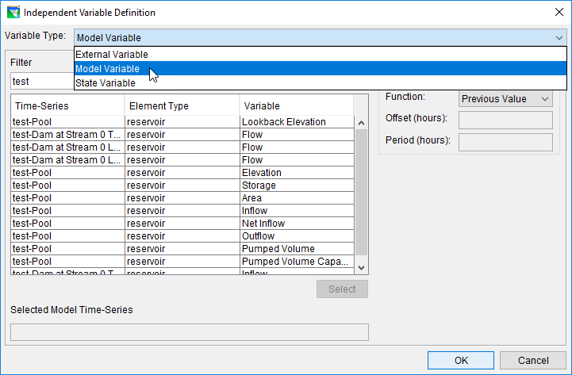
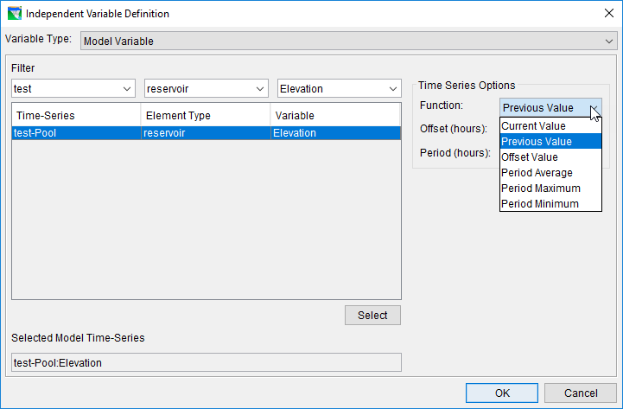
Test Values – Time Series

Slide 8
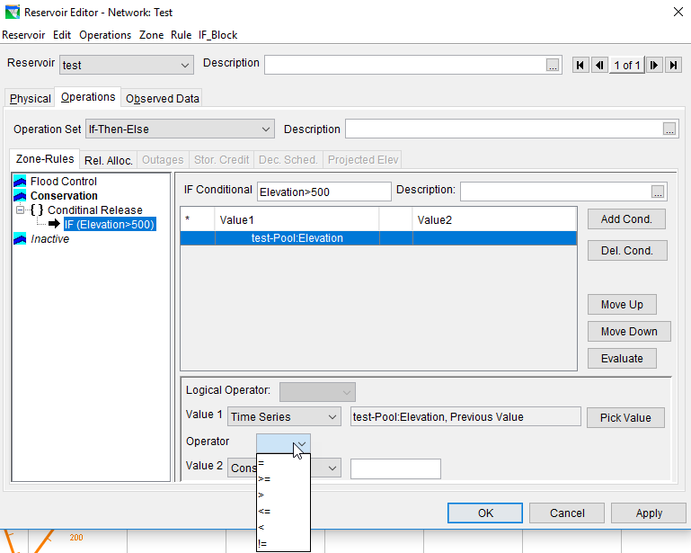
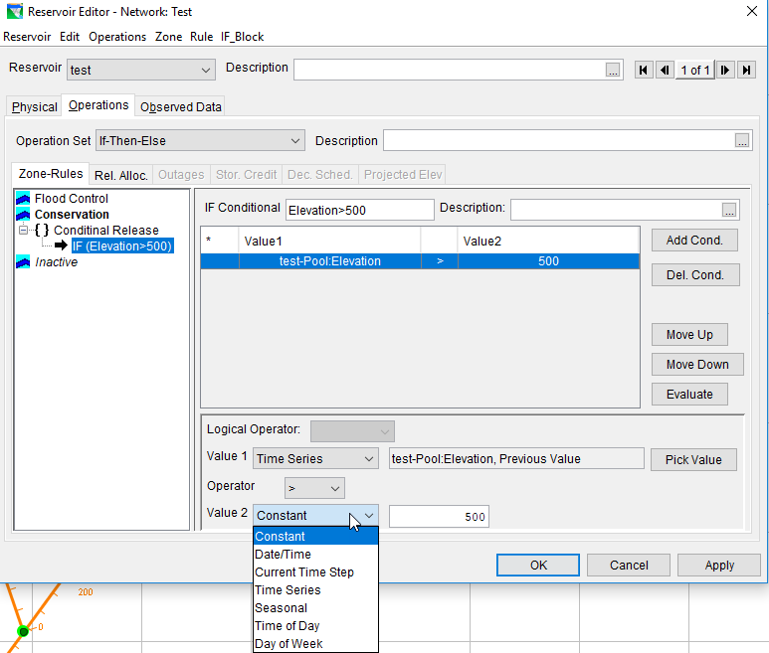
Test Operators

Slide 9
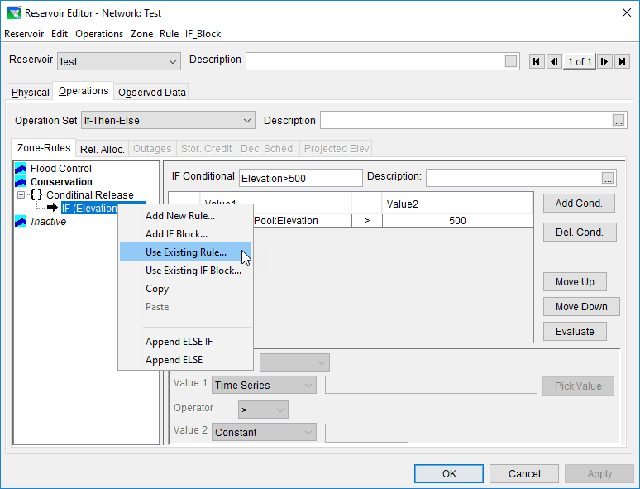
Add rules to the IF block

Slide 10
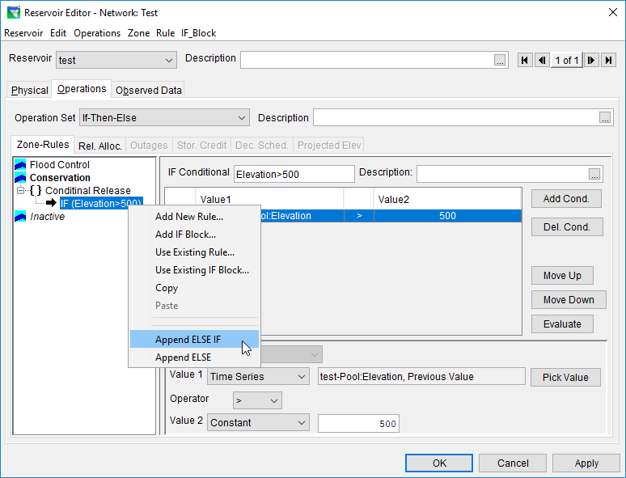
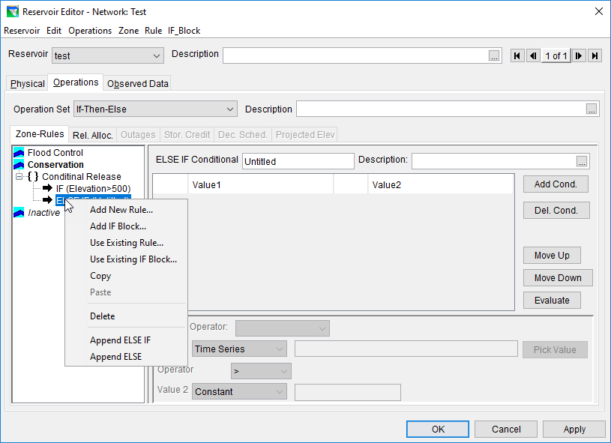
Add ELSE IF blocks

Slide 11
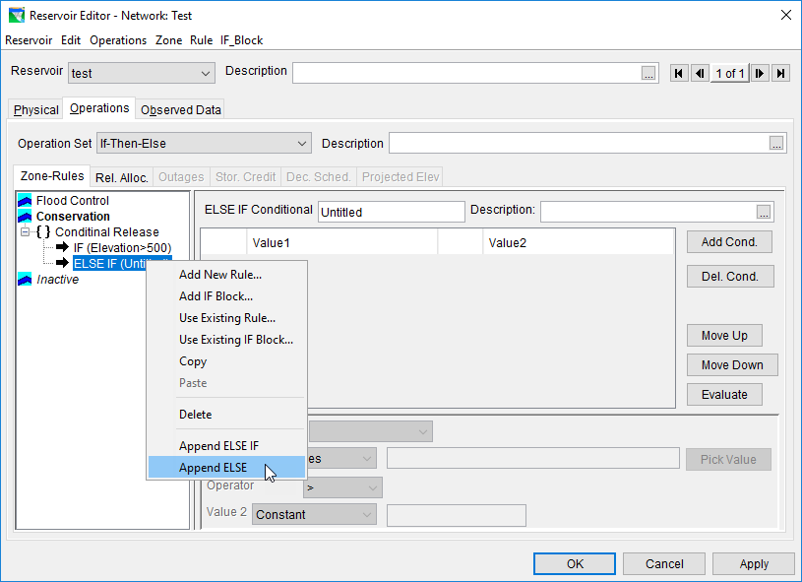
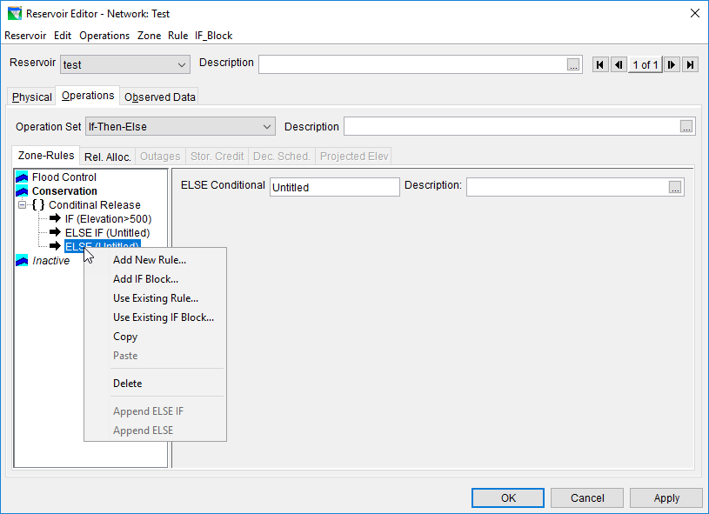
Add ELSE blocks

Slide 12
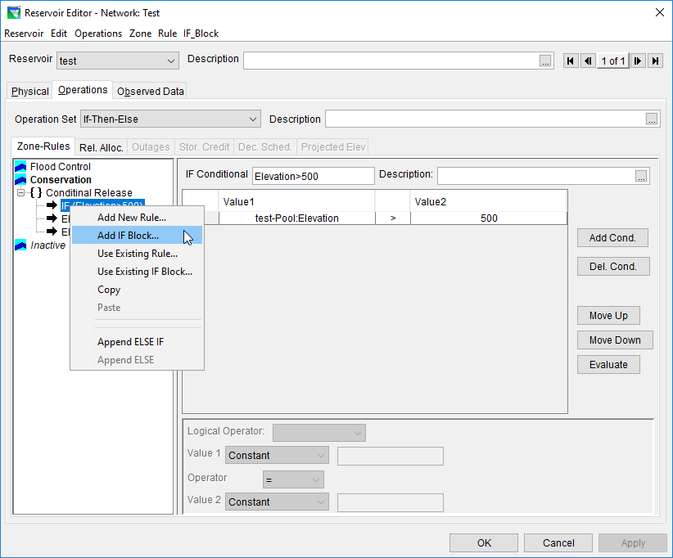
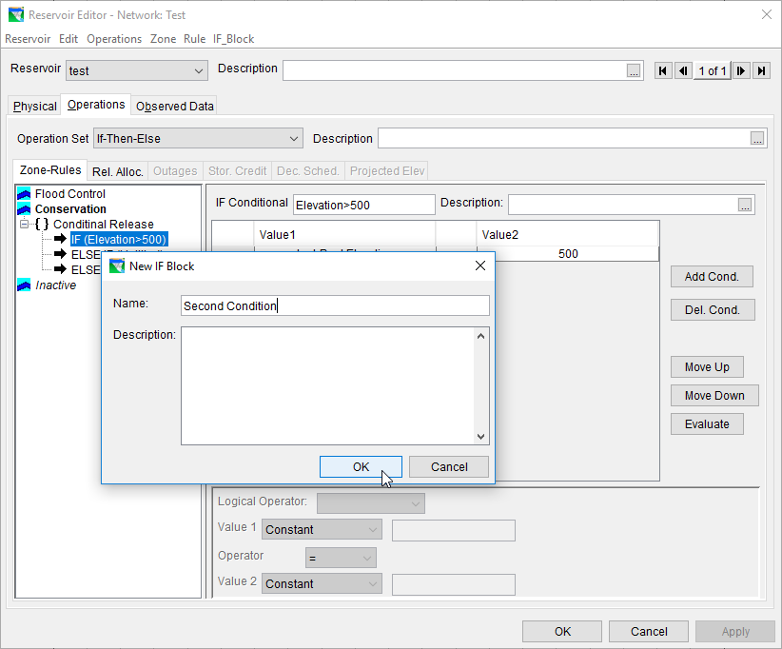
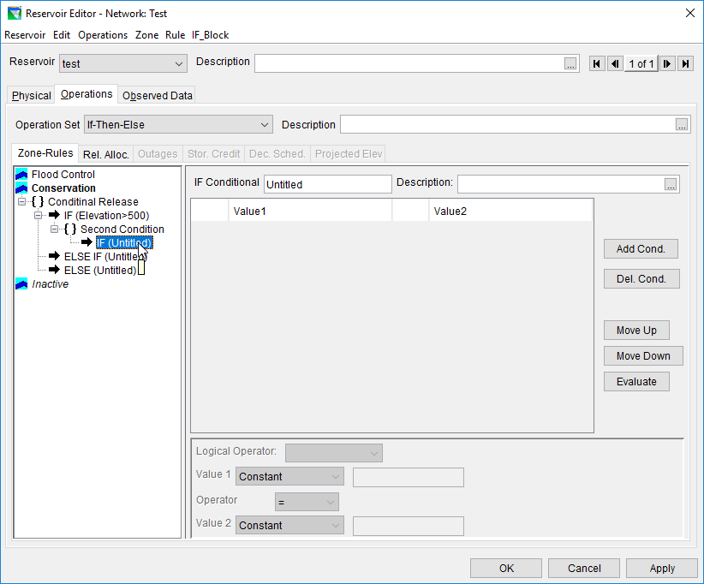
Nested If blocks

Slide 13
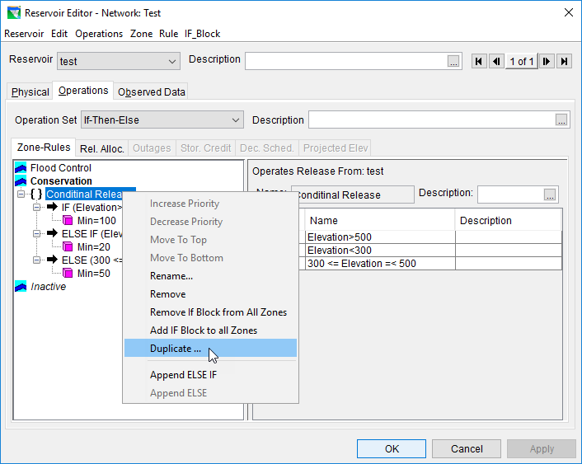
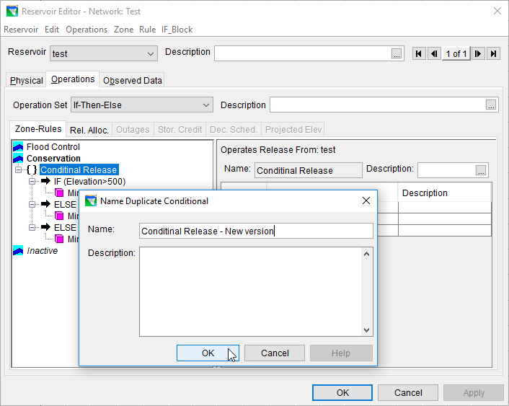
Duplicate If-Blocks

Slide 14
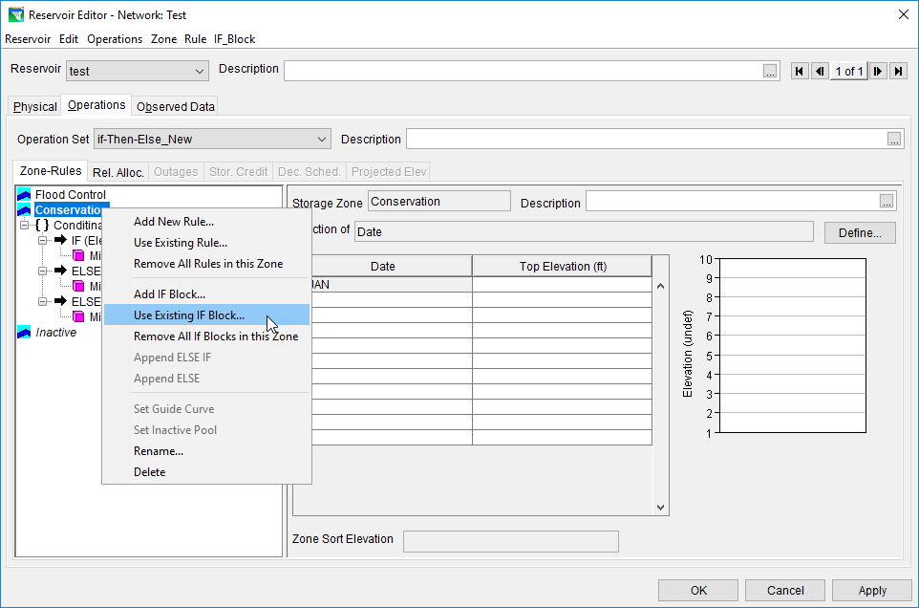
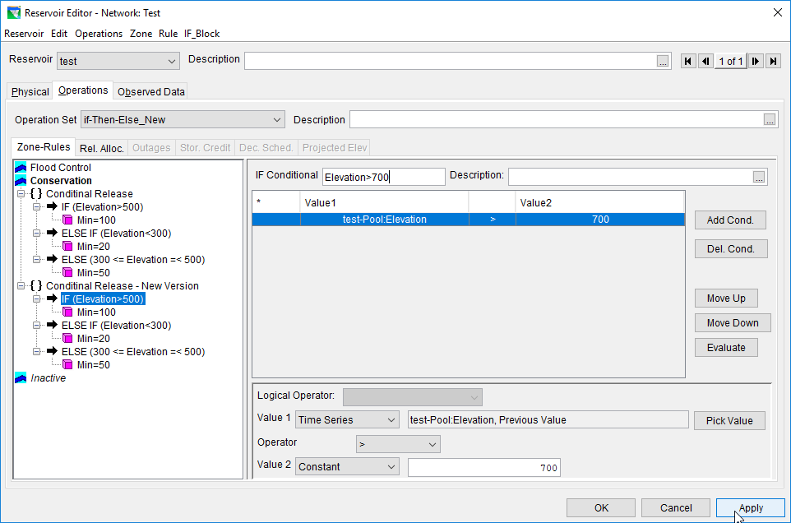
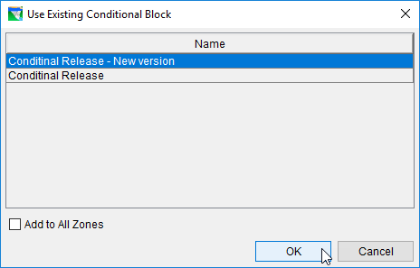
Duplicate If-Blocks, cont’d.

Slide 15
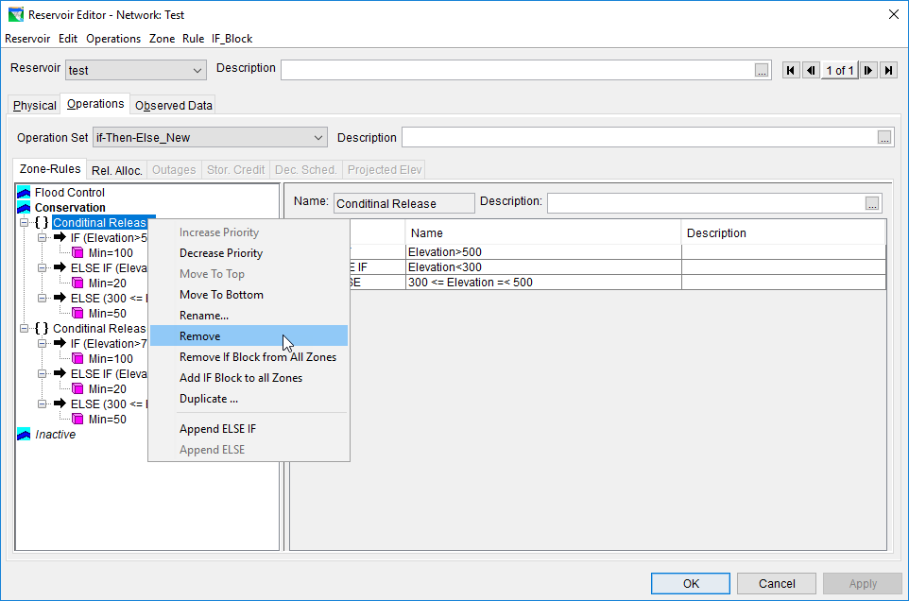
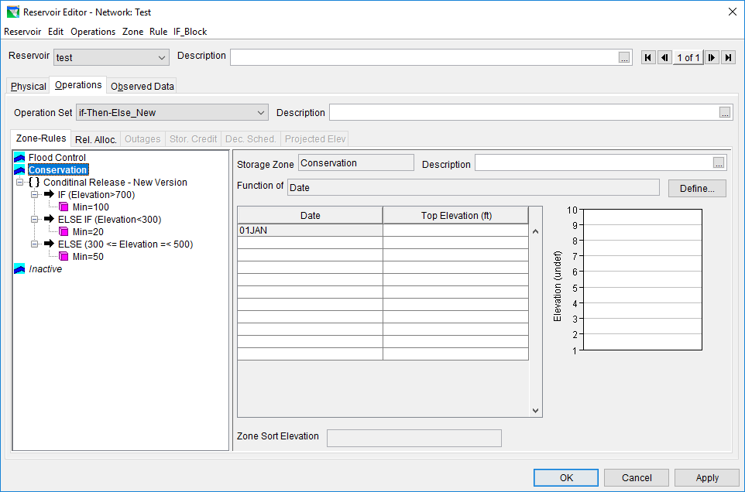
Duplicate If-Blocks, cont’d.

Slide 16
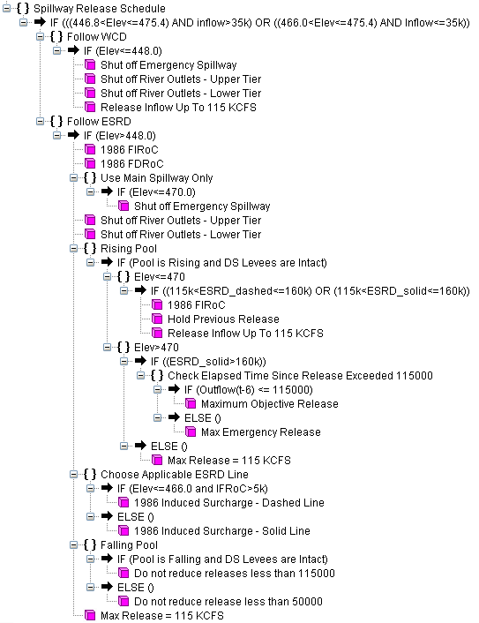
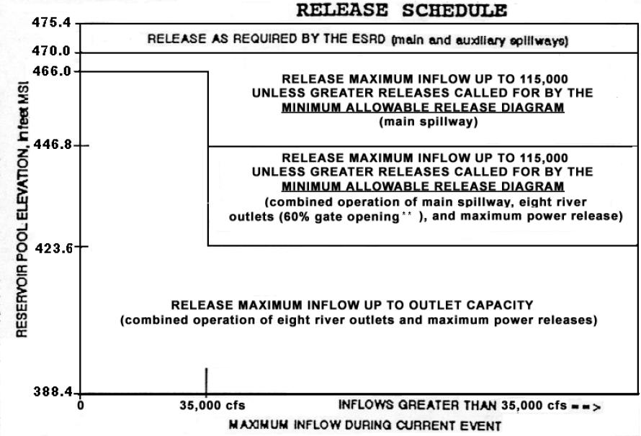
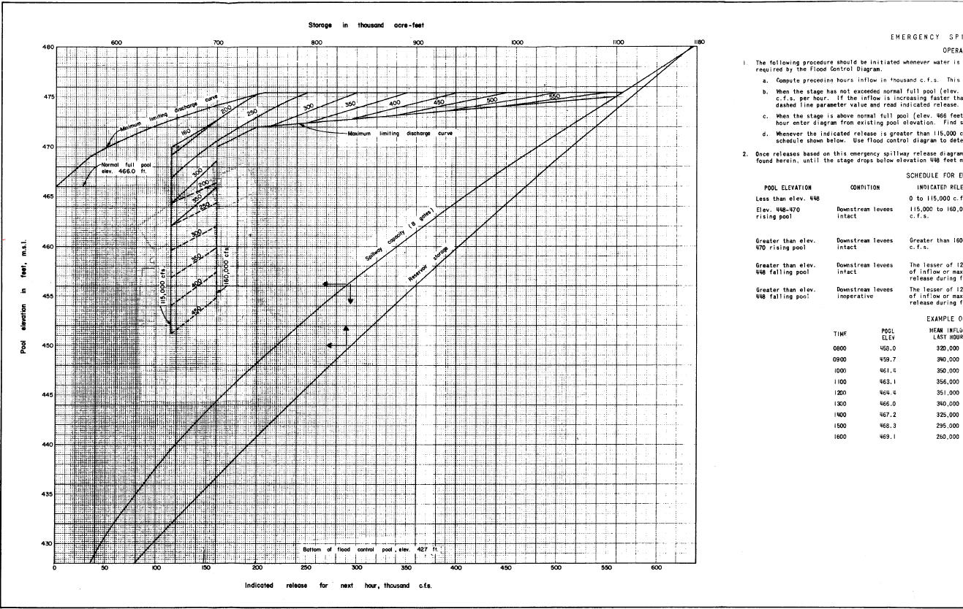
Complex Example

