Slide 1
Advanced Topics - Compute Blocking
Evan Heisman, PE

Slide 2
Outline
How ResSim Computes
Examples of Operational Dependencies
What are compute blocks?
How can you find them?
Why should you care about them?
How to influence them?

Slide 3
How ResSim computes
ResSim computes through several loops:
Time blocks
Compute blocks
Compute passes
Timesteps
Elements, in hydrologic order

Slide 4
How ResSim computes
ResSim computes through several loops:
Time blocks
Compute blocks
Compute passes
Timesteps
Elements, in hydrologic order
Time Blocks: Computes are split across time to fit into memory – this can cause problems with scripts
Notes:
Time blocking rarely happens with enough RAM

Slide 5
How ResSim computes
ResSim computes through several loops:
Time blocks
Compute blocks
Compute passes
Timesteps
Elements, in hydrologic order
Compute Blocks: Links together elements that must compute together, ResSim computes each compute block across the Time Window, upstream to downstream.

Slide 6
How ResSim computes
ResSim computes through several loops:
Time blocks
Compute blocks
Compute passes
Timesteps
Elements, in hydrologic order
ResSim applies rules over several compute passes, starting with at-site rules (1), adding scripted rules (2), downstream control (3), and finally system operations (4).

Slide 7
How ResSim computes
ResSim computes through several loops:
Time blocks
Compute blocks
Compute passes
Timesteps
Elements, in hydrologic order
Timesteps: Within a compute block, ResSim computes one timestep at a time for every element, upstream to downstream.

Slide 8
How ResSim computes
ResSim computes through several loops:
Time blocks
Compute blocks
Compute passes
Timesteps
Elements, in hydrologic order
Elements: Every junction, reach, reservoir, outlet, outlet group, diversion (etc.) is an element.

Slide 9
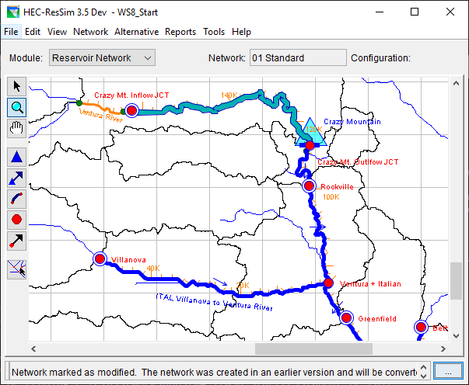
How ResSim computes

Slide 10
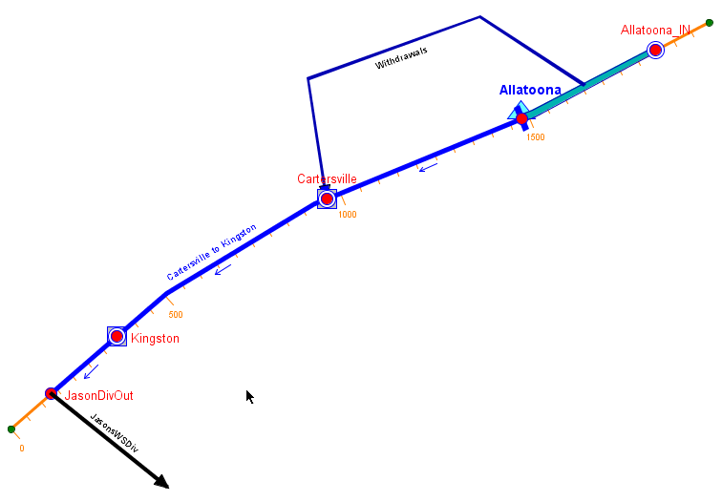
Example of an Operational Dependency
Local Downstream Control

Slide 11
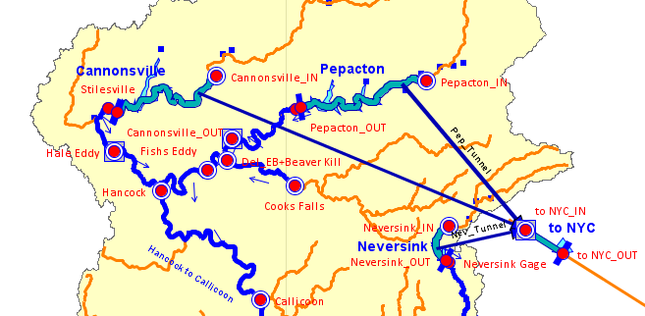
Example of an Operational Dependency
Local & System Downstream Control

Slide 12
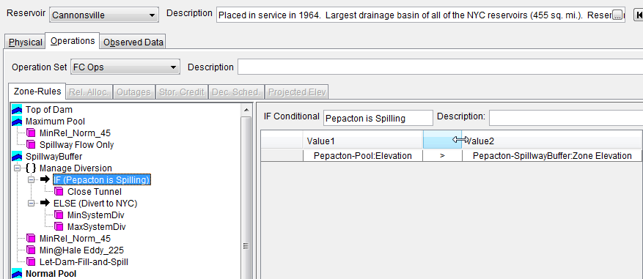
Example of an Operational Dependency
What’s happening at another reservoir…

Slide 13
Terminology
Operational Dependency
A location and parameter that must be considered when making release decisions.
Examples
Downstream Control
Current Flow/Stage at a Gage
Current state of another reservoir
What else?

Slide 14
How to identify dependencies…
Do any of your reservoirs operate for a requirement or limit at a location outside of the project?
Do you have any diversions?
Do you have any “complex” ratings?
Do you have any scripts?
If so, do any of your scripts require a model variable that is not computed by the reservoir or diversion that uses the script?

Slide 15
Terminology
Compute Block*
The set of model elements that must be computed together, timestep by timestep, in order for the reservoir to estimate the state of the dependency and thus make a release decision.
* Called Iteration Blocks in the compute log.

Slide 16
What is included in compute blocks..
The (operational) element that has the dependency
Reservoir
Diversion
Junction?
The location of the dependency
Everything in between…

Slide 17
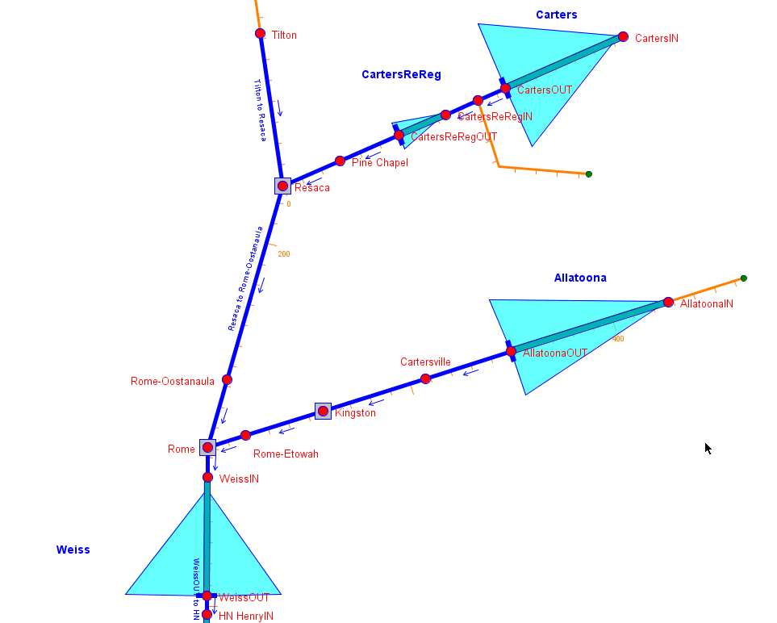

Slide 18
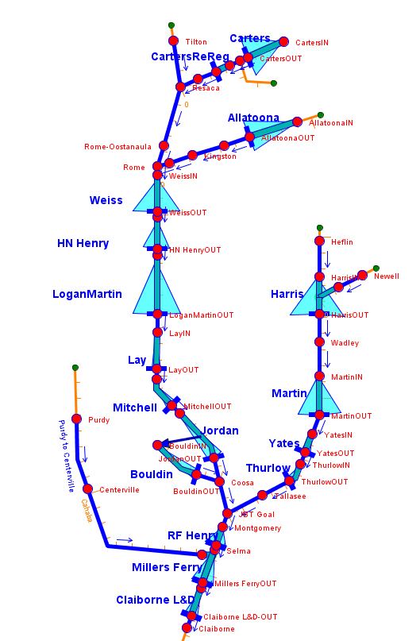

Slide 19
How ResSim identifies them...
ResSim processes through the native model features to find dependencies. It looks at:
Release Rules
Downstream Control Rules
If-Block Conditional Expressions
Zones
Diversion connections and functions
Ratings
What’s missing?

Slide 20
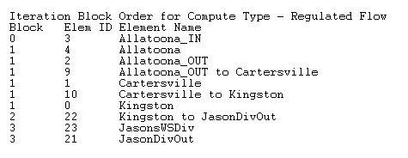
Finding ResSim’s Compute Blocks…
View the compute log…
Go to the bottom of the log then scroll up until you find this table:

Slide 21
Why should you care…
An If blocks or rule may not function properly and you cannot figure out why…
A state variable or scripted rule has missing or incorrect values
in one or more of the timeseries it uses

Slide 22
What to do about it
Apply a modeling technique to force ResSim to include your dependency into the compute block you identify.
Dummy Rule is the most common
Other techniques are also available…

Slide 23
Advanced Topics - Modeling Techniques

Slide 24
Terminology
What is a Modeling Technique?
It is a fancy label for a “work around”.
Okay, so what is a Work Around?
A Work Around is something a modeler does to get the modeling software to behave in a desired manner. It is often used to deal with (work around) a software bug or deficiency .

Slide 25
Known Uses for Modeling Techniques
To force the compute blocking logic to include elements it otherwise wouldn’t.
To bring external time series into the model so that a script doesn’t have to (an “external” dependency).
To compute a state variable that is a dependency to other state variables.
Others…

Slide 26
How to influence the Compute Blocks…
Use an existing modeling feature to inform the compute blocking logic:
A release rule
A downstream control rule
A zone
An If Block
A diversion

Slide 27
Influencing Compute Blocks…
If the ONLY purpose of the additional rule, zone, etc, is to influence the compute blocking, then it should be designed to have NO OTHER IMPACTS.
Minimum flow rule = 0
Zone below inactive
If test that is always false (without an else)
Diversion = 0

Slide 28
Influencing Compute Blocks…
“Dummy Rules” are rules that are used to influence or aid the ResSim decision logic without directly affecting the “allowable range”.
Influence is attained by making the rule’s “function of” the location and/or parameter of interest.
No effect is attained by specifying the “function” (lookup table) as a minimum flow which always evaluates to a value less than or equal to 0.0.

Slide 29
Types of Modeling Techniques
Dummy Rules
Compute Blocks, State Variables, Time Series
Dummy Zones
Compute Blocks, State Variables, Time Series
Dummy Diversions
Compute Blocks, State Variables, Time Series
Dummy Junctions
Time Series
And even Dummy Reservoirs!

Slide 30
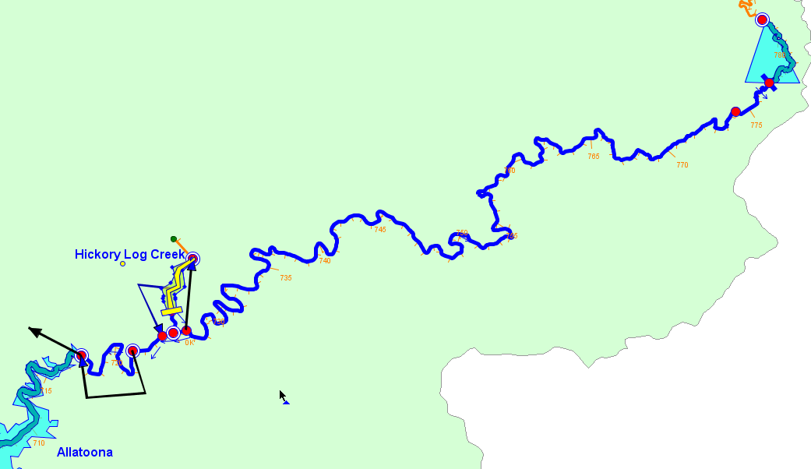
Dummy_abv_Dawsonville
A dummy reservoir was used to:
Launch a State Variable
Force a Compute Block
Bring in a bunch of external time series

Slide 31
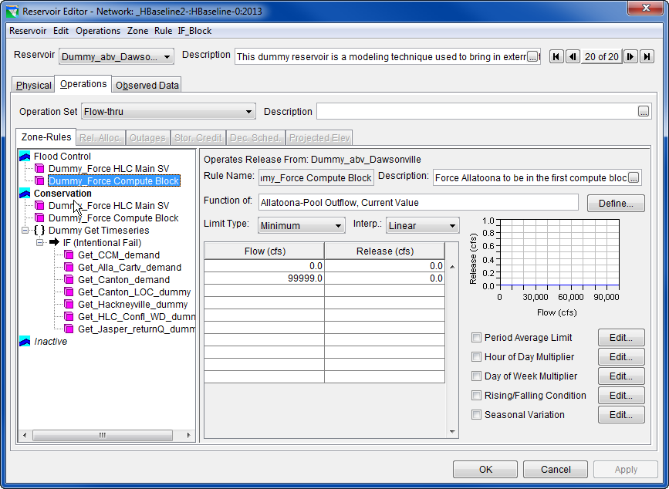

Slide 32
Back to scripting…

Slide 33
RunTimeStep and RunTimeWindow
RunTimeStep
Wraps an integer counting number of timesteps into compute (including lookback)
Acts as an array index for any timeseries in the model
ResSim increments this and hands it to each script.
Can convert to HecTime
RunTimeWindow
Keeps track of total number of timesteps, start and end times
Can provide key (start/end/lookback) times as HecTime

Slide 34
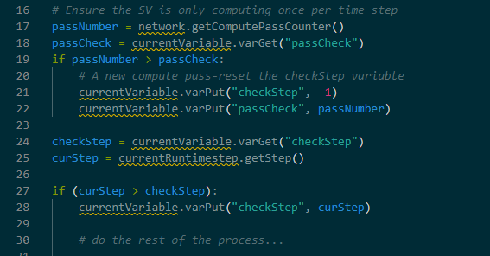
Scripting compute passes
What if I only want to…?
Compute once per pass?
Compute once per timestep?
Check current pass/step, save progress with local variables.

Slide 35
Element compute order vector
Try to avoid scripting against a certain network order.
It could change!
Use ‘previous value’ and dummy rules
network.getElementVector()
Returns list of elements, ordered for compute
You can check if one element computes before another.

Slide 36

Summary
Simulation broken into Compute Blocks and Compute Passes
How to identify compute blocks.
In a script, how to check where the model is at.
Don’t use “current” value for something not yet solved!
Downstream flow, elevation/storage at the current dam

