Slide 1


Building a SCRIPT
Evan Heisman, PE
USACE IWR-HEC
21 August 2023

Slide 2
Objectives
How do I go from an idea to implementation?
Steps to think through the scripting process
Outline some best practices

Slide 3
OUTLINE
Before you start… Why write code?
Script lifecycle:
Designing a script
Writing a script
Testing a script
Maintaining a script
Some best practices

Slide 4
BEFORE YOU START…
  What’s the first question you should ask?
  Should you write this code?

Slide 5
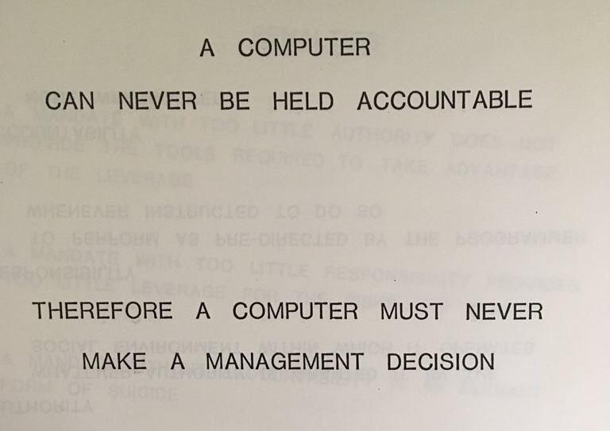
Should you Write This Code?
Some factors to consider:
How often do we need to run this code?
  Development time < expected time
Will the scripted solution do better?
  How will you validate/test the code?
Who will maintain the code?
  Who / what will pay for it?
From a 1970’s IBM training document…

Slide 6
Why Write code?
Automation:
  Repeatability of a task
  Consistency between several tasks
  Time-savings to users, labor savings to organization
Adding capabilities:
  Some tasks are impossible to do “by hand” or with off-the-shelf solutions
  Extending or customizing existing programs.

Slide 7
Script LifecyclE: Four Steps
design
implement
test
maintain

Slide 8
Script Lifecycle: DESIGN
Document requirements / specifications!
- Inputs
- Calculations Performed
- Outputs
Break the problem into elements
Define a “minimum viable product” (MVP)
Add more features after MVP is done
Iterate through the cycle for each part of the design
Specifications should inform testing
Notes:
t

Slide 9
Script Lifecycle: Implement
Implement in small pieces, following the four steps for each: Design, implement, test, maintain
Design:
Write “pseudo-code” to get a picture of the algorithm;
Identify the inputs, computations, and outputs at each step
Implement:
Translate pseudo-code into specifics, figure out steps to transform inputs into outputs.
Revisit design decisions as you encounter issues.
Test:
As you write each element, test your assumptions
Much easier to test individual pieces than the whole program!
Maintain:
Sharing the code, documenting, use version control, identify TODOs

Slide 10
Script Lifecycle: IMPLEMENT
Top-down approach
Start at the outer-most level, and mock-up inner pieces.
inputFile = DSS.open(…)
configFile = open(…)
results = list()
for configRow in configFile.readlines():
resultsRow = processRow(configRow, inputFile)
results.append(resultsRow)
# mock implementation
def processRow(config, dssfile):
return True

Slide 11
Script Lifecycle: IMPLEMENT
Bottom-up approach
Start with the inner most-level and mock-up the framework that runs it. Or use an interpreter to run and test.
Implement functions to perform the most basic calculations first, slowly wrap in higher level functionality.
def processRow(config, dssfile):
ts = dssfile.read(config[“pathname”])
values = dict()
percentiles = config[“percentiles”].split(“;”)
for perc in percentiles:
values[formatPerc(perc)] = computePercentile(ts, perc)
return values
# interactively now:
>>> testFile = DSS.open(“C:/…/testingData.dss”)
>>> testRow = {“percentiles”=“50;75;90;95;99”, …}
>>> processRow(testRow, testFile)
{“99%”: 5192, “95%”: 4910, “90%”: 3615, … }

Slide 12
Script Lifecycle: TEST
Approaches:
“In-situ” testing: Manually test the code on real/example data and check the results
Adding ‘print statement debugging’ or logging
Create examples to test/break code.
Automated testing: Implement code that tests your code
Unit testing (testing small pieces)
Integration testing (testing all the pieces work together)
Testing frameworks – allows you to declare expected outcomes for inputs
Test-Driven Design (TDD): invert the writing and testing steps:
1. write tests for the specifications
2. implement code until tests pass
Regression testing: when a bug is identified, add a test for that bug!

Slide 13
Script Lifecycle: MAINTAIN
Storing the script / Version Control:
Eternal questions: What’s the current version of the script? What version are you using? What changed? Did I fix that bug yet?
Documentation:
Code comments
API documentation in code (JavaDoc, Sphinx, Doxygen)
External “readme” files / manual / user guide
Demo datasets or example scripts (for libraries)
Document dependencies for users to get started.
Debugging and Support:
Contact information!
Issue tracking systems

Slide 14
Some BEST PRACTICES
Plan your program (or changes) before you start writing code.
Make use of libraries/modules/packages – steal shamelessly! (HEC API – Day 1/2 lectures)
“Modularize” your code – smaller functions and objects (Day 1/2 workshops)
Use an IDE (Eclipse, VS Code, IntelliJ, others)
  Organize files into a project
  Debugging features
  Auto-complete and error checking
  Refactoring
  Integration with version control
Use Version Control system (Git/GitHub – Thursday)

