Slide 1
Scripting HEC-ResSim

Slide 2
Topics
Two Categories of Scripts
Scripts Executed Outside Simulations
Utility Scripts (also called “static” scripts)
We’ll use this for first two workshops!
Scripts Executed During Simulations
State Variable Scripts
Scripted Rule Scripts

Slide 3
Two Categories of Scripts – 1 of 2
Scripts executed outside simulations
These scripts can:
Pre-process data for simulations
modify input data
modify models (What? Danger!)
Run simulations (some or all alternatives)
Post-process data from simulations,
generate plots and reports, etc…
These scripts cannot:
Interact with a running simulation

Slide 4
Scripts Executed Outside Simulations
There is only one type of script executed outside simulations, which we call static or utility scripts.
Utility scripts resemble HEC-DSSVue scripts:
They can be executed from the Script Selector, Script Pane, or Script Editor.
They are edited and tested in the Script Editor.
Their location in the Tree Pane of the Script Editor corresponds to a file on disk.
Utility scripts go beyond HEC-DSSVue scripts:
Script location in the Tree Pane determines script visibility.
Scripts can have knowledge of the current module and current simulation.

Slide 5
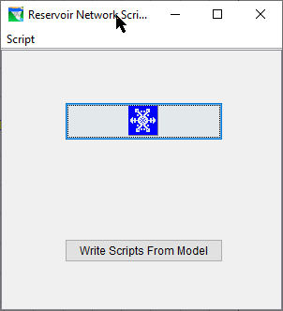
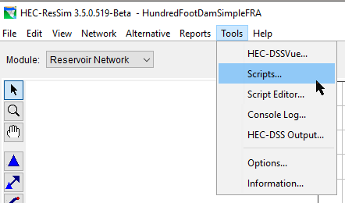
The Script Selector
The Script Selector is accessed by the Tools→Scripts menu item in any module.
The Script Selector is titled according to the current module.
Execute a script by pressing its button.

Slide 6
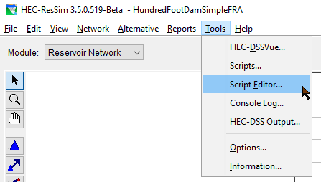
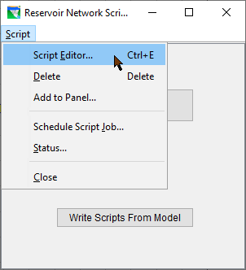
Accessing the Script Editor
The Script Editor is accessed by the Tools→Script Editor… menu item on the HEC-ResSim menu bar, or by Script→Script Editor menu item on the Script Selector.

Slide 7
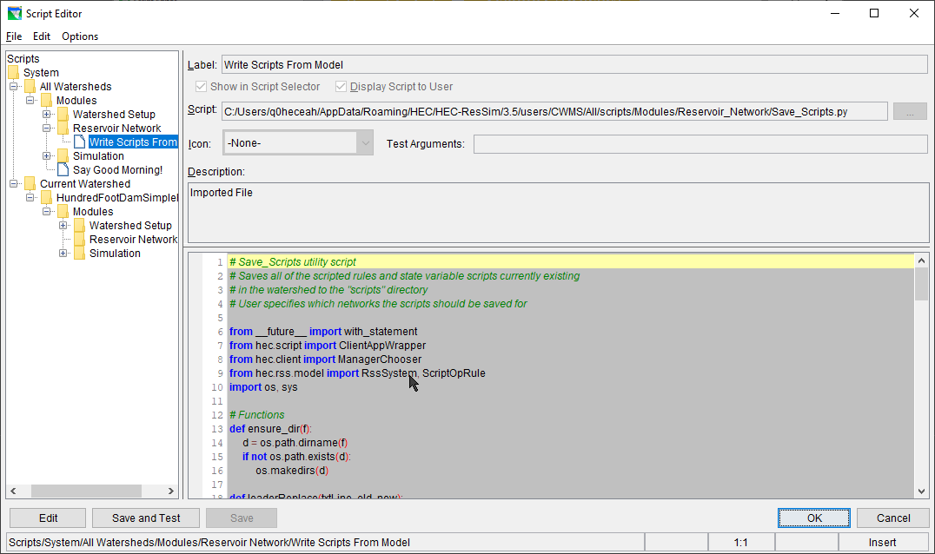
The Script Editor
Also in DSSVue*!
Notes:
DSS Vue has a different script tree on the side

Slide 8
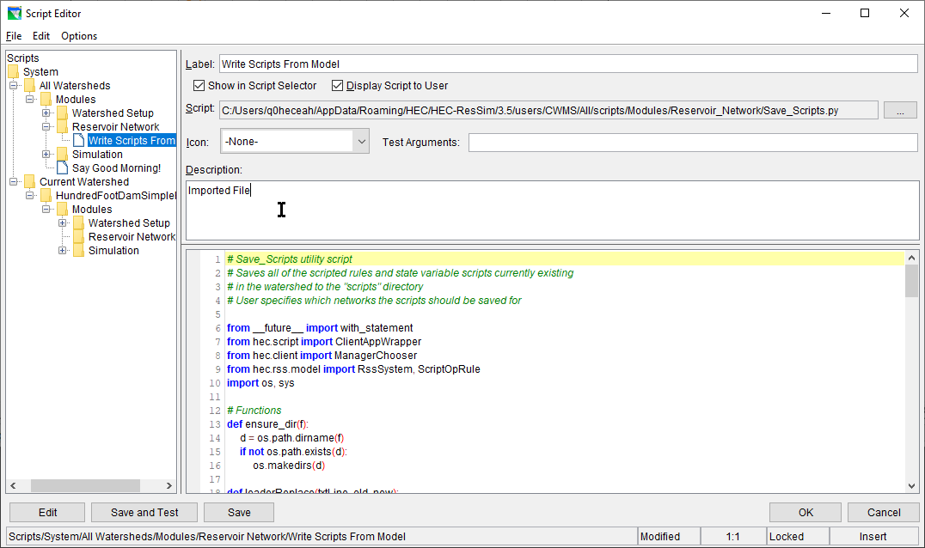
The Script Editor
Script Label
Visibility Switches
Tree Pane
File Name
Icon Selector
Pre-Defined Config Variables
Description Pane
Editor Pane
Edit/Save/Test Buttons
Location / Mode Indicators

Slide 9
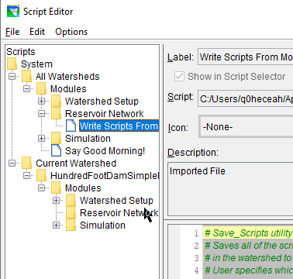
Utility Script Visibility
For a utility script to be visible:
In the Tree Pane:
must be in the All Watersheds folder or Current Watershed folder
must be in Modules folder or folder corresponding to the current module
its Show in Script Selector switch must be checked to be in the Script Selector
its Display Script to User switch must be checked to be in the script pane

Slide 10
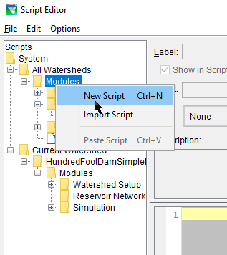
Creating a New Utility Script
To create a new utility script:
right-click on one of the folders under either the All Watersheds or Current Watershed:
Modules
Watershed Setup
Reservoir Network
Simulation
select New Script from the context menu
enter a name in the Label field
enter the script text in the Editor Pane
press the Save or Save and Test button

Slide 11
Editing Existing utility Scripts
To edit an existing Utility Script, do one of the following:
double-click on its entry in the Tree Pane
right-click on its entry in the Tree Pane and select Edit Script from the context menu
select its entry in the Tree Pane and do one of the following:
select File→Open from the menu bar
press Ctrl-O
press the Edit button

Slide 12

Testing Existing Utility Scripts
To test an existing Utility Script from the Script Editor, select its entry in the Tree Pane and do one of the following:
select File→Test from the menu bar
OR press the Save and Test button

Slide 13
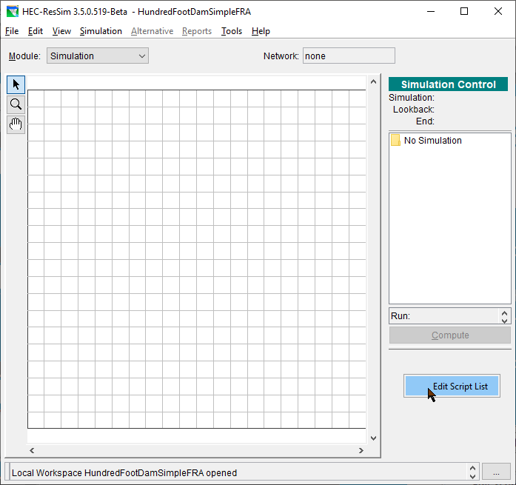
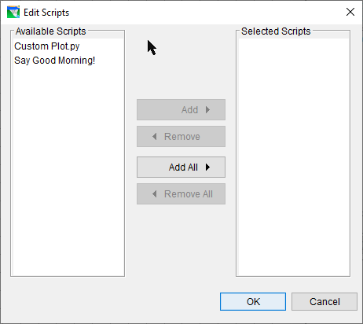
Adding Scripts to the Simulation Module Script Pane
To add a script to the simulation module script pane:
right-click in the scripts area
select Edit Script List from the context menu
use the Edit Scripts dialog to move desired scripts to the Selected list

