Slide 1
Scripting HEC-ResSim
Part 2

Slide 2
Topics
Two Categories of Scripts
Scripts Executed Outside Simulations
  Utility Scripts (also called “static” scripts)
Scripts Executed During Simulations
  State Variable Scripts
  Scripted Rule Scripts

Slide 3
Two Categories of Scripts – 2 of 2
Scripts executed during simulations
  These scripts can:
    Compute a flow limit (minimum, maximum, specified) at each simulation time step
    Compute and store the state of some (concrete or abstract) portion of the model at each simulation time steps

Slide 4
Scripts Executed During Simulations
There are two types of HEC-ResSim scripts that are executed during simulations
  Scripted Rules
    a.k.a. User-Defined rules - Scripts that compute a desired release or operating limit of the associated reservoir or release element. Used when none of the standard rule types can adequately reflect the desired operation.
Notes:
State Variables have the benefit of being able to be used by multiple rules and also may be viewed in plots or tables.
Scripted Rules have the benefit of being able to set not just the value of a constraint, but the constraint type, and even whether a constraint exists at all – may need elaboration

Slide 5
Scripts Executed During Simulations
  State Variables
    Scripts that set the value of a state variable, which can be used by rules and IF-THEN-ELSE blocks to specify flow constraints
      A model variable represents the state of some parameter of an element of the network computed by ResSim at each time step of the simulation (thus, a time series). e.g., the reservoir pool elevation.
      A state variable is a model variable-like time series whose values are computed by a user-defined script for each time step; it need not represent the state of a parameter of single element.
Notes:
State Variables have the benefit of being able to be used by multiple rules and also may be viewed in plots or tables.
Scripted Rules have the benefit of being able to set not just the value of a constraint, but the constraint type, and even whether a constraint exists at all – may need elaboration

Slide 6
Scripts Executed During Simulations
Common Properties of State Variables and Scripted Rules
  They are executed and should determine a value at every iteration of every time step
  Computation at any time step may depend on any model variables at previous time steps, and may depend on other State Variables at the current time step
  Scripts are normally only executed when used in an active alternative, but can be forced to execute otherwise
Notes:
Scripts that depend on other State Variables at the same time step must manually ensure they have been executed before the current script

Slide 7
Limitations of Model Variables
Model variables provide the states of single elements within a ResSim model.
Therefore, model variables cannot represent abstract concepts that require analysis of more than one element such as:
  basin wetness
  drought level
  system storage utilization
  depth-area-duration considerations

Slide 8
State Variables vs. Model Variables
Like model variables, state variables are time-series objects that belong to the Network.
Like model variables, state variables are globally accessible, so they may be used in multiple rules and in multiple reservoirs.
Unlike model variables, state variables are not associated with specific network elements (pools, junctions, etc…). As such, they can represent complex or abstract concepts.
Notes:
The Network is the program object that holds all objects that make up the reservoir system being modeled. The GUI refers to it as the Reservoir Network.
Reservoirs, Reaches, Junctions, and Diversions are all objects within the Network. These objects are compound objects, each containing other objects. The reservoir object is the most complex. It contains the pool and outlet objects, as well as the operation sets, zones, and rules.

Slide 9
State Variable Scripts
HEC-ResSim computes a state variable by executing a Jython script for that variable at every time step (when requested) through the entire simulation period.
The script can access model variables and other state variables for the current and prior time steps.
  Scripts that depend on other State Variables at the same time step must be manually ensured to be executed after the script they depend upon
The script can also perform any function available to Jython
  Care must be taken not to perform lengthy tasks (e.g. disk or network access) because of the number of times the script is executed!
Notes:
Jython is a Java implementation of the Python programming language and provides the common basis for ResSim, DssVue, and CWMS scripting.
State Variable definition scripts do not return anything. They must “set” the value of the TimeSeries object for the current time step, or have set it in an earlier time step. The script may optionally set values into the future (through the end of the computation time window).

Slide 10
Creating New State Variable Scripts
To create a new State Variable script:
  Select Edit→State Variables from the Simulation Module menu bar.
  Select StateVariable→New from the State Variable Editor menu bar.
  Enter the desired name in the Name field of the New State Variable dialog.
  Press the OK button.
  Enter the desired parameter (DSS C Part) in the Parameter Name field.
  Select the desired parameter type from the Parameter Type list.
  Edit the script text as desired.
  Press the Compile Script button to check for syntax errors.
    Fix any errors and repeat this step.
  Save the script by selecting StateVariable→Save from the menu bar or pressing Ctrl-S.
  Close the State Variable Editor dialog.

Slide 11
Editing Existing State Variable Scripts
To edit an existing State Variable script:
  Select Edit→State Variables from the Network or Simulation Module menu bar.
  Select the desired State Variable name from the Name field.
  Edit the script text as desired.
  Press the Compile Script button to check for syntax errors.
    Fix any errors and repeat this step.
  Save the script by selecting StateVariable→Save from the menu bar or pressing Ctrl-S.
  Close the State Variable Editor dialog.

Slide 12
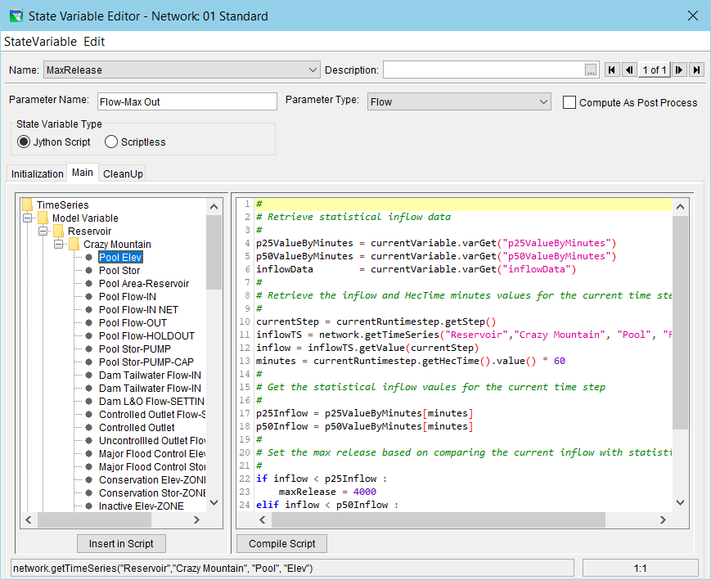
The State Variable Editor
Script Tabs
Script Pane (editor window)
Object Pane (aka API window or “tree)
API preview & Cursor Location

Slide 13
Using the State Variable Editor API Pane
Selecting a node (not a folder) in the API Pane causes the API insertion text for the selected node to be displayed in the API preview bar.
Double-clicking on a node in the API Pane causes its API text to be inserted at the current cursor position in the Editor Pane.
  The same can be accomplished by selecting a node in the API and then selecting the Insert in Script button under the API Pane.
Dragging a node in the API Pane to some position in the Editor Pane causes its API text to be inserted at that location in the Editor Pane.

Slide 14
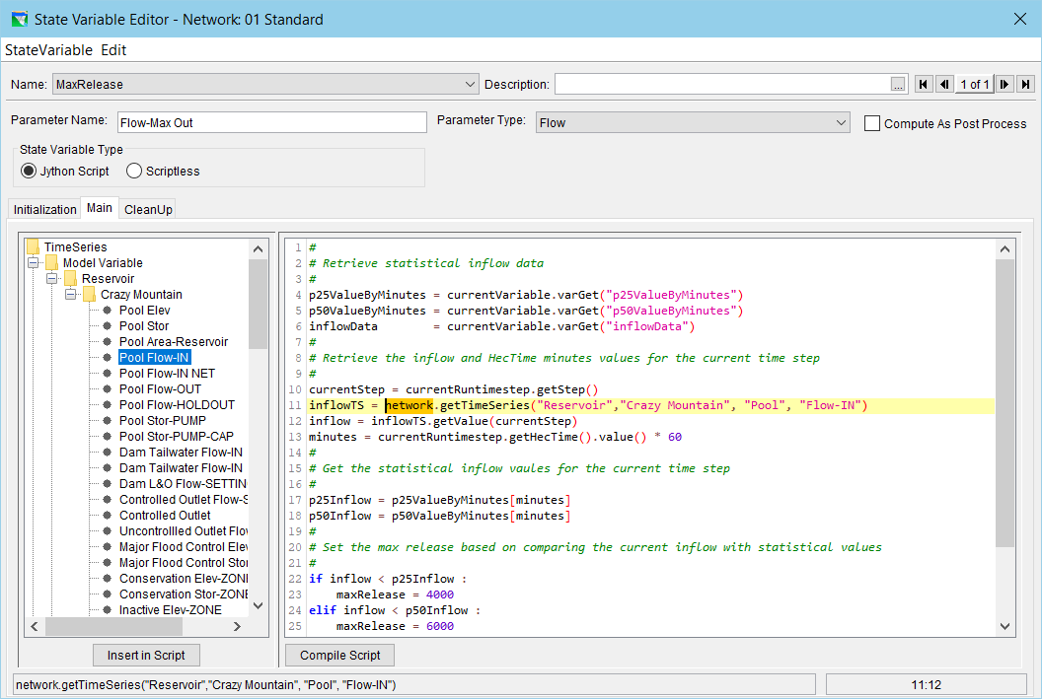
State Variable Editor API Pane Example

Slide 15
State Variable: Three Parts
Initialization (function in script)
  Runs during initialization, after initial conditions set, before any model timesteps
Main
  Runs each time a value is requested from the SV
Cleanup
  Runs after the model is finished

Slide 16
Creating New Scripted Rules
To create a Scripted Rule:
  Open the Reservoir Editor to the Zone-Rules tab of the Operations tab.
  Right-click the desired zone and select Add New Rule… from the context menu.
  Enter the desired name and select the desired release element in the New Operating Rule dialog.
    Select Script for the Rule Type.
  Press the OK button.
  Edit and check syntax as with a State Variable.

Slide 17
Editing Existing Scripted Rules
To edit an existing Scripted Rule:
  Select the desired rule in the Zone-Rules tab of the Operations tab of the Reservoir Editor.
  Edit the script as desired. The editor is similar to the State Variable editor.

Slide 18
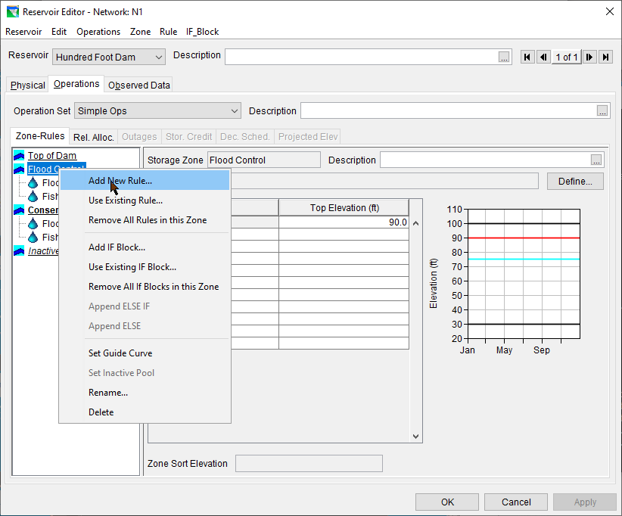
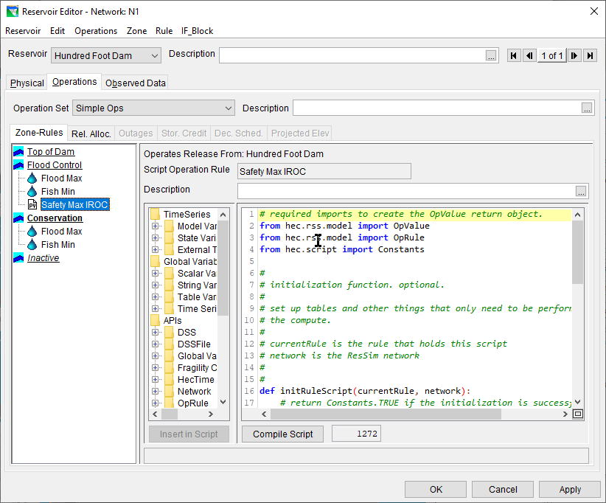
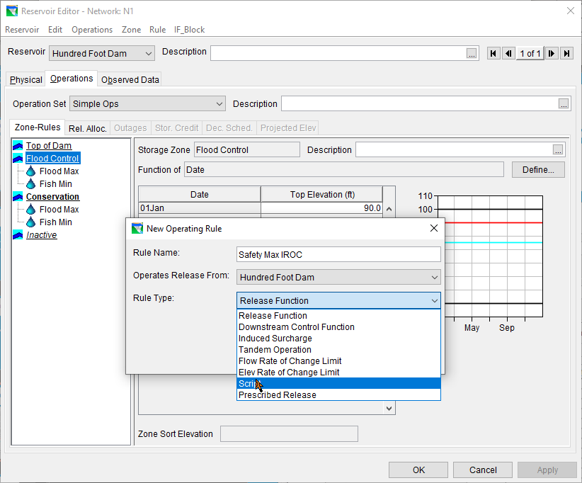
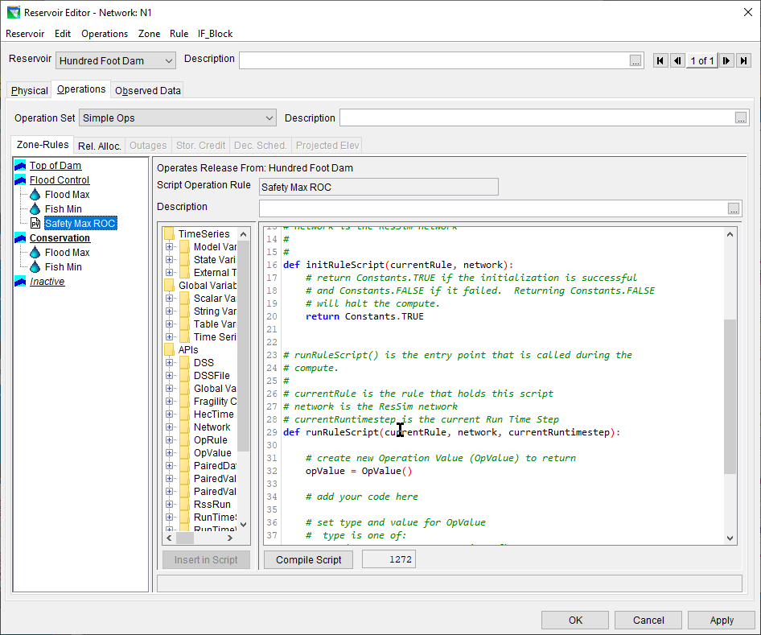
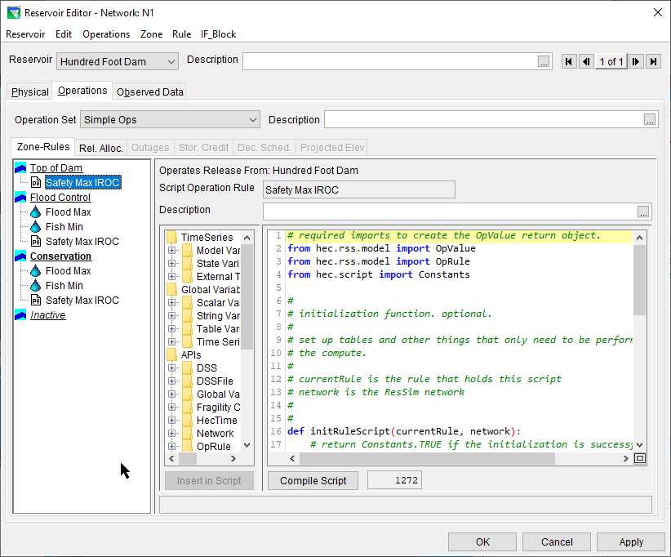
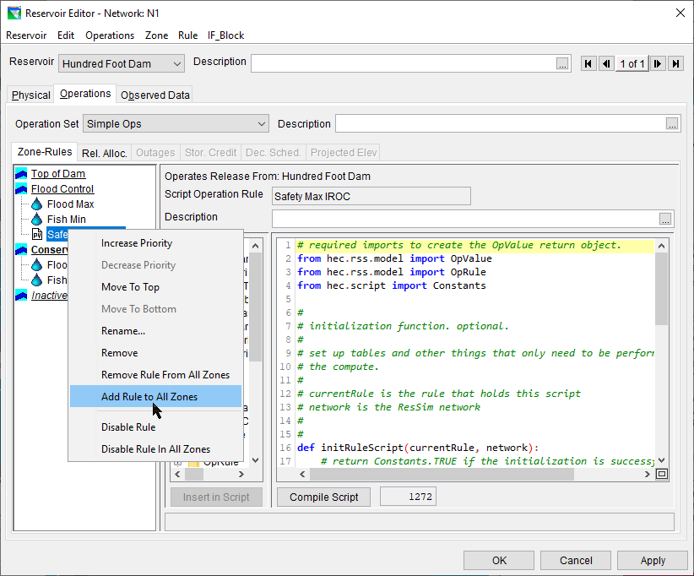
Scripted Rule Example
Operates from…
Rule name
Rule in rule stack
Description
Initialize rule
Run rule
initRuleScript function
API tree
“compile” button
Script length

Slide 19
InitRuleScript Function
Runs once before the simulation
Use this for slow or resource-demanding processes!

Slide 20
RunRuleScript function
Runs in timestep, each time the rule stack evaluates!
Avoid slow or resource demanding processes!

Slide 21
Commonly used Objects
network object / RssSystem class
  Represents ResSim Network
  Useful to access just about everything!
currentRunTimestep / RunTimestep class
  Where in the simulation are we?
currentVariable / StateVariable class
  Represents the SV being executed
currentRule / ScriptedRule class
  Represents the rule being executed

Slide 22
Passing Data Between Scripts
Local variables
  for complex objects, configuration data, doesn’t change with time
  Key-value mapping: Acts similar to a python dictionary.
  varPut, varGet, varList, varExists
  Example:
    currentRule.varPut(“initMaxFlowVal”, initMaxflow)
    maxQ = currentRule.varGet(initMaxFlowVal)
Local timeseries
  for scalar data that changes over time!
  Treat like timeseries values.
  localTimeSeriesNew, localTimeSeriesGet, localTimeSeriesExists
Get to other state variables or rules via `network` object

Slide 23
Review
Scripts Executed During Simulations
  State Variable Scripts
  Scripted Rule Scripts
Scripts Executed Outside Simulations
  Utility Scripts

