Slide 1
Object Oriented Programming and Reading JavaDocs
Evan Heisman, PE
USACE IWR-HEC
Water Resource Systems Division

Slide 2

Outline / Objectives
Goal: Get familiar with OOP documentation to become a better scripter!
Object-Oriented Programming 101
Navigating JavaDocs
ResSim classes of interest
Notes:
Object oriented programming 101
Navigating the JavaDocs
Navigating ResSim Classes
Brief tour of ResSim classes that you might run into
TS Record Object vs. HEC Math Object
Runtimestep vs HecTime vs. java.time
Lots of technical terms that you run into – OOP in general, or specific classes in ResSim; gives a brief tour of both
My goal in this presentation is to get you comfortable with the terms to help you learn more
Analogy – lots of domain specific names for parts of a turbine, I don’t spend enough time thinking about them in detail, don’t ask me to get them all right

Slide 3
Object Oriented Programming 101
“I promise I am not going to talk about cars or fruit...”

Slide 4
What is Object Oriented Programming?
What it is:
Code is organized around data and objects, instead of focused on algorithms
Not manipulating raw bytes or pointers in memory
What it is not?
Procedural or Functional
Languages can be mix of paradigms
Java is very OOP-centric – hence this presentation!
Python appears procedural but has OOP everywhere
This is focused on Java
Terminology can vary across languages
Notes:
Procedural – code written to be read / processed from top to bottom – in a way, all code is like this
Functional – code written as functions, “without side effects”, from a more mathematical lineage

Slide 5
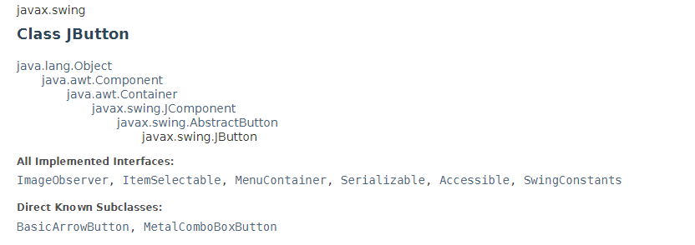
Object Oriented Programming 101
Okay
Class
javax.swing.JButton
Generic representation in code
No data associated with it
Instance
myButton = JButton(“Okay”)
Constructor method creates an instance
Can have multiple combinations of arguments
JButton(“Okay”)
JButton(“Okay”, Light Grey)

Slide 6
Object Oriented Programming 101
Okay
Method
aka “Function”, “Subroutine”
Often a phrase starting with a verb
get/set methods typically associated with a field
Ends in paratheses, with 0 or more parameters
Can have different combinations of parameters (overloading)
Field
aka “Properties” or “Attributes”
Represent data contained inside the object
Often accessed with get and set methods; not always needed
Notes:
Other languages use other names, not always behave identically between languages, but the concept is generally verb vs. data

Slide 7
Object Oriented Programming 101
Okay
What can you do with it? (methods)
What properties does it have? (fields)
Methods:
click()
draw()
setLabel(“text”)
Fields:
Text label
Font/size/color
Background color
Location on window
Enabled (or greyed out)

Slide 8
Object Oriented Programming 101
Okay
Dot Notation
Used to access methods and fields
Methods can return a value or operate on the object itself
myButton.click()
myButton.getEnabled()
myButton.color = “grey”
myButton.setLabel(“Okie Dokie”)
buttonText = myButton.getLabel()

Slide 9

Object Oriented Programming 101
4 Key Principles:
Inheritance
Abstraction
Encapsulation
Polymorphism
Stack of Java textbooks in my mom’s basement ;)
Notes:
Terms are easy to gloss over in programming books, and few describe them well
I could not understand the purpose of these until I took a class, and actually started writing code –
Related concepts with a lot of overlap – but they get applied in JavaDocs; particularly the two in bold I don’t expect you to walk away knowing what each of these are

Slide 10

Object Oriented Programming 101
Inheritance
Classes can inherit properties from a ‘super class’ (parent)
sub-class (child) implement all methods and fields of super class
sub-class can override methods to change their behavior
Java classes can only have one parent! Implementing an “Interface” is a way around this.
UI Element
Button
CheckboxButton
Notes:
In Java: “implements Interface”
Provides a standard set of methods an object must have
Java doesn’t allow multiple inheritance
Interfaces allows an object to be many things at once

Slide 11
Object Oriented Programming 101
Abstraction
Programmers don’t need to care about what an object does internally – only the defined ways of interacting with it.
Implementation can use different methods to get to data or do calculations
Updates don’t have to break existing code if the definition is added to, not changed
Encapsulation
Objects can have private or protected methods and fields, only intended to use internal to the object.
Java forces code to obey these.
Python uses “_” prefix in code.
Notes:
Abstraction as external facing – how you look at it
Encapsulation is internal facing – what is allowed to get out or be changed by others
Example of encapsulation might be a field that tracks number of items in a list – you don’t want to change that number unless something is added or removed

Slide 12
Object Oriented Programming 101
Polymorphism
Object can be multiple things at once; calling code doesn’t need to know exactly what it is.
UI Element
Button
for elem in allUIElements: elem.show()
CheckboxButton
Notes:
One example is drawing things on the screen – all of these are UI elements, and the example code doesn’t care as long as it has a show method
Another example is the Comparable interface – meaning that you can compare two objects and decide if one is greater or less than another – this lets other programmers use a generic sorting algorithm to sort in a list.
HecTime class has a comparable interface, can check if one date is greater or less than another.

Slide 13
What class do I have?
To figure out what class something is in Jython:
print type(myObject)
Prints the type/class of the object:
All java objects classes show up as “type”
Useful to look up documentation on class (Java docs)
Classes live in a package
package is a group of classes
many places expect the full name – uses dot notation
hec.heclib.util.HecTime
Package
Notes:
Names try to be helpful – but ResSim has a lot of internal lingo in class names based on the compute process
Searching through the Index can help you find what you need, or searching for related terms will get you to the right class
Type is a little bit fuzzy here – java classes show up as a “type” in Jython
Other ways to do this in Java or other languages (MATLAB, R, others that interface with Java)

Slide 14
>>> from hec.heclib.util import HecTime
>>> ht = HecTime()
>>> type(ht)
<type 'hec.heclib.util.HecTime’>
>>> i = 4
>>> type(i)
<type 'int’>
>>> import datetime
>>> dt = datetime.datetime.now()
>>> dt
datetime.datetime(2022, 8, 8, 10, 5, 30, 809000)
>>> type(dt)
<class 'datetime.datetime'>
>>> type(datetime)
<type 'module’>

Slide 15
JavaDocs

Slide 16
What is a JavaDoc?
Many HEC programs (ResSim, HMS, CAVI, WAT) are written in Java
Jython allows you to access HEC Java classes, other Java classes
using a Python 2 syntax
JavaDoc is documentation of the code:
view the functionality of classes
rather than sifting through the .java source
Created from source – so the method and field names, parameters, types are always correct…
for the version they were created from.

Slide 17
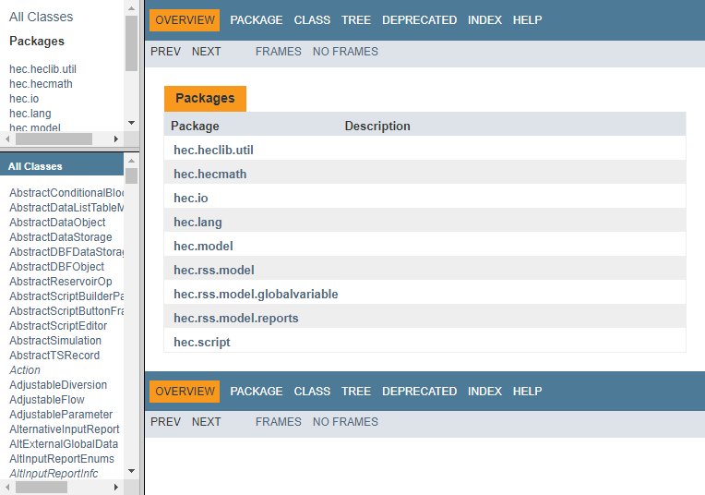
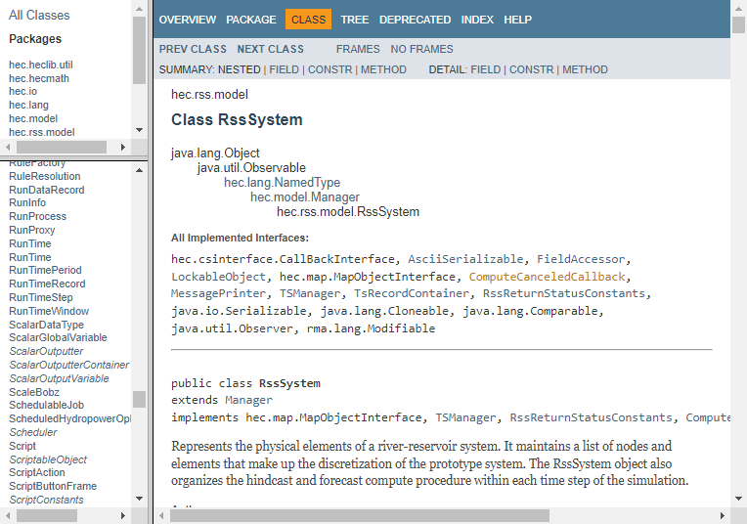
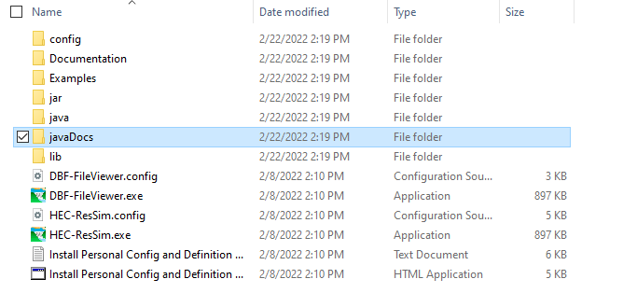
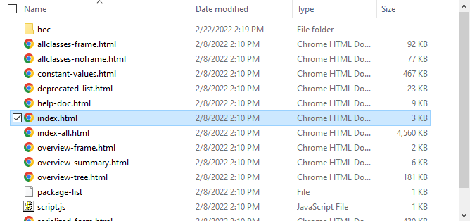
What is a JavaDoc?
Navigation buttons
Package List
Main page
List of classes
Notes:
Use the JavaDocs for the version of ResSim (or other software) you have – API can change between versions
May not be a complete set – not all classes show up; ResSim is fairly complete
Index has alphabetical list of every class, method, field – use this if you want to do a “control-F” freeform search
Deprecated shows list of things you shouldn’t use as they might go away in a future version
Don’t have to know the Java language to understand a Javadoc
A javaDoc is an assembly of the header comments in the ResSim source code that are intended to document each class and its member data and methods. Generated from the code itself!

Slide 18
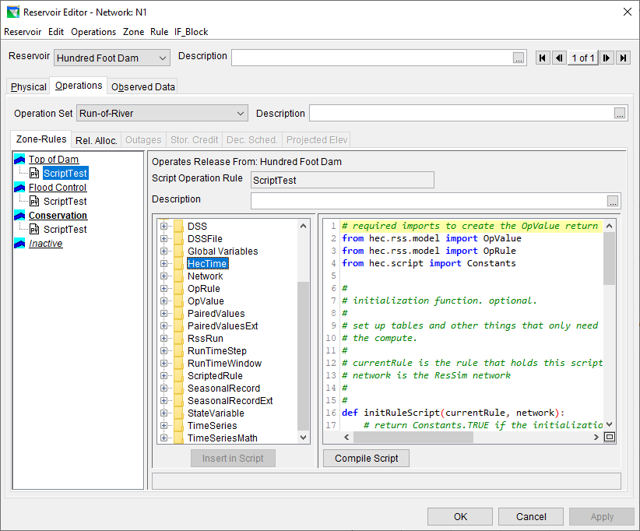
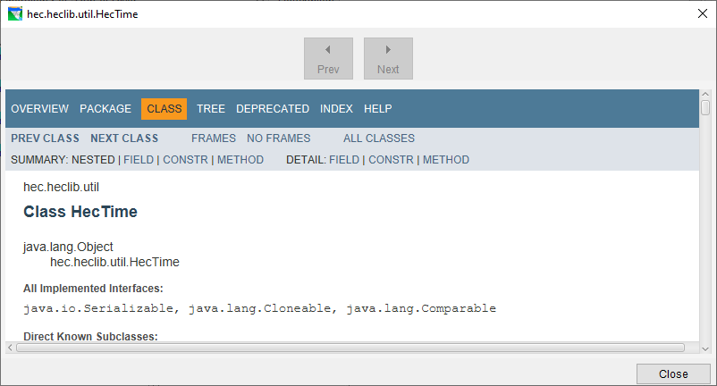
JavaDocs in ResSim
Inside ResSim script editor, select an API tree item, and press F1 to see the JavaDoc page
Press F1 to see the Javadoc for HecTime

Slide 19
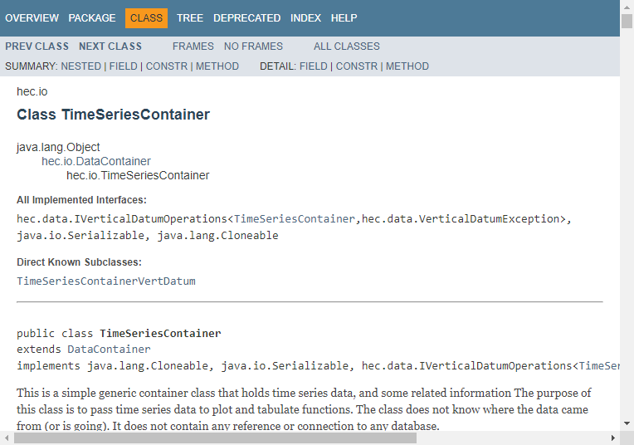
javaDoc example
Class Name
Parent Classes
Interfaces
Children

Slide 20
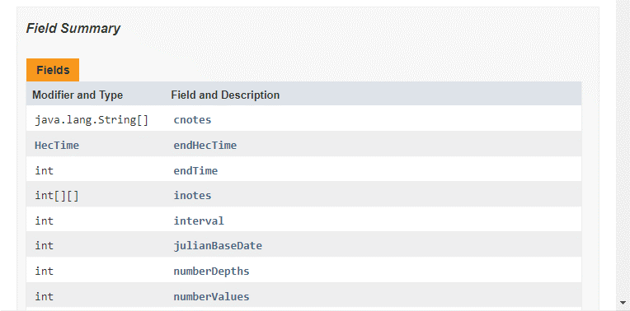
All fields in the class (data that defines the object)
Notes:
Most fields have a get method, or if writable a set method – you should use that!

Slide 21
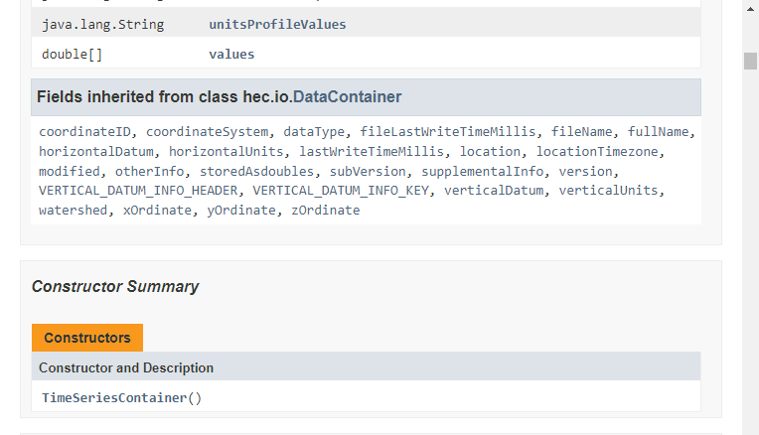
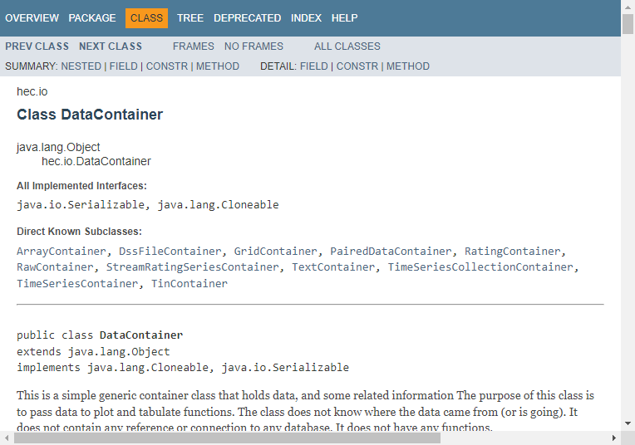
Fields inherited from the parent class
How to create an object of this class

Slide 22
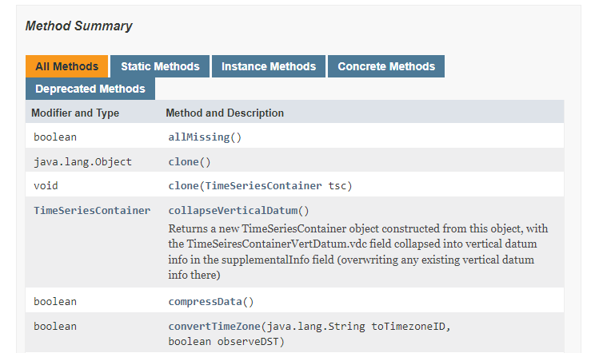
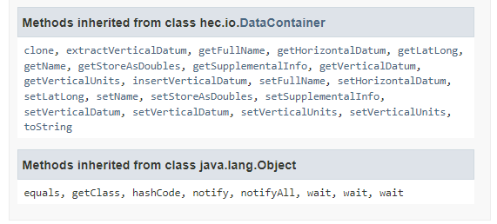
Return types (void if none)
Method names and parameters
Methods inherited from the parent class

Slide 23
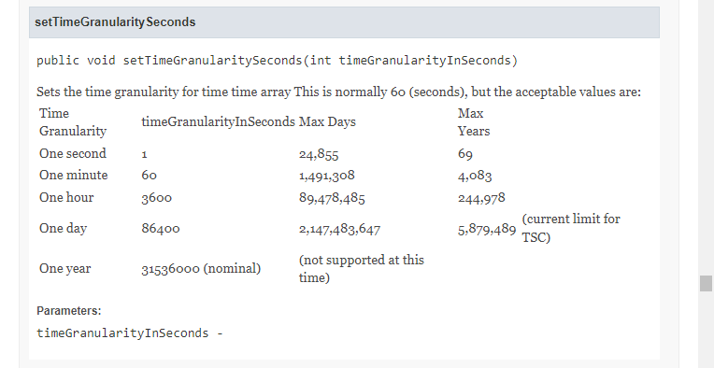
Methods and fields may have more details listed below the summaries

Slide 24
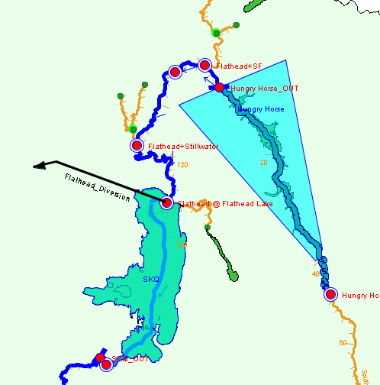
ResSim Java Classes
Everything you see in the ResSim GUI has a class; mostly in the hec.rss.model package
hec.rss.model.JunctionElement
hec.rss.model.ReservoirElement
hec.rss.model.DiversionElement
Notes:
You know how to get there in the GUI, sometimes challenging to get there in a script
All of these inherit from NamedType and Element, which means they have functions to get their display name and upstream/downstream connections

Slide 25
Following the chain
Dot notation lets you chain together method calls.
Each level is another object – starting broadly, tunneling down to what you need.
RssSystem
RssRun
RunTimeWindow
HecTime
Integer
Notes:
network – object of physical watershed, but also data for current run, way to access model variables, state variables, etc.
getRssRun() returns the run – information about the alternative, and information specific to the current simulation like the RunTimeWindow
RssAlt is object with alternative information
runTimeWindow contains start/end/lookback dates
getStartTime gives a HecTime object
Month() gets the month

Slide 26
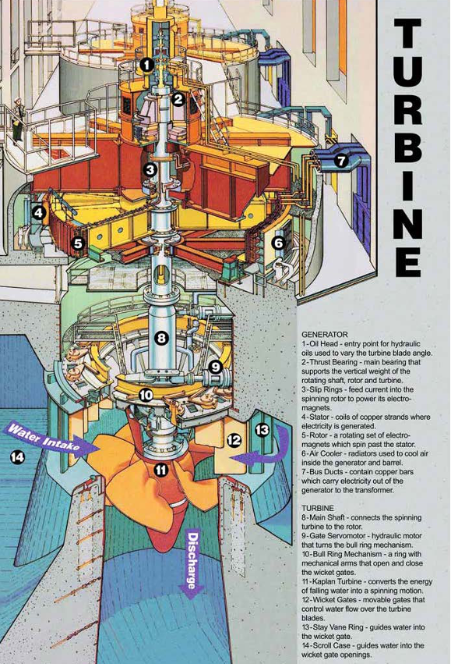
Questions?
Notes:
Hope that this presentation is something like the poster on the left – trying to show you the parts and give you the names to improve understanding, not showing you how to design it from scratch

