Slide 1
HEC API – putting it together

Slide 2
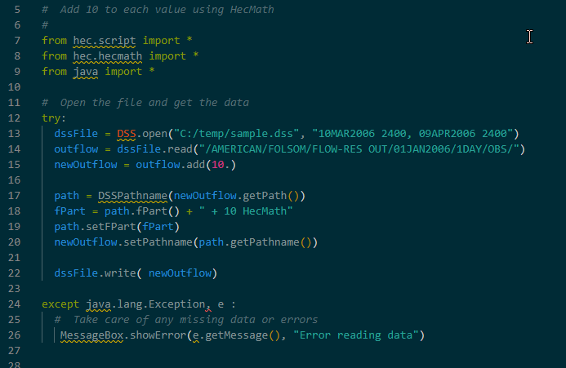
HECMATH EXAMPLE – ADDING 10
Notes:
Import * … bad practice, doesn’t tell you what the script reads, but makes it easy to just start adding things
Try except clause
Try running it, what happens?
Step through pieces

Slide 3
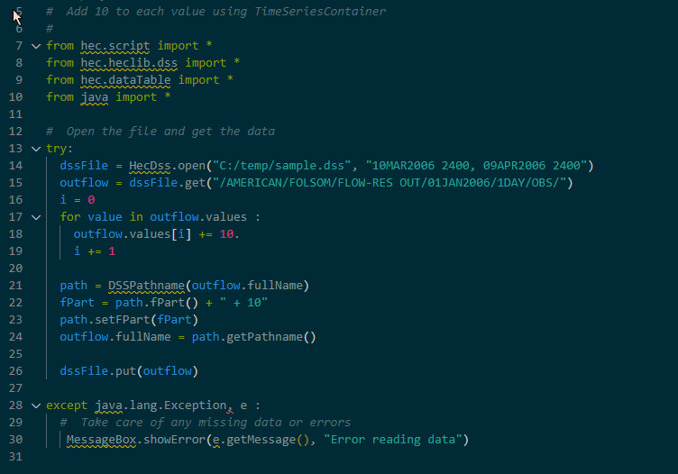
TIMESERIES CONTAINER EXAMPLE – ADDING 10
Notes:
Import * … bad practice, doesn’t tell you what the script reads, but makes it easy to just start adding things
Try except clause
Try running it, what happens?
Step through pieces

Slide 4
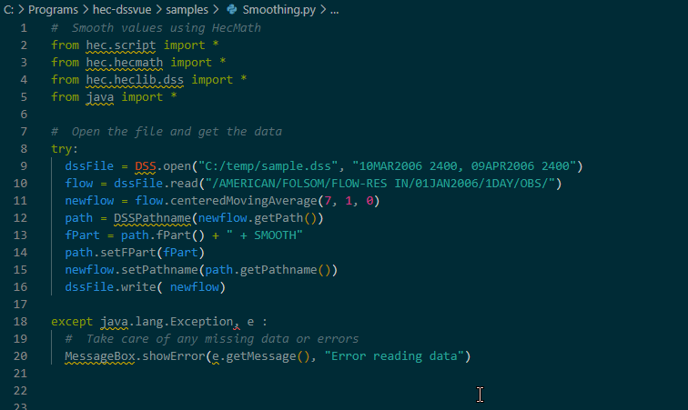
HECMATH EXAMPLE - SMOOTHING
Notes:
Import * … bad practice, doesn’t tell you what the script reads, but makes it easy to just start adding things
Try except clause
Try running it, what happens?
Step through pieces

Slide 5
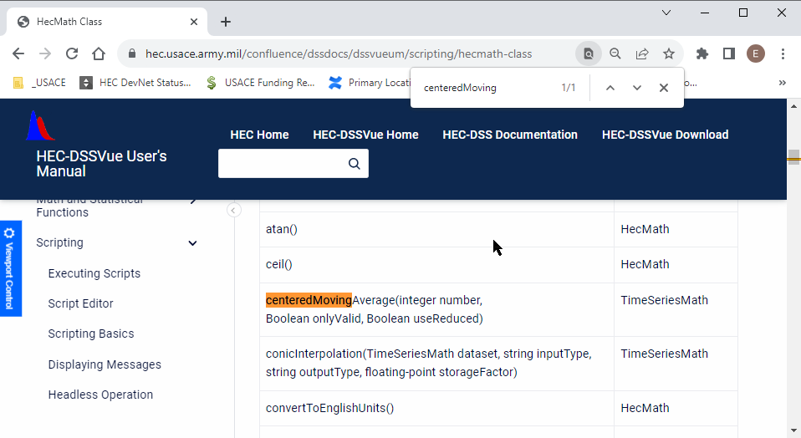
HECMATH EXamplE - SMOOTHING

Slide 6
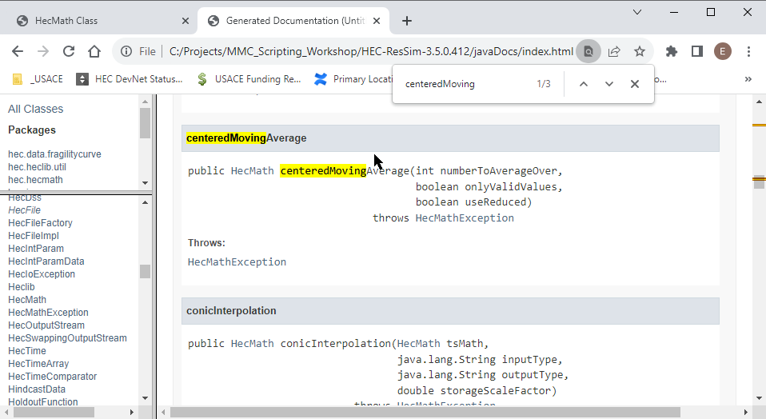
HECMATH EXamplE - SMOOTHING

Slide 7
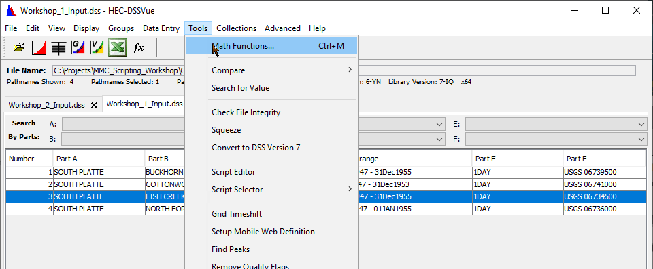
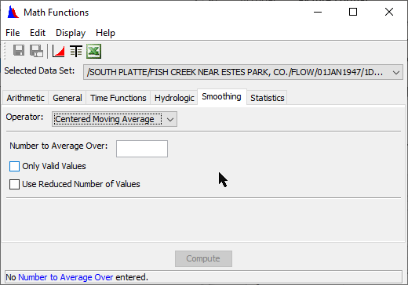
HECMATH EXamplE - SMOOTHING

Slide 8
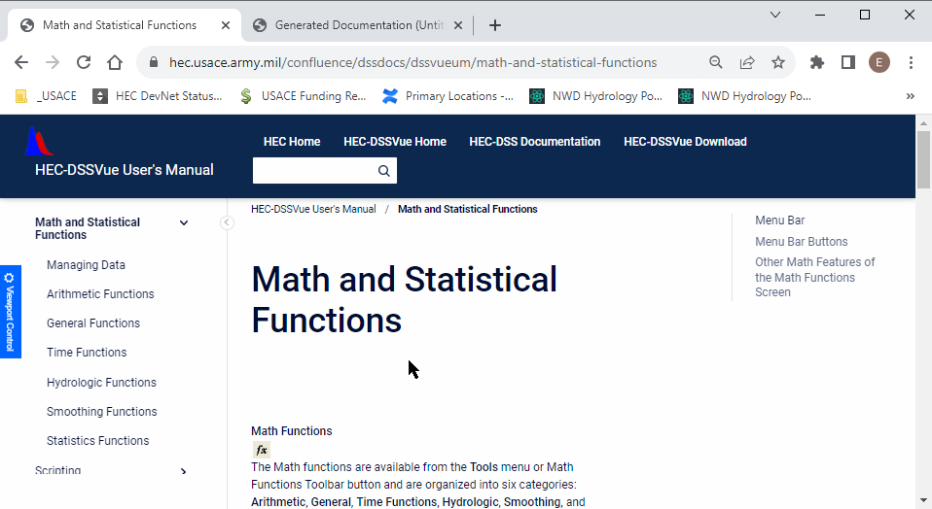
HECMATH EXamplE - SMOOTHING

Slide 9
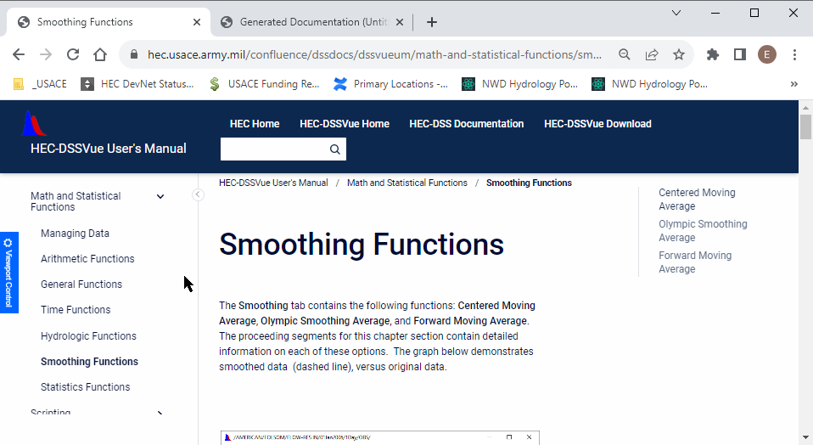
HECMATH EXamplE - SMOOTHING

Slide 10
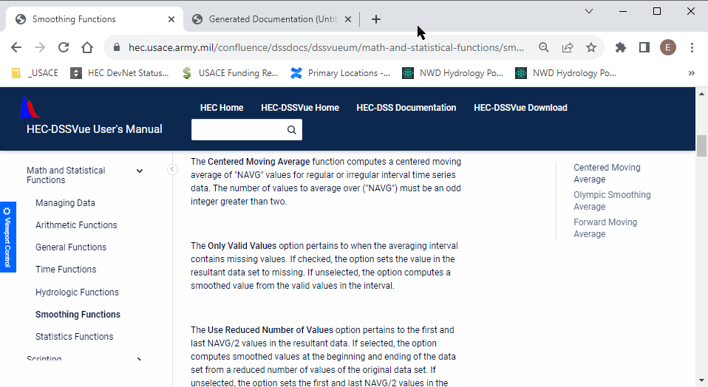
HECMATH EXamplE - SMOOTHING

Slide 11
Class Exercise – LIVE DEMO
Let’s take the add 10 example and modify it:
Report the minimum
Report the maximum
In a message box
… For HecMath and TimeSeriesContainer

