Slide 1

HEC-ResSim Scripting Applications Overview
Fauwaz hanbali
MMC HEC-ResSim Scripting
August 2023

Slide 2
Agenda
HEC-ResSim Scripting Purposes
HEC-ResSim Scripting Applications

Slide 3
Purposes
Preprocessing
  Parsing text input files and preparing DSS inputs
  Computing statistics and important criteria
Reservoir Operations
  Computing non-standard variables for use in decisions
  Non-standard and complex decision logic
Visualization
  Custom plot layouts, styles, and content
Post Processing
  Data transformations and datum shifts
  Byproduct variables and statistics
  Results plots and report generation
Automated Computes
Notes:
Adding custom capability beyond HEC-ResSim generalized features:
Driving computation
State variable (pre, main, post)
Global variable
Scripted rule (pre, main, post)
OSI
Depending on preference and application, can also use scripting editors in CAVI/DSS or ResSim for following:
Plots and statistics for analysis
Data preprocessing and post processing
Report generation

Slide 4
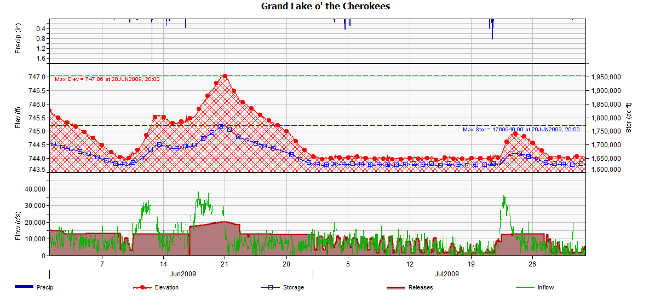
Customized Plotting
Notes:
Multiple viewports
Reverse Axis and Multiple Axes
Markers and Labels
Colors (Curves and Symbols)
Filling Below/Above Curves
Legend Labels

Slide 5
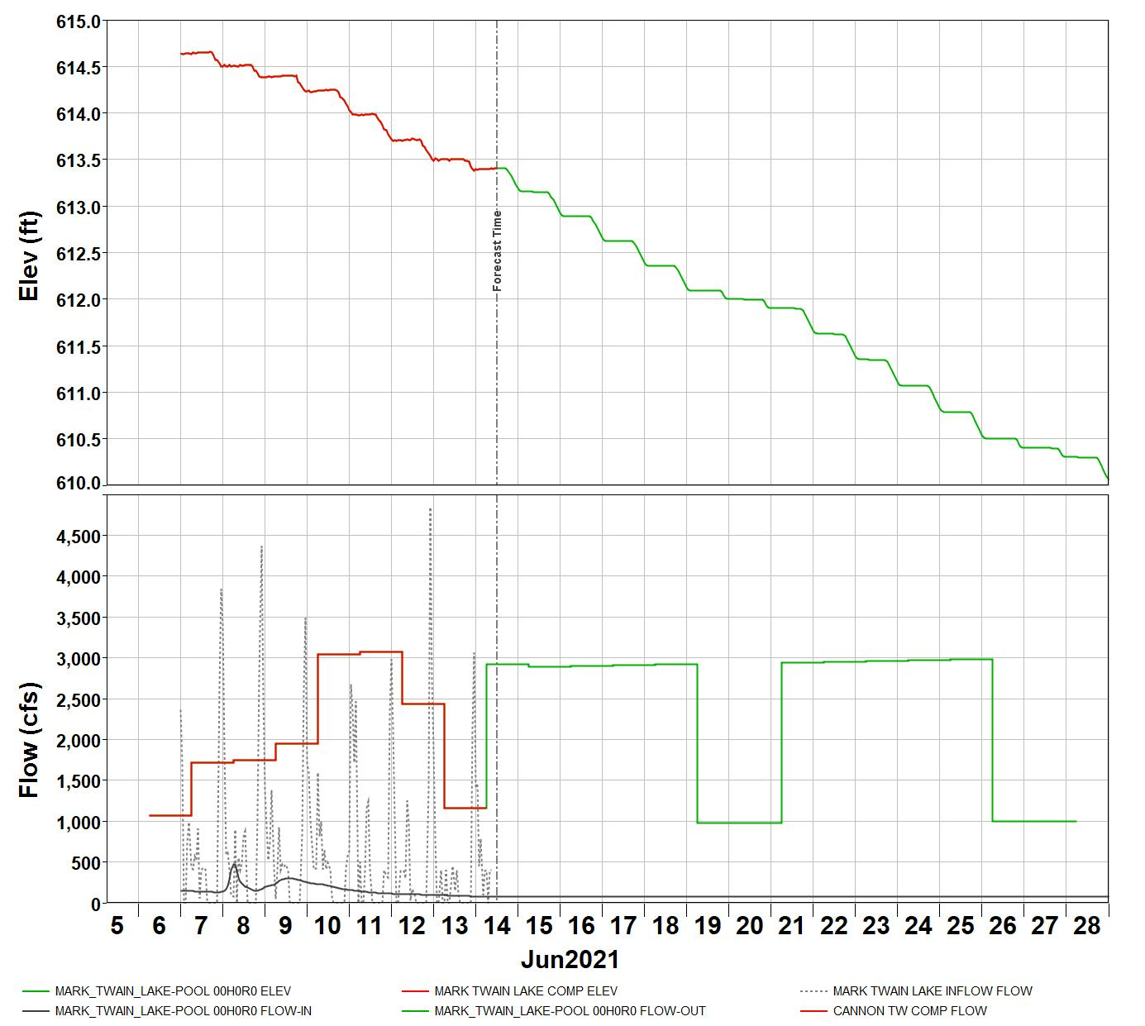
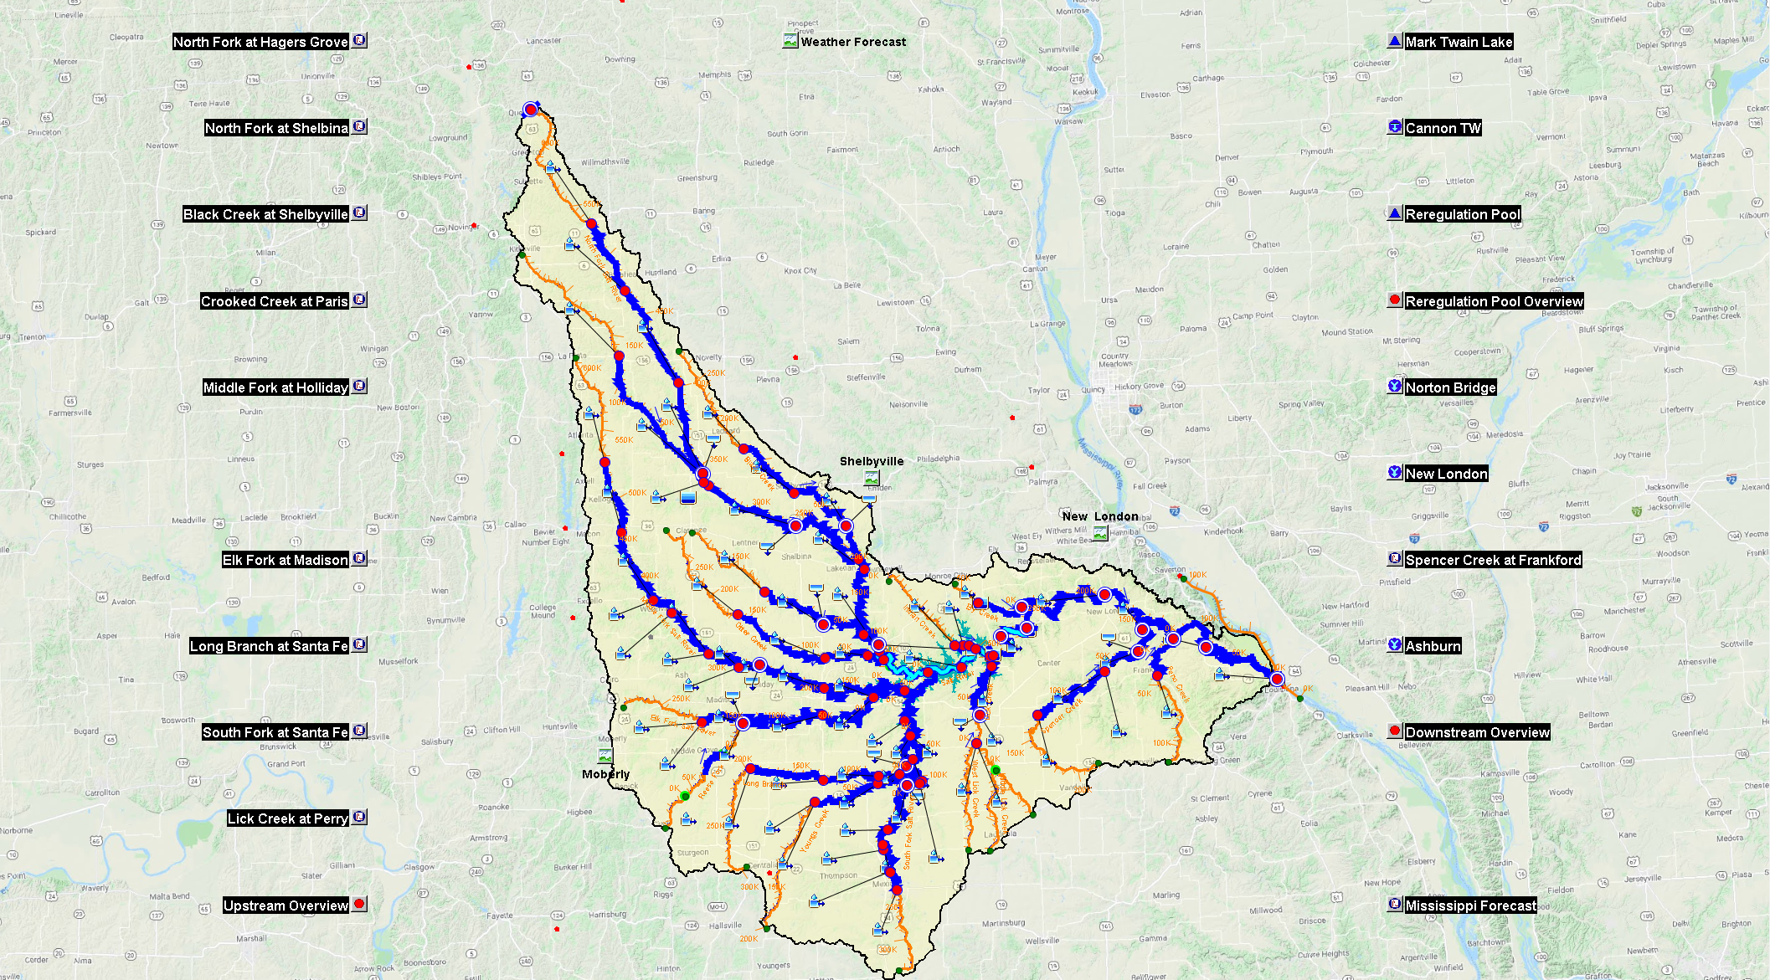
Forecast Reservoir Plot
Notes:
Back computed observed reservoir inflows
Time of Forecast Axis
Observed vs. computed reservoir variables
Elevation
Inflow
Outflow

Slide 6
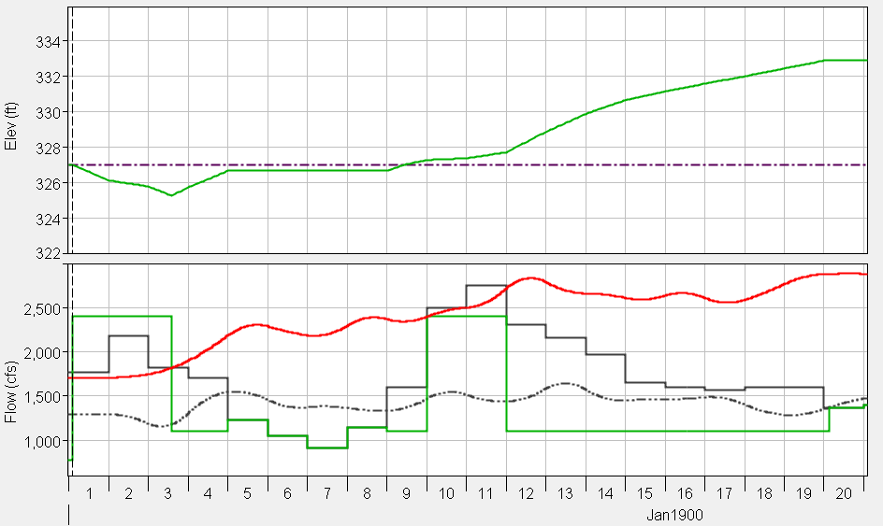
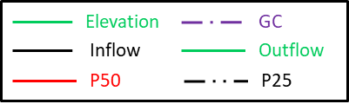
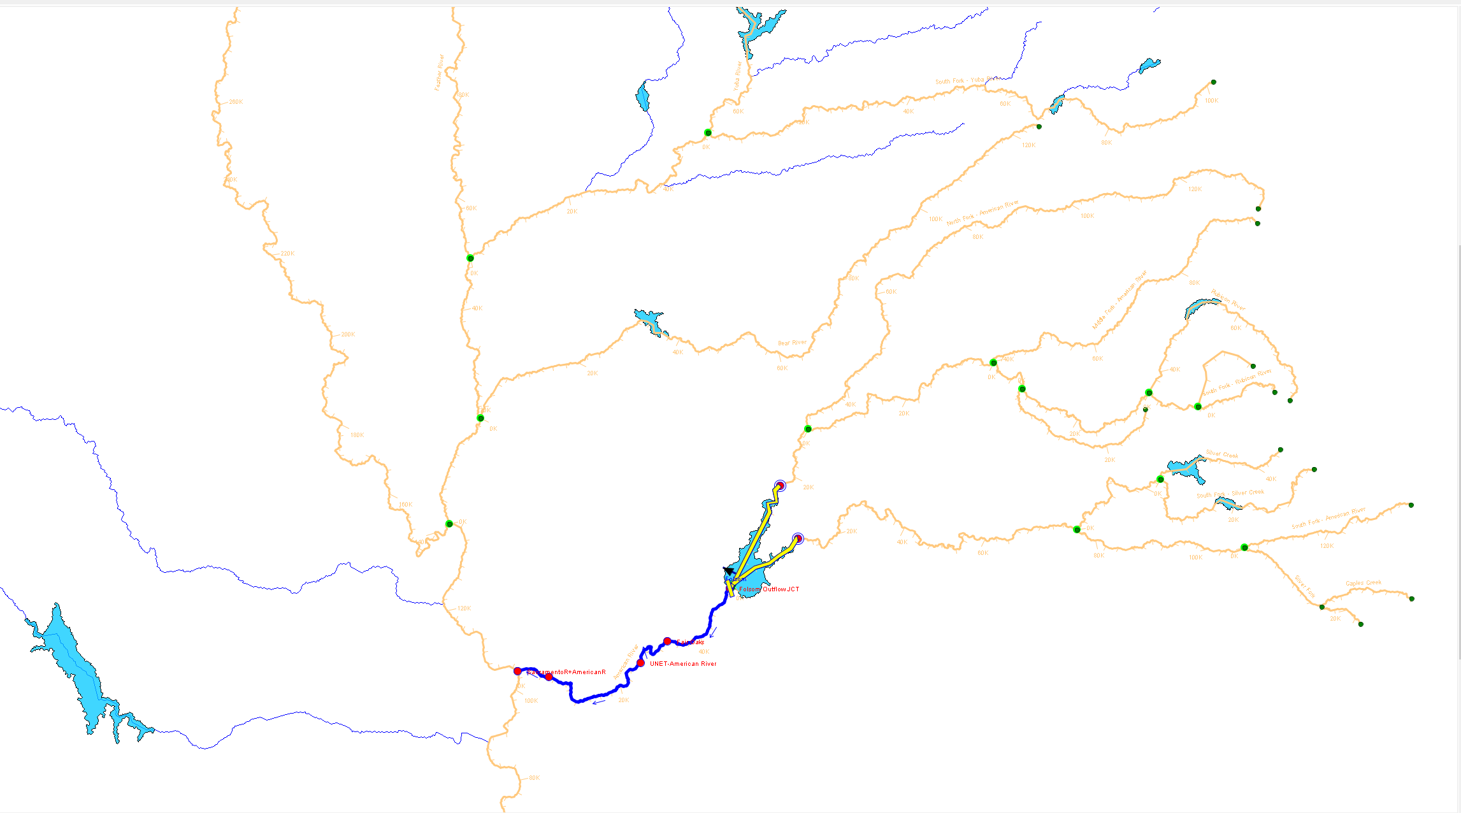
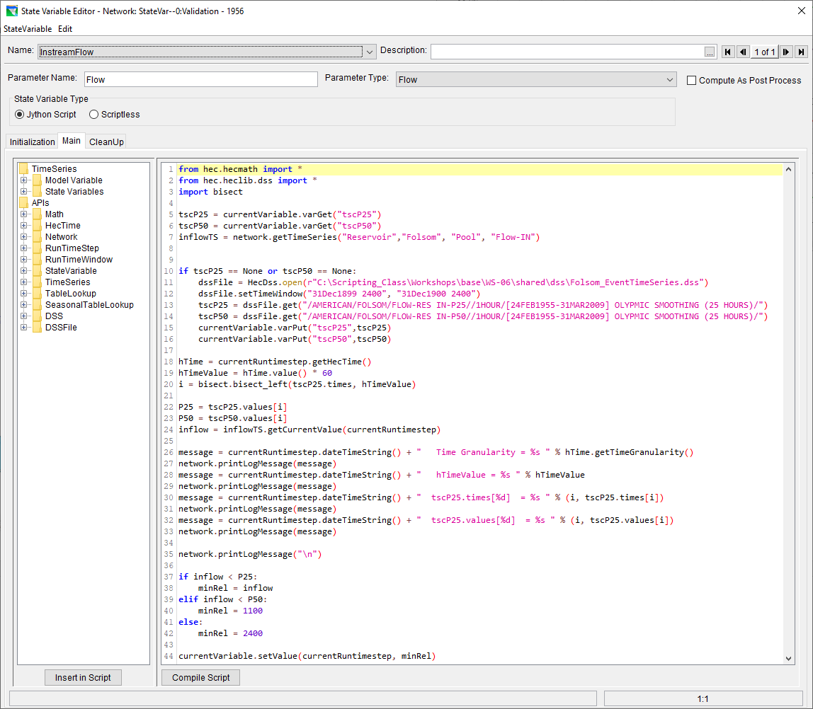
Scripted Conditional
Minimum Releases
Notes:
Preprocessed 25- and 50-percentiles using period of record and cyclic analysis
Time interval based checks on whether or not input inflows fall within or outside the range between the 25- and 50-percentiles

Slide 7
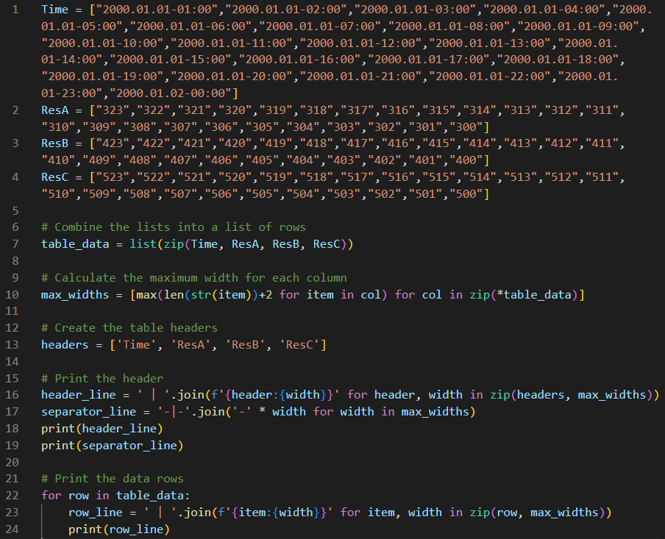
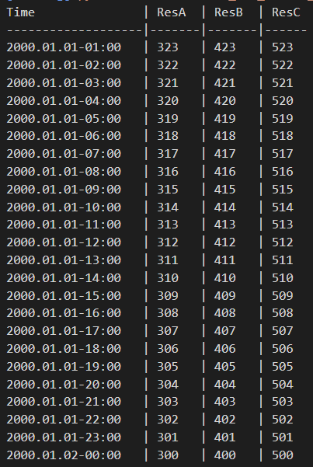
Report Generation
Notes:
Create a table from data lists using string manipulation

Slide 8
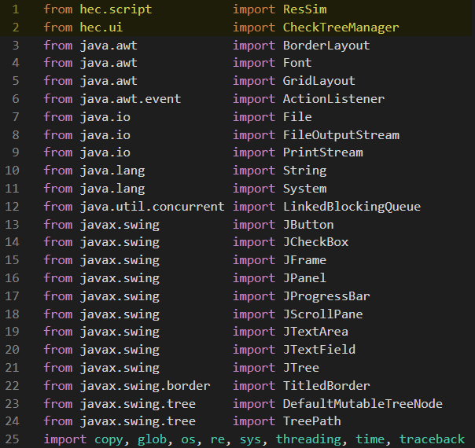
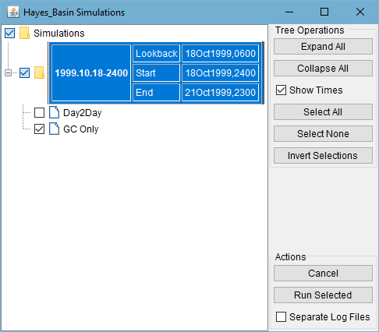
Automated Computes
Example script and a document describing usage:
  https://drive.hecdev.net/share/SjQrzCH7
Notes:
Use ResSim API for accessing and driving simulation and alternatives analysis
Use Java packages for building a convenient interface for driving the desired automated computes

Slide 9
Applications
SPK – Folsom Dam
LRN – Jay Percy Priest Dam
LRN – Cumberland River System
SAM – ACF System
NWDMR – Missouri River System
NWD – Columbia River System

Slide 10
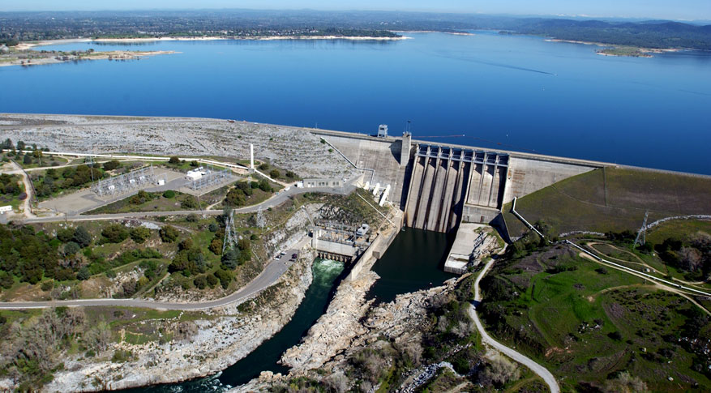
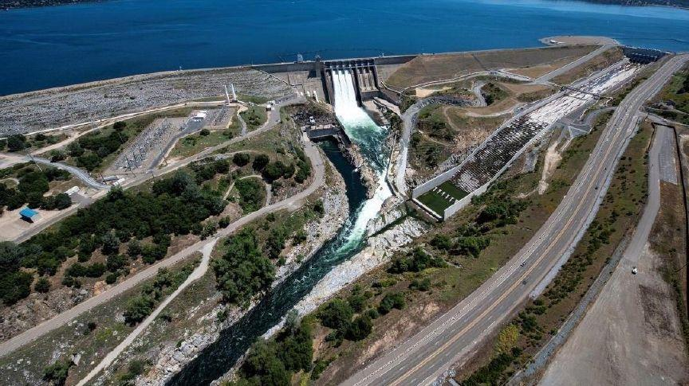
Folsom Dam
Notes:
Folsom dam’s outlet structures:
Lower tier bottom outlets
Upper tier bottom outlets
Hydropower plant
Main dam gated spillway group of 5
Main dam gated spillway group of 3 with flip buckets
Side spillway
Emergency Spillway

Slide 11
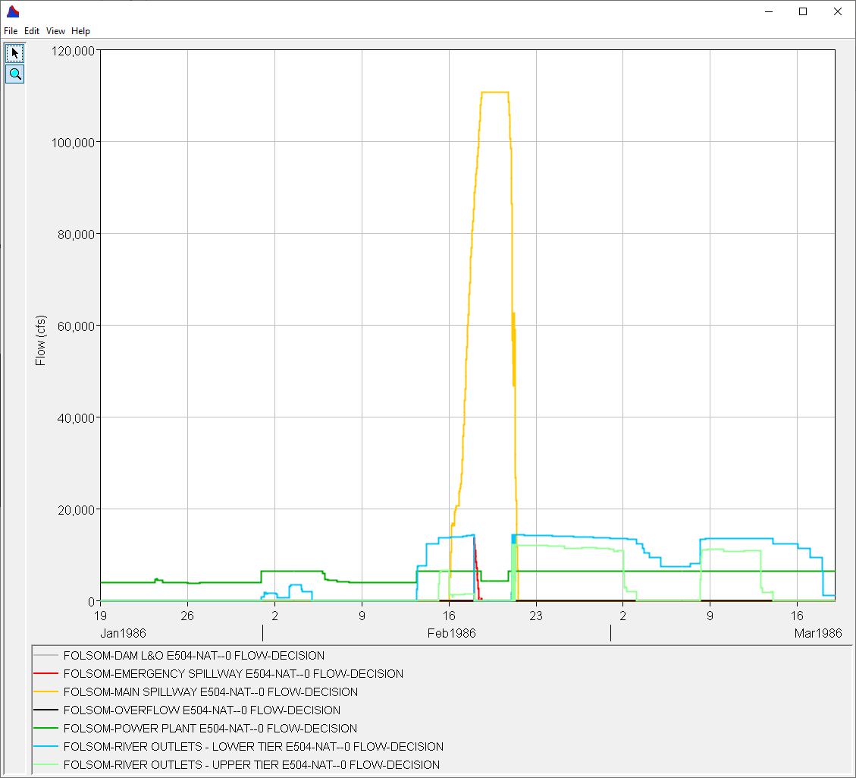
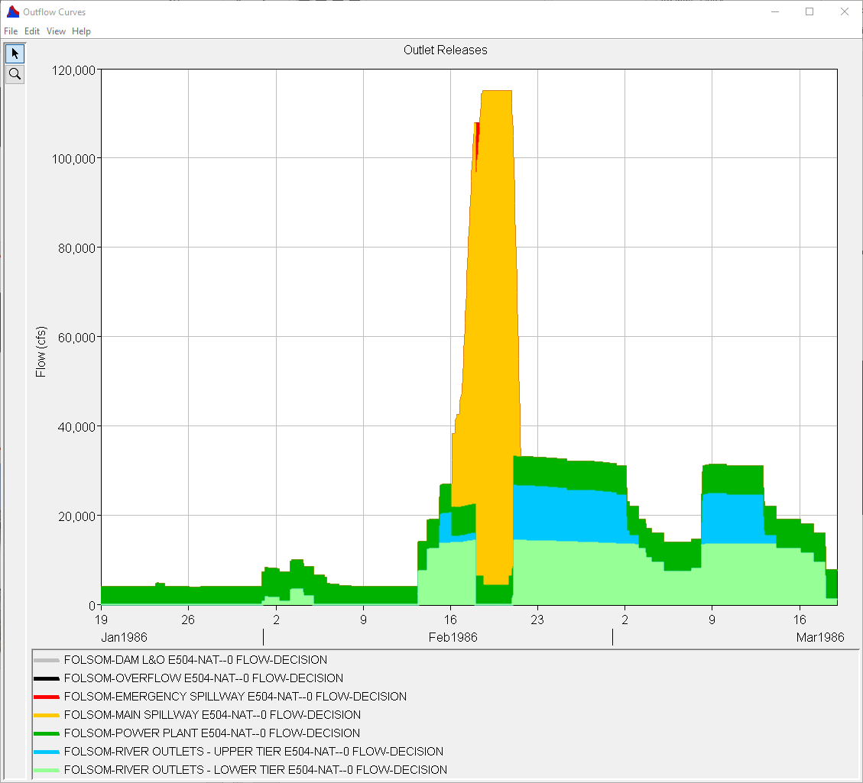
Outlet Release Allocations
Notes:
Folsom reoperation study model included
Stacked release allocations plot
Use HEC Math to add up outlet flows
Order the accumulated outlet flow curves and fill below curves
Automated computes for hundreds of alternatives

Slide 12
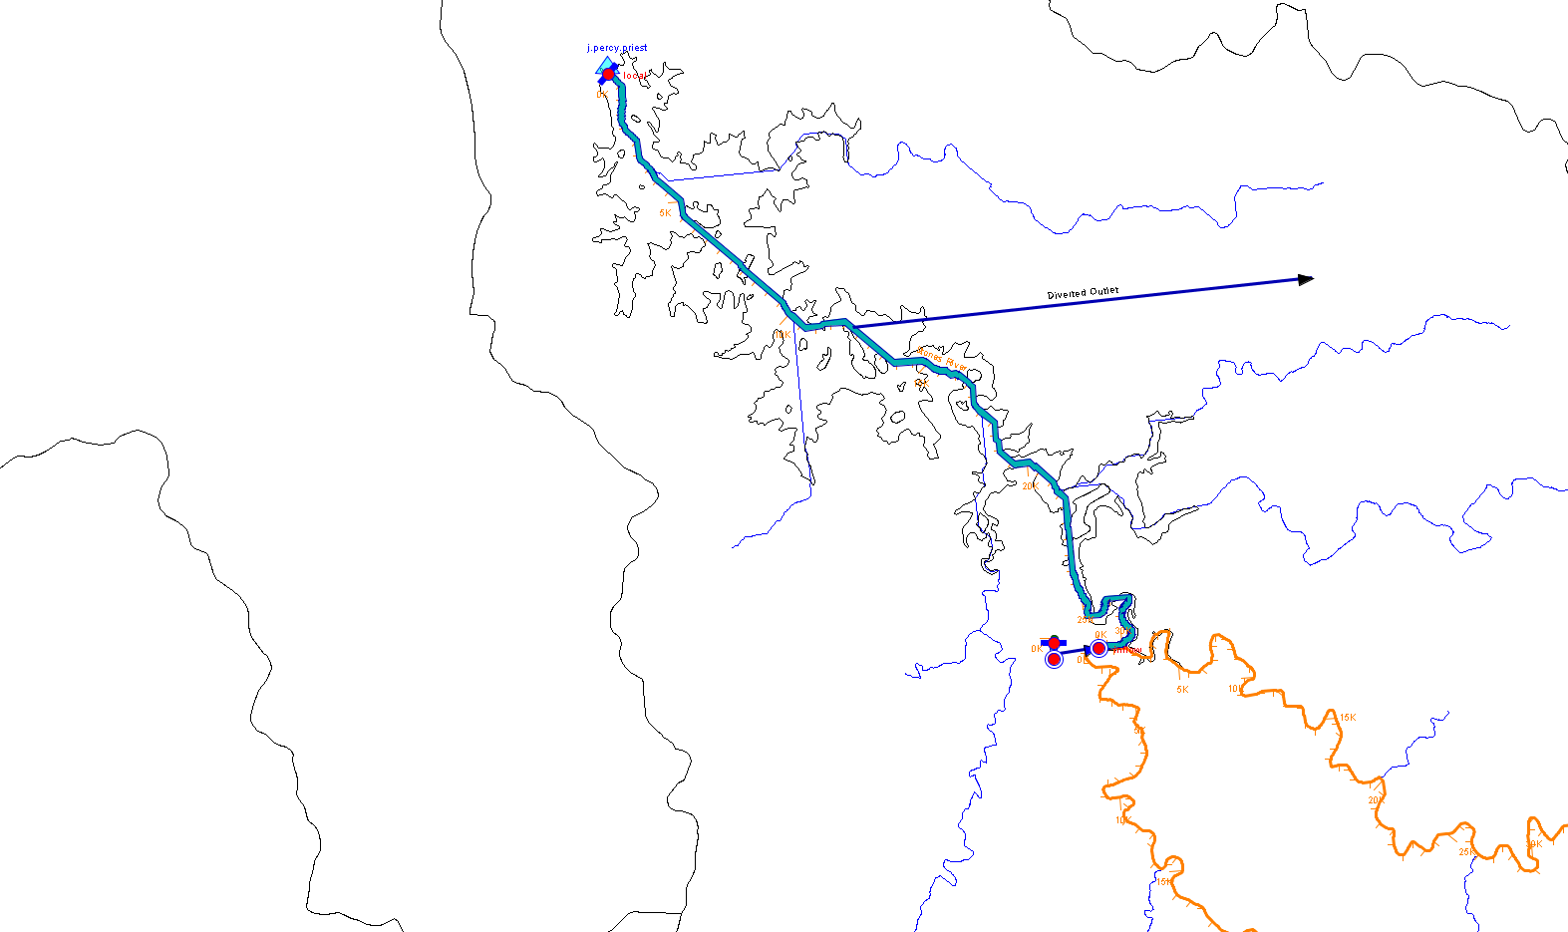
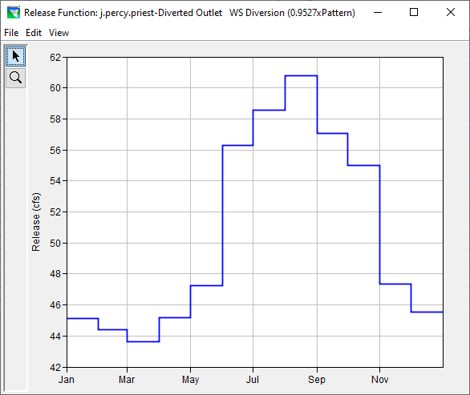
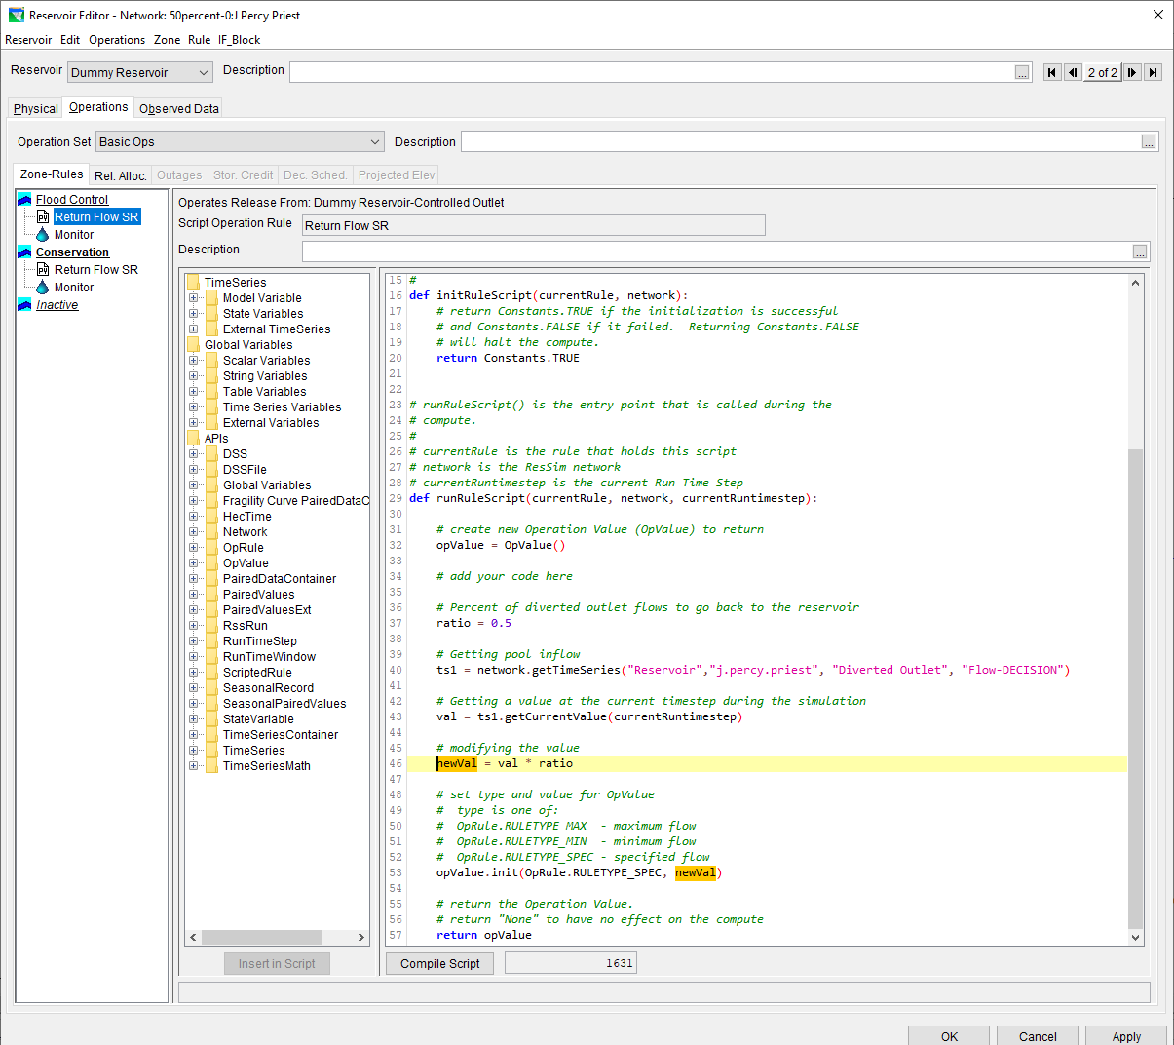
Jay Percy Priest Dam
Return Flow Via Dummy Reservoir
Notes:
Workaround HEC-ResSim’s limitation in handling circular flow:
Use a dummy reservoir with infinite storage
Read the real reservoir’s diversion decision
Apply a return flow ratio and feed back as inflow to the real reservoir

Slide 13
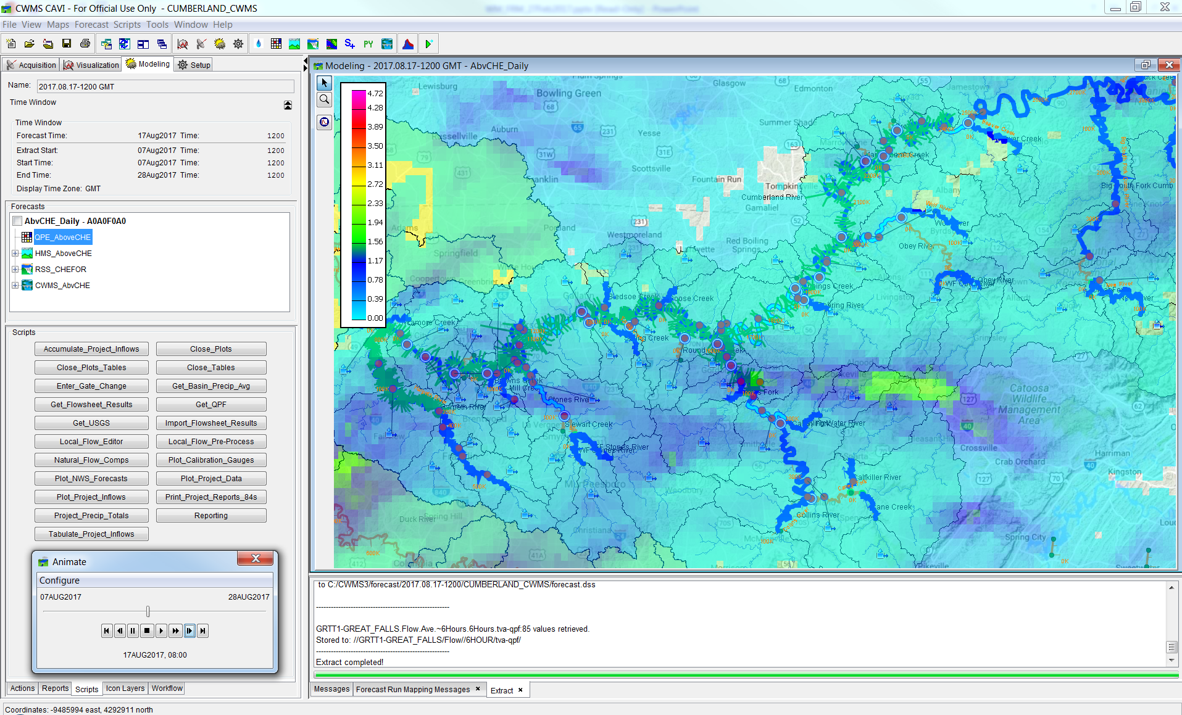
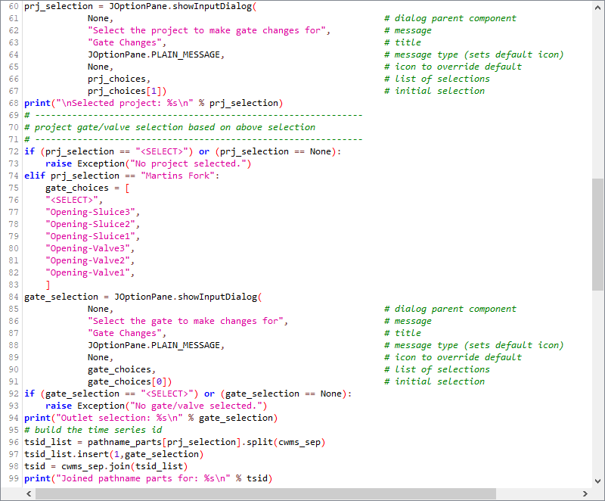
Cumberland River System
Notes:
Several scripts to assist with daily forecast modeling routine, including:
Observed (USGS) data importing
Plotting of real-time data and simulation results
Interpreting reservoir release flow decisions and translating to gate change instructions

Slide 14
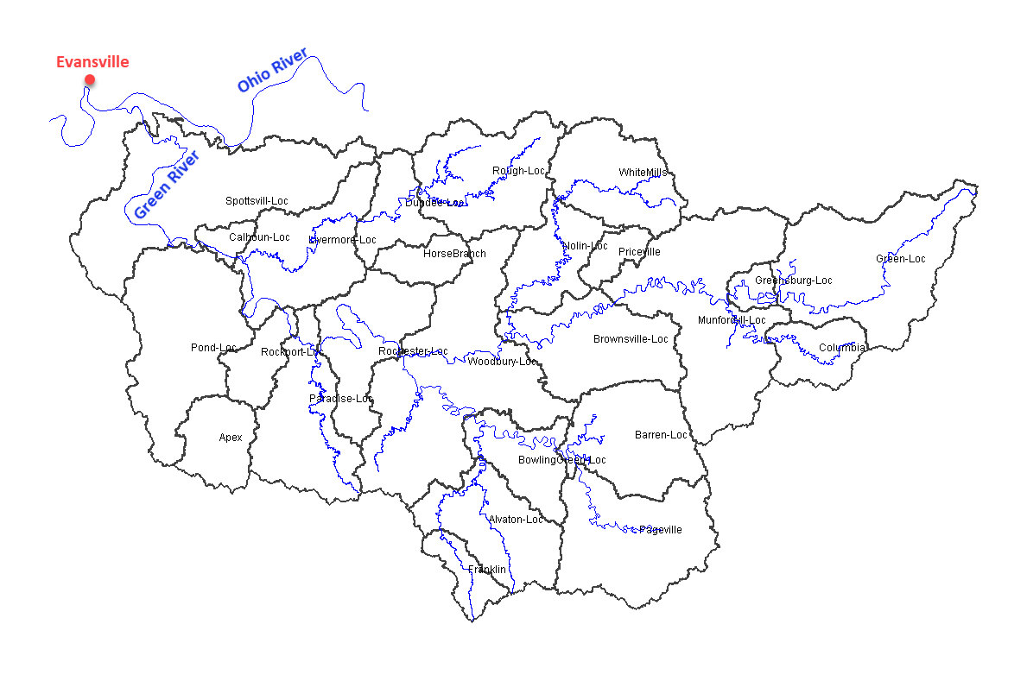
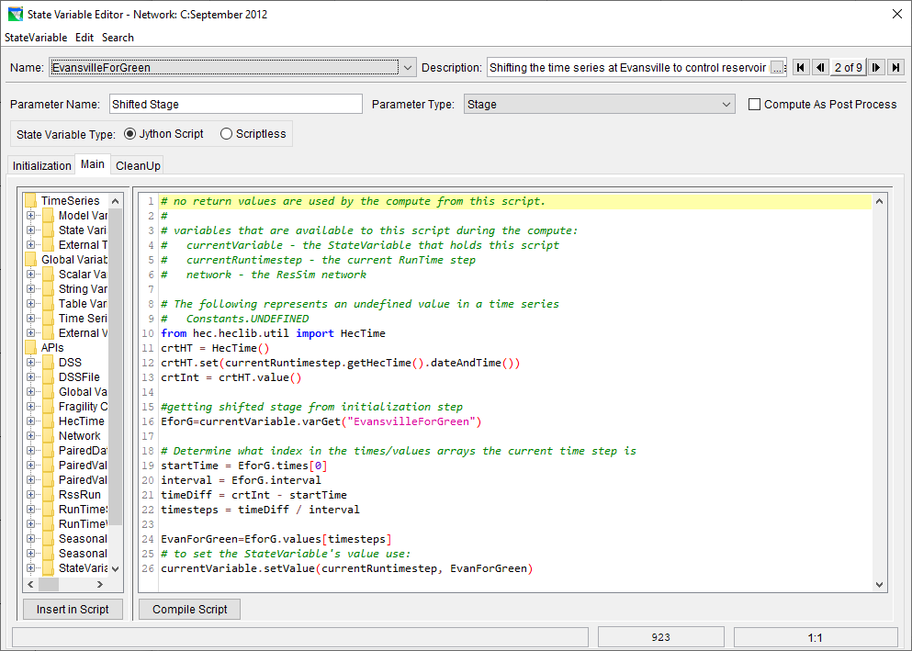
Green River System
Notes:
As a few reservoirs in the Green River system operate for stage criteria at a downstream location (Evansville, IN) along the Ohio River, real-time and forecast stages are simply read from the CWMS database for the downstream location without having to expand the model’s domain to include the Ohio River.

Slide 15
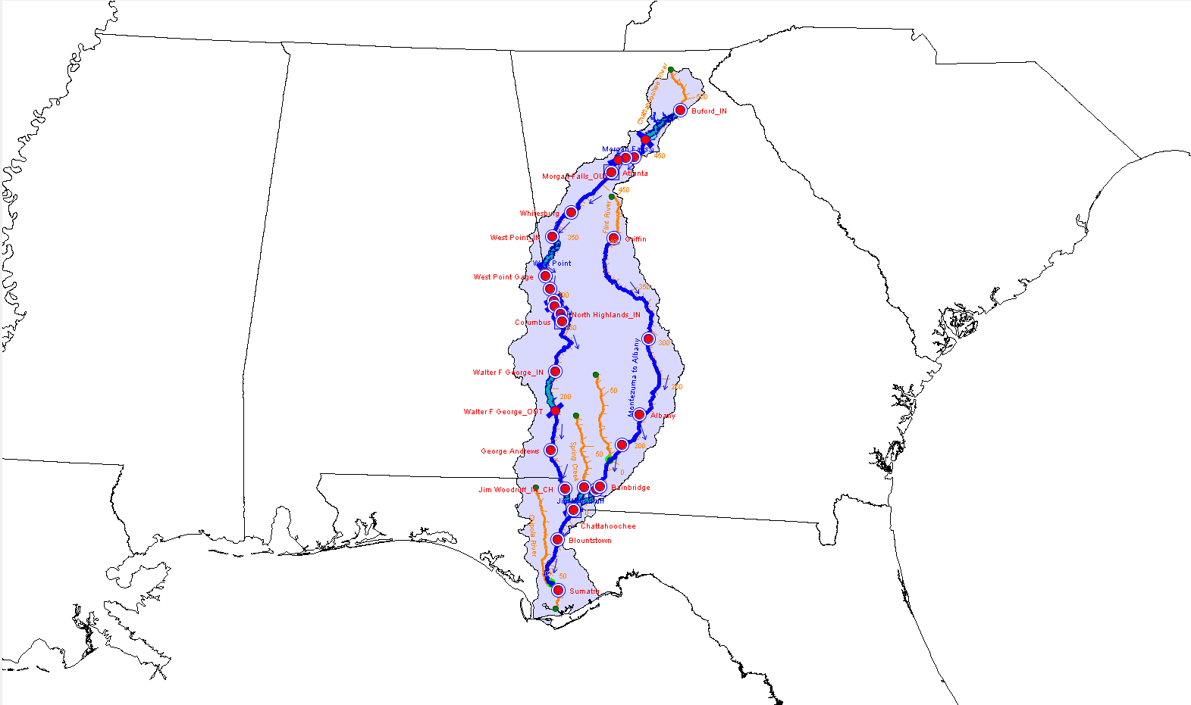
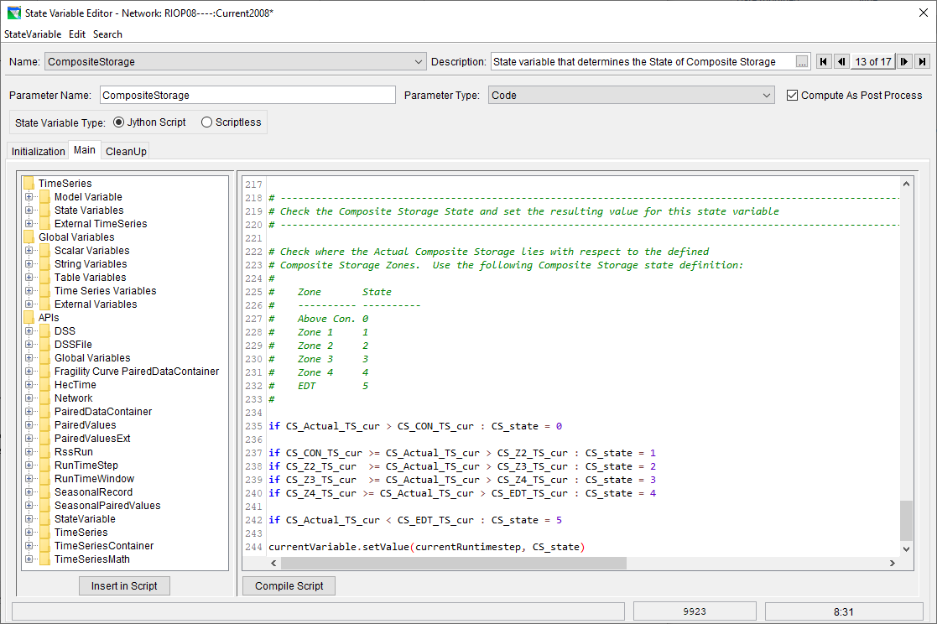
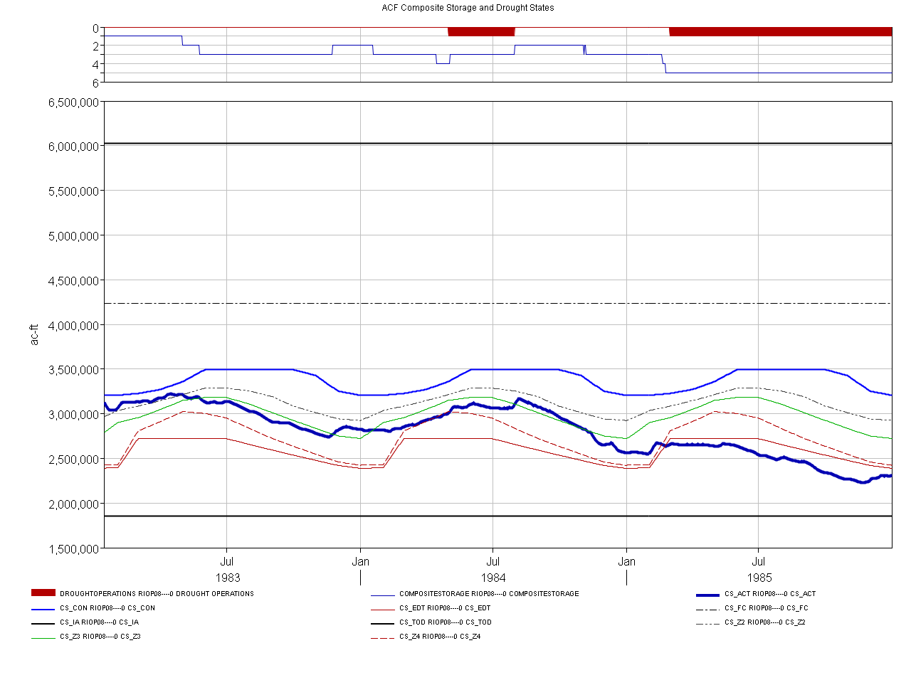
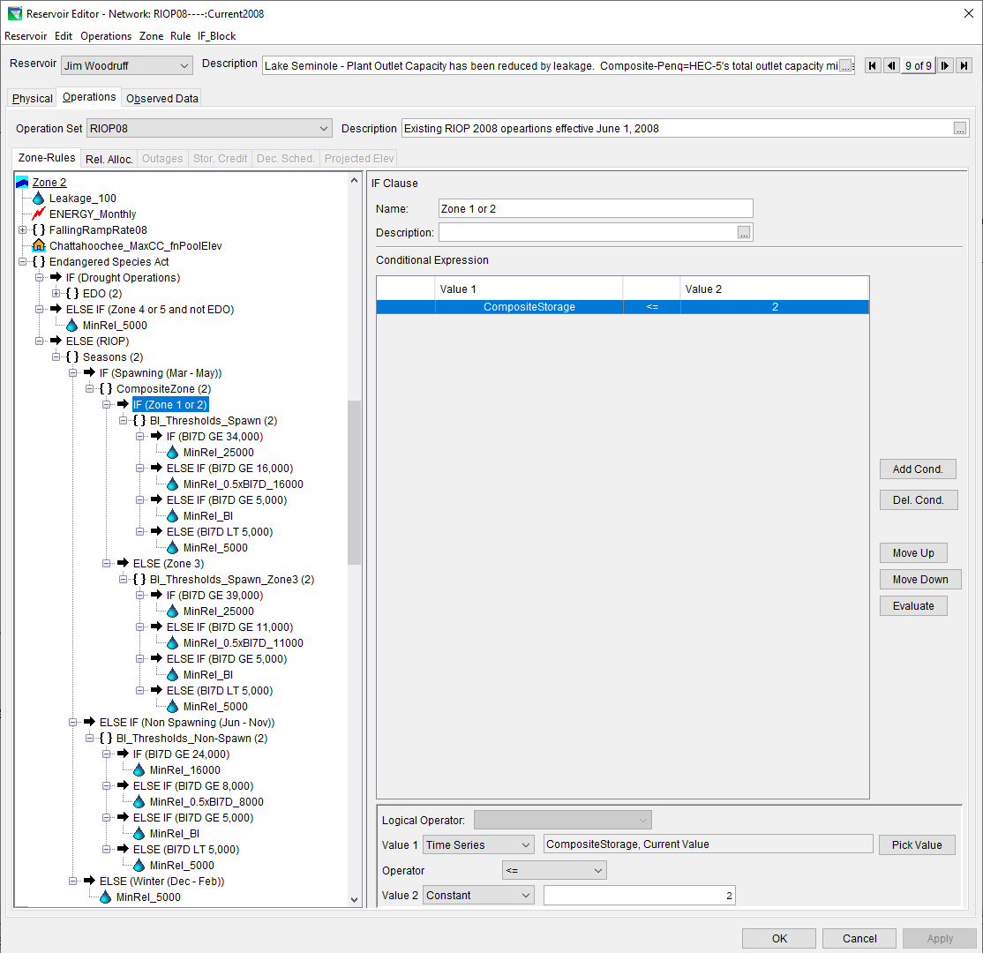
ACF System
Notes:
The composite storage of the three major reservoirs in the ACF Basin is checked against a handful of system levels that trigger drought operations from mild to severe measures.

Slide 16
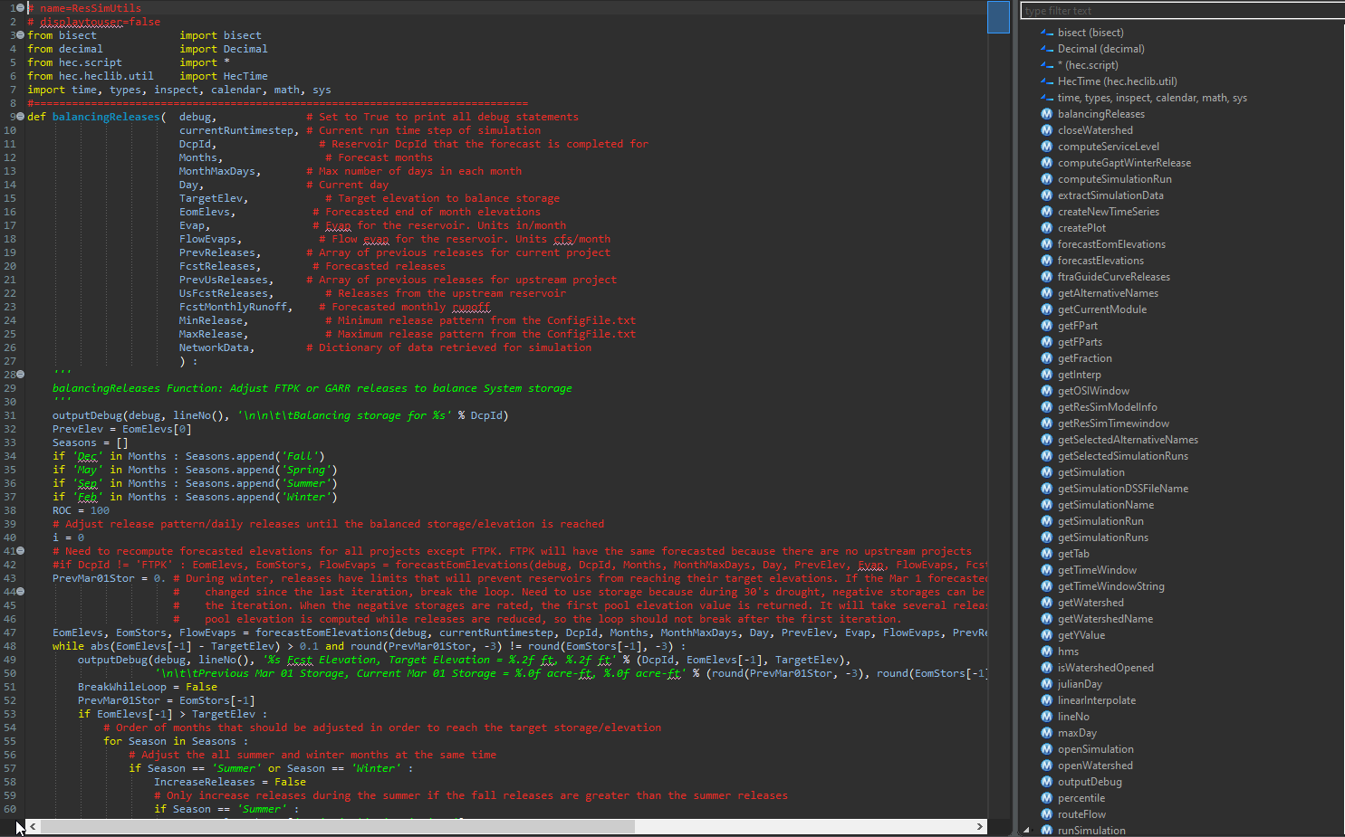
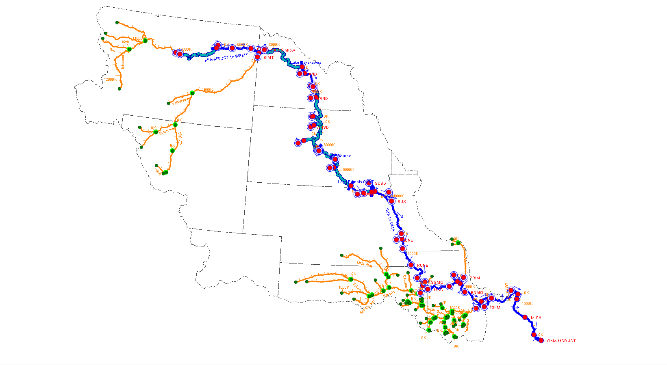
Missouri River System
Notes:
Due to limitation in HEC-ResSim’s tandem system and downstream control operations, the entire Missouri River System operations are scripted:
Several scripts that balance reservoir storages and release to meet downstream flow and stage targets
ResSim Utils module with several HEC-ResSim API functions and user defined functions

Slide 17
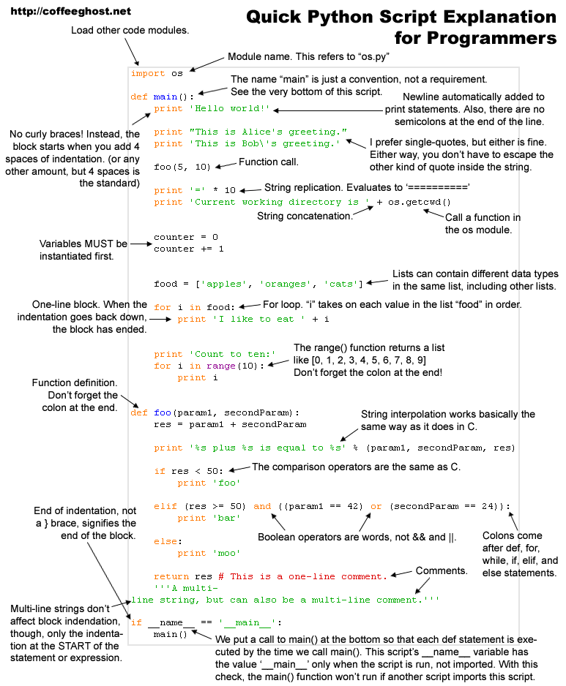
Questions
?

