Slide 1
ResSim Scripted Rules
Reyn Aoki
8/23/2023
Original material developed by Alex Flanigan

Slide 2
Overview
Scripted rule basics
Important classes
  RunTimeStep, RunTimeWindow
  RssSystem
  TSRecord
  StateVariable
Data Persistence (local variables)
External Data from DSS

Slide 3
Scripted Rule Basics
  Scripts use customizable Python logic to determine releases
  Scripts are executed at every iteration of every timestep*
  Can use any and all available modeling data
  The standard scripted rule functions must return a value
    initRuleScript(currentRule, network)
      Constants.TRUE or Constants.FALSE
    runRuleScript(currentRule, network, currentRuntimestep)
      OpValue object

Slide 4

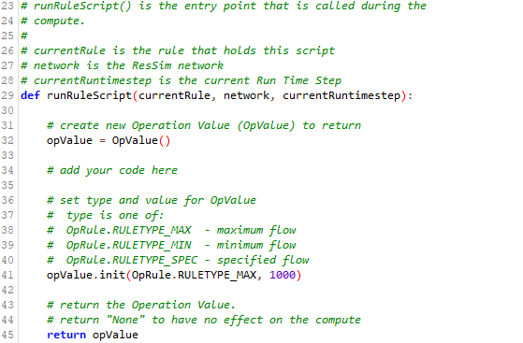

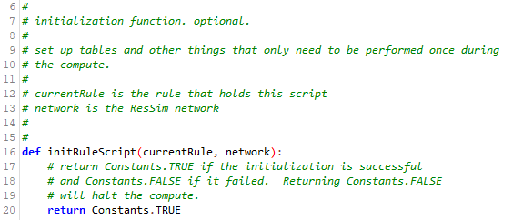
Anatomy of a Scripted Rule
Imports
Main
Constants
Initialization
Notes:
Imports – HEC modules, built-in Python/Java modules, custom modules
initRuleScript – for tasks that you only want to perform once, at the beginning of the simulation
The runRuleScript function is called on each timestep

Slide 5
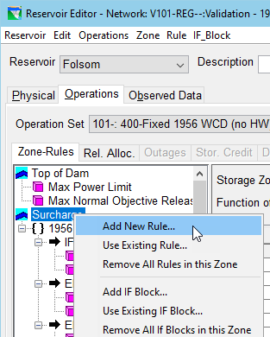
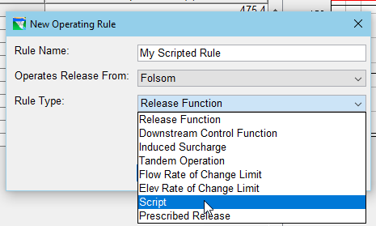
Creating a Scripted Rule
To create a Scripted Rule:
  Open the Reservoir Editor, Operations tab
  In the Zone-Rules tree on the Zone-Rules tab, right-click the desired zone and select Add New Rule… from the context menu.
  Give the rule a name, select the release element
  Select Script for the Rule Type.
  Press the OK button.
  The Scripted Rule Editor appears in the rule’s Edit pane. It is very similar to the State Variable Editor.

Slide 6
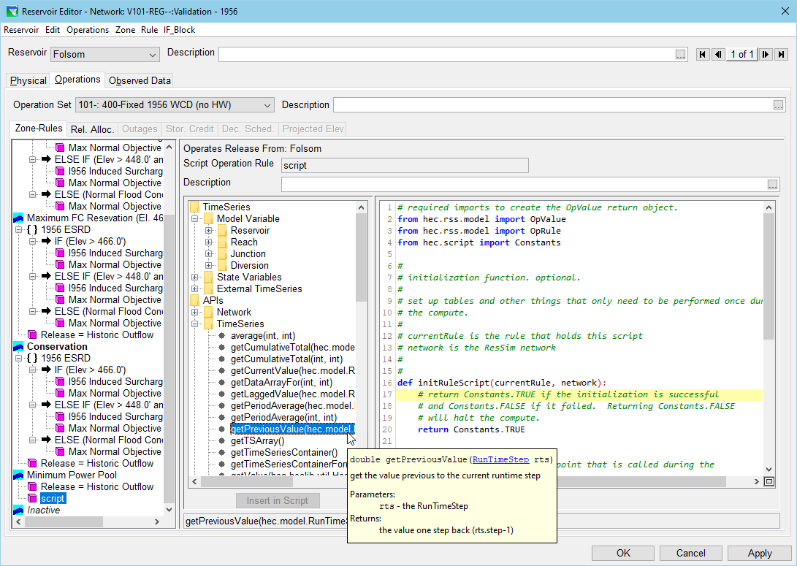
Scripted Rule Editor
API Tree
Edit Pane
API Preview
Notes:
API preview shows the code that would be added

Slide 7
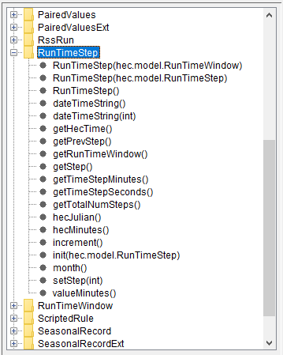
RunTimeStep Class
A RunTimeStep object contains information about a timestep (compute interval), including:
  the number of steps
  the current step
  the time span of each step
  the date and time of each step
It also provides access to the RunTimeWindow of the current simulation.
Timeseries access: A RunTimeStep object can be supplied to a TSRecord object to access specific values within the time series.
The currentRuntimestep variable is a RunTimeStep object.
RunTimeStep methods are listed under RunTimeStep in the APIs section of the API tree in the State Variable and Scripted Rule editors.

Slide 8
RunTimeStep Methods
dateTimeString() | Returns the date/time string of the current step.
dateTimeString(int step) | Returns the date/time string of the specified step.
getHecTime() | Returns an HecTime object for the current step.¹
getPrevStep() | Returns the step prior to the current one.
getRunTimeWindow() | Returns the RunTimeWindow.
getStep() | Returns the current step.
getTimeStepMinutes() | Returns the step time span in minutes.
getTimeStepSeconds() | Returns the step time span in seconds.
getTotalNumSteps() | Returns the number of steps in the RunTimeStep object.
hecJulian() | Same as getHecTime().julian(). ¹
hecMinutes() | Same as getHecTime().minutesSinceMidnight(). ¹
increment() | Increases the current step by one.
Init(RunTimeStep rts) | Initialize the RunTimeStep to rts.
month() | Returns the month of the current step.
setStep(int step) | Sets the current step to the specified step.
valueMinutes() | Same as getHecTime().value() ¹
¹See HEC-DSSVue documentation for HecTime usage.
Notes:
getHecTime, getRunTimeWindow, getStep, setStep

Slide 9
Using currentRuntimestep (RunTimeStep)
curStep = currentRuntimestep.getStep()
rtw = currentRuntimestep.getRunTimeWindow()
lookbackRtw = rtw.getLookbackTime()
totalSteps = rtw.getNumSteps()
currentDate = currentRuntimestep.getHecTime()
chfiStorTS = network.getTimeSeries("Reservoir","CHFI", "Pool", "Stor")
prevStor = chfiStorTS.getPreviousValue(currentRuntimestep)
Notes:
Can get the current step, which can be used to access a timeseries value by index
Can get the RunTimeWindow to extract the lookback time or total number of steps. Total steps can be useful for iterating over a timeseries
Can get the currentDate, useful for seasonal operations or as a reference to a target date
Finally, can directly use the currentRuntimestep to extract certain values out of a timeseries (i.e., retrieving the previous storage)

Slide 10
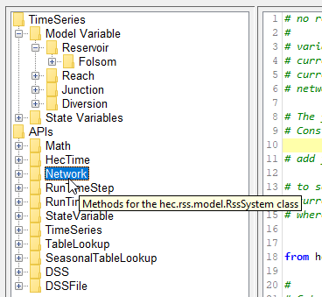
Network - RssSystem Class
network, the default variable, is an RssSystem object. It holds all the elements, model variables, and state variables defined in your model.
The RssSystem class appears as Network in the APIs section of the ResSim scripting API tree. It includes a variety of useful functions including:
  getComputePassCounter()
  getReservoirNames()
  getRssRun(),
  RssRun provides access to:
      The Alternative
      The Output DSS File
      The Output F part
      The Run Time Window

Slide 11
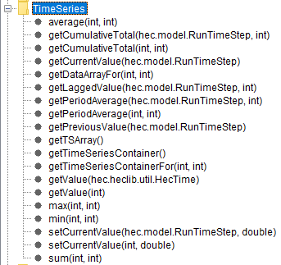
TSRecord Class
Timeseries within the network are stored as TSRecord objects.
TSRecords can be used to gain information from timeseries relative to the RunTimeStep or step.

Slide 12
TSRecord Methods
getTimeSeriesContainer() | Return a TimeSeriesContainer filled with the data. ³
getTSValueAt(HecTime time) | Return the value at the specified time.
getCurrentValue(RunTimeStep rts) | Return the value at the specified time step.
getValue(int step) | Return the value at the specified time step.
getLaggedValue(RunTimeStep rts, int lagAmount) | Return the value at the specified time step minus the specified number of steps.
getPreviousValue(RunTimeStep rts) | Return the value previous to the specified time step.
getPeriodAverage(RunTimeStep rts, int period) | Return the average of values over the specified period ending at the specified time step².
getPeriodAverage(int step, int period) | Return the average of values over the specified period ending at the specified time step².
getCumulativeTotal(RunTimeStep rts, int period) | Return the sum of values over the specified period ending at the specified time step².
getCumulativeTotal(int step, int period) | Return the sum of values over the specified period ending at the specified time step².
setCurrentValue(RunTimeStep rts, double value) | Set the value at the specified time to the specified value.
setCurrentValue(int step, double value) | Set the value at the specified time to the specified value.
²Missing values are unexpected, values beyond the limits of the data are considered constant
³See HEC-DSSVue documentation for TimeSeriesContainer and TimeSeriesMath usage

Slide 13
Using TSRecords
Use network.getTimeSeries(…) to access any model variable. Helpful to use API tree (listed under TimeSeries)
flowTs = network.getTimeSeries("Reservoir",“Shasta","Pool",“Flow-IN")
flowNow = flowTs.getCurrentValue(currentRuntimestep)
flowNow = flowTs.getLaggedValue(currentRuntimestep, 0)
flowPrev = flowTs.getPreviousValue(currentRuntimestep)
flowPrev = flowTs.getLaggedValue(currentRuntimestep, 1)
flowBefore = flowTs.getLaggedValue(currentRuntimestep, 2)

Slide 14
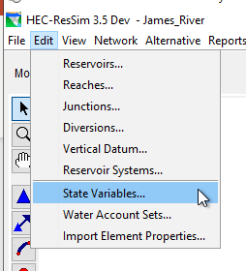
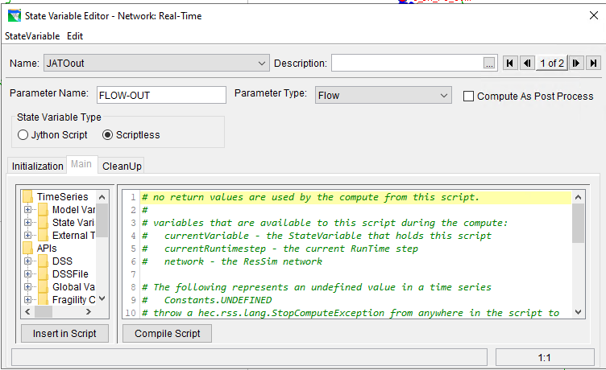
The StateVariable Class
  Variable defined by user
    System Storage Calculation – Hitting a trigger stage, etc.
    Allows calculated values to be used in other rules

Slide 15
Using StateVariables
  Set the state variable so it can be used in other rules
    network.getStateVariable("JATOout").setValue(currentRuntimestep, 0)
  Bring State Variable information into current script
    prevFlowOut = network.getStateVariable("JATOout").getPreviousValue(RunTimeStep)
    curFlowOut = network.getStateVariable("JATOout“).getValue(RunTimeStep)

Slide 16
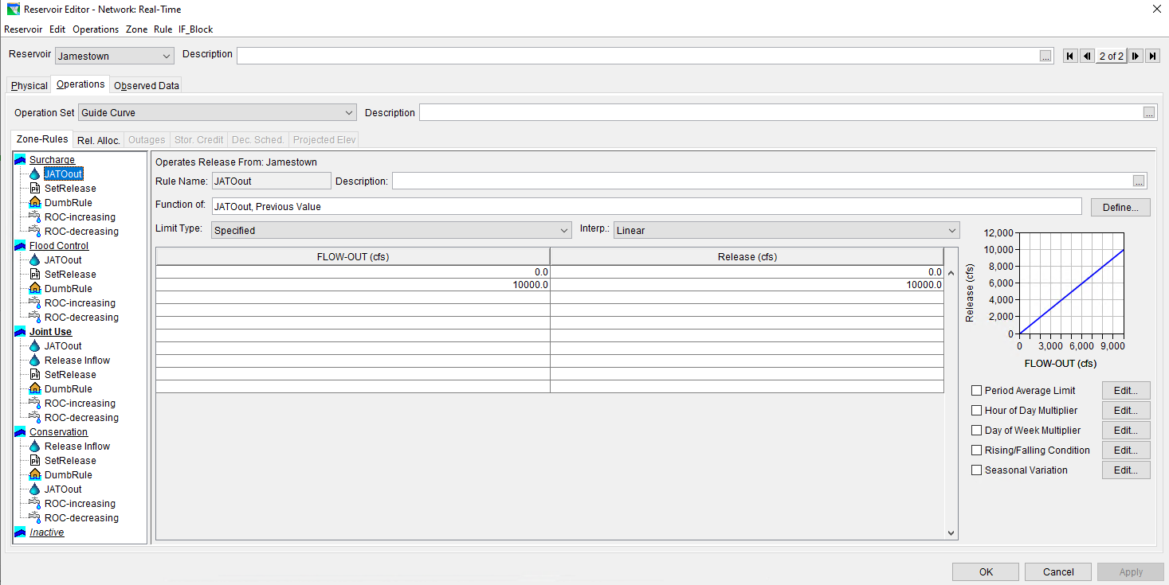
Using StateVariables to Set Releases
Notes:
Deciding releases relative to state variable value

Slide 17
Data Persistence
The variables in scripted rule reset for each timestep, creating several issues:
  Information from previous timestep often needs to carry forward
    Flow change triggers, calculated local flows, etc.
  Reading / writing data to text files or DSS each timestep is too slow
Here are some of the available methods for storing and retrieving local variables:
varGet(name) | Returns the object whose key is name
varPut(name, object) | Stores the object with a key of name to the state variable
localTimeSeriesNew(name) | Create a new time series in the list with the key name.
localTimeSeriesNew(name, tsc) | Initialize a new local time series with the TimeSeriesContainer tsc.
localTimeSeriesGet(name) | Returns the time series with the key name
localTimeSeriesWrite(name) | Write the time series with the key name to the output DSS file. Use this command in the cleanup script

Slide 18
Data Persistence Example
  import time
  currentTime = time.time()
  if currentVariable.varExists('lastTime') :
  firstExecution = False
  lastTime = currentVariable.varGet('lastTime')
  else :
  firstExecution = True
  lastTime = None
  currentVariable.varPut('lastTime', currentTime)
+
2
1

Slide 19
Accessing DSS Data In A Script
Bring external data into your script using DSSFile (hec.hecmath.DSSFile)
    DSSFile.read(str pathName)
    DSSFile.read(str pathName, str timeWindow)
    DSSFile.read(str pathName, str startTime, str endTime)
    DSSFile.write(str pathName)
  read returns an HecMath object
    The specific type of HecMath object returned will depend on the pathname identifying the dataset requested
  get returns a DataContainer object
    Or use .read(pathName).getData()

Slide 20
DSS IO Example
    from hec.hecmath import DSS, DSSFile, TimeSeriesMath
    # Gather data about the simulation
    myRun = network.getRssRun()
    dssFilename = myRun.getDSSOutputFile()
    fPart = myRun.getOutputFPart()
    rtw = currentRuntimestep.getTimeWindow()
    rtwStr = rtw.getTimeWindowString()
    # Open DSS file
    dssDb = DSS.open(dssFilename,rtwStr)
    # Get timeseries from DSS file
    pathname = r'/American/Folsom/ELEV//1HOUR/Obs/'
    tsm = dssDb.read(pathname)
    Tsc = dssDb.get(pathname)
    # Do stuff to tsm and then write to DSS file
    tsm.setVersion(fPart)
    dssDb.write(tsm)
    dssDb.put(Tsc)

Slide 21
Good Info To Have - GITH
Next slides show useful setup and background information used in scripted rules
These may not be necessary to all scripts, but can generally be added without problems

Slide 22
GITH– Access to simulation.dss
shared = ResSim.getWatershed()
wsDir = ResSim.getWatershed().getWorkspacePath()
scriptDir = os.path.normpath(os.path.join(wsDir, "shared"))
simulationDir = ResSim.getCurrentModule().getSimulation()
path = str(shared) + "/rss/"+str(simulationDir)+"/simulation.dss"

Slide 23
GITH – Info About Your Simulation
def getResSimModelInfo() :
module = ResSim.getCurrentModule()
simulation = module.getSimulation()
rssRun = module.getActiveRun()
#network = rssRun.getRssSystem()
Fpart = rssRun.getKey()
OutputDssPath = simulation.getOutputDSSFilePath()
return module, simulation, Fpart, OutputDssPath
module, simulation, Fpart, OutputDssPath = getResSimModelInfo()

Slide 24
GITH – Compute Pass Counter
PassCounter helps user control which pass a script runs
PassCounter = network.getComputePassCounter() # Pass number of simulation
PassNumber = PassCounter + 1

Slide 25
Questions?

