Slide 1
ResSim Script Examples/Demos
Ryan Cahill
Hydrologic Engineer
Portland District, River and Hydrologic Engineering

Slide 2
Examples
  Utility ResSim Script (export all rules to CSV)
  Maximum draft rate based on pool elevation
  IRRM Pool Restriction
  Simple Downstream Control Rule

Slide 3
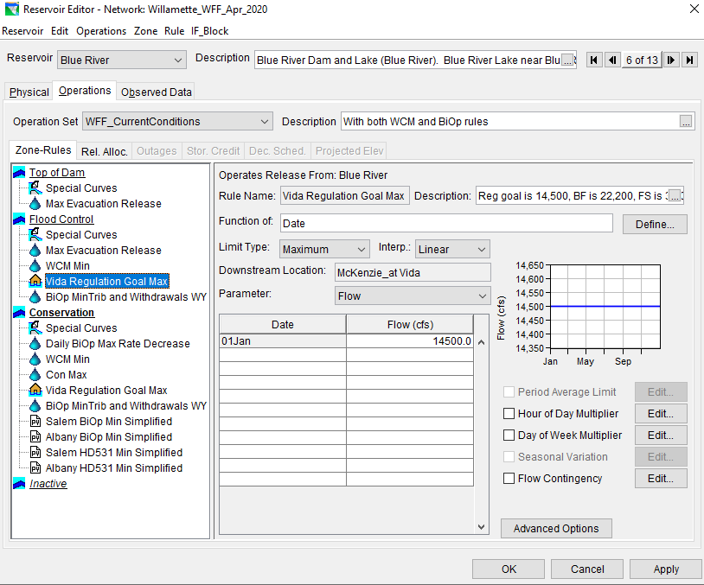
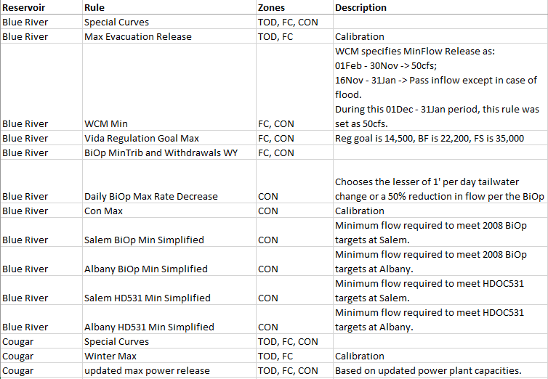
Export All Rules to CSV
  Utility Scripts can be executed from ResSim without running a simulation
  Pushes all rules to a table that can be used in documentation

Slide 4
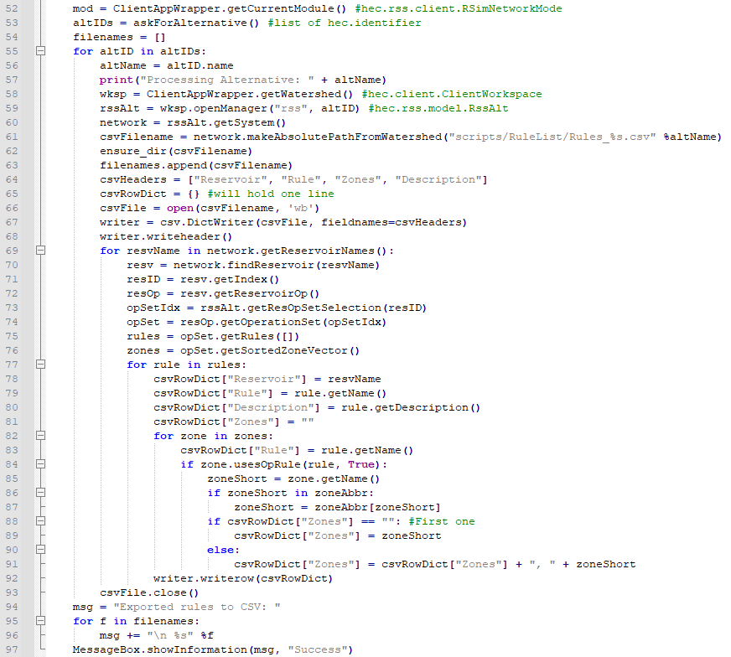
Export All Rules to CSV

Slide 5
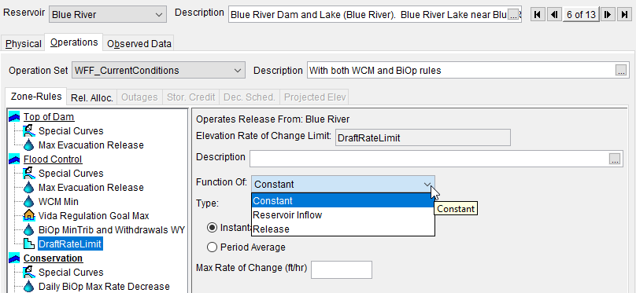
Maximum Draft Rate Based on Pool Elevation
  Sometimes a reservoir can only draft XX ft/day to prevent bank sloughing
  Occasionally these limits vary by reservoir elevation
  Current ResSim rule options don’t include elevation as a parameter

Slide 6
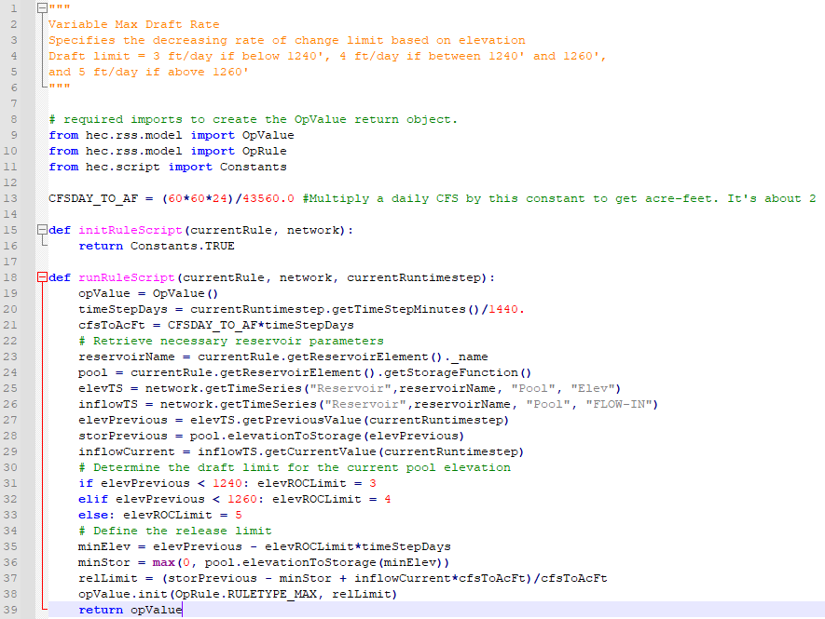
Maximum Draft Rate Based on Pool Elevation

Slide 7
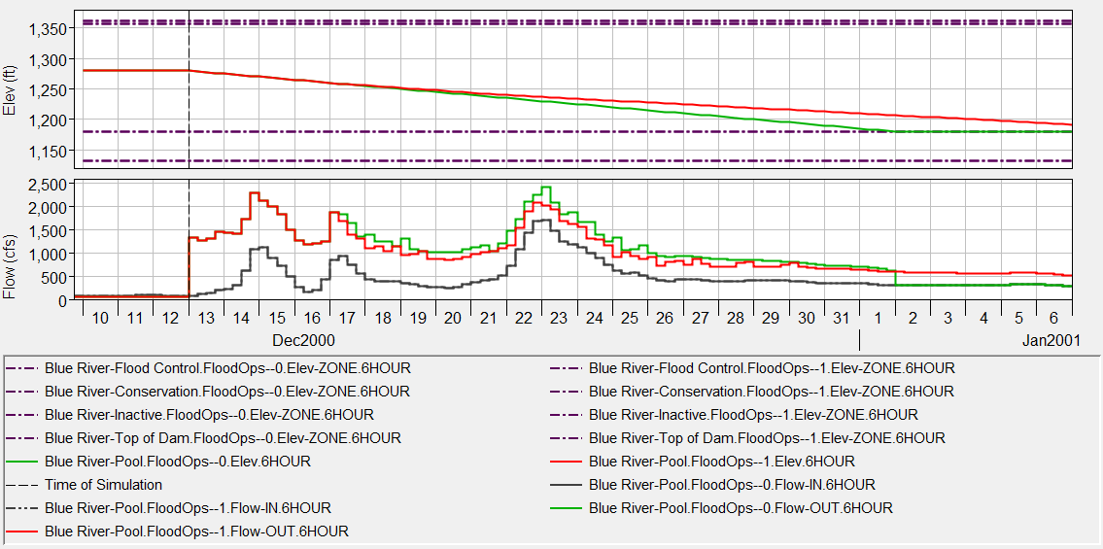
Maximum Draft Rate Based on Pool Elevation

Slide 8
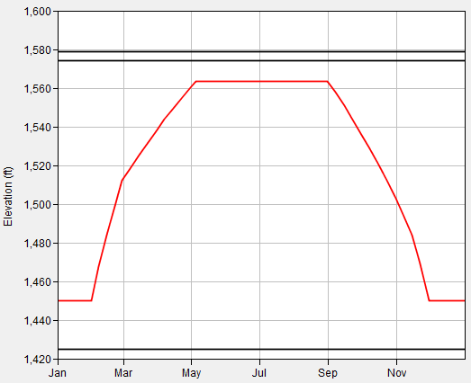
IRRM Pool Restriction
  Dam is vulnerable to a large earthquake when the pool is high
  Solution: Interim Risk Reduction Measure (IRRM)
    During regular operations, don’t allow the pool to go above a certain level
    But pool is allowed to rise during floods for short durations
IRRM Elev

Slide 9
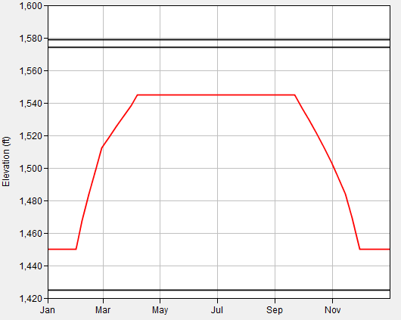
IRRM Pool Restriction
  Could do this in ResSim by modifying the guide curve
  Drawbacks?
IRRM Elev

Slide 10
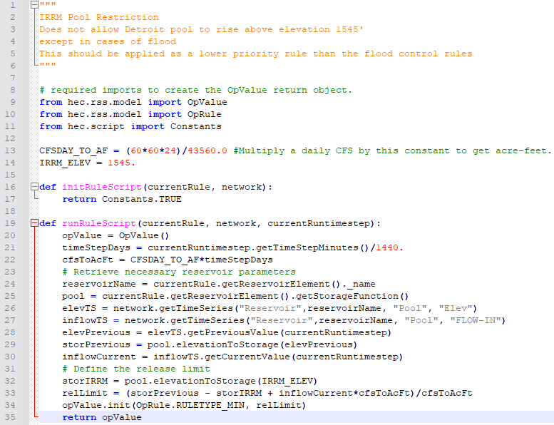
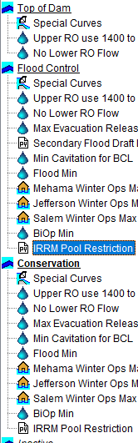
IRRM Pool Restriction
  Can easily do this in a scripted rule

Slide 11
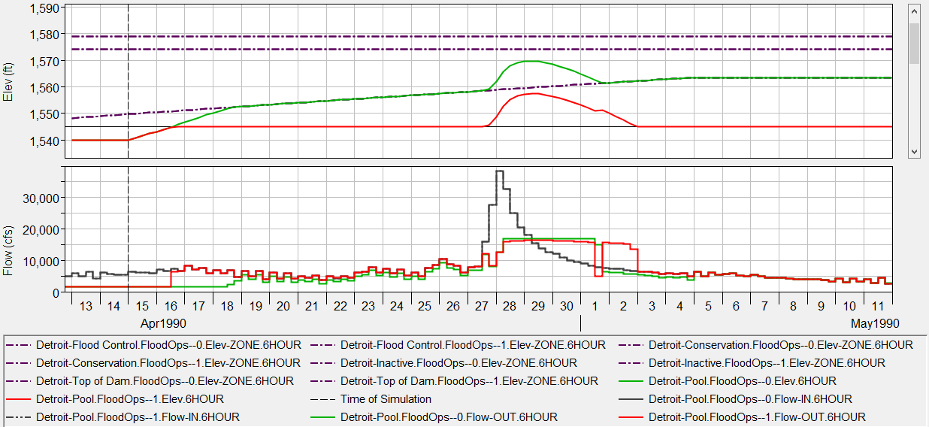
IRRM Pool Restriction

Slide 12
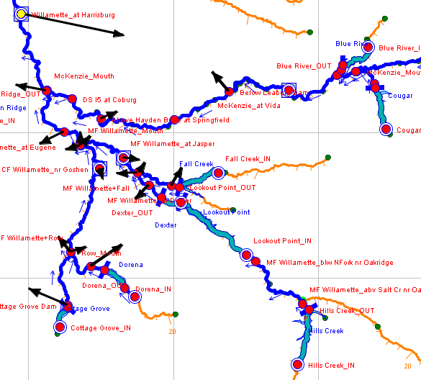
Simple Downstream Control rule
  Downstream control rules in ResSim can lead to oscillations in release
  Greatly increases compute time when many reservoirs operate to the same point
  Simplified downstream control rule at smaller reservoirs often works better, producing more stable results and faster runtimes

Slide 13
Simple Downstream Control rule
  Simplified rules reduce compute time from 13 seconds to 4 seconds
  Compute blocking
Native ResSim Downstream control rule
Simplified scripted rules

Slide 14
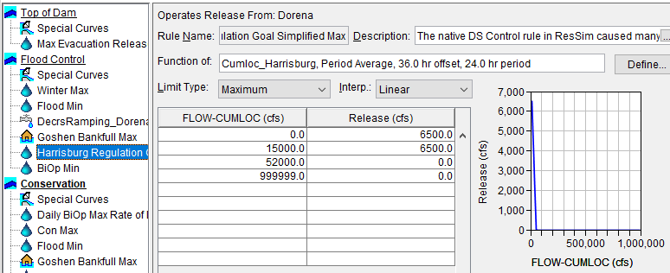
Simple Downstream Control rule
  Keep native ResSim rule at the project with most influence (Lookout Point)
  At small projects, max release is based on cumulative local flow at Harrisburg
    Cumulative local=all inflow downstream of dams
  Smoothly transition from normal maximum release at low cumlocs to 0 outflow at cumloc at bankfull or flood stage
  Routing time is approximated

Slide 15
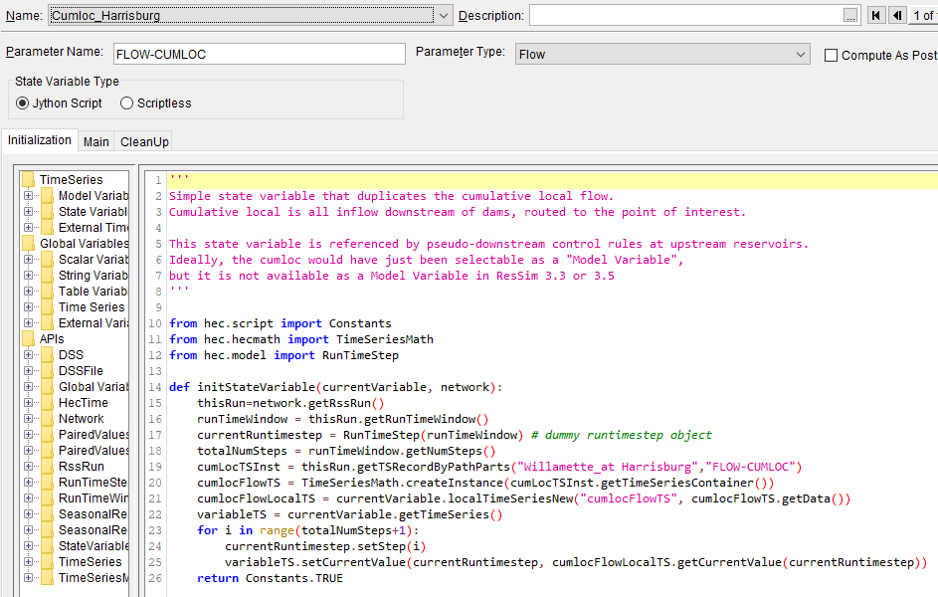
Simple Downstream Control rule
  State variable to hold the cumulative local flow (not available as a “model variable” to select).

Slide 16
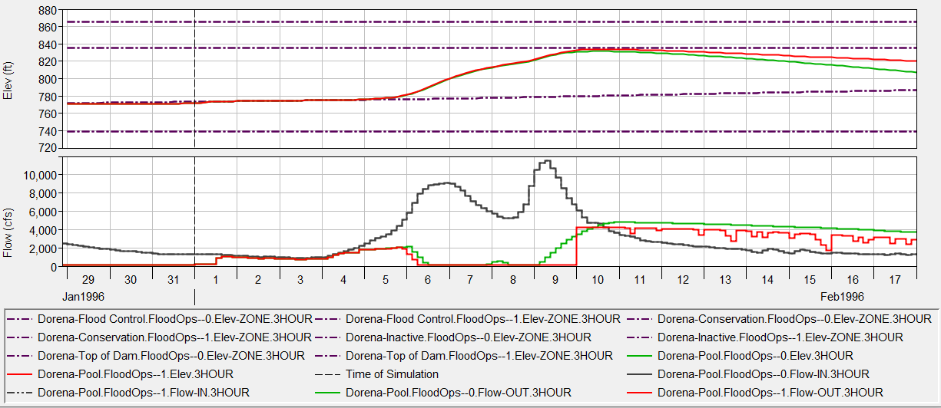
Simple Downstream Control rule
Native ResSim Downstream control rule
Simplified Rule using cumulative local
  Dorena

Slide 17
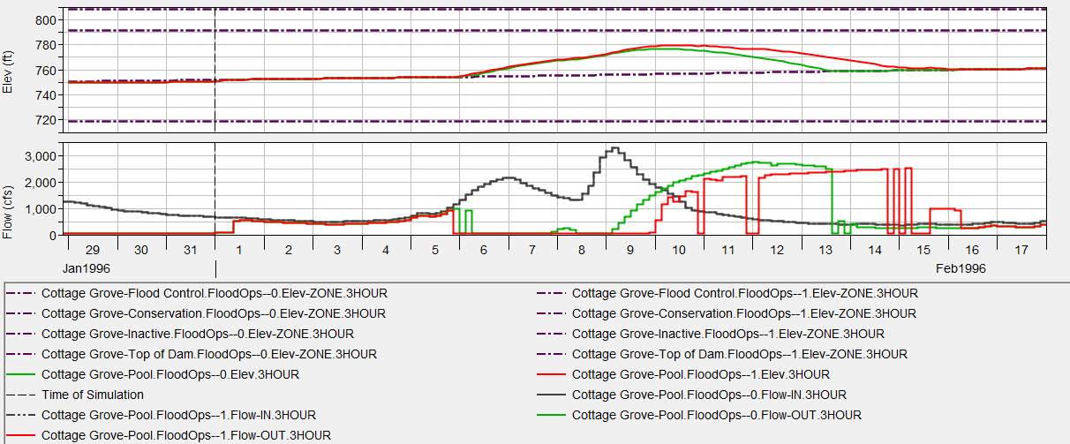
Simple Downstream Control rule
Native ResSim Downstream control rule
Simplified Rule using cumulative local
  Cottage Grove

Slide 18
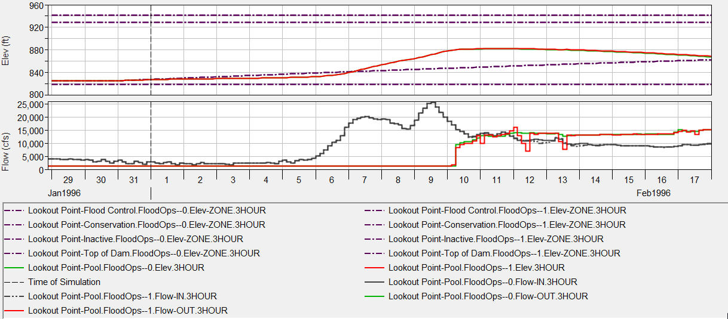
Simple Downstream Control rule
Native ResSim Downstream control rule
Simplified Rule using cumulative local
  Lookout Point

Slide 19
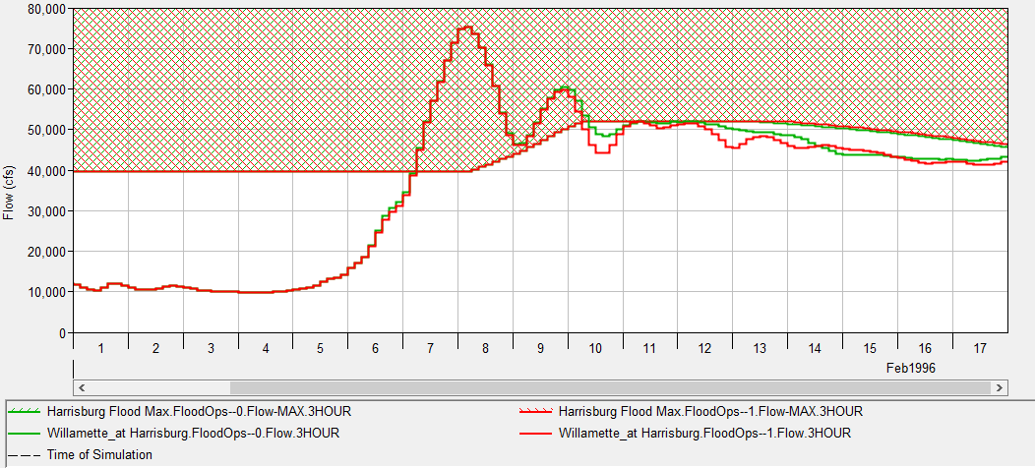
Simple Downstream Control rule
Native ResSim Downstream control rule
Simplified Rule using cumulative local
  Harrisburg

Slide 20
Questions
  Watershed available with these scripts in the course materials

