Slide 1
Scripting in the OSI
Mitch Weier Mitchell.S.Weier @usace.army.mil
Alex Flanigan Alexander.J.Flanigan@usace.army.mil

Slide 2
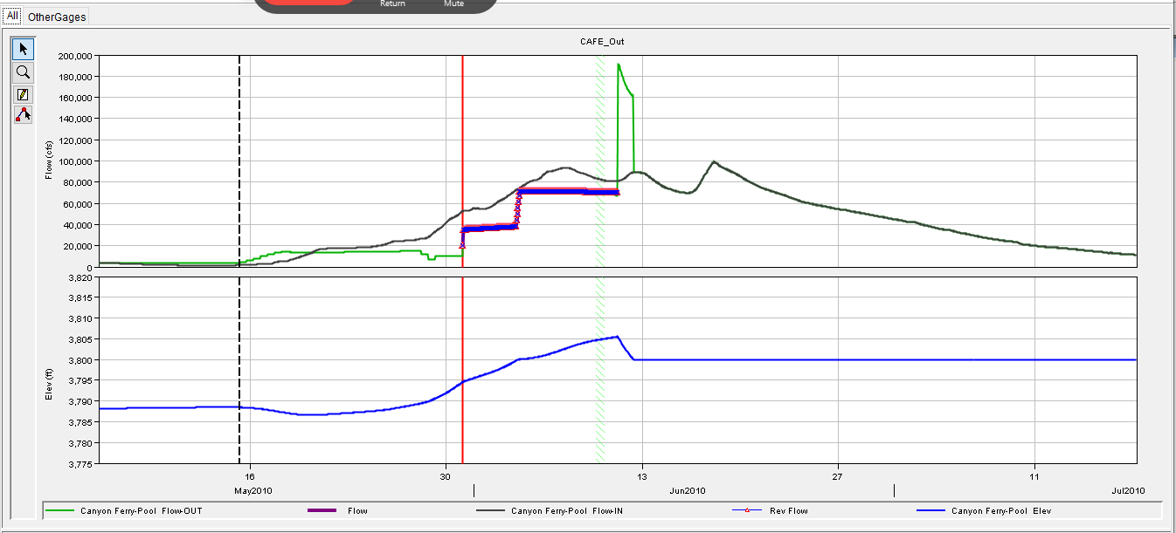
ResSim – Chasing the spike
Wait 30 seconds for compute…….. :)

Slide 3
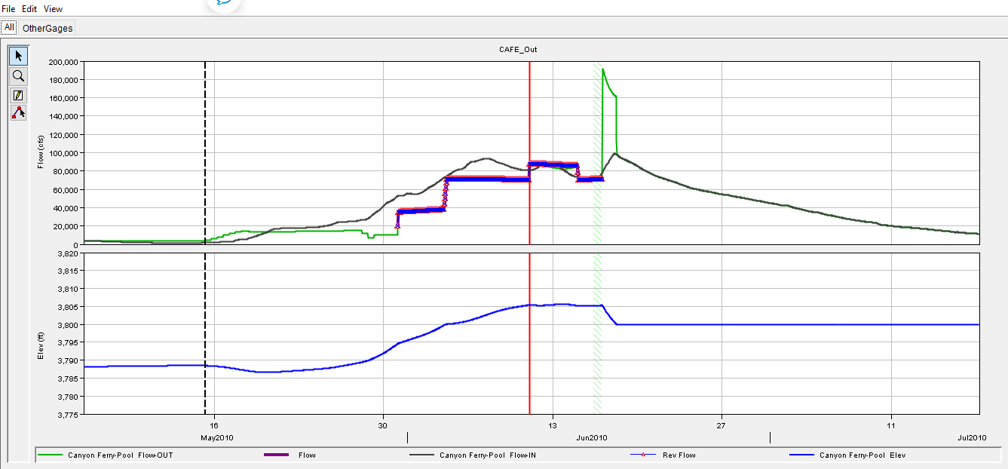
ResSim – Chasing the spike
Post March 2020
    Gridded data availability
    Ace-IT patch
    LDM firewall connections
    NWS data feeds
    Ace-IT password lockouts
    In-office network latency
    Modeler availability / cross-training
    VPN
    Corps to home network latency
Wait 30 seconds for compute…….. :(

Slide 4
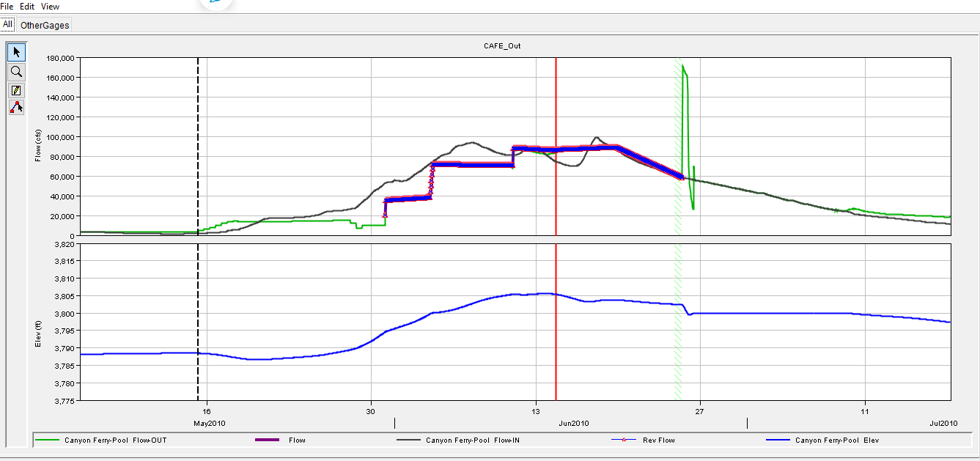
ResSim – Chasing the spike
Wait 30 seconds for compute…… !@*&

Slide 5
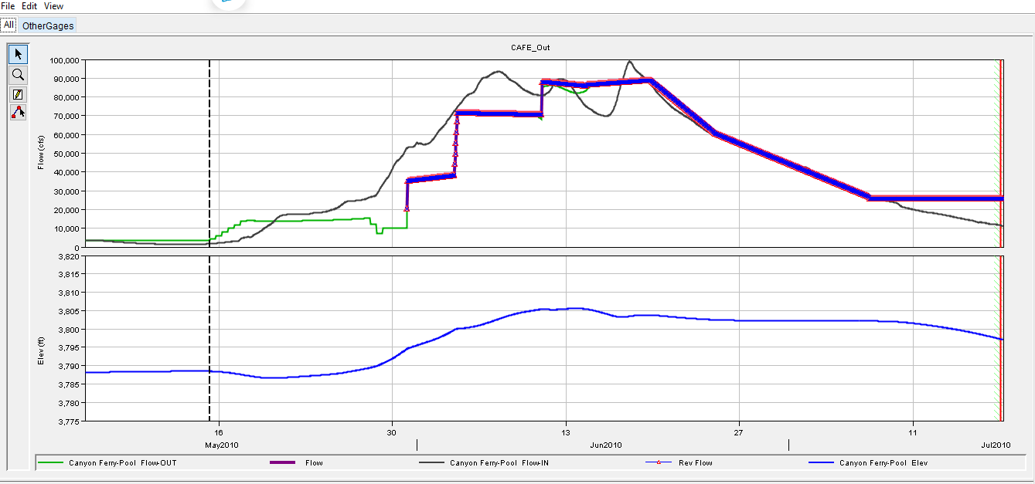
ResSim – Chasing the spike
One size fits all
Each office has different challenges and needs
Use same frame with different options

Slide 6
Why Script in the OSI?
CLOSEST THING TO EXCEL FUNCTIONALITY
  Script any operations
  Run script on demand
  Forward looking model
  Runs Fast

Slide 7
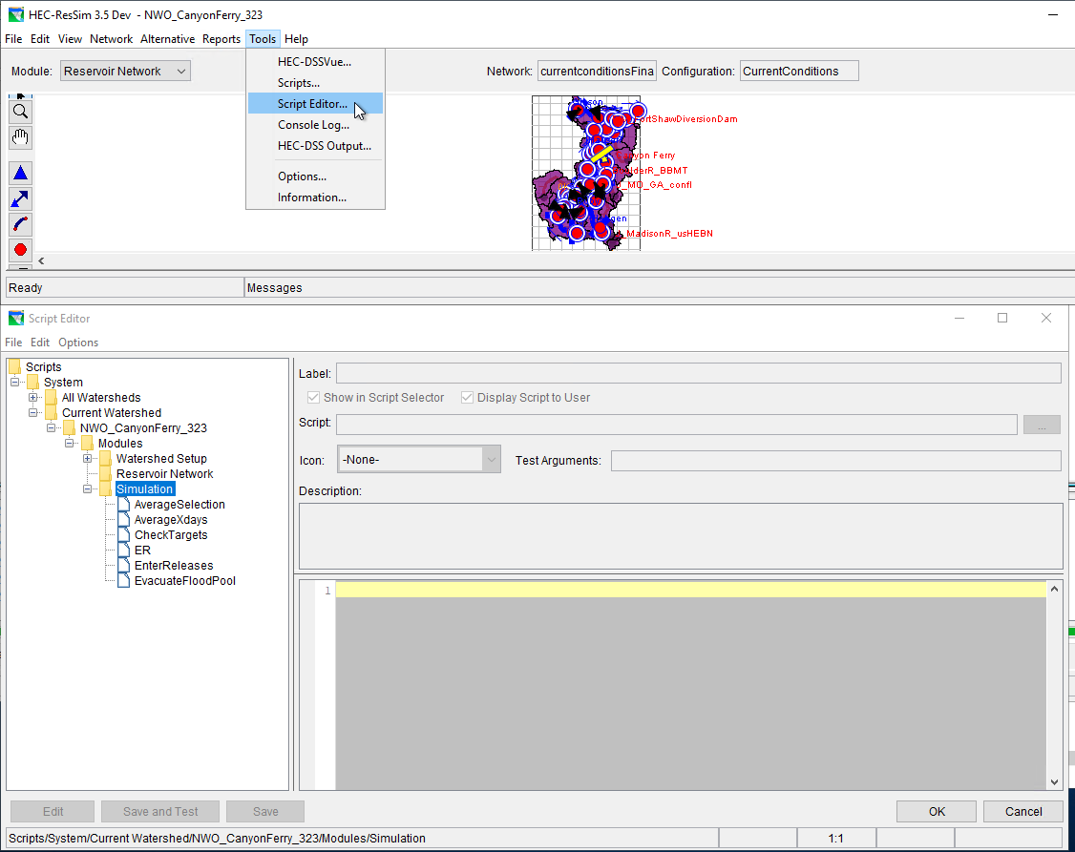
Where to script?

Slide 8
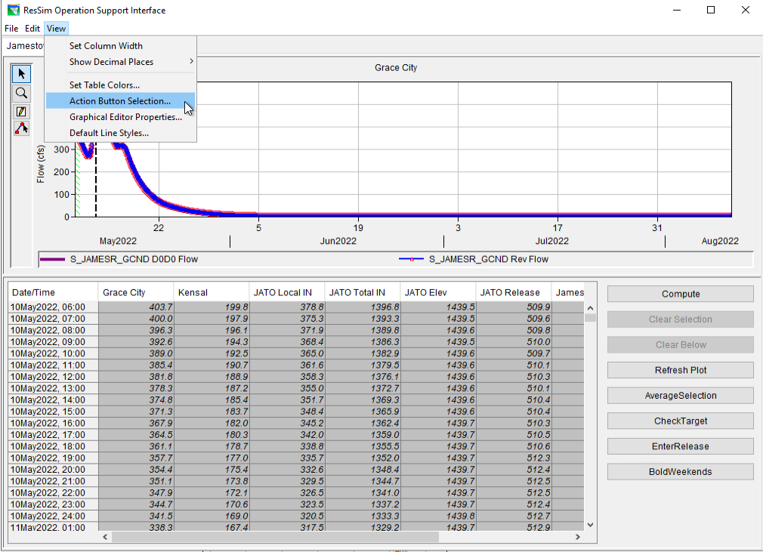
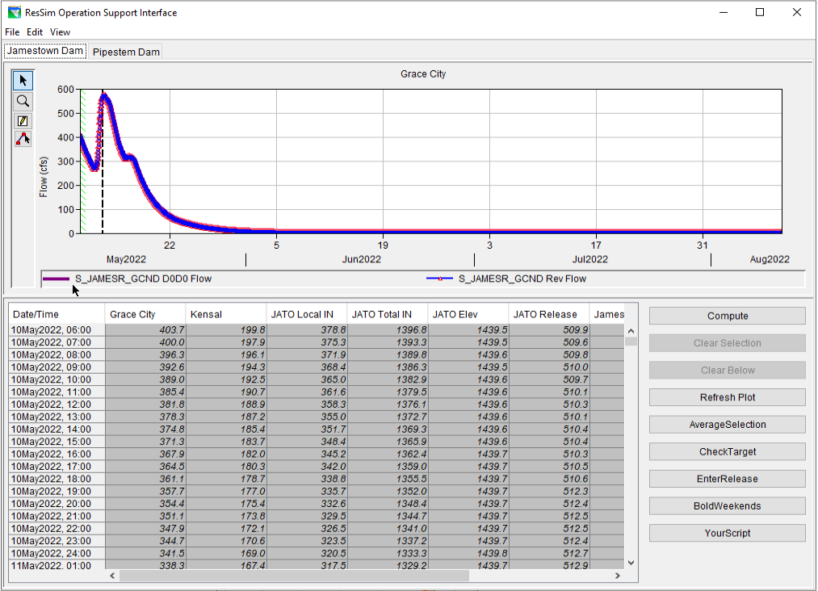
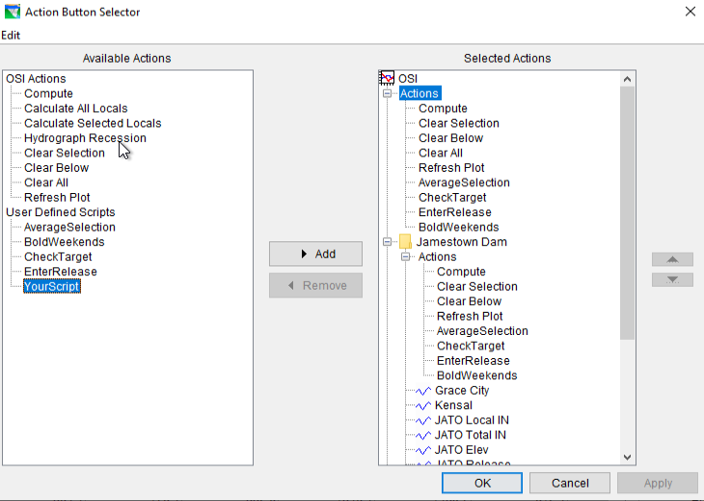
Add scripts to OSI panel

Slide 9
Add scripts to OSI panel

Slide 10
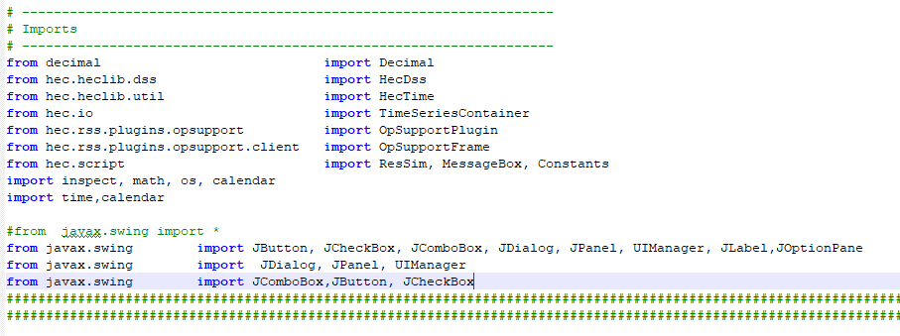
Starting a script
Start with your imports

Slide 11
Starting OSI script
Tab = 'All’ - Name of your tab
SwitchToTab = False - Setting
OsiWindow = getOSIWindow(SwitchToTab) # OpSupportFrame - Opens OSI
OsiTab = getTab(OsiWindow, Tab, SwitchToTab) # OpSupportTabPanel - Opens Tab
OsiTable = OsiTab.getTable() # OpSupportTabPanel$OpSupportTable - Opens Table data
ActionPanel = OsiTab.getActionPanel() - Opens Action Panel

Slide 12
Workhorse Commands ****!!!!****
myVariable = OsiTable.getValueAt(row, column)
returns osi table value based on the row and column
OsiTable.setValueAt(float, row, column)
stores data into override columns based on the row and column

Slide 13
Workhorse Commands ****!!!!****
CurrentRow = OsiTable.getSelectedRow() – returns integer of current row
CurrentColumn = OsiTable.getSelectedColumn() – returns integer of cur col
SelectedRows = OsiTable.getSelectedRows() - returns index row selection
SelectedColumns=OsiTable.getSelectedColumns() -returns index col selection
MaxRows = OsiTable.getRowCount()
StartFcstRow = OsiTable.getRowAtStartOfForecast()+1
ActionPanel.refreshPlot () - refreshes plot with modifications

Slide 14
Example Script – Average Selection - slide 1 of 2
Tab = 'All'
SwitchToTab = False
OsiWindow = getOSIWindow(SwitchToTab) # OpSupportFrame
OsiTab = getTab(OsiWindow, Tab, SwitchToTab) # OpSupportTabPanel
OsiTable = OsiTab.getTable() # OpSupportTabPanel$OpSupportTable
ActionPanel = OsiTab.getActionPanel()
SelectedRows = OsiTable.getSelectedRows()
column = OsiTable.getSelectedColumn()

Slide 15
Example Script – Average Selection - slide 2 of 2
SumValue = 0.0
for row in SelectedRows :
flow = float(OsiTable.getValueAt(row, column))
SumValue += flow
NumValues =len(SelectedRows)
AverageValue = SumValue / NumValues
for row in SelectedRows :
OsiTable.setValueAt( AverageValue, row, column)
ActionPanel.refreshPlot ()

Slide 16
Ex Script – Changing fonts and colors (1 of 2)
#
# Format OSI to bold the weekends
#
# Should the script automatically open the OSI window and the correct tab?
SwitchToTab = False
OsiWindow = getOSIWindow(SwitchToTab) # OpSupportFrame
if OsiWindow is not None :
# Get selected Tab
OsiTab = OsiWindow.getSelectedTab() # OpSupportTabPanel
OsiTable = OsiTab.getTable() # OpSupportTabPanel$OpSupportTable
ActionPanel = OsiTab.getActionPanel()
MaxRows = OsiTable.getRowCount()
StartFcstRow = OsiTable.getRowAtStartOfForecast()
# Retrieve fonts from table
OsiCellFont = OsiTable.getCellFont(0, 0)
FontFamily = OsiCellFont.getFamily()
FontSize = OsiCellFont.getSize()
FontName = OsiCellFont.getName()
DefaultFont = Font(FontName, Font.PLAIN, FontSize)
DefaultItalicFont = Font(FontName, Font.ITALIC, FontSize)
DefaultBoldFont = Font(FontName, Font.BOLD, FontSize)
DefaultBoldItalicFont = Font(FontName, Font.BOLD | Font.ITALIC, FontSize)
OsiTable.setTableColoringOverride(1) # Set setTableColoringOverride to True so default color and font settings are ignored
# Format cells so weekend cells are bolded
for row in range(0, MaxRows, 1) :
OsiHecTime = OsiTable.getHecTimeForRow(row)
DayOfWeek = OsiHecTime.dayOfWeek()
for column in range(OsiTable.getColumnCount()) :
ModelVariable = OsiTable.getModelVariableAtColumn(column)
outputDebug(debug, lineNo(), 'Model Variable = ', ModelVariable, '\trow = ', row, '\tcolumn = ', column)
# Bold the font
if DayOfWeek == 1 or DayOfWeek == 7 :
outputDebug(debug, lineNo(), OsiHecTime, ' ', str(ModelVariable), '\tOsiCellFont = ', OsiCellFont)
if OsiCellFont is not None :
if row < StartFcstRow : OsiTable.setCellFont(row, column, DefaultBoldItalicFont)
else : OsiTable.setCellFont(row, column, DefaultBoldFont)
OsiTable.repaint()
else :
if row < StartFcstRow : OsiTable.setCellFont(row, column, DefaultItalicFont)
else : OsiTable.setCellFont(row, column, DefaultFont)
OsiTable.repaint()

Slide 17
Ex Script – Changing fonts and colors (2 of 2)
# Format cells so weekend cells are bolded
for row in range(0, MaxRows, 1) :
OsiHecTime = OsiTable.getHecTimeForRow(row)
DayOfWeek = OsiHecTime.dayOfWeek()
for column in range(OsiTable.getColumnCount()) :
ModelVariable = OsiTable.getModelVariableAtColumn(column)
# Bold the font
if DayOfWeek == 1 or DayOfWeek == 7 :
outputDebug(debug, lineNo(), OsiHecTime, ' ', str(ModelVariable), '\tOsiCellFont = ', OsiCellFont)
if OsiCellFont is not None :
if row < StartFcstRow : OsiTable.setCellFont(row, column, DefaultBoldItalicFont)
else : OsiTable.setCellFont(row, column, DefaultBoldFont)
OsiTable.repaint()

Slide 18
Example Script – DIMT Downstream Control
DimtTT = 24 # Dimt Travel time - number of timesteps
DimtFlowTarget = 1000 # Dimt max flow target
counter = OsiTable.getRowAtStartOfForecast()+1
while counter < (totalSteps-72):
CLCAcut = 0.0
CLCAout = float(OsiTable.getValueAt(counter,0))
DimtLocalFlow = float(OsiTable.getValueAt(counter+DimtTT,12))
DimtFlow = DimtFlowLocal + CLCAout
PCLCAcut = DimtFlow – DimtFlowTarget
CLCAcut = max(CLCAcut,PCLCAcut)
CLCAoutNew = CLCAout – CLCAcut
CLCAoutNew = max(CLCAoutNew, 0.0)
OsiTable.setValueAt(CLCAoutNew, counter,0)
counter +=1

Slide 19
OSI API - Accessing the OSI
ClientAppWrapper.getCurrentModule() A static method that returns the active ResSim Module. When called from the ResSim Simulation Module, the method will return an object of the type RSimSimulationMode.
RSimSimulationMode.getRssRun() Returns the currently active RssRun. Will return null if no simulation is running.
OpSupportPlugin.openOSI(RssAlt alt) Opens the OSI instance (OpSupportFrame) for the given ResSim Alternative.
OpSupportPlugin.openOSI(RssRun rssRun) Returns the OSI instance (OpSupportFrame) for the given RssRun.
OpSupportPlugin.getOSI() Returns the currently open or last open OSI instance (OpSupportFrame). If no OSI instance has been opened, it will return null.

Slide 20
OSI API - Accessing OSI Components
OpSupportFrame.getSelectedTab() Returns the currently selected tab (OpSupportTabPanel).
OpSupportFrame.setSelectedTab(int tabIndex) Selects the tab indicated by the given index for display and returns the corresponding OpSupportTabPanel object. Returns null if the tab does not exist.
OpSupportFrame.setSelectedTab(String name) Selects the tab indicated by the given name for display and returns the corresponding OpSupportTabPanel object. Returns null if the tab does not exist.
OpSupportFrame.getTab(int tabIdx) Returns the OpSupportTabPanel object with the specified index. Returns null if a tab with that index does not exist.
OpSupportFrame.getTab(String tabName) Returns the OpSupportTabPanel object with the specified name. Returns null if a tab with that name doesn’t exist.
OpSupportTabPanel.getTable() Returns the table associated with the tab.

Slide 21
OSI API - Accessing and editing table data
OpSupportTablePanel Methods, note that row and column indexes range from 0 to numRows-1 and numColumns-1 respectively, following the Java array indexing convention.
getRowCount() Returns the number of rows in the table.
getColumnCount() Returns the number of columns in the table.
getSelectedRow() Returns the currently selected row. Returns -1 if no row is selected.
getSelectedColumn() Returns the currently selected column. Returns -1 if no column is selected.
getValueAt(int row, int col) Returns the value of cell identified by the given row and column as a double. Returns RMAConst.UNDEF_DOUBLE if the cell does not contain a valid value.
setValueAt(double val, int row, int col) Sets the value of the cell identified by the given row and column to the given value. If the given row or column id is outside of the table range, or the cell is not editable, nothing is done.
getHecTimeForRow(int row) Returns the HecTime object associated with the given row. If the row is out of the table range, the method returns null.

Slide 22
OSI API - Accessing and editing table data
getRowTimeStepMinutes() Returns the time difference between rows in minutes, note that the time step will be the same between all rows.
getRowAtStartOfForecast() Returns the row at the start of the ResSim forecast period.
getModelVariableAtColumn(int col) Returns the OpSupportModelVariable object associated with the given column. Returns null if col is out of the table range.
getColumnForModelVariable(String name) Returns the column id associated with the OpSupportModelVariable with the given name. Returns -1 if the no Model Variable is present in the table with that name.
setTableColoringOverride(boolean b) Setting the Table Coloring Override to true disables the automated assignment of table cell foreground and background colors and text fonts so that those properties can be set through a script.
getCellForeground(int row, int col) Returns the foreground (text) color currently set for the given cell. Returns null if the row or col is out of range.
getCellBackground(int row, int col) Returns the background color currently set for the given cell. Returns null if the row or col is out of range.
getCellFont(int row, int col) Returns the text font currently set for the given cell. Returns null if the row or col is out of range.
setCellForeground(int row, int col, Color clr) Sets the foreground (text) color for the given cell. Does nothing if the row or col is out of range.
setCellBackground(int row, int col, Color clr) Sets the background color for the given cell. Does nothing if the row or col is out of range.
setCellFont(int row, int col, Font font) Sets the font for the given cell. Does nothing if the row or col is out of range.
repaint() Under certain conditions, repaint might not be called automatically. It is best to call repaint after changing any color or font aspects of the table.

Slide 23
OSI API - Accessing and Editing Column Variables
getMaxLimit() Returns the value of the Operation Support Variable Editor Max Target field as a double.
getMinLimit() Returns the value of the Operation Support Variable Editor Min Target field as a double.
getTimeShift() Returns the value of the Operation Support Variable Editor Time Shift field as an int.
getViewPort() Returns the Operation Support Variable Editor Viewport for Graphical Display field’s value as an int.
setMaxLimit(double d) Sets the Operation Support Variable Editor Max Target field to the specified value.
setMinLimit(double d) Sets the Operation Support Variable Editor Min Target field to the specified value.
setTimeShift(int i) Sets the Operation Support Variable Editor Time Shift field to the specified value.
setViewPort(int i) Sets the Operation Support Variable Editor Viewport for Graphical Display field to the specified value.

Slide 24
OSI API – Triggering Actions
getActionPanel() Return the OpSupportActionPanel that holds the action and script buttons.
OpSupportActionPanel.computeMethod() Run the Compute action as though the user clicked the Compute button.
OpSupportActionPanel.calcLocal() Run the Calculate All Locals action as though the user clicked the Calculate All Locals button.
OpSupportActionPanel.calcWithObsTSData() Run the Calculate Selected Locals action as though the user clicked the Calculate Selected Locals button.
OpSupportActionPanel.recessionMethod() Run the Hydrograph Recession action as though the user clicked the Hydrograph Recession button.
OpSupportActionPanel.clearTimeSeriesAll() Run the Clear All action as though the user clicked the Clear All button.
OpSupportActionPanel.clearTimeSeriesBelow() Run the Clear Below action as though the user clicked the Clear Below button.
OpSupportActionPanel.clearTimeSeriesSelected() Run the Clear Selected action as though the user clicked the Clear Selected button.
OpSupportActionPanel.refreshPlot() Run the Refresh Plot action as though the user clicked the Refresh Plot button.

