Slide 1
External Modules in ResSim
Reyn Aoki
8/24/2023

Slide 2
Overview
External Modules Basics
Adding External Modules
  from Python/Jython
  from Java
  from C/Fortran

Slide 3
External Module Basics
  Why use external modules?
    Access to new features not available through internal (built-in) modules
    Modularized code
      Reusable
      Maintainable
  HEC software already includes libraries of external modules
    Typically listed in a configuration file
  Two steps to enable use of external modules
    Modify the system path or classpath (if necessary)
    Import the external module
Notes:
Don’t need to remake the wheel. Take advantage of third party libraries

Slide 4
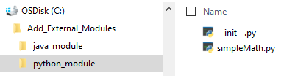
Adding External Modules (Python/Jython)
  Requires a file called __init__.py in the module folder
  Add module folder to system path
Implementation in Python/Jython
import sys
externalModulePath = 'C:/Add_External_Modules/python_module'
sys.path.append(externalModulePath)
import simpleMath
print(simpleMath.multiply(2, 5))
Example: New module named simpleMath.py, containing a multiply function:
def multiply(a,b):
return a*b
simpleMath.py is located at: C:/Add_External_Modules/python_module

Slide 5

Adding External Modules (Python/Jython)
  Alternatively, can define the externalModulePath as the parent folder:
    “C:/Add_External_Modules”
    Both Add_External_Modules and python_module folders need to contain an __init__.py file now
Implementation in Python/Jython
import sys
externalModulePath = 'C:/Add_External_Modules'
sys.path.append(externalModulePath)
from python_module import simpleMath
print(simpleMath.multiply(2, 5))

Slide 6

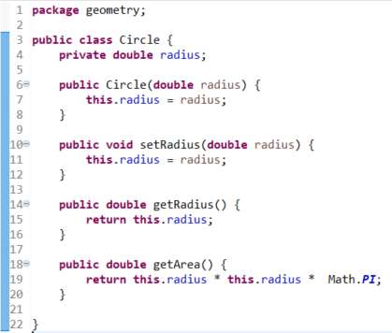
Adding External Modules (Java)
  If necessary:
    Write a Java class
    Compile Java class to JAR file
  Add JAR to system path (no flexibility on parent/containing folders)
  Import using package name
  Does not require the __init__.py file
Implementation in Python/Jython
import sys
externalModulePath = 'C:/Add_External_Modules/java_module/shapes.jar'
sys.path.append(externalModulePath)
from geometry import Circle
newCircle = Circle(10)
print(newCircle.getArea())
Example: shapes.jar, containing a package called geometry and a single class file called Circle
Notes:
Note that most of the HEC libraries are stored as JARs and imported this way (technically through Java classpath and not Python system path)

Slide 7
Adding External Modules (C/Fortran)
  Using Java native interface (JNI)
  If necessary:
    Write a Java class that wraps the native methods
    Compile Java class to JAR file
  Add JAR to classpath
  Import Java class to Jython script
Java wrapper
public class Heclib
{
public static native void Hec_zset(String parameter, String alpha, int number);
public static void zset(String parameter, String alpha, int number)
{
Hec_zset(parameter, alpha, number);
}
static
{
System.loadLibrary('javaHeclib');
}
}
Implementation in Jython
from hec.heclib.util import Heclib
# set DSS version to 6
Heclib.zset('DSSV', '', 6)
Notes:
Only from some natively compiled language to Java using JNI, and then from Java to Jython. If coding outside of HEC programs, pydsstools is an API to access HEC-DSS libraries using Python 3.

Slide 8
Questions?

