Slide 1
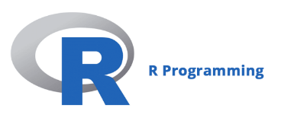
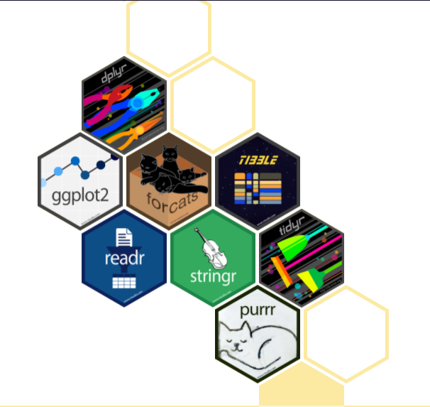
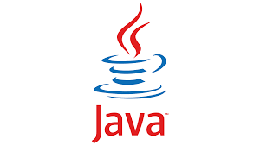
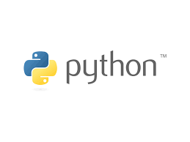
Other Programming Languages Overview: Java, Python, and R
Reyn Aoki
Hydraulic Engineer
NWS, Hydrology Branch
Date: 23 May 2023
Notes:
The intent of this presentation isn’t to show which of these languages is best, but more to highlight the strengths of each. The best programming language to use for an application is the one you’re most comfortable with.
Difficult to teach much about how to use the languages a single lecture, the purpose of this presentation is to:
Highlight strengths of a few languages
Show by example usages for multiple languages to chain together a workflow

Slide 2
Outline
Focusing on Java, Python, and R
Background of Languages
Basic Syntax Differences
Example Applications

Slide 3
Language Background
Feature | Java | Python | R
Programming Paradigm | Object Oriented | Object Oriented | Object Oriented
Compiled or Interpreted? | Compiled then interpreted | Compiled then interpreted | Interpreted
Typing | Strong, Static | Strong, Dynamic | Strong, Dynamic
Strength of Language | Fastest, compatible on almost any platform (“write once run anywhere”) | Fast, readable, easy to learn | Statistics, data mining, data analysis, portable
Notes:
*Object Oriented Programming (OOP): A programming paradigm that uses objects to represent and manipulate data. Everything (e.g., single numbers, data frames, and complex classes) within the language is represented by an object with attributes and methods.
**Compiled vs interpreted: In a pre-compiled language, the code converted into machine code that can then be executed, which tends to be more efficient. In an interpreted language is executed line by line.
Why is Java both compiled and interpreted? The Java program compiles source code to byte code (not machine code), then the byte code is interpreted by the Java Virtual Machine.

Slide 4
Jython Refresher
Jython implements Python in Java
Allows access to both worlds: Python code is typically much shorter, Java runs faster
Access Java objects
Runs on the Java Virtual Machine (JVM)
Why do we care about Java?
HEC API is written in Java
Jython allows access to HEC API if the libraries are added to the classpath
  Note: R and Matlab also have Java interfaces to access HEC API

Slide 5
Basic Syntax and Scripting
Feature | Java | Python | R
End of statement/expression character | “;” | None needed | None needed
Access Method or Feature | “.” | “.” | “$”
Chaining commands | Series of “.” e.g., system.out.println() | Series of “.” e.g., sys.path.append() | Nested “()” or pipeline (R >4.2). E.g., mean(getFirstValueFromEach(getVector())) Or getVector() > getFirstValueFromEach() > Mean()
Comment Character | “//” | “#” | “#”

Slide 6
Example USAGE: Mean of a Series of Values
Java:
// Need to define the variables and define type prior to or during assignment
float[] x = {5, 10, 15};
float avg, sum = 0;
for(int i = 0; i < x.length; i++)
sum = sum + x[i];
avg = sum/x.length;
System.out.println(avg);
Python:
# Create a numeric list, no need to define type (numeric, character, …)
import numpy as np # numpy library needed to use the mean function
x = [5, 10, 15]
avg = np.mean(x)
print(avg)
R:
# Create a numeric vector, no need to define type (numeric, character, …)
x <- c(5, 10, 15)
avg <- mean(x)
print(avg)

Slide 7
Example JAVA USAGE: Event Data Summary Tool (EDST)
Currently used for Columbia River Treaty studies
WAT output produces 5,000 to 50,000 individual events (years)
The WAT results are very large, and not easily accessed by most tools
The EDST distills data from each event, given instructions on metrics to compute
The EDST also includes some Jython code in addition to Java
Able to push raw WAT data to other formats (binary, SQLite, NetCDF) so it is more accessible to other tools
Useful metrics computed by EDST, e.g.:
Average flows over time interval
Peak flows within time window
Reservoir elevation on a given date
Percentile value
…

Slide 8
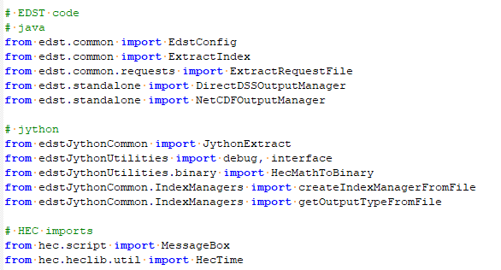
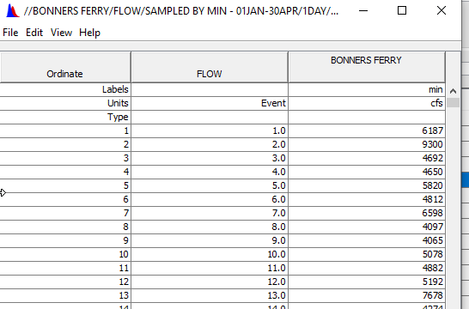
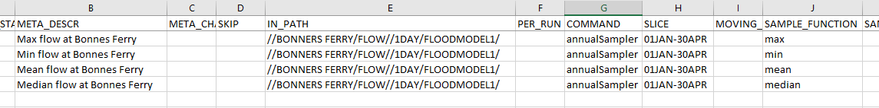
Event Data Summary Tool (EDST)
Mixed Java and Jython code
Example Output
Example Configuration File
Notes:
Note import statements are referencing code from both Jython and Java
The configuration file indicates which paths to pull data from, the time window of interest, and metrics to apply
Tabular output is saved to DSS for all (in this case) 5k events

Slide 9
Example Python Usage: Climate Change Study
Using Python 3
Produce high quality graphics for Climate study conducted by NWD
Utilizes EDST tool’s NetCDF output as basis for analysis
Powerful Python libraries for data analysis and plotting: numpy, xarray, pandas, matplotlib

Slide 10
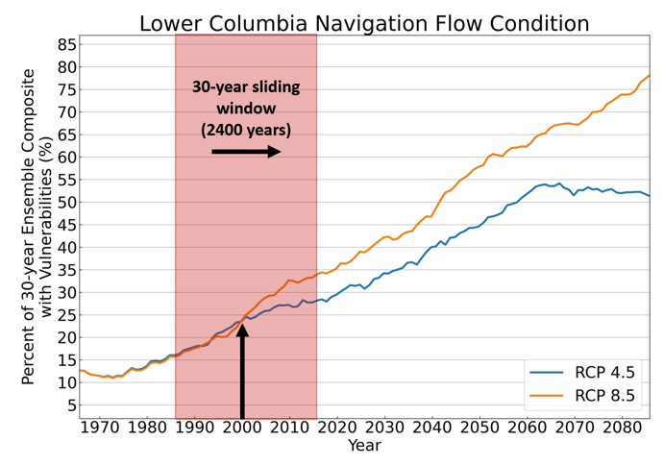
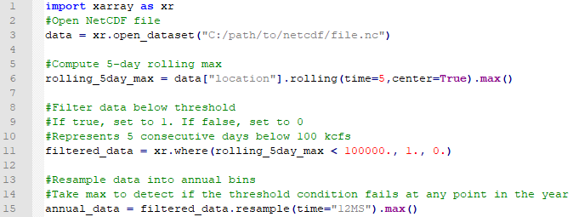
Python 3 in Climate Change Study
Python implementation is a post-process to EDST:
Reads in NetCDF data
Compute metrics using xarray library
Produce high quality plots using matplotlib library
Code snippet using xarray package to perform data analysis over rolling time window:
Notes:
Sample Python code extracts 1’s for years where there are 5 consecutive days under 100 kcfs, and sets all other years to 0’s. 1 = has the vulnerability, 0 =does not have the vulnerability
Some things to note in the code:
efficiency: more comments than there are lines of code
Python syntax of chaining commands together with “.”
Xarray package is very rich, with base methods for most data analyses conducted for H&H
(Further data analysis not shown in the code snippet on the slide)
- Would split data into the two climate emissions scenarios, and then apply a 30-year rolling time window and compute the percent of years with the vulnerability
Use matplotlib to visualize how the vulnerability changes over time

Slide 11
Example R Usage: WAT Plotter
Currently used for Columbia River Treaty studies
In addition to summary statistics (tabular) from EDST, there is a need to produce plots for upward reporting and QA of WAT results.
The WAT plotter creates Excel plots from WAT results, given a set of instructions.
Also has an on-the-fly exploratory data analysis
Uses R’s “shiny” library for easy design of user interfaces, and has lots of online help

Slide 12
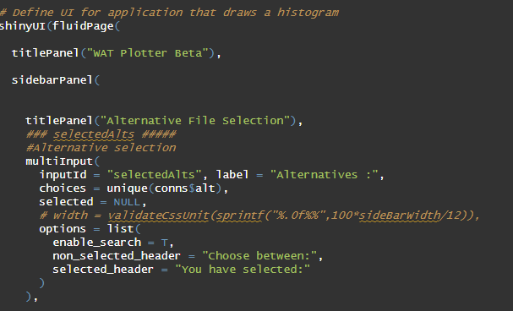
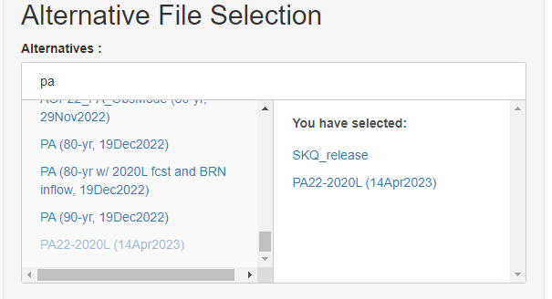
WAT Plotter: R Shiny code
Define an R “shiny” user interface
Define the sidebar panel options
Set the title of a panel
Create a multiple input selector for selecting alternatives

Slide 13
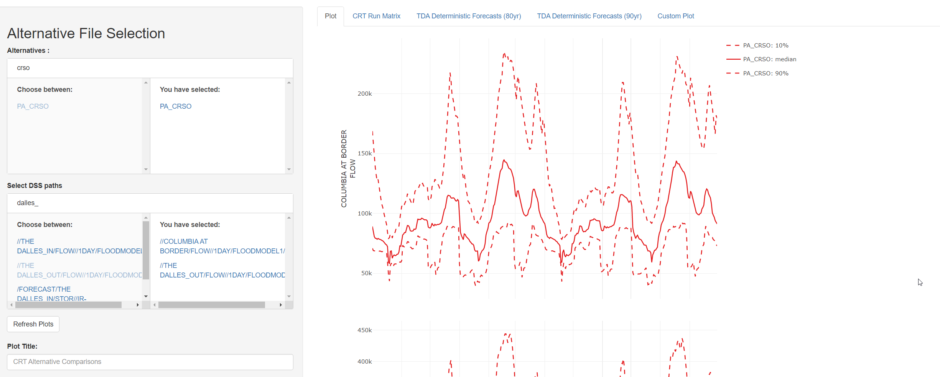
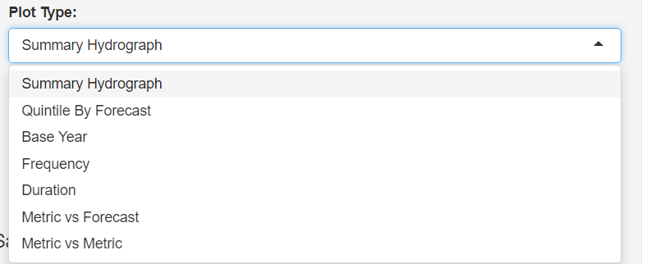
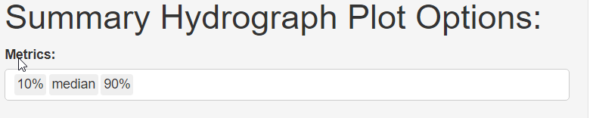
WAT Plotter: On-the-Fly plots
Ad hoc interface
Example batch configuration file
Example batch output
1
1) User selects the alternative (FRA run) and 2) time series to be plotted, 3) then the type of plot that’s desired and associated metrics
2
3
Notes:
Ad hoc interface allows use to arbitrarily select the alternatives (FRA runs) and time series to plot, then select the plot type
For the Treaty studies, we typically have a standard set of plots that we want to produce with each run.
To do this same process in bulk, the WAT plotter can be given a batch configuration file
Output from the batch process is a series of Excel files, labelled

Slide 14
Multiple Languages For Different Uses
WAT Monte Carlo compute
5,000 to 50,000 water years of data spread throughout hundreds of large DSS files
Event Data Summary Tool
Java
Jython
Tabular metrics from WAT written to DSS
Raw time series as binary files
Raw time series or tabular metrics as NetCDF files
WAT Plotter
R
Climate Tool
Python 3
Report quality graphics
Ad Hoc Analysis
Report quality graphics
Notes:
Highlights that using
Why Java/Jython for EDST? 1) Can directly access HEC libraries for DSS manipulation, 2) fast
Why Python 3 for climate studies? 1) Able to use powerful Python libraries to easily write high-level code for data analysis
Why R for WAT potter? 1) R shiny allows quick development of user interface, 2) R code streamlined for high-level data analysis

Slide 15
Questions?

Slide 16
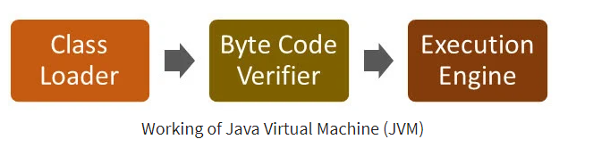
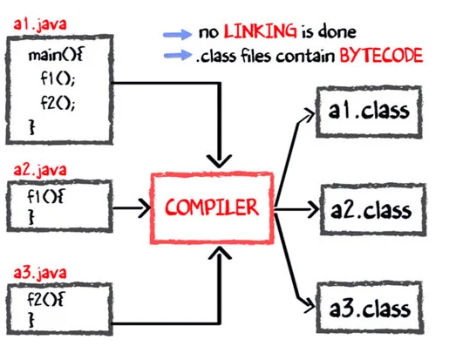
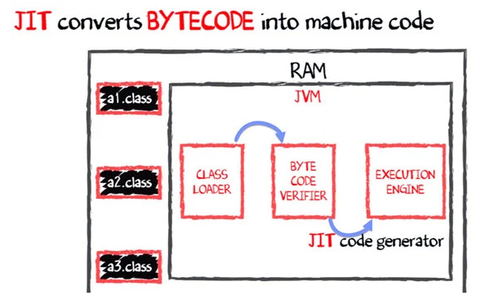
How does the Java Virtual Machine (JVM) Work?
https://www.guru99.com/java-virtual-machine-jvm.html#:~:text=The%20Java%20VM%20or%20Java,Bytecode%20into%20Native%20machine%20code.
Notes:
In this example there are three *.java source code files that are being compiled.
In the first step (bottom left), the source code files are compiled into bytecode *.class files (not machine code).
In the second step, these class files are loaded into the JVM, and the bytecode is the interpreted into machine code by the JVM.
The JVM is running in memory (RAM)
Acronyms:
RAM = Random Access Memory
JVM = Java Virtual Machine
JIT = Just-in-time

Slide 17
Resources
R:
Simple R cheat sheet
Cheat sheets for multiple packages
The R Manuals (written by R development core team)
Python:
Translation between Python pandas and R data.frame
Java:
Explanation of Java Virtual Machine

Slide 18
Online Compilers
Can test simple code without need to set up environment
Java compiler:
https://www.programiz.com/java-programming/online-compiler/
Python compiler:
https://www.programiz.com/python-programming/online-compiler/
R compiler:
https://www.programiz.com/r/online-compiler/
Notes:
Open each in a separate window, adjust to fit a single screen using windows + (arrow key) to make them all fit

