Slide 1
CHEC/MMC Scripting Class
WMS Plot Scripting
Mitch Weier
St. Paul District
Mitchell.s.weier@usace.army.mil

Slide 2
Overview
Review of plot components/features
Necessary Modules
Accessing Data
  Data source (DB vs. DSS)
  Time window
Plotting Classes and Methods
  Plot Object
  Plot Layout
  Viewports, Axis, Lines and Labels
  Templates
Command Line Operation
Plotting Applications
  Input Files
  GUI

Slide 3
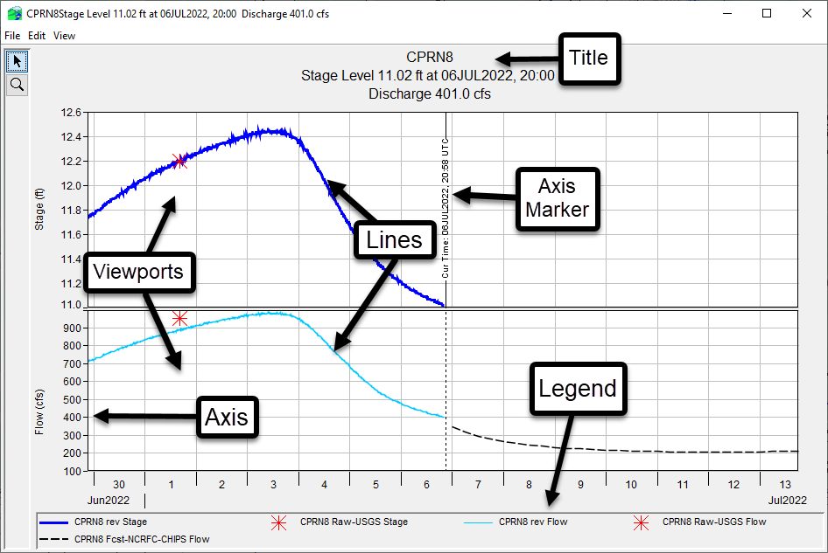
Plot Components

Slide 4
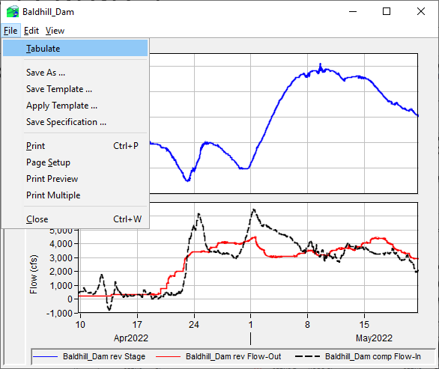
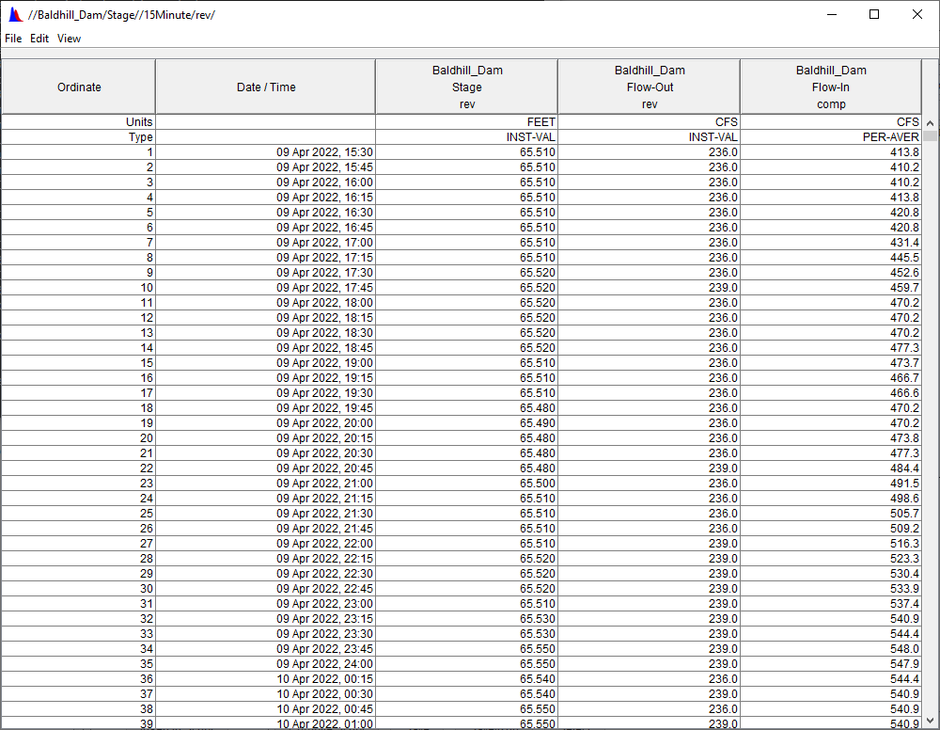
Plot Features - Tabulate
Notes:
tabulate

Slide 5
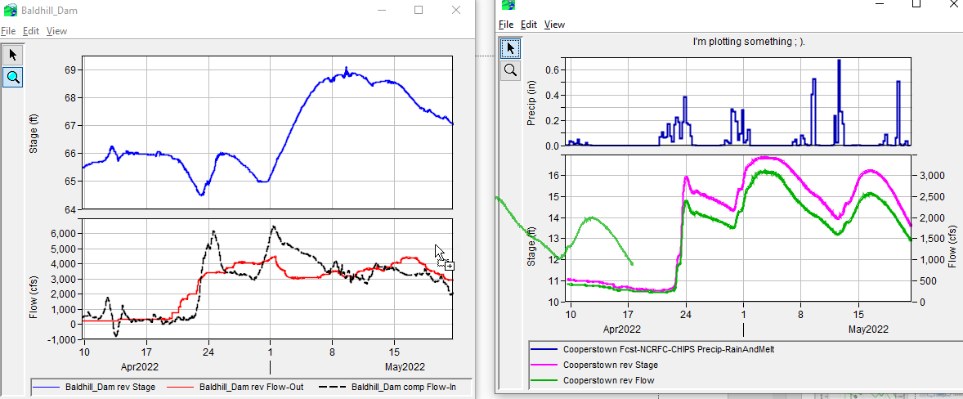
Plot Features – Drag and Drop
Notes:
tabulate

Slide 6
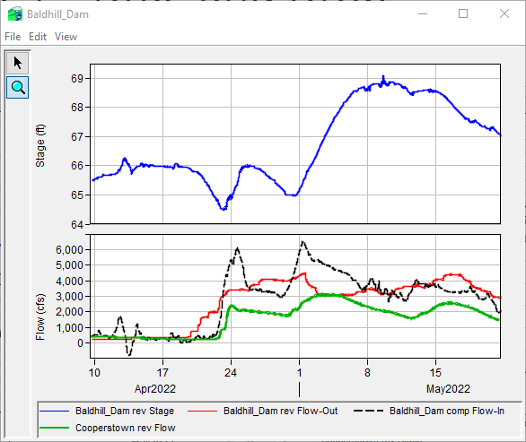
Plot Features – Drag and Drop

Slide 7
Necessary Modules
The module hec.script contains classes for plots, tables, and messaging, and is almost always imported.
The HecDss class in the hec.heclib.dss module contains functionality for accessing HEC-DSS files and needs to be imported by every script that will read/write HEC-DSS files
from hec.script import Plot, MessageBox
from hec.heclib.dss import HecDss
The DBAPI allows for accessing CWMS database
from hec.script import Plot, MessageBox
import DBAPI
Notes:
Jython 2.7 doesn’t allow from module import * if module is a Java class.

Slide 8
Accessing Data
DSS Data
The HecDss class in the hec.heclib.dss module has a method named open
HecDss.open(file_name) returns an HecDss object which can be used to read and write HEC-DSS files
Use DSS file paths
//Baldhill_Dam/Flow-Out/01Apr2022/15Minute/rev/
CWMS Oracle Data
import DBAPI
Use TS Id’s
Baldhill_Dam.Flow-Out.Inst.15Minutes.0.rev

Slide 9
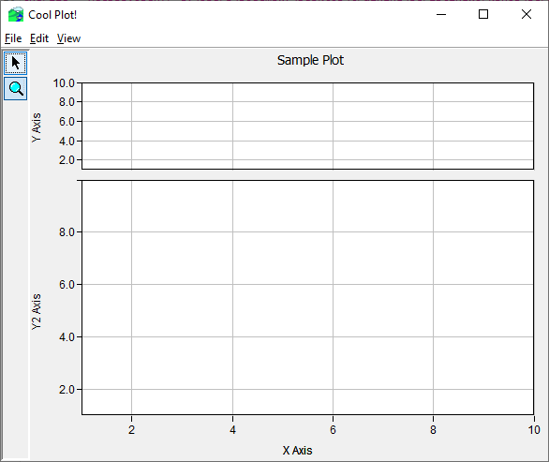

Plot (G2dDialog) Object
Plot object holds all other objects

Slide 10
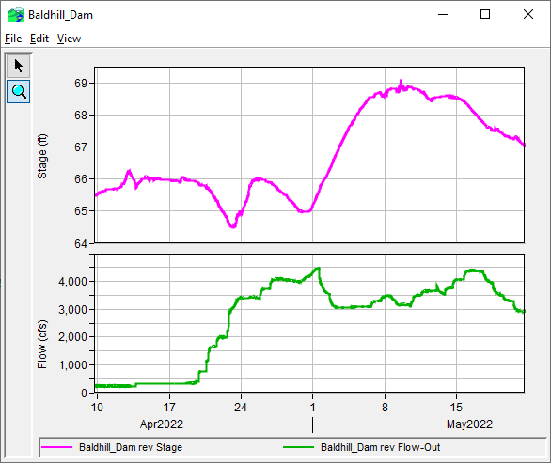
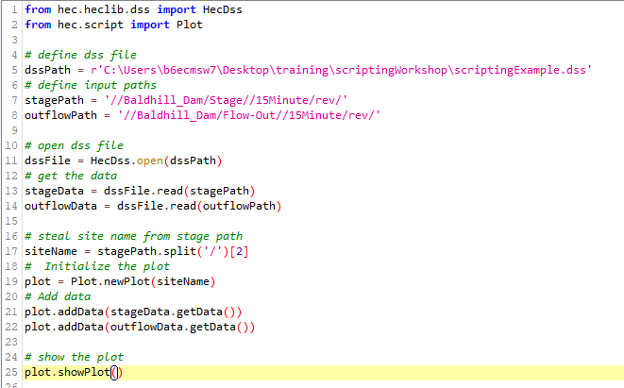
Plot (G2dDialog) Object
For simple plots, add data right to the plot object
No control over what dataset goes into what viewport though
Notes:
Plot object creates viewports, axis etc…..IMPORTANT, must showPlot to create viewports, axis etc…

Slide 11
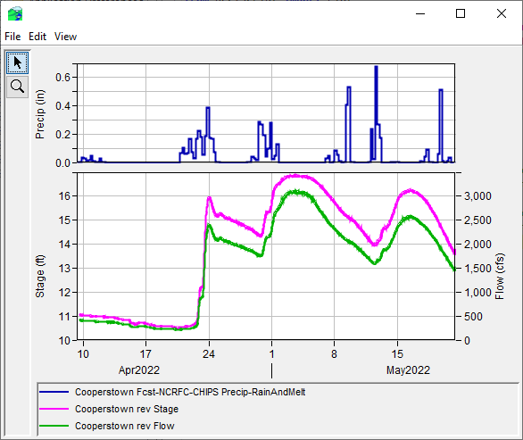
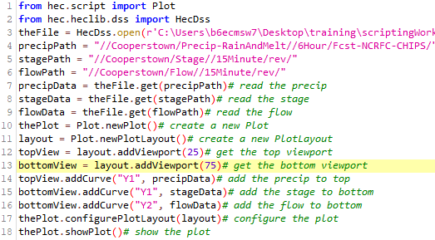
Plot Layout/Viewport Layout
Using a plot layout gives greater control
  Plot secondary y-axis
  Viewport size
  Invert Axis
Notes:
from hec.script import Plot
from hec.heclib.dss import HecDss
theFile = HecDss.open(r'C:\Users\b6ecmsw7\Desktop\training\scriptingWorkshop\scriptingExample.dss')# open myFile.dss
precipPath = "//Cooperstown/Precip-RainAndMelt//6Hour/Fcst-NCRFC-CHIPS/"
stagePath = "//Cooperstown/Stage//15Minute/rev/"
flowPath = "//Cooperstown/Flow//15Minute/rev/"
precipData = theFile.get(precipPath)# read the precip
stageData = theFile.get(stagePath)# read the stage
flowData = theFile.get(flowPath)# read the flow
thePlot = Plot.newPlot()# create a new Plot
layout = Plot.newPlotLayout()# create a new PlotLayout
topView = layout.addViewport(25)# get the top viewport
bottomView = layout.addViewport(75)# get the bottom viewport
topView.addCurve("Y1", precipData)# add the precip to top
bottomView.addCurve("Y1", stageData)# add the stage to bottom
bottomView.addCurve("Y2", flowData)# add the flow to bottom
thePlot.configurePlotLayout(layout)# configure the plot
thePlot.showPlot()# show the plot

Slide 12
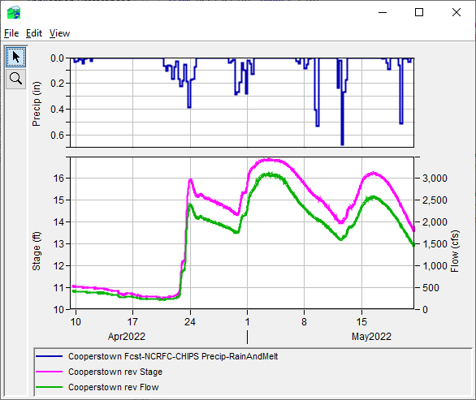
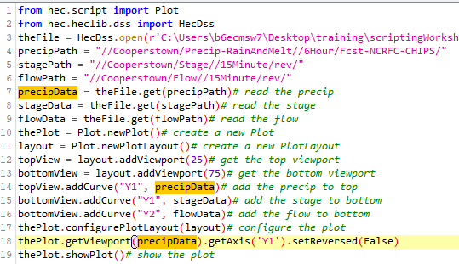
Plot Layout/Viewport Layout
thePlot.getViewport(0).getAxis(‘Y1’).setReversed(False)

Slide 13
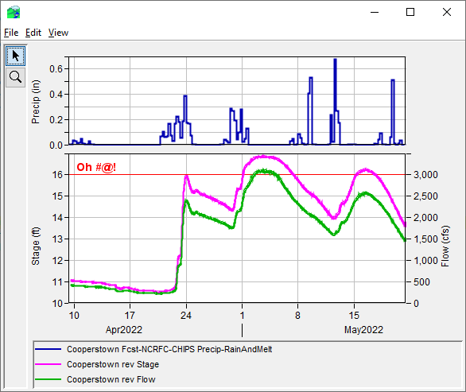
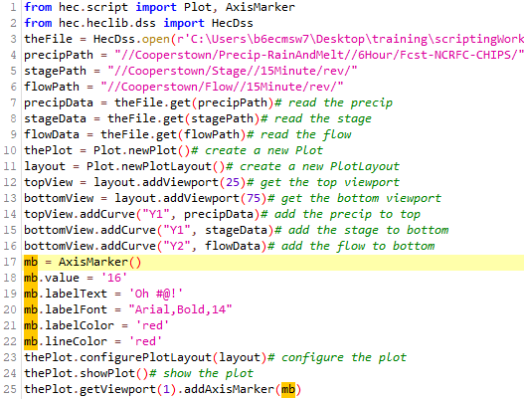
Axis Marker

Slide 14
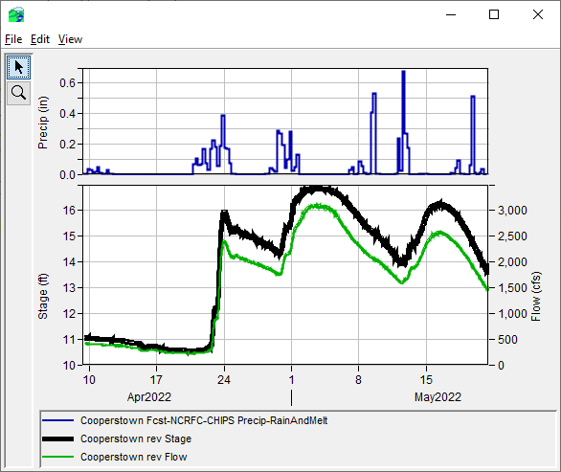
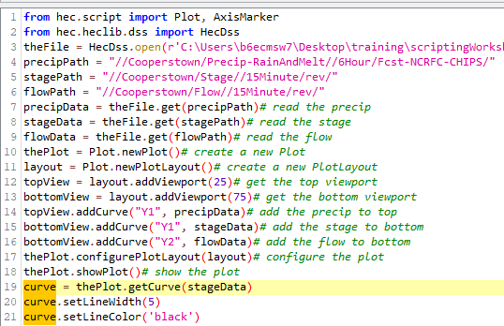
Line Formatting
Notes:
Show plot first so objects exists, then you can get the curve from the Plot object by with the data object input

Slide 15
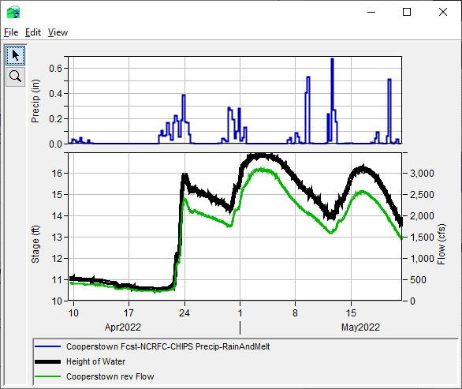
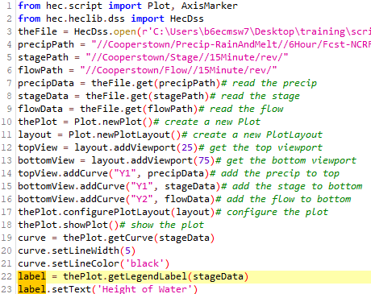
Legend

Slide 16
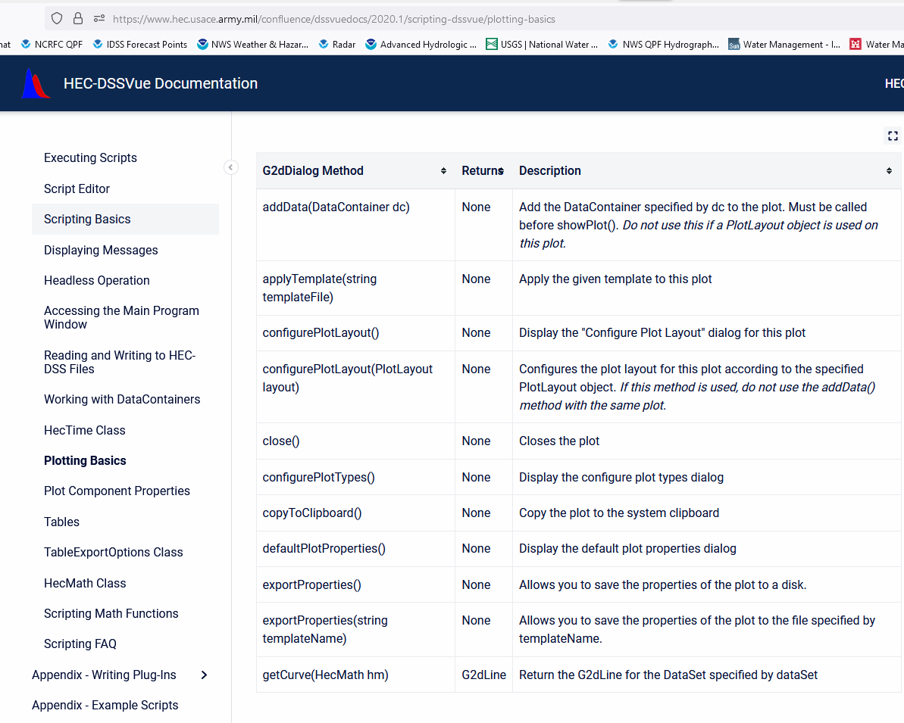
Many More Methods!
https://www.hec.usace.army.mil/confluence/dssvuedocs/2020.1/scripting-dssvue/plotting-basics

Slide 17
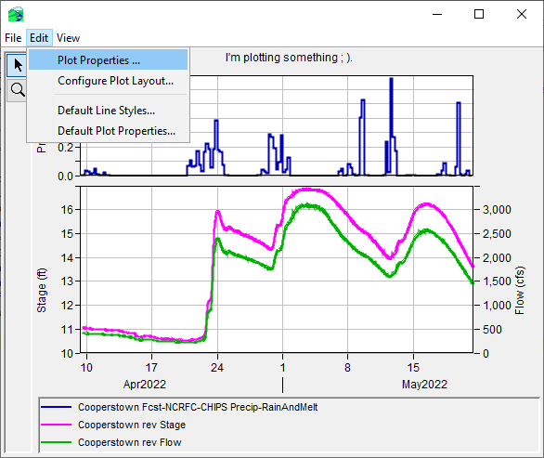
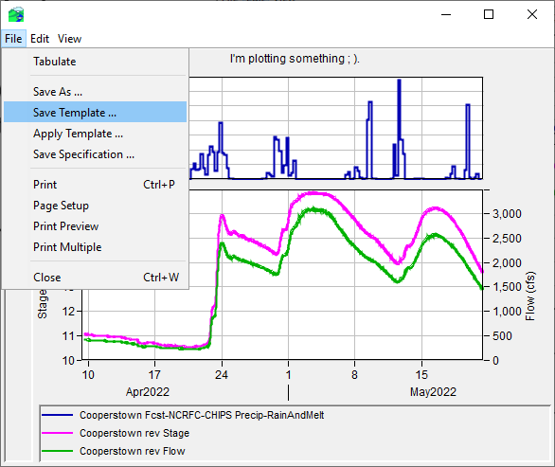
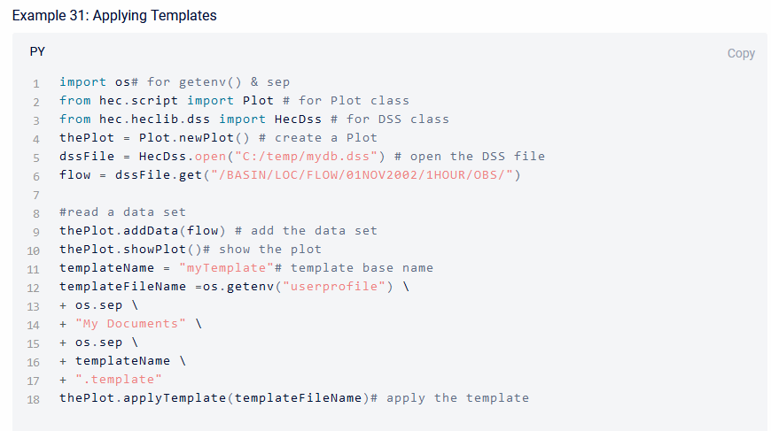
Templates
Use DSS/CWMS-VUE GUI to format plot template
  https://www.hec.usace.army.mil/confluence/dssdocs/dssvueum/customizing-plots/customizing-plots-overview
Apply template in script
Disadvantage – data inputs must be identical
Notes:
https://www.hec.usace.army.mil/confluence/dssdocs/dssvueum/customizing-plots/customizing-plots-overview

Slide 18
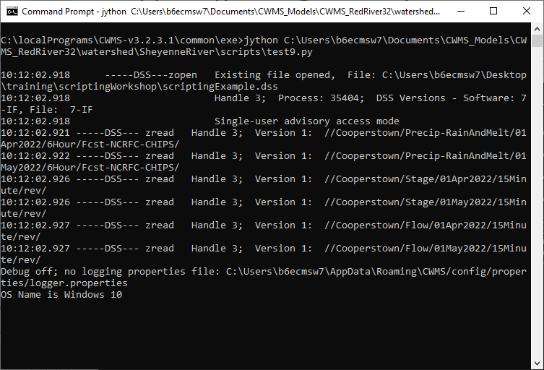
Command Line Operation
Notes:
Change directory to common/exe and type jython and the script path

Slide 19
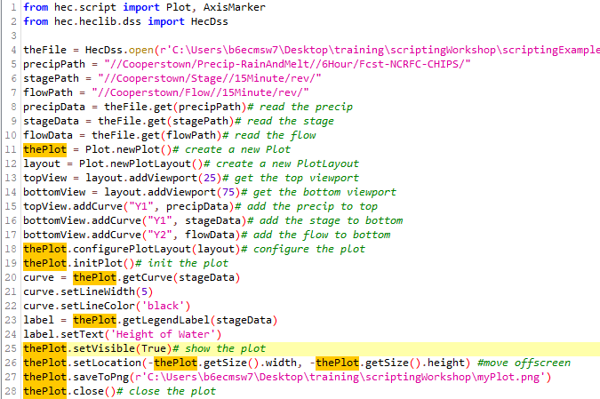
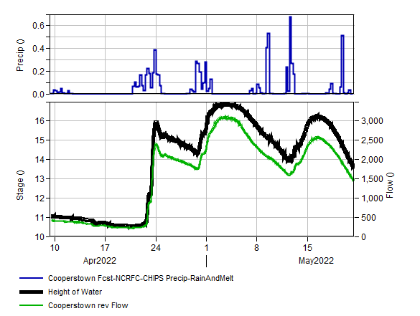
Command Line Operation
Notes:
https://www.youtube.com/watch?v=a9MezagDN3g
from hec.script import Plot, AxisMarker
from hec.heclib.dss import HecDss
theFile = HecDss.open(r'C:\Users\b6ecmsw7\Desktop\training\scriptingWorkshop\scriptingExample.dss')# open myFile.dss
precipPath = "//Cooperstown/Precip-RainAndMelt//6Hour/Fcst-NCRFC-CHIPS/"
stagePath = "//Cooperstown/Stage//15Minute/rev/"
flowPath = "//Cooperstown/Flow//15Minute/rev/"
precipData = theFile.get(precipPath)# read the precip
stageData = theFile.get(stagePath)# read the stage
flowData = theFile.get(flowPath)# read the flow
thePlot = Plot.newPlot()# create a new Plot
layout = Plot.newPlotLayout()# create a new PlotLayout
topView = layout.addViewport(25)# get the top viewport
bottomView = layout.addViewport(75)# get the bottom viewport
topView.addCurve("Y1", precipData)# add the precip to top
bottomView.addCurve("Y1", stageData)# add the stage to bottom
bottomView.addCurve("Y2", flowData)# add the flow to bottom
thePlot.configurePlotLayout(layout)# configure the plot
thePlot.initPlot()# init the plot
curve = thePlot.getCurve(stageData)
curve.setLineWidth(5)
curve.setLineColor('black')
label = thePlot.getLegendLabel(stageData)
label.setText('Height of Water')
thePlot.setVisible(True)# show the plot
thePlot.setLocation(-thePlot.getSize().width, -thePlot.getSize().height)
thePlot.saveToPng(r'C:\Users\b6ecmsw7\Desktop\training\scriptingWorkshop\myPlot.png')
thePlot.close()# close the plot

Slide 20
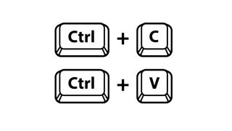
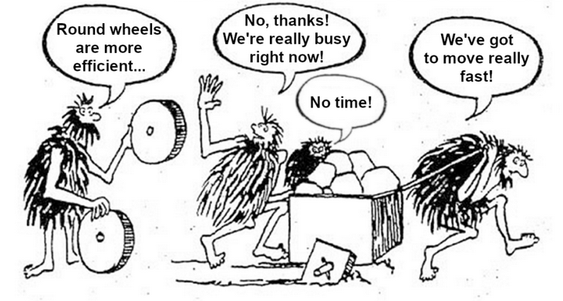

Plotting Applications
Notes:
Copy and pasting code works great but….
A lot of CAVI’s, projects, gages can result in a lot of scripts to maintain!
Consider developing plotting functions or applications that can easily be ported to other sites

Slide 21

Take advantage of similarities
Project/Gage data
  Stage
  Flow
  Precip
CWMS DB/DSS naming convention
Code structure
  Plot
  Plot Layout
  Viewports, axis, lines, legend
Notes:
Generally, projects have identical or similar data….pool elev, outflow, inflow, thresholds, etc…

Slide 22
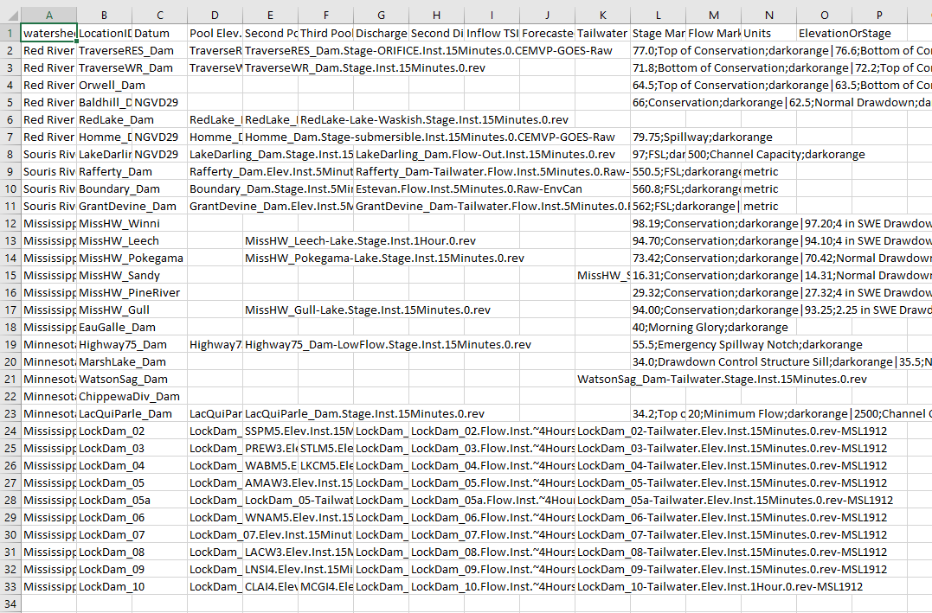
Define script inputs by CSV or Text File

Slide 23
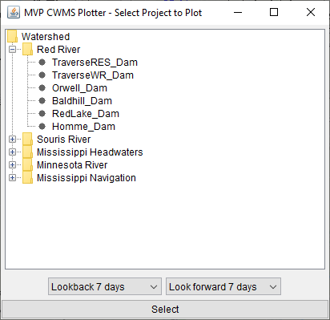
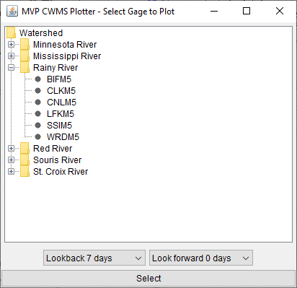
Define script inputs by GUI

Slide 24
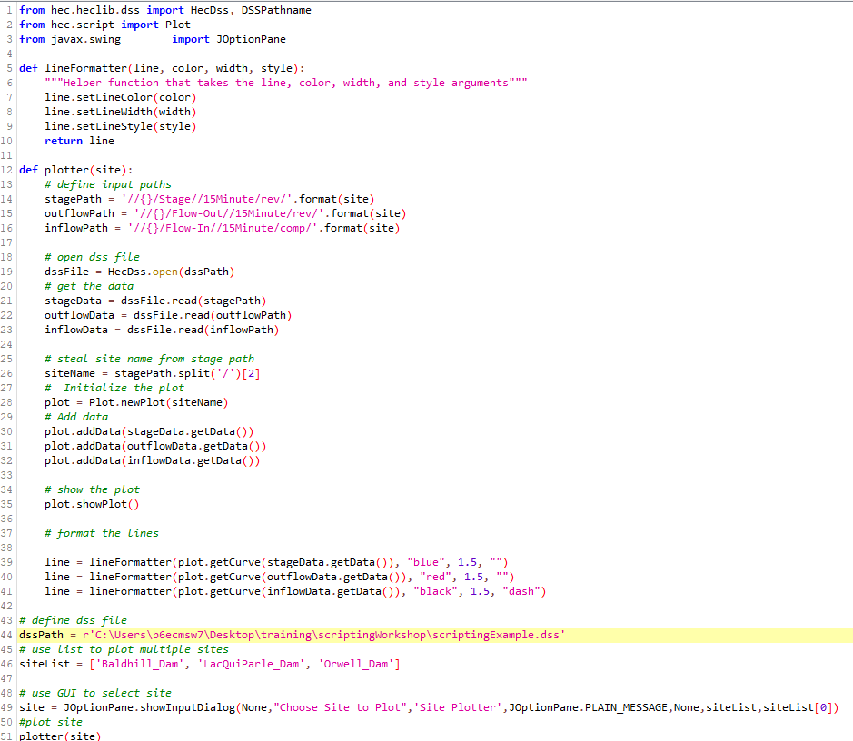
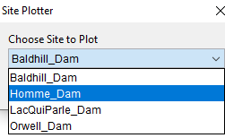
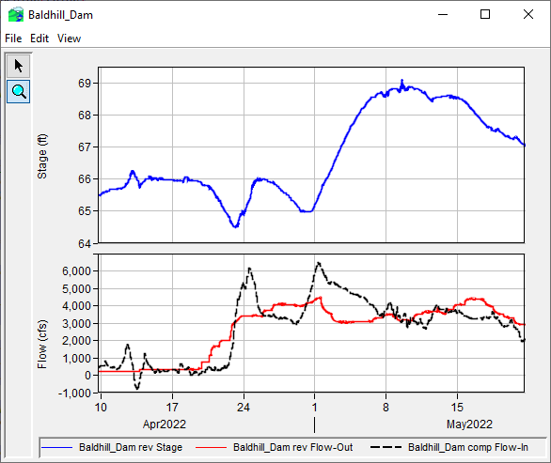
Example using GUI and list of sites
Line format function
Plotting function
Input data
Input site name
Drop down GUI from list
Notes:
from hec.heclib.dss import HecDss, DSSPathname
from hec.script import Plot
from javax.swing import JOptionPane
def lineFormatter(line, color, width, style):
"""Helper function that takes the line, color, width, and style arguments"""
line.setLineColor(color)
line.setLineWidth(width)
line.setLineStyle(style)
return line
def plotter(site):
# define input paths
stagePath = '//{}/Stage//15Minute/rev/'.format(site)
outflowPath = '//{}/Flow-Out//15Minute/rev/'.format(site)
inflowPath = '//{}/Flow-In//15Minute/comp/'.format(site)
# open dss file
dssFile = HecDss.open(dssPath)
# get the data
stageData = dssFile.read(stagePath)
outflowData = dssFile.read(outflowPath)
inflowData = dssFile.read(inflowPath)
# steal site name from stage path
siteName = stagePath.split('/')[2]
# Initialize the plot
plot = Plot.newPlot(siteName)
# Add data
plot.addData(stageData.getData())
plot.addData(outflowData.getData())
plot.addData(inflowData.getData())
# show the plot
plot.showPlot()
# format the lines
line = lineFormatter(plot.getCurve(stageData.getData()), "blue", 1.5, "")
line = lineFormatter(plot.getCurve(outflowData.getData()), "red", 1.5, "")
line = lineFormatter(plot.getCurve(inflowData.getData()), "black", 1.5, "dash")
# define dss file
dssPath = r'C:\Users\b6ecmsw7\Desktop\training\scriptingWorkshop\scriptingExample.dss'
# use list to plot multiple sites
siteList = ['Baldhill_Dam', 'LacQuiParle_Dam', 'Orwell_Dam']
# use GUI to select site
site = JOptionPane.showInputDialog(None,"Choose Site to Plot",'Site Plotter',JOptionPane.PLAIN_MESSAGE,None,siteList,siteList[0])
#plot site
plotter(site)

Slide 25
Review
Need a data source, data, and time window
Import correct plotting modules (minimum hec.script)
PlotObject can be highly customized using PlotLayout object
Must show or init the plot before customizing objects within it
Many methods can be used to customize (view Scripting DSSView Help)
Templates may be used via scripting
Plotting Applications using GUI and input files may reduce maintenance

Slide 26
References
HEC-DSSVue Documentation Scripting DSS
  https://www.hec.usace.army.mil/confluence/dssvuedocs/2020.1/scripting-dssvue/plotting-basics
HEC-DSSVue Scripting Workshop
  https://www.hec.usace.army.mil/confluence/dssvueguides/hec-dssvue-scripting-workshop-54662884.html
Scripting and Customizing HEC-DSSVue (April 2021)
  https://www.hec.usace.army.mil/confluence/dsstr/scripting-and-customizing-hec-dssvue-april-2021
Water Data Management With HEC-DSSVue (July 2021)
  https://www.hec.usace.army.mil/confluence/dsstr/water-data-management-with-hec-dssvue-july-2021
Customizing HEC DSSVue Functionality
  https://www.youtube.com/watch?v=SUYeb-xsQDQ
Scripting Demo in HEC DSSVue and CWMS Vue
  https://www.youtube.com/watch?v=a9MezagDN3g
DSSVue-Example-Scripts
  https://github.com/HydrologicEngineeringCenter/DSSVue-Example-Scripts
AI
  Bing.com
  https://openai.com

