Slide 1
Hydropower Simulation
HEC-ResSim

Slide 2
Objectives
To know how to:
  Add a Power Plant to a reservoir and define Power Plant Data
  Add Hydropower Rules to the system
  Control Release Allocation to outlets
  Review the hydropower output options

Slide 3
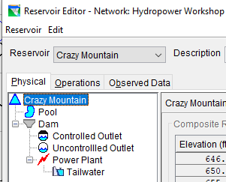

Hydropower Data
Physical Data
Add Power Plant
Define Power Plant Data
  Outlet Capacity
  Power Capacity
  Efficiency
  Losses
    Station Use
    Hyd. Losses
  Operating Limits
Add Tailwater Elevation
Notes:
A Power Plant is a type of controlled outlet that has the additional capability of computing hydropower generation. A Power Plant can be added to a Dam, Diverted Outlet, or Outlet Group. To edit data for a Power Plant, select the Power Plant in the Reservoir Tree.

Slide 4
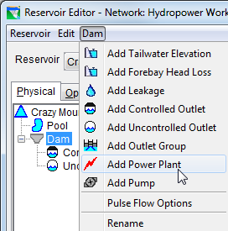
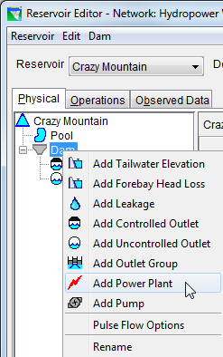
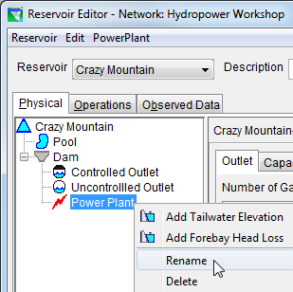
Add a Power Plant
  Add Power Plant
  Use component-specific menu
  Use right-click shortcut menu

Slide 5
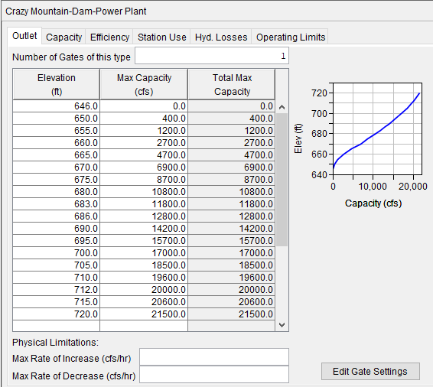
Power Plant Data-Outlet Capacity
Physical Powerhouse Capacity
  Elevation vs Flow
Limits Flow for power generation
Notes:
On the Outlet tab, you will enter the rating table for the physical capacity of this outlet. You can also specify the increasing and decreasing physical limitations (i.e., physical rate-of-change constraints).
To enter Outlet data:
Specify the Number of Gates of this type.
Enter Elevation and corresponding Max Capacity flow values (per gate) into the table. You can either copy and paste data from a spreadsheet application or type in the values manually.
Optionally, specify Physical Limitations for Max Rate of Increase and Max Rate of Decrease.

Slide 6

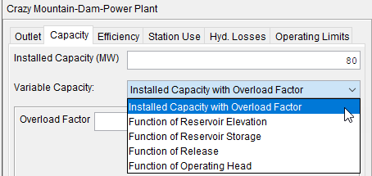
Power Plant Data-Power Capacity
Select Capacity tab in Power Plant dialog
Enter the Installed Capacity (MW).
Select the Variable Capacity option
  Installed Capacity with Overload factor
    Enter the Overload Factor
  Function of Reservoir Elevation
  Function of Reservoir Storage
  Function of Release
  Function of Operating Head
Notes:
On the Capacity tab, you must specify the generating capacity of the power plant. All power plants come with a general “nameplate” or installed capacity. In addition, the capacity of the plant may vary as a function of elevation, release, or net head. Both forms of generating capacity are required input – the Installed Capacity and the Variable Capacity.
The Installed Capacity will be used by the Hydropower Requirement operating rules that determine required generation using Plant Factor. The Installed Capacity is entered as a constant value in units of megawatts (MW).
The Variable Capacity will be used by all the Hydropower Requirement rules to limit the plant’s generating capability computed using the power equation and the other properties of the power plant. The Variable Capacity can be specified with one of the following five options.
Installed Capacity with Overload Factor: This option is the equivalent of defining the variable capacity as constant. The Overload Factor is used as a multiplier for the Installed Capacity to determine the maximum generating rate the plant can operate at. For example, to overload a plant’s installed capacity by 10%, enter a factor of 1.10. To use the full Installed Capacity with no overload, enter an Overload Factor of 1.0.
Function of Reservoir Elevation: If the generating capacity of your power plant varies as a function of the pool elevation of the reservoir, select Function of Reservoir Elevation for your Variable Capacity. Then, right click on the blank row in the function table and insert the number of rows you need to specify the functional relationship. Enter the data specifying the relationship between elevation and generating capacity into the table in increasing order of elevation.
Function of Reservoir Storage: If the generating capacity of your power plant varies as a function of the current storage in the reservoir, select Function of Reservoir Storage for your Variable Capacity. Then, right click on the blank row in the function table and insert the number of rows you need to specify the functional relationship. Enter the data specifying the relationship between storage and generating capacity into the table in increasing order of storage.
Function of Release: If the generating capacity of your power plant varies as a function of the previous release from the reservoir, select Function of Release for your Variable Capacity. Then, right click on the blank row in the function table and insert the number of rows you need to specify the functional relationship. Enter the data specifying the relationship between release and generating capacity into the table in increasing order of release.
Function of Operating Head : If the generating capacity of your power plant varies as a function of the net head for the power plant, select Function of Operating for your Variable Capacity. Then, right click on the blank row in the function table and insert the number of rows you need to specify the functional relationship. Enter the data specifying the relationship between net head and generating capacity into the tab in increasing order of head.

Slide 7
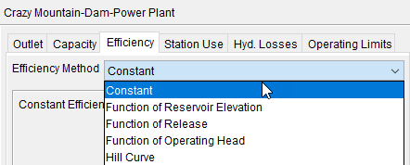
Power Plant Data-Plant Efficiency
Select Efficiency tab in Power Plant dialog
Select the Efficiency Method option
  Constant
  Function of Reservoir Elevation
  Function of Release
  Function of Operating Head
  Hill Curve
Notes:
.
Efficiency represents a percentage of the total potential energy the power plant (generator efficiency & turbine efficiency) could theoretically generate. Typical plant efficiency ranges between 80% and 90%. In actual operation, however, the turbine-generator efficiency varies throughout its range of operation.

Slide 8
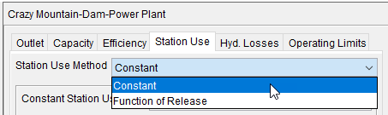
Power Plant Data-Station Use
Select Station Use tab in Power Plant dialog
Select the Station Use Method option
  Constant
  Function of Release
Notes:
Station Use is the quantity of flow used to run a “station” unit whose power is used to operate the powerhouse. It is a portion of the flow that passes through the powerhouse, but it is not used to generate power for the “grid” and is therefore considered a loss.
On the Station Use tab of the Power Plant edit pane, you can define the Station Use as constant flow rate or as a function of flow entering the powerhouse (release).

Slide 9
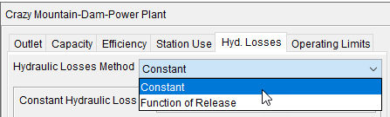
Power Plant Data-Hydraulic Losses
Select Hyd. Losses tab in Power Plant dialog
Select the Hydraulic Losses Method option
  Constant (feet/meter)
  Function of Release (Release vs. loss)
Hydraulic Loss is subtracted from Gross Head in power computations.
Notes:
Hydraulic loss can also be referred to as head loss and is used to represent the friction losses in the penstock. ResSim uses net head (the difference between the pool elevation and the tailwater elevation) in the power equation to calculate generating capacity. When you specify a hydraulic loss, you are describing a loss to the head, which results in a reduction in the plant’s generating capacity.
You can specify the head loss as a constant or as a function of flow through the penstock (entering the powerhouse):

Slide 10
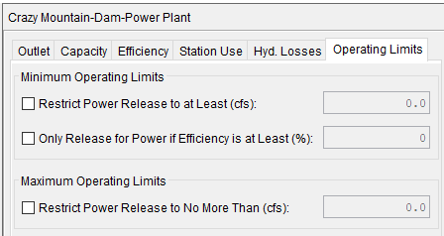
Power Plant Data- Operating Limits
Select Operating Limits tab in Power Plant dialog
  Minimum Operating Limits
  Maximum Operating Limits

Slide 11
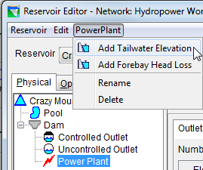
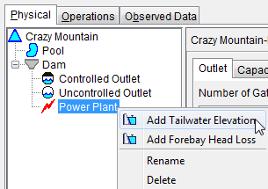
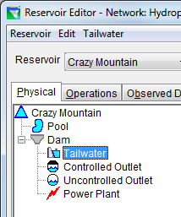
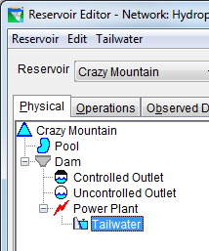

Add Tailwater Elevation
  Add Tailwater
  Use component-specific menu
  Use right-click shortcut menu
  Tailwater
  Tailwater appears in tree below the selected component

Slide 12
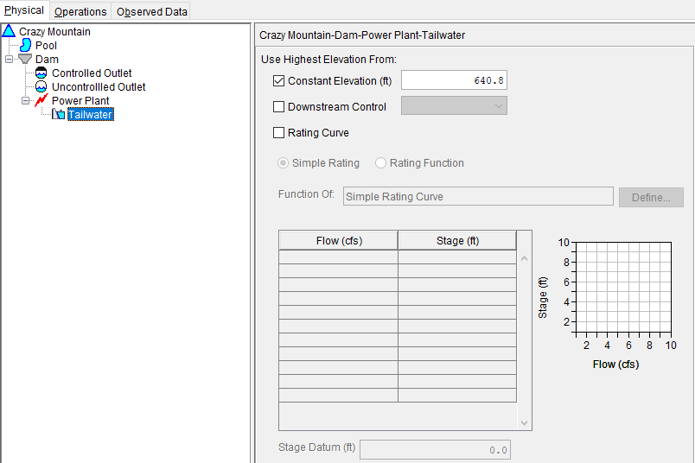
Define Tailwater Elevation
Select Tailwater
Enter data
  Constant Elevation
  Downstream Control
  Rating Curve
If multiple data, higher controls

Slide 13
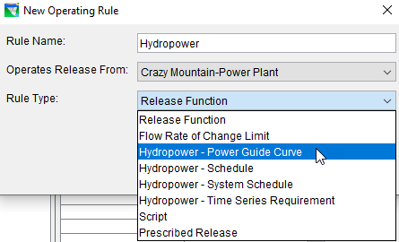
Hydropower Operation Rules
Hydropower - Power Guide Curve
Hydropower - Schedule
Hydropower - System Schedule
Hydropower - Time-series Requirement
Notes:
Hydropower rules specify a power generation requirement from the power plant at reservoir or a system of reservoirs. When evaluated, the hydropower rules determine the minimum flow that must be released through the power plant to produce the required energy given the plants generating capacity, the hydraulic head, and the generation pattern. The various hydropower rules each provide a different way of specifying the generation requirement:
The Power Guide Curve rule allows you to specify the required generation as a function of storage.
The Schedule rule allows you to specify the requirement as a function of date.
The Time Series Requirement lets you specify the requirement directly through an external time series.
And the System Schedule rule allows you to define the generation requirement in the same manner as the Schedule rule but the System Schedule rule is applied to multiple reservoirs so that together they can operate to meet the generation requirement specified in the rule.

Slide 14
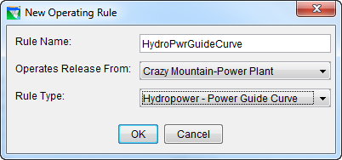
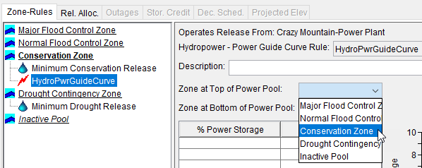
Hydropower-Power Guide Curve
Create the rule
Select the top and bottom zones of the power pool
Notes:
The Hydropower – Power Guide Curve rule allows you to define a function that describes the hydropower generation requirement with respect to the available storage in the power pool. The power pool is defined by identifying two top-of-zone curves – one that marks the top power pool and one that marks the bottom.
The power requirement must be described in units of percent of plant factor. Plant factor is a fraction of the capacity of the plant to generate; so percent plant factor is a percentage of the capacity of the plant to generate. Plant factor can also be interpreted to mean the fraction (or percentage) of the day the plant generates at full capacity. Thus, a plant factor of .25 (or 25%) may mean that the plant generates at 25% of capacity all day long, or the plant generates at full capacity for 25% of the day (or 6 hrs a day). No matter how you phrase it, this specification is a quantity of energy in MWHs. How the plant actually generates is a function of the power generation pattern.

Slide 15
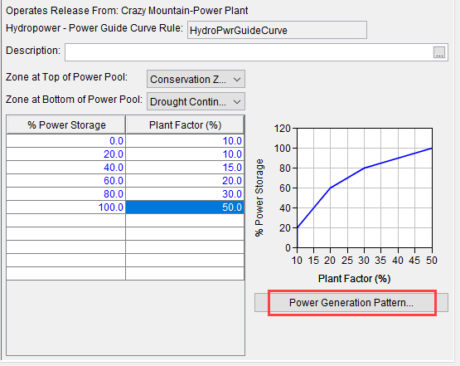
Power Guide Curve
Complete the table to define the rule
% Storage vs. % Plant Factor
Power Generation Pattern

Slide 16
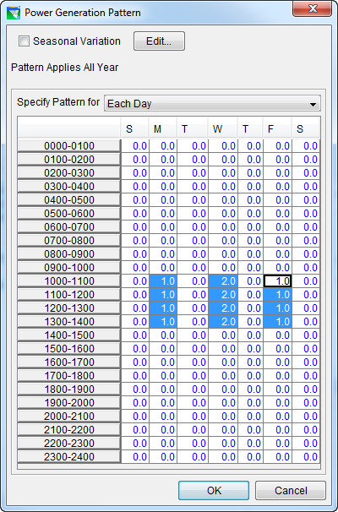
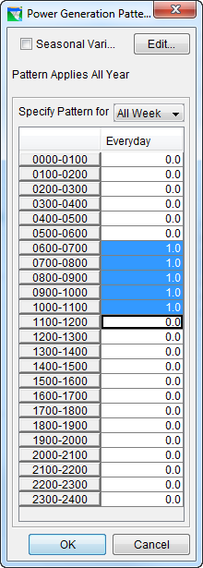
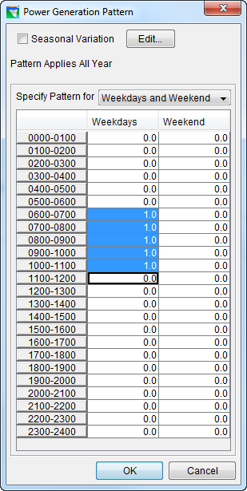
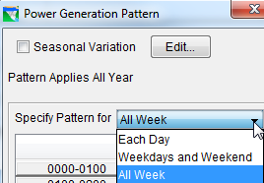
Power Generation Pattern
Pattern applies all year
  Weekly Pattern
  Seasonal Variation
Specify Pattern for:
  Each Day
  Weekdays & Weekends
  All Week

Slide 17
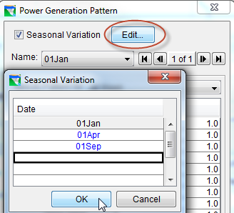
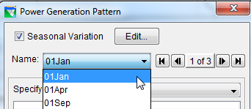
Power Generation Pattern
Seasonal Variation

Slide 18
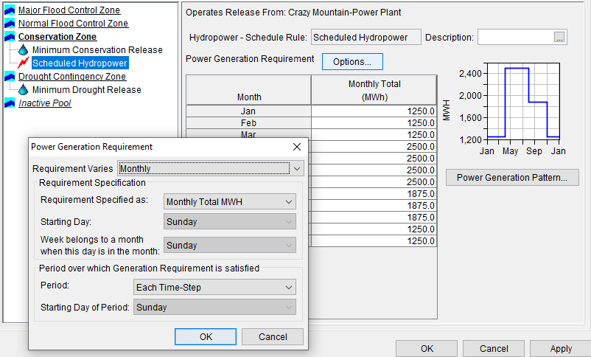
Hydropower-Schedule
Create the rule
Requirement varies
  Monthly
  Seasonally
Specified as:
  Plant Factor
  Daily MWH
  Weekly MWH
  Monthly MWH
Starting Day
Week belongs to a month when this day is in the month of
Period over which Generation Requirement is satisfied
Notes:
The Hydropower – Schedule rule allows you to define a regular monthly or user specified seasonally varying hydropower requirement. The various options on this rule editor allow you to define each month’s or season’s power generation requirement, the type of the requirement (megawatt-hours or plant factor), and the hours of the day and days of the week during which the plant can generate.

Slide 19
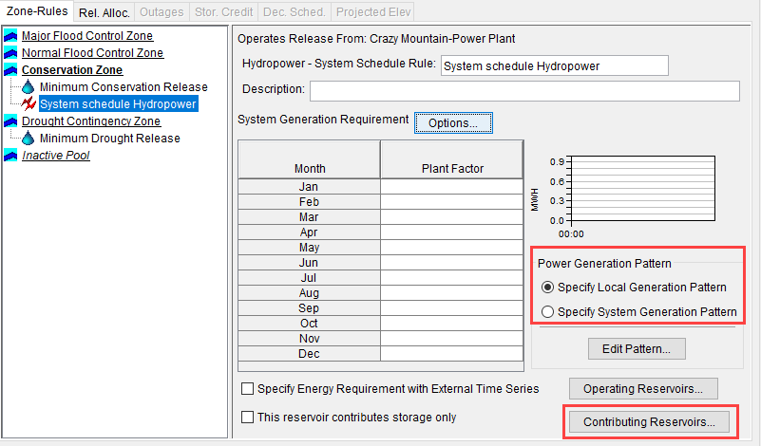
Hydropower-System Schedule
Notes:
The Hydropower – System Schedule rule allows you to specify a hydropower generation requirement that a set of reservoirs (a reservoir system) will operate to try to meet. This rule describes the hydropower generation requirement in the same manner as the Hydropower - Schedule rule (as described above). The System Schedule rule, however, has some additional options for specifying the power generation pattern and for identifying reservoirs whose power generation and/or storage can be used to meet the system requirement.

Slide 20
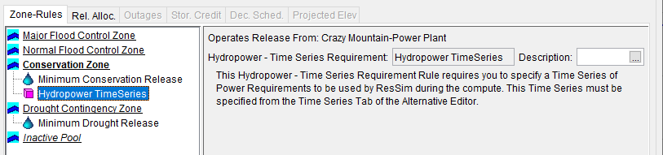
Hydropower-Time Series
Notes:
The Hydropower – Time Series Requirement rule allows you to define an irregular schedule of Hydropower requirements through the use of a DSS time-series record. Except for the Description, there are options or attributes to be selected or edited in this rule editor, not even a Power Generation pattern since the time series directly indicates the generation requirement for each timestep. Instead, a message is included in the editor to remind you that you will need to specify a time series of required power in units of megawatts when you setup an alternative that uses this operation set for this reservoir.

Slide 21
Release Allocation - What?
What is Release Allocation?
    Which outlets should release first, next, and so on
    Balanced approach
      Evenly weighted (e.g., 50:50 split (default))
      Unevenly weighted (e.g. 60:40 split)
    Sequential approach
Hydropower reservoirs often direct any release to the power plant first
Other outlets release water when the power plant reaches capacity
Release Allocation is an “operations” option
  Define the priority (or order) to the available outlets
Notes:
Release Allocation is the method ResSim uses to allocate the release from the reservoir to the available outlets. The capability of specifying which outlets should release first, next, and so on is available by using the Release Allocation option.

Slide 22
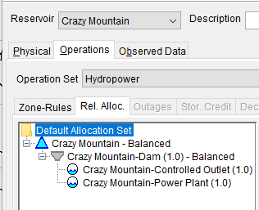
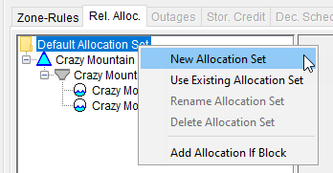
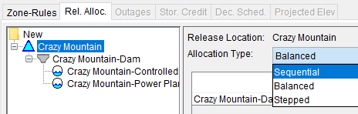
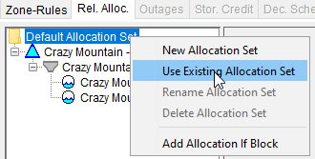
Release Allocation – How?
Default Allocation Set
New Allocation Set
  Specify Allocation Type
    Sequential
    Balanced
    Stepped
      Use Existing Allocation Set
Notes:
By default, HEC-ResSim uses an evenly balanced approach to share the unallocated release across the available outlets of a reservoir.
In many hydropower reservoirs, any release is usually directed to the power plant first (to achieve incidental power generation) and other outlets would be used only when the power plant has reached capacity. Therefore, methods for specifying the usage order of the different outlets and approach for distributing releases among them are available by using the Release Allocation option in the reservoir editor.
The three Allocation Types available are Balanced, Sequential, and Stepped and they can be applied to the different components in the reservoir hierarchy (e.g., the Reservoir, Dam(s), controlled outlet(s), diverted outlet(s), power plant(s), and pump(s)).
The Allocation Types are described as follows:
Balanced: When Reservoir’s Allocation Type is evenly Balanced, the total release from the reservoir is evenly weighted (i.e., 1:1 ratio) between the Dam (1.0) and the Power Plant (1.0). A Balanced allocation type can also be specified as being unevenly weighted (e.g., a release distribution of 60% through the Dam and 40% through the Power Plant) by entering the appropriate weights (0.60 and 0.40). The release allocation for the reservoir’s Dam outlets (Main Gates, Power Plant, and Pump) can be evenly balanced or unevenly balanced using weighting factors for a desired distribution.
Sequential: The available outlets can be given an order of priority, indicating which outlet gets the release until it reaches release capacity, then the next outlet gets the remainder of the release until it reaches capacity, and so on (e.g., Power Plant, then Main Gates, then …). To do this, highlight the appropriate component (e.g., the “Dam”) in the left panel of the editor. In the right panel of the editor, select Sequential from the Allocation Type list, then change the order of the outlets (select the outlet and use the arrows located on the right side of the editor to move the outlet up or down in the list). The outlet at the top of the list will be the first to release (up to its capacity), then the next outlet in the list will release (if needed, up to its capacity), and so forth. Figure 10.15 shows a Sequential release allocation for the two outlets of the Dam.
Stepped: The combination of Balanced and Sequential allocation types is available by selecting a Stepped Allocation Type. Stepped allocation allows for distribution of a reservoir release among multiple outlets with the portion of the release allocated to each outlet varying over a specified range of outlet capacities.

Slide 23
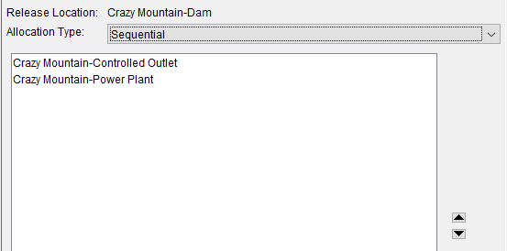
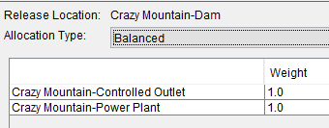
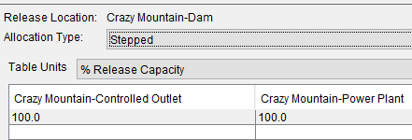
Release Allocation
Sequential
  Specify the component order
Balanced
  Specify the component weighting
Stepped
  Specify the release capacity balance

Slide 24
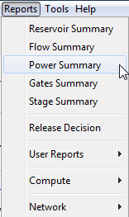
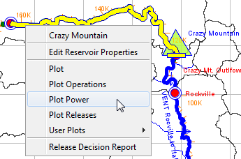
Power Output Options
Reports
  Power Summary
Plots Options
  Plot Power
  User Plots

Slide 25
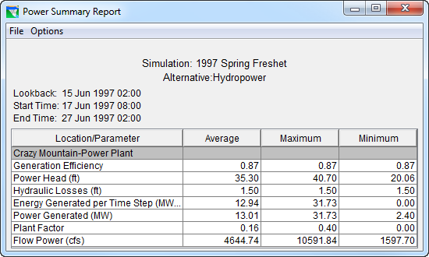
Power Summary Report
Notes:
The Power Summary Report displays Average, Maximum, and Minimum values for individual location parameters.

Slide 26
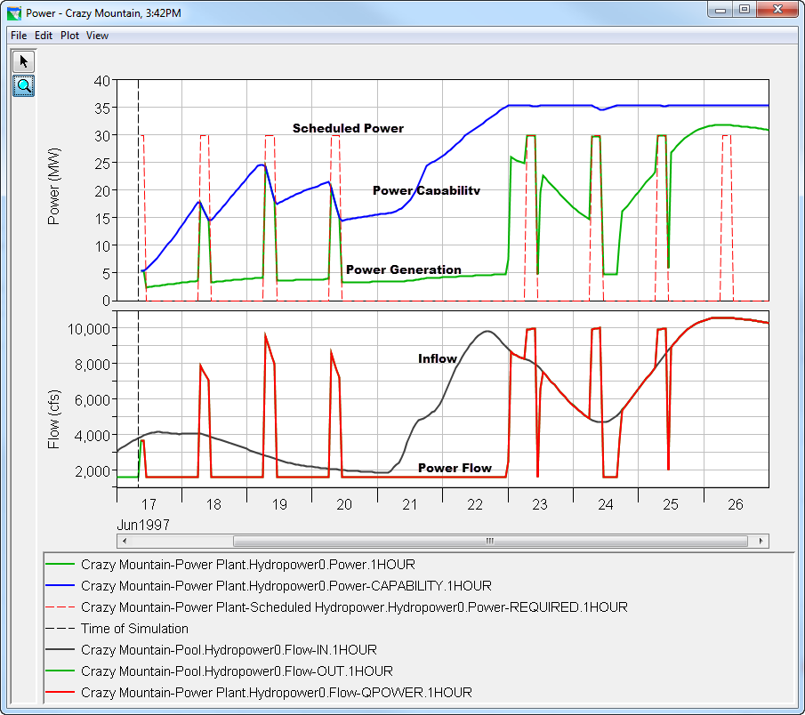
Power Plot

Slide 27
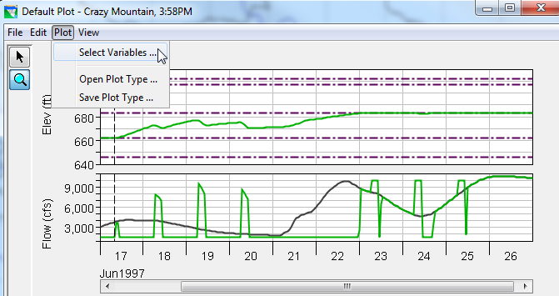
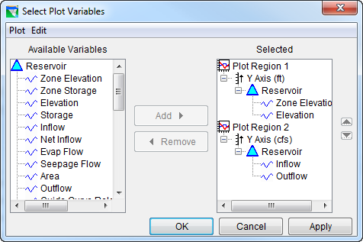
User Designed Plot Example
Bring up the default plot
Open the “Select Plot Variables” dialoge

Slide 28
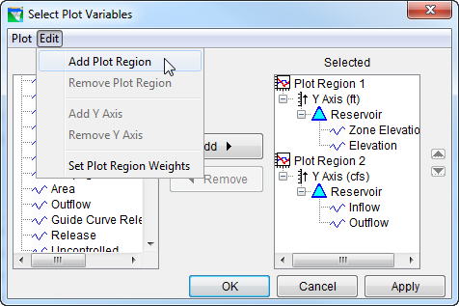
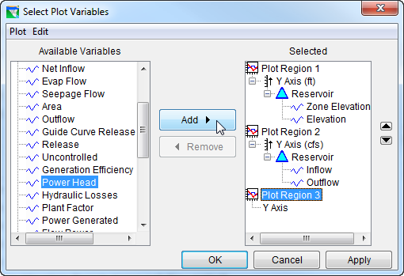
User Designed Plot Example

Slide 29
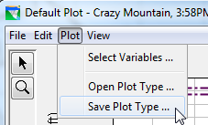
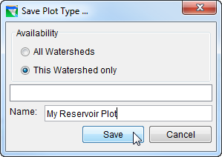
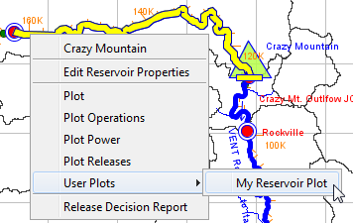
Save Custom Plots for reuse

Slide 30
Summary
In the Reservoir Editor, Physical Tab…
  Add Power Plant
  Define Power Plant Parameters
  Add Tailwater
In the Reservoir Editor, Operations Tab…
  Add Hydropower Rule to an Operating Zone
  Specify Hydropower Requirements
  Specify Release Allocation Type
Analyze results with plots and reports

