Slide 1
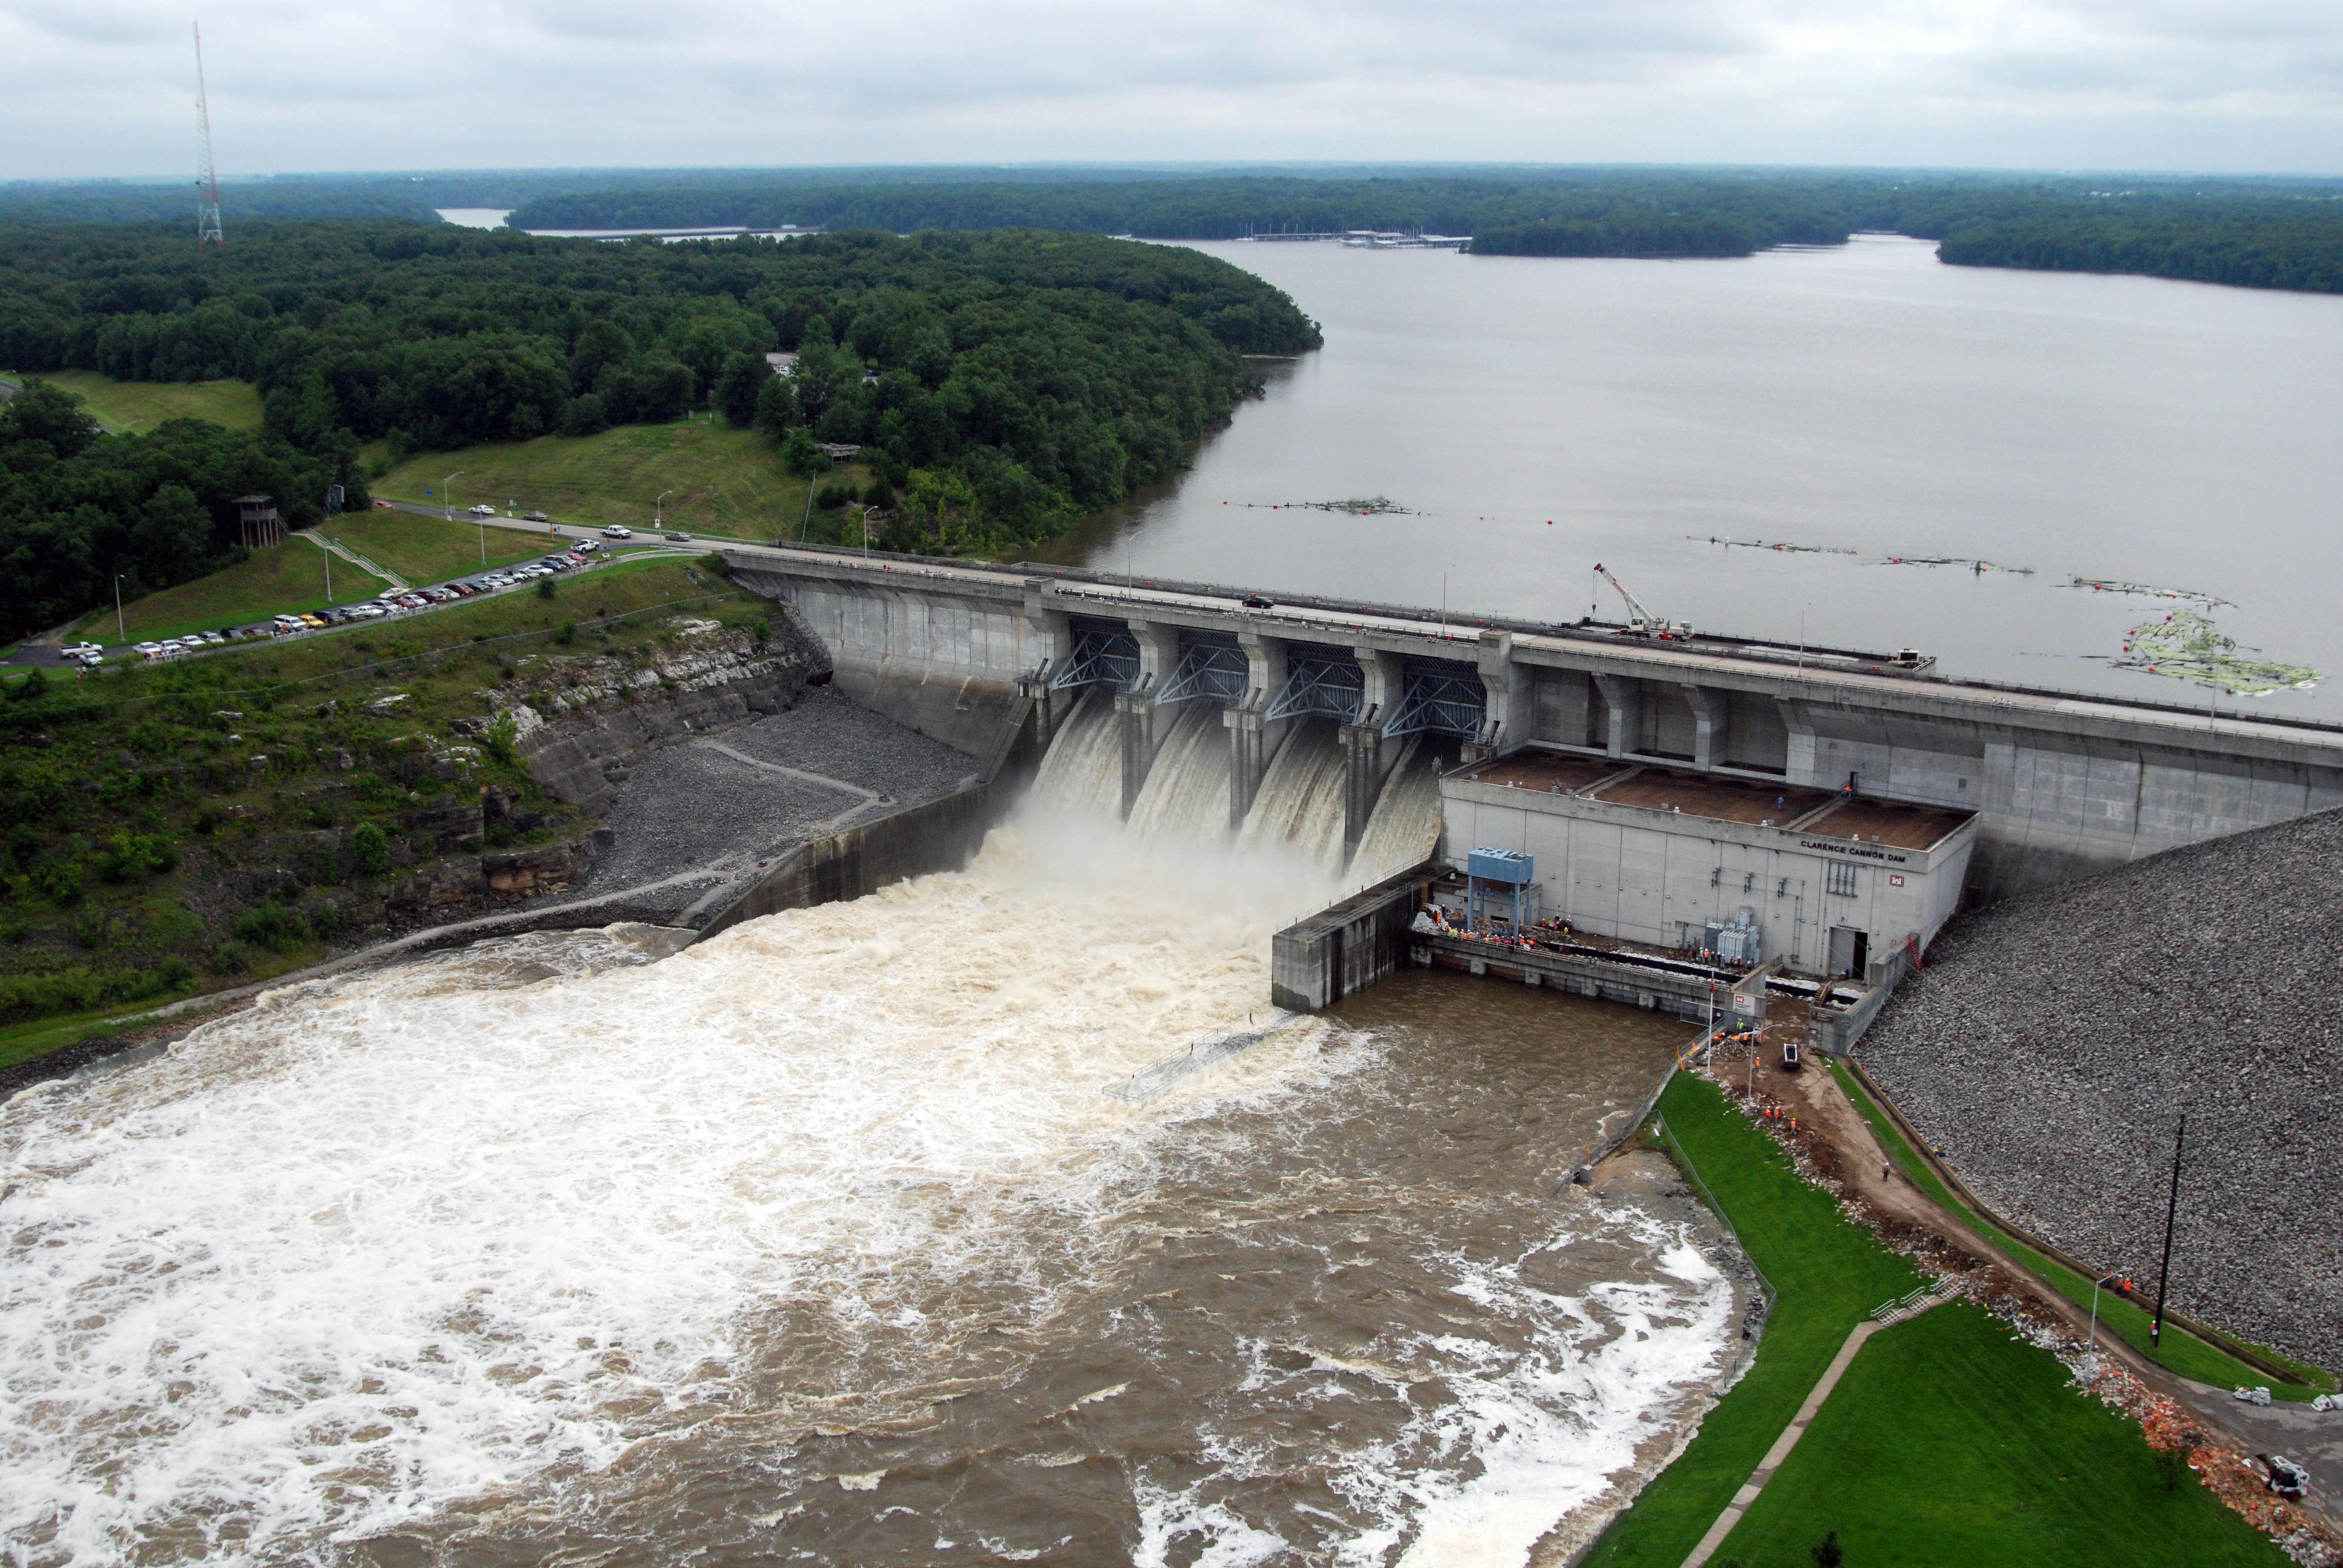
Simulating Reservoir Systems
Reservoir System Analysis with HEC-ResSim

Slide 2
Objectives
To know the basic principles for simulating reservoir operation:
  Operational goals by purpose
  Reservoir system data requirements
      Physical data
      Operational data
      Flow data
  Simulation considerations

Slide 3
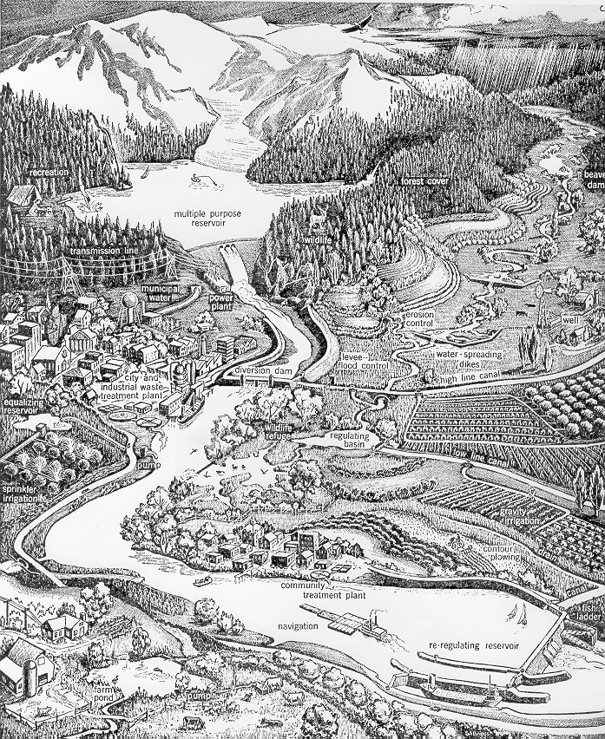
What you need to know…
System Extent
Authorized Purposes
Study Objectives
Data Resources
Operational Goals & Constraints
Evaluation Criteria
Appropriate Modeling Software

Slide 4
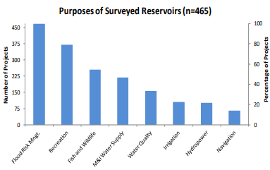
Authorized Purposes from: “Authorized and Operating Purposes of Corps of Engineers Reservoirs”, (USACE, 1992)
Flood Risk Management (a.k.a. Flood Control)
Navigation
Hydropower
Irrigation
M&I Water Supply
Water Quality
Fish & Wildlife (incl spawning, fisheries habitat, and wildlife preservation)
Recreation
Notes:
Figure taken from presentation titled “Status and Challenges for USACE Reservoirs” by Jeannette M. Baker, 23May2019 to the Western States Water Council. Information was derived from the National Portfolio Assessment for Water Supply Reallocations (2016-Res-01).
Flood Control Operation is often in conflict to all other purposes. Flood Control is represented by “Available Space” in the pool
All other project purposes fall under the category of Conservation Operation. Conservation is represented by “Available Storage or Water” in the pool.

Slide 5
Authorized Purposes → Operational Goals
Authorized Purpose | Operational Goal
Flood Risk Management | Reduce or minimize damages
Navigation | Maintain draft depth
Hydropower | Meet load, no spill
Irrigation | Meet seasonal diversion demands
Water Supply (M&I) | Meet withdrawal demands
Water Quality | Meet specified requirements
Fish & Wildlife | Meet pool fluctuation requirements for habitat; meet flow & temperature in channel. Often varies seasonally
Recreation | Maintain pool during recreation season

Slide 6
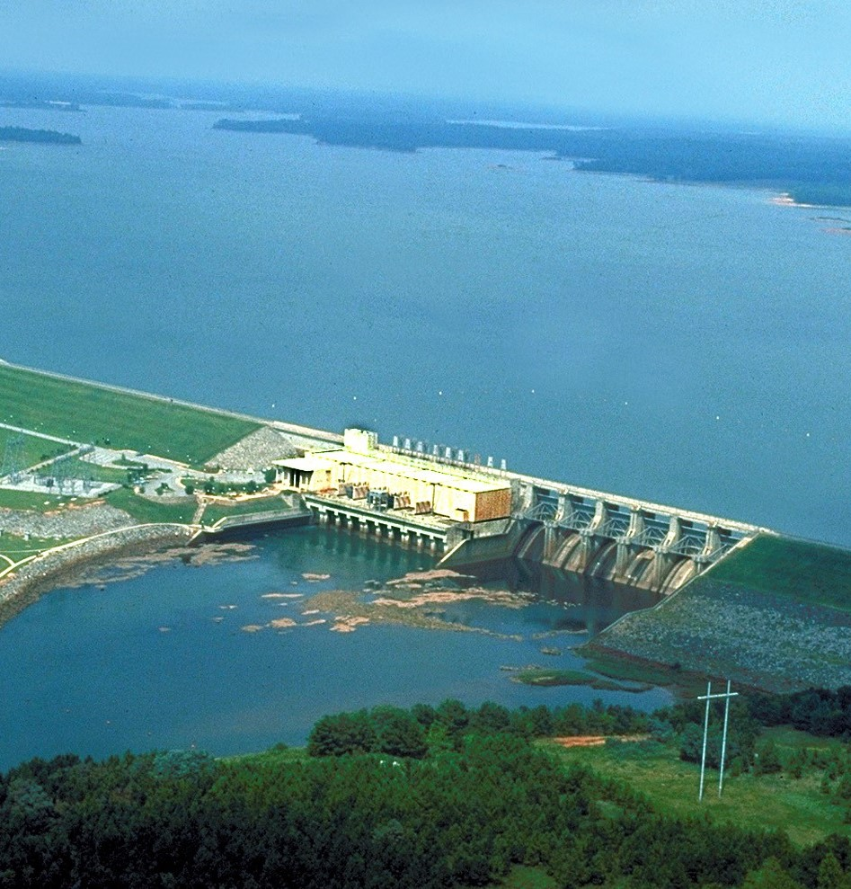
Basic Operating Questions from “Economics of Water Resources Planning” by James and Lee
Store or pass inflow?
Store water for Conservation or empty space for Flood Control
  Maintain Pool, fill, or draw down?
  Release water from storage or save?
Release through which outlet(s)?
  Release from what level in the reservoir?
Release from which reservoir?
Notes:
Figure taken from presentation titled “Status and Challenges for USACE Reservoirs” by Jeannette M. Baker, 23May2019 to the Western States Water Council. Information was derived from the National Portfolio Assessment for Water Supply Reallocations (2016-Res-01).
Flood Control Operation is often in conflict to all other purposes. Flood Control is represented by “Available Space” in the pool
All other project purposes fall under the category of Conservation Operation. Conservation is represented by “Available Storage or Water” in the pool.

Slide 7
Basic Principles for Flood Risk Management Operation
“The objective of regulation for flood control is to reduce flood damages to the extent possible with available facilities.” (EM 1110-2-3600)
The constraints:
  Do not endanger the dam
  Evacuate flood storage as quickly and safely as possible
  Do not unnecessarily store water in the flood control pool
Bottom line: Never make the downstream flooding worse than it would have been without the project!
Notes:
Flood Control -> Flood Damage Reduction -> Flood Risk Reduction - >Flood Risk Management

Slide 8
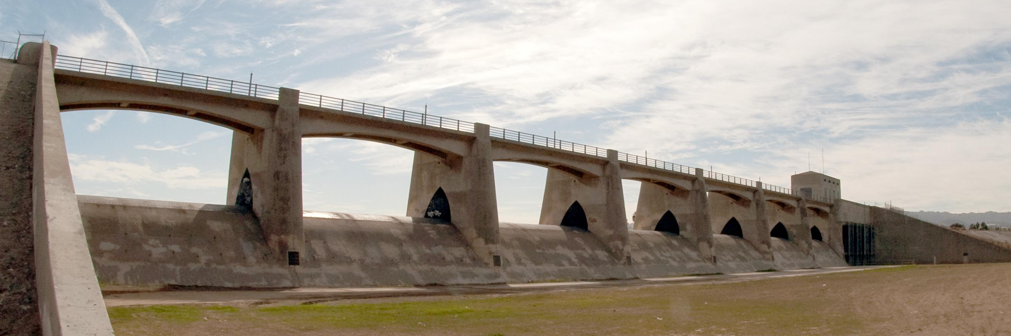
Basic Principles for Conservation Operation
Store (conserve) water when inflows exceed demand
Release water from storage when inflows don’t meet demand
Demand is a function of the non-flood control purposes of the reservoir
Demand varies with time and season
Demand varies with purpose and priority
Notes:
Demand is how much water is needed to be “released” from the reservoir, whether that be:
released into the channel or
withdrawn from the pool.
Demand can be specified in units of
flow
power or energy
target pool elevation
rate of change limits on flow or elevation

Slide 9
Operating Conflicts
Flood Control vs. Conservation
  Save Space for future flood or save water for future demand
Hydropower vs. Environmental vs. Recreation vs. Water Supply
  Pulse flows to meet peak demands vs steady flows to support spawning or habitat
  Steady flows to meet base load vs naturally varying flows to encourage wetland development and ecosystem maintenance
  Physical impacts on fish passing through turbines
  Selective Withdrawal for Temperature and other WQ objectives in pool and river.
  Flow Augmentation to meet irrigation and M&I withdrawals while maintaining minimum channel flow

Slide 10
Modeling, Simulation, and Analysis Process
Define study objectives and evaluation criteria (metrics)
Develop data sets
  Physical, operational, inflows
Validate data & operations
  Check flow continuity through the system
  Compare simulation to historic data
Perform simulation with specified demands and constraints
Evaluate output & performance
Compare output with evaluation criteria

Slide 11
Physical Data Requirements
Watershed Schematic
  River Network
  Project locations and extents
  Gage locations & control points
Reservoirs
  Pool Elevation-Storage-Area relationship
  Dam and Spillway specifications
  Outlet Ratings
  Losses
Diversions
  Capacity
  Losses or Returns
Junctions
  Inflow locations
  Gage ratings
Reaches
  Routing method & parameters
  Losses

Slide 12
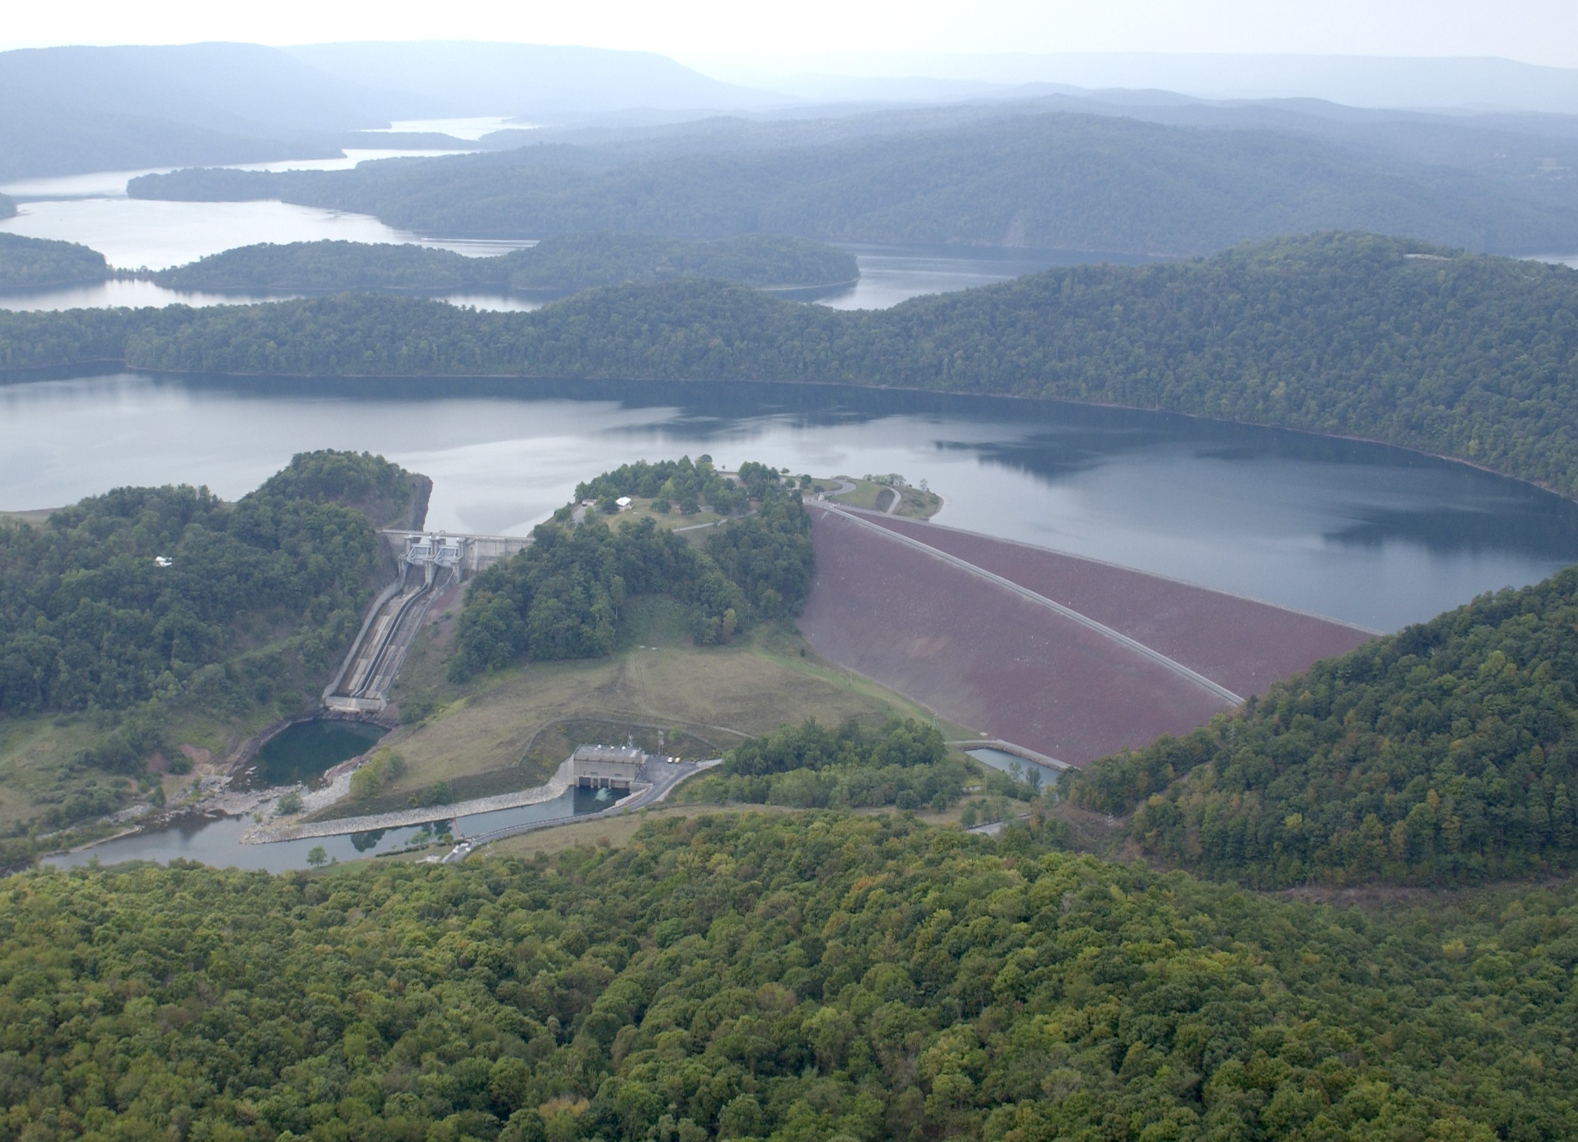
Operational Data Requirements
Instream flow requirements
Channel Capacities – non-damaging channel flows
  NWS Flood Stages or Flows
    Warning
    Flood
    Major Flood
Minimum Navigation Draft Depth
Hydropower Demand Schedule
Diversion Demands & Schedules
Ecosystem Requirements and Constraints
Rate of Change Constraints
Notes:
Rule Priorities or Relative Priority of Authorized Purposes?
What else are we missing?
Drought operations
Recreation
?
We’ll cover operations data and operating rules in a future lecture and workshop

Slide 13
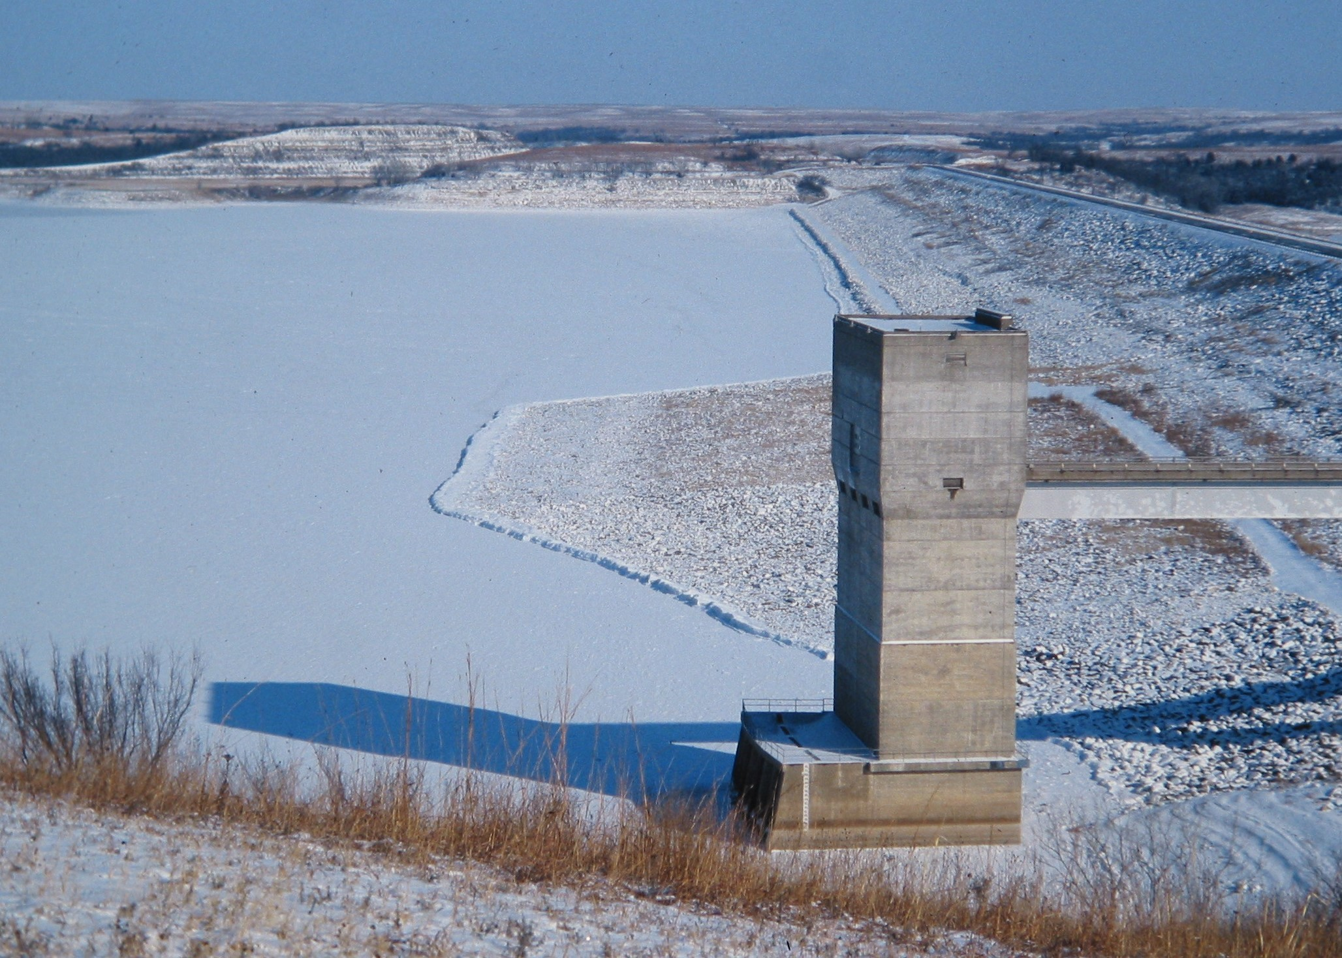
Reservoir Storage Allocation
Operation Zones or Levels
  Flood Control
  Conservation
  Inactive
Additional Zones for:
  Emergency Operation
  Drought Conditions
  Hydropower
  Recreation
  Other?

Slide 14
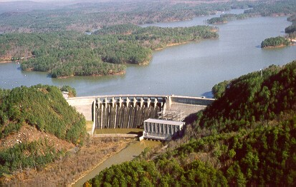
Flow Data Considerations
Select Appropriate Time Interval
  Short – e.g. 15min, 1 hour
  Longer – e.g. 6 hour, 1day
Determine Simulation Length
  Event(s)
  Critical Period
  Period of Record
Identify Required Flow Data
  Historic (gaged) events and period of record
  Synthetic Events – design floods and frequency events
  Stochastic extension of existing flow record
  Headwater/Reservoir Inflows and Incremental Local

Slide 15
Data Gathering Considerations and Limitations
Outdated Records and Information
Missing Information
Use of data from other models
  (e.g., HEC-5, HEC-1, HEC-HMS, HEC-RAS)
  Introduction of modeling “errors” and assumptions
Operations Data
  By-the-Book vs. Actual field process
  Gaged Outflows vs Logged gate settings

Slide 16
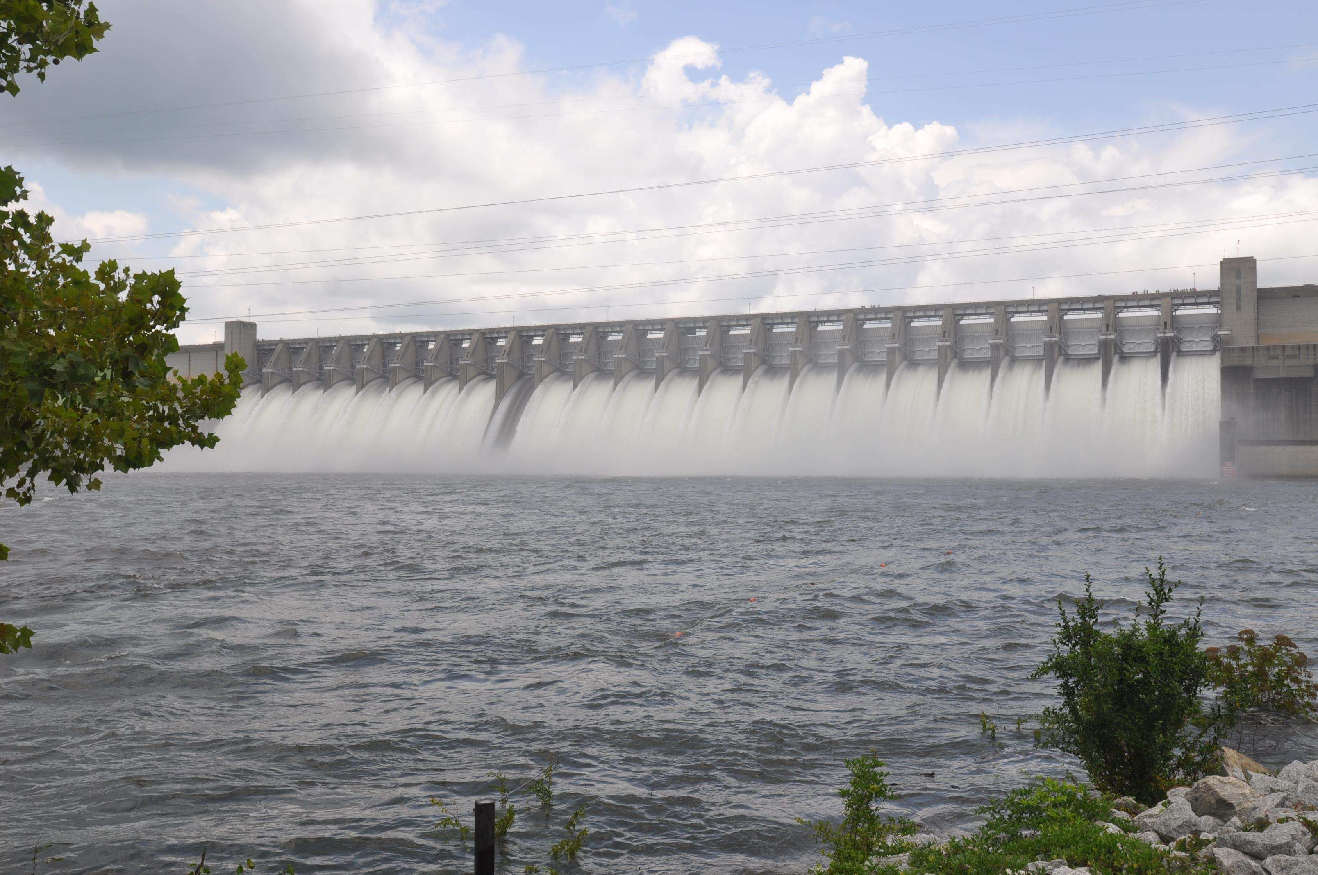
Simulating Reservoirs
Combine Physical,
Operational, &
Flow Data
Set Initial Conditions
Set the Time Window
Compute…
Notes:
Create Alternatives – That’s the combining of Physical, Operational, and Flow Data… plus Initial Conditions
Initial Conditions – Pool Elevation, Releases,
are we forgetting anything?
Create a Simulation – that’s where you define the time window… And Compute.
We’ll talk about Alternatives and Simulations and your options for analyzing the results this afternoon.

Slide 17
Reservoir Release Considerations
Current Conditions
  How does the Pool Elevation compare to the target pool?
  What are the Limits on the release?
    Operational
    Physical
Downstream Conditions – at one or more control points
  Uncontrolled Local Inflow
  Routed Releases (previous, current, future)
  Channel Capacity
Notes:
Downstream Conditions
Demand at the Control Points
Channel Capacity at the control points – warning stage, flood stage, major flood stage
Competing priorities
Uncontrolled Local Inflow – below the reservoirs, inside or reaching the channel, diversion potential
The translation of the release Hydrograph – routing effect – timing and attenuation. Includes previous release, current release, potential future releases
What are we forgetting?
Other reservoirs in the system?

Slide 18
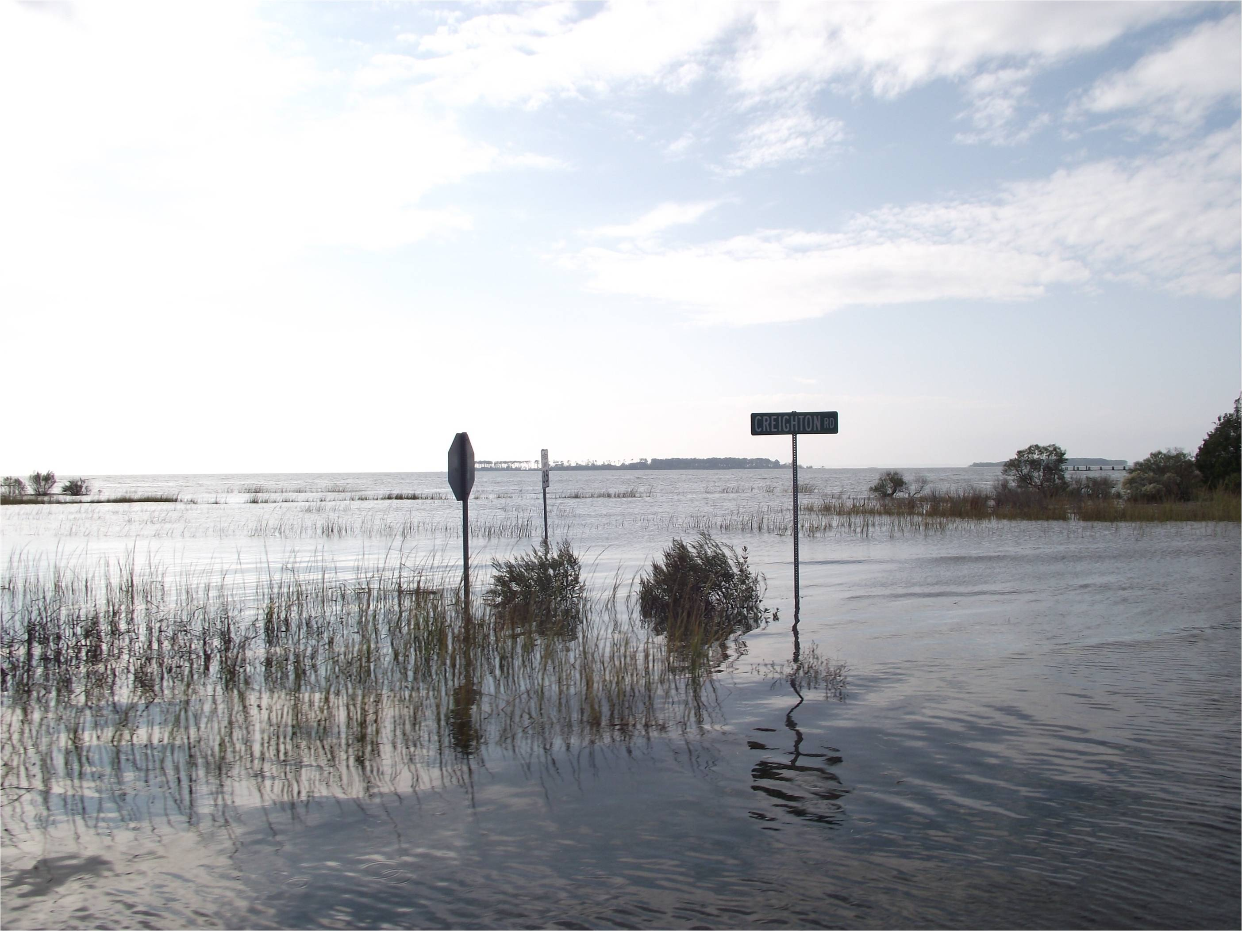
Completed Simulation
Review Results
  Plots, Reports, DSS, Post Processing
Verify Operations
  Release Decision Report
  Compare to Observed
  Is the model performing as intended?
Evaluate Metrics
  Up and Downstream impacts
  Storage Utilization
  In-channel impacts
Develop Alternatives
  Simulate
  Verify
  Evaluate
Notes:
Evaluate Metrics
Performance Criteria….
Flood Damages
Upstream flooding - pool backwater
How ‘bout minimum objectives?
Risk of exceeding key pool levels?
In-channel – flow velocities, depths, duration
What about diversion demands? Shortages?

Slide 19
Other Considerations
Emergency Gate Operations – Save the Dam
  Induced Surcharge Routing
  Spillway Adequacy
Future Downstream Capacity
  Floodplain development
  Impacts on channel due to regulation
Preserving Storage Capacity and Utilization of Pool
  Shoreline development
  Sediment accumulation
Conservation Operation Issues
  Evaporation, Seepage, Channel Losses
  Increased Withdrawals
  Storage Reallocation
Notes:
Evaluate Metrics
Performance Criteria….
Flood Damages
Upstream flooding - pool backwater
How ‘bout minimum objectives?
Risk of exceeding key pool levels?
In-channel – flow velocities, depths, duration
What about diversion demands? Shortages?

Slide 20
Questions?

Slide 21
References
Economics of Water Resources Planning
L. D. James & R. R. Lee, McGraw-Hill, 1971
Management of Water Control Systems
EM 1110-2-3600, 1987
Digest of Water Resources Policies and Authorities
USACE, 1989, EP 1165-2-1
A Preliminary Assessment of Corps of Engineers’ Reservoirs, Their Purposes and Susceptibility to Drought
HEC RD #33, 1990
Authorized and Operating Purposes of Corps of Engineers Reservoirs
USACE, 1992
Flood-Runoff Analysis
EM 1110-2-1417, 1994
Hydrologic Engineering Requirements for Reservoirs,
EM 1110-2-1420, 1997
Management of Water Control Systems,
EM 1110-2-3600, 2017

