Slide 1
Alternatives and Simulations
HEC-ResSim 3.5

Slide 2
Overview & Objectives
HEC-ResSim Modules
What are Alternatives?
  How to create one…
What is a Simulation?
  How to create one and what to do with it…
Watershed Setup
Network Module
Simulation Module
Alternative

Slide 3
What is a ResSim Alternative?
An HEC-ResSim Alternative is a specific selection of:
  A Reservoir Network
    Model schematic with physical properties plus operating plan(s)
  The Computation Type and Interval (timestep)
  The Active Operation Set for each Reservoir
  The Initial Conditions for each Reservoir
  The Inflows and other required Time Series Inputs
Alternative 1
Inflow
Diversion
Reservoir
Routing
Reservoir Data
Physical Definition
Initial Storage
Initial Release
Operating Rules
Diversion Data
Initial Diversion
Diversion Schedule
Routing Method
Inflow
Alternative 2
Res. 1
Res. 2
Routing
Res. 1 Data
Physical
Initial State
Op. Rules
Res. 2 Data
Physical
Initial State
Op. Rules
Local Inflow

Slide 4
Composing an Alternative
CONFIGURATION
NETWORK
OPERATION SET
LOOKBACK
INPUT TIME SERIES
ALT 1
Std. Ops
Normal Pool
100-yr
One Reservoir
One Reservoir
Planning Ops
Encr. Pool
ALT 2
500-yr
Normal Pool
ALT 3
Std. Ops
100-yr
Two Reservoirs
Two Reservoirs
Planning Ops
Encr. Pool
ALT 4
500-yr
Notes:
Each alternative represents the combination of a reservoir network, a selection of one operation set per reservoir, the specification of the initial conditions of each reservoir, and the selection of inflows and other input time-series datasets needed by your model.

Slide 5
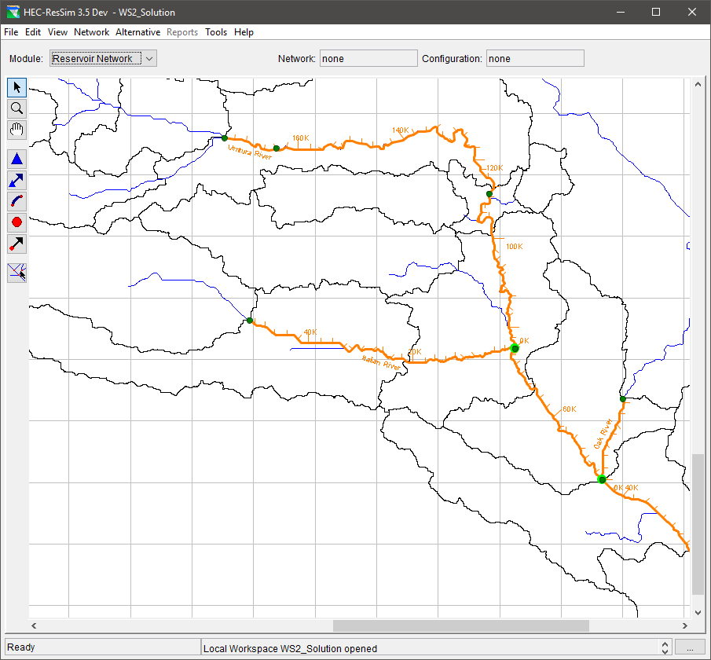
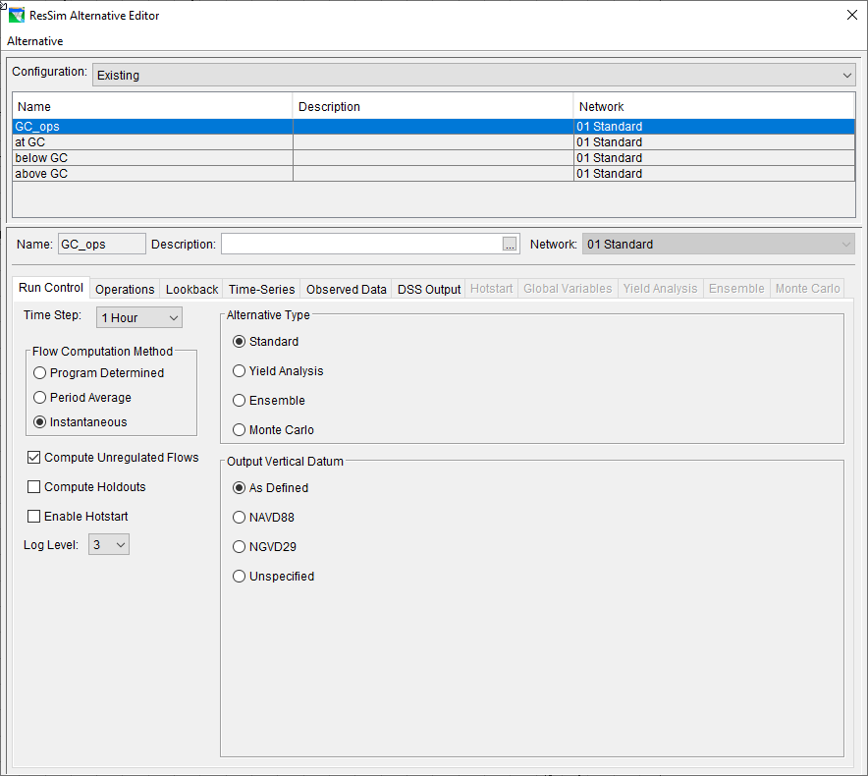
The Alternative Editor
Required Specifications
  Network
    Based on a Configuration
  Run Control
  Operations
  Lookback
  Time-Series
Optional
  Observed Data
  DSS Output
  Hotstart
  Global Variables
  Yield Analysis
  Ensemble
  Monte Carlo
Tabs
Notes:
An Alternative consists of a Reservoir Network, Run Control specifications, an Operation Set for each Reservoir in the network, a definition of initial (Lookback) conditions, and a mapping of all Time-Series records to identified local inflows.

Slide 6
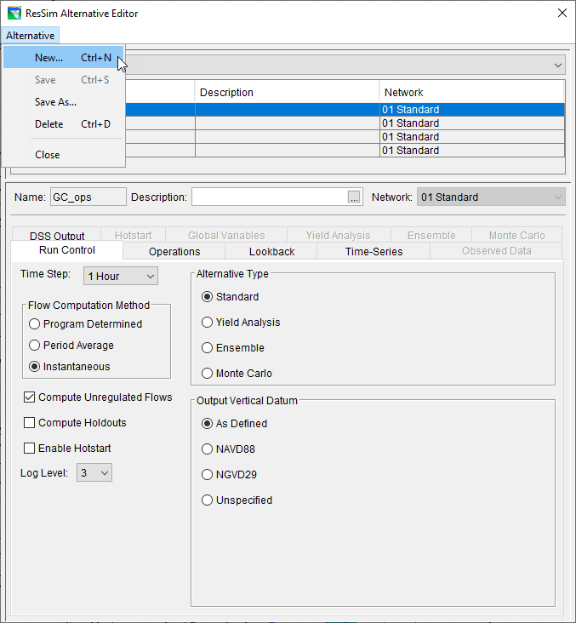
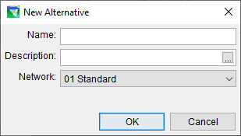
Creating an Alternative…
Create New Alternative
  Name the Alternative
  Add a Description
  Select a Network
    NOTE: Once you press OK here, you cannot change the network selection.
Notes:
The first step in creating an Alternative is to give it a Name and Description, and then select the reservoir Network you want to use.
From the Alternative menu of the Alternative Editor, select New. The New Alternative dialog will open
Enter a Name and Description
Select a Network by choosing from the list of available networks.
Click OK to close the New Alternative dialog. The name and description you entered will now appear in the Name and Description fields of the Alternative Editor

Slide 7
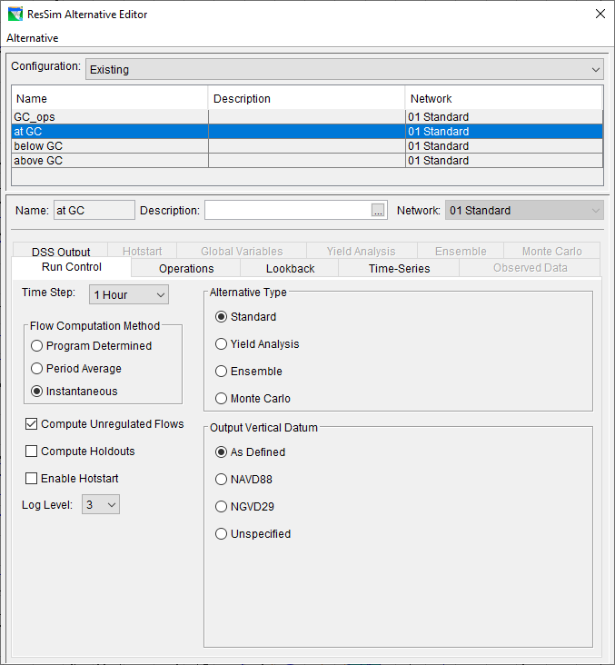
Setting Up an Alternative…
Run Control
Run Control Tab
  Time Step
  Flow Computation Method
  Compute Unregulated Flows
  Compute Holdouts
  Log Level
Notes:
Program Determined—determined by ResSim from reviewing time intervals of the input time series data.
Period Average—typically used when the time interval of the input time series data is daily or longer.
Instantaneous—typically used for short-interval data (e.g., hourly) that is less than a daily time interval.
Compute Unregulated Flows—ResSim performs additional calculations to determine the unregulated conditions in the watershed (i.e., without the regulation of reservoir and diversion projects).
Compute Holdouts—ResSim calculates the amount of water the reservoir stores (as opposed to just releasing inflow). Holdouts indicate the effects of reservoir regulation and are most applicable when you will be performing a subsequent Flood Impact or Flood Damage analysis.
Hotstart-Typically, the Lookback period is used for warming-up the state of the watershed. However, instead of using the Lookback period and associated data for determining the system state, you can save (and subsequently use) the data from one simulation to another simulation by using the Hotstart options. In other words, you can use the Hotstart as a way of assigning a previously simulated watershed state to another simulation.
Log Level—(1-10) controls the number of detailed messages that will be displayed during the computations. A log level of 10 will provide the highest level of detailed messages.

Slide 8
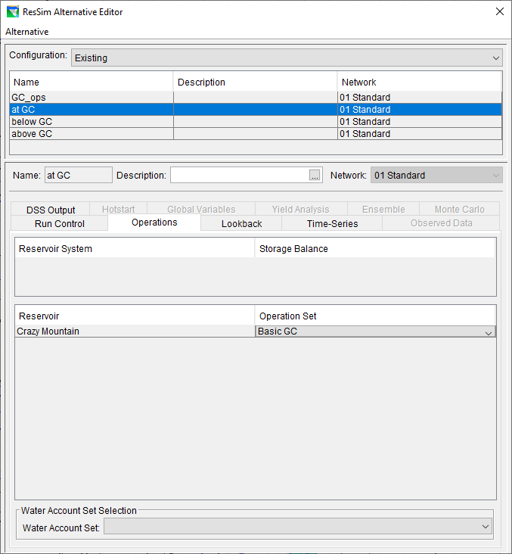
Setting Up an Alternative…
Operations
Operations Tab
  Select an operation set for each reservoir
List of Reservoir Systems
and Associated Storage Balance Operation Sets
List of Reservoirs
and Associated Operation Sets

Slide 9
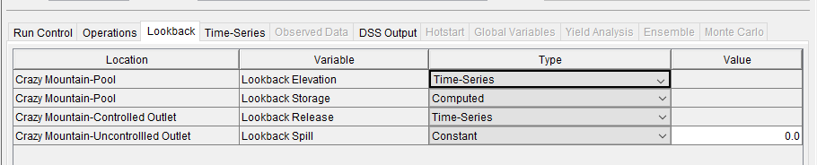
Setting Up an Alternative…
Initial Conditions
Lookback Tab
  Lookback Variables
    Pool Elevation
    Pool Storage
    Outlet Releases
    Diversion Flow
    State Variables
  Lookback Types
Notes:
After specifying the operation set for each of your reservoirs, you will need to specify the initial (or starting) conditions for the alternative. This is referred to in ResSim as the Lookback (or warmup) period. You will need to specify what type of data will define each element and parameter during the Lookback period.
For each location (Reservoir) depending on the parameter (Pool, Controlled Outlet, Uncontrolled Outlet), in the Type column there are different options available from the dropdown list to define the lookback.

Slide 10
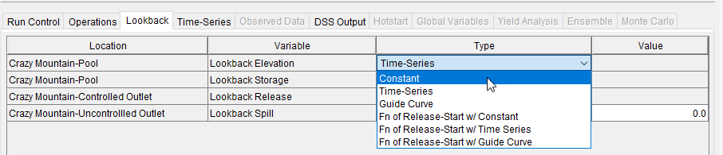
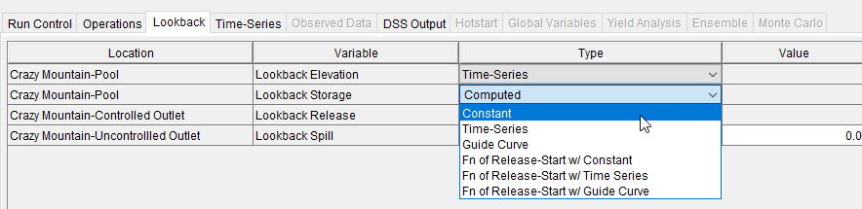
Lookback-Pool
Pool (Elevation and Storage)
*When a lookback option for one of these parameters (elevation or storage) is defined the lookback option for the other one is set to computed automatically.
Notes:
Pool
For the Pool parameter lookback elevation and lookback storage should be defined. Lookback options for these parameters are the same
When a lookback option for one of these parameters is defined (elevation or storage) the lookback option for the other one is set to computed automatically to compute the values for storage based on elevation if lookback elevation is defined by the user or to compute the values of elevation based on storage if lookback storage is defined by the user.
There are six options available to define the lookback elevation or storage for Pool:
Constant
When you have selected Constant as the lookback type, the value of the lookback is set to the constant value for the lookback time that is set in the simulation time window. Enter the value for the constant in the Value field.
Time-Series
When you have selected Time-Series as the lookback type, map the timeseries for the associated lookback variable under Time-Series tab. The value of the lookback is selected from the mapped timeseries for any lookback time that is set in the simulation time window.
Guide Curve
When you have selected Guide Curve as the lookback type, the value of the lookback is selected from the defined guide curve for any lookback time that is set in the simulation time window.
Fn of Release-Start W/ Constant
When you have selected Fn of Release-Start W/ Constant as the lookback type, the first value of the lookback time window is set to constant and the rest is calculated based on the mass balance of net inflow and total release.
Fn of Release- Start W/ Time Series
When you have selected Fn of Release- Start W/ Time Series as the lookback type, the first value of the lookback time window is selected from the mapped timeseries and the rest is calculated based on the mass balance of net inflow and total release.
Fn of Release- Start W/ Guide Curve
When you have selected Fn of Release- Start W/ Guide Curve as the lookback type, the first value of the lookback time window is selected from the defined guide curve and the rest is calculated based on the mass balance of net inflow and total release.

Slide 11
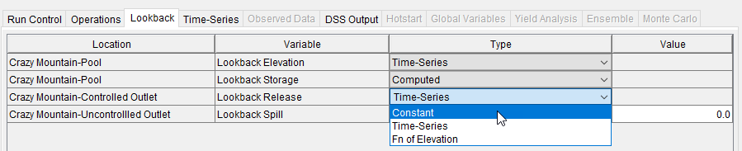
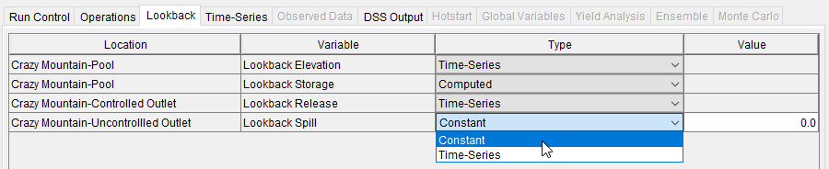
Lookback- Outlets
Controlled Outlet
Uncontrolled Outlet
Notes:
Controlled Outlet
There are three options available to define the lookback release for controlled outlet:
Constant and Time-Series options are the same as what described for the pool.
When you have selected Fn of Elevation as the lookback type, the lookback reservoir elevation (or storage) along with the known inflows are used to calculate the total lookback release for each timestep of the lookback period. The calculated release is applied to this outlet only. The lookback releasee for all other outlets will be set to constant zero.
Uncontrolled Outlet
There are two options available to define the lookback spill for uncontrolled outlet.
Constant and Time-Series options are the same as what described for the pool.

Slide 12
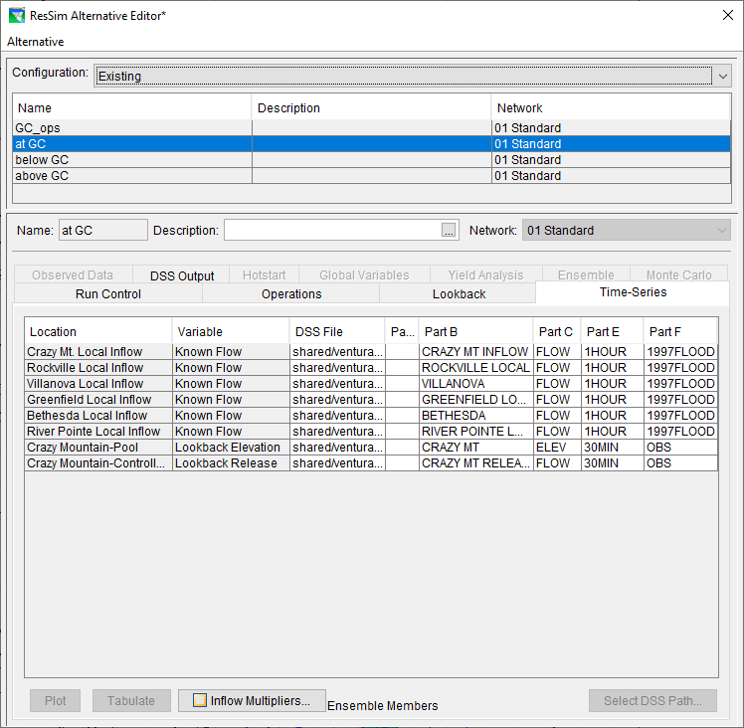
Setting Up an Alternative…
Inflows & Other Time-Series
Time-Series Tab
  Time Series Variables include:
      Inflow (Known Flow)
      Evaporation Rate
      Zone Elevation
      Lookback Elevation & Release
      External Data for a Rule or Diversion
  The DSS Path Selector is used to map (associate) HEC-DSS time series records to each entry in the table.
  Inflow Multipliers
  Plot and Tabulate
Notes:
Each row in the Time-Series table is a local flow location (specified in the Local Flow tab within the Junction editor in the Reservoir Network module), an element/parameter you have defined on the Lookback tab as Time Series, or a Time Series that is referenced in the Operation rules. Select each row, one at a time, and click Select DSS Path to access the Select Pathname dialog

Slide 13
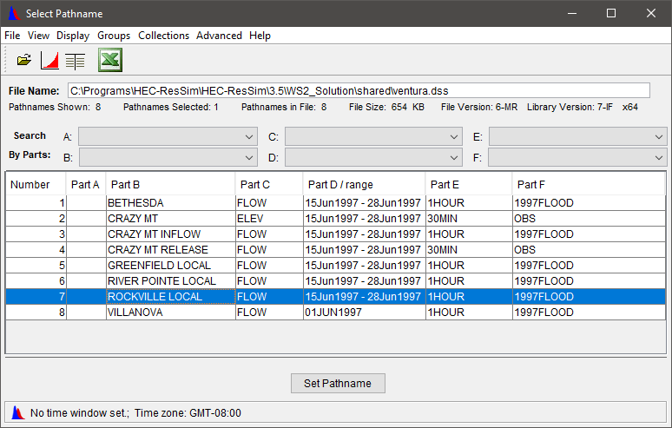
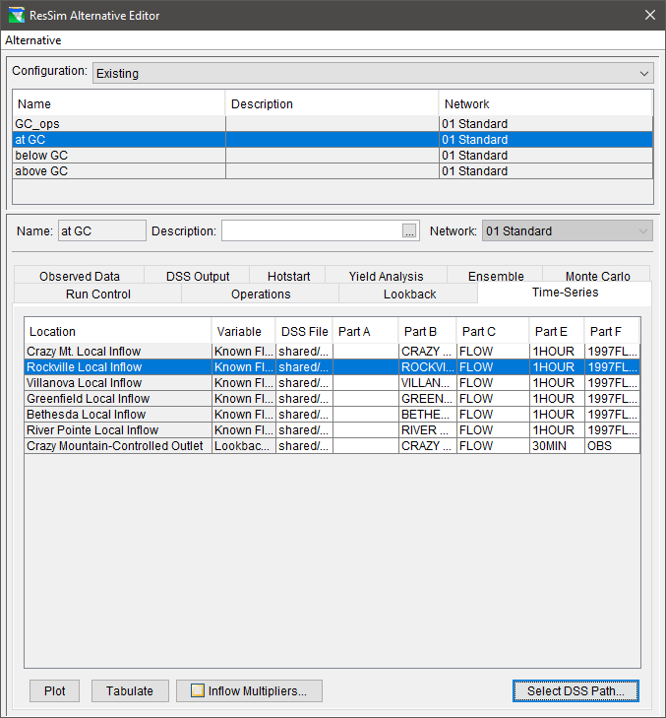
Setting Up an Alternative… The DSS Path Selector
To enter a pathname into a row on the Time Series Tab:
Select the row you want to fill in
From the DSS Path Selector…
  Highlight a record and Double Click
  or
  Highlight a record and Click Set Pathname

Slide 14
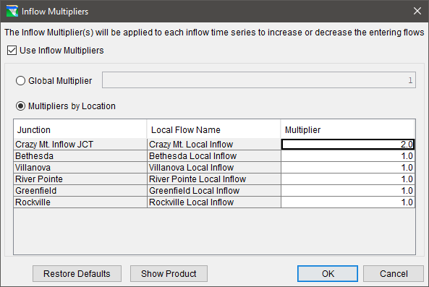
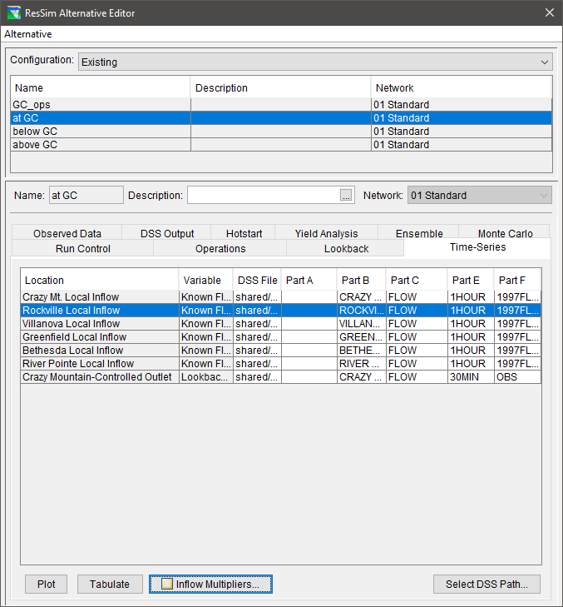
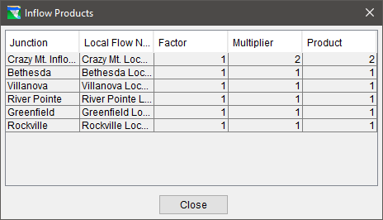
Setting Up an Alternative… Inflow Multipliers

Slide 15
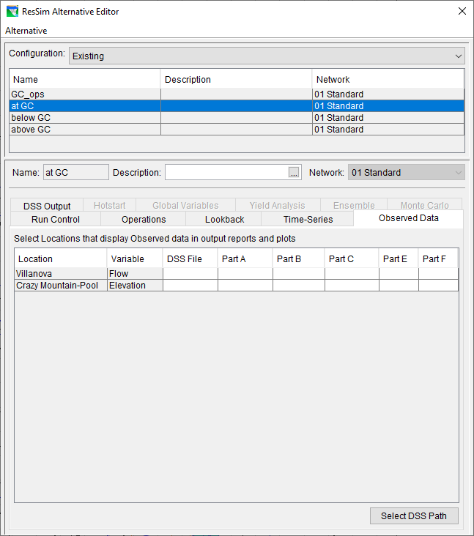
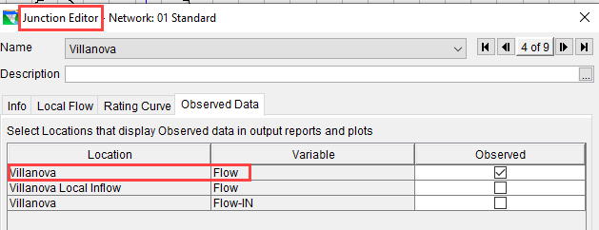
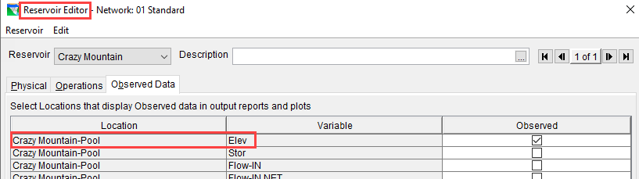
Setting Up an Alternative…
Observed Data
Observed Data Tab
  The Observed Data tab is similar to the Time-Series Tab, however…
  The Locations and Variables are identified in the Network element editors (reservoir, junction, etc).
  Specification of observed data is optional.
Notes:
While defining your reservoir network, if you have specified (by checking the appropriate box or boxes in the Observed tab within each element’s editor in the Network module) that observed data is available for individual reservoirs, junctions, reaches, diversions, and diverted outlets, then the Observed Data tab of the Alternative Editor will list these locations in a table along with the DSS path information associated with them

Slide 16
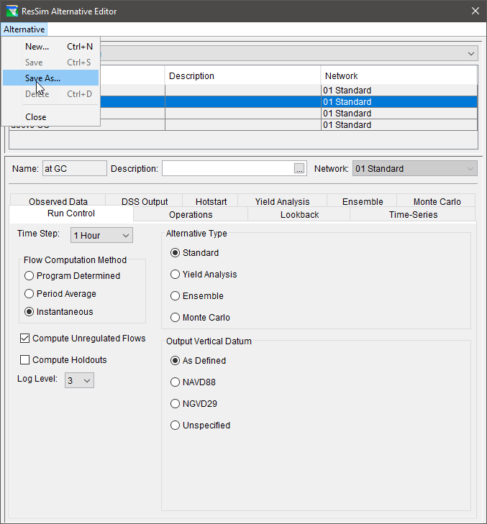
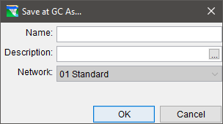
Managing Alternatives
Alternative Menu
  New
  Save
  Save As
    This option will create a COPY of the currently selected alternative.
    The Network selection cannot be changed, but everything else can…
  Delete
  Close

Slide 17
What is a ResSim Simulation?
An HEC-ResSim Simulation is a “workspace” in which you can compute alternatives, analyze results, and refine your model.
  A simulation is defined by the specification of a Time Window and a selection of alternatives.
  The default Name of a simulation is formed from the start time of the specified time window. HOWEVER, a more descriptive name can and should be entered to replace the default.
  A sub-directory or folder is created to hold the simulation’s files. It has the same structure as the watershed and includes copies of all the files that define the alternatives.
Notes:
A Simulation is where you specify the time window and time interval parameters for either a single Alternative or a group of Alternatives. After a successful Simulation, you can analyze the results, make revisions, and perform additional Simulations to better evaluate the reservoir operations in your watershed.
When you create a simulation you must specify a simulation time window and select the alternatives to be analyzed. ResSim then creates a folder with the name of the simulation in the rss folder of the watershed; this folder represents the simulation. Within this simulation folder will be a partial copy of the watershed, including only those files needed by the selected alternatives. Also created in the simulation folder is a DSS file named simulation.dss, which will contain all the DSS records that represent the input and output for the selected alternatives.

Slide 18
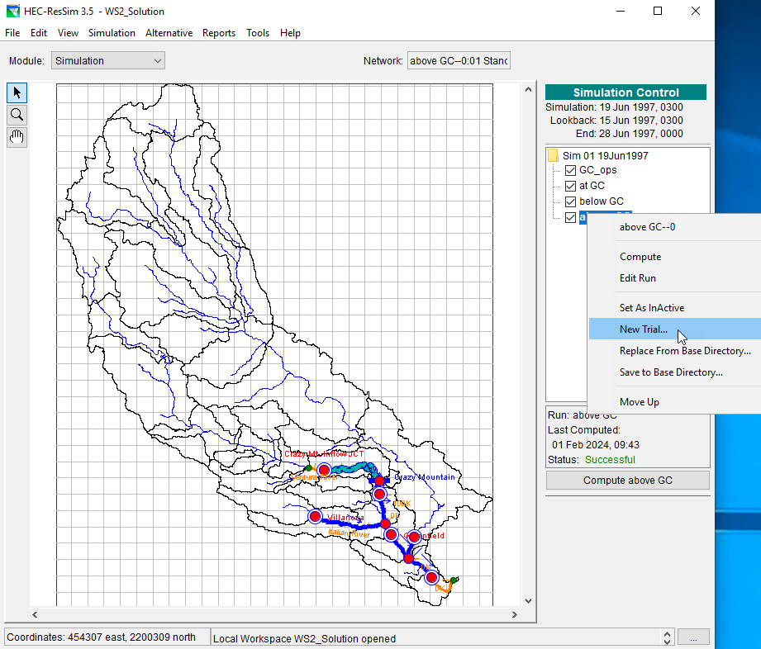
The Simulation Module
Create Simulations
Compute Alternatives
Review Results
Refine the model
Perform “What if..?” scenarios

Slide 19
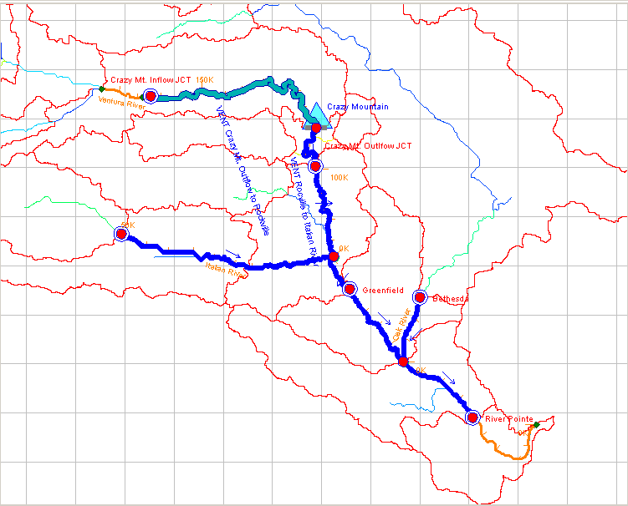
Simulation Time Window
Lookback Period
  To initialize the model elements and routing and reaches (No Release Decision)
  Should be at least as long as the travel time from the upstream-most reservoir to the downstream-most control point
Simulation Period
  The period during which the model evaluates the input and makes release decisions then routes the releases and inflow through the network
  Should be at least 2x the length of the lookback period
32 Hours
28 Hours
Notes:
More specifically, for downstream control operations or system operations, the lookback period should be at least as long as the travel time from the upstream-most reservoir to its downstream-most control point.

Slide 20
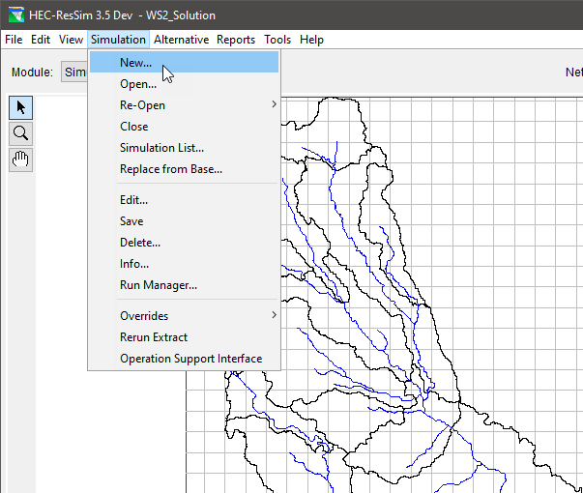
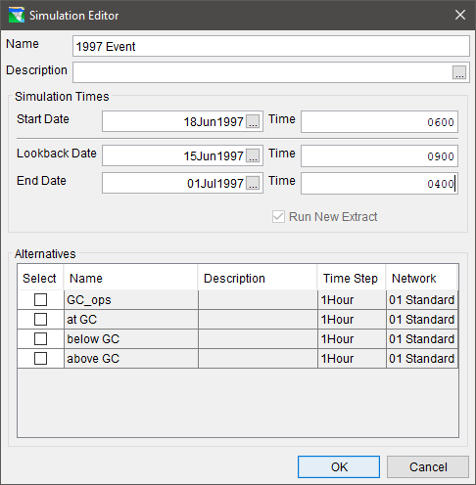
Creating a Simulation
From the Simulation Module’s Simulation Menu, select New…
Enter the Lookback, Start and End Dates and Times for the simulation’s time window.
Select the Alternatives you want to work with.
Enter a Name and Description for your Simulation.

Slide 21
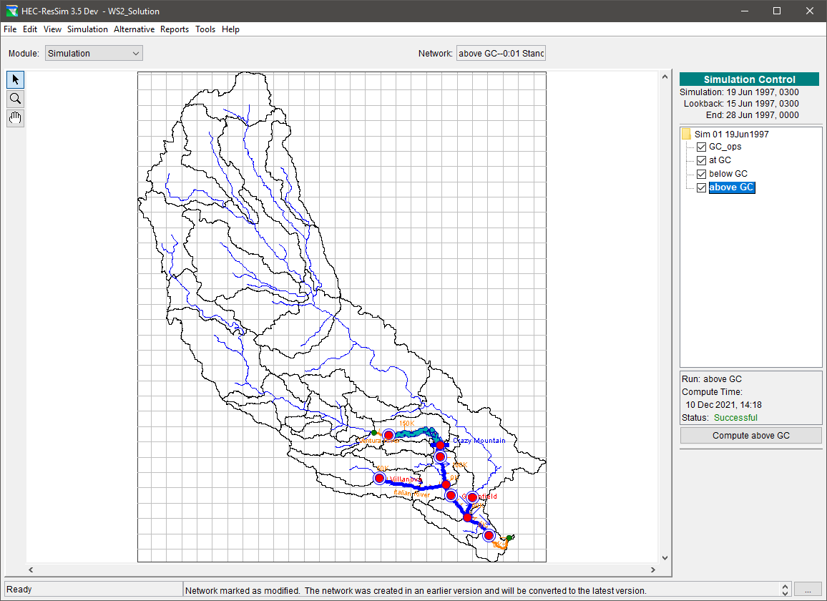
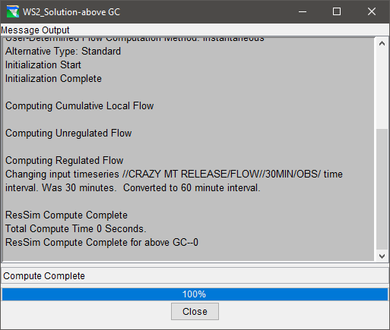
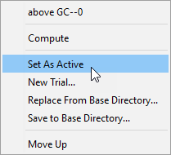
Running a Simulation
Make an alternative “Active” (right click menu)
Compute and check the Compute Dialog for successful computation or errors and warnings

Slide 22
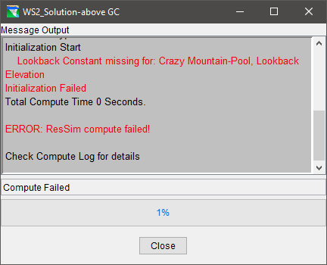
Common Simulation Errors
Choosing a simulation time window that is beyond the coverage of the selected time-series data
One or more Initial conditions are not specified in the Lookback tab of the Alternative Editor
Input time-series has missing data

Slide 23
Common Simulation Errors
Input Time-Series have not been specified on the Time-series tab of the Alternative Editor
A required Time Series is incompletely specified or the specified file &/or pathname cannot be found.
Inflows at Headwater junction(s) are not identified or specified
Routing parameters are not entered
Reservoir data is incomplete (pool definition, outlet capacity, zones, rules)
Incomplete or broken network connectivity

Slide 24
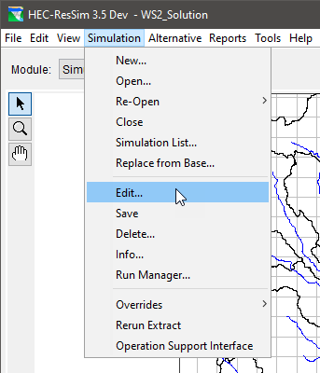
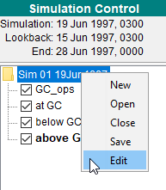
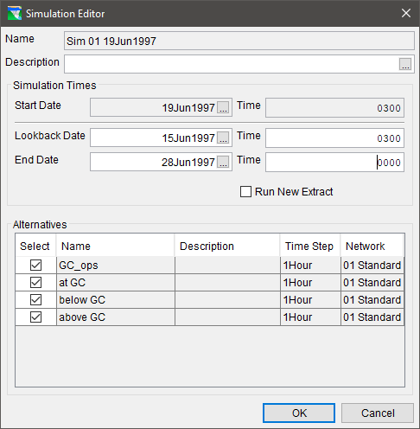
Editing a Simulation
  Open the Simulation
  Editor from the …
    Simulation menu:
      Select New…
  Or
    Context menu:
    Right-click on the simulation name in the Control Panel
  Change Lookback or End date and/or time
  Add or Drop an Alternative
  Run a New Extract

Slide 25
Creating a Simulation
When a Simulation is created, ResSim creates…
  a new folder with the name of the Simulation in the watershed/rss folder and puts a copy of the watershed in it with those files needed to represent the selected alternatives
  a DSS file called simulation.dss in the simulation folder and puts a copy of (extract) all the input time-series records needed for the selected alternatives.

Slide 26
When to make a new Extract?
When changing input time series links
When expanding the simulation time window beyond the dates for which the data was extracted:
  If the lookback is changed to an earlier date
  If the end of the simulation is changed to a later date
Note …
  The simulation start time cannot be changed

Slide 27
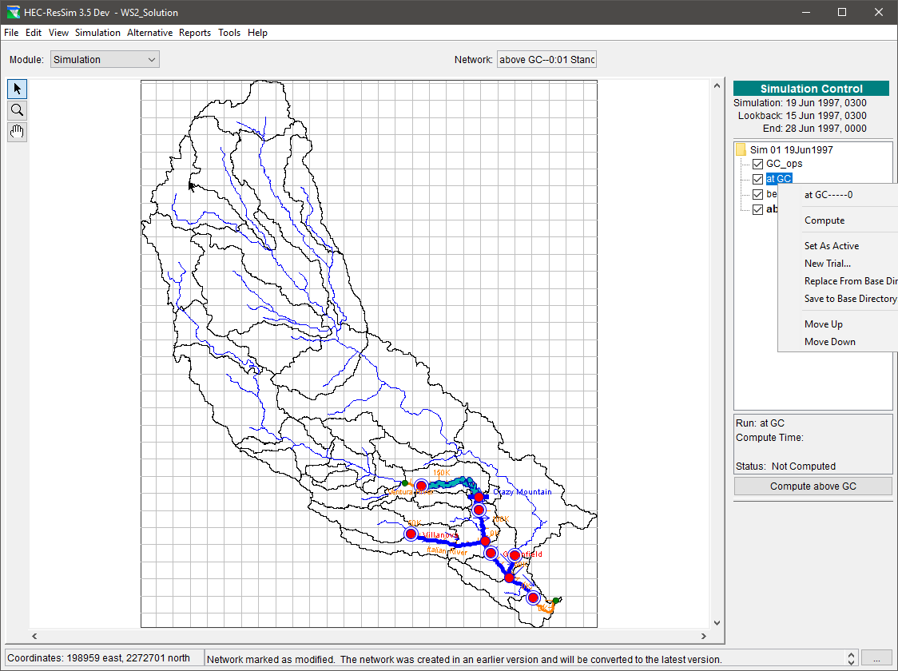
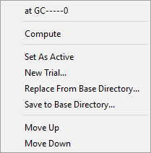
Simulation Control Panel
Set an Alternative Active
Compute an Alternative that is not active
Check the Alternative boxes to access results for the checked Alternatives
Create Trials…
Notes:
After one or more alternatives have been added to a simulation, you can create a Trial of the alternative. A Trial is a copy of an existing alternative, and can be used to quickly test “what if” scenarios involving various changes to the alternative (e.g. flows, rule priority, overrides, etc.). Unlike Alternatives, Trials are created in the Simulation Module.

Slide 28
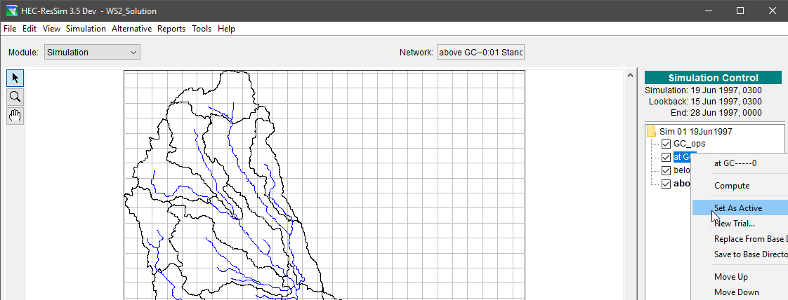
“Set As Active”
Set As Active - This command makes the alternative editable and displays its network in the map region.

Slide 29
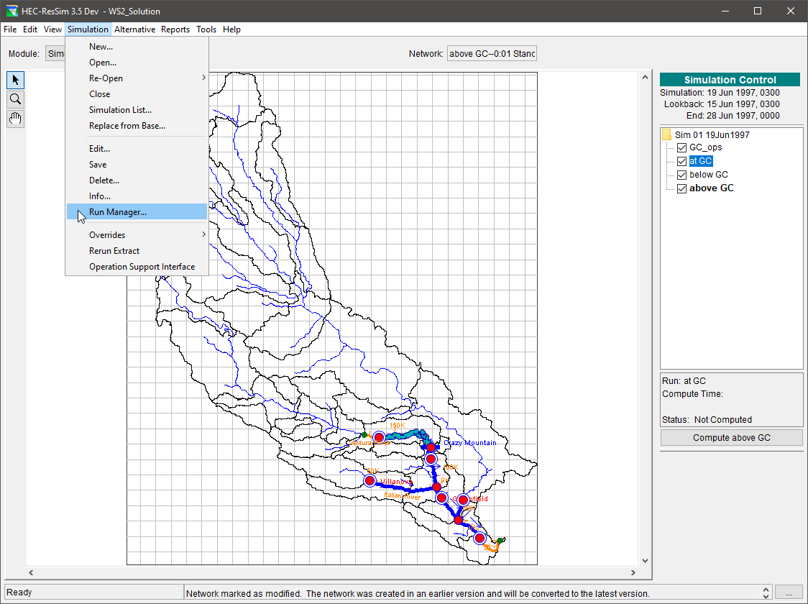
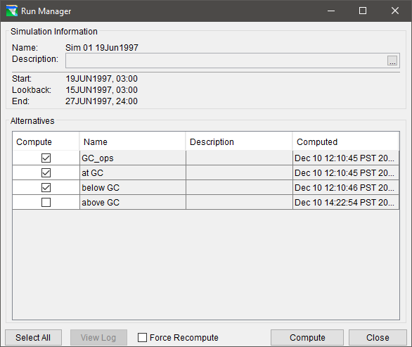
Run Manager
Select and compute multiple alternatives
Review Compute Status
View Compute Logs

Slide 30
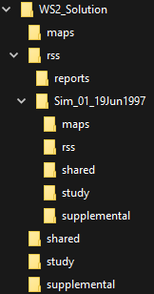
To Save-to-Base or Replace-from-Base?
An Alternative is created in the Reservoir Network module and belongs to the “base” rss folder of the watershed.
When a simulation is created, a copy of the Alternative is made and stored in the simulation’s rss folder of the watershed.
The “base” rss directory
The “simulation” rss directory
Notes:
ResSim facilitates archiving and sharing of Simulation data. There are two operations involved in managing Simulation data. You can save your data to the base directory to make it available for other Simulations, and you can replace data in a Simulation for a specific Alternative with data from the base directory.

Slide 31
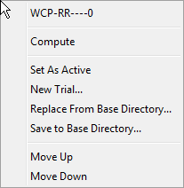
To Save-to-Base or Replace-from-Base?
Save-to-Base: Updates the Reservoir Network module’s (base) copy of the selected alternative and its associated network data from the Simulation module’s copy.
Replace-from-Base: Recreates the Simulation module’s copy of an alternative and its associated network data from the Reservoir Network module’s (base) copy.
Notes:
When you edit model data from the Simulation Module, your changes apply only to an individual Alternative and are saved in your Simulation directory
If you want your changes to be available for use in other Simulations, you will need to Save the data back to the Base directory.
While editing Simulation data, if you need to revert to the original Alternative data (as it exists in the Reservoir Network module), you can replace the changed data in your Simulation directory with data from the Base directory.

Slide 32
Points to Remember
Alternatives are a combination of:
  A network
  An operation scheme
  A set of initial conditions
  A set of inflows
  Run Control selections
Simulations are a combination of:
  A time window
  A set of alternatives to run, refine, and compare

