Slide 1


Developing Inflows
and Linking to HMS

Slide 2
Overview
Reservoir Inflows
Methods for Computing Local Inflows
Sources of Local Inflows
Linking to HMS results

Slide 3

Reservoir Inflows
Routed from upstream
Flow gage or Forecasted Inflow Point
Mass Balance Formula
$$\frac{S_{t+1}−S_{t}}{∆t}=\frac{{I_{t+1}+I}_{t}}{2}−\frac{O_{t+1}+O_{t}}{2}−Losses$$
Notes:
Mass balance – change in storage is change in inflow minus change in outflow minus losses
Graphs show the increasing elevation for the same amount of storage. The loss of storage for a specific elevation could mean sedimentation

Slide 4
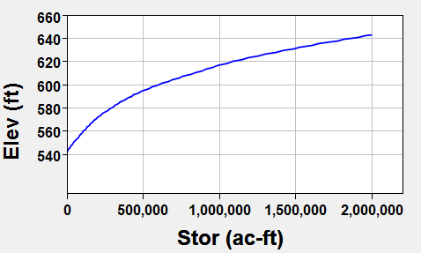
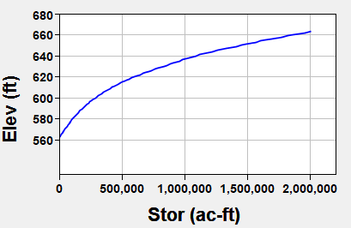
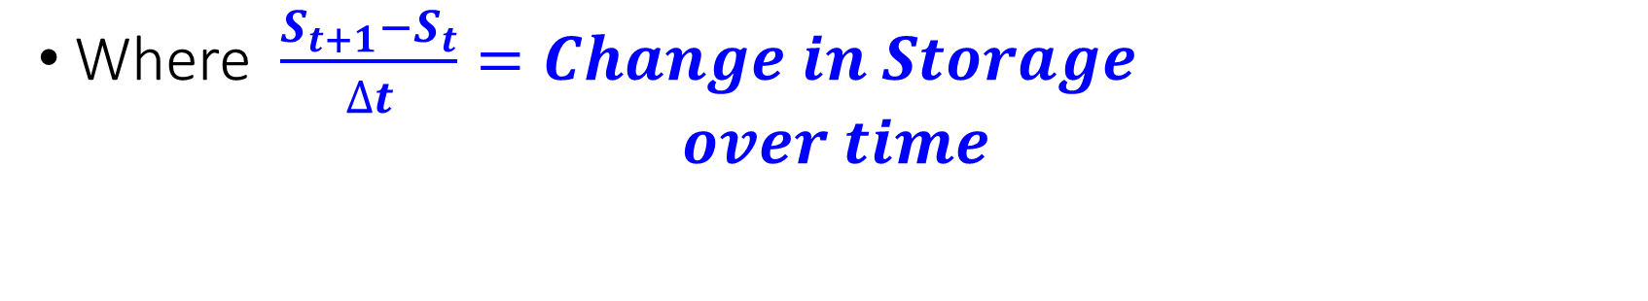

Reservoir Inflows
Mass Balance Formula – Storage
Elev-Stor Curve (2020)
$$\frac{S_{t+1}−S_{t}}{∆t}=\frac{{I_{t+1}+I}_{t}}{2}−\frac{O_{t+1}+O_{t}}{2}−Losses$$
1970
Known Variables: Final Storage (S_{t+1})
                Initial Storage (S_{t})
Where $\frac{{S_{t+1}−S}_{t}}{∆t}=Change in Storage$
$over time$
Present
Notes:
Mass balance – change in storage is change in inflow minus change in outflow minus losses
Graphs show the increasing elevation for the same amount of storage. The loss of storage for a specific elevation could mean sedimentation
When calculating inflows, will need to be mindful of changes in storage over the period of record.
Change in storage over time can be calculated with the DSS Math function Time Derivative

Slide 5
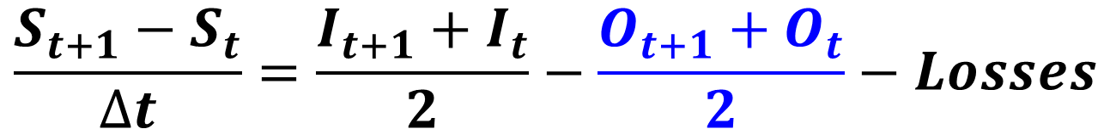
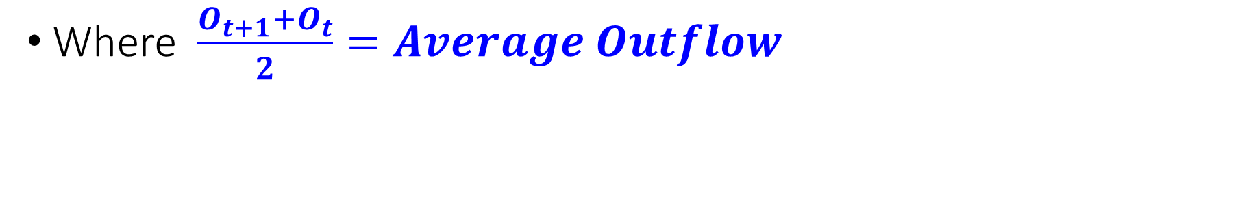
Reservoir Inflows
Mass Balance Formula – Outflow
$$\frac{S_{t+1}−S_{t}}{∆t}=\frac{{I_{t+1}+I}_{t}}{2}−\frac{O_{t+1}+O_{t}}{2}−Losses$$
Known Variables: Final Outflow (O_{t+1})
                Initial Outflow (O_{t})
Where $\frac{{O_{t+1}+O}_{t}}{2}=Average Outflow$
Notes:
Mass balance – Average Outflow
Outflow can be calculated from gate rating curves or measured

Slide 6

Reservoir Inflows
Mass Balance Formula – Losses
$$\frac{S_{t+1}−S_{t}}{∆t}=\frac{{I_{t+1}+I}_{t}}{2}−\frac{O_{t+1}+O_{t}}{2}−Losses$$
Losses:
  Reservoir Evaporation
  Seepage
  Gate Leakage
    could be in the outflow already
  Water Supply/Irrigation
Notes:
Mass balance – Average Outflow
Outflow can be calculated from gate rating curves or measured

Slide 7
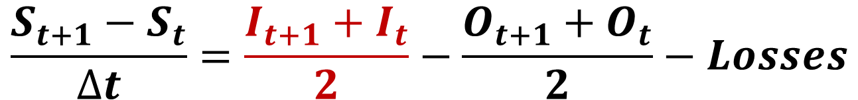

Reservoir Inflows
Mass Balance Formula – Inflow
$$\frac{S_{t+1}−S_{t}}{∆t}=\frac{{I_{t+1}+I}_{t}}{2}−\frac{O_{t+1}+O_{t}}{2}−Losses$$
Unknown Variables: Final Inflow (I_{t+1})
                Initial Inflow (I_{t})
Where $\frac{{I_{t+1}+I}_{t}}{2}=Average Inflow$
Notes:
Mass balance – Average Outflow
Outflow can be calculated from gate rating curves or measured

Slide 8
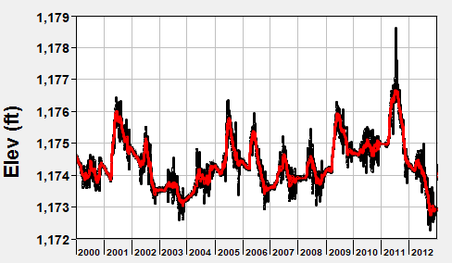
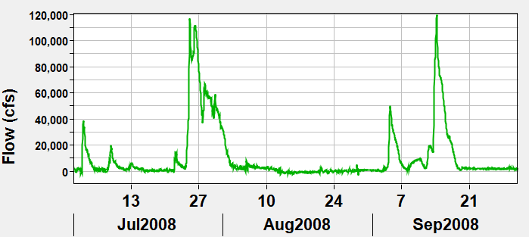

Methods for Computing Reservoir Inflows
Mass Balance Formula
Utilize smoothing techniques to reduce or eliminate negative values while maintaining volume
$$I_{Avg}=\frac{S_{t+1}−S_{t}}{∆t}+\frac{O_{t+1}+O_{t}}{2}+Losses$$
Notes:
Can be calculated:
By hand
In excel
DSSVue
Mention of negative values – this can occur for a few reasons
Outflow – whether measured or calculated, there can be an error that will affect the inflow calculation
Losses – assumed losses may need updating
Storage – dependent on last survey and impacted by sediment

Slide 9
Methods for Computing Local Inflows
Derive the locals from Observed flows
  By hand
  Use a spreadsheet or script
  Use a program like HMS or ResSim
Use a calibrated hydrology (HMS) model to estimate the local inflows
Notes:
More detail on methods on following slides

Slide 10
Reach Routing
10
Notes:
Open channel flow modeling or reach routing, as it’s referred to within HEC-ResSim, is an approach that is used to predict the temporal and spatial variations of a hydrograph as it moves through a river or stream.
The effects of storage and flow resistance are reflected by changes in the hydrograph shape and timing as the flood wave moves from upstream to downstream.
The figure shown here demonstrates the major changes that can occur as a hydrograph moves through a reach.
Specifically, the blue inflow hydrograph is translated or shifted in time and the peak inflow is reduced or attenuated to produce the pink outflow hydrograph.

Slide 11
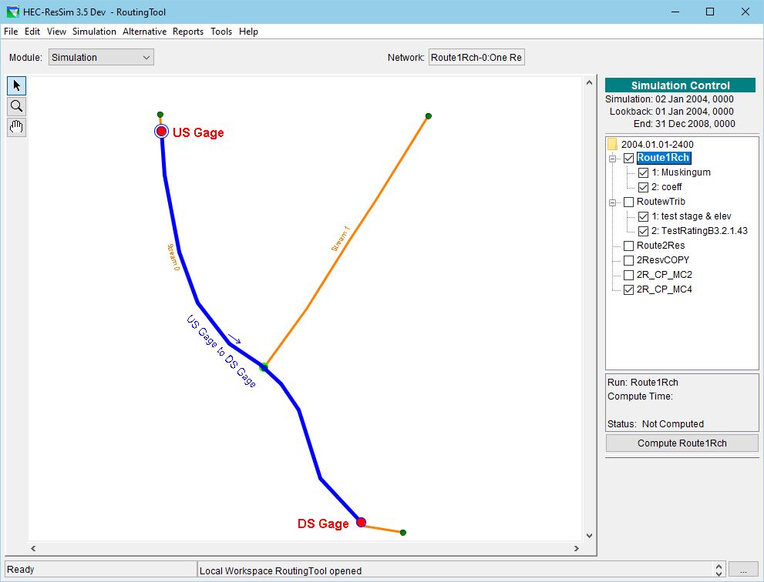
To perform the routing…
Use paper and pencil
Use DSSVue math functions
Script it
Write an Excel Macro
Use HMS
Use ResSim…
Notes:
Use a “routing only” watershed to route flows from one location to another. It may seem clunky but I can swap out the upstream flow time series easily, modify the routing parameters, and compute – over and over and over again.
Can have different networks and alternatives to model special configurations.
Can even use an OSI for these alternatives to “calculate the locals” one local at a time so you don’t have to do it by hand or in a spread sheet.
Of course, you could do this same thing on a larger scale to minimize the repetitive work, but at a small scale, it is easy to locate and correct errors.
And, of course, if you are handier with HMS, could do the same thing there, instead.

Slide 12
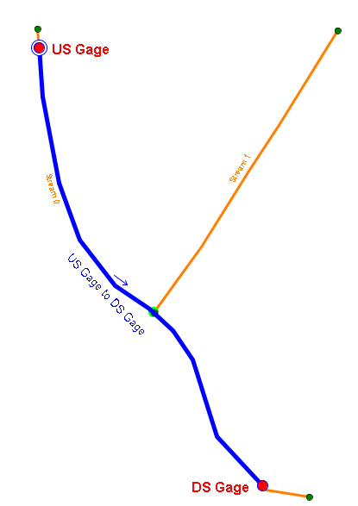
Deriving Locals from Observed
Local Flow = Total flow - Routed flow
Gather observed (total) flows at gages.
Route observed from gage to gage
Subtract.
  DS Gage FLOW-LOCAL =
  DS Gage FLOW – US Gage to DS Gage FLOW
Adjust for “losses” – evaporation, seepage,
withdrawals
Utilize smoothing techniques to reduce or
eliminate negative values while maintaining volume
Notes:
Note the equation – no matter what tool you use, they all ultimately utilize this basic equation/method.
By Hand
be sure to account for ungaged withdrawals and stream losses
review results then apply one or more smoothing techniques to reduce or eliminate negative values in your inflow time-series.
Use HMS
a) compute locals with a standard basin runoff model
b) compute locals with a routing only model
Use the OSI
Uses the same concepts as the “hand calcs” and HMS, but implemented in ResSim
Complex to setup and use – but the bigger the watershed, the more benefit you gain over hand-calcs.

Slide 13
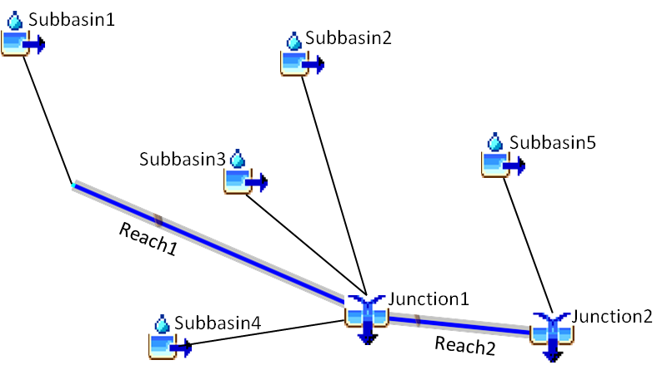
Using HEC-HMS – to estimate local inflow
Rainfall/Snowmelt Runoff Model
Turn ON the Local Flow option in
the Basin Model.
  HMS will:
  perform subbasin runoff computations
  route and combine those flows through
  the basin
  compute local flow at all junctions in the model
  Local Flow= Total Flow – Flow routed in
If Observed Data is available, attach it to applicable junctions and specify Blending
  replace simulated flows with Observed Flows at the gage
Notes:
The flow from a subbasin is an incremental local flow!
There may be multiple subbasins that gather at a given location on a stream.
Let HMS gather the inflows to produce a single composite local flow at a junction.

Slide 14
Using ResSim’s OSI - to derive local inflows
In the network –
  Identify inflow junctions and gage locations and “Turn On” observed flow
In the alternative –
  Input all time series in the Time Series and Observed Data tabs
    Names must be unique
In the Operational Support Interface (OSI) –
  Create a Local Flow tab and add your Variables (local flows you want to compute)
  Click on the OSI Action button Compute Locals
  ResSim will:
    Replace (in memory) the computed total flow at each junction with the observed flow (where it has it),
    Route those flows through the network to each “local inflow” OSI Variable location
    Subtract the routed flow from the observed total flow to get the computed local
Notes:
Local inflows are identified on the Local Flow tab of the Junction Editor. Each identified inflow will show up on the Time Series tab of the Alternative Editor
Observed “total” flows can be “turned on” on the Observed Data tab of the Junction Editor – it’ll be the first Flow “variable” in the list. Each checked variable will appear on the Observed Data tab of the Alternative Editor.
All Entries on the Time Series tab of the Alternative Editor MUST be mapped to a DSS time series
All Entries on the Observed Data tab of the Alternative Editor are optional, however the key entries needed for computing local inflows MUST be mapped to an observed DSS time series.
The OSI is the Operations Support Interface in ResSim. It is a “fully configurable” interface designed for developing real-time release schedules (overrides) for the reservoirs in your watershed. But it was also designed to enable a real-time OR study modeler to compute local inflows based on observed total flows at key (gage) locations in the model.
An OSI Variable is the specification of a ResSim input or computed “model” variable to be plotted, tabulated, and possibly edited in the OSI.
A “local inflow” OSI variable is special type of OSI variable, only available at junctions, that identifies a specific local inflow that can be computed by ResSim through the OSI “Compute Locals” option.
- note, when using this method, only ONE local inflow should be identified per junction.
After computing the local inflows, ResSim will use the compute locals for each standard compute performed for the current alternative in the current simulation (or forecast)
If you want to use those locals for other alternative and/or other simulations, you must copy the inflow time series from the simulation.dss (or forecast.dss) file into a separate DSS file in the base watershed and map your alternative(s) to that file and its data.

Slide 15
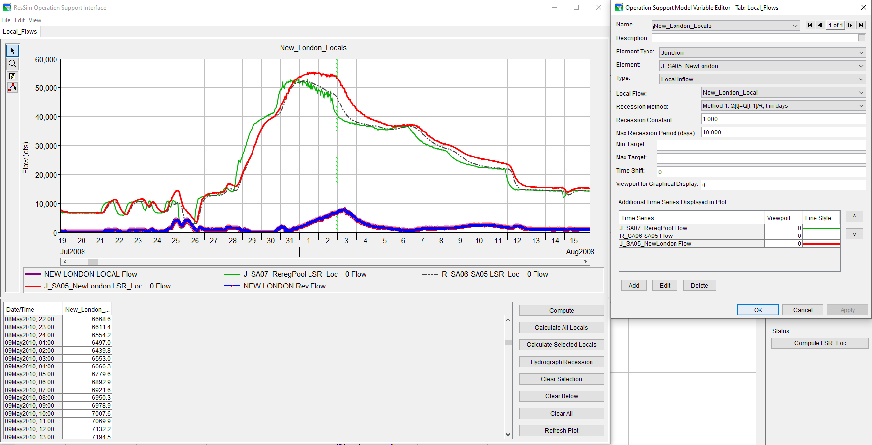
Use ResSim’s OSI, continued.
Notes:
The OSI is the Operations Support Interface in ResSim. It is a “fully configurable” interface designed for developing real-time release schedules (overrides) for the reservoirs in your watershed. But it was also designed to enable a real-time OR study modeler to compute local inflows based on observed total flows at key (gage) locations in the model.
An OSI Variable is the specification of a ResSim input or computed “model” variable to be plotted, tabulated, and possibly edited in the OSI.
A “local inflow” OSI variable is special type of OSI variable, only available at junctions, that identifies a specific local inflow that can be computed by ResSim through the OSI “Compute Locals” option.
- note, when using this method, only ONE local inflow should be identified per junction.
After computing the local inflows, ResSim will use the compute locals for each standard compute performed for the current alternative in the current simulation (or forecast)
If you want to use those locals for other alternative and/or other simulations, you must copy the inflow time series from the simulation.dss (or forecast.dss) file into a separate DSS file in the base watershed and map your alternative(s) to that file and its data.

Slide 16
(Other) Sources of Local Inflows
Existing Study Models
  Rainfall & Snowmelt Runoff Models – e.g., HEC-HMS
Partner Agencies – e.g., NOAA-NWS
Derived from Observed Data- CWMS and/or Study Databases
  Automated Computations
  Specific Study Effort
Notes:
Consider the purpose of your model – is it a study model or a realtime model?
Are other types of models involved in your study or modeling effort – I.e., is a rainfall runoff (HMS) model being built for this study?
If this is a study model, have there been other studies on the same watershed? Could those studies have developed local inflow data the you could use?
Or do you need to perform that effort as part of this study? If so, do you have a complete set of observed data?
If this is a real-time model, are there any automated processes that compute locals from observed? Is an HMS model included in your CWMS watershed?
Or, is there a data stream setup to bring in local inflows from the local RFC’s forecast models?

Slide 17
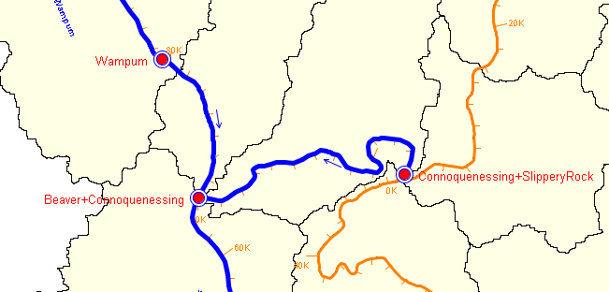
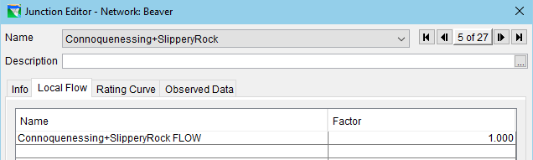
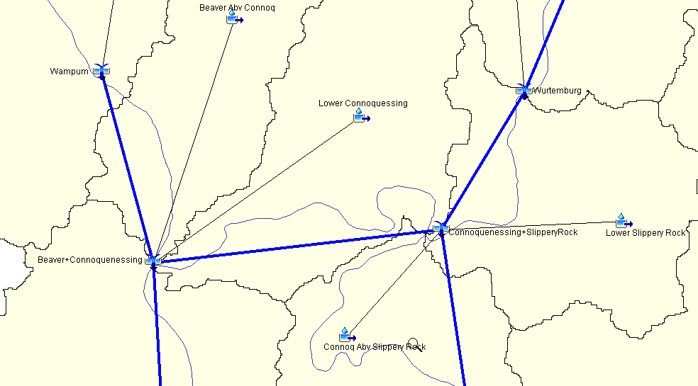
Linking HMS to ResSim
At ResSim headwater junctions,
  Identify a local inflow
  Give it a name similar to the HMS element and an indicator of what “kind” of flow is needed
  (e.g. FLOW or TOTAL FLOW)
  Map to the associated HMS element in the Alternative Editor
Notes:
Headwater junctions – what if there isn’t a matching junction in HMS?
find the subbasin(s) that flow(s) into the headwater reach
convince the HMS modeler to add headwater junctions to his model
what if the HMS model is modeling the subbasins on a grosser scale than ResSim?
consider using basin weighting factors to distribute the subbasin flow to the relevant ResSim headwater junctions.
Interior junctions – what if the there is no matching junction in HMS?
not all ressim junctions must have local inflows
however, if the junction is a control point, consider using basin weighting factors to distribute the next downstream local…

Slide 18
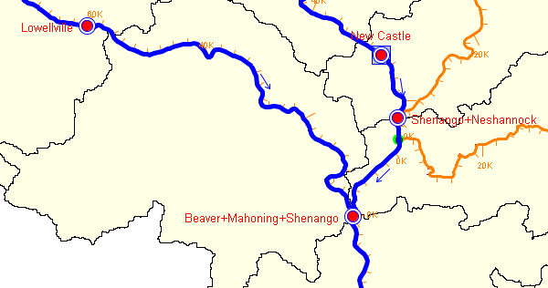
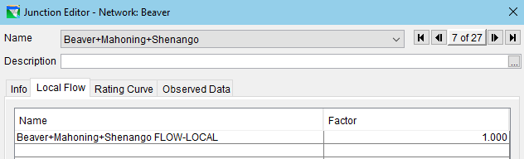
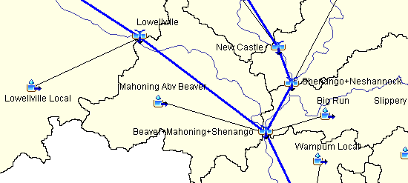
Linking HMS to ResSim
At ResSim interior junctions
  Identify a local inflow
  Give it a name similar to the HMS element and an indicator of what “kind” of flow is needed
  (e.g. LOCAL or FLOW-LOCAL)
  Map the associated HMS element in the Alternative Editor

Slide 19
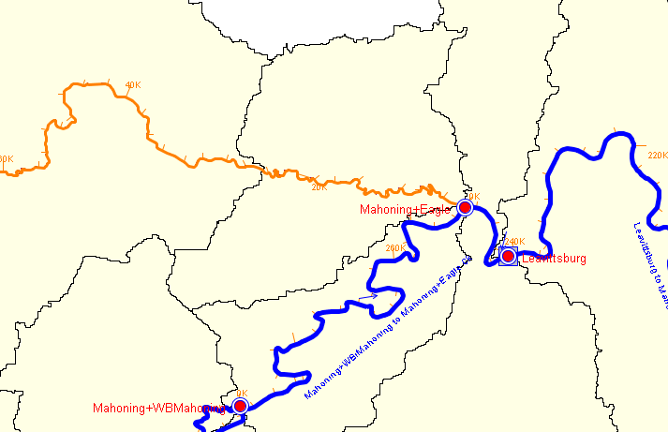
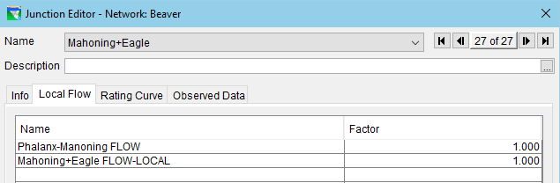
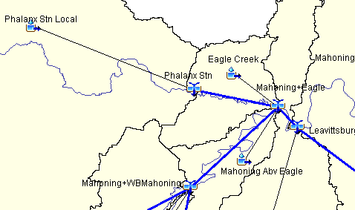
Linking HMS to ResSim
At ResSim interior junctions where HMS has a connected tributary but ResSim does not…
  Identify the local tributary inflow
  Give it a name similar to the HMS element and an indicator of what “kind” of flow is needed
  (e.g. FLOW.)
  Map the associated HMS element in the Alternative Editor
Notes:
NOTE: this element is most often a reach, but it could be almost any HMS element type whose computed outflow represents the total tributary flow

Slide 20
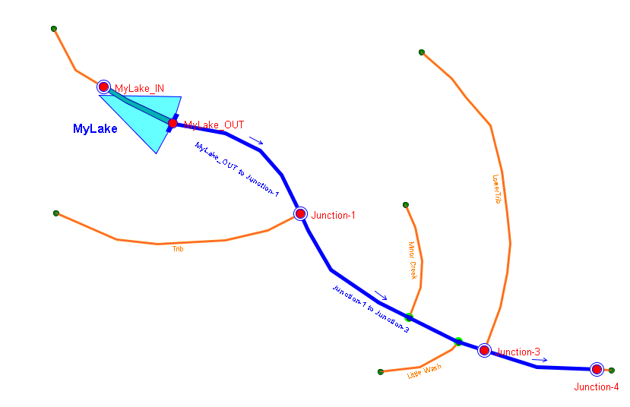
Linking HMS to ResSim
A Simple ResSim Model:
Notes:
Here’s an Example Watershed in ResSim
MyLake_IN Specify one local – i.e. MyLake Inflow. Factor will give the weight.
Junction 1 Specify 2 locals
Junction 1 Local – map it to HMS’s Junction-1 FLOW-LOCAL
Tributary Flow - map it to HMS’s Trib-Mouth FLOW
Junction 3 Specify 2 locals
Junction 3 Local – map it to HMS’s Junction-3 FLOW-LOCAL
Lower Trib Flow – map it to HMS’s Rch 2 to 3 FLOW
Junction 4 Specify 1 local – Junction 4 Local and map it to HMS’s Junction-4 FLOW-LOCAL

Slide 21
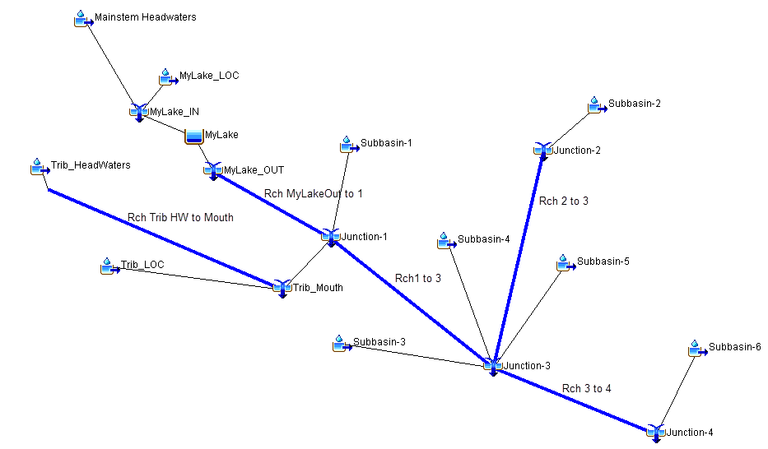
An HMS Model for the same simple watershed
Notes:
And, Here’s the SAME Example Watershed in HMS
HMS is usually going to model more of the watershed and ResSim
HMS models cover the whole watershed – because that’s where the water lands and runs-off from
ResSim models usually cover a subset of the watershed, usually from the reservoirs, down – because that is what is impacted by the reservoir operation
This is an important difference and should be kept in mind when identifying the HMS flows to use in ResSim.
MyLake_IN FLOW = MyLake_IN FLOW-LOCAL You can use either FLOW or FLOW-LOCAL for ResSim’s MyLake Inflow
MyLake_IN FLOW-LOCAL = Mainstem Headwaters FLOW+ MyLake_LOC FLOW
Junction-1 FLOW-LOCAL = Junction-1 FLOW minus flow routed in Use Junction-1 FLOW-LOCAL. But, it won’t capture all the inflows needed here.
= Subbasin-1
Junction-1 flow routed in = Rch MyLakeOut to 1 FLOW plus Trib_Mouth FLOW
The significance here is that the Trib_Mouth flow is considered “routed” to Junction-1 and therefore is not included in the FLOW-LOCAL for Junction-1.
Trib-Mouth FLOW is also needed as a ResSim local inflow.
Junction-2 FLOW = Junction-2 FLOW-LOCAL
Junction-2 FLOW-LOCAL = Subbasin-2 Use Junction-2 FLOW-LOCAL instead of the subbasin flow
Junction-3 FLOW-LOCAL = Junction-3 FLOW minus flow routed in Use Junction-3 FLOW-LOCAL – it captures the sum of the subbasin flows
= Subbasin-3 FLOW + Subbasin-4 FLOW + Subbasin-5 FLOW
Junction-4 FLOW-LOCAL = Subbasin-6 FLOW Use Junction-4 FLOW-LOCAL instead of the subbasin flow
Other elements, not shown – sources and sinks may look like junctions but HMS doesn’t treat them as such, therefore, FLOW-LOCAL is not computed for these elements.

Slide 22
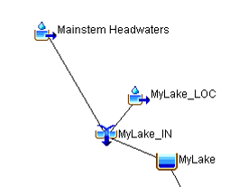
Linking HMS to ResSim
Notes:
Here’s an Example Watershed in ResSim
MyLake_IN Specify one local – i.e. MyLake Inflow. Factor will give the weight.
Junction 1 Specify 2 locals
Junction 1 Local – map it to HMS’s Junction-1 FLOW-LOCAL
Tributary Flow - map it to HMS’s Trib-Mouth FLOW
Junction 3 Specify 2 locals
Junction 3 Local – map it to HMS’s Junction-3 FLOW-LOCAL
Lower Trib Flow – map it to HMS’s Rch 2 to 3 FLOW
Junction 4 Specify 1 local – Junction 4 Local and map it to HMS’s Junction-4 FLOW-LOCAL

Slide 23
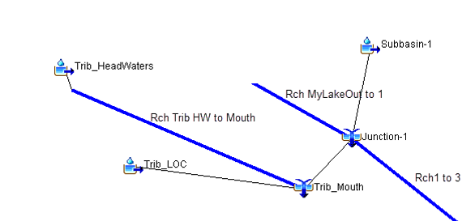
Linking HMS to ResSim
Notes:
Here’s an Example Watershed in ResSim
MyLake_IN Specify one local – i.e. MyLake Inflow. Factor will give the weight.
Junction 1 Specify 2 locals
Junction 1 Local – map it to HMS’s Junction-1 FLOW-LOCAL
Tributary Flow - map it to HMS’s Trib-Mouth FLOW
Junction 3 Specify 2 locals
Junction 3 Local – map it to HMS’s Junction-3 FLOW-LOCAL
Lower Trib Flow – map it to HMS’s Rch 2 to 3 FLOW
Junction 4 Specify 1 local – Junction 4 Local and map it to HMS’s Junction-4 FLOW-LOCAL

Slide 24
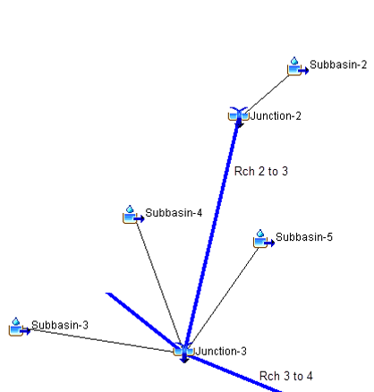
Linking HMS to ResSim
Notes:
Here’s an Example Watershed in ResSim
MyLake_IN Specify one local – i.e. MyLake Inflow. Factor will give the weight.
Junction 1 Specify 2 locals
Junction 1 Local – map it to HMS’s Junction-1 FLOW-LOCAL
Tributary Flow - map it to HMS’s Trib-Mouth FLOW
Junction 3 Specify 2 locals
Junction 3 Local – map it to HMS’s Junction-3 FLOW-LOCAL
Lower Trib Flow – map it to HMS’s Rch 2 to 3 FLOW
Junction 4 Specify 1 local – Junction 4 Local and map it to HMS’s Junction-4 FLOW-LOCAL

Slide 25
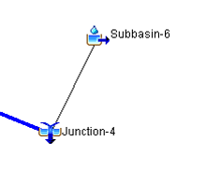
Linking HMS to ResSim
Notes:
Here’s an Example Watershed in ResSim
MyLake_IN Specify one local – i.e. MyLake Inflow. Factor will give the weight.
Junction 1 Specify 2 locals
Junction 1 Local – map it to HMS’s Junction-1 FLOW-LOCAL
Tributary Flow - map it to HMS’s Trib-Mouth FLOW
Junction 3 Specify 2 locals
Junction 3 Local – map it to HMS’s Junction-3 FLOW-LOCAL
Lower Trib Flow – map it to HMS’s Rch 2 to 3 FLOW
Junction 4 Specify 1 local – Junction 4 Local and map it to HMS’s Junction-4 FLOW-LOCAL

Slide 26
Linking HMS to ResSim
At ResSim Reservoir Inflow junctions
  In general, follow instructions on previous slide
  However, the modeling of reservoir inflows in the two models can vary significantly. Conditions that may make it difficult to identify the appropriate inflow(s) for the ResSim reservoir:
    In HMS, all inflowing elements link directly to a reservoir element
    In HMS, all inflowing elements link to a “sink” element
    In HMS, all inflowing elements link to a single “reservoir inflow” junction, BUT in ResSim, the associated reservoir has two or more inflow junctions
  Consider changing the HMS model – most changes are trivial
  Consider changing the ResSim model - usually not quite as easy as HMS
Notes:
A – convince the HMS modeler to:
Use Junctions to collect the HW subbasin flows, even if there’s only one.
Create a reservoir inflow junction to collect the inflows to the reservoir element (for each associated Reservoir Inflow junction in ResSim).
Use HMS reservoirs (or junctions) instead of Sinks and Sources
If you can’t change the HMS model, Use what’s available – subbasin flows, reach flows, sink total flow (inflow) – identify each HMS element’s flow as a separate local inflow to the ResSim reservoir inflow junction(s)
Note:
HMS Reservoirs produces a FLOW-COMBINE record that represent the reservoir’s “combined” inflow. == to ResSim ResvName-POOL/FLOW-IN record
HMS Sinks produce a FLOW (and a FLOW-COMBINE) record that represents the total flow (inflow) for the element.
B – reevaluate how the reservoir is modeled in ResSim
Are multiple inflow junctions really necessary – are there modeled reservoirs above this one on more of the tribs?
Are the discretized inflows providing needed output –for the modeler? For a “downstream” model?
Use what’s available, consider basin weighting to distribute one HMS flow to multiple inflow locations.
If necessary, apply inflow to one junction and a “dummy” zero inflow to the other. The factor can be used to force any inflow to zero.

Slide 27
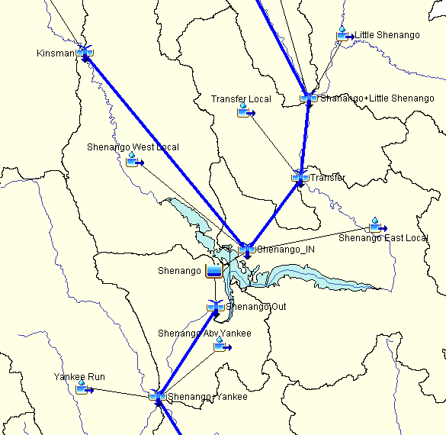
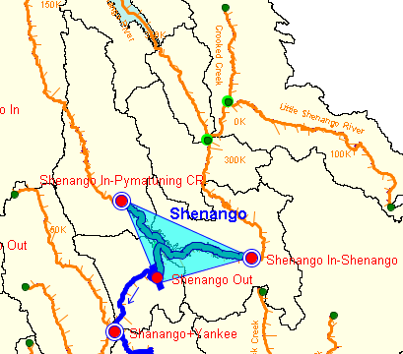
Notes:
One option is to update the HMS model to match the ResSim.
Other options is to assign a weight factor of 0.5 to each inflow point of the reservoir in ResSim for each junction’s local flow.

Slide 28
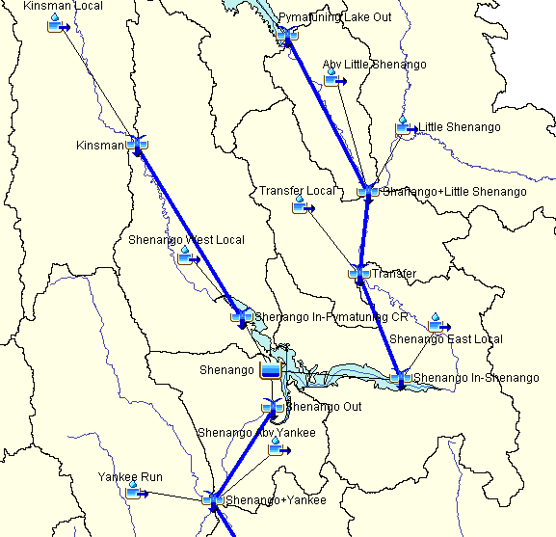

Slide 29
Linking HMS to ResSim Take-Home Points
Don’t double up
Don’t miss anything
Model as little of HMS in ResSim as possible
Be consistent
Compute Unregulated Flows

Slide 30
Take-Home Points
ResSim needs
  Total flow for headwater junctions (i.e. reservoirs or tributary headwater)
  Incremental local flows for interbasin junctions, not total flows
Observed / Gaged data reflect total flows
Incremental locals
  Modeled – with a Rainfall-Runoff (HMS) model
  Derived from Observed
    By hand, scripts, DSSVue, …
    Using HMS or ResSim

Slide 31
Questions?

Slide 32

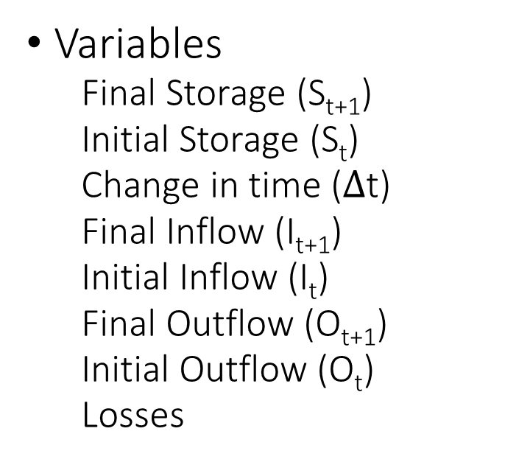
Reservoir Inflows
Mass Balance Formula
$$\frac{S_{t+1}−S_{t}}{∆t}=\frac{{I_{t+1}+I}_{t}}{2}−\frac{O_{t+1}+O_{t}}{2}−Losses$$
Variables
  Final Storage (S_{t+1})
  Initial Storage (S_{t})
  Change in time ($∆$t)
  Final Inflow (I_{t+1})
  Initial Inflow (I_{t})
  Final Outflow (O_{t+1})
  Initial Outflow (O_{t})
  Losses
Notes:
Mass balance – change in storage is change in inflow minus change in outflow minus losses
Graphs show the increasing elevation for the same amount of storage. The loss of storage for a specific elevation could mean sedimentation

Slide 33
Using HEC-HMS - to derive local inflow
Runoff Model or Routing Model
Attach an observed flow to each junction representing a gage
Turn ON the Local Flow option in the Basin Model.
Specify Blending at each gage
  HMS will…
  replace simulated flows with Observed Flows at each gage
  route flows through the model
  compute local flow at all junctions in the model
  Local Flow = Total (Observed) Flow – Flow routed in

Slide 34
Use ResSim’s OSI, continued.
In the OSI -
  Define a “local inflow” OSI Variable at each (interior) gage location
  Compute Locals – click on the OSI Action button Compute Locals
  ResSim will:
    Replace (in memory) the computed total flow at each junction with the observed flow (where it has it),
    Route those flows through the network to each “local inflow” OSI Variable location
    Subtract the routed flow from the observed total flow to get the computed local
    Overwrite the “dummy” time series mapped to the local inflow with the computed local inflow time series (in the simulation.dss file).
    Perform a standard compute, using the newly computed locals

