Slide 1
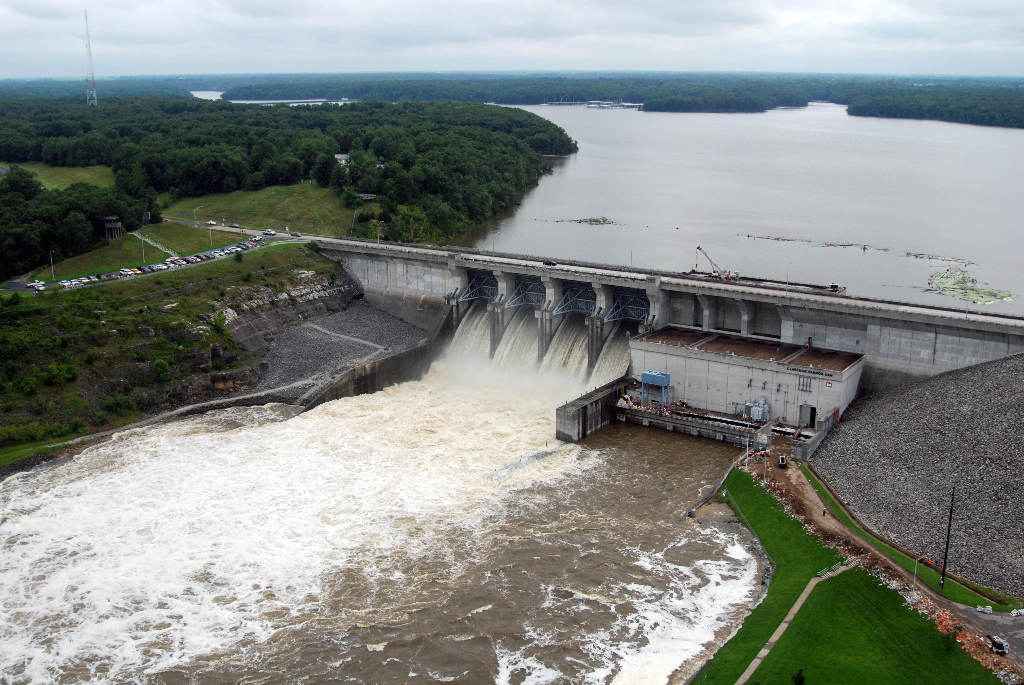
Operation for Downstream Objectives
How it works & How to use it

Slide 2
Outline
Some Terminology
Examples of downstream constraints & objectives
Creating downstream rules
Rule priority, decision logic, and rule-conflicts
Slide 2

Slide 3
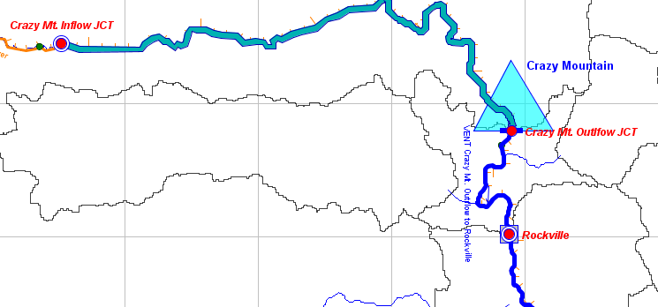
Terminology
Downstream control:
  operate to meet an objective at a location downstream from the reservoir
Slide 3

Slide 4
Terminology
Operate:
  make a decision about something we can control (and act on that decision)
  What can we control?
  When is the effect seen?
  How Much can I release now so that the objective is met when the released water arrives at the downstream location?
Slide 4

Slide 5
Terminology
(Downstream) Objectives:
  Minimum or Maximum flow or stage
  …at the control point.
Control Point:
  The downstream location for which the reservoir is trying to operate - usually an active gage location
Slide 5

Slide 6
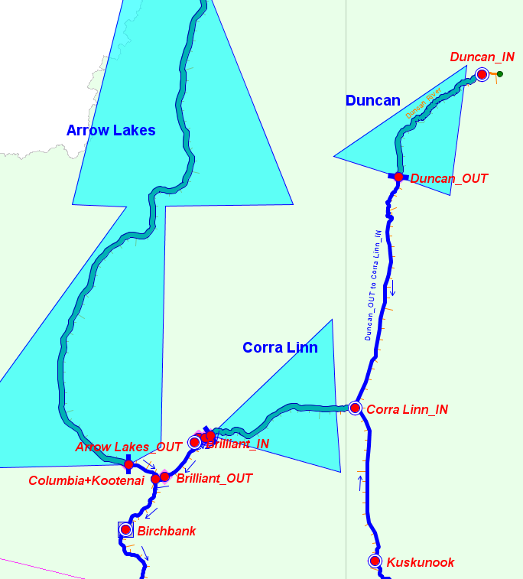
Information needed…
DS Objective(s)
Current + future local inflows
Routing time and attenuation impacts
Releases from other reservoirs that affect flow/stage at the control point
Slide 6

Slide 7
…About those flows!!!
Foresight! Foresight! Foresight!
Foresight: What you know (or assume) about the future will guide how you determine releases to meet downstream objectives.
  HEC-ResSim uses limited perfect foresight…
  (It “knows” the exact local flows for a future period that affect the release decision. That future period is based on the routing time between the reservoir and the control point.)
Slide 7

Slide 8
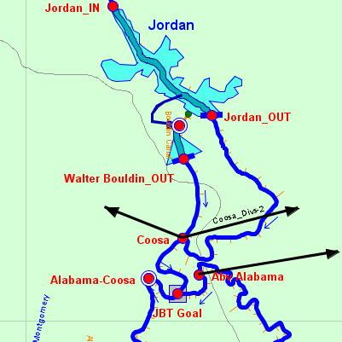
Examples of…
Downstream Constraints
“4600 cfs is needed in the Alabama River at Coosa to maintain navigation.”
Slide 8

Slide 9
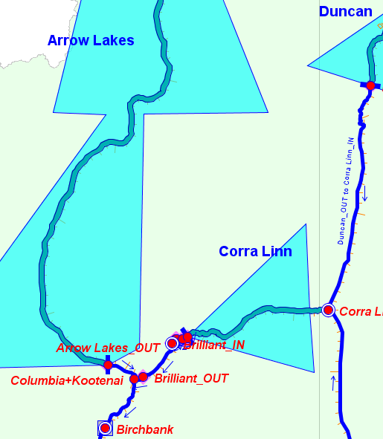
Examples of…
Downstream Constraints
“The risk of failure of the Birchbank levees is acceptably low until flows exceed 225,000 cfs at which point the risk increases greatly. Therefore, both local and system flood control storage at Arrow Lakes will be used to manage flows in the Columbia River at Birchbank to not exceed 225,000 cfs.”
Slide 9

Slide 10
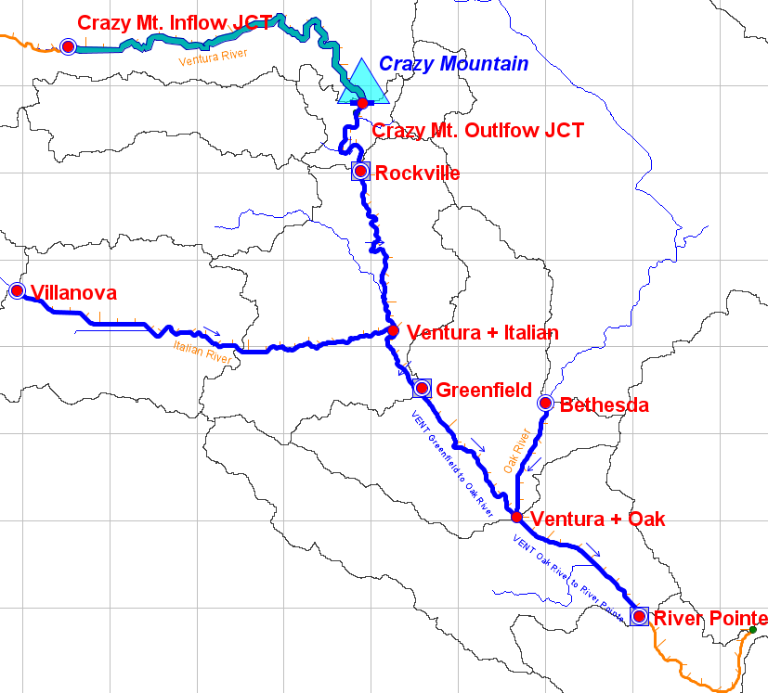
Examples of…
Downstream Constraints
“Limit flows at Greenfield to 12,000 cfs during the (May-Dec) growing season.”
“During normal operations, flow at Rockville should be maintained at or above 2,500 cfs. Likewise, the flow at Greenfield should be maintained at or above 3,500 cfs…”
Slide 10

Slide 11
Specifying Operations
HEC-ResSim Operating Rule Types
Release Function (at-site) O D R
Flow Rate of Change Limit O D R
Elev Rate of Change Limit R
Downstream Control Function R
Induced Surcharge R
Tandem Operation R
Hydropower … O D R
…
A rule can be applied to:
O=Outlet D=Dam or Group R=Reservoir
Slide 11
Notes:
Those in white we’ll be looking at today (first four)
Those in yellow, tomorrow (next 5)
Those in orange, in the Advanced ResSim class – next year? (last three)

Slide 12
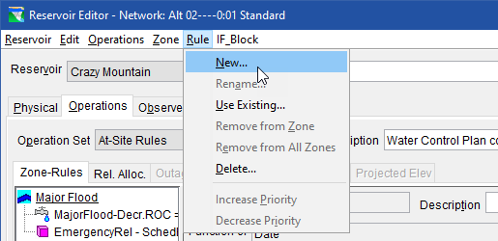
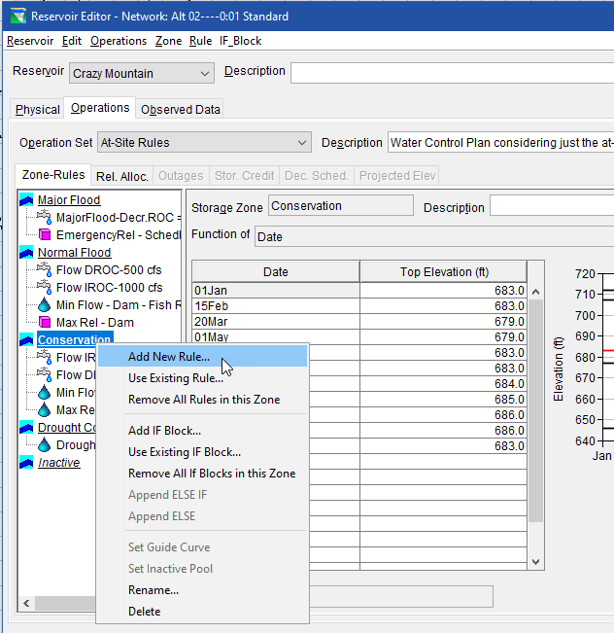
Creating a Downstream Rule…
…Reservoir Editor
…Operations tab
…Choose an Operation Set
…Select a zone
Right click on the zone and select Add New Rule
Or, from the Rule menu, select New.
Slide 12

Slide 13
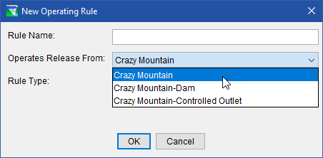
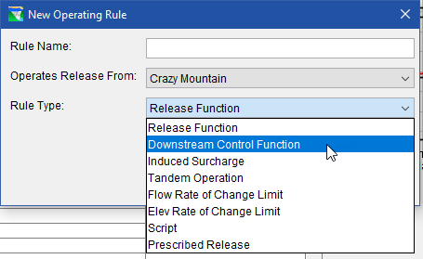
Creating a Downstream Rule…
Select the Reservoir from the “Operates Release From” list.
Select Downstream Control Function from the “Rule Type” list.
Slide 13

Slide 14
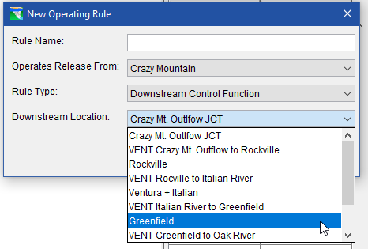
Creating a Downstream Rule…
The New Rule dialog changes - a new list is added…
Select the Downstream Location from the “Downstream Location” list.
Name the rule
Press OK.
Slide 14

Slide 15
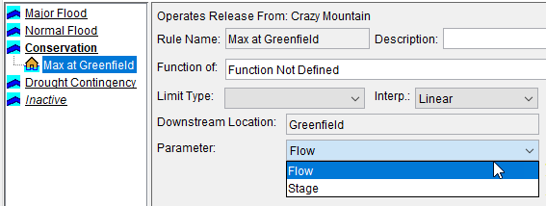
Creating a Downstream Rule…
Define the rule in the same way as for a Release Function rule…
Additional field: Parameter..
    Flow
    Stage
…if specifying stage, you must enter a flow/stage rating curve at the downstream location
Slide 15

Slide 16
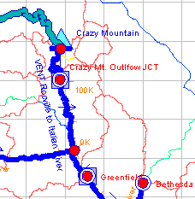
More about…
Downstream Control Rules
A grey square appears around each control point
Network Module: if a downstream control rule exists (even if not used)
Simulation Module: if a downstream control is used in the current operation set of the active alternative
A downstream control rule defined at one reservoir can be assigned to other reservoirs upstream of the control point
(Select Use Existing from Rule Menu)
Slide 16

Slide 17
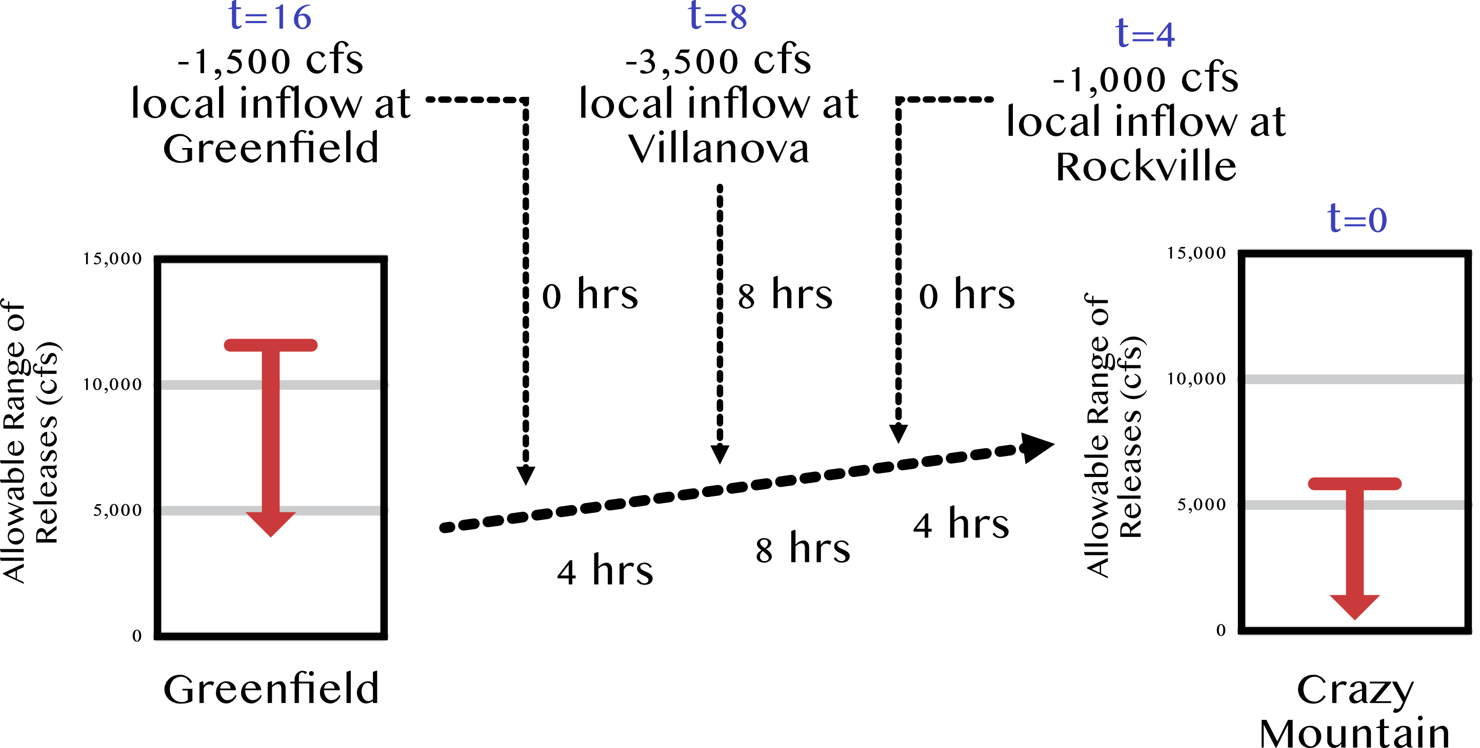
Back-routing calculation…
Example 1
“Limit flows at Greenfield to 12,000 cfs …”
Slide 17

Slide 18
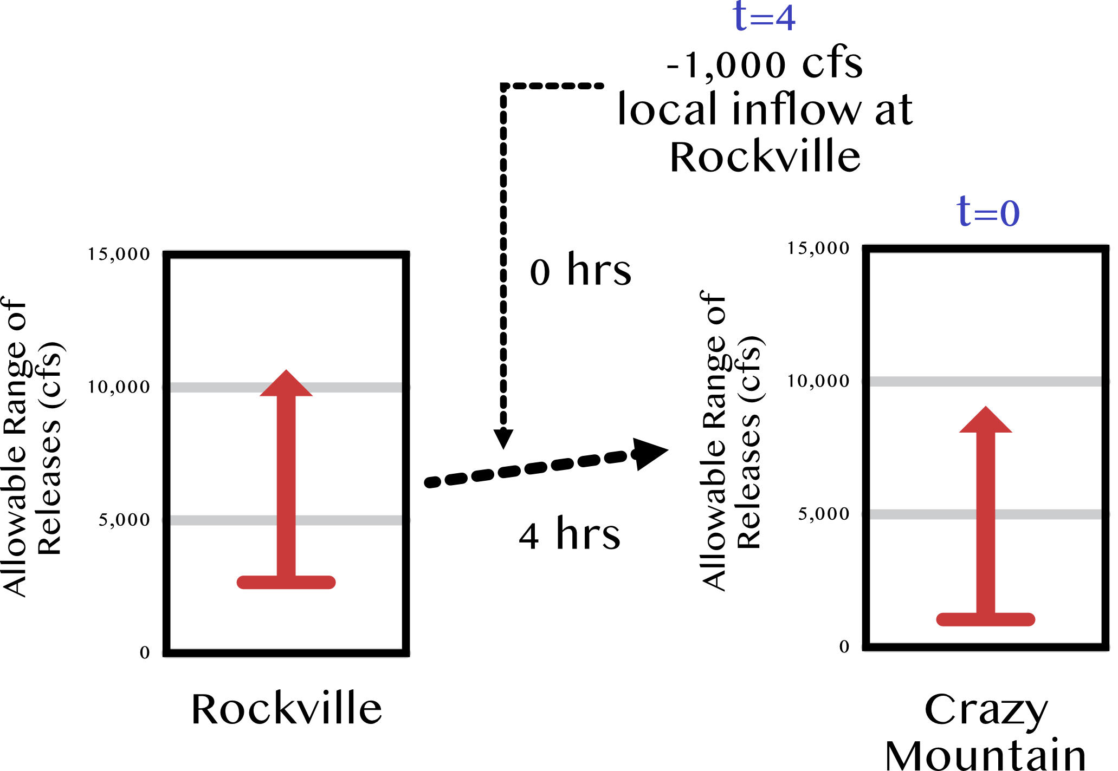
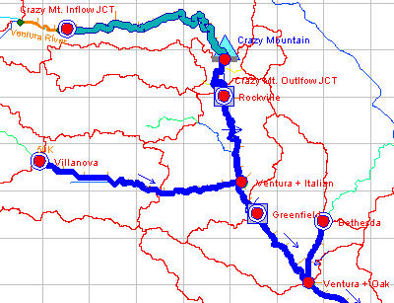
Back-routing calculation…
Example 2
  “…flow at Rockville should be maintained at or above 2,500 cfs”
Slide 18

Slide 19
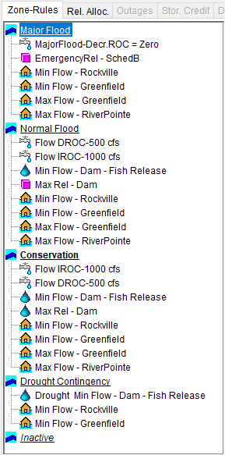
Defining Rule Priority
Rule Priority:
the order in which rules are evaluated and applied to the “allowable range”
In HEC-ResSim, rules appear in each zone of the Operations Tree in order of their priority (highest priority is at the top of the list)
Priority can differ by zone…
Slide 19

Slide 20
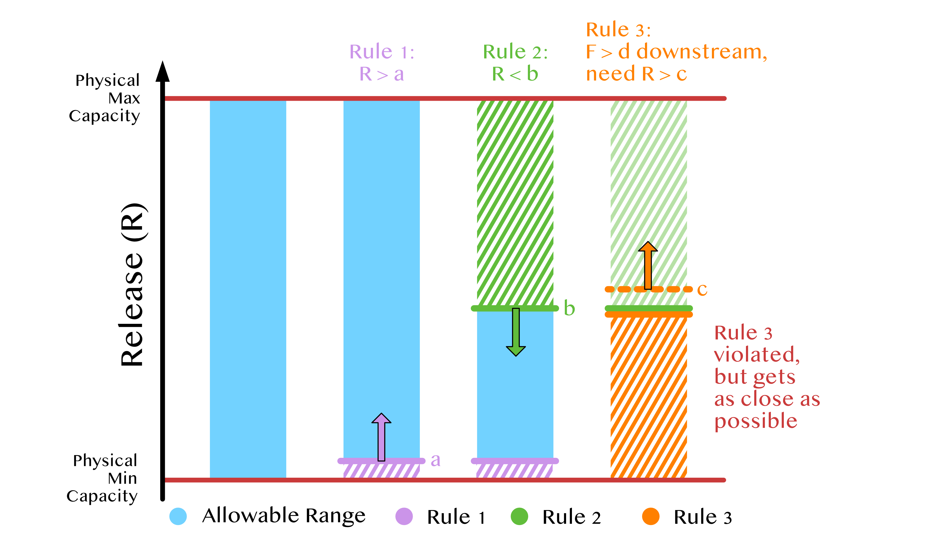
Rule Logic - revisited
Rules refine the allowable range of release…
Slide 20
Notes:
Rule 1 Minimum release of 1000 cfs
Rule 2 Maximum release of 9000 cfs
Rule 3 Minimum downstream flow of 12,500 cfs -> translates to min 10,000 release at reservoir

Slide 21
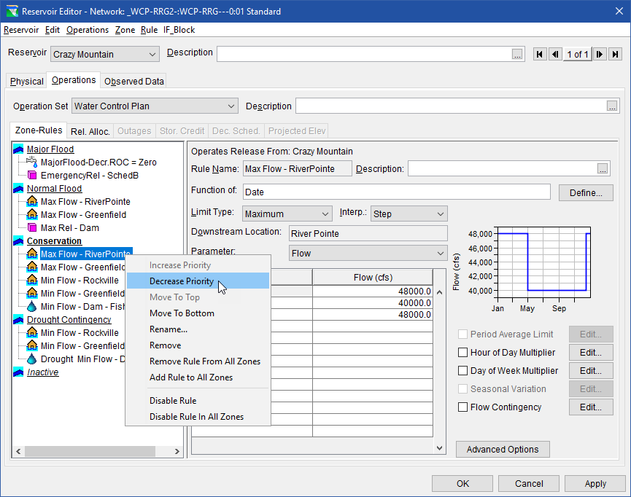
Rule Logic - revisited
What if the rules were re-ordered?
Right-click on rule
Slide 21

Slide 22
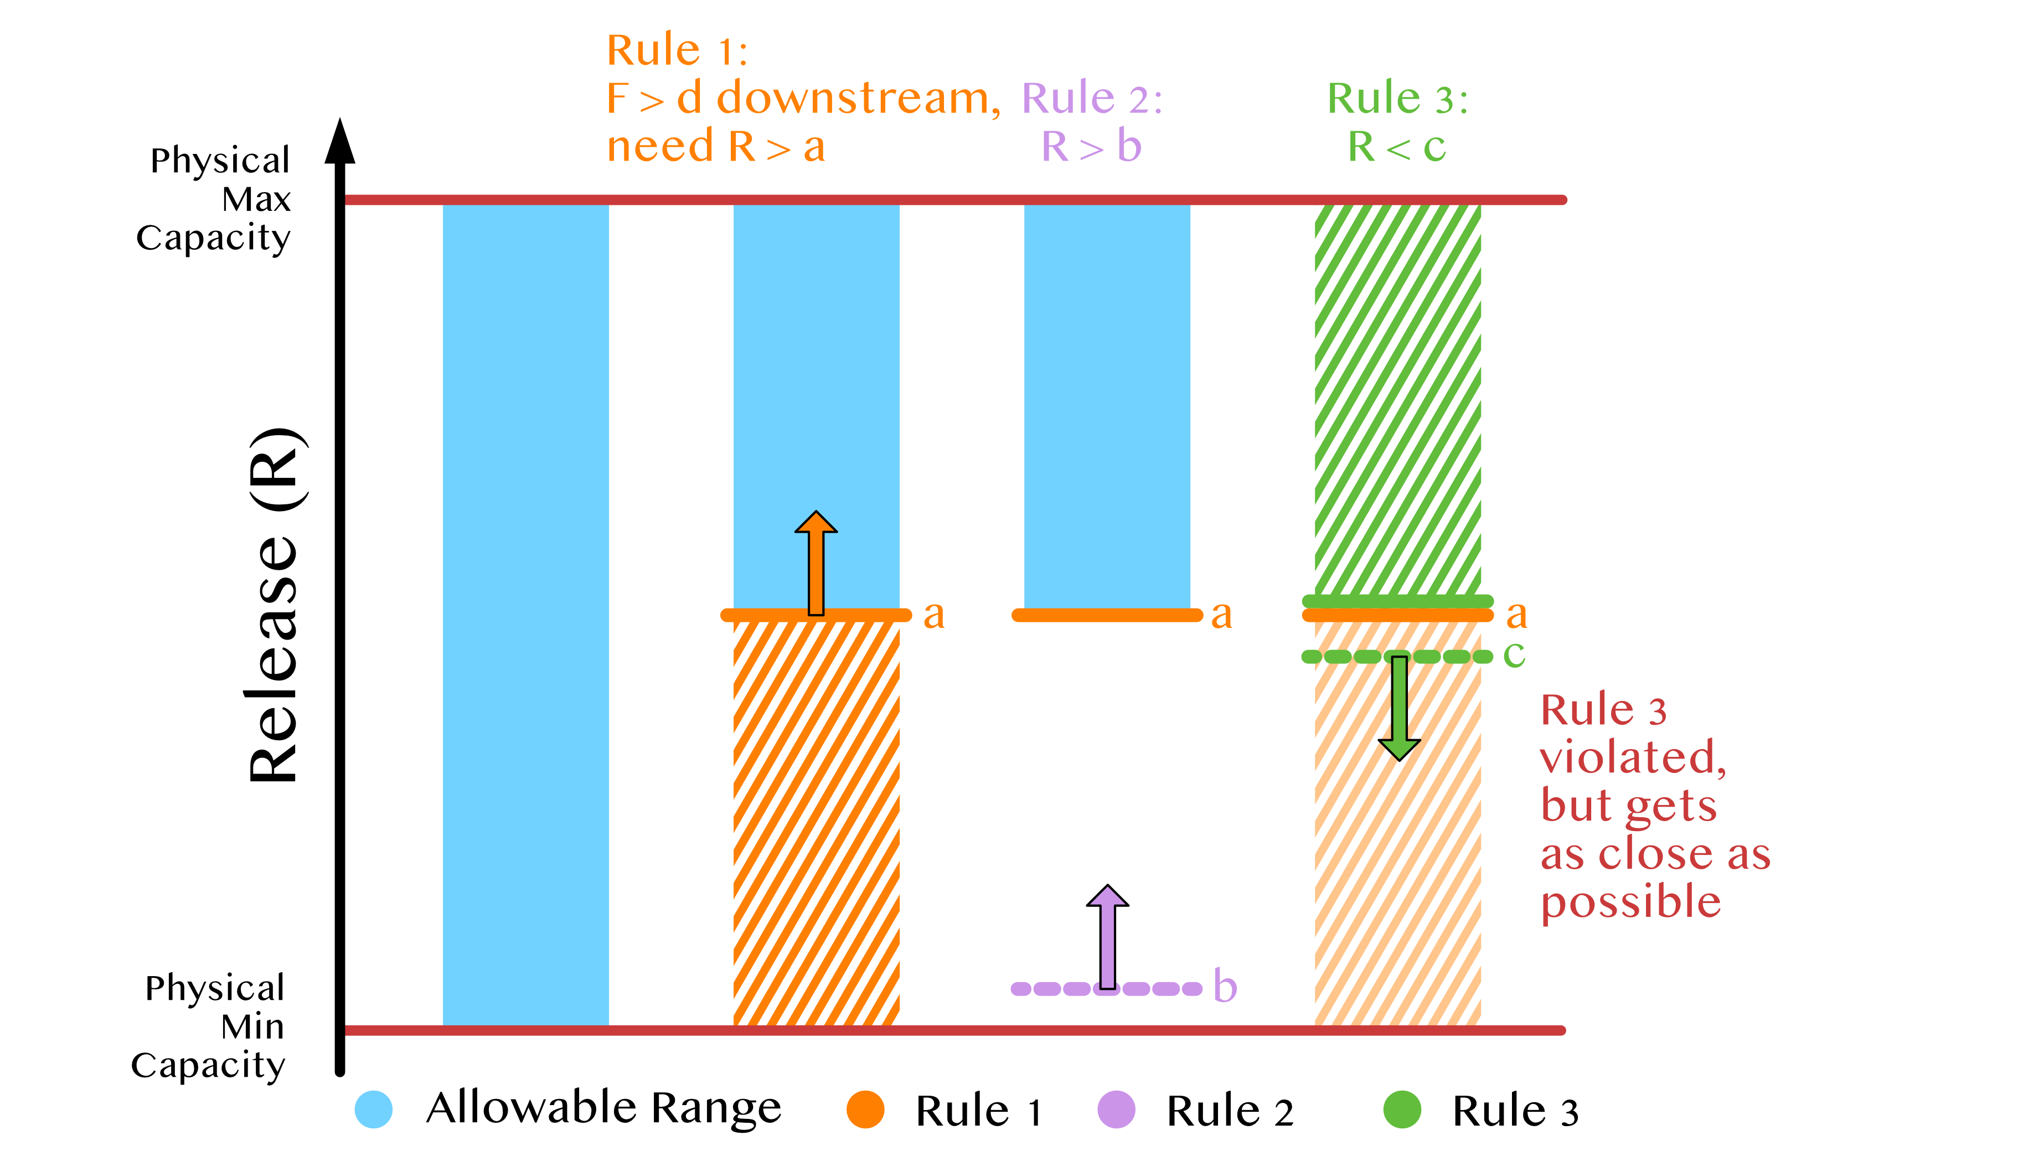
Rule Logic - revisited
What if the rules were re-ordered?
Slide 22
Notes:
Rule 3 is now Rule 1: Minimum downstream flow of 12,500 cfs -> translates to min 10,000 release at reservoir
Rule 2: Minimum release of 1000 cfs
Rule 3: Maximum release of 9000 cfs

Slide 23
Take-home points
Downstream operation - work to meet an objective at a location downstream from the reservoir
Limited Foresight is used to determine the reservoir release to meet the downstream objective
Implement as Downstream Control Function rule in HEC-ResSim
Priority describes the precedence for constraining the region of allowable releases
Slide 23

Slide 24
Advanced Topic – Pulse Flows
Initialization for downstream control involves releasing a pulse of water from each reservoir that operates for downstream objectives.
The resultant pulse hydrograph at the control point is analyzed and various parameters are estimated:
  time to peak,
  number of routing steps,
  the set of linear coefficients
The size of the default pulse flow is 5000 cfs.
  If this is not appropriate, you can change it…
Review the results in the simulation.dss file
  Filter for C part of Flow-Routing…
  Select pathnames for the reservoir outflow junction and the downstream control point, then plot…
Slide 24

Slide 25
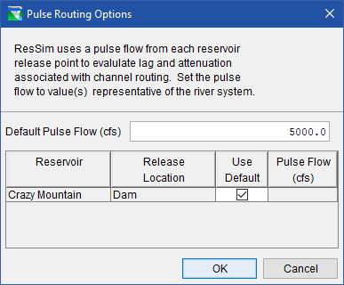
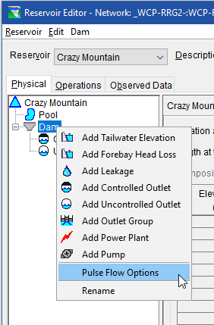
Pulse Flow Options
Reservoir Editor
  Dam Menu…
  Pulse Flow Options
Slide 25

Slide 26
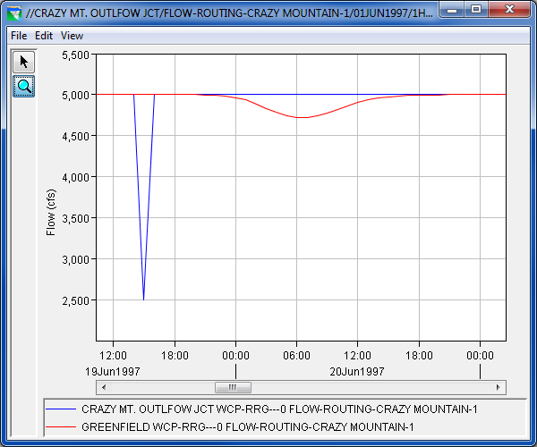
The pulse flows…
Routing Window
Attenuation
Lag
Slide 26

Slide 27
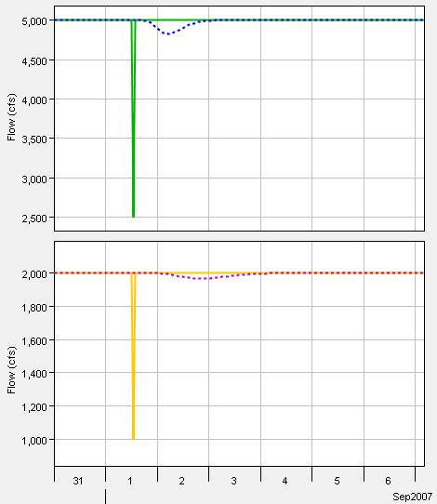
Effect of non-linear routing
Non-linear routing
Muskingum-Cunge, Modified Puls, SSARR, Working R&D, Variable Lag&K
Recommendation
Set pulse flow approximately equal to the expected channel flow between release point and downstream objective when operating for the most important limit
Change in Lag resulting from different pulse flows with non-linear routing
Slide 27

Slide 28
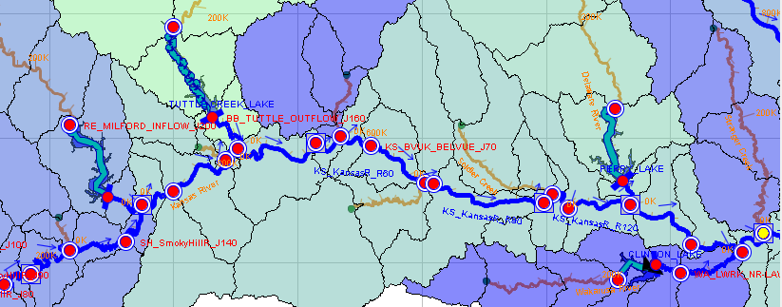
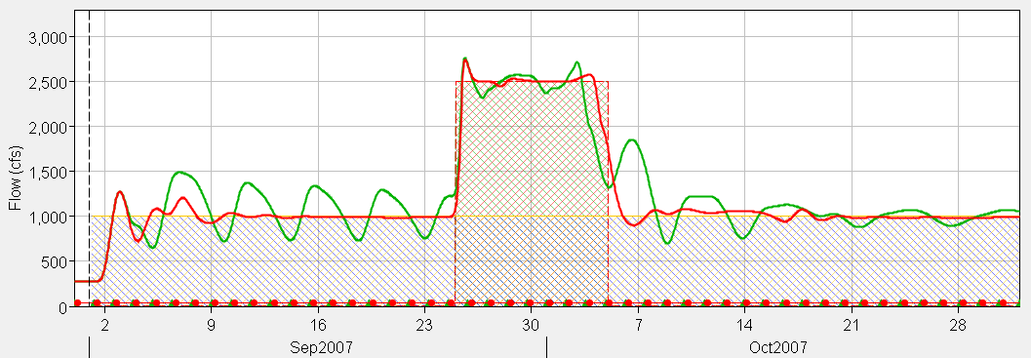
Tuning pulse flows to improve downstream operation with non-linear routing
P=1000cfs
P=800cfs
P=2200cfs
DS Control
Before pulse tuning
After pulse tuning
Slide 28

Slide 29
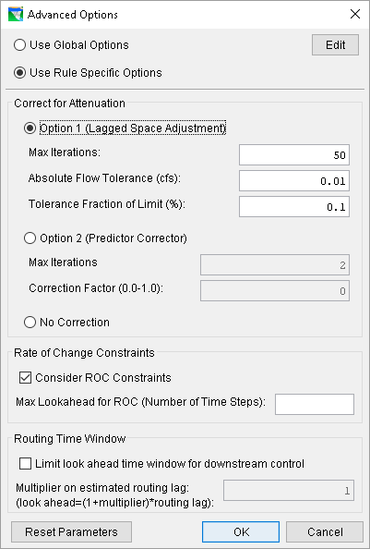
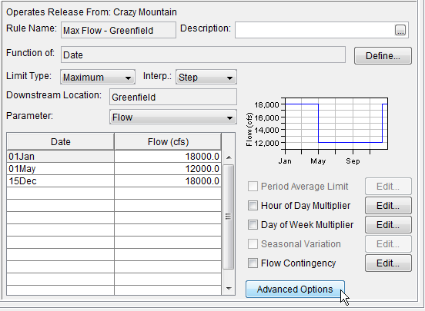
Advanced Options…
Slide 29

Slide 30
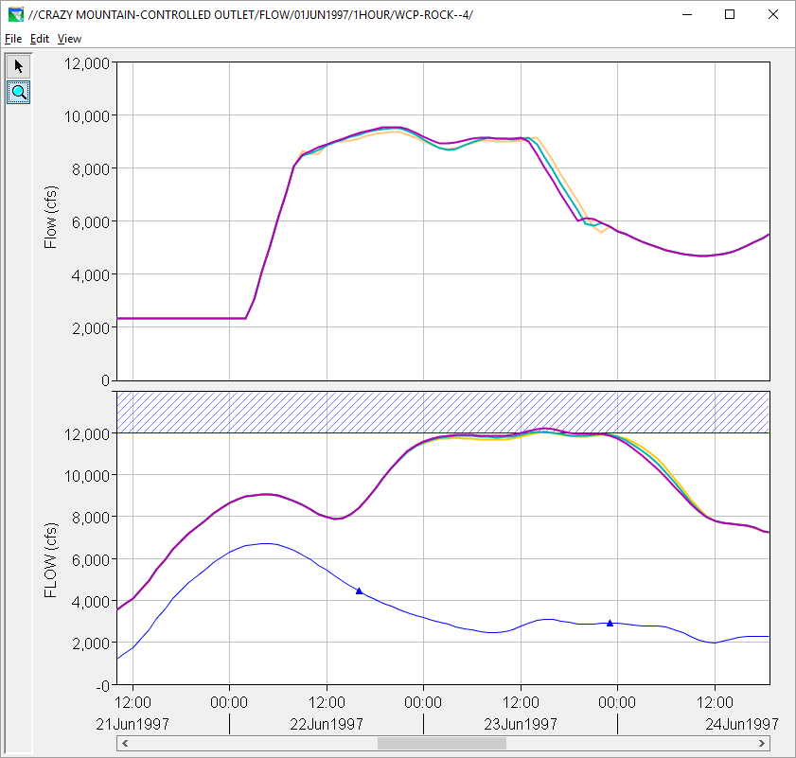
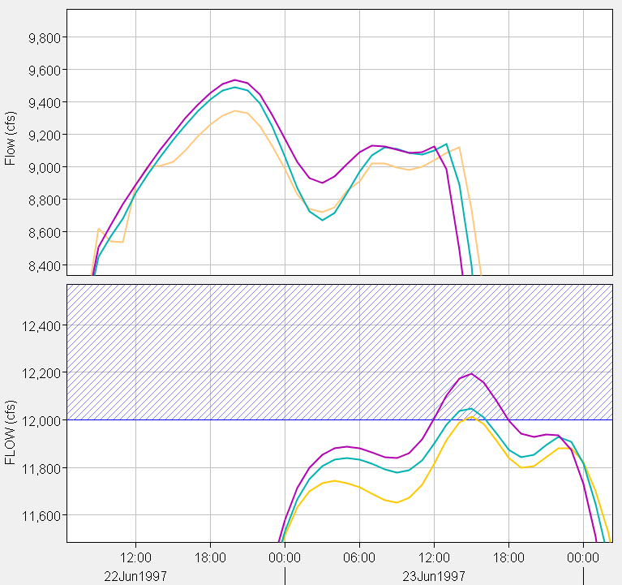

Comparison of Advanced Downstream Control Options
Correction for Attenuation
Option 1 (Lagged Space Adjustment)
Typically, less likely to exceed target
May cause irregular releases
Option 2 (Predictor Corrector)
May exceed target
Typically, slower than Option 1
No Correction
May exceed target significantly
Fastest method
Non-linear routing issues
All methods will perform poorly if lag estimate is bad
Set pulse release near target flow
More robust logic in upcoming version
Release
Downstream
Routing Lag
Slide 30

Slide 31
Questions?
Slide 31

