Slide 1
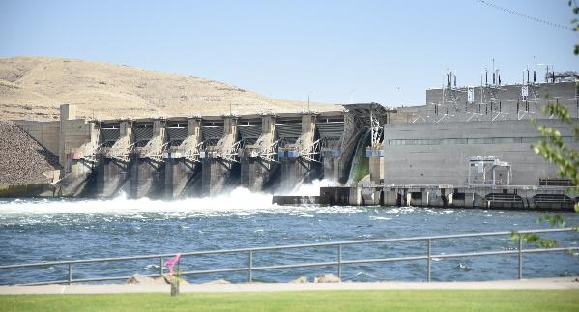
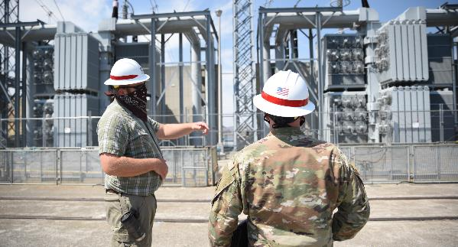
Hydropower Concepts
Background and Basics
How hydropower demands impact ResSim Simulation.
Notes:
Hydropower is a big factor in reservoir operations
You might not need to model specific details of a hydropower operation, but it is good to know how they work
Advise modeling as little as possible, as hydropower gets complex
What do we need to model hydropower?
On a daily basis?
On an hourly basis?
What about weekly?
Or seasonal/annual demands?
We’ll get into HOW to model these in ResSim in the next lecture, but for now we need to define some terms and concepts

Slide 2
Objective:
To review some basic hydropower concepts and how they affect reservoir system analysis.
  General Energy Concepts
    Definitions
    The Nature of Power Demand and Supply
  Types of Hydropower Projects
  Computing Hydropower Releases
  Reservoir Hydropower Simulation
Notes:
Nature of supply and demand is a big source of uncertainty in hydropower modeling
Types of hydropower projects – understand what to model
How ResSim determines releases for hydropower, and how ResSim calculates hydropower production

Slide 3
Definitions
Work = Force × Distance (ft-lbs. or N-m)
Power = Rate of doing work
  Referred to as Capacity (to do work)
  Electric Capacity given in Megawatts*
  1 Kilowatt = 1,000 N-m/sec = 737.56 ft-lbs./sec
  1 Megawatt = 1000 Kilowatts.
Energy = Work = Power * Time
  Electric Energy given in Kilowatt-hours*
  Work accomplished, but not how fast!
Notes:
These definitions are things you might have learned about in Physics 101.
Kilowatts (KW) and Kilowatt-Hours (KWh) are common units reported to the consumer to describe their power/energy usage. The scale of what you see on your power bill.
However, Megawatts, Gigawatts, and Terawatts are all units used in the industry to describe demand and generation at the plant or system level
ResSim works in Megawatts (MW) and Megawatt-Hours (MWh).
Has anyone sized a solar power system for their house? How big was that? ~6-10KW
How big is a typical hydropower turbine? In the neighborhood of 10s or 100s of KW to 100s of MW for the largest single turbines.
Largest powerplants by capacity are around 6 gigawatts of power.
Anyone know what total US hydropower production is – in terms of energy that is? A rough estimate? ~250 to 300 billion kilowatt hours
Total for all US electric power? 4,178 billion KWh (2023)
See sources:
https://www.eia.gov/todayinenergy/detail.php?id=61883
https://www.eia.gov/tools/faqs/faq.php?id=427&t=3

Slide 4
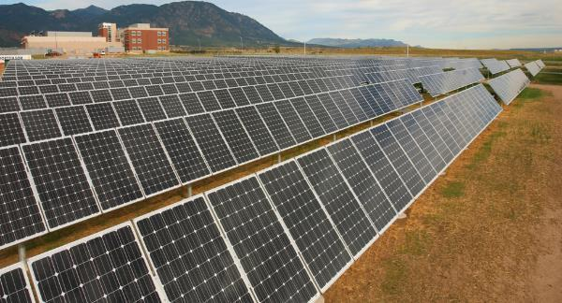
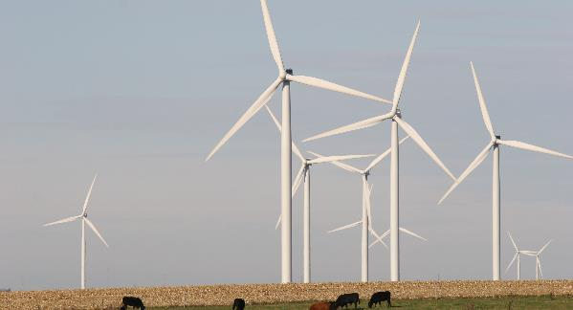
The Nature of Power Demand and Supply
4
Notes:
Anyone have a guess why I have solar and wind on this slide?
Large power

Slide 5


Nature of Power Demand
Demand for Power must be exactly met
  Over supply – if not sold, it’s waste.
  Under supply – undesirable consequences…
But, Demand varies…
  Throughout each day
  From day to day
  And from week to week, month to month, year to year…
  Supply must match demand at all times
Notes:
Supply MUST EQUAL Demand – Really? Or is this just an objective? Why would we make this statement?
Because undersupply has undesirable consequences – blackouts, brownouts, damage to infrastructure and equipment
And oversupply goes to waste – if it can’t be sold. Electricity can’t be stored – although it can be converted to other forms of energy – e.g., batteries store electrical energy as chemical energy. What other ways can we “store” energy.
Dogs: Amanda Walsh’s dogs: Archer and Flynn (puppies), Archer and Boe

Slide 6
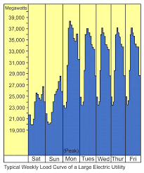
Load Curves
Load = demand for power
Load Curve: Graph of load changing with time
  Hourly, Daily, Weekly,
  Monthly, Seasonally, Annually
Example: Typical Weekly Load
  Weekends low
  Nights low
  Mid-day peak

Slide 7
Load Characterization
Daily Load Curve
Load-Duration Curve
Power Demand
Peak Load
Peak Load
Intermediate
Load
Intermediate
Load
Base Load
Base Load
Time of Day
% of Day
System Capacity is Sized to Meet Maximum Power Demand
Notes:
Baseload sources operate day and night, generating at a constant rate – this is the most efficient use of the turbines and generators and reduces the code of energy production. Nuclear, coal, oil, gas
Intermediate Load sources – not as difficult to ramp up as base load, not as expensive to operate as peak load. Combined cycle thermal plants – gas, oil, biomass, geothermal. Scheduled Hydropower. Solar. Wind.
Peak Load sources – able to ramp up quickly, inefficient and therefore expensive. Gas turbines (simple cycle), peaking hydropower (often with pumpback storage)

Slide 8

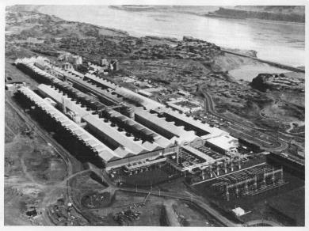
Large Power Demands
Some industries are very high in power demand:
  Aluminum smelting, other large industrial processes
  Data centers for “the cloud”
These tend to be a very big influence on having a large base load in the region.

Slide 9
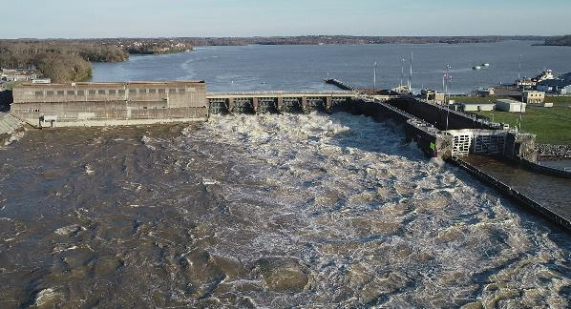
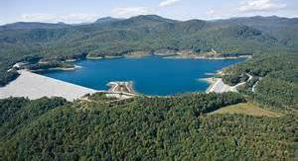
Hydropower Definitions
9
Notes:
Old Hickory Lock & Dam
Bad Creek Lake (a pump-back / pumped hydro project)

Slide 10
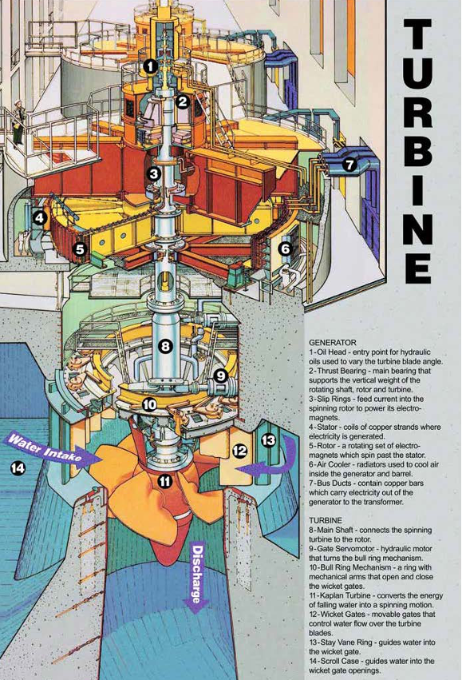
How does hydropower work?
Difference in potential energy: Headwater vs tailwater:
  head = headwater – tailwater – hyd. losses
Water flows through penstocks into the turbine, as controlled by gates
Turbine rotates to turn magnetized rotor
Stator picks up magnetic field and turns into electricity.
Stator is connected to electric grid
Notes:
Lots of terms for what is in a powerplant / unit

Slide 11
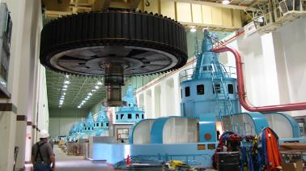
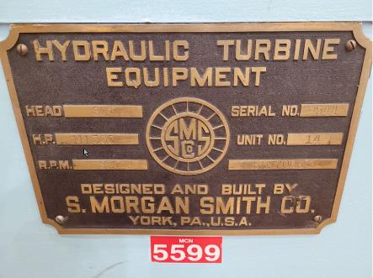
Other terms
Capacity:
  Total “installed/rated/nameplate” power of units in the power plant
Capacity Factor (%):
  fraction of capacity available due to outages
Capability:
  total possible (nominal) generation for a period
    limited by head
Plant Factor (%):
  Actual energy produced / total capacity
    over a specified period
Notes:
Capacity factor and plant factor used in a few different places in ResSim, and honestly can be confusing if you’re not used to it

Slide 12
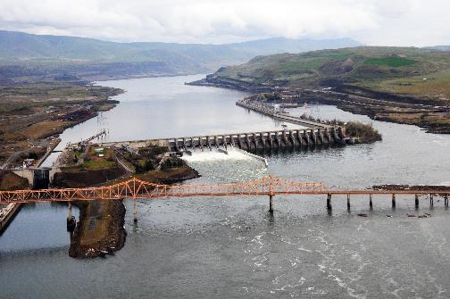
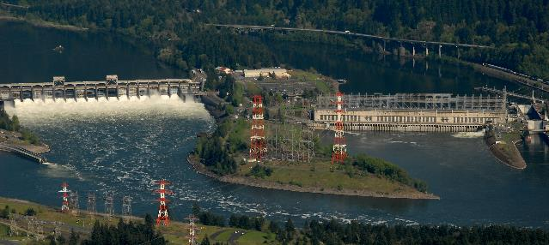
Run-of-River Projects
Headwater essentially constant:
  +/- a few feet, often not modeled
Tailwater dependent on flow
Energy computed for flow passage
Energy is Secondary with lower value
Often downstream from storage project
Flow-Duration can estimate energy
Sequential Routing needed to model upstream storage projects
Notes:
The Dalles
Bonneville
Both on Columbia River

Slide 13
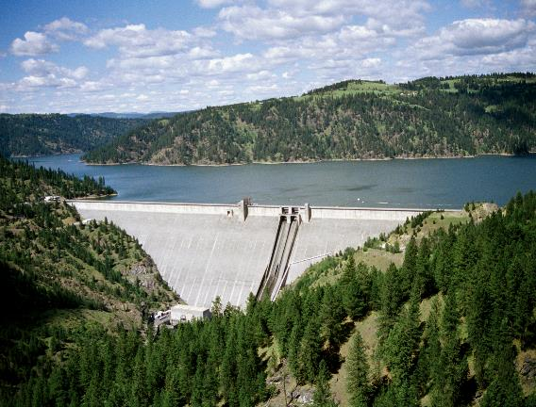
Storage Projects
Specified Power Storage Zone
Operate to meet Energy demand
Storage used when inflow is low
  Headwater varies with pool
  Tailwater dependent on flow
Sequential simulation generally required
Primary and Secondary energy are outputs
Notes:
Dworshak Dam, Idaho, Clearwater River. Tributary of Snake and then Columbia
3rd tallest dam in US, tallest in USACE portfolio, tallest straight axis concrete dam in US.
Why is height important on a storage reservoir? High head -> more capacity to make power with less flow.
Power capacity and releases vary by pool elevation/head.
Does a storage dam need a powerplant to generate hydropower?
Dworshak has a powerplant, but also each drop of water from Dworshak flows through 8 more dams, another ~750ft of head.

Slide 14
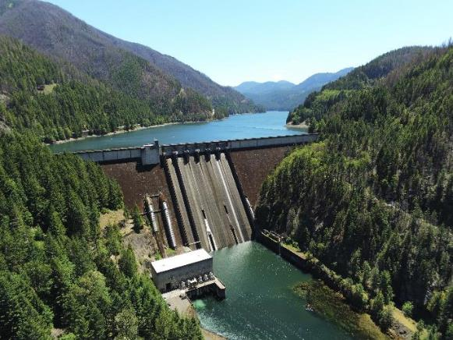
Storage – Peaking Projects
Peaking Power operates for short interval
Short time interval required to evaluate release*
  Maximum timestep = Time plant is generating
  High releases during generation
  Limited Releases when not generating
Downstream Impacts…
Notes:
Willamette - Detroit Dam
Short Interval Required to “accurately” evaluate release.
However, longer interval can be used when evaluating seasonal operation

Slide 15
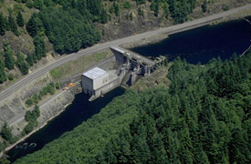
Re-Regulation Projects
Downstream of Peaking Project
Limited Storage
Variable Pool
Steady release
Reduced impact on downstream
Notes:
Big Cliff Dam – Downstream of Detroit
Simple rules typically in order to level out flows,
Does not require a powerplant, but power produced is incidental benefit as not the primary purpose.

Slide 16
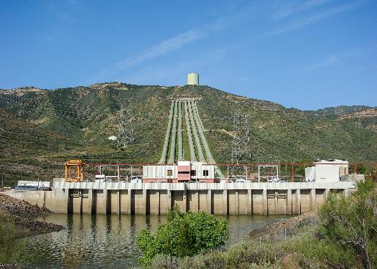
Pumped Storage
Storage project
  Reversable pump/turbines
  Separate inlet/outlet systems
Use excess (cheap) energy off the grid to pump uphill
Generate power when needed by running pumps in reverse
“rechargeable battery”
Notes:
There are a lot of proposals to build these, but a limited number that USACE offices deal with right now. (I can think of a handful that exist and influence USACE watersheds
Pictured is Castaic power plan near Los Angeles – note the penstocks on the surface of the hill behind the powerplant; others include Banks Lake off of Grand Coulee Dam on the Columbia River, which is also an irrigation withdraw, and Northfield Mountain (New England District); SAS has one in the Savannah River system as well
IMPORTANT: These requires some thought to model well in ResSim – for reasons we will talk about on Thursday during the compute blocks lecture. These can create “loops” in the network – in the way water flows through the watershed. This presents problems for computing elements in the correct order, upstream to downstream. ResSim will either fail to compute or compute some unexpected results.
Ideally, you can model it as a one-way exchange with a net flow, but that’s not always possible, especially if hydropower _results_ are needed.
Some of them can be modeled just as a diversion element.
There are pumps in ResSim, but you may not need to use those.
https://www.wbur.org/news/2016/12/02/northfield-mountain-hydroelectric-station

Slide 17
Storage – Power Guide Curve
Power demand expressed as a function of pool level
Firm energy from minimum power pool to power rule curve
Provides more energy when water supply is high
Notes:
Hydropower Storage Projects
Power Guide Curve used to expressed power demand as a function of pool elevation or available storage
This is a targeted power production amount (across one or more reservoirs)

Slide 18
Firm Energy
The amount of energy intended to have assured availability to the customer to meet all or any agreed upon portion of his load requirements.
Assured availability usually means that no shortages will be tolerated
Determined for the known or expected Critical Period
Dependable Capacity is the capacity associated with Firm Energy
Notes:
Calculated with yield analysis module, which we’ll show on Friday

Slide 19
Dependable Capacity
Load carrying ability of a station under adverse conditions for the time interval and period specified when related to the characteristics of load being applied.
Critical Hydro‑Period when the limitations of hydroelectric power supply due to water conditions are most critical with respect to system load requirements.
Notes:
Determined by yield analysis, matching water / hydrologic record with demands.

Slide 20
Value of Energy and Capacity
Separate benefits for energy & capacity
Primary Power benefits for dependable capacity and firm energy
  Energy based on kW-Hrs on demand
  Capacity based on availability at critical period or time
Secondary Power benefits for energy produced during high flow periods
  Secondary value usually much lower

Slide 21
Computing Hydropower Releases
21

Slide 22
The Power Equation
Power = weight of a discharge falling a distance
Power (kW) = [Q * w * h * e] / 737.56
  Q = discharge in cfs
  w = weight of water in lbs./ft3
  h = net head in feet (Total h - Hydraulic losses)
  e = efficiency of generator & turbine units
  737.56 ft-lbs./sec = 1 Kilowatt
Notes:
What do you notice about the equation? Are there any terms that are a function of the others?

Slide 23
Calculation of Power Releases
Q = 737.56 (P) / (w * h * e)
  P = power required (in kW)
  e = efficiency
  w = weight of water = 62.4 lbs./ft3
  h = Headwater - Tailwater – Losses (net head)
Q = 11.82 ( P / h * e )
  Efficiency, Headwater, Tailwater, & Losses depend on Q
  Iterative solution is required
Notes:
Rearrange the Power equation to get Q
Simplify the known constants
737.56 / (62.4) = 11.82
What do you notice about the equation? Are there any terms that are a function of the others?

Slide 24
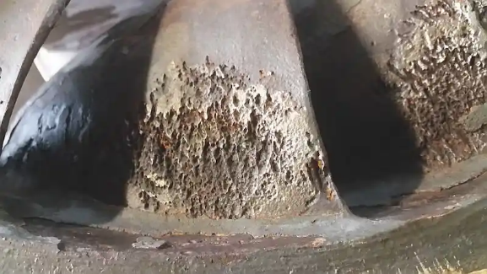
Hydropower Limits
Penstock Flow Capacity - can’t release more than penstock can carry
Penstock Cavitation limits – high and low flow
Generator Overload Capacity - can’t generate more than maximum capacity
Variable efficiency
  maximum efficiency exists in a narrow range of head and discharge
  Low efficiency can waste water…
Notes:
Photo of cavitation damage
https://www.waterpowermagazine.com/analysis/combating-cavitation-and-erosion-at-hydropower-plants/?cf-view

Slide 25
Reservoir Hydropower Simulation

Slide 26
Power Release Determination: Instantaneous
Assume net Head
  Initial based on previous period
Compute Q, based on capacity (kW)
  Q_{outflow} = Q_{power} + Q_{losses} + Q_{evaporation}
Determine Tailwater for Q
Calculate net Head, based headwater, tailwater and losses
Compute new discharge using net Head
Repeat until net Head remains same
Notes:
TODO add images of instantaneous and period average data

Slide 27
Power Release Determination: Period Average
Compute Average Q for period
  Q_{outflow} = Q_{power} + Q_{losses} + Q_{evaporation}
Compute ending Storage
Determine ending Elevation
Calculate avg. Head & Efficiency for period
Return and repeat cycle until average Q remains the same

Slide 28
Water Lost to Hydropower
Leakage & Seepage
Evaporation - dependent on release
Fish Ladders, Fish Spill, Other…
Navigation Locks
Station use – cooling, power, water supply

Slide 29
Take Home Points
Load Curve
Duration Curve
Types of Hydropower Projects
  Storage
  Peaking
  ReReg
  Run of River
  Others?
Firm Energy
Dependable Capacity
Primary vs Secondary Energy
Power Equation:
  Power (kW) = [Q * w * h * e] / 737.56
Iterative Solution – solve for Q
  Q = 737.56 (P) / (w * h * e)

Slide 30
References
Estimate of National Hydroelectric Power Potential at Existing Dams, USACE, July 1977
Hydroelectric Power Evaluation, Federal Power Commission, FPC P-35, March 1968
Hydropower, EM 1110-2-1701, 31 Dec 1985
Potential for Increasing the Output of Existing Hydroelectric Plants, USACE, HEC July 1981

