Slide 1
Emergency Spillway Gate Operation Induced Surcharge Operation
Beth Faber, PhD, P.E.
USACE, Institute for Water Resources, Hydrologic Engineering Center
HEC-ResSim

Slide 2
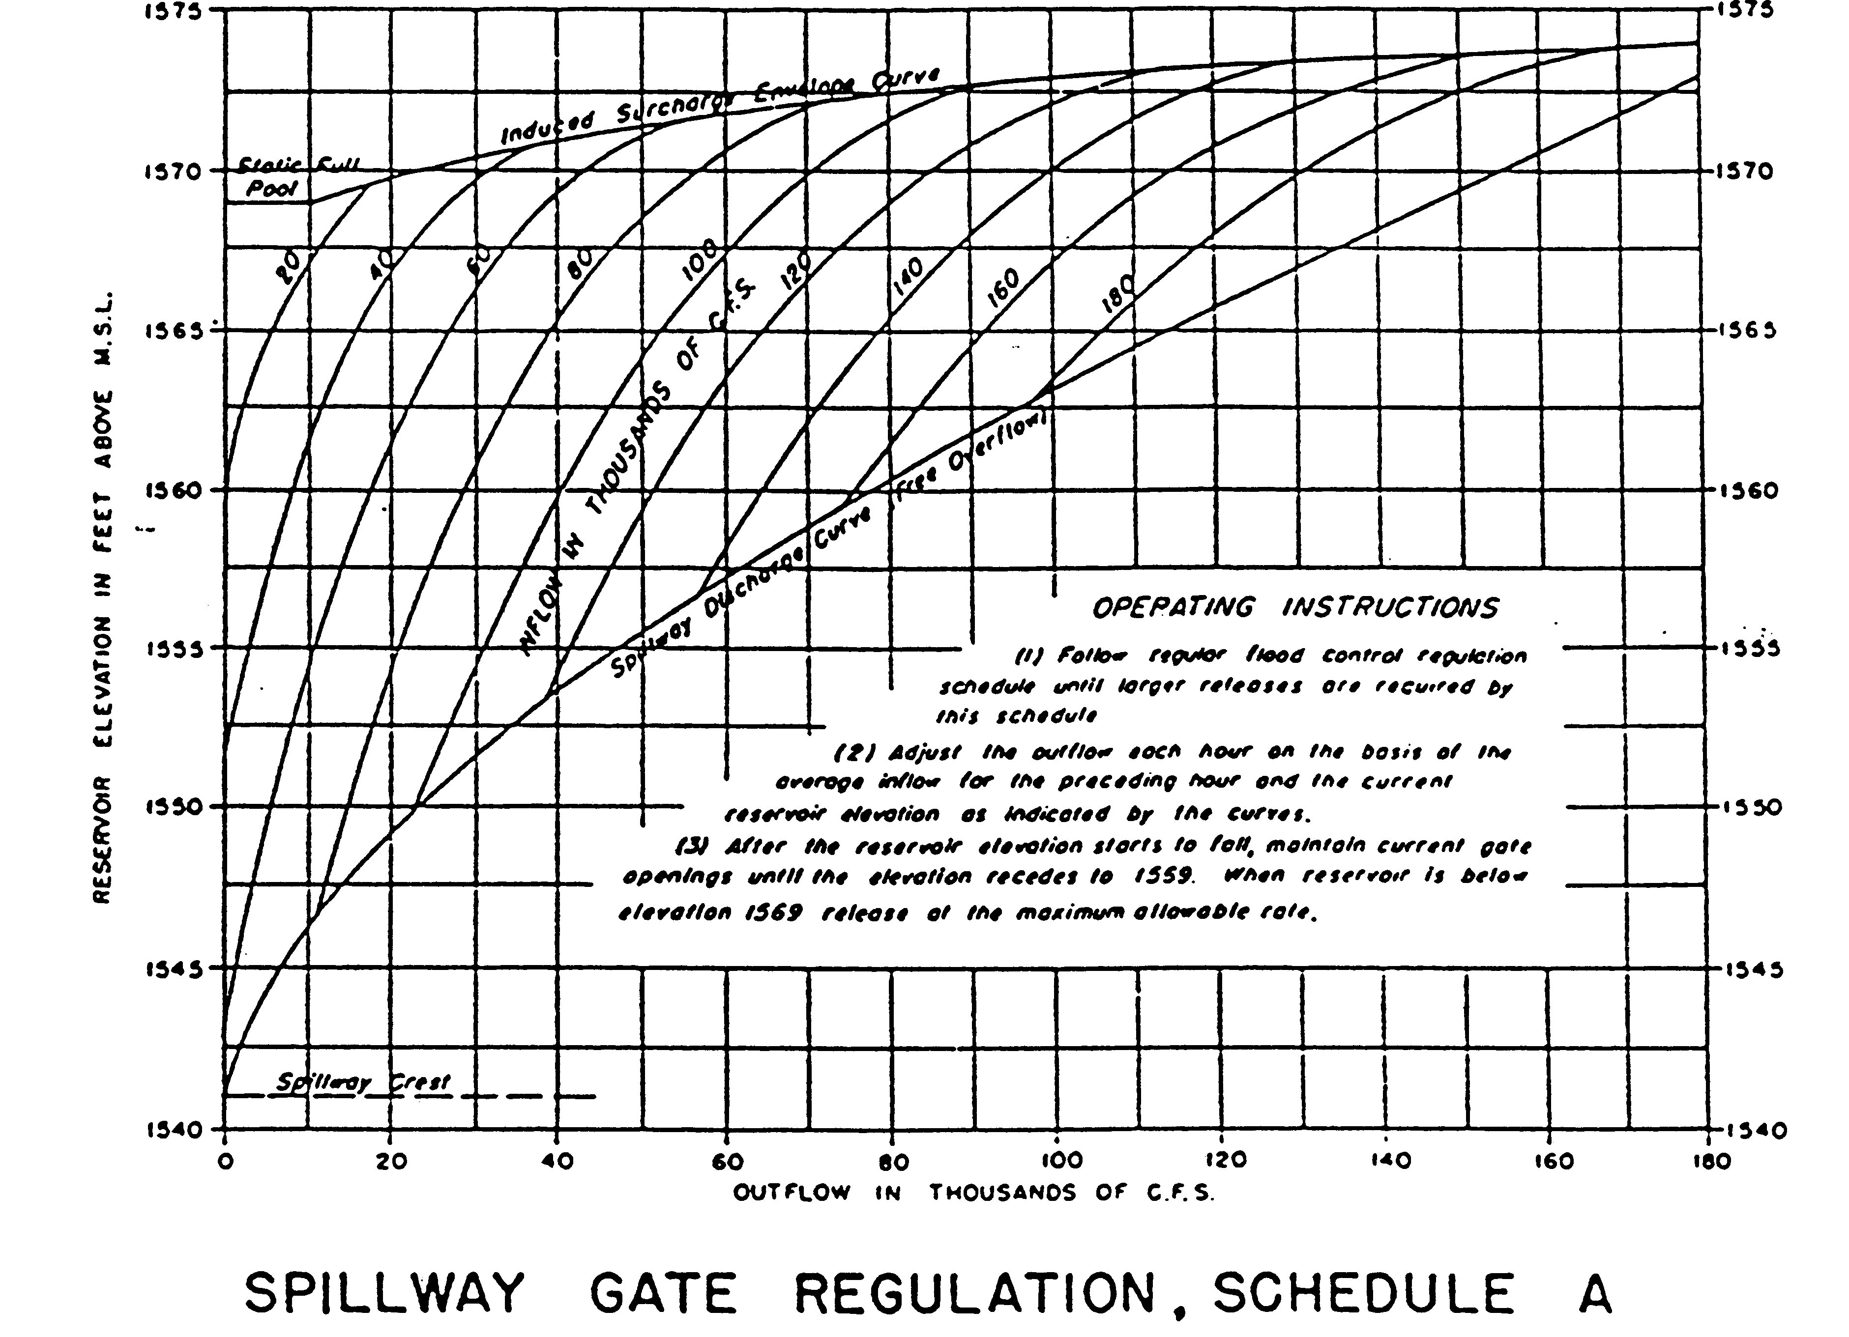
Induced Surcharge Envelope Curve
100 kcfs
140 kcfs
Spillway Discharge Curve (Free Overflow)
Inflow Level
Reservoir Elevation [ft]
Spillway Crest
Reservoir Outflow [1,000 cfs]
Notes:
This presentation covers the operation of spillway gates to aid flood operations. This diagram shown is one developed by a logic called “Induced Surcharge” which directs the release from a reservoir as a function of pool elevation (vertical axis) and inflow (diagonal lines).

Slide 3
Outline
Terms and Background
Induced Surcharge Theory
How to develop the diagram
How to use the diagram
Induced Surcharge in ResSim
What to look for in operations
Oroville event (2017)

Slide 4
Terms and Background
“Surcharge Storage” is water stored above the top of the flood pool – or (if more literal), above the spillway crest
surcharge happens naturally with any overflow structure (weir, spillway crest)
we can “induce” surcharge storage in a controlled way with a gated spillway, restricting release to store higher

Slide 5
Background
Slide 5
Why induced surcharge operation?
Allows maximum use of the available flood storage space in the reservoir
AND
Allows evacuation of flood waters in a planned manner as the reservoir rises, before the flood pool has filled
as opposed to a “fill and spill” operation
store more
release sooner, so fill later
Notes:
Why should we release sooner? To delay letting the reservoir reach “full,” and thus delay the outflow = inflow result. Hopefully, delay until inflow is low enough to pass safely.

Slide 6
Gated Spillway Operation
Slide 6
Flood Objectives (or Constraints)
Do not endanger the dam
Do not let water flow over the spillway gates
Do not make the flood worse
Do not let the peak outflow exceed the pre-project natural peak discharge
Do not let the rate-of-increase of outflow exceed acceptable limits
Notes:
These are the standard objectives involved in operation of reservoirs for flood risk management. Most important is protecting the dam, as the dam itself and the water stacked behind it represents the potentially most dangerous element of flood protection. We’ve created a hazard (the stored water) to allow us to reduce flood risk by storing high flows. But we must ensure that this greater hazard (the dam and stored water) is kept in check. Hence, the highest priority is protecting the dam from breach.
Each objective may be violated to prevent violating a higher objective. So, not endangering the dam is most important. Not making the flood “worse” is next in importance, but it would be done to avoid endangering the dam. Similarly, not exceeding acceptable rate of increase in release is next in importance, but it would be violated to avoid making the flood worse, or endangering the dam.

Slide 7
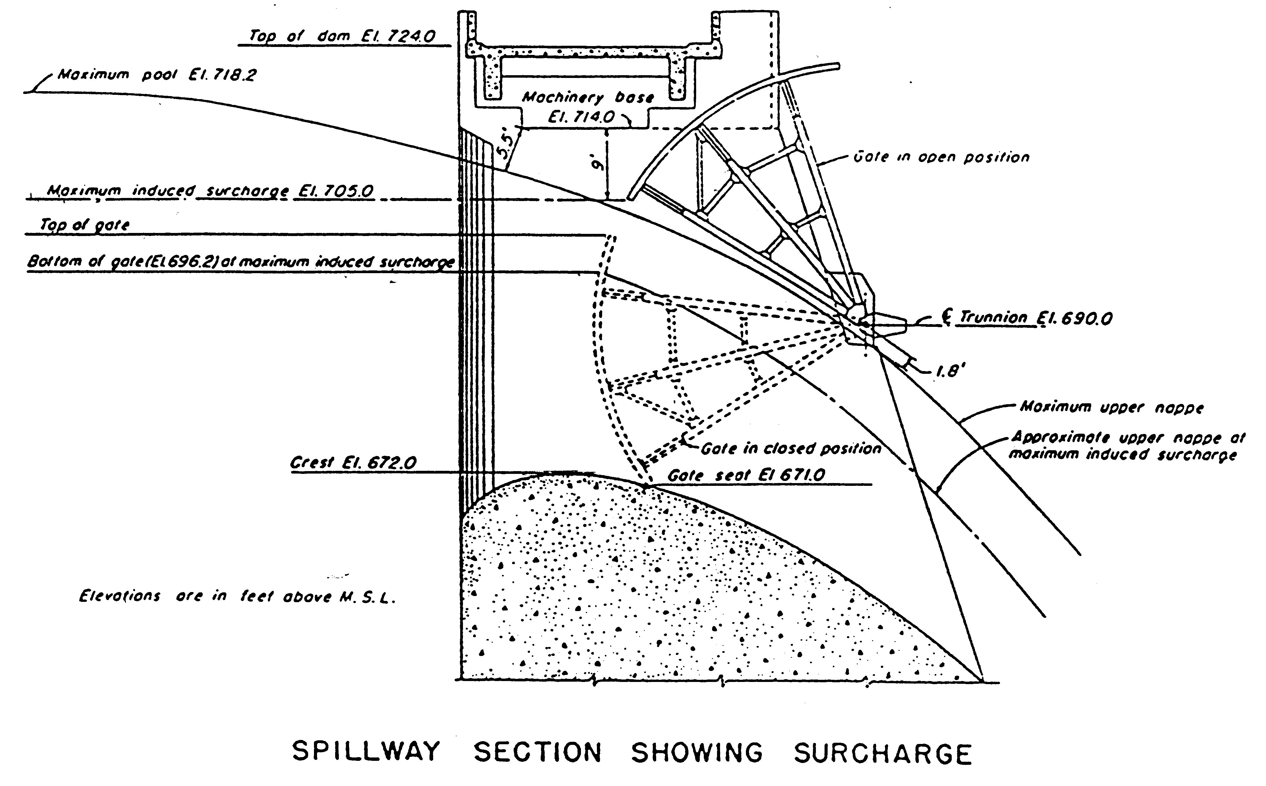
Spillway Gate Section
Slide 7
Radial (Tainter) Gate
Top of Flood Pool
Water!
Notes:
Right out of the Water Control EM, Gate Regulation section
Picture of a typical spillway gate – too busy, lets break it down
Flood Control Pool – Physical Significance: Up to the level, you can keep the releases at 0 to provide maximum protection for the downstream.
Max Pool – as high as the pool can go without overtopping the gates.
Max Induced Surcharge – this is subjective (a choice). Factors include estimation of risk, physical characteristic of flow and gate stability, …

Slide 8
Spillway Gate Section
Slide 8
Radial (Tainter) Gate
Max Pool
Water!
Notes:
Right out of the Water Control EM, Gate Regulation section
Picture of a typical spillway gate – too busy, lets break it down
Flood Control Pool – Physical Significance: Up to the level, you can keep the releases at 0 to provide maximum protection for the downstream.
Max Pool – as high as the pool can go without overtopping the gates.
Max Induced Surcharge – this is subjective (a choice). Factors include estimation of risk, physical characteristic of flow and gate stability, …

Slide 9
Spillway Gate Section
Slide 9
Radial (Tainter) Gate
Max Induced Surcharge
Water!
Notes:
Right out of the Water Control EM, Gate Regulation section
Picture of a typical spillway gate – too busy, lets break it down
Flood Control Pool – Physical Significance: Up to the level, you can keep the releases at 0 to provide maximum protection for the downstream.
Max Pool – as high as the pool can go without overtopping the gates.
Max Induced Surcharge – this is subjective (a choice). Factors include estimation of risk, physical characteristic of flow and gate stability, …

Slide 10
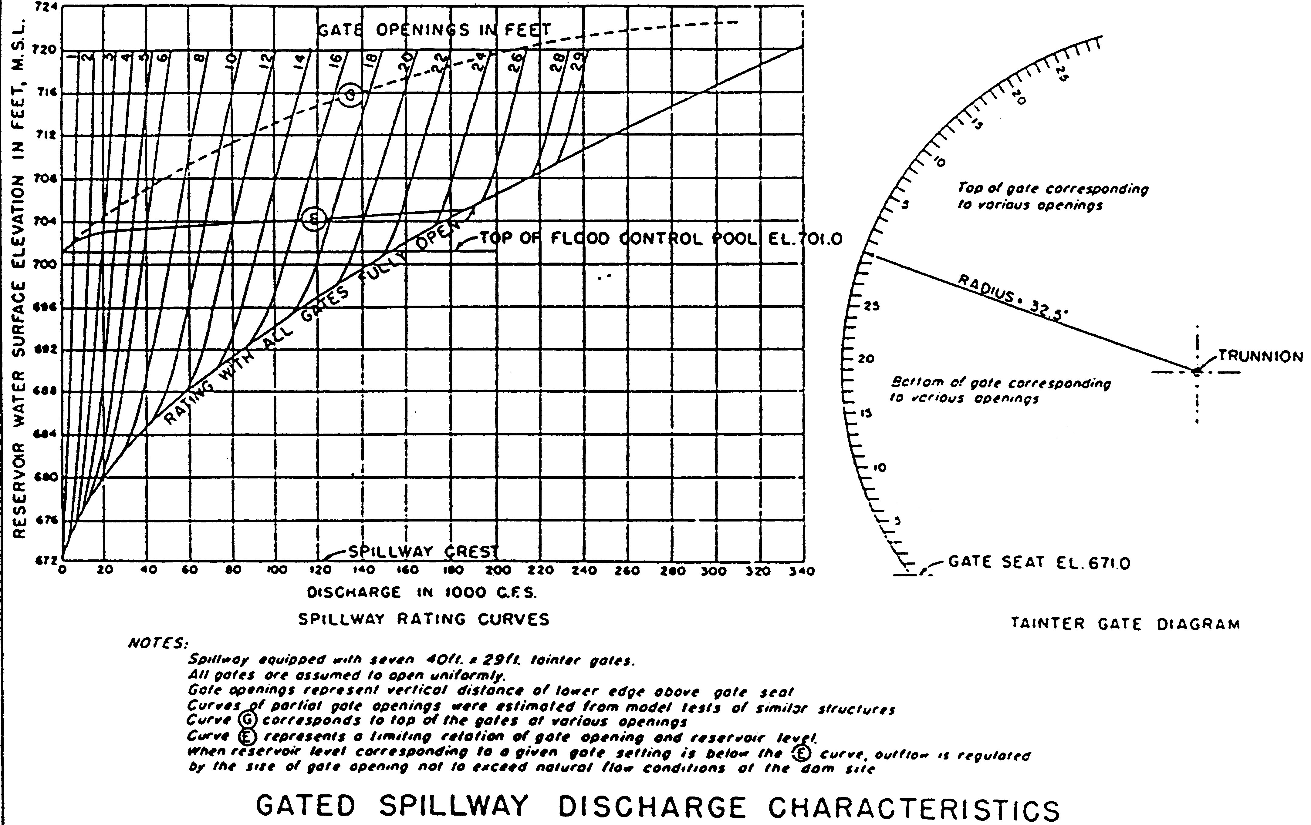
Spillway Gate Capacity Diagram
Slide 10
Induced Surcharge Envelope
Maximum
Permissible
Elevation
Minimum
Permissible
Release
Reservoir Elevation [ft]
Top Of Flood Pool
Release With Gates Fully Open
Spillway Discharge [1000 cfs]
Notes:
Here we see the gated spillway capacity diagram, which tells outflow given elevation and how far open the gate is. The green line is with the gates fully open, and so free overflow over the spillway. Each black line is 1 foot further closed.
The top of the flood pool is shown in blue. The induced surcharge envelope is shown in orange. Note, this line is two-dimensional on this plot, meaning it is not just one elevation, but rather an elevation that increases as release increases.
The induced surcharge Envelope represents two things
max elevation at a given discharge
And min discharge at a given elevation
Notice the slope – much steeper at low flow
this means you don’t react as much for small changes in elevation when elevation is still low
the flatter slope at higher elevation indicates a much larger reaction for small elevation changes
as soon as you are in surcharge, you’ve got a min release – you cannot just let it rise.
NOTE, the induced surcharge envelope’s definition is subjective. It is also not a release specification. The intention is for the reservoir to never reach the induced surcharge envelope!

Slide 11
Induced Surcharge Envelope
Slide 11
The Induced Surcharge Envelope is:
the maximum permissible reservoir elevation at any rate of spillway release
OR
the minimum release at any extreme reservoir elevation
Steeper slope in more-used portion
required release increases more slowly w/elevation
Flatter slope for more extreme events/elevations
required release increases rapidly w/elevation
save the dam!

Slide 12
Induced Surcharge Diagram
Slide 12
The Surcharge Diagram provides release instructions for emergency operation
a.k.a. Emergency Gate Regulation Schedule or Emergency Spillway Release Diagram
Based on not exceeding the envelope in the event
Required release is based on volume of remaining inflow “expected” during the event, and current storage space
For a given pool elevation and inflow (or rate of rise), indicated release should ensure the pool does not rise above the surcharge envelope curve before the end of the event

Slide 13
Induced Surcharge Computation
Slide 13
Decision Point
Recession, Defined By T_{s}
Streamflow
Current Release
Time
Notes:
The following images describe the induced surcharge logic and its use in computation of the diagram.
This image is a flood hydrograph, with dark blue inflow, and light blue dashed release. The vertical line is the current time of decision, with the earlier flow values known, and the later flow values not yet known. The pink link is the presumed recession from the current inflow, if it were the peak of the event.

Slide 14
Induced Surcharge Computation
Slide 14
Current inflow assumed to be peak, to avoid releasing more than needed. Will revisit in next time-step…
Decision Point
Recession, Defined By T_{s}
Streamflow
Current Release
Time
Notes:
Here, future inflows are not seen, and the pink recession represents the presumption of the current point being the peak of the event. This seems to be a low estimate, which would likely underestimate the event. However, any releases suggested by this assumption would only be used for an hour, with the next inflow point an hour later being brought in, and thus presuming a new recession. (See next slide.)
This potential underestimation is also somewhat balanced

Slide 15
Induced Surcharge Computation
Slide 15
Later Decision Points
Decision Point
Recession Hydrographs
Recession, Defined By T_{s}
Streamflow
Current Release
Time
Notes:
This image includes the next two inflow values, with each of them presumed as the peak of the event for further computation. So, note that as the flood even precedes, the expected inflow volume continues to increase as inflow increases. The reason for this “conservative” estimate is that at some point, the releases called for by the induced surcharge diagram exceed channel capacity. We do not want to cause damage if there is a chance it isn’t necessary. With the recessional assumption, we are sure any releases called for are necessary to protect the dam.
This potential underestimation is also somewhat balanced by the additional assumption in the diagram that release is constant into the future. In fact, the release will be increasing with each time step as inflow increases, based on the diagram itself.

Slide 16
Induced Surcharge Computation
Slide 16
Decision Point
Recession, Defined By T_{s}
Streamflow
Larger Value Of T_{s}
Smaller Value Of T_{s}
Time
Notes:
The reservoir assumed from the current inflow is defined by a recession constant, Ts. Note that a higher value assumes a slower recession in pink that produces more volume (area under the hydrograph). The lower Ts with the quicker recession shown in orange produces less volume. The value of Ts is estimated for the watershed by large storms or design events.

Slide 17
Induced Surcharge Computation
Slide 17
Decision Point
Recession, Defined By T_{s}
Streamflow
Current Release
Time

Slide 18
Induced Surcharge Computation
Slide 18
Decision Point
Q_{i}
Recession, Defined By T_{s}
Streamflow
Current Release
Volume To Be Managed
Q_{o}
Time
Notes:
A hydrograph is flow versus time, and so volume per time against time. This means that the area under the curve is volume. Starting from the decision point, the area under the inflow hydrograph is the volume of water into the reservoir to be managed.

Slide 19
Induced Surcharge Computation
Slide 19
Decision Point
note, cannot solve for Q_{o}
Q_{i}
Streamflow
inflow drops below release
Current Release
volume to be stored
Q_{o}
volume of release
Time
Notes:
If we subtract the volume of release from the volume of inflow to be managed, we’re left with the volume to be stored in the reservoir. This volume is shown by the darker gray “triangle” above the release line.
The equation for the volume to be stored is shown at the top right. It includes current inflow Qi, current outflow Qo, and the recession constant Ts. Note that while our interest is actually in the release we need to make from the reservoir, this equation can not be solved for Qo. Thus, we must use it another way…

Slide 20
Induced Surcharge Computation
Slide 20
Questions defining the computation of the diagram:
Would the “volume to be stored” put the reservoir above the allowable surcharge envelope (at current release)?
What elevation is low enough that the volume will fit?
Creating and Using diagram:
For many inflow/outflow pairs, compute & plot that elevation. Plotting and connecting points for a given inflow creates the surcharge diagram.
For a real-time inflow and elevation, the surcharge diagram provides the operating instructions to define release.
creating
using
Notes:
Question 2, what elevation is low enough that the “predicted” volume will fit in the reservoir, is the one that we use to define the induced surcharge diagram.
To create the induced surcharge diagram, we specify a series of inflow and outflow pairs, and for each compute the pool elevation that would allow the event to end right at the induced surcharge envelope. We connect lines of equal inflow.
To use the diagram, we note current elevation and inflow, and read release from the diagram.

Slide 21
Induced Surcharge Envelope Curve
Slide 21
vol to store
100 kcfs
140 kcfs
1564
Spillway Discharge Curve (Free Overflow)
Inflow
Reservoir Elevation [ft]
Spillway Crest
26
Reservoir Outflow [1,000 cfs]
Notes:
Suppose the computation for inflow = 100 kcfs and outflow = 40 kcfs. We compute the volume to storage from the Volume equation, then we subtract that volume from the envelope at its height at 40 kcfs. The result is the elevation that would lead to reaching the envelope at the end of the event if the recession proceed as assumed by Ts. Draw a dot. Repeat this computation for other outflow values. For outflow of 50 kcfs, the volume stored would be smaller, and for outflow 30 kcfs, the volume stored would be larger. Subtracting those volumes from the envelope at those outflows creates more dots and traces out the 100 kcfs line. Do the same for other inflows, and all of those outflows. This series of computations generates the diagram.
When it comes to using the diagram during an event, we enter the diagram with current elevation, here 1564 feet. We go to the inflow line for current inflow, here 60 kcfs, and look down to the outflow axis for the required outflow. Here, the required outflow is 26 kcfs from this diagram.

Slide 22
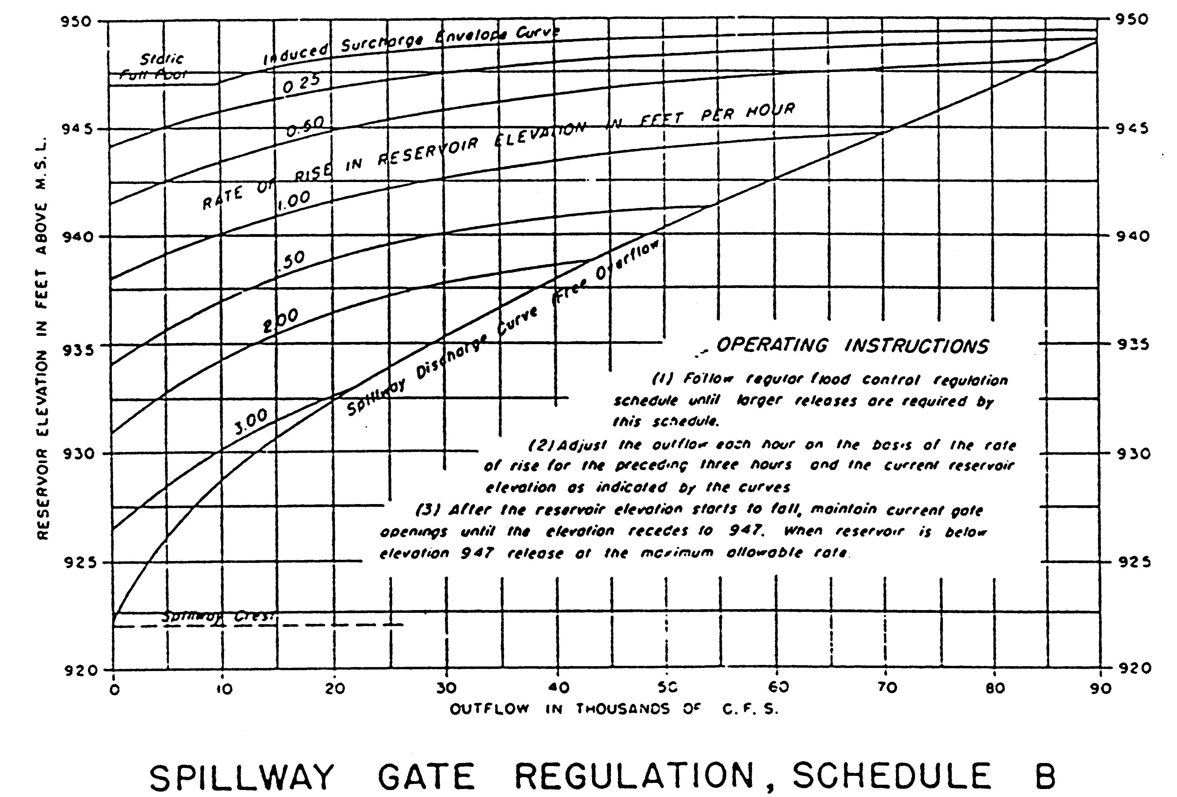
Slide 22
Induced Surcharge Envelope Curve
in Reservoir Elevation
Rate of Rise
1 ft/hour
Spillway Discharge Curve (Free Overflow)
1
Reservoir Elevation [ft]
Spillway Crest
Reservoir Outflow [1,000 cfs]
Notes:
Inflow to an onstream reservoir can rarely be measured directly. To estimate inflow, we use mass balance and compute outflow plus change in storage in the reservoir, based on measuring release, and two consecutive elevations to estimate the storage change.
In a flood event, when decisions must be made quickly, it can be more efficient to simply compute rate of change in elevation rather than inflows and storages. Therefore, the diagram is sometimes drawn with lines for rate of elevation rise, rather than inflow. The diagram is more complicated to draw, but once done, it is efficient to use.

Slide 23
Recession Constant, T_{s}
Slide 23
How is the recession constant Ts defined?
Plot recession limb of project (or spillway) design storm on semi-log paper, and fit a straight line
Find time needed to decrease from some flow Q_{A} to Q_{B}, where
Q_{B}= Q_{A}/e (or Q_{B}= Q_{A}/2.71)
Q_{A}
Q_{A}
log_{e} streamflow
Q_{B} = Q_{A}/e
Q_{B} = Q_{A}/2.71
Q_{B}
T_{S}
time
Notes:
The recession constant, Ts, must be estimated for the watershed. Usually, an historical event or design event it used, focusing on the recession limb of the hydrograph.
Plot the recession limb of the hydrograph on a log axis. Usually, natural log e is the log-base chosen, which is approximated equal to e=2.71. The recession time is the time it takes to decrease from a flow rate QA to a flow rate QB that is equal to QA divided by the log base. So, QB = QA/2.71. By nature of a log scale, this time value is independent of the flow value chosen as QA.

Slide 24
When is Induced Surcharge Operation Needed?
Slide 24
When one or more of the following conditions are present…
Large to very large inflow event
Rapidly rising inflow
Multi-peak
Long duration
Small or rapidly decreasing flood pool
Dam stability concerns
Notes:
Induced Surcharge operation is needed when the is the potential for reservoir levels that approach the top of the dam, meaning a full reservoir. Thus, reservoir releases that exceed channel capacity might be needed, and the induced surcharge logic is a structured way of managing the upper flood pool and the spillway gates.

Slide 25
Outline
Slide 25
Terms and Background
Induced Surcharge Theory
How to develop the diagram
How to use the diagram
Induced Surcharge in ResSim
What to look for in operations
Oroville event (2017)

Slide 26
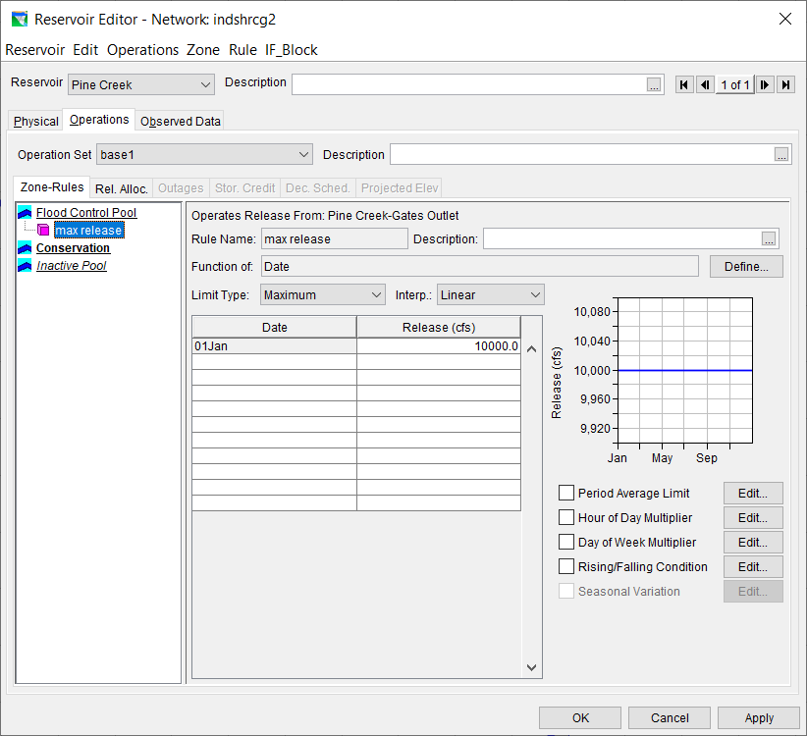
Slide 26
Notes:
This is a simple operation set, with a maximum release rule of 10,000 cfs. Let’s see how this operates a flood event, and whether it has the features we need for induced surcharge operation.

Slide 27
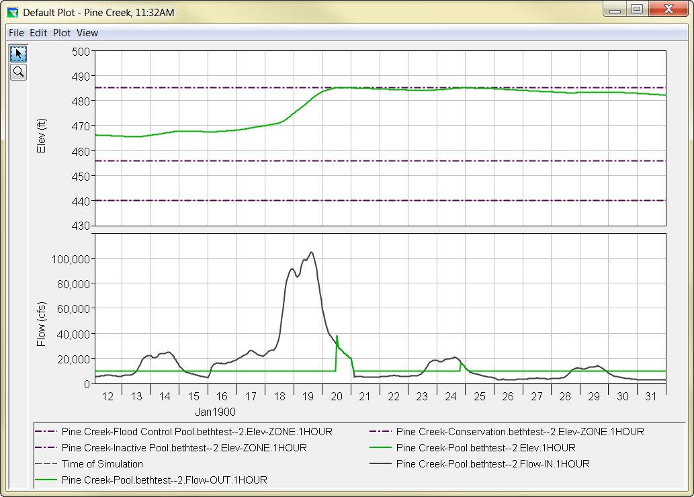
Slide 27
Top Of Flood Pool
fill and spill
Top Of Conservation
Notes:
This operation, with just the max flow rule, allows the reservoir to fill the flood pool, and then jumps to passing inflow.
While exceeding the maximum, this result is not terribly serious because the flood has mostly passed when the reservoir fills. Let’s see it if the reservoir starts higher in the flood pool, perhaps following an earlier flood.

Slide 28
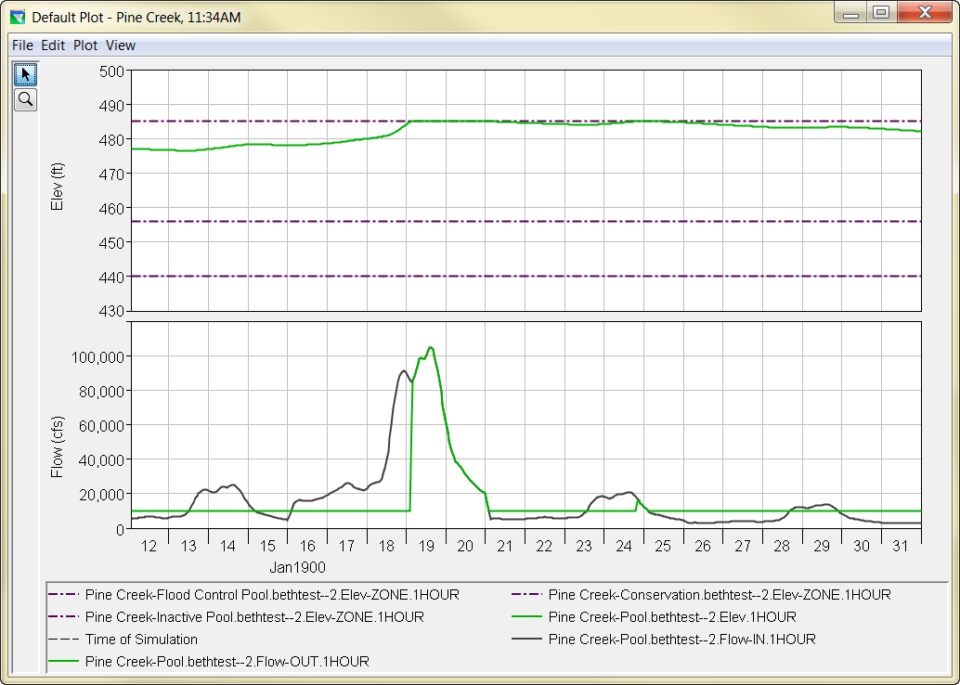
Slide 28
Top Of Flood Pool
fill and spill
Top Of Conservation
Notes:
Here’s the same event, but following another event and so the flood pool is partially filled already.
Here, the reservoir fills before the event peak, and so must pass the entire peak of the flood.
What could be we do better?

Slide 29
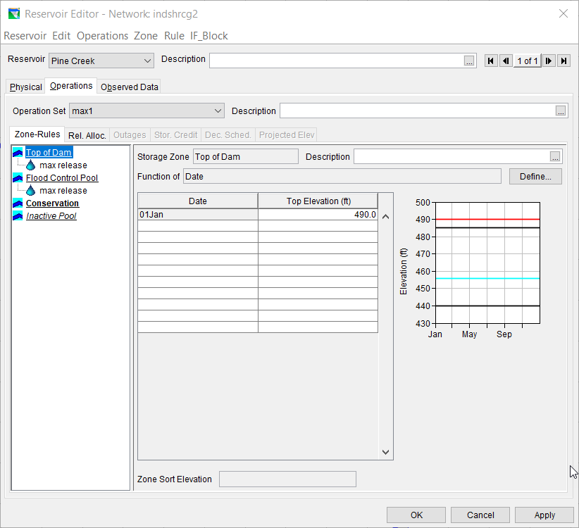
Slide 29
Notes:
Well, there is no zone above the top of the flood pool, so let’s add a zone called Top of Dam. We can put the same maximum flow rule in it.

Slide 30
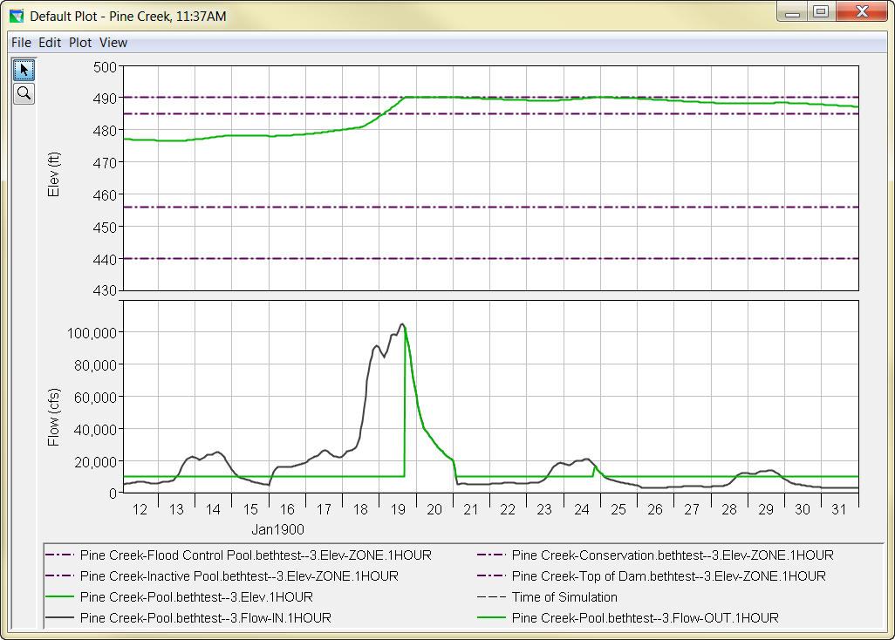
Slide 30
Top Of Dam
Top Of Flood Pool
Top Of Conservation
Notes:
Here, we have extra storage space with the new zone, but the operation follows the same “fill and spill” process.
What else could we do better?

Slide 31
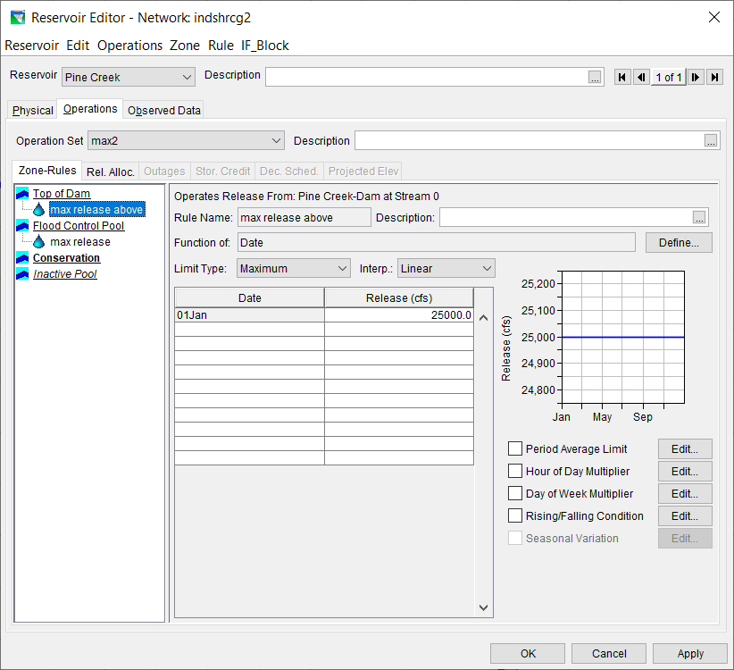
Slide 31
Notes:
Let’s release more aggressively in the higher zone, allowing 25,000 cfs when the reservoir passes the top of Flood zone.

Slide 32
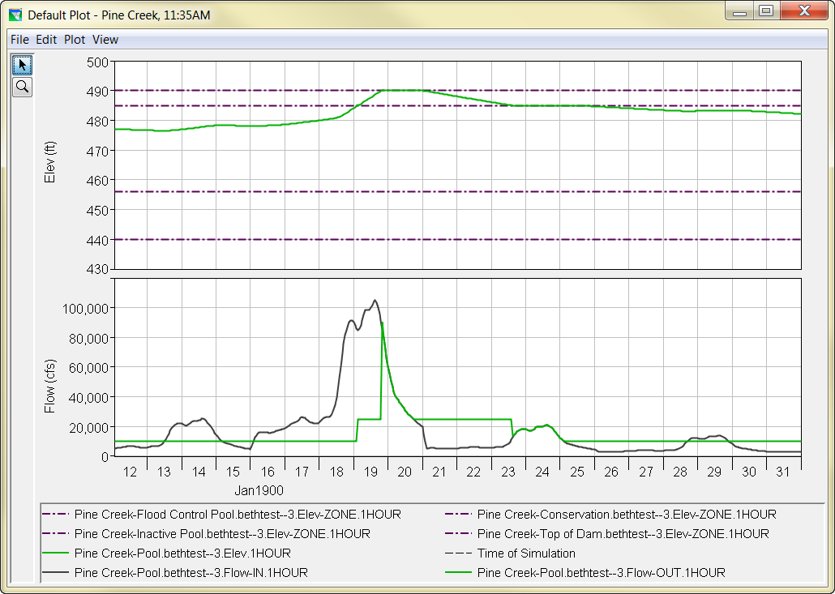
Slide 32
Top Of Dam
Top Of Flood Pool
Top Of Conservation
Notes:
This more aggressive rule makes it take longer for the reservoir to fill, but the outcome is still poor, and very dependent on the level at which the reservoir starts.

Slide 33
What’s wrong?
Slide 33
The Problem:
Rules are letting the reservoir become full
AND, the model doesn’t know what to do when the reservoir is full, other than pass inflow
The Solution:
We need a rule to allow a higher release when the reservoir is close to full
release as function of elevation?
…but also depends on high inflow…
use the Induced Surcharge rule!
Notes:
We have 2 main problems. The reservoir is reaching full, and the model doesn’t really know how to prevent it or what to do other than passing inflow at that point.
We want operation to do things differently. What about releasing more as elevation goes up? That would be a release function rule, which is a function of elevation. But, that rule would not include inflow also. The release function rule can pair elevation with date, but not with inflow.
So, there is a ResSim rule specifically to implement Induced Surcharge.

Slide 34
Induced Surcharge in ResSim
Slide 34
How do we produce Induced Surcharge operation in the ResSim environment?
with the Induced Surcharge Rule
In which zones should we put the rule?
in those zones that appear in the diagram
Does the IS rule apply to the Pool or Dam?
the Pool
What type of limit is the Induced Surcharge rule?
the Induced Surcharge rule is a MINIMUM rule

Slide 35
Induced Surcharge in ResSim
Slide 35
What information is needed for the IS rule?
Surcharge Envelope curve
Time of Recession, T_{s}
Inflow (Time-series) Option
Falling Pool instructions
Decrease time
Transition elevation
Falling pool release option
Notes:
To define the induced surcharge rule, we primarily need the induced surcharge envelope from the diagram, and the recession constant Ts needed to compute the inflow lines. We also need to specify whether we assume current inflow is know, or as in real operation, only estimated for the previous time period. Finally, we need to add instruction on what the rule should do after the reservoir level begins to fall, including when the rule should “shut off” and stop controlling.
Note, ResSim’s induced surcharge rule based on the IS logic doesn’t explicitly use the inflow lines, but rather does the equivalent of solving the volume-to-be-stored function for Qo, by iterating on Qo until the equation balances.

Slide 36
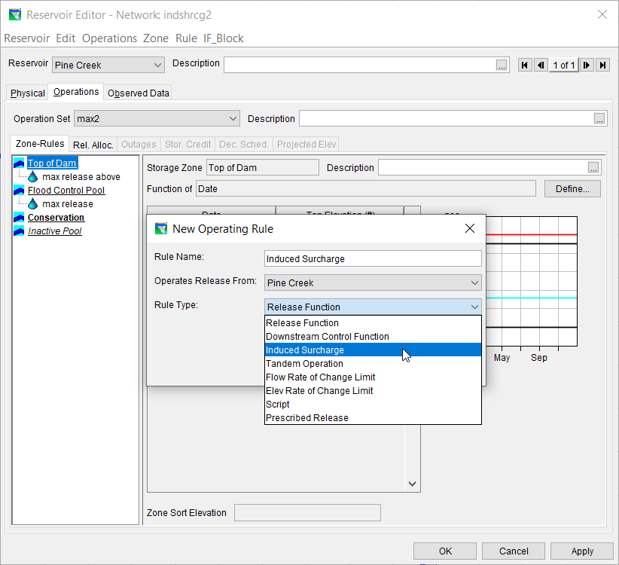
Slide 36
indsrchgRes
Notes:
The induced surcharge rule is available as a rule type only when the rule operates from the Pool, which is the first option in “operates from:”

Slide 37
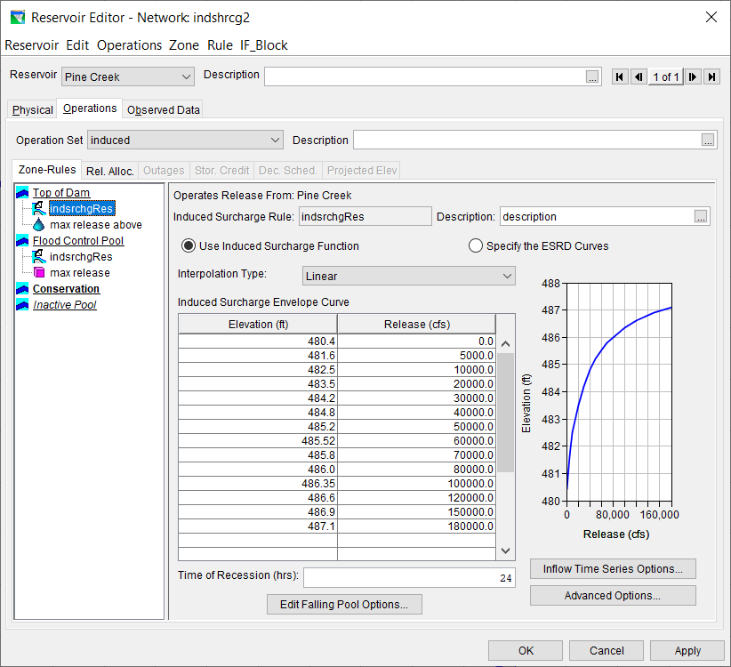
Slide 37
Notes:
This is the dialog box for the induced surcharge rule. The table of elevation versus release is where the IS envelope is defined. The plot shows the envelope graphically. The recession constant, Ts, is entered in a field below the table.

Slide 38
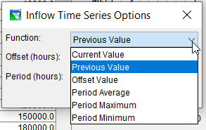
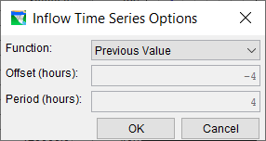
Slide 38
Notes:
The inflow option is found with a button in the lower right.

Slide 39
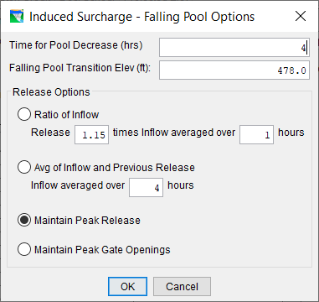
Slide 39
Notes:
Falling pool options are found behind the button in bottom center. There are 3 falling pool items to specify.
1- how many time periods the pool must fall before it’s said to be falling.
2- what elevation the pool falls to for the rule to turn off
3- what releases to make when the pool is falling
the first option defines release as a multiple of flow. Note, it must be greater than one (larger than flow) or the pool will rise again.
the second option averages inflow and release, which will be higher than inflow when inflow is lower than release (as it is when pool is falling)
the third and fourth option maintain current settings, either release, or gate setting. Note, constant gate will let release drop a bit.

Slide 40
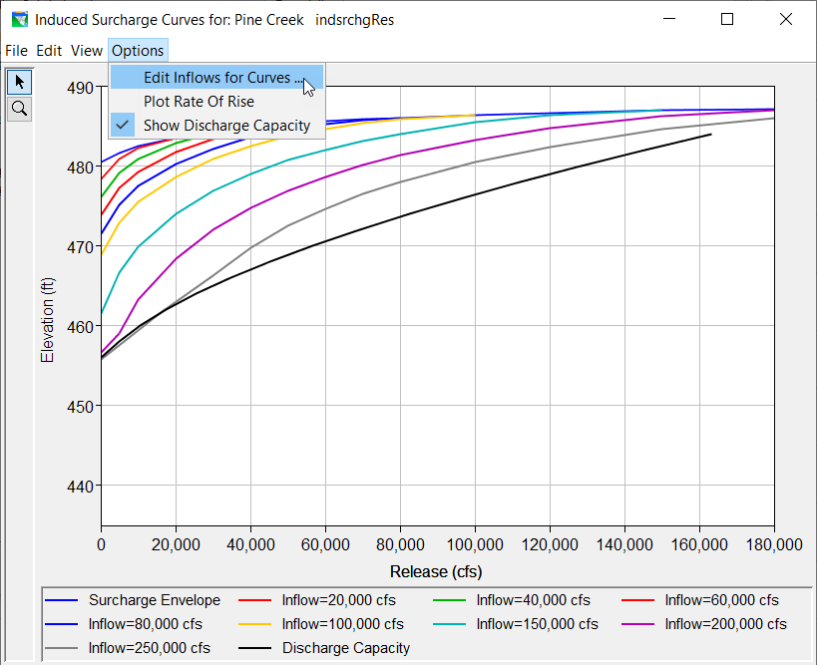
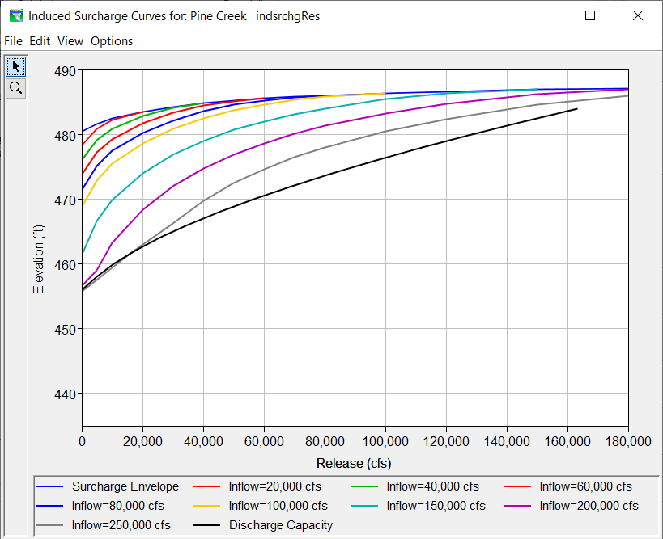
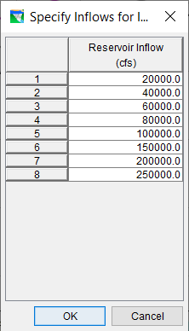
Slide 40
Notes:
It’s important to check that the induced surcharge inputs to ResSim reproduce the guidance in the reservoir regulation manual. To see the diagram inflow lines computed from the envelop and recession constant, Ts, double click on the envelop plot to pop it out. At first, it will show only the envelop and the free release curve. To add the inflow lines, select Options menu, and “Edit Inflows for Curves….”, and list the inflows used in the manual’s curve. Once entered, the lines for those inflows will show up in the diagram.
If the lines don’t match, it’s most likely due to the recession constant Ts not being the value used for the original diagram, as the envelope can be read directly. You can estimate whether it is too high or too low as follows:
When Ts is higher, this lead to higher volume-to-store, which leads to lower lines. If line are too low, try lowering Ts
When Ts is lower, this leads to lower volume-to-store, which leads to higher lines. If lines are too high, try raising Ts.

Slide 41
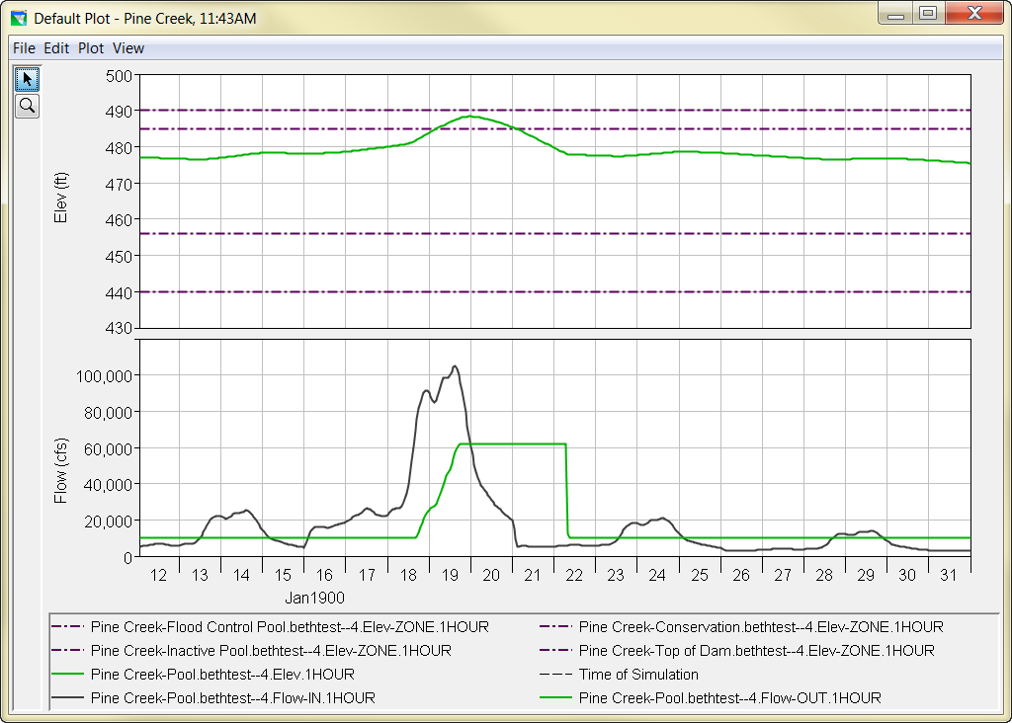
Slide 41
Top Of Dam
Top Of Flood Pool
Top Of Conservation
Notes:
Here is operation with the induced surcharge rule. This is good for several reasons. Release starts increasing before the pool reaches top of flood, and thus the pool doesn’t quite fill. Release stays high long enough to bring the pool back down some amount.
Note the point that the reservoir pool starts to fall. It happens when inflow drops below release. Of course. It’s important to keep the mass balance in mind!
There are a few things to consider and to fix here, such as what happens when the transition elevation 478 feet is reached and the rule shuts off. We’ll get to those issues soon! But first….

Slide 42
More to know
Slide 42
The Induced Surcharge rule is a MINIMUM release rule
It MUST be paired with a maximum rule at a lower priority to produce the right operation
physical capacity
IS min rule
max rule
Induced Surcharge release (min rule)
max rule
lower priority, so violated, but restricts release to the min…
Notes:
Let’s talk about how the induced surcharge rule works as a minimum flow rule.
First, it is a minimum flow rule, not a specified flow rule. (For reasons we won’t get into here.) So, the reservoir’s ultimate release must be greater than that computed for induced surcharge. But, if it were the only rule, the allowable range would be from induced surcharge up to maximum release capacity, and so max release capacity (as top of the range) would be implemented. (The top of the range is always chosen when the pool is above the guide curve.)
Thus, there needs to be a lower priority max flow rule also included in the zone with the IS rule.
There are 2 elements here – (1) a max rule, and (2) at a lower priority
As a max rule, it will always set an upper bound on the allowable release range. So, the release will never defer to max physical capacity.
As a lower priority rule, it will not limit the induced surcharge release. It will be violated when the induced surcharge release is higher, but even being violated it will still act to provide a cap to the allowable release range. The threshold may be exceeded, but by no more than necessary and called for by induced surcharge. This is because violated rules still have power – they don’t go away when violated – they still pull ☺

Slide 43

Slide 43
Notes:
Here is the reservoir Operations tab with the induced surcharge rule in place in the flood and top of dam zones, paired with a lower priority max release rule.

Slide 44
Slide 44
Top Of Dam
Top Of Flood Pool
Top Of Conservation
Notes:
Note that the release flattened to constant before falling pool conditions were reached. Let’s look at why.

Slide 45
Induced Surcharge in ResSim
Slide 45
What’s “hidden” in the surcharge rule?
While the rule is active,
Release may not be higher than previous peak inflow
Release may not decrease until falling pool condition
If diagram calls for a non-compliant release, the release is instead held constant
ResSim knows future inflow, though the chosen settings using previous inflow are meant to mimic what is truly known by operators
Notes:
The release in the previous slide’s plot went flat because the dropping inflow called for a lower induced surcharge release. By design, the release may not exceed peak inflow, and may not decrease until the pool starts falling. This second restriction is what caused the release to go level, to prevent the release from dropping.

Slide 46
More to know
Slide 46
A decreasing rate of change rule will help to temper the transition between the Induced Surcharge operation and normal flood operation
Notes:
Now let’s look at what happens when the rule turns off at the transition elevation. In the results we currently see, release drops straight from induced surcharge to the max = 10,000 release. That is too abrupt. We need a limit on the rate at which release may decrease. For this, we use a rate of change in flow rule for decreasing flow.

Slide 47
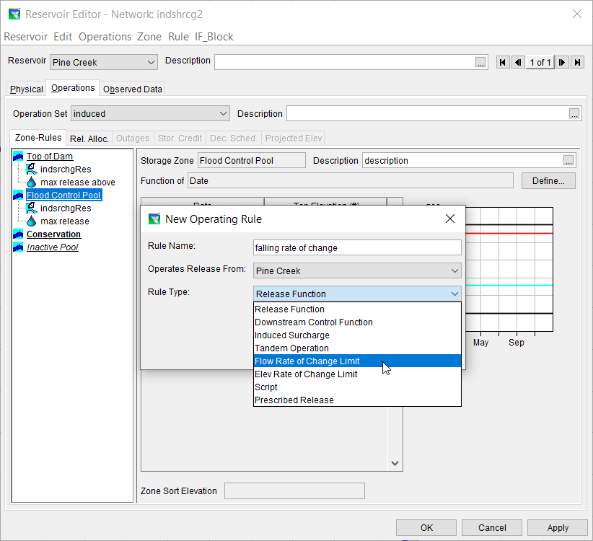
Slide 47

Slide 48
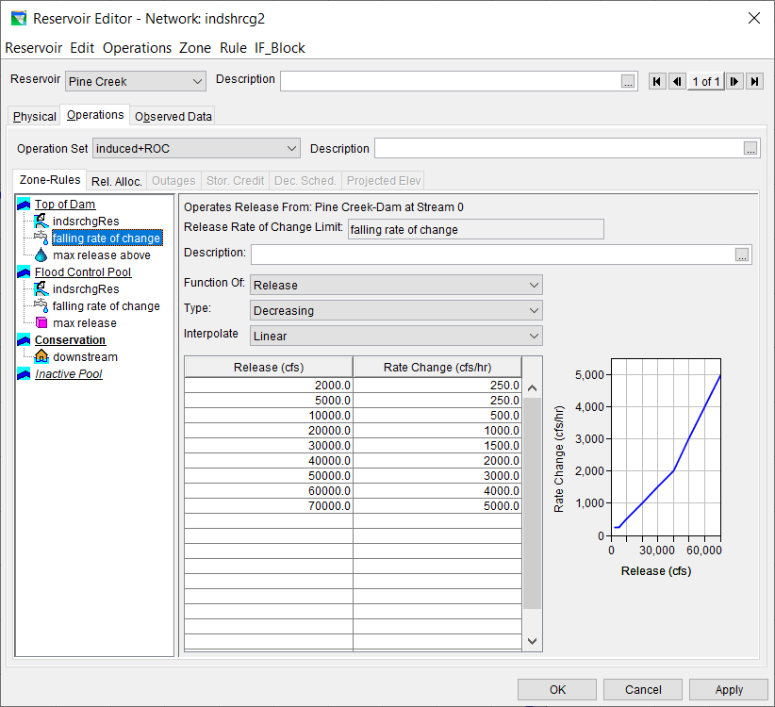
Slide 48
Notes:
Note in the rule stack that the rule limiting rate of change in flow may be lower in priority than induced surcharge, but it must be higher in priority than the maximum release rule.
Decreasing rate of change restriction is a minimum rule, because is keeps release above a certain increment from the previous release. Thus, to function, it must be higher in priority than the max rule, so we can control how quickly that max flow is reached.

Slide 49

Slide 49
Top Of Dam
Top Of Flood Pool
Top Of Conservation
Notes:
This is the plot with the decreasing rate of change in flow rule implemented. It would be a linear decrease if the rule were constant. But because the allowable increment of decrease increases with flow (and so decreases with flow), we get a gentle transition.

Slide 50
Outline
Slide 50
Terms and Background
Induced Surcharge Theory
How to develop the diagram
How to use the diagram
Induced Surcharge in ResSim
What to look for in operations
Oroville event (2017)

Slide 51
Analyzing Results
Slide 51
Induced Surcharge operation can often be difficult to analyze because…
The release decision report does not identify the Induced Surcharge rule as the controlling rule
If the inflow event has multiple peaks, the Induced Surcharge rule may turn on and off
Use DSSVue
Plot the FLOW-MIN and FLOW-MAX records for the relevant rules together with the release (Pool, FLOW-OUT) or FLOW-DECISION record.
Notes:
It can be difficult to know when induced surcharge is controlling the reservoir release. The release decision report, which tells us what rules are controlling operation at any time, doesn’t generally point to the induced surcharge rule. Instead, it points to the final rule affecting the release choice, which is the maximum release rule, even when it is violated. It provides the “cap” on release, and so has the final say.
One way to see what’s going on is to look at the ResSim outputs in DSSVue.

Slide 52
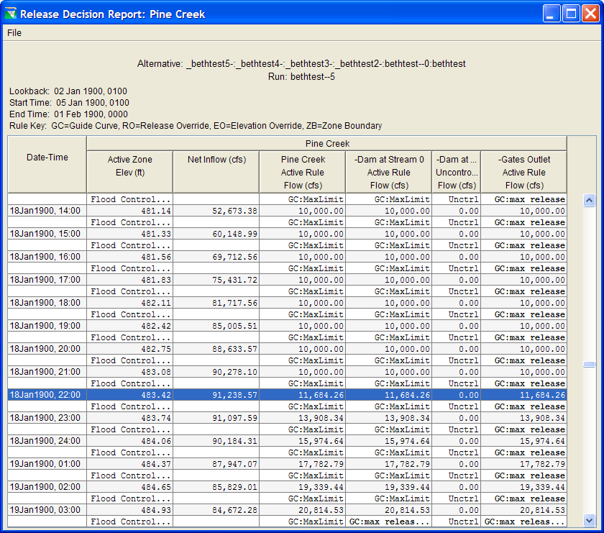
Slide 52
Notes:
This table is the release decision report. The final column shows the release, and the rule driving it. Note that even when release goes above 10,000 cfs, meaning the induced surcharge rule has kicked in, the max release rule is still noted as driving, as it has the final say.

Slide 53
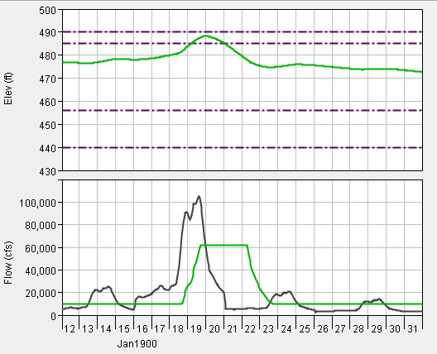
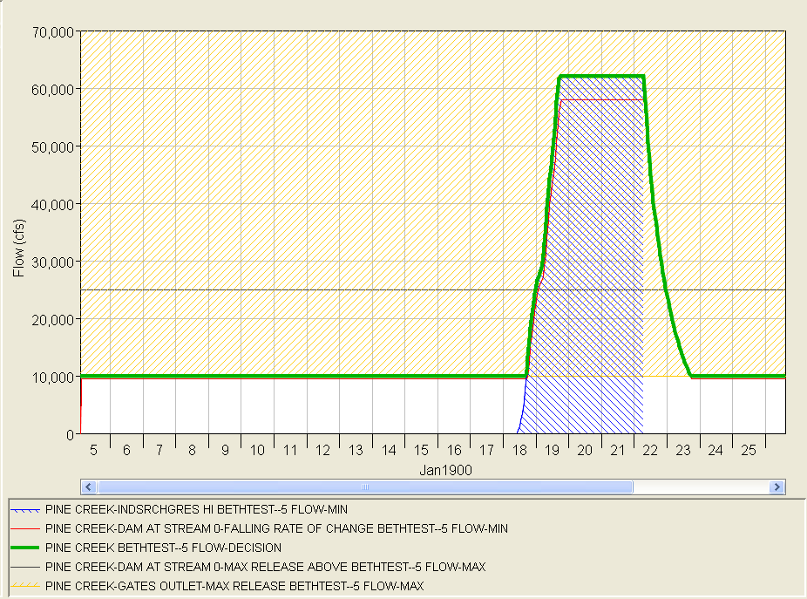
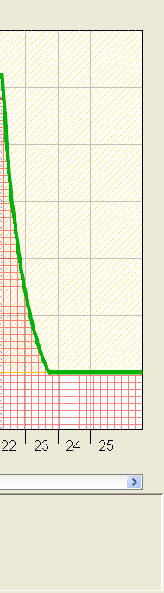
Slide 53
Notes:
This figure shows the ResSim operations plot as the inset above, and several time-series in DSSVue below.
Green is release. Yellow is the maximum release rule of 10,000 cfs. Since it’s a max rule, the space above the rule that it disallows is hatched in yellow.
Blue is the induced surcharge rule. Since it’s a min rule, the space below the rule that it disallows is hatched blue.
Red is the rate of change in release. Again, it’s a min rule, so the space below it is hatched red.
Unhatched area is the allowable release range. Note that only through Jan 18 is there any unhatched area, as the allowable range is between zero and the max rule. ResSim chooses the max rule at the top of the range to aim toward the guide curve. After Jan 18, there is now unhatched area, and so rules are either exactly met or violated.
Green is final release. So ResSim’s release follows the 10,000 cfs rule. On Jan 18, the induced surcharge rule is not only on, but it starts computing flows greater than 0. Later on Jan 18, IS flows exceed 10,000 cfs, and so the higher priority minimum of the IS rule causes the 10,000 cfs max to be violated. The IS rule stays active and controlling until Jan 22, when the falling pool transition elevation is reached and the IS rule shuts off. At that point, the falling rate of change rule in red is the highest priority and controls the release decent until it reaches the 10,000 cfs maximum again.

Slide 54
Input ESRD Curves
Slide 54
Originally, only the Induced Surcharge Function Rule was available in ResSim.
A newer form of this rule allows the user to select either the original function method for describing the rule or direct entry of the ESRD family of curves.
The original function form is appropriate for designing this operation from scratch.
The ESRD form is appropriate for describing this operation when the curves have been altered from those produced by the function.
Notes:
Thus far in this presentation, we’ve talked about the induced surcharge logic, and the version of the ResSim rule that uses that logic.
At certain reservoirs, the induced surcharge or emergency spillway release diagram (ESRD) has been altered from the logic. To follow such diagrams, we must be able to enter the diagram itself into ResSim.
In the induced charge rule, there is a radio button that can be switched from “use induced surcharge function” to “specify ESRD curves” When this option is chosen, ResSim will follow the entered diagram and interpolate between specified curves in the same way an operator would in real time.

Slide 55
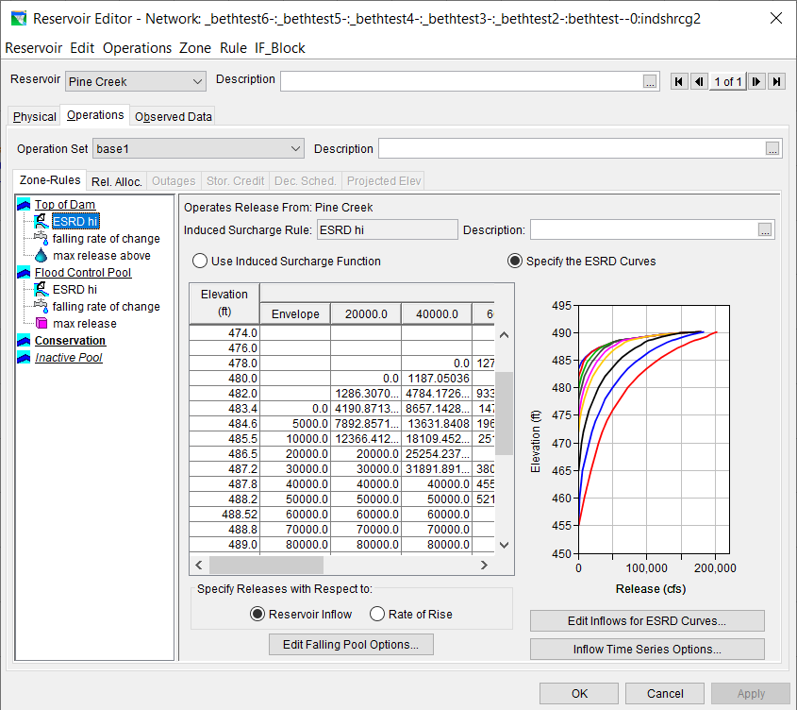
Slide 55
Notes:
On this slide, the “specify the ESRD curves” option is chosen. To demonstrate, the same operation we’ve been viewing is entered as curves, simply by producing ResSim plot of those curves and tabulating them, and then copying the result into this rule table.
Here, the first column in the table is still the induced surcharge envelope. Further columns are for the inflow lines that are computed by the logic in the other version of the rule.

Slide 56
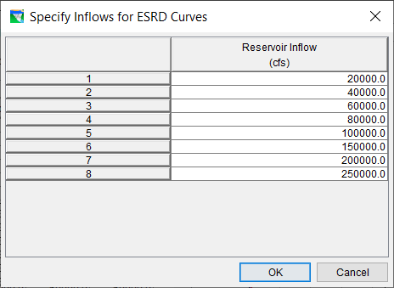
Slide 56
Notes:
To add columns to the table, the “edit flows” button is pressed. Enter the inflow associated with each line on the diagram.
Then, enter the elevation versus flow for each of those lines.

Slide 57
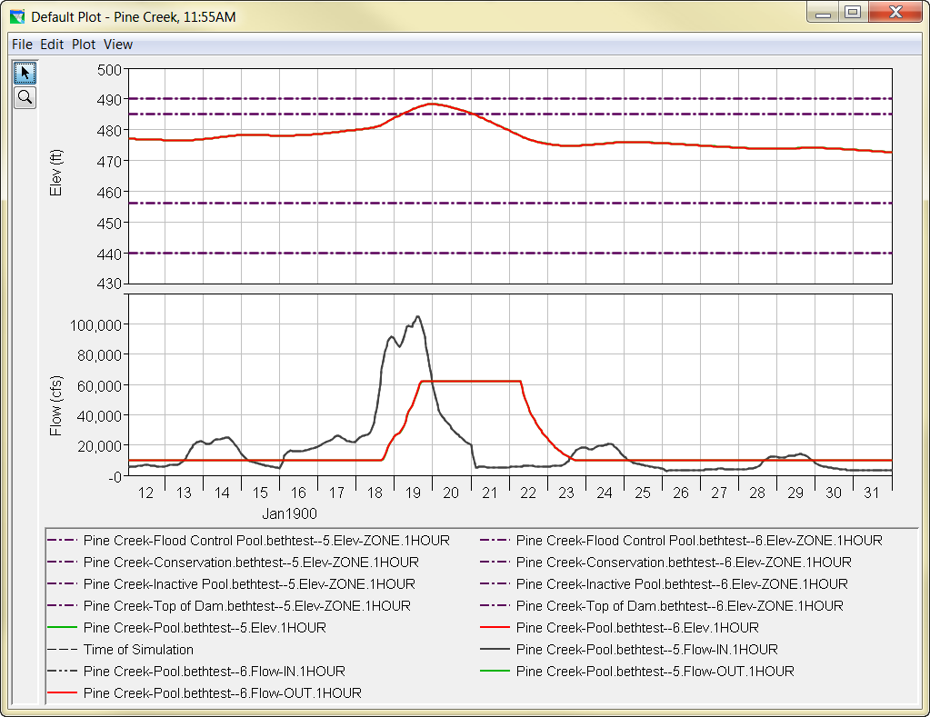
Slide 57
Notes:
In this image, the operation with the “ESRD curves” choice is in red, and the original is in green. They are exactly the same, because I simply entered the computed lines, telling ResSim to operate with a diagram made from its log.
If this option of the induced surcharge rule was used because the diagram in the regulation manual had been altered, operation would be different!

Slide 58
Summary Points
Slide 58
Induced Surcharge Operations…
Protect the dam
Allow planned use of the flood pool by releasing earlier
The Induced Surcharge Diagram (or Emergency Spillway Release Diagram) contains the “instructions”
Release is based on Inflow and Reservoir level
Minimal information needed for ResSim rule is:
Surcharge envelope, Recession constant Ts
Falling Pool rules

Slide 59
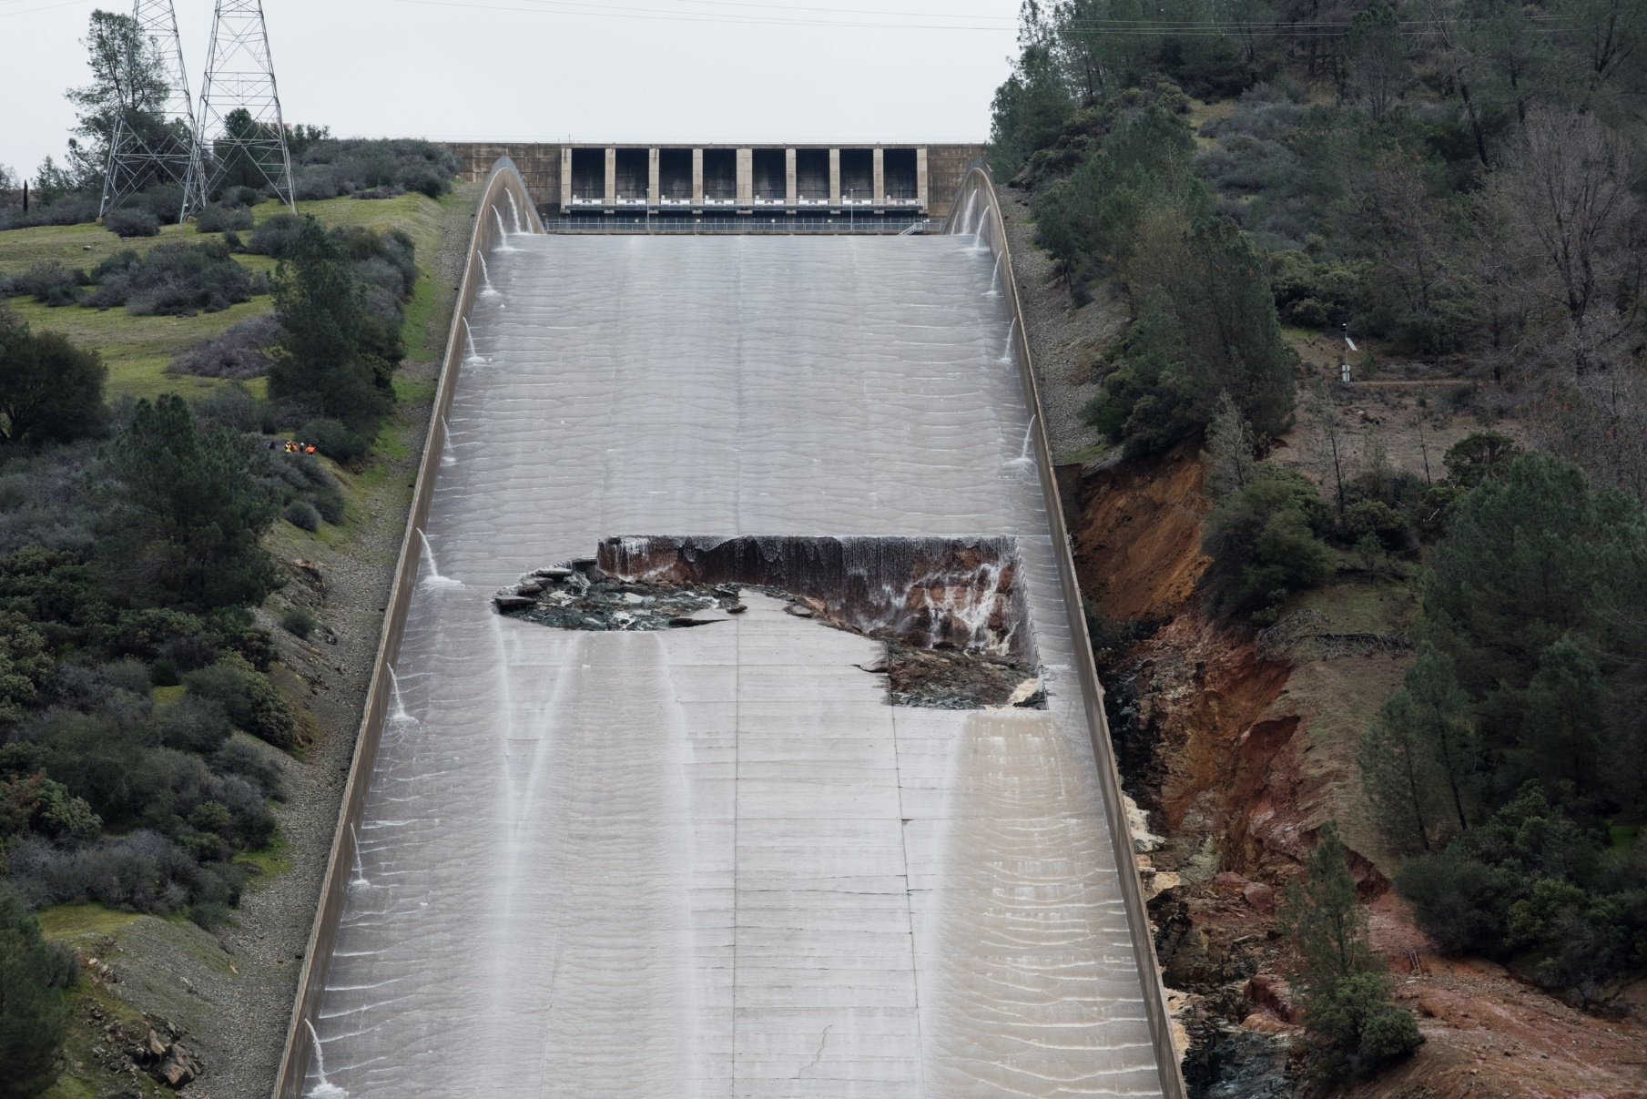
Oroville Spillway Emergency
Slide 59
https://www.youtube.com/watch?v=jxNM4DGBRMU

Slide 60
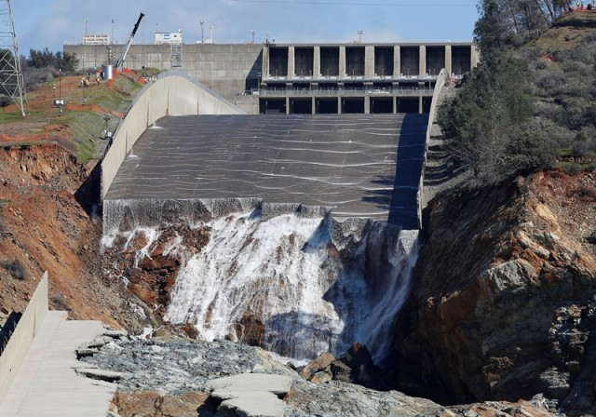
Oroville Spillway Emergency
Slide 60

Slide 61
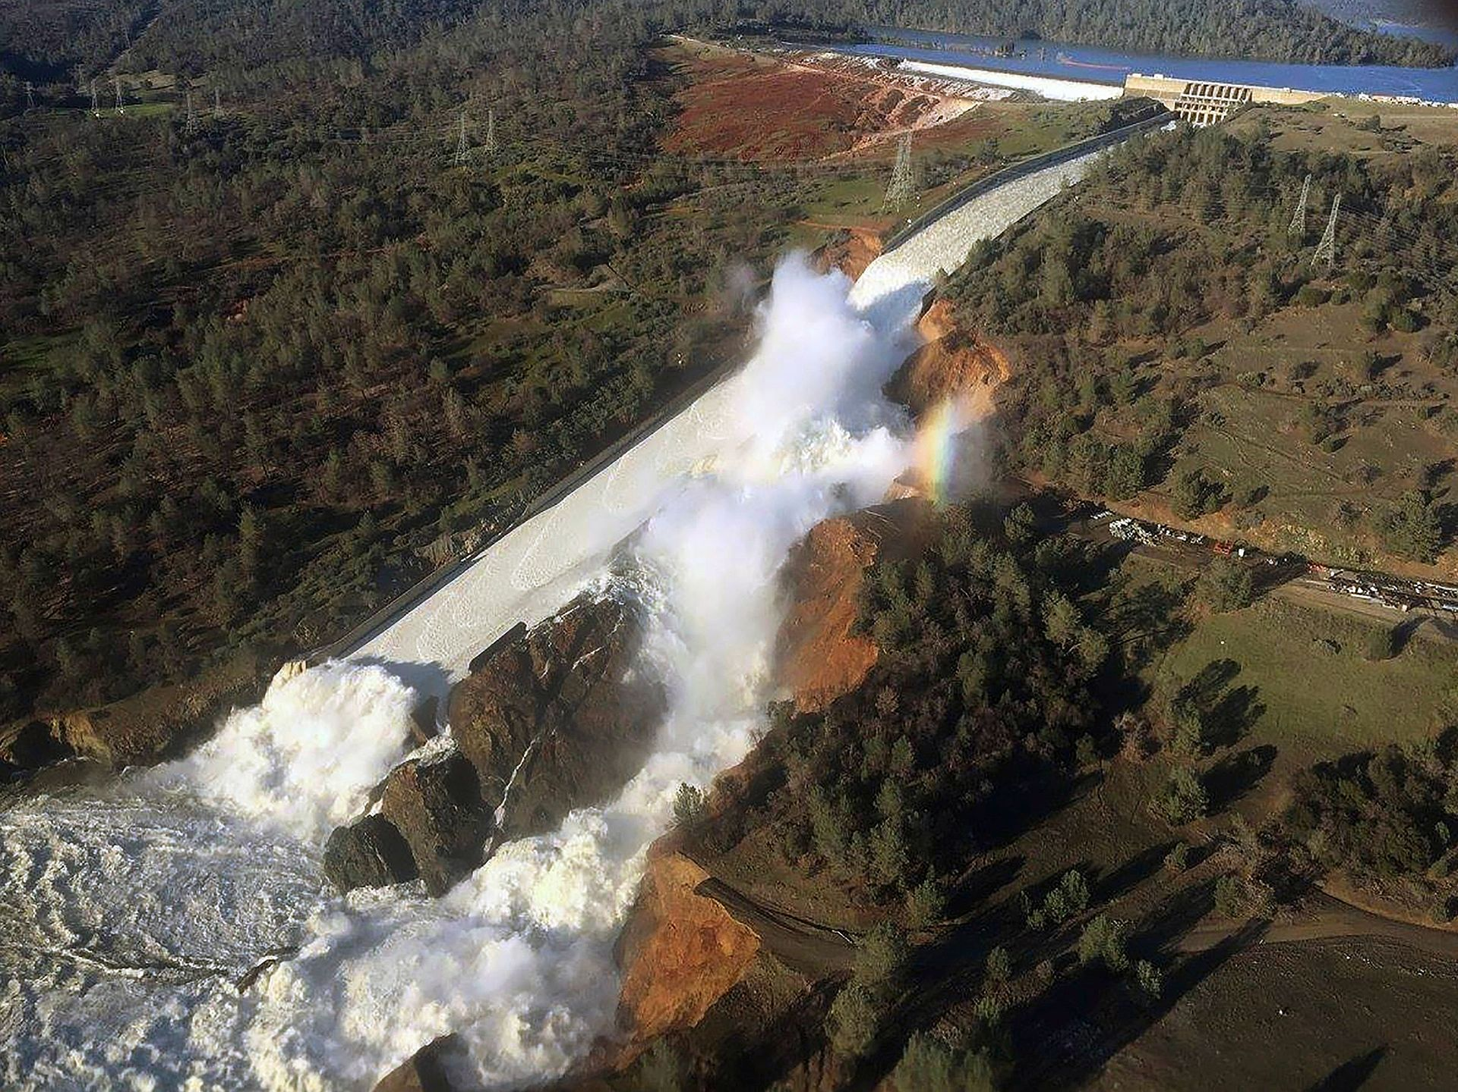
Oroville Spillway Emergency
Slide 61

Slide 62
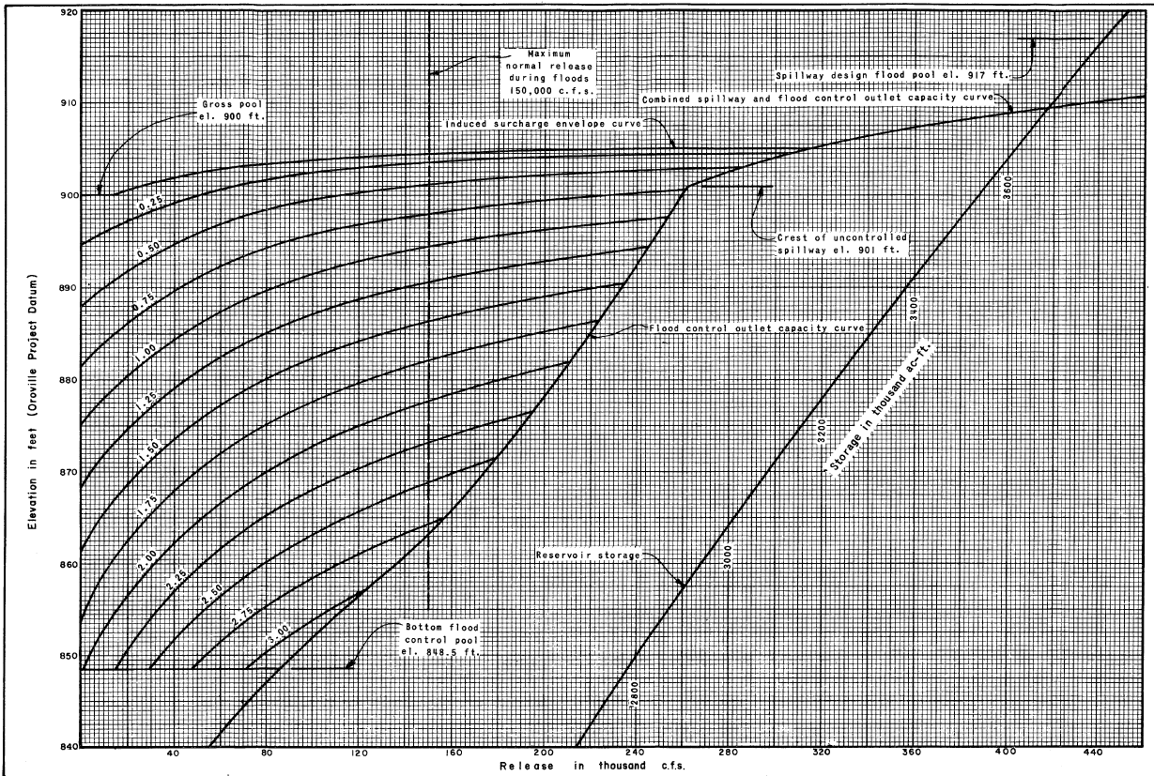
Slide 62
2/11
0.25
2/10
0.50
0.75
2/9
1.00
2/8
2/7

Slide 63
Slide 63
2/11
0.25
2/10
0.50
0.75
2/9
1.00
2/8
2/7

Slide 64
Slide 64

