Slide 1
Developing a
Watershed Schematic
The Watershed Setup Module

Slide 2
Watershed Setup Tasks
Draw Stream Alignment
Define Configurations
Place Project Elements
  Reservoirs
  Diversions
  Etc.
Place Computation Points

Slide 3
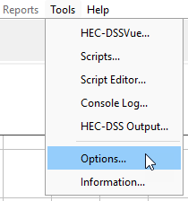
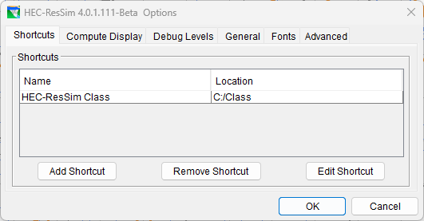
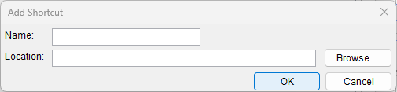
Configure ResSim
Watershed Location
  an alias or logical name for a place on your disk where you will put your watersheds
  You can identify several watershed locations.

Slide 4
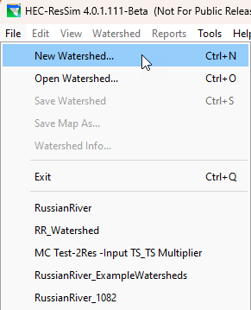
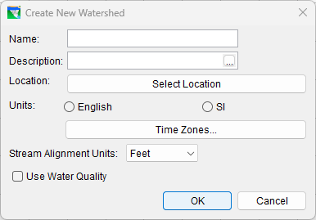
Creating a Watershed
The File Menu
  New
  Open
  Save
Provide:
  Name & Description
  Location
  Units
  Time Zone
  Stream Alignment Units

Slide 5
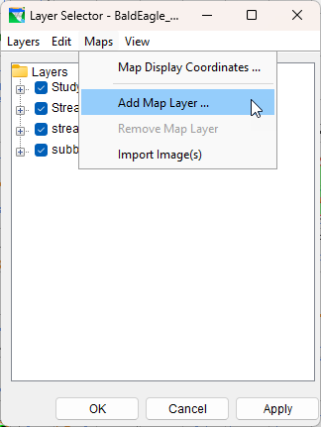
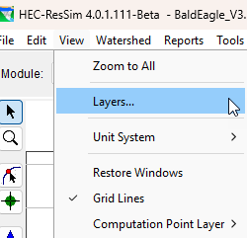
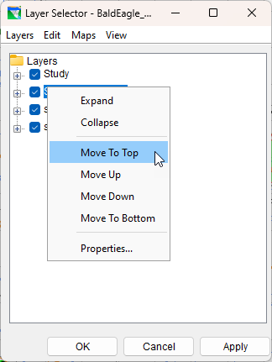
Preparing the map region
View -> Layers…
The Layer Selector
  Add Map Layer…
  Order Layers
  Edit layer properties

Slide 6
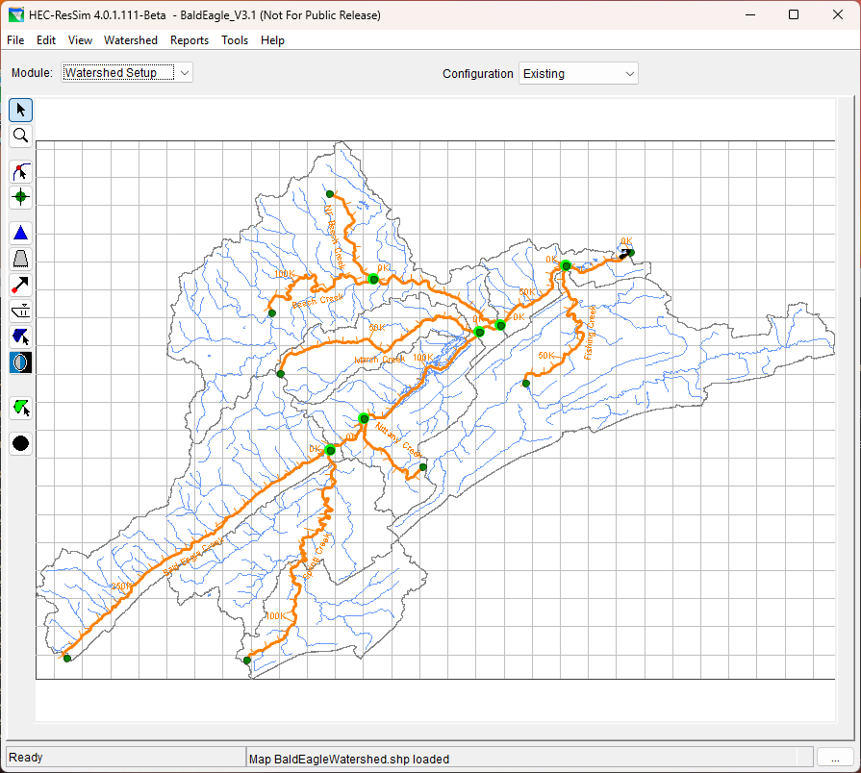
The Stream Alignment
Represents the river system in
the watershed
Composed of…
  Stream Elements
  Stream Nodes
  Stream Junctions
Defines flow direction…
  The stream alignment typically should be drawn from upstream to downstream
  By default, the station at the downstream end of an element is Station zero, and the stationing increases upstream along the stream element
Notes:
Don’t be too detailed – causes slow redraw of main screen
Green halos denote “connection” of streams

Slide 7
A Stream Element
A “polyline” - a series of line segments defined by vertex points.
  Typically begins or ends at a confluence, bifurcation, or at the boundary of a river system.
The level of the detail of the stream alignment is dependent on the needs of the overall study.
  If you are going to be using another model that will provide a geo-referenced layer (such as RAS) then the stream alignment needs to be fairly detailed.
  If geo-referencing is not an issue, the stream alignment can be as simple as a “stick figure”.
Stream Alignment Tool - is used to create, delete, and edit stream elements.
Notes:
Stream element default color is orange.

Slide 8
A Stream Node and Junction
A stream node is used to establish the stationing for a stream element.
  Default Nodes: Upstream & Downstream endpoints of a stream element.
  Intermediate: Added by user to set the station of known landmarks.
  A stream junction is automatically created where stream elements connect.
Stream Node Tool - used to create, delete, and edit stream nodes and to edit stream junctiona on the stream alignment.
Notes:
Default color is green.

Slide 9
Before you start drawing…
It will be useful to display a background map of the river system if it is avaialble.
If your stream alignment is based on a map layer, the map layer can be added to the watershed.
If the shapefile of the stream alignment is available, it is possible to “import” the stream alignment.

Slide 10
To Draw a Stream Element
From the map toolbar, press the Stream Alignment tool .
Find a location on the display area where you want to start a stream element.
Hold down the CTRL key while clicking the left mouse button. Each click creates a vertex point as you point to locations on the display area. To place the last vertex point release the CTRL key, and then click the mouse button.

Slide 11
Drawing Order
Draw streams from upstream to downstream.
  Use the “Reverse Direction” option to reverse the direction of the stream element
Draw mainstem first, then the major tributaries, and then the minor tributaries.
Remember that this stream alignment may be shared by other models and needs to encompass the streams needed by all models.

Slide 12
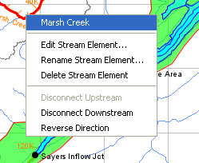
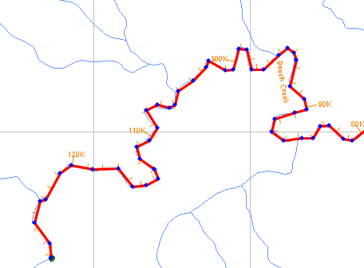
Functions of..
The Stream Alignment Tool
Draw Mode – ctrl-click
Select Mode – Right click
  Edit, Rename, Delete,….
Edit Mode – double click
  Add Vertex Points to a Stream Element (ctrl-click)
  Move Vertex Points of a Stream Element (select and drag)
  Delete Vertex Points (ctrl-shift-click)
Stream Alignment Popup Menu
Stream Alignment Vertex points

Slide 13
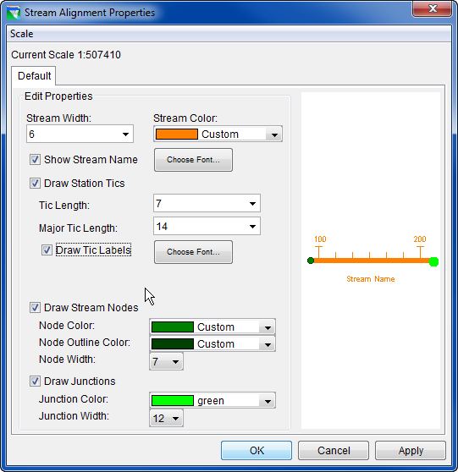
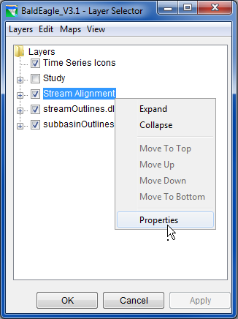
Stream Alignment Properties
Stream element properties (stream width, color, font, tic mark lengths and font,...)
Node properties (color, outline color, width)
Junction properties (color, width)
Notes:
To access the Stream Alignment Properties dialog, on the View menu, click
Layers. From the Layer Selector dialog, right-click on Stream Alignment, from
the shortcut menu click Properties and the Stream Alignment Properties dialog
will open.

Slide 14
Configurations
The physical arrangement of elements to be used for the study of the watershed.
Developed by the whole modeling team, this will reduce the possibility of incompatible model data sets.
Elements in a Configuration are identification shells. They only store name and location.
A configuration does not have time-window specific information nor model data.
Study is NOT a configuration. It is the “bucket” that holds the entire set of all project elements that have been defined in the watershed.

Slide 15
How does ResSim use a Configuration?
A Reservoir Network will inherit the project elements from a selected configuration.
The physical and operational data associated with the elements are added and stored in the Reservoir Network.

Slide 16
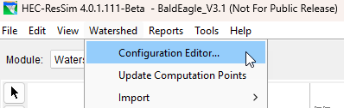

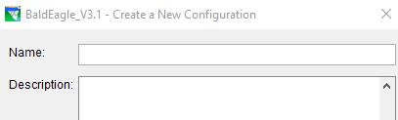
Configuration Editor
The Configuration Editor is used to create and edit configurations.
On the Watershed menu, click Configuration Editor. The Configuration Editor will open.
From the Configuration menu, click New. The Create a New Configuration dialog box will open. Enter a name and click OK. Then save the configuration and close the editor by pressing OK again.

Slide 17
Projects
A project is a man-made structure that reduces flood damage by reducing flood stages (e.g. a reservoir) or by protecting property from flood stages (e.g. levee).
Project Tools are used to create, delete, and edit projects in the display area.
Available Project Types:
  Reservoirs
  Levees
  Diversions
  Channel Modifications
  Storage Areas
  Other

Slide 18
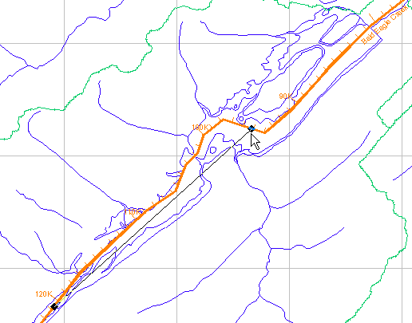
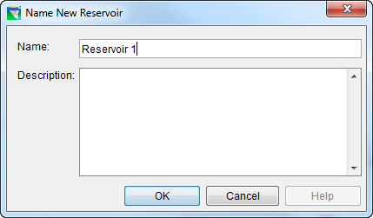
Drawing a Reservoir
In the Watershed Setup Module…
On the stream alignment, starting at the upstream end of the reservoir, hold down the CTRL key and click the left mouse button.
Release the CTRL key and move the mouse to the downstream end of the reservoir and click. You will be asked to give the reservoir a name.

Slide 19
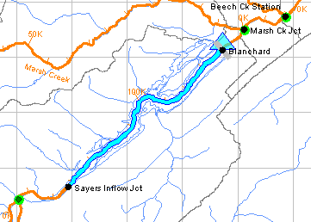
Drawing a Reservoir, cont’d.
The reservoir will appear in the display area. It is represented by
  a (light blue) triangle,
  a (grey) dam,
  and a (light blue) storage reach.
Two computation points are added to identify the reservoir’s inflow and outflow points. Don’t forget to rename these points!

Slide 20
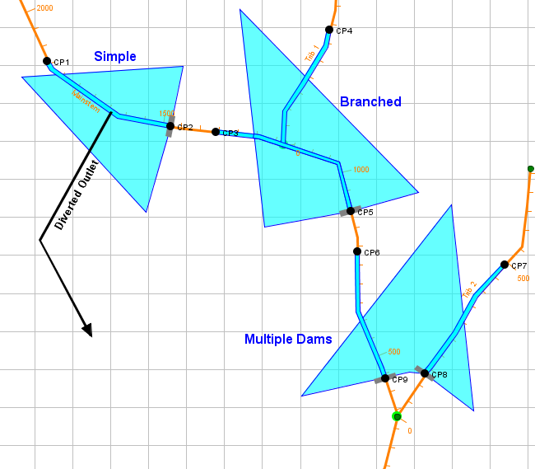
Reservoir Complexity
Simple
  1 in, 1 out
Branched
  Multi in – 1 out
Multiple Dams
  1 or more in, 2 or more out
Diverted Outlets

Slide 21
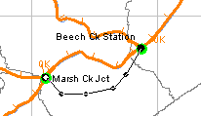
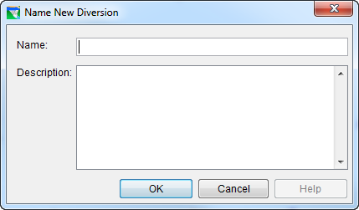
Drawing a Diversion
In the Watershed Setup Module…
On the stream alignment, starting at the upstream end of the diversion, hold down the CTRL key and click the left mouse button.
While continuing to hold the CTRL key, click the mouse to add “shaping points” to the diversion as you move toward the downstream end of the diversion.
Release the CTRL key and move the mouse to the downstream end of the diversion and click. You will be asked to give the diversion a name.

Slide 22
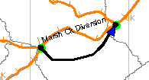
Drawing a Diversion, cont’d.
The diversion will appear in the display area. It is represented by a heavy black polyline with an arrowhead at the downstream end.
The color of the arrowhead denotes connectivity
  blue for connected
  black for unconnected
Up to two computation points may also be added.
  As with a reservoir, when a diversion is drawn, if the upstream or downstream computation points are not already in the watershed, they will be created with the diversion to identify the diversion’s inflow and outflow points.
Don’t forget to rename the computation points!

Slide 23
Computation Points
Computation points are locations where time-series information is to be exchanged between models.
Some computation points are automatically generated for the watershed based on the projects.
Remember the two points added at the reservoir?

Slide 24
Computation Points
Computation Point Tool - allows you to add your own computation points.
Add computation points at locations where the models need information but may not have been automatically generated by the placement of projects.
  Gage Locations
  Control Points
  Confluences or Inflow points

Slide 25
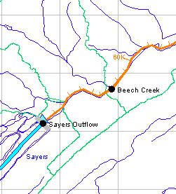
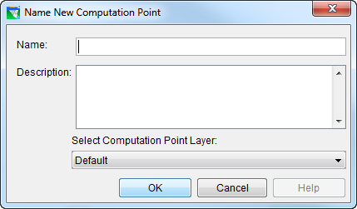
Placing Computation Points
In the Watershed Setup Module
Using the computation point tool, move the cursor to the location in the map region where you want to place the computation point, then hold down the CTRL key and click.
You will be prompted to enter a name for the computation point.
A black dot and the name will appear where you placed the point.

Slide 26
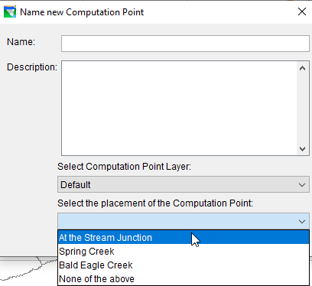
Placing Computation Points
Special Case: Stream Junctions
  When you place a computation point at a confluence (stream junction), an extended form of the “Name new Computation Point” window will appear.
  You must select WHERE the
  computation point will be placed…
    At the stream junction – TYPICAL
    On one of the connecting reaches
    None – off the streams completely

Slide 27
Points to Remember…
The Watershed Setup Module is where you…
  Create Watersheds.
  Define the basic model schematic of your watershed.
The Stream Alignment is…
  The skeleton for your model schematic.
A Configuration is..
  The selection of project elements that will be represented by a set of models for this watershed.
Project Elements and Computation Points are…
  Identification placeholders for model elements.

