Slide 1
Reservoir Networks
Modeling the River System
Notes:
HEC-ResSim
Module 1 of the Reservoir Evaluation System
1. ResSim: Reservoir Operations Simulation
2. ResFloodOpt: Reservoir Flood Operations Optimization
3. ResPRM: Prescriptive Reservoir Optimization Model

Slide 2
Reservoir Network Module
Tasks
  Create a Reservoir Network Model
    Establish Element Connectivity
    Provide Element Definition
      Physical Parameters
      Operation Plans
  Define Alternatives
Notes:
“Configuration” – a selection of schematic element (projects) and a set common computation points that describe a version of a river system that will be modeled by the set of programs to be used for the study of this watershed. If more than one selection or arrangement of elements will be considered in this study, then more than one configuration will be needed. Configurations should be developed by the whole modeling team before the models for an individual program are produced. Although a configuration represents a specific selection of the available project elements that you have created for your watershed, a special configuration, called Study, is maintained by the program to contain all elements from all configurations in the watershed.
“Reservoir Network” or just “Network” – a ResSim data set that models the relevant elements from a selected “configuration”. This data set includes the connectivity, the physical properties, and the operational schema for each element in the network.
“Alternative” – a specific selection of configuration, network, operation scheme (per reservoir), inflows, and initial conditions that will be simulated.
“Simulation” – more specifically “Simulation Period”. The Time Window during which ResSim will operate the reservoirs in the network based on a selected operation scheme and the inflow regime. Also associated is the selection of alternatives to be computed for the defined time window.

Slide 3
Reservoir Networks
A Reservoir Network is based on a Watershed Configuration.
  Think of a Watershed Configuration as a concept. Then, a Reservoir Network is an implementation of that concept
A Reservoir Network contains the model schematic and the physical (and operational) data that describe each element of the schematic.
Watershed Setup Module
Watershed Configurations
Computation Points
Reservoirs
Diversions
Reservoir Networks
Reservoirs
Junctions
Reaches
Diversions
State Variables
Reservoir Network Module
Notes:
“Configuration” – an arrangement of physical elements, common computation points, and other physical properties that will be modeled by the set of programs to be used for the study of this watershed. If more than one arrangement of elements will be considered in this study, then more than one configuration will be needed. Configurations should be developed by the whole modeling team before the models for an individual program are produced. While you add elements to your configurations, a special configuration, called Study, is developed by the program to contain all elements from all configurations in the watershed.
“Network” – a reservoir data set that models the relevant elements from a “configuration”. This data set includes the connectivity, the physical properties, and the operational schema for each element in the network.
“Alternative” – a specific selection of configuration, network, operation scheme (per reservoir), inflows, and initial conditions that will be simulated.
“Simulation” – more specifically “Simulation Period”. The Time Window during which ResSim will operate the reservoirs in the network based on a selected operation scheme and the inflow regime. Also associated is the selection of alternatives to be computed for the defined time window.

Slide 4
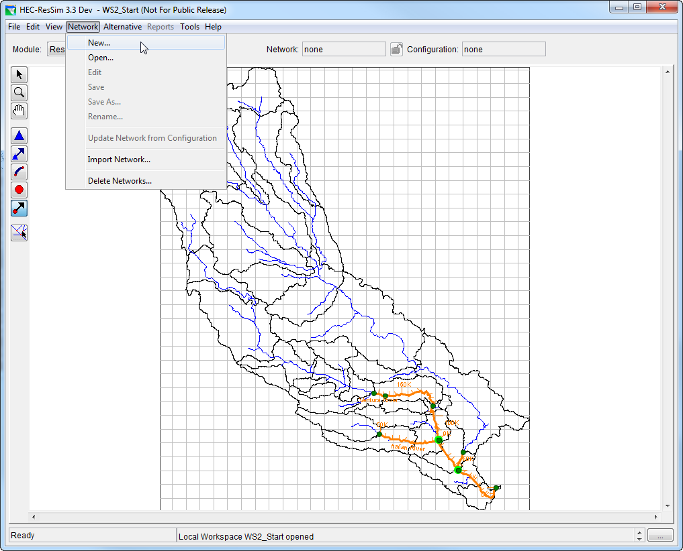
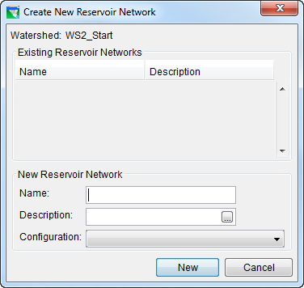
Create a Reservoir Network
Network menu
  New
Select a Configuration
  The network schematic will inherit the elements from the configuration.
Provide a unique Name.

Slide 5
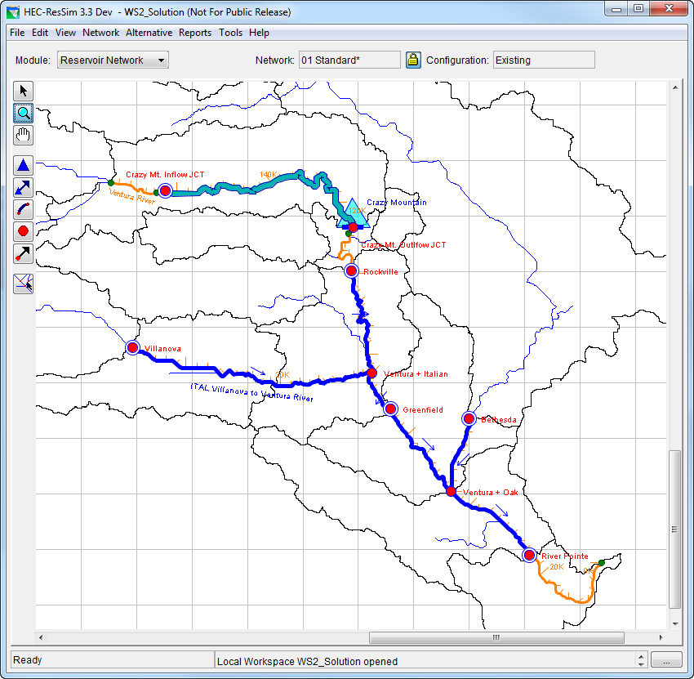
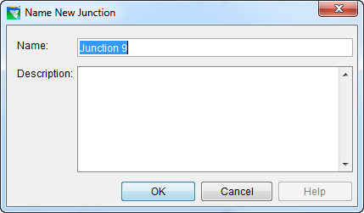
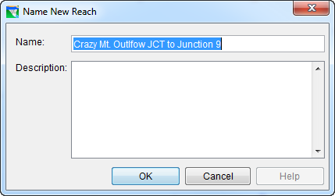
Establish Connectivity
Add Routing Reaches
  Draw reaches using the Reach Tool.
  Draw from Upstream to Downstream…
  If a junction does NOT exist at either end, a new one will be created.
  You will be prompted for a Reach name.
Notes:
The first step in fleshing out your network is to establish the connectivity between the elements of your schematic. In other words, you need to make sure the water that enters your network at the upstream end and flow uninterrupted through a series of model elements all the way to the downstream end. Remember, the stream alignment is just a backbone or framework for your schematic to be built upon – it is not a model element and does not ‘move water”.
Reaches, Diversions, and Reservoir all “move water”. Junctions connect the other elements together and provide a means of bringing in “local” flows.
Most, if not all, of the junctions in your model schematic were created based on the computation points you created in Watershed Setup, they are not the “connectivity elements” you need.
And, since the reservoirs (and possibly the diversions) of your network were created based on the selected configuration, the elements that you need to add are reaches (and perhaps diversions).

Slide 6
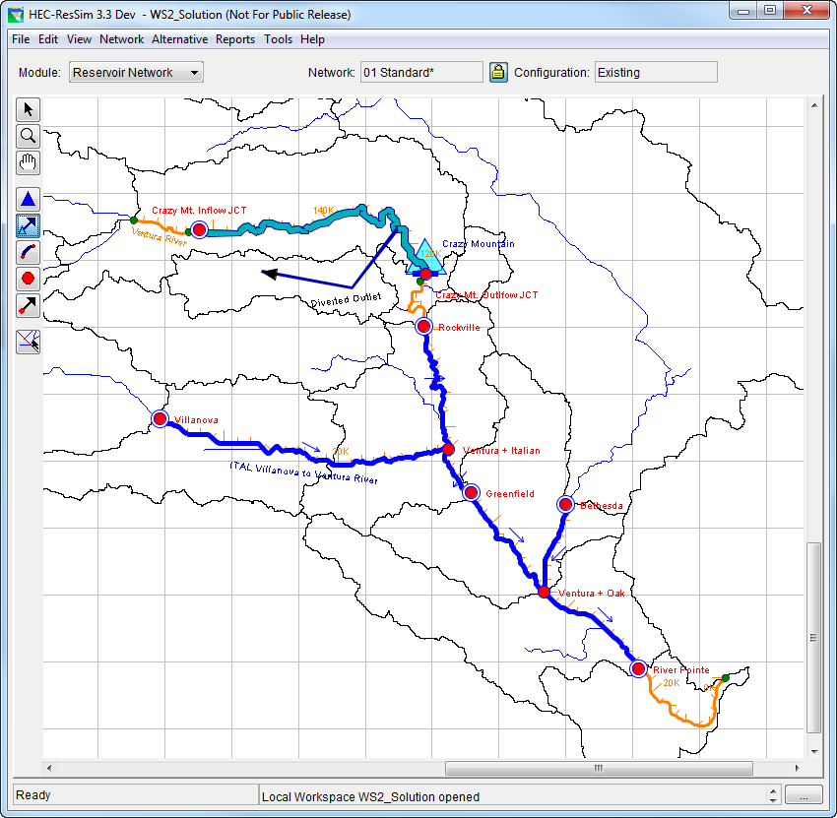
Add Additional Elements
Additional Projects
  Reservoirs
  Diversions
  Diverted Outlets
Intermediate Junctions
  To break up long routing reaches for better routing definition
Notes:
Discuss diversions and diverted outlets. When you use one or the other.
Leave further discussion of diverted outlets to the reservoir outlets section.

Slide 7
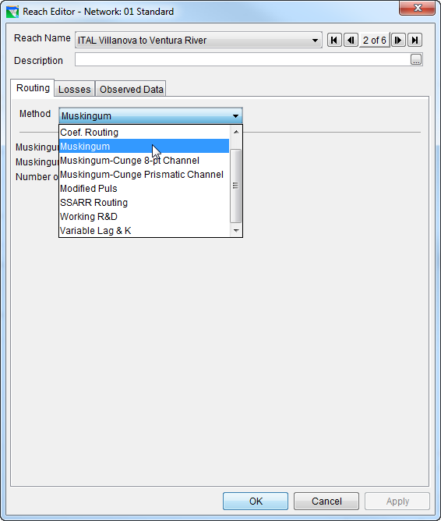
Provide Element Definition - Reach Data
Routing Methods
  Muskingum
  Muskingum-Cunge
    8 Pt. Channel
    Prismatic Channel
  Modified Puls
  SSARR
  Working R&D
  Variable Lag & K
  Coefficient
Optional Losses
  Seepage
Notes:
For each reach, you must select a routing method and specify the associated parameters to describe how flows will route through the reach.
A reach also can have seepage losses specified that can impact the flow through the reach. Be aware that seepages losses take water away from the reach (system) never to be seen again…

Slide 8
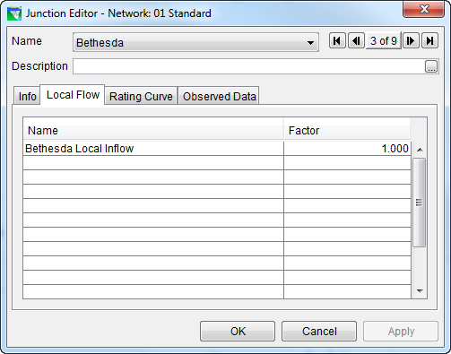
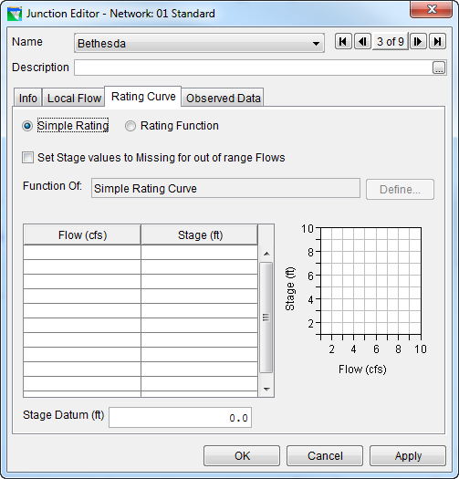
Provide Element Definition - Junction Data
Identify Inflows
  Name
  Factor
  Note:
    Inflows are required at each headwater junction
    More than one inflow can be identified at each junction
Optional Rating Curve
  If provided, a rating curve will cause stage to be computed based on the junction’s computed flow.

Slide 9
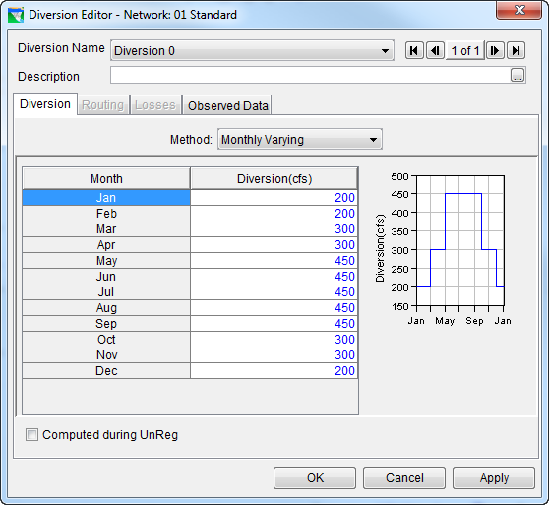
Provide Element Definition - Diversion Data
Diverted Water can…
  leave the system or
  return at a Junction
Diversion Types –
  Constant
  Monthly Varying
  Seasonal
  Function of Flow or Pool
  Time-Series
  Flexible – function of…
Returning Diversions include…
  Routing
  Optional Losses
Notes:
A diversion contains the flow definition, losses, and routing (losses and routing are only defined if it is connected back into the system).
A diversion leaves from a junction and if it returns, comes back to another junction.
Diversion types:
Constant – pretty simple, just a set flow
Monthly Varying – also straight forward, you get a define a different flow for each month
Seasonal – provides date and time, and less rigid than a monthly varying rule so flows can change mid-month
Func. Of Flow – You define a relationship between flow at a junction and the diversion, it can be any junction in the network.
Func. Of Pool – the relationship is between the pool elevation and the diversion for any reservoir in the network.
Time-Series – You’ll map a time-series of values to any alternative based on this network to define what the flows should be.
Flexible – function of date, model variable, state variable, external time series
NEW in 3.1…Diversions can be negative. A negative diversion ADDS water to the network rather than taking it away. Beware when routing negative flow in a connected diversion.

Slide 10
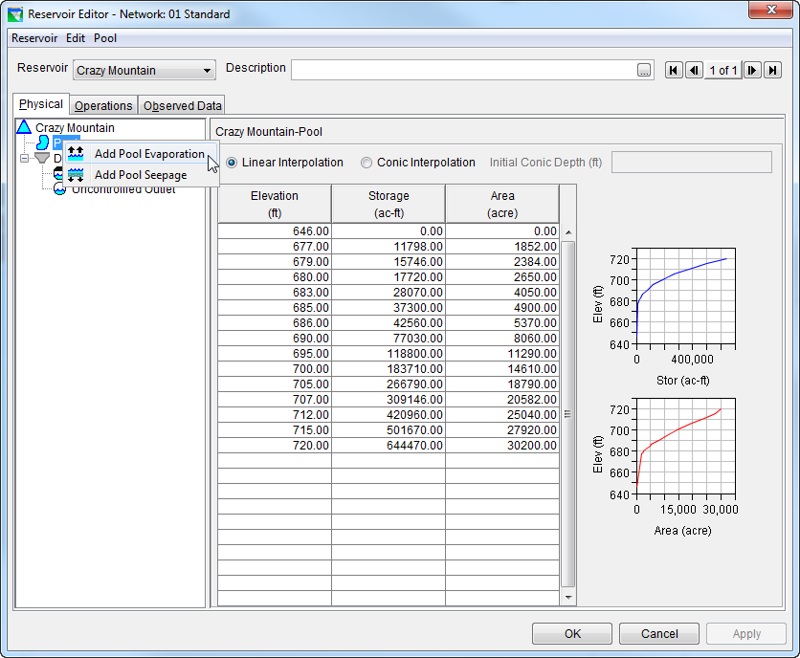
Provide Element Definition -
Reservoir Data – The Pool
Elevation–Storage–Area Relationship
  Linear
  Conic
Optional Losses
  Evaporation
  Seepage
Notes:
Note about tables: In ResSim, if you look up a value above or below the range of the table (an elevation about 720 ft in the table above, for example) you’ll get the last value in the table—not an extrapolation. Storage(725 ft) = 644470 ac-ft. Storage(640 ft) = 0.

Slide 11
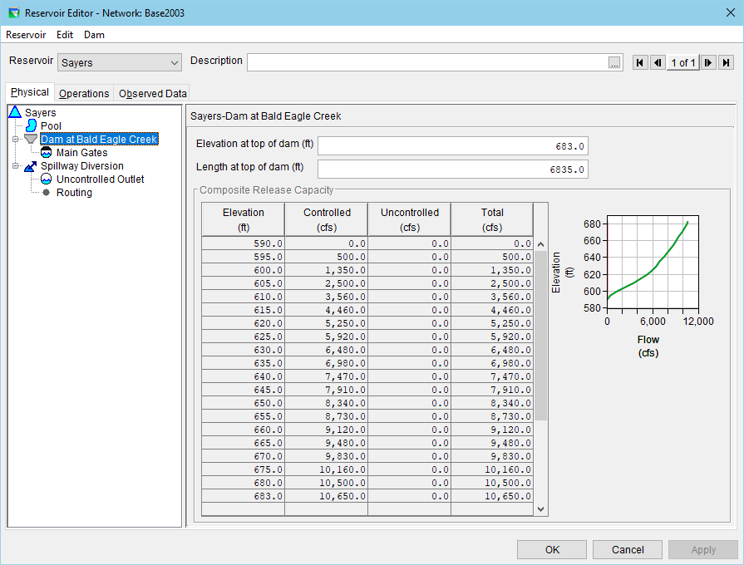
Provide Element Definition -
Reservoir Data – The Dam
Dam ≈ Weir
  Elevation
  Length
  Optional Losses (leakage)
Outlet Hierarchy
Composite Capacity Table

Slide 12

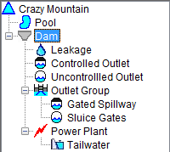
Provide Element Definition -
Reservoir Data - Outlet Hierarchy
Dam ≈ Group
  Outlets & Outlet Groups
    Controlled
    Uncontrolled
    Power Plant
    Pump
    Optional Tailwater Definition

Slide 13
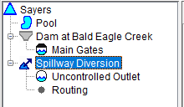
Provide Element Definition -
Reservoir Data - Outlet Hierarchy
Diverted Outlet ≈ Group
  Outlets & Outlet Groups
  Routing Needed for Connected Diverted Outlets

Slide 14
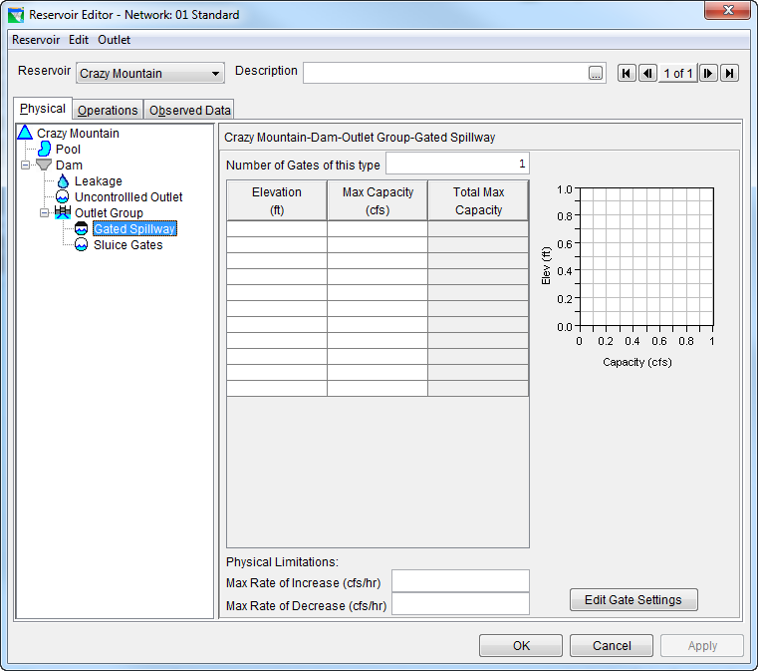
Controlled Outlet – Maximum Capacity

Slide 15
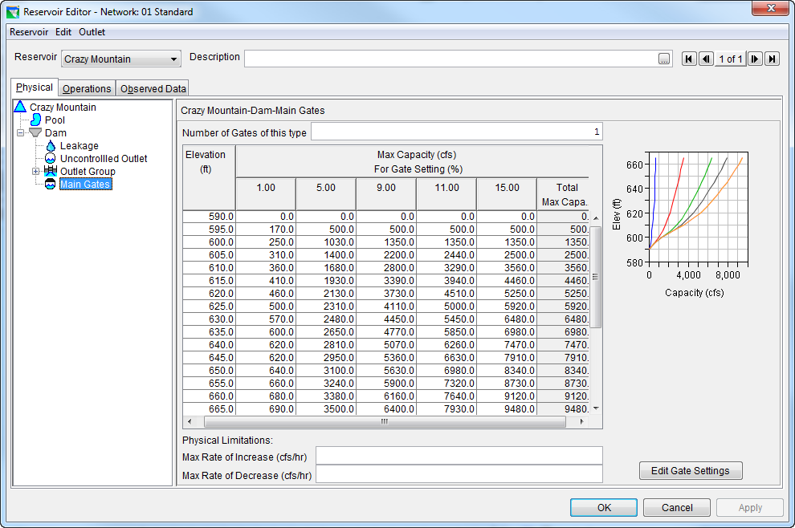
Controlled Outlet – Capacity per Gate Opening

Slide 16
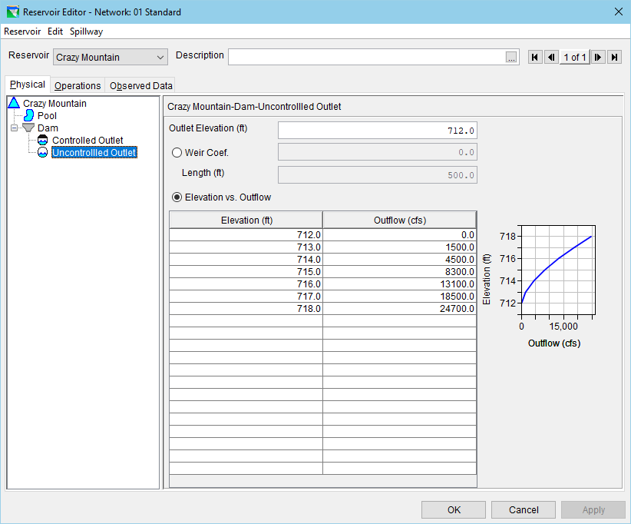
Uncontrolled Outlet – Rating Table or Weir Data

Slide 17
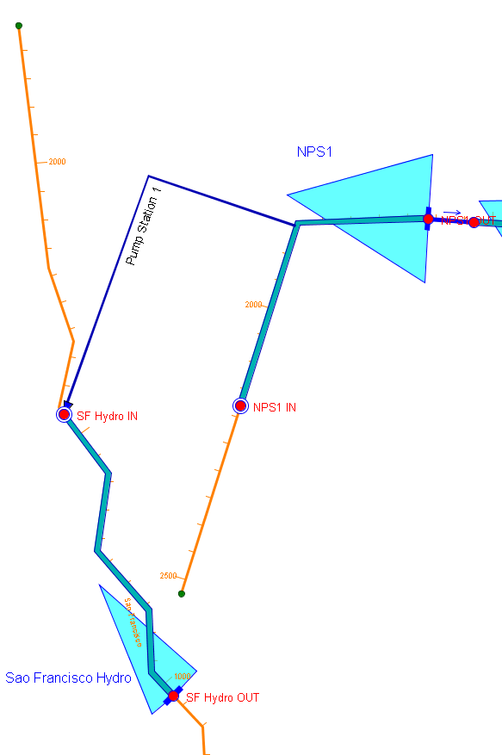
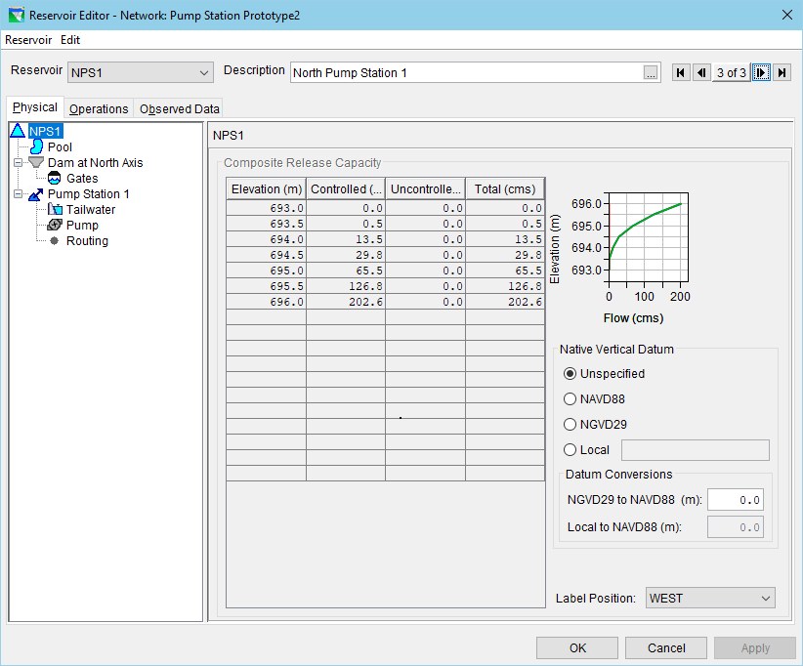
Diverted Outlets

