Slide 1
If-Then-Else Blocks
Adding Conditional Logic to the HEC-ResSim Operation Scheme
Notes:
Conditional logic can be added directly to the rule stack using “If Blocks”

Slide 2
Need for IF-THEN-ELSE logic
Typically, reservoir operations follow conditional paths for decision-making
Conditions are used to determine the applicability of operational goals and constraints
Using the ResSim “IF-block” feature, you can define conditional tests that determine when and which rules apply in the release decision process.
Reservoir Elevation > 610 ft?
No
Min Release Constraint
Yes
In Flood Control Space?
No
Hydropower Release
Yes
Flooding Downstream?
No
New Release = Max Inflow
Yes
Max Release Constraint
Notes:
Clear need for conditional statements in reservoir operation

Slide 3
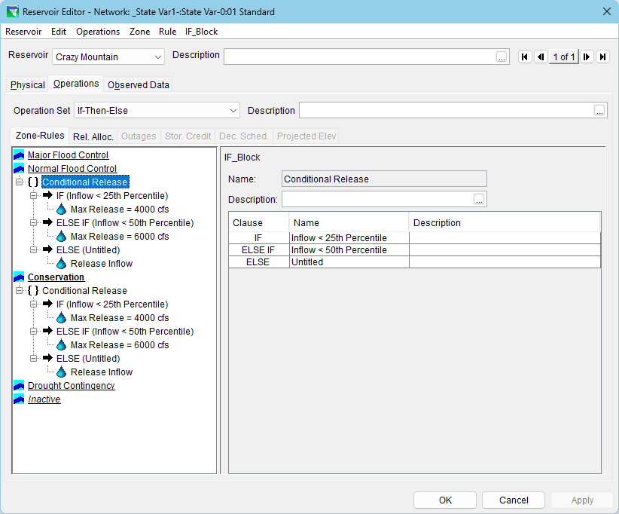
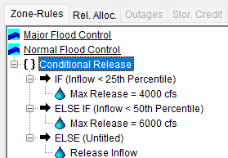
“IF Blocks” – Conditional Logic in HEC-ResSim
Conditional statements can be used with operation rules by adding IF Blocks to the
rule stack.
{ } IF_Block: The top level describes the overall block
➔ Clauses: IF, ELSE IF, ELSE
Implied THEN: nest rules under the clauses
Notes:
IF Blocks are used within the rule stack to add conditional logic around the rules.
The top level demarks the
Here is an example
IF
ELSE IF
ELSE

Slide 4
Parts of an IF Block
{ } IF Block
IF Block Name
(implied THEN): Rules
Conditional Expressions:
➔ Clauses: IF, ELSE IF, ELSE
IF and ELSE IF Clauses require a Boolean Conditional Test:
IF (Value 1 operator Test Value 2)
Operator: =, >, >=,
Notes:
IF Blocks are used within the rule stack to add conditional logic around the rules.
The top level demarks the
Here is an example
IF
ELSE IF
ELSE

Slide 5
Parts of an IF Block
{ } IF_Block: Name
  Conditional Expression made up of clauses
  ➔ Clauses: IF, ELSE IF, ELSE
  IF (Value 1 operator Test Value 2)
    (implied THEN): Rules
IF Block Name
{ } IF Block
Conditional Expressions
Notes:
IF Blocks are used within the rule stack to add conditional logic around the rules.
The top level demarks the
Here is an example
IF
ELSE IF
ELSE

Slide 6
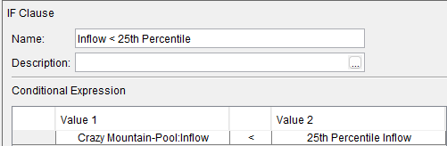
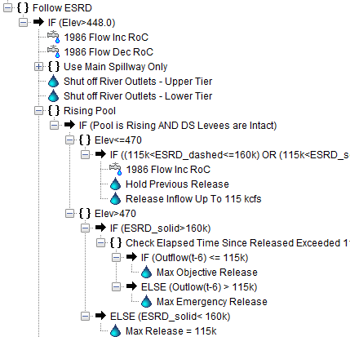
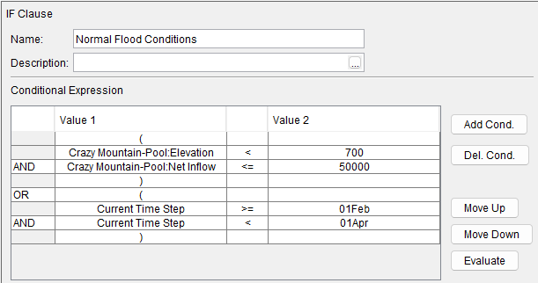
Ways of Applying IF Blocks
Simple If-Then
  basic IF-THEN statement
  ELSE is optional
Compound Conditional
  e.g., If ((x AND y) OR (z)) Then
  use parentheses and
  logical operators
Nested Conditionals
  If blocks can be nested within higher level if blocks. e.g.,
  If (x) Then
  If (y) Then
  Rule
Notes:
The IF Block feature allows conditional statements that can be
Simple If – then
Compound – if x and if y or z
Nested – nest a secondary test within the first test

Slide 7
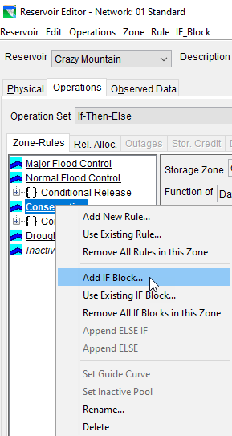

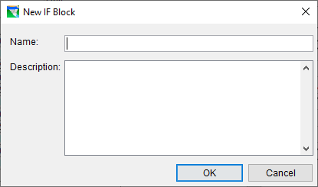
How to…Create an IF Block
From the Operations tab of the Reservoir editor, select a zone in your current operation set
Right-click on the zone in the tree and Select Add IF Block…
Under the IF_Block menu, click New
Give the IF Block a name..

Slide 8
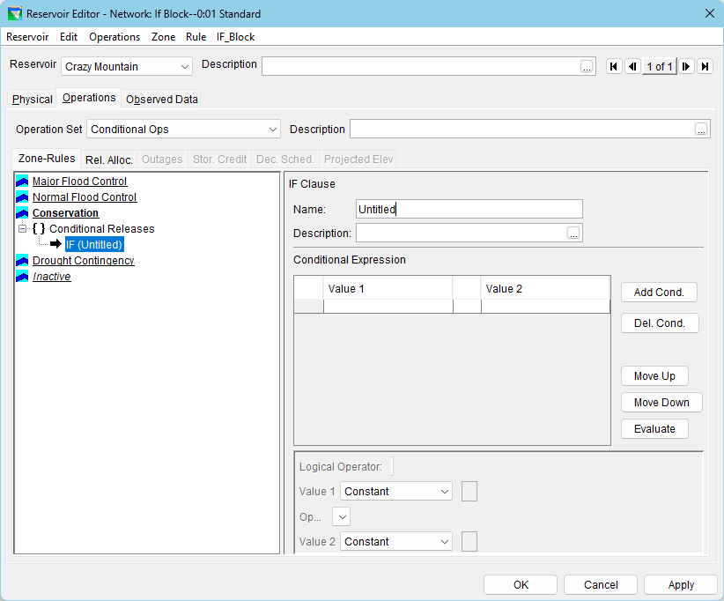
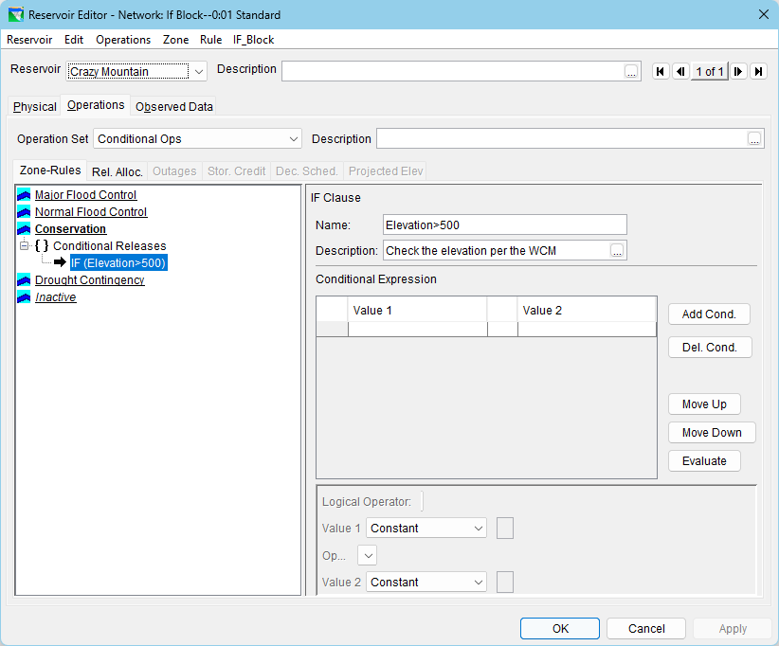
Naming the IF Clause

Slide 9
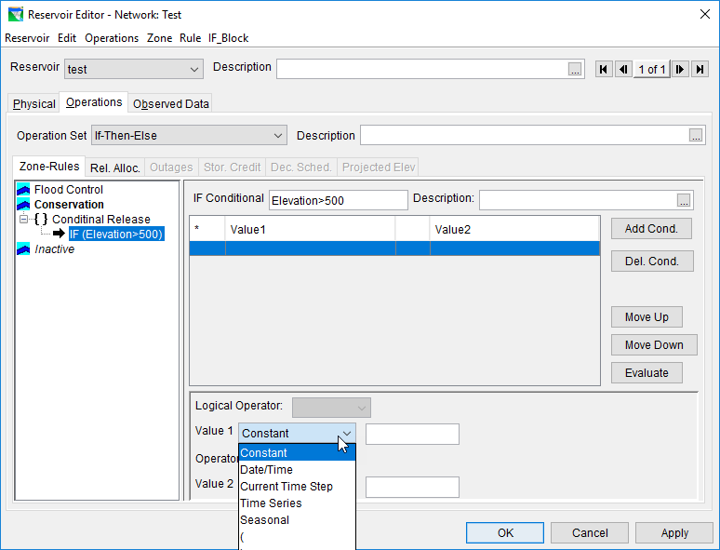
Add Condition(s)
Constant -> numeric value
Date/Time ->
ddmmmyyyy, hh:mm
Current Time Step
Time Series ->
  External Variable
  Model Variable
  State Variable
Seasonal -> ddmmm
( ) -> group conditional tests

Slide 10
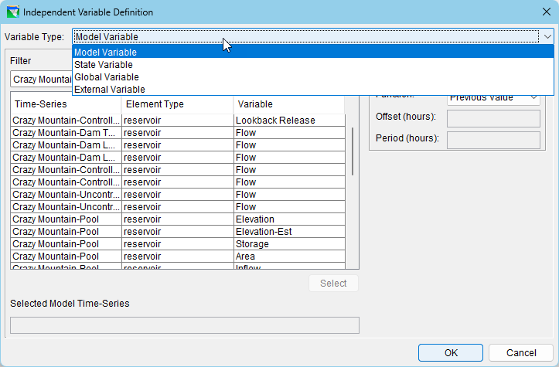
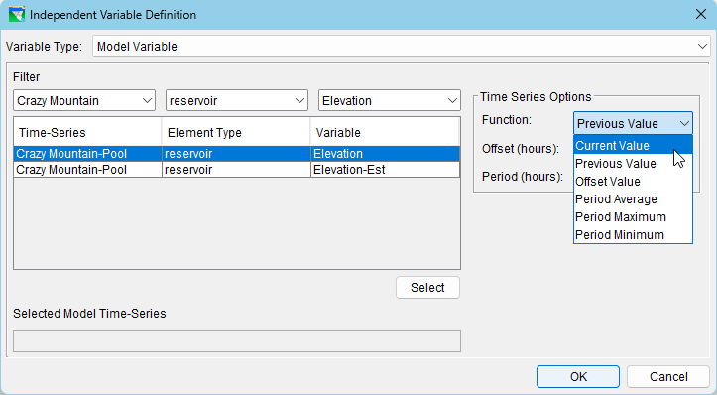
Test Values – Time Series

Slide 11
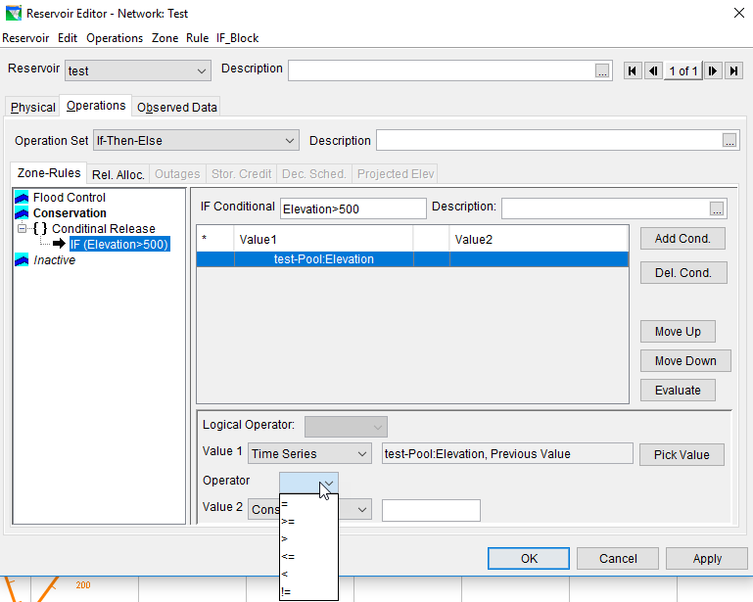
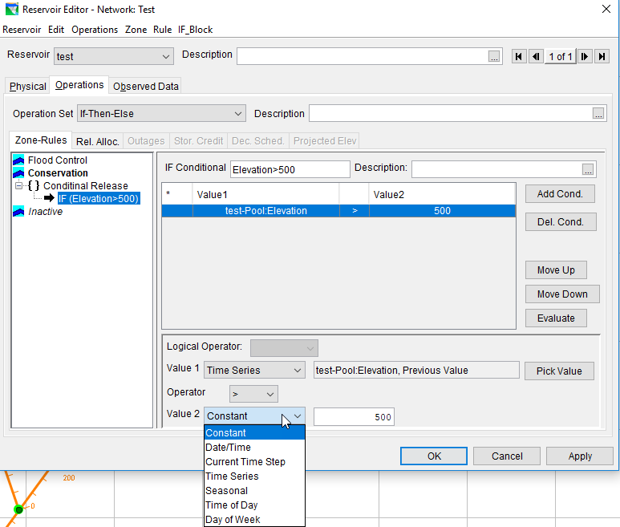
Test Operators

Slide 12
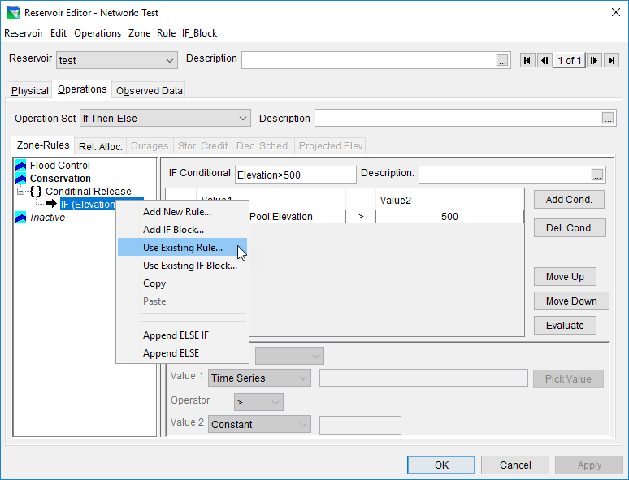
Add rules to the IF block

Slide 13
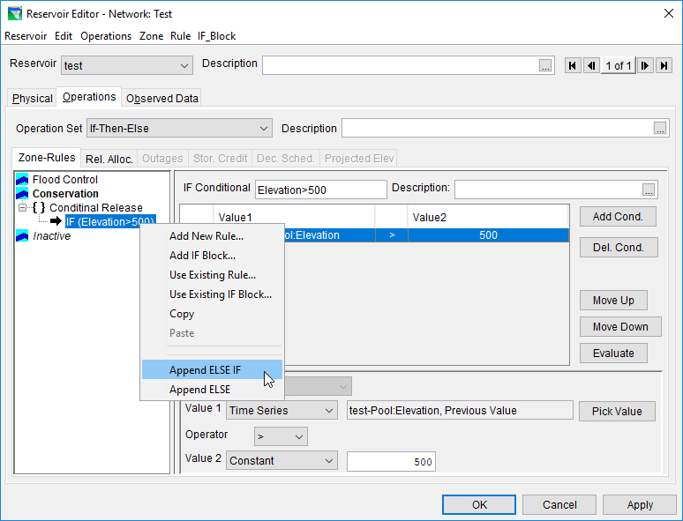
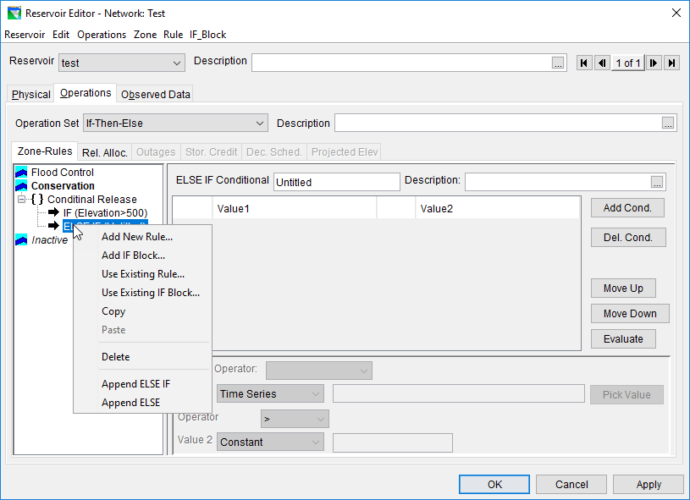
Add ELSE IF blocks

Slide 14
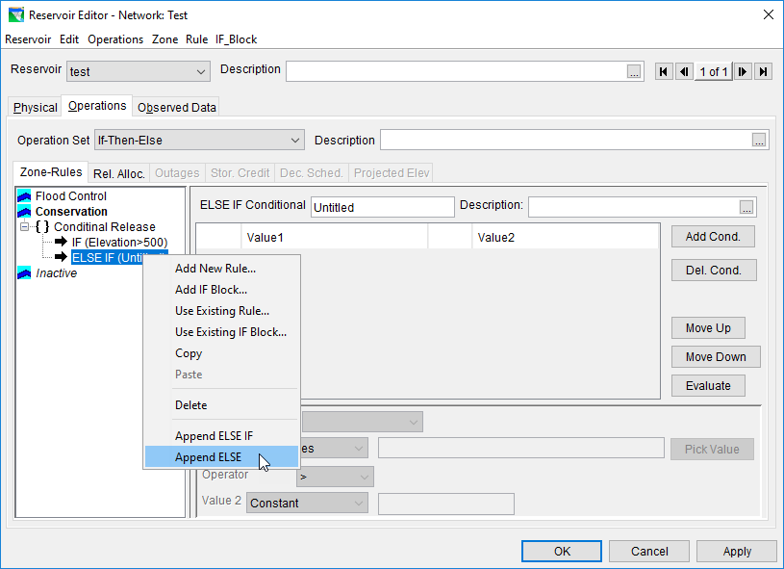
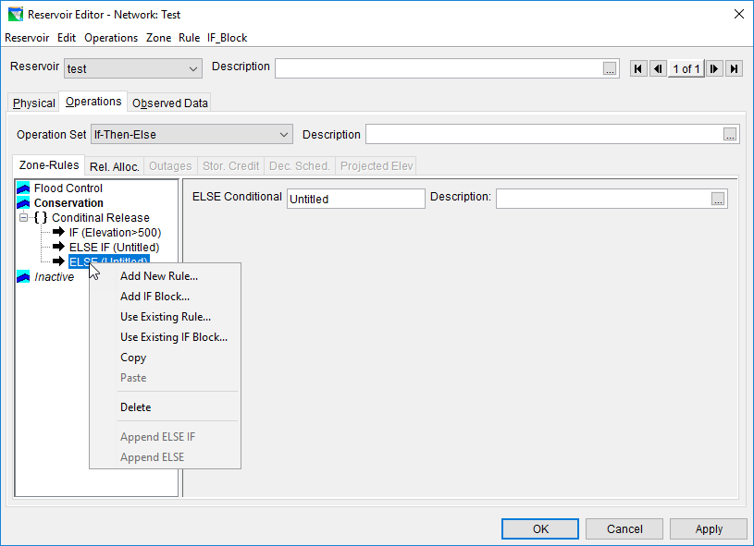
Add ELSE blocks

Slide 15
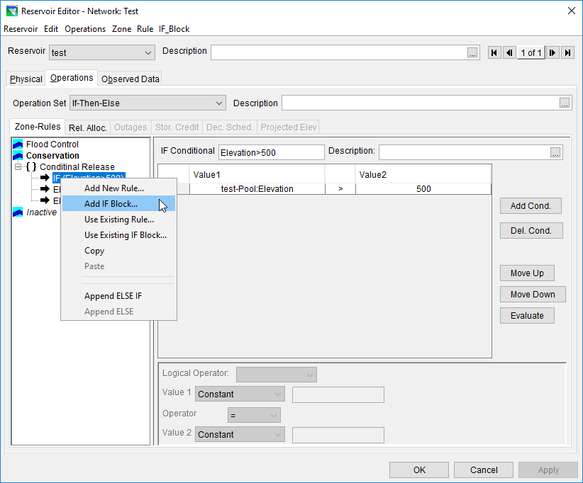
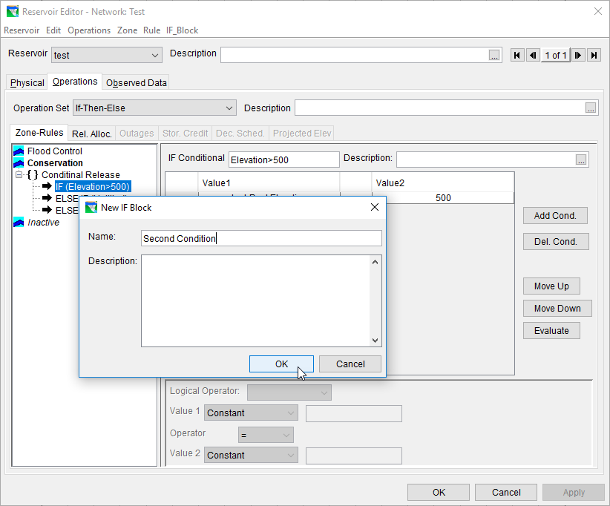
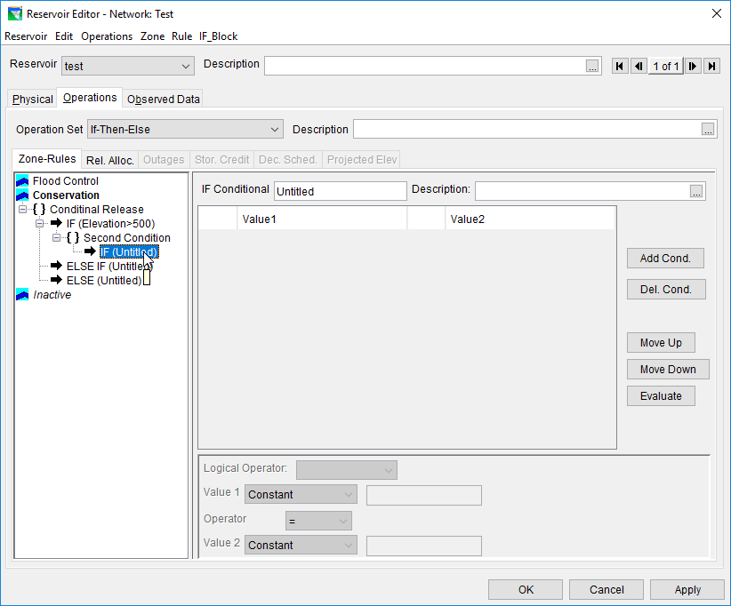
Nested If blocks

Slide 16
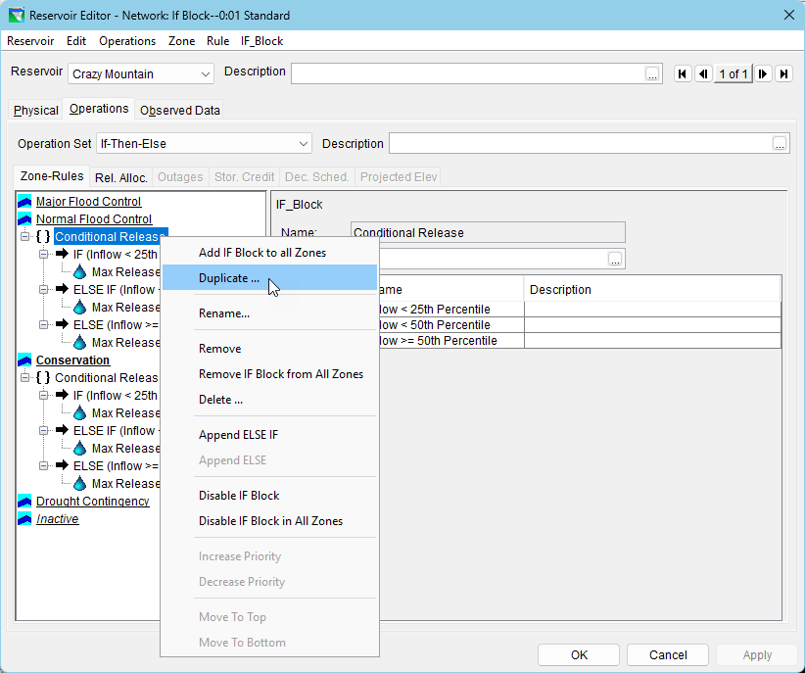
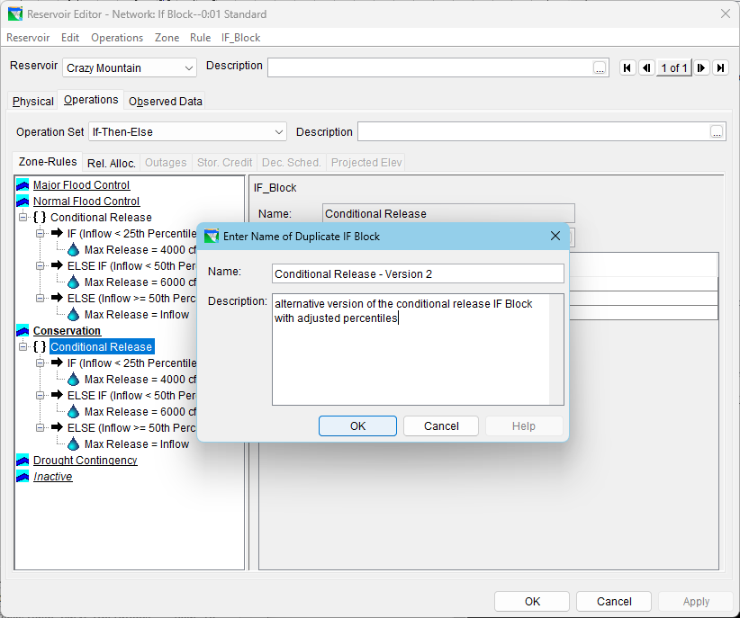
Duplicate If Blocks

Slide 17
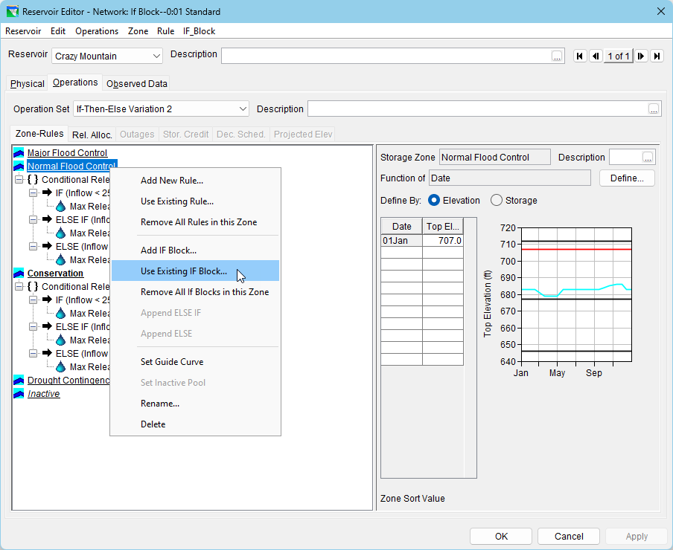
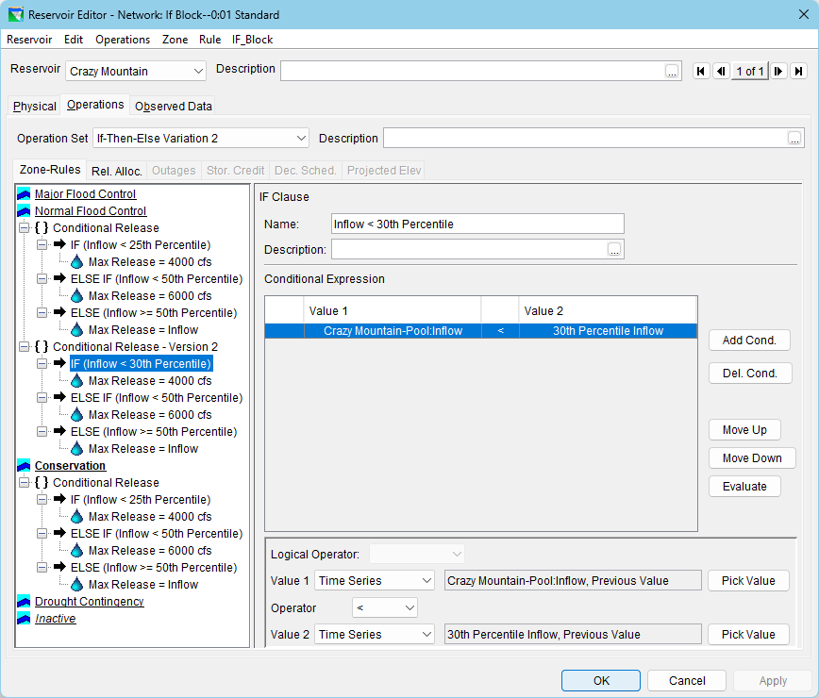
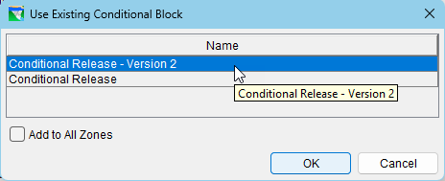
Duplicate If Blocks, cont’d.

Slide 18
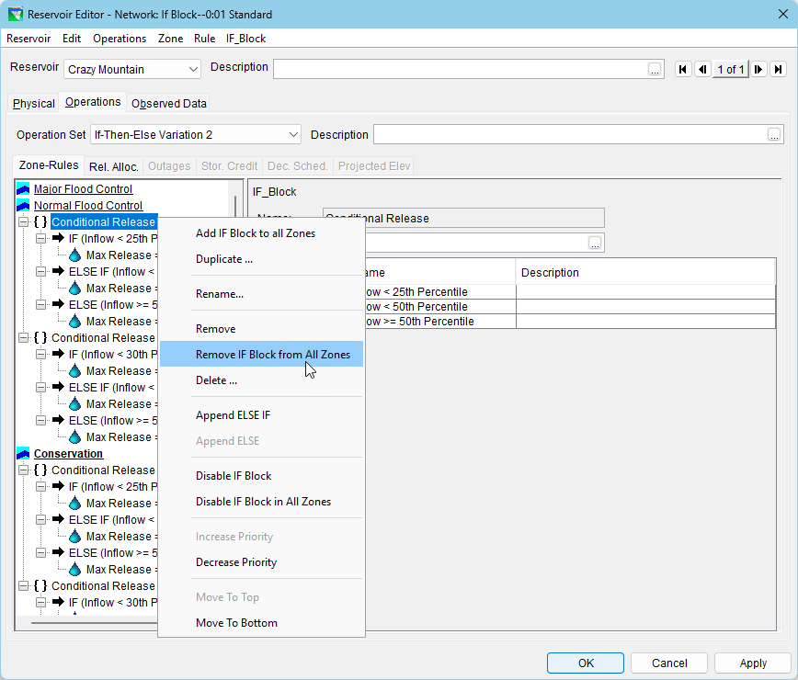
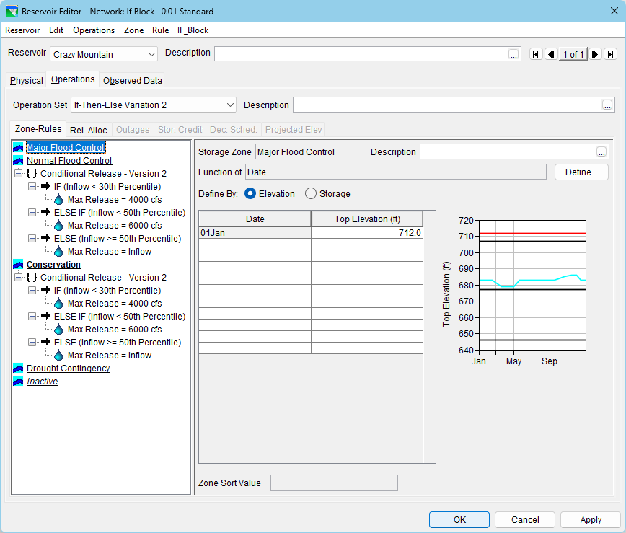
Duplicate If-Blocks, cont’d.

Slide 19
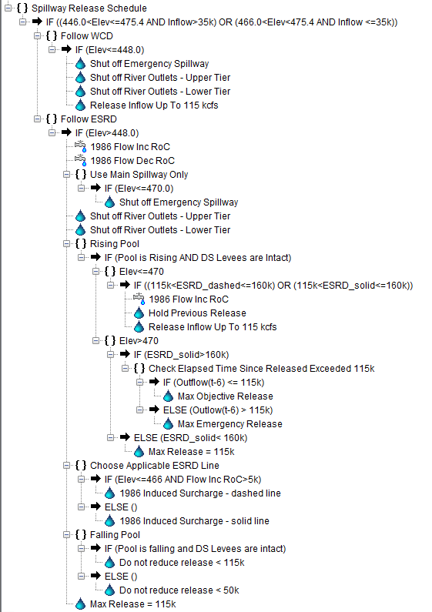
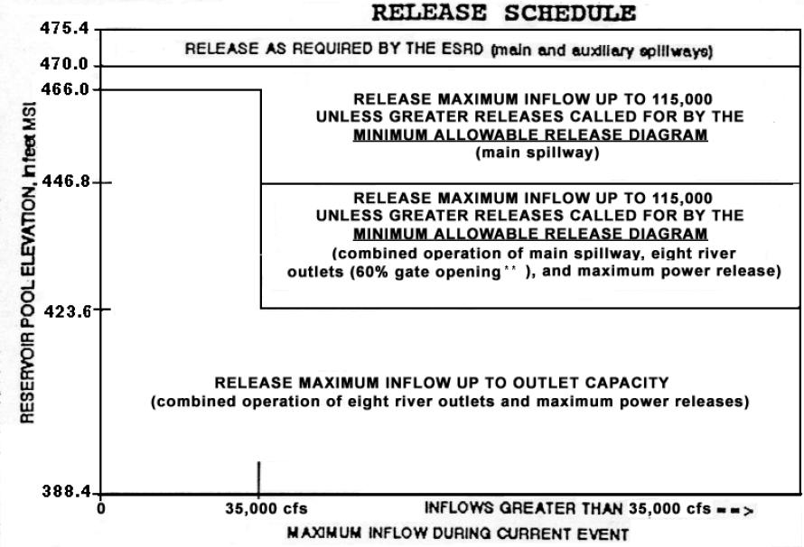
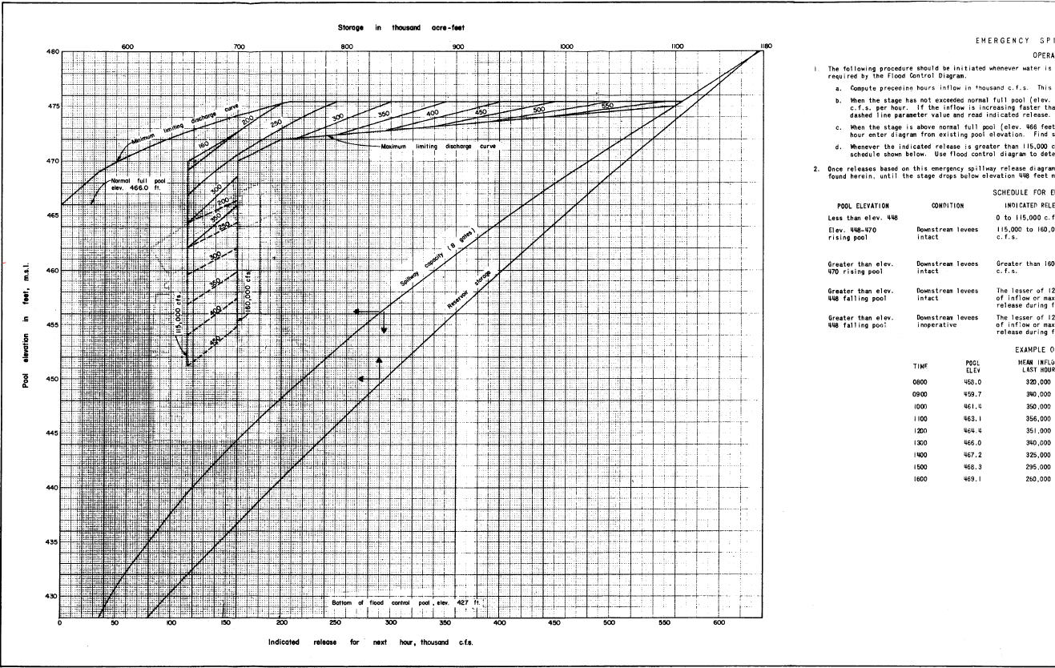
Complex Example

