Slide 1
Reservoir Networks …Continued
Defining the Operation Scheme
- The Guide Curve -
Notes:
Basic Guide Curve Operations
1.5-L-04
Klipsch 1.5-L-04
1

Slide 2
Outline
Definition of Terms
Reservoir Operation
Zones (or Pools)
Guide Curve
Guide Curve Operation
Rules
Operation Sets
Reservoir Computations
Release Limit Types
Allowable Range of Release
Release Decision Report

Slide 3
What is Reservoir Operation?
The act of storing or releasing water from a Reservoir.
The “to-release or not-to-release” and “how-much” decision-making process
The set of goals and constraints that define the release decision-making process
Notes:
Basic Guide Curve Operations
1.5-L-04
Klipsch 1.5-L-04
3

Slide 4
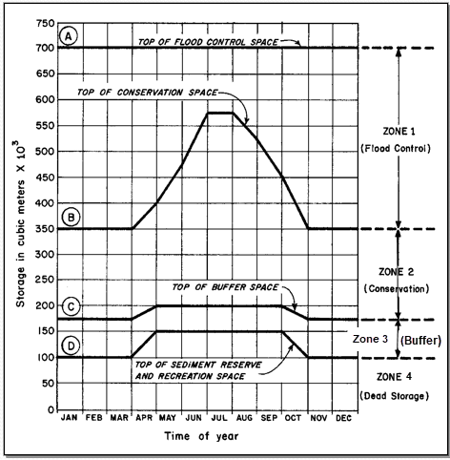
What are Zones (or Pools)?
The allocation of storage within a reservoir for one or more purposes
Zones are defined by their “top of pool” elevation, which may vary seasonally
Zones should not cross one another

Slide 5
What is a Guide Curve?
The target or desired reservoir pool elevation or storage
AKA: “Normal Pool”, “Top of Conservation”, …
The dividing line between the part of the reservoir pool that is designated as “flood control” from the part that is designated as “conservation”
The foundation of the HEC-ResSim release decision logic

Slide 6
What is Guide Curve Operation?
In general, “Guide Curve Operation” is the process of determining releases from a reservoir in order to get to and maintain the reservoir pool at its guide curve elevation.
To ResSim, Guide Curve Operation means: “Get to guide curve as fast as possible and stay there.”
Guide Curve Operation is constrained by:
Physical Outlet Capacity
Elevation, Release, and Capacity Overrides
Reservoir Operating Rules
Notes:
Basic Guide Curve Operations
1.5-L-04
Klipsch 1.5-L-04
6

Slide 7
What are Rules?
The objectives of – or constraints on – the operation of a reservoir or system of reservoirs.
Rules are specified in terms of:
Flow - minimum or maximum
Elevation/Stage - minimum or maximum
Energy Generation - needed
Maximum Flow Rate-of-Change
Maximum Pool Elevation Rate-of-Change

Slide 8
What is an Operation Set?
An Operation Set holds all the information that describes the reservoir’s operating goals and constraints.
The key elements of an operation set are:
Zones
Guide Curve identification
Rules
A reservoir can have more than one operation set, but only one can be “active” for a given alternative.

Slide 9
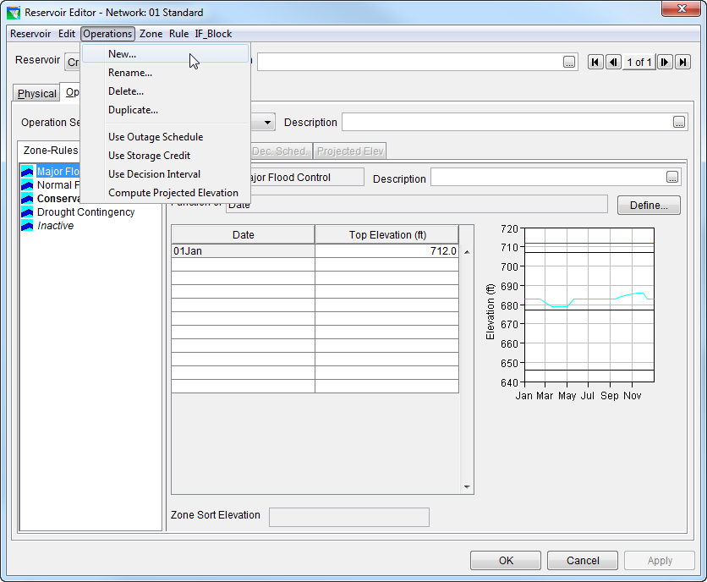
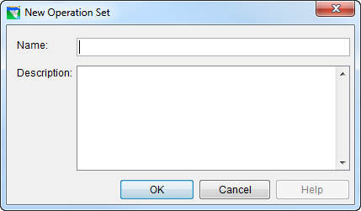
How to Create an Operation Set
In the Reservoir editor, select the Operations tab
From the Operations menu, select New.
Give it a name and description and click OK.

Slide 10
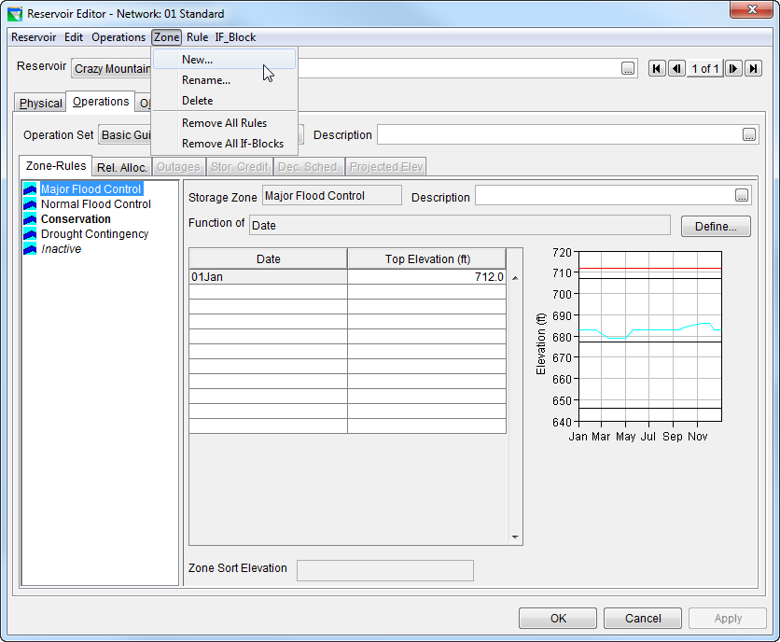
How to Create Zones
Three default zones are created with each new operation set(Flood Control, Conservation, Inactive).
Add more zones by selecting New from the Zone menu.
Rename zones by selecting Rename… from the Zone menu.
Enter the Top of Zone curve in the table.

Slide 11

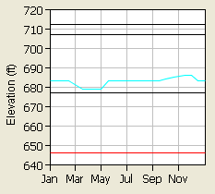
How is the Guide Curve defined in ResSim?
To ResSim, the Guide Curve is the line or curve defining the top of a selected operating zone.
By default, the guide curve is identified as the top of the default Conservation zone.
You can re-assign it to a different ‘top of zone’ curve.
It can vary seasonally.
“Guide Curve”
Notes:
Basic Guide Curve Operations
1.5-L-04
Klipsch 1.5-L-04
11

Slide 12
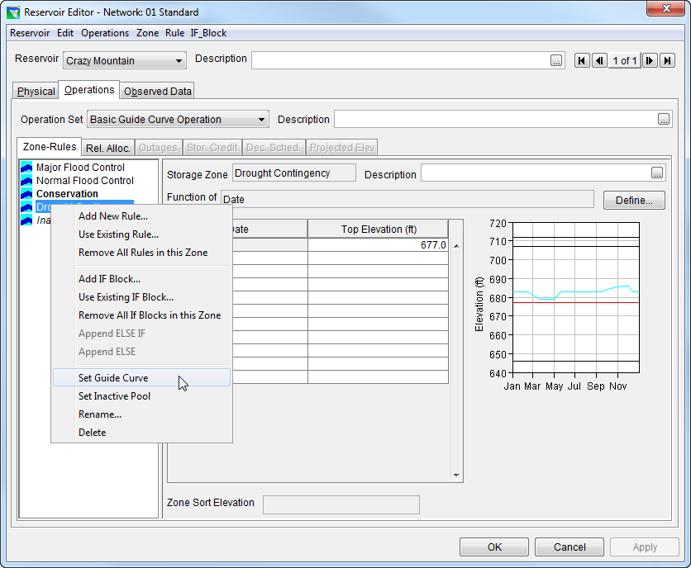
How to Identify the Guide Curve
Bold Text
To reset, Use “Set Guide Curve” from Context menu
Cyan Curve
Notes:
Basic Guide Curve Operations
1.5-L-04
Klipsch 1.5-L-04
12
From the context (right-click) menu of the current zone in the Zone-Rules Tree, select “Set Guide Curve”.
In the Zone-Rules Tree, the Guide Curve is always bold
In the thumbnail plot (or hotplot), the guide curve is always cyan, unless it’s zone is the currently selected zone. The currently selected zone is red in the plot, and highlighted (not bold) in the tree.

Slide 13
Basic Guide Curve Operation
When the reservoir level is above the Guide Curve, ResSim will increase releases as necessary (or possible) in a given period in an effort to lower the pool elevation to the Guide Curve.
When the reservoir level is below the Guide Curve, ResSim will reduce releases as necessary (or possible) in a given period in an effort to raise the pool elevation to the Guide Curve.
When the reservoir level is at the Guide Curve, ResSim will release “just enough” to maintain the pool elevation at the Guide Curve. This usually equates to “release inflow.”
Notes:
Basic Guide Curve Operations
1.5-L-04
Klipsch 1.5-L-04
13

Slide 14
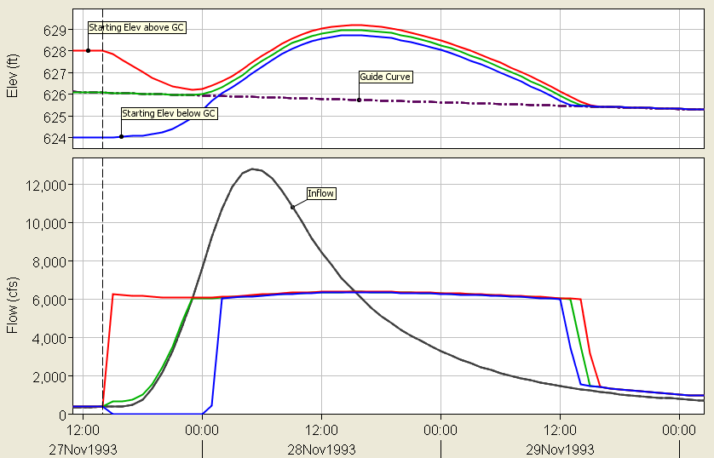
Sample Results – Guide Curve Operation

Slide 15
Reservoir Release Decision Determinations and Mass Balance Computations
❖
√
√
√
√
◆
√
Known Variables
Initial Storage (S_{t})
Initial (I_{t}) and Forecast Inflow (I_{t+1})
Initial Outflow (O_{t})
Losses Estimates
Computed Variables
Final Outflow (O_{t+1}):
based on Release Decision Logic
Final Storage (S_{t+1}):
based on Mass Balance
√
◆
√
√
❖
√

Slide 16
Release Limit Types
Maximum Limit: Cannot exceed this limit
Minimum Limit: Cannot fall below this limit
Specified Limit: Cannot exceed or fall below this limit

Slide 17
Summary of HEC-ResSim Rule and Limit Types
Rule | Return Variable | Limit
Release Function | Flow | Min/Max/Specified at Current Time Step
Downstream Control | Flow | Min/Max/Specified at Current Time Step
Flow Rate of Change | Flow | Min/Max at Current Time Step relative to change limit from Previous Time Step Release
Elevation Rate of Change | Flow | Min/Max at Current Time Step relative to change limit from Previous Time Step Release
Hydropower | Flow | Min at Current Time Step
Induced Surcharge | Flow | Min at Current Time Step
Tandem | Flow | Specified at Current Time Step
Script | Flow | Min/Max/Specified at Current Time Step

Slide 18
Release Decision Factors
Outlet Release Capacity (Min & Max Physical Limits)
Operating Rules (Min/Max/Specified Limits)
Constrain GC Operation to achieve other operating goals
Temper GC behavior by providing Release Limits
Rule Priorities
Highest priority is the top of the rule stack
Lowest priority is the bottom of the rule stack
Priorities resolve conflicts between rule limits
Guide Curve (GC) Operation (Specified Limit)
Underlying logic for reservoir Operation
Specified release to empty storage above GC
Curtailed release when pool level is below GC

Slide 19
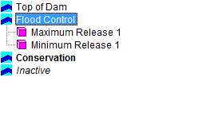
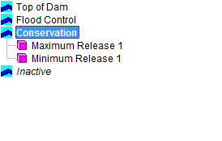
Allowable Range of Releases & Release Decision
When the pool is above GC, the Release Decision will be the upper limit of the Final Allowable Range of Releases.
When the pool is below GC, the Release Decision will be the lower limit of the Final Allowable Range of Releases.

Slide 20
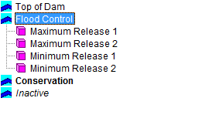
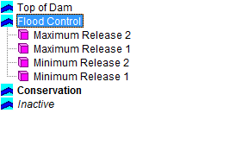
Multiple Rules – Compatible Limits
When a sequence of maximum/minimum rules are together in the rule stack, their relative priority does not matter – the lowest max “Wins”/the highest min “Wins”.
For Compatible Limits, any rule prioritization order would result in the same Final Range of Allowable Releases.

Slide 21
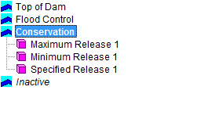
Muliple Rules – Compatible Limits

Slide 22
What is a conflict?
In ResSim context - a situation when one goal or constraint (rule) desires a release limit that is incompatible with the release limit desired by another goal or constraint.
Example:
A minimum rule calls for a release of 5,000 cfs but due to downstream local flow and channel capacity, the reservoir should not release more than 2000 cfs.
Rule priority resolves conflicts

Slide 23
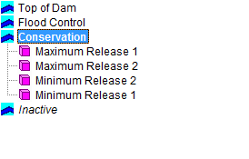

Multiple Rules – Conflicting Limits

Slide 24

Multiple Rules – Conflicting Limits
When different limits conflict, lower priority Limits are violated and the Final Allowable Range of Releases is determined based on the highest priority limits
Physical Capacity limits always have a higher priority than Operating Rule Limits

Slide 25
Multiple Rules – Multiple Outlets & Limits
Flow (cfs)
Flow (cfs)

Slide 26
Multiple Rules – Multiple Outlets & Limits

Slide 27
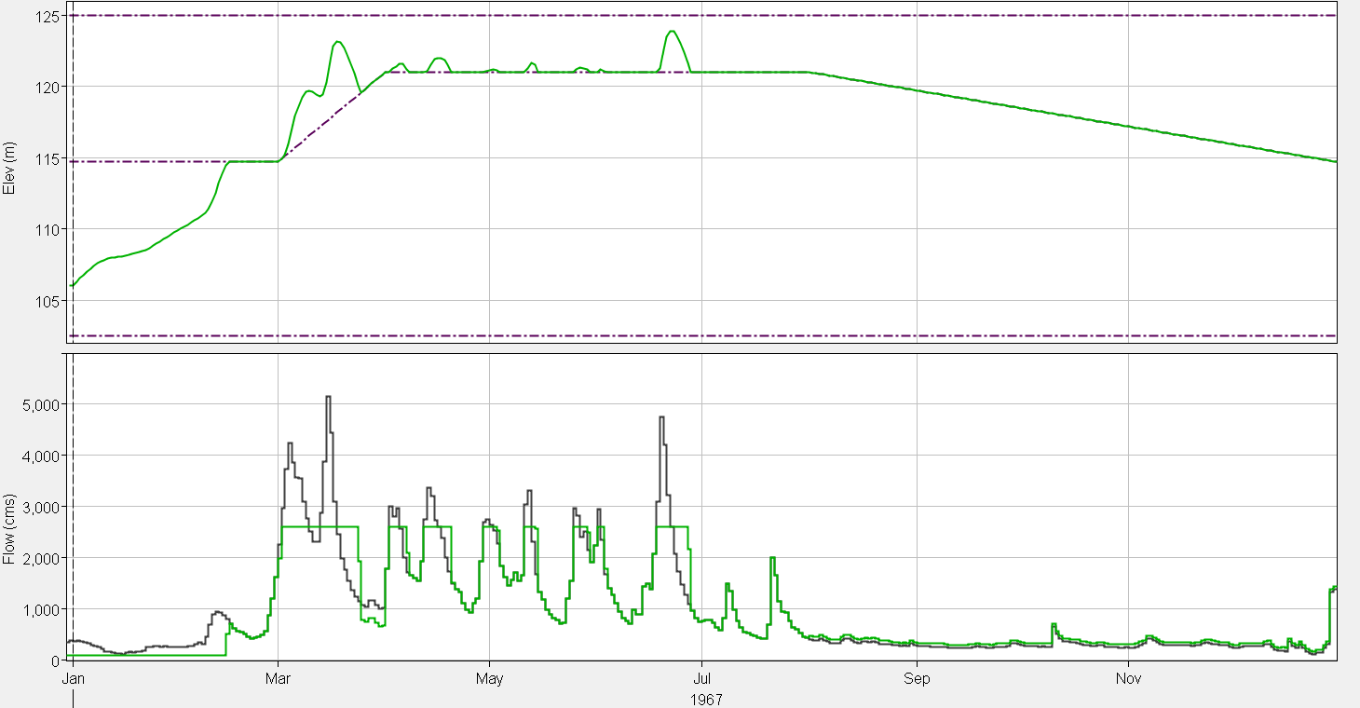
Reservoir Operation
Flood Control Zone
Guide Curve Level
Conservation Zone
Reservoir Elevation
Inflow
Maximum Release
Outflow
Minimum Release
Guide Curve Release

Slide 28
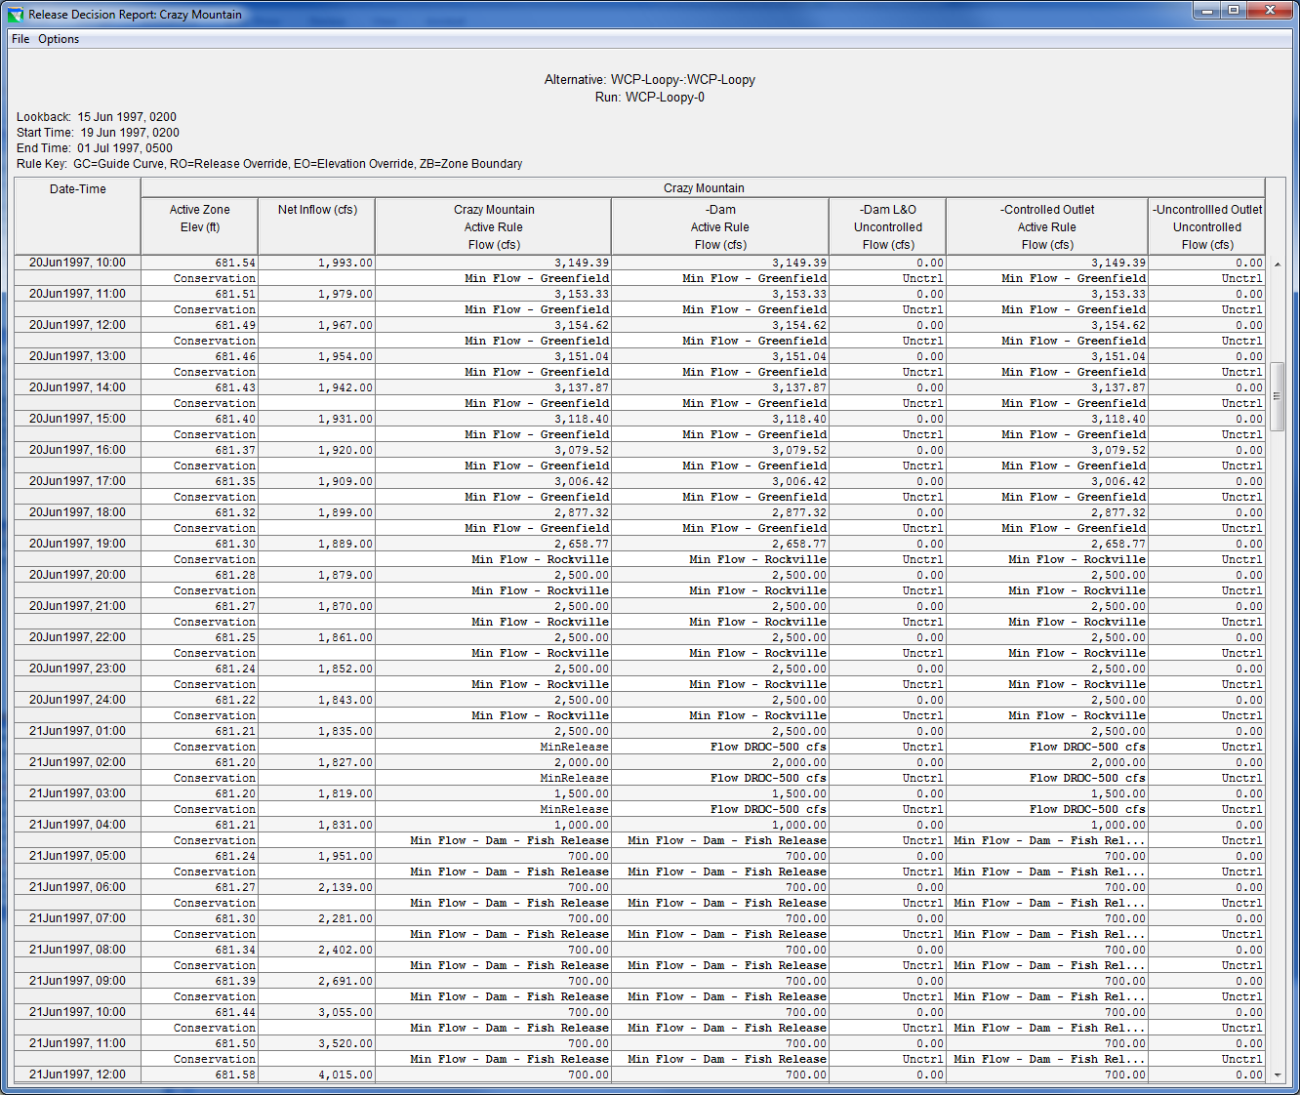
HEC-ResSim’s Release Decision Report

Slide 29
Summary of HEC-ResSim’s Release Decision Logic
Determine Outlet Release Capacity (Min & Max Physical Limits)
Apply Overrides (Capacity/Release/Elevation)
Evaluate Operating Rules (Min/Max/Specified Limits)
Respect Rule Priorities & Determine Final Allowable Release Range
Calculate the Desired Guide Curve (GC) Release
Make Final Release Decision at the limit of the allowable range of releases that is closest to the desired GC Release

Slide 30
Points to Remember
Reservoir operation: The act of storing or releasing water from a Reservoir
Zones : The allocation of storage within a reservoir
Guide Curve: The target reservoir pool elevation or storage
Guide Curve Operation: Get to guide curve as fast as possible and stay there
Rules: The objectives of – or constraints on – the operation of a reservoir or system of reservoirs
Operation set: Holds all the information that describes the reservoir’s operating goals and constraints
Reservoir Release Decision: Is based on Mass Balance Computations
Rule Priorities: Highest priority is the top of the rule stack and Lowest priority is the bottom of the rule stack (Priority resolves conflicts )
Allowable Range of Releases: Compatible Limits, Conflicting Limits, Multiple Outlets

