Slide 1
Implementing Operation Sets
Part 1
Assessing Operational Plans
Adding Operational Rules:
Rate of Change & Release Function Rules

Slide 2
Implementing Operation Sets
Part 1 Outline
Recap of Operations for Guide Curve & Physical Constraints
Considering Operational Objectives & Constraints
  Where/how to find operational constraints for a reservoir
    Identify the Operation Plan
    Identify the Zones and Rules
How to input operational rules in HEC-ResSim
  Creating Operation Sets
  Creating basic at-site Rules
    Rate of change rules
    Release rules

Slide 3
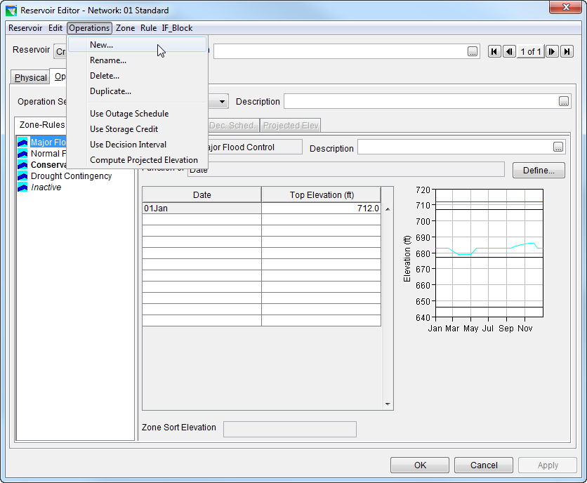
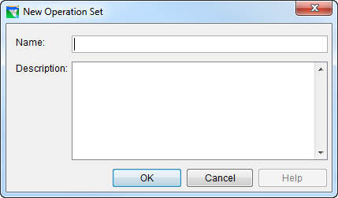
How To…Create an Operation Set
In the Reservoir editor, select the Operations tab
From the Operations menu, select New.
Give it a name and description and click OK.
Notes:
From prior presentation

Slide 4
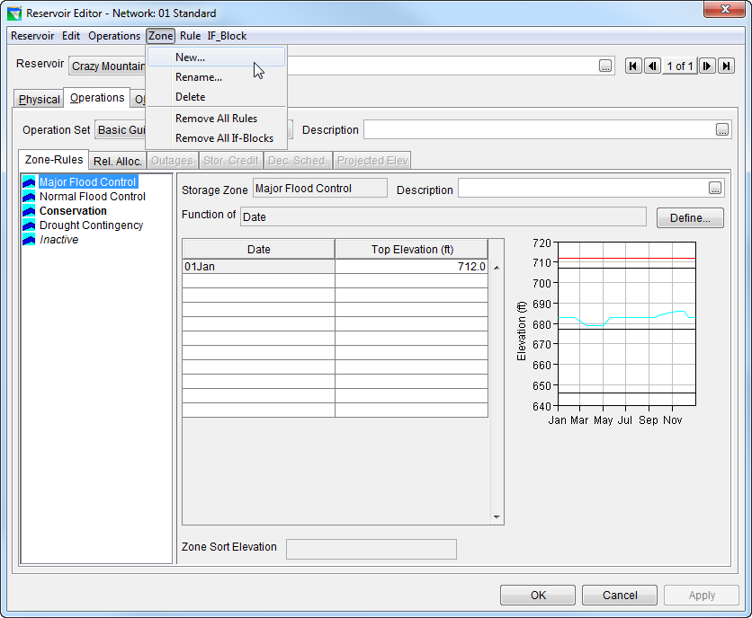
How To…Create Zones
Three default zones are created with each new operation set
Add more zones by selecting New from the Zone menu.
Enter the Top of Zone curve in the table.

Slide 5
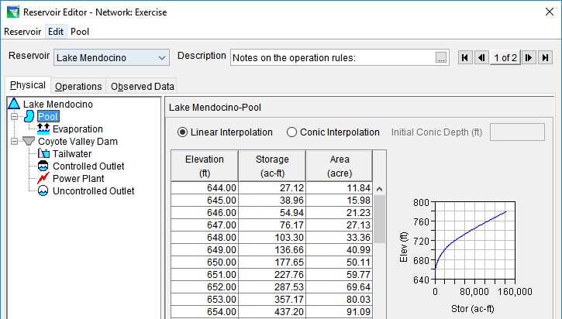
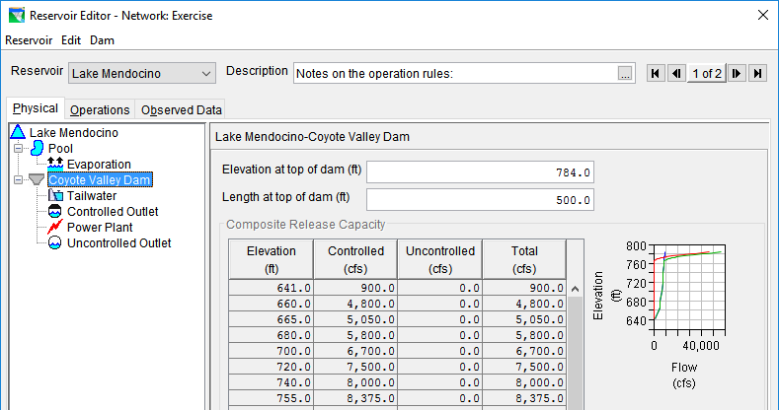
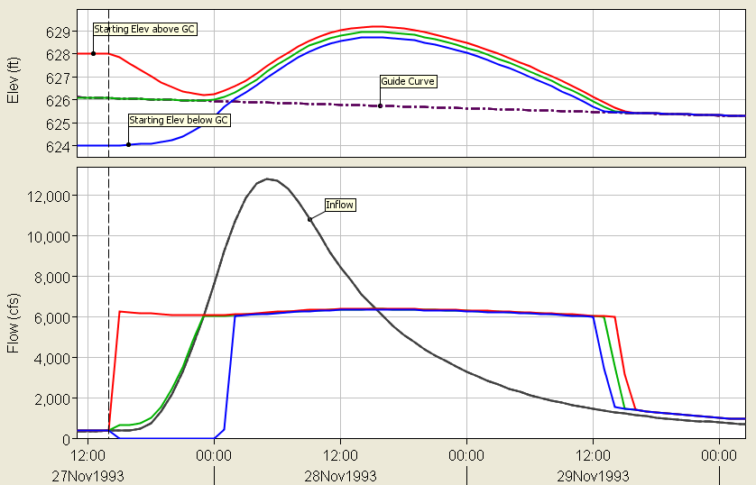
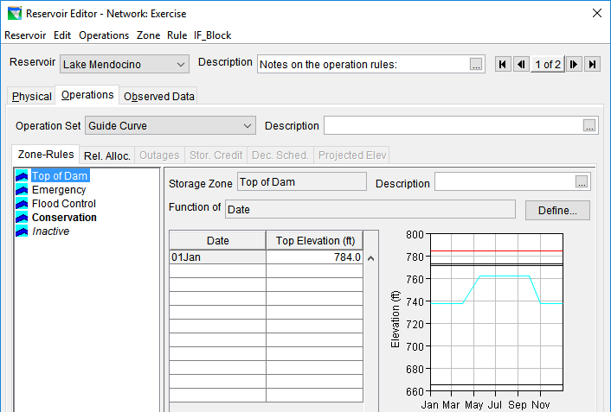
Prior to Adding Rules, ResSim Operations are based on:
physical release constraint
Notes:
Results from prior presentation
Physical Properties - Pool
Physical Properties – Dam & Outlets
Operations – Zones
Results – showing Guide Curve operations & physical constraints only.

Slide 6
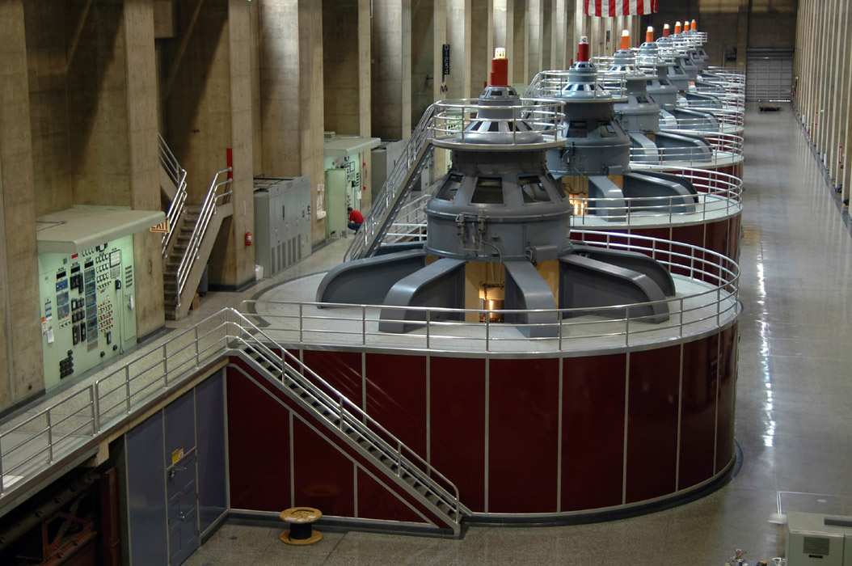



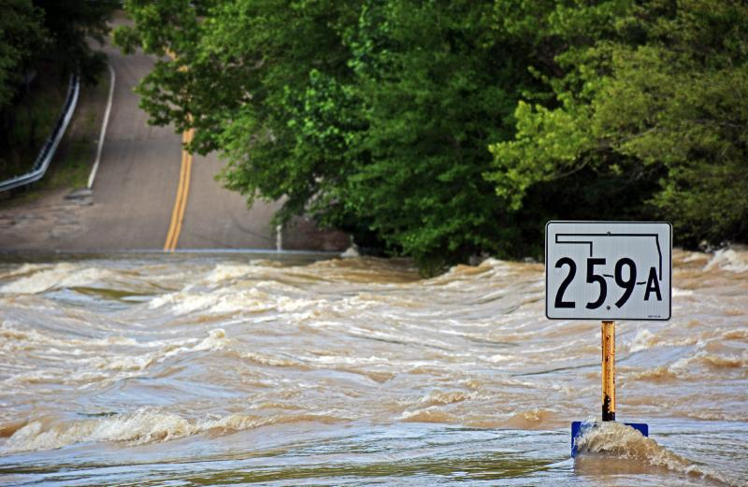
Operational Constraints
Notes:
Images reflect - Hydropower, water quality, fish & wildlife, flood risk reduction
Operational objectives and constraints

Slide 7
Where to Find Operational Constraints

Slide 8
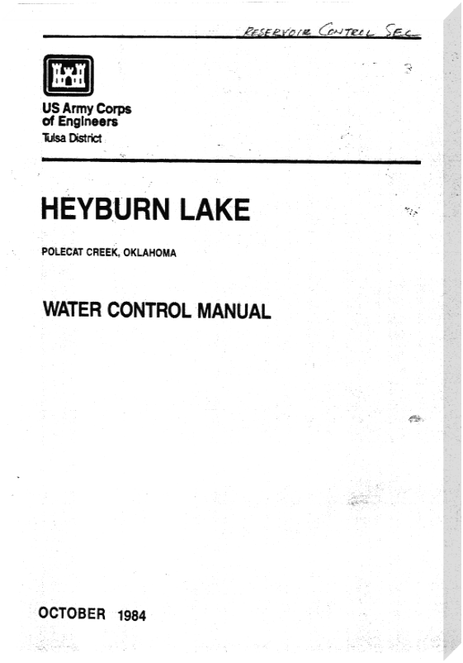
Sources for Operational Constraints
Water Control Manual
  Best source for operational constraints for USACE reservoirs
No water control manual?
  Contact the operating agency
  Contact state water resources agency

Slide 9
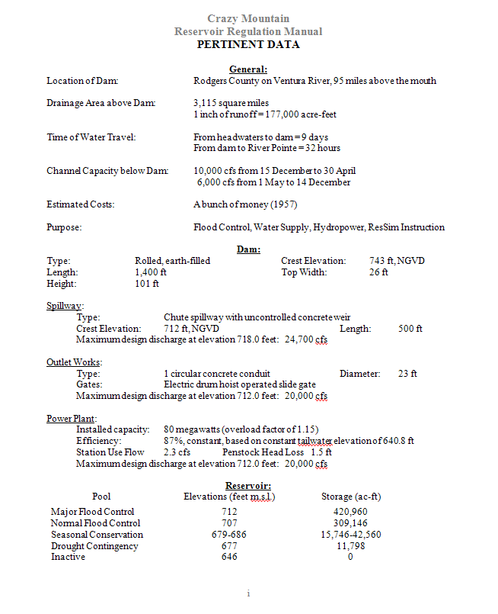
Pertinent Data
Become familiar with characteristics of the reservoir
Reservoir’s purpose and operating constraints
Keywords and phrases:
  Project Purposes
  Pool Levels
  Channel Capacity

Slide 10
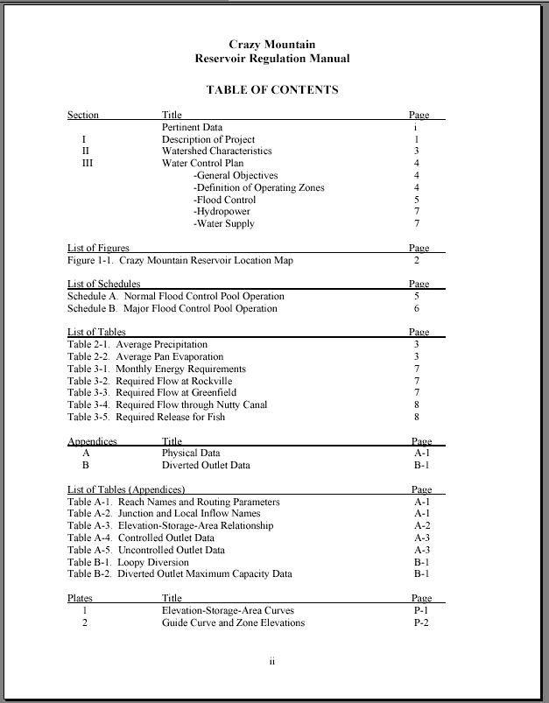
Table of Contents
Look at the table of Contents:
  Lists of Figures, Tables
  Plates and Exhibits
Keywords and phrases:
  Water Control Plan
  Instructions to Operators
  Operating Zones
  Operating Constraints
  Hydropower

Slide 11
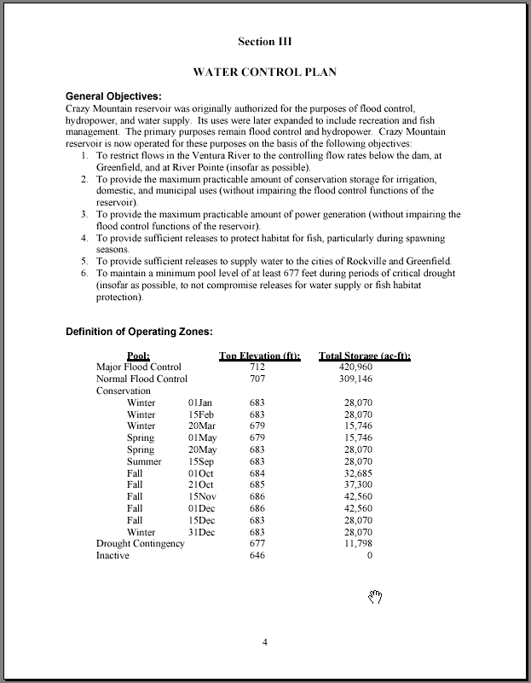
Water Control Plan
Read the plan CAREFULLY
Look for descriptions of requirements the reservoir must meet
Look for pool levels that will define your operating zones
Tables are great
  Some constraints are only mentioned in the text !

Slide 12
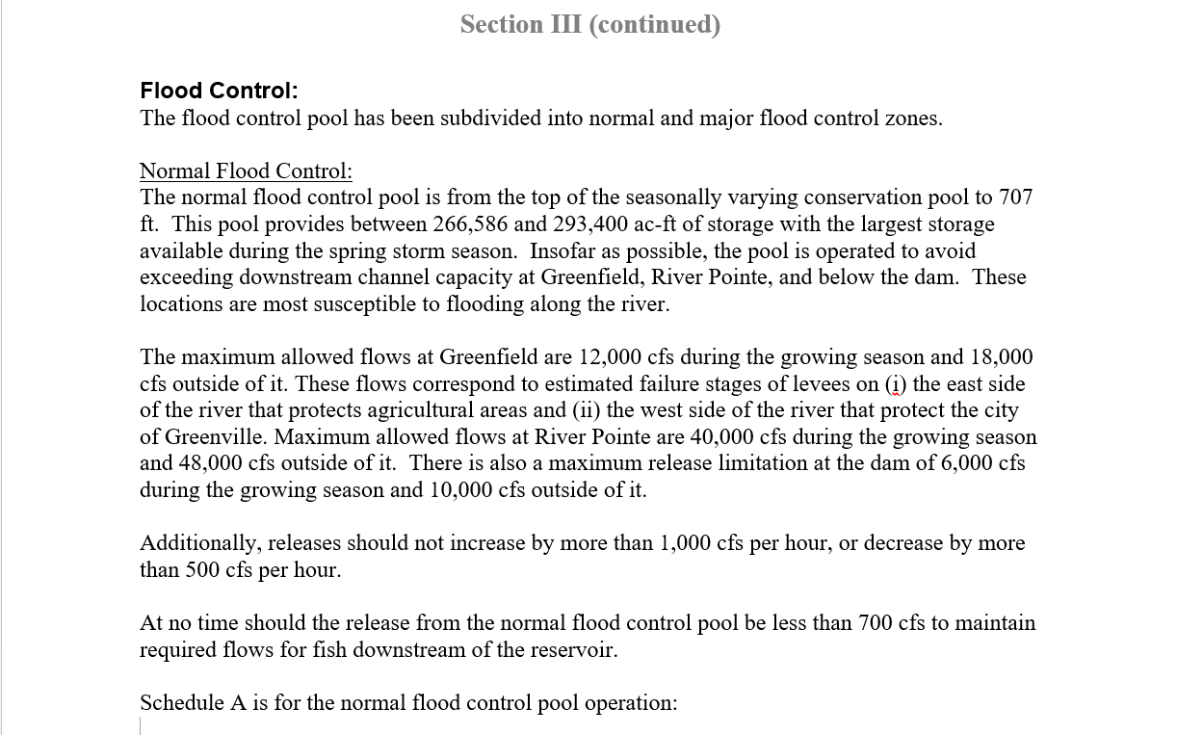
Operational Constraints
Downstream Constraint (Maximum)
At-site Release Constraint (Maximum)
At-site Rate of Change Constraint (Increase/Decrease)

Slide 13
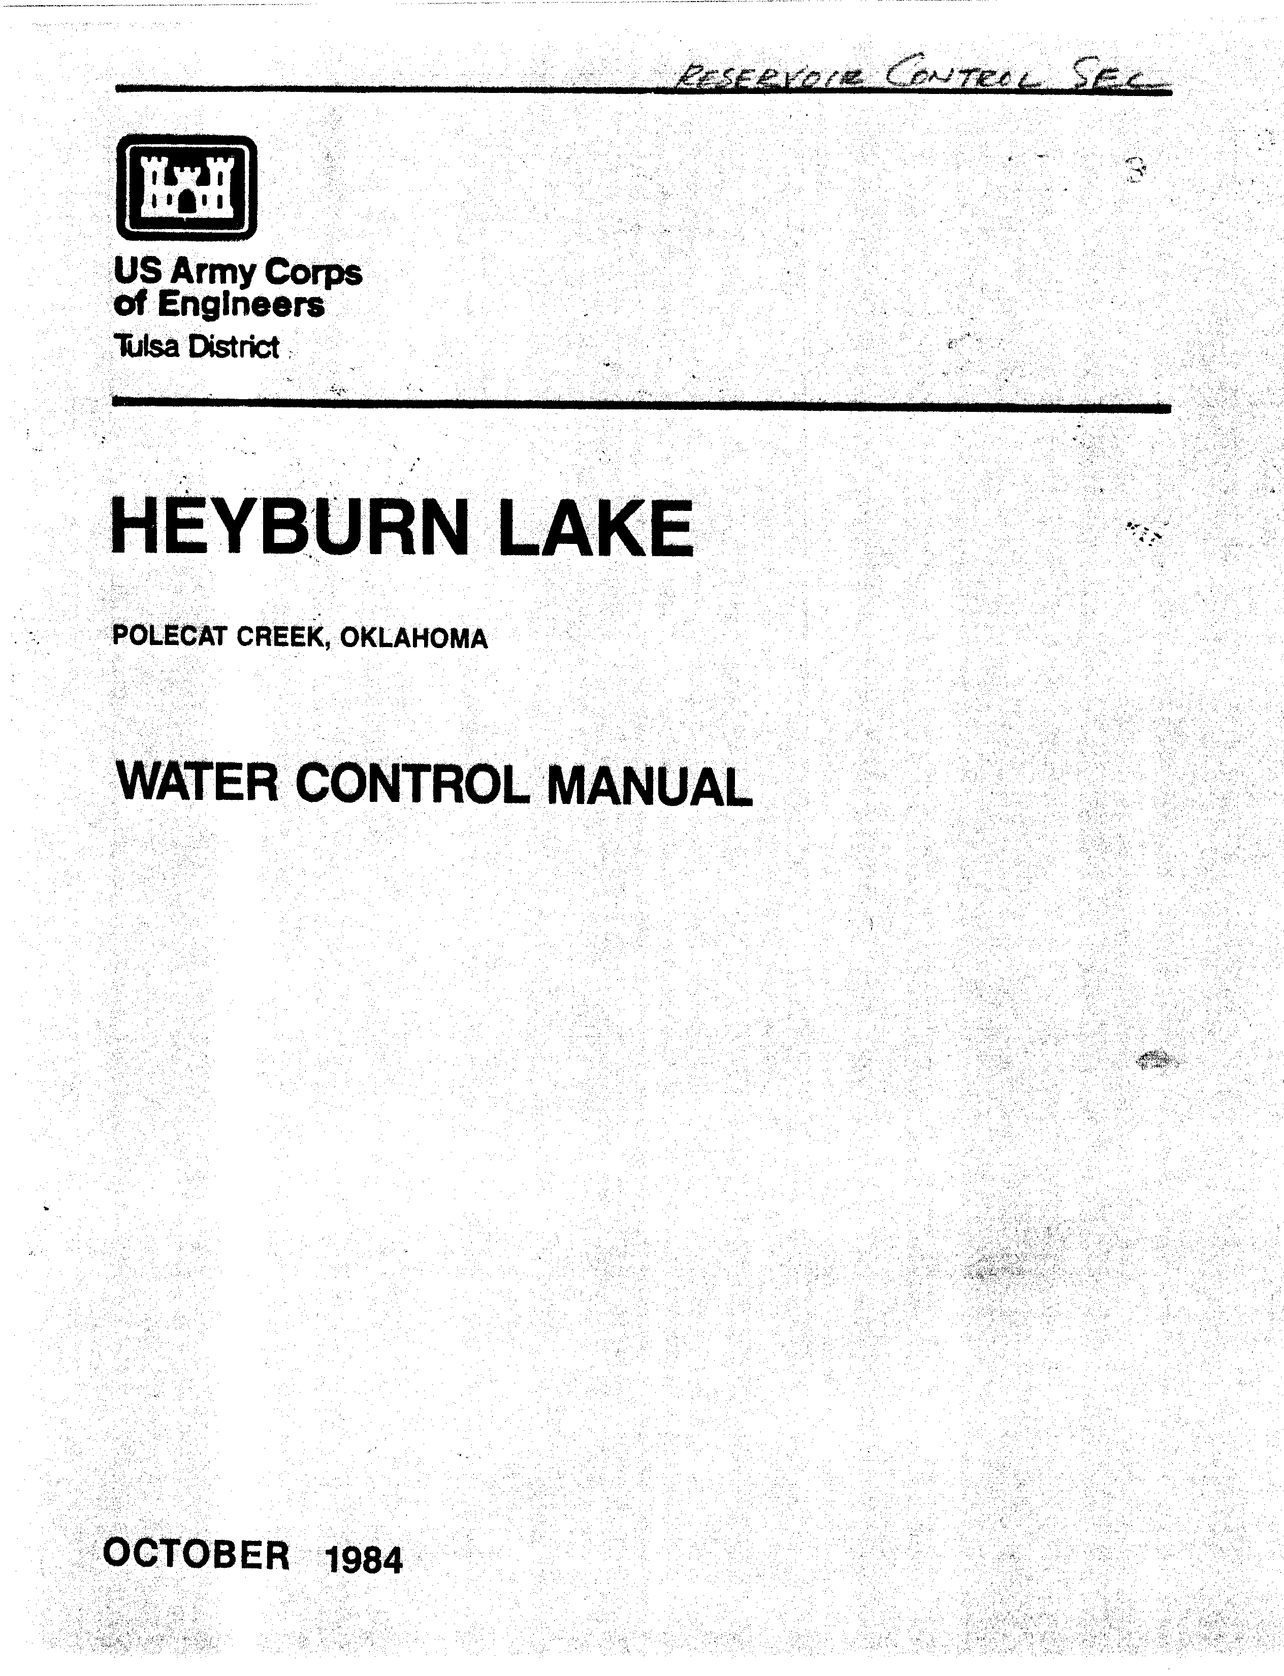
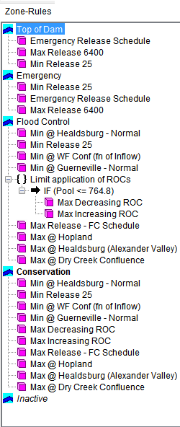
Next, Convert to Operational Rules

Slide 14
Turning Operating Objectives & Constraints into HEC-ResSim Operating Rules
Notes:
Turning Operating Objectives & Constraints into HEC-ResSim Operating Rules

Slide 15
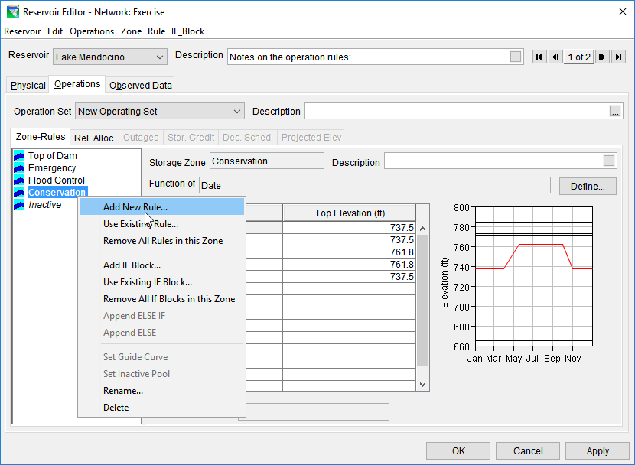
Steps for Adding
Operational Constraints
Use the Reservoir Editor Operations tab
Create Operation Set
Define Zones
Define Rules and add to appropriate Zones

Slide 16
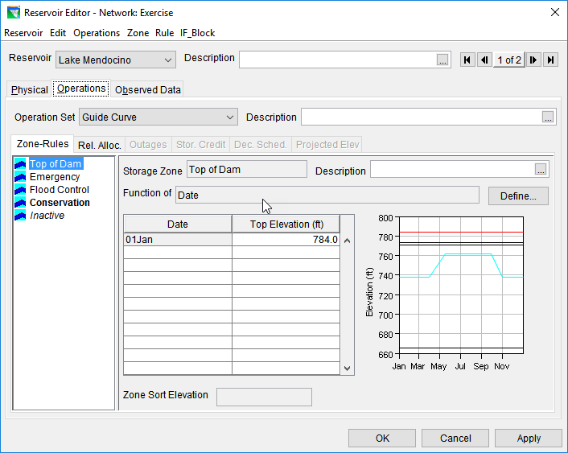
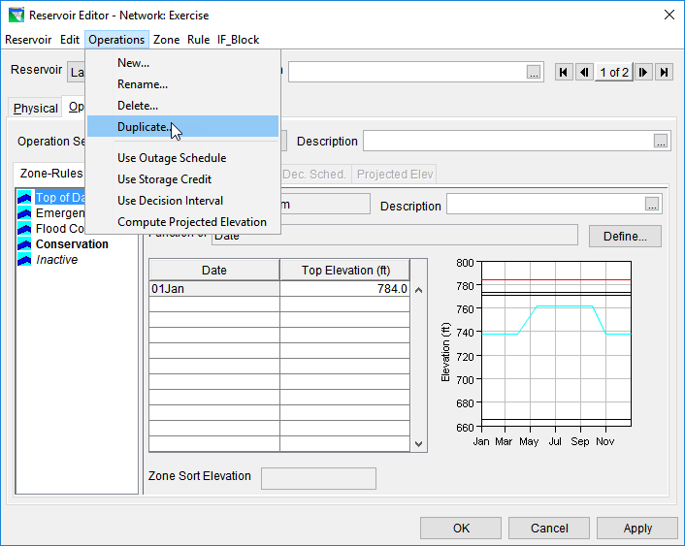
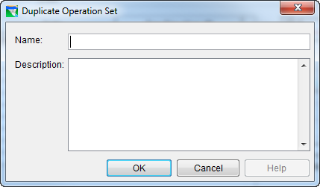
Create a New Operation Set
Operation Set: The set of zones and rules that describe a water control plan
  Instead of creating from scratch, use Duplicate…

Slide 17
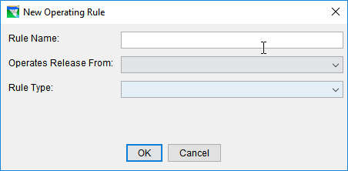
How to Create a Rule
Right click the Zone where you want to add the rule
    The rule will apply when the reservoir storage is in this Zone
Select Add New Rule… from the Rule Menu
1
2

Slide 18
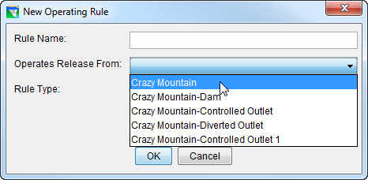

Creating a Rule: Release From
Select the reservoir element the rule will affect
  The pool (labeled as the reservoir itself)
  The dam
  An outlet group or a specific outlet
3
Notes:
Next slides will depict options

Slide 19
Elements of a ResSim Reservoir Element
Inflow Junction
Reservoir
Pool
Diverted Outlet
Outlets
Dam
Dam Tailwater
Outflow Junction

Slide 20

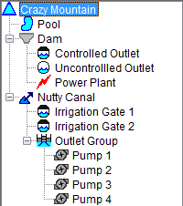
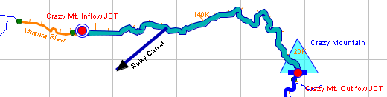
Elements of a ResSim Reservoir Element
The Physical tab helps you visualize the elements within a reservoir

Slide 21
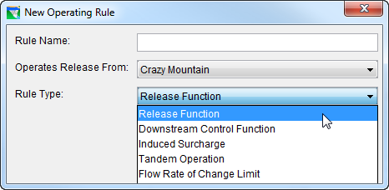
Creating a Rule: Rule Type
Select the rule type
  Many different rule types to select
    Some elements can’t use certain rule types
    Drop down will update based on element
Finally, name the rule
5
4

Slide 22
Rule Types
Rate of Change - Flow
Rate of Change - Elevation
Release Function
Downstream Control (covered in Part 2)
Tandem (covered in later lesson)
Induced Surcharge (covered in later lesson)
and more…

Slide 23
Rate of Change Rules
Flow & Elevation

Slide 24
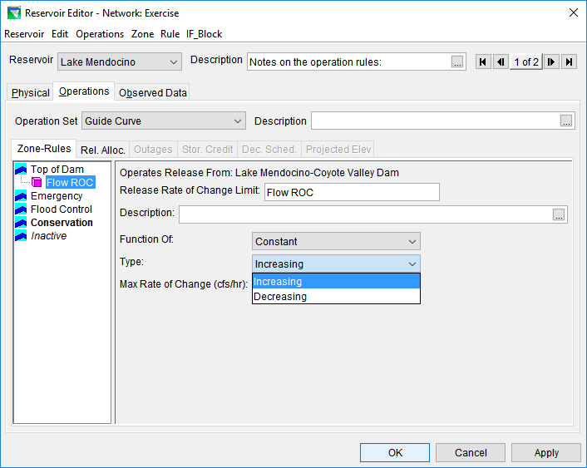
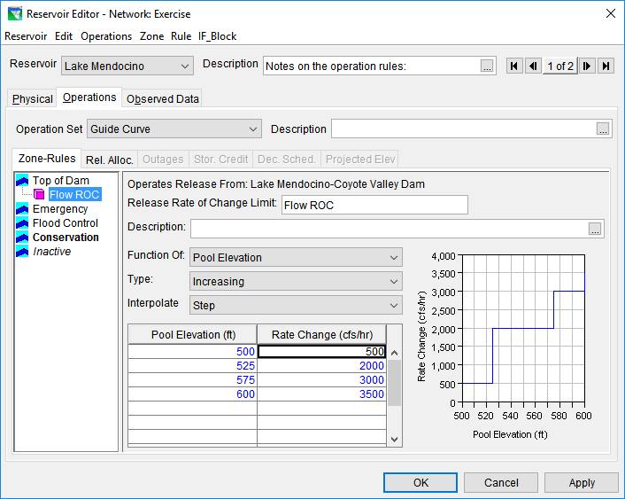
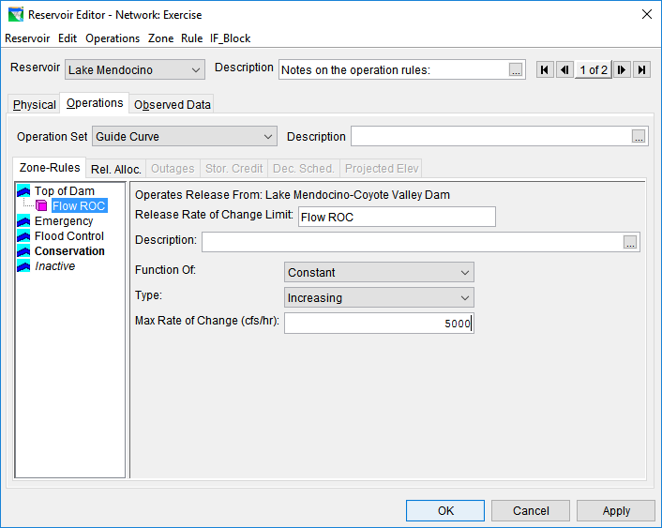
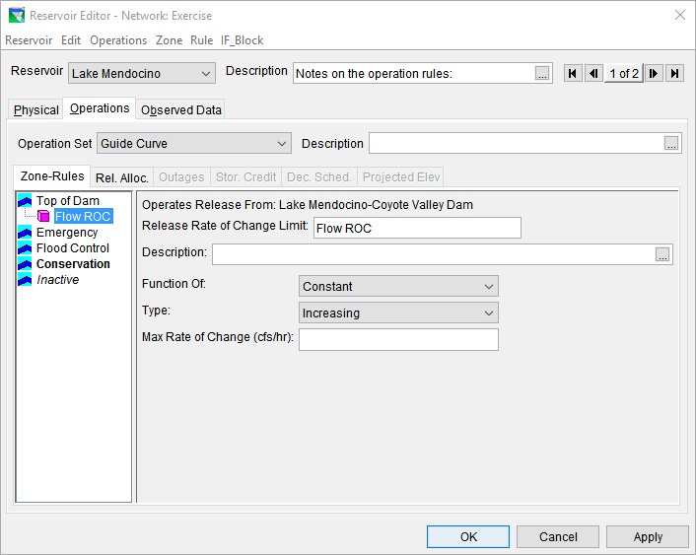
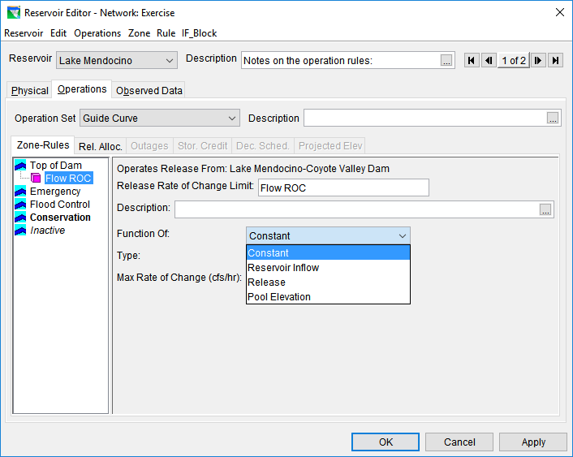

Flow Rate of Change Rules
Limits the rate of change (cfs/hr) of releases
Evaluated instantaneously

Slide 25

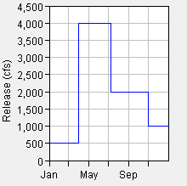
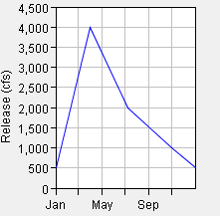
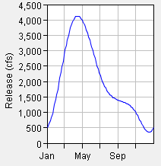
Interpolation Options
Step
Linear
Cubic
Notes:
Shows different interpolation options for the relationship, although in this case we are looking at a relationship with respect to date, not a ROC

Slide 26
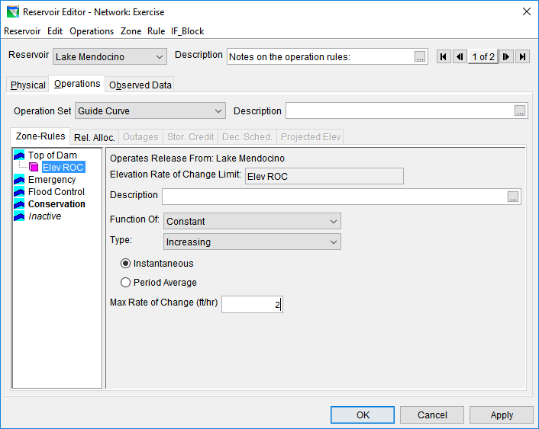
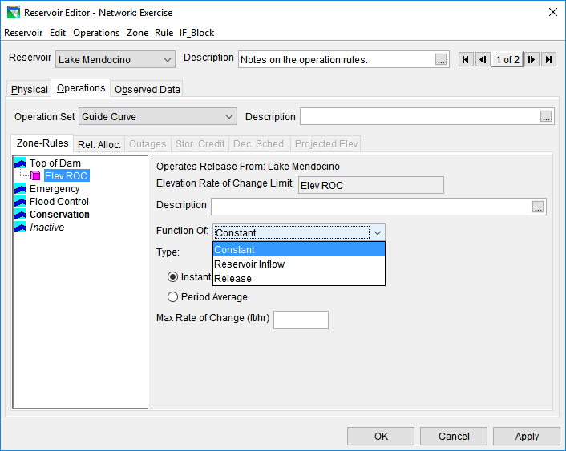
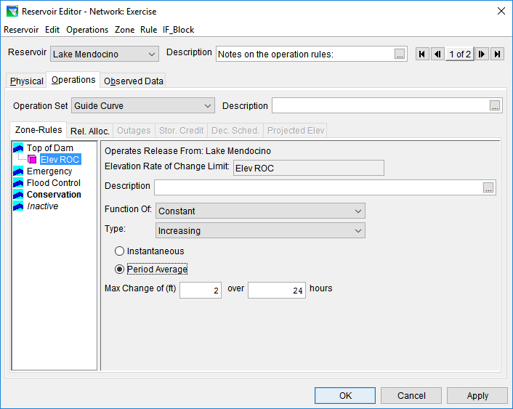
Elevation Rate of Change Rules
Limits the rate of change (feet/hr) of reservoir elevation
Instantaneous or Period Average

Slide 27
Release Function Rules
Release can be a Function of:
Date
Date & Time
Model Variable
External Variable
Scripted Variable
Notes:
& soon additional types

Slide 28
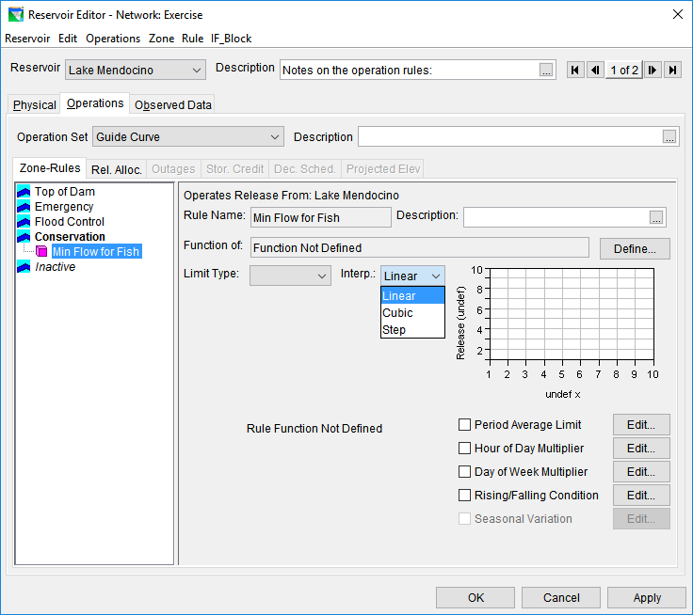
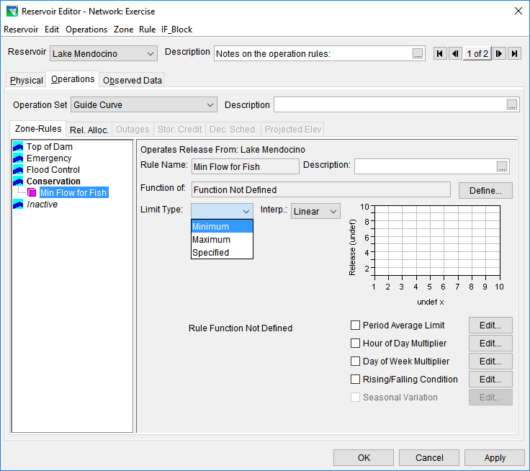
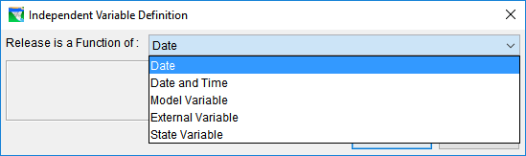
Release Function Rules
Set releases as a function of a variable
One of the most powerful and flexible rule types

Slide 29
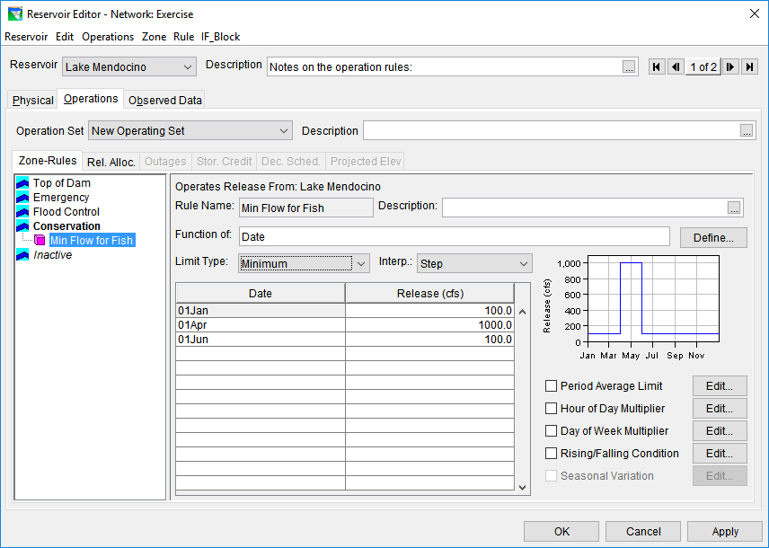
Function of: Date or Date & Time

Slide 30
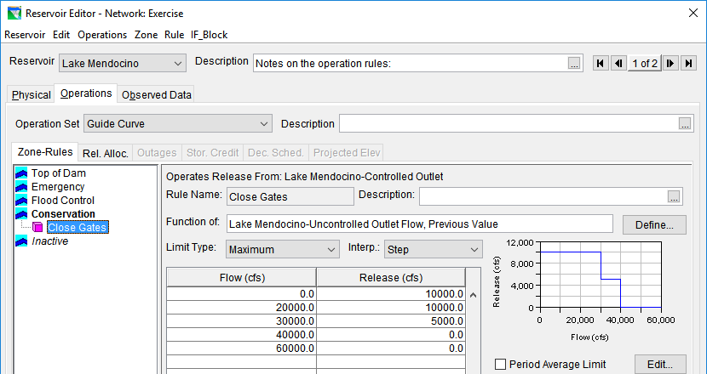
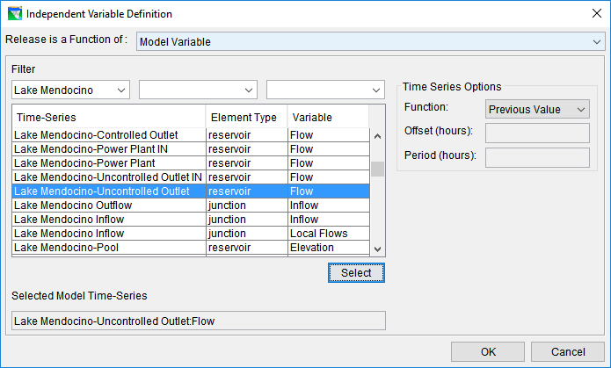
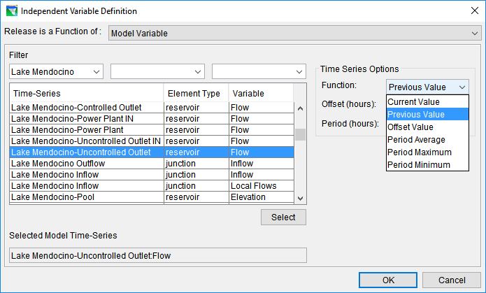
Function of: Model Variable
Makes releases based on a time series the model computes, or model input

Slide 31
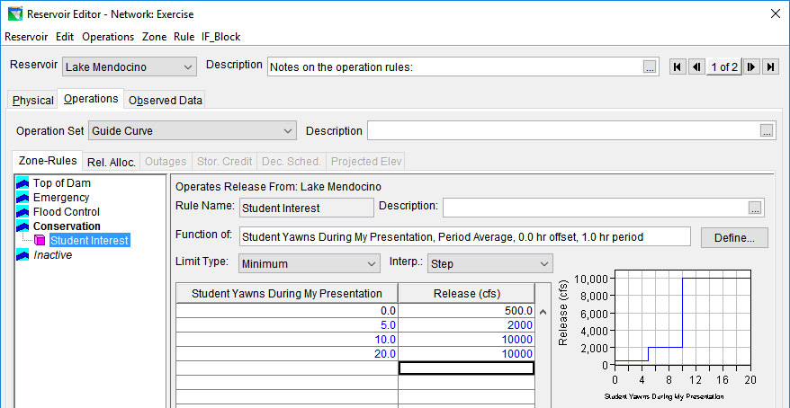
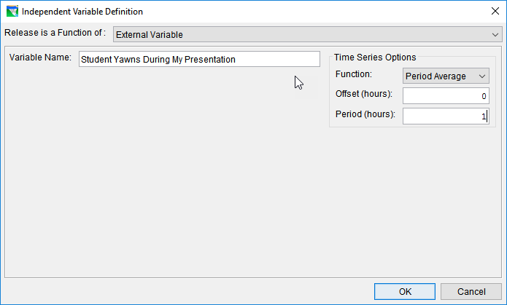
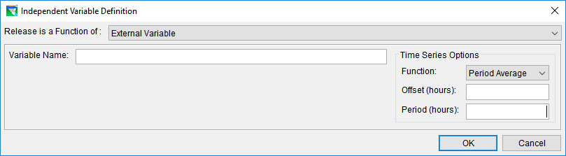
Function of: External Variable
Makes releases based on a user defined time series external to the model

Slide 32
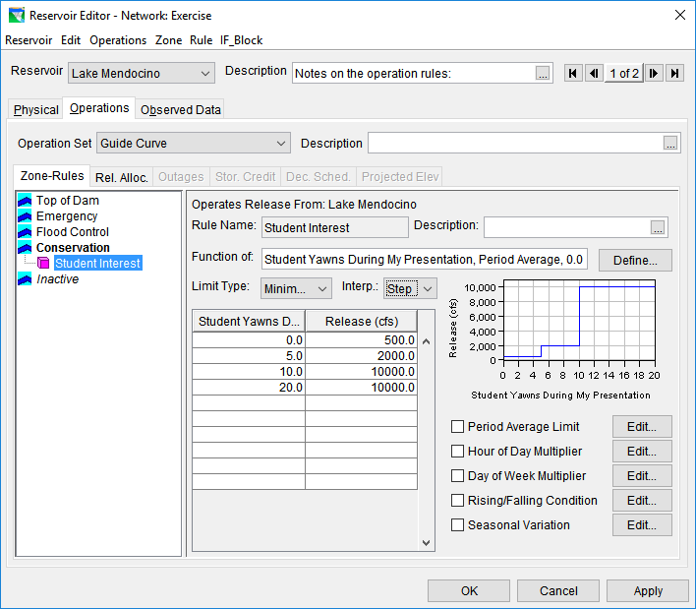
Additional Modifiers

Slide 33
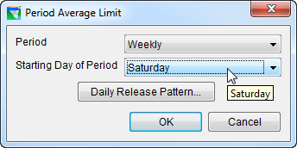
Period Average Limit
Sets the rule to meet a target averaged over a period
Period
  None
  Daily
  Weekly
Starting Day of Period
  For weekly only, set the start day of the week
Daily Pattern
  Acts as a weighting pattern for meeting the flow requirement

Slide 34
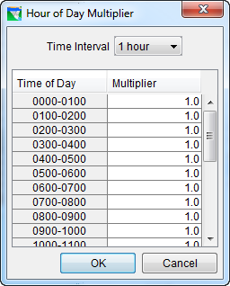
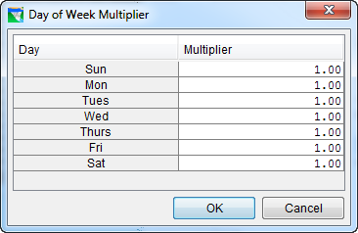
Hour of Day & Day of Week Multipliers
Applies a multiplier to the release for specific days of the week, or hours of the day
  Can effectively turn off a rule with a 0.0 multiplier

Slide 35




Rising/Falling Condition
Sets the rule to only be applied during a rising or falling condition
Averaging Period
  Hours over which the condition will be determined
Tolerance
  The amount by which the beginning and end of the period can differ and still be considered constant

Slide 36


Seasonal Variation
Sets the rule to behave differently throughout the year
  Adds date columns to the existing tables
  Obviously, won’t work with a function of date rule

Slide 37
Take-home Points
A reservoir’s Water Control Manual (or similar) can provide most of the information needed to model the reservoir operations
  Where else can you go for information on reservoir operations?
At-Site Rules limit the reservoir release explicitly
  What’s the difference between a physical constraint and an operational one?
Release Function Rules can be used to describe a vast array of operational constraints.
  Channel Capacity
  Water Supply
  Environmental Support
  Explicit (Specified) Releases
  Etc.

Slide 38
Definitions
Physical Constraint – Outlet maximum discharge capacity and rate of increase or decrease constraints
Operational Constraint – A regulation. A requirement defined in the Water Control Plan. A limit on the release.
At-Site Constraint – An operational constraint specified for the reservoir itself or one of its outlets; not a downstream constraint.
Notes:
At-site constraint in comparison with downstream.

Slide 39
More Definitions
Operational Zone – A portion or range of the reservoir pool for which certain constraints have been specified.
Operation Rule – The ResSim data input form used to specify an operational constraint so that the constraint can be simulated.
Operation Set – The set of zones and rules the describe a water control plan
Rule Types – The specific kinds of rules that you can define with ResSim

