Slide 1
Implementing Operation Sets Part 2
Release Allocation, IF Blocks, Downstream Control Rules, Prioritizing Rules

Slide 2
Implementing Operation Sets Part 2 Outline
Additional Operational Settings & Rules
Release Allocation
IF Blocks (Nesting rules in Conditional Statements)
Downstream Control Rules
Combining and Prioritizing Rules

Slide 3
Release Allocation
Defined & Explained
How to use Release Allocation

Slide 4
Release Allocation
What is Release Allocation?
Which outlets should release first, next, and so on
Balanced (weighted) approach
Evenly weighted (e.g., 50:50 split (default))
Unevenly weighted (e.g. 60:40 split)
Sequential approach
Stepped approach
Hydropower reservoirs often direct any release to the power plant first
Other outlets release water when the power plant reaches capacity
Release Allocation is an Operations setting
Define the priority (or order) to the available outlets

Slide 5
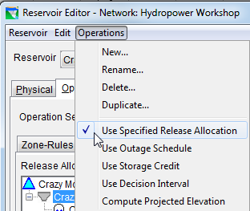
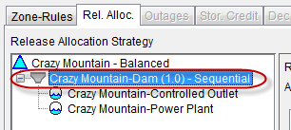
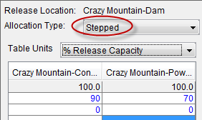
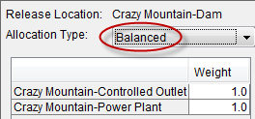
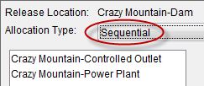
Specifying a Release Allocation
Operations Tab in Reservoir Editor
Use Specified Release Allocation
Specify Allocation Type
Sequential
Specify the component order
Balanced
Specify the component weighting
Stepped
Specify the release capacity balance
Always Active in v3.3
Notes:
This is always turned on (no option) in v3.3

Slide 6
IF Blocks
Making Rules Conditional with IF-THEN-ELSE
Conditional nature of operations
IF Blocks in HEC-ResSim
How to use IF Blocks in HEC-ResSim
Notes:
Add conditional logic

Slide 7
Need for IF-THEN-ELSE logic
Typically, reservoir operations follow conditional paths for decision-making
Conditions are used to determine the applicability of operational goals and constraints
Using the ResSim IF Block feature, you can define conditional tests that determine when and which rules apply in the release decision process.
Reservoir Elevation > 610 ft?
No
Min Release Constraint
Yes
In Flood Control Space?
No
Hydropower Release
Yes
Flooding Downstream?
No
New Release = Max Inflow
Yes
Max Release Constraint

Slide 8

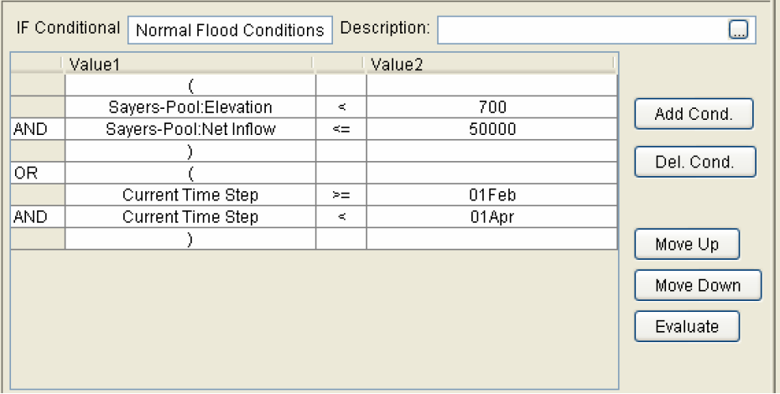
IF-THEN-ELSE in HEC-ResSim
Simple IF statement
IF Block can be very simple, with a single conditional test
Compound conditional test
using parentheses and logical operators
Nested IF statement
A nested if is an if statement that is the target of another if statement

Slide 9
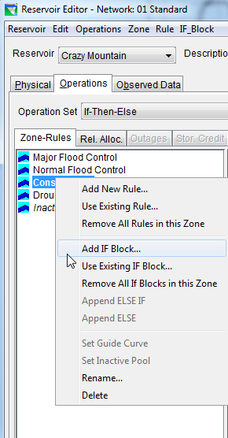
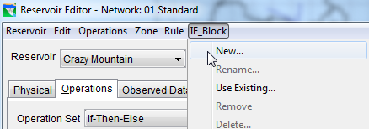
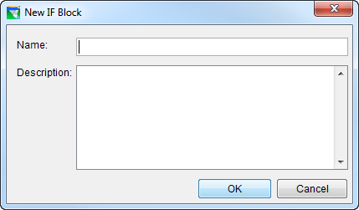
How to…Create an IF Block
Operations tab of the Reservoir Editor, select a zone in your current operation set
Right-click on the zone in the tree and Select Add IF Block…
Under the IF_Block menu Click New
Name & Describe the IF Block…

Slide 10
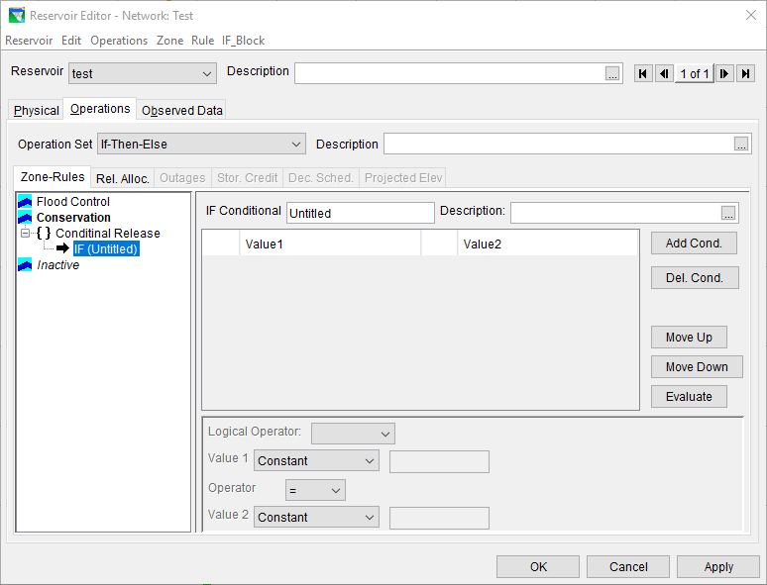
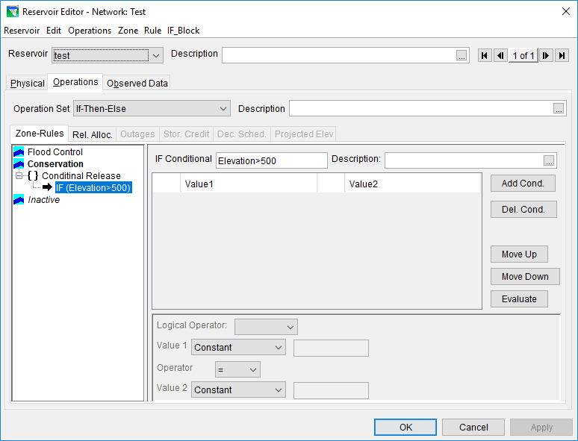
Naming & Describing IF Blocks

Slide 11
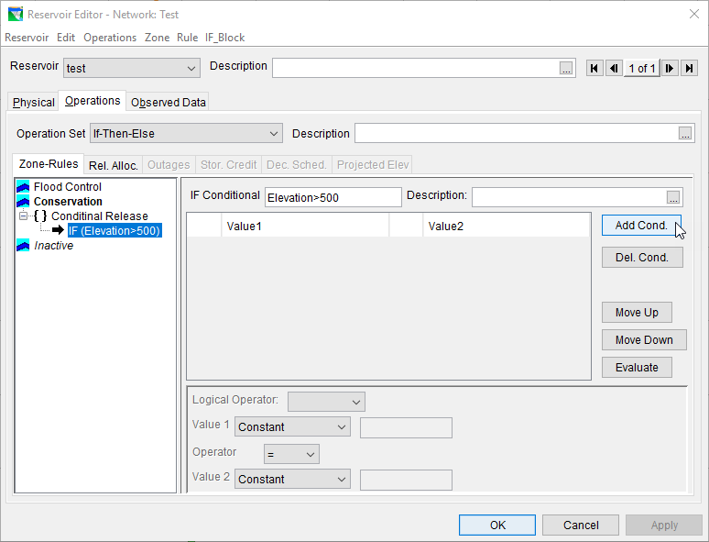
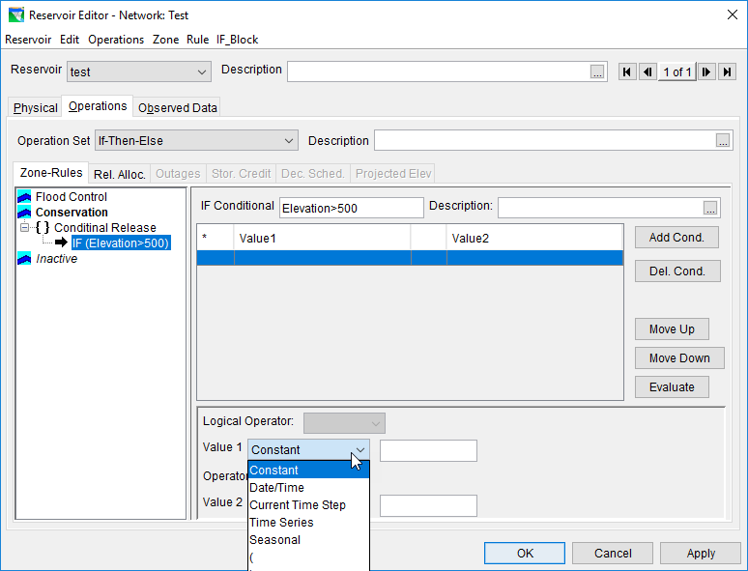
IF Blocks: Adding Conditions
Constant -> numeric value
Date/Time -> ddmmmyyyy, hh:mm
Current Time Step
Time Series ->
External Variable
Model Variable
State Variable
Seasonal -> ddmmm
( ) -> group conditional tests

Slide 12
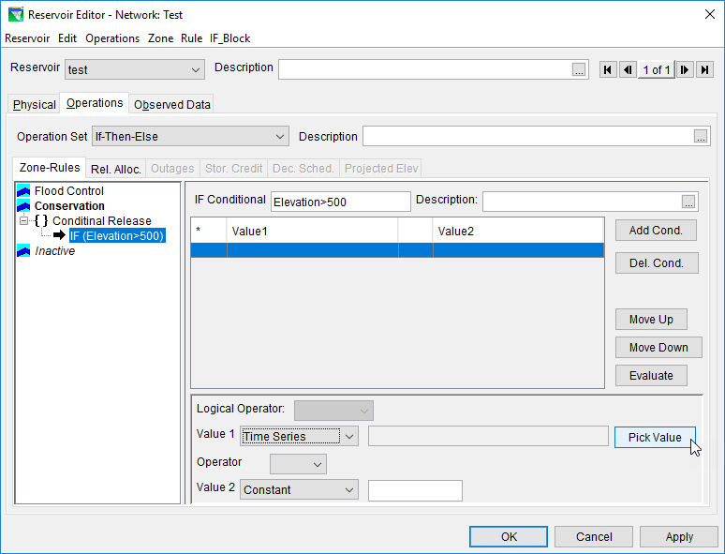
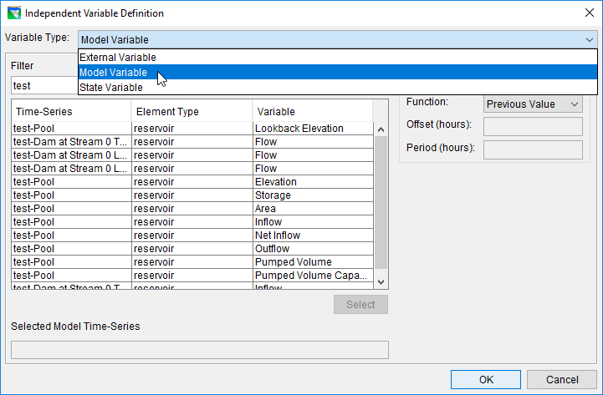
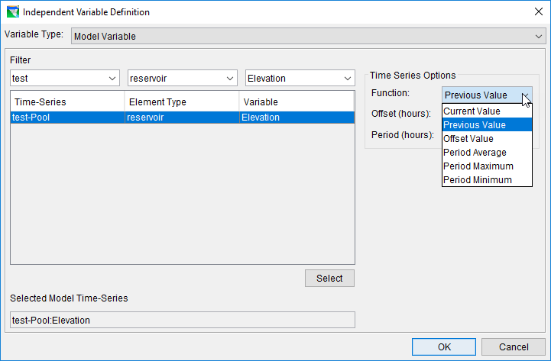
IF Block Test Values – Time Series

Slide 13
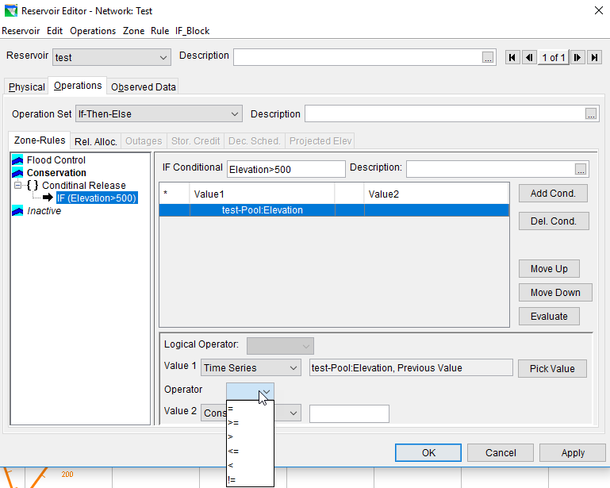
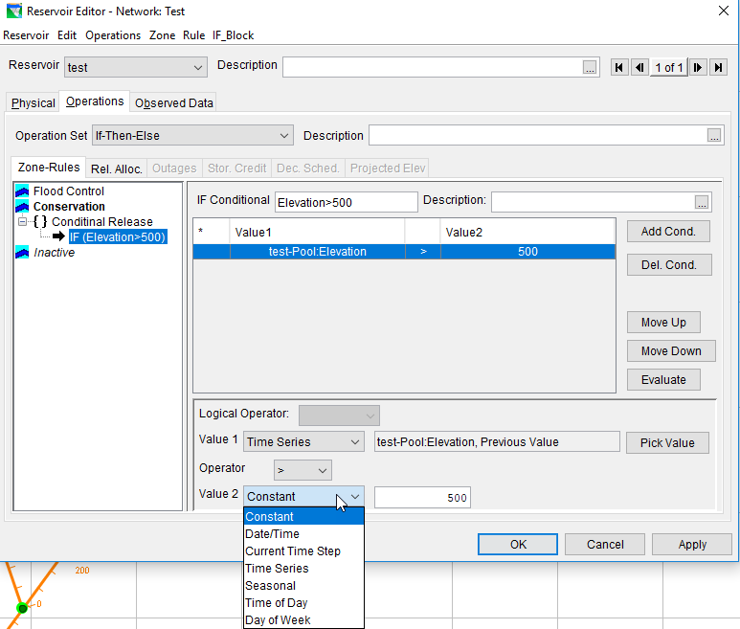
IF Block Test Operators

Slide 14
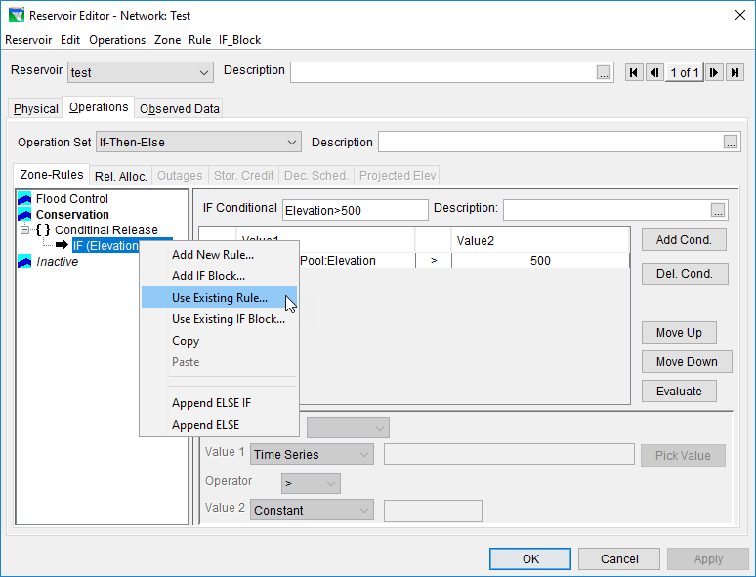
Adding rules to the IF Block

Slide 15
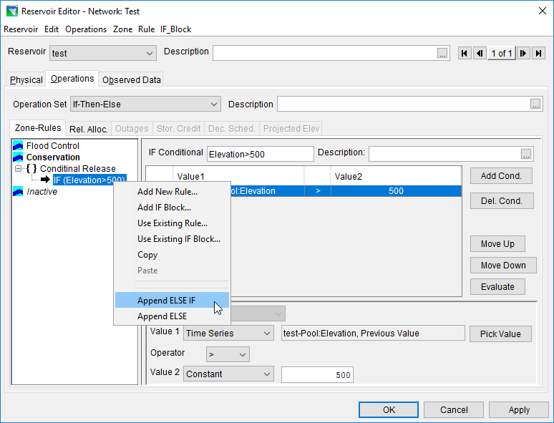
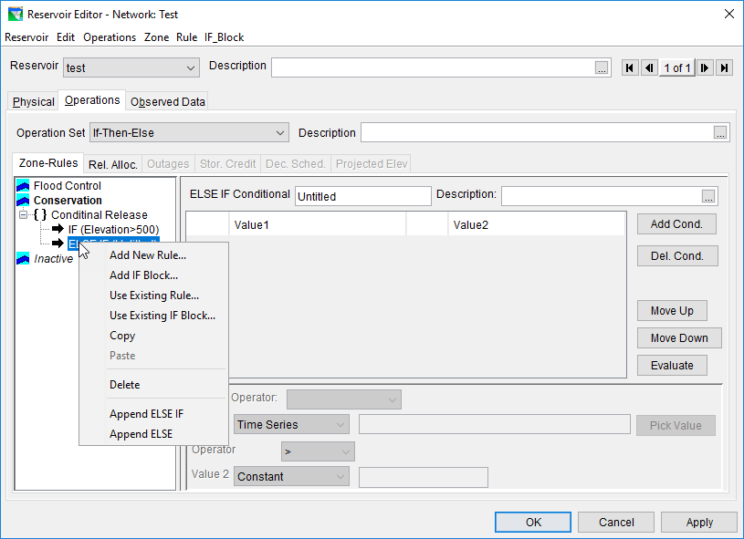
Appending ELSE IF Statements

Slide 16
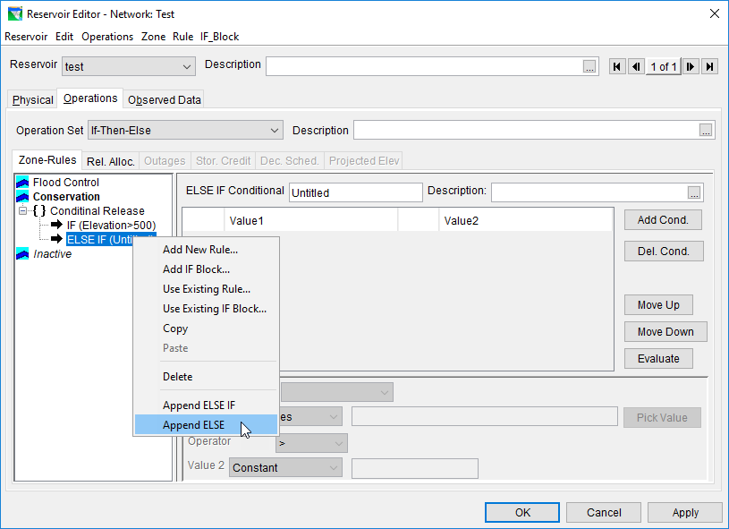
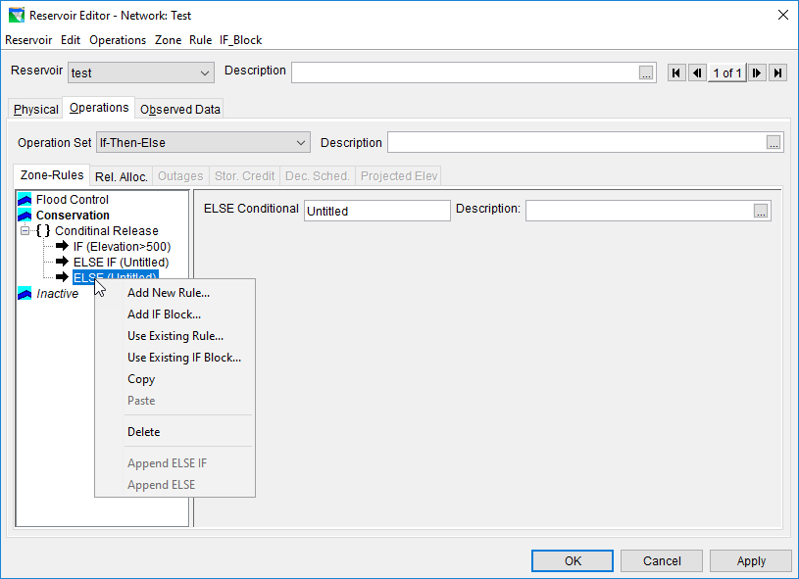
Appending ELSE Conditions

Slide 17
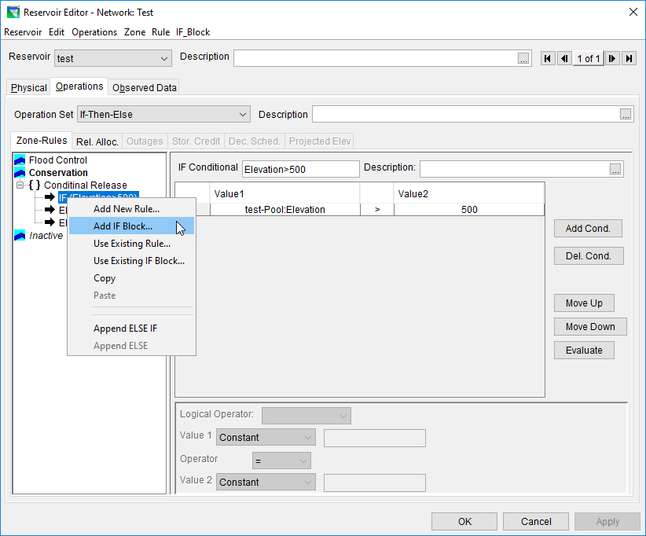
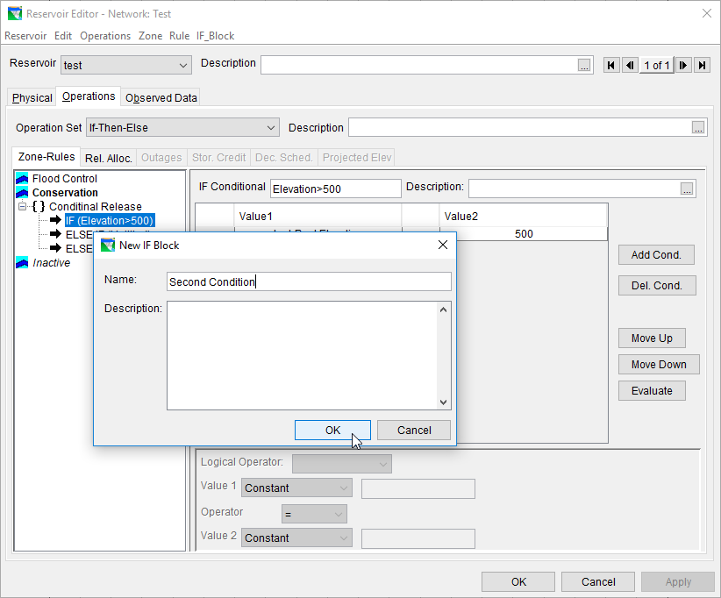
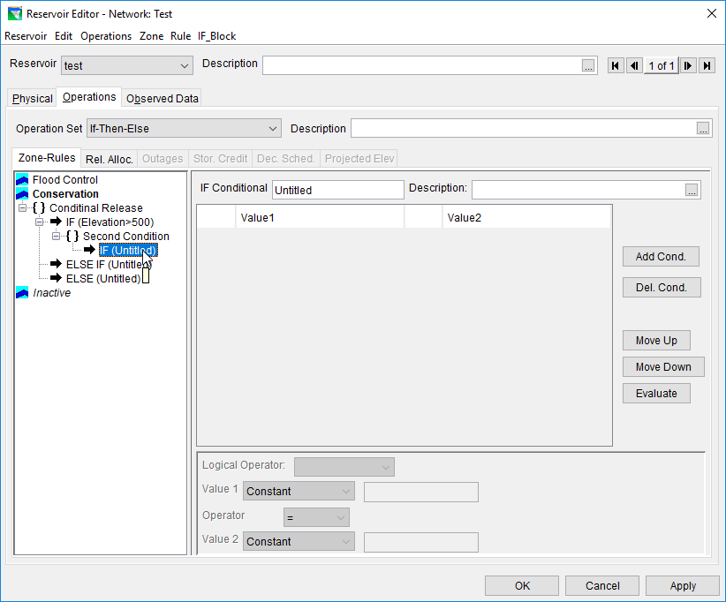
Nested IF Blocks

Slide 18
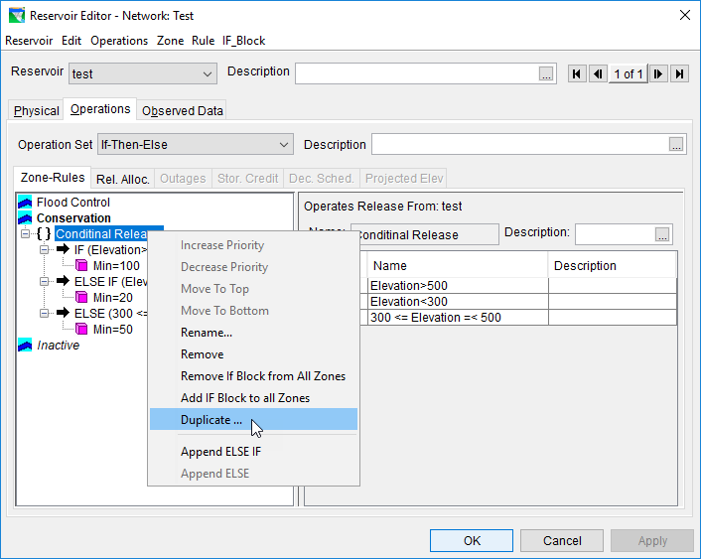
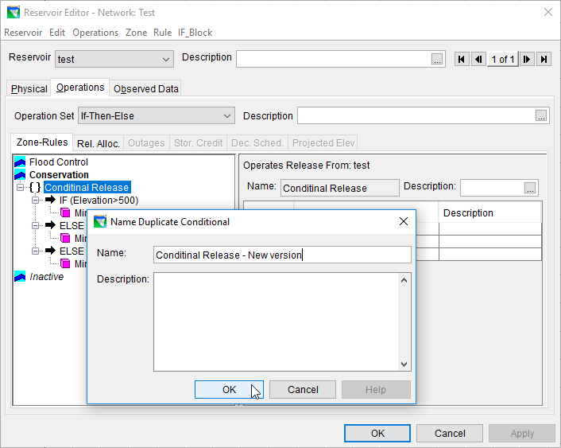
Duplicate IF Blocks

Slide 19
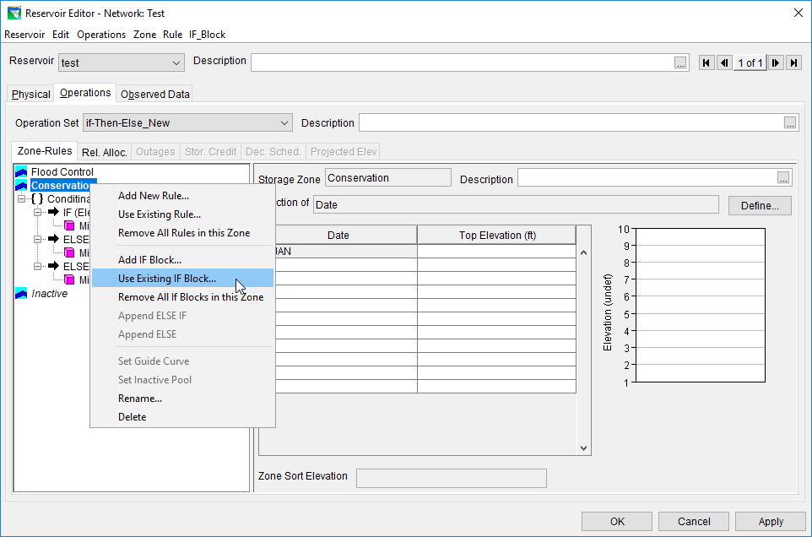
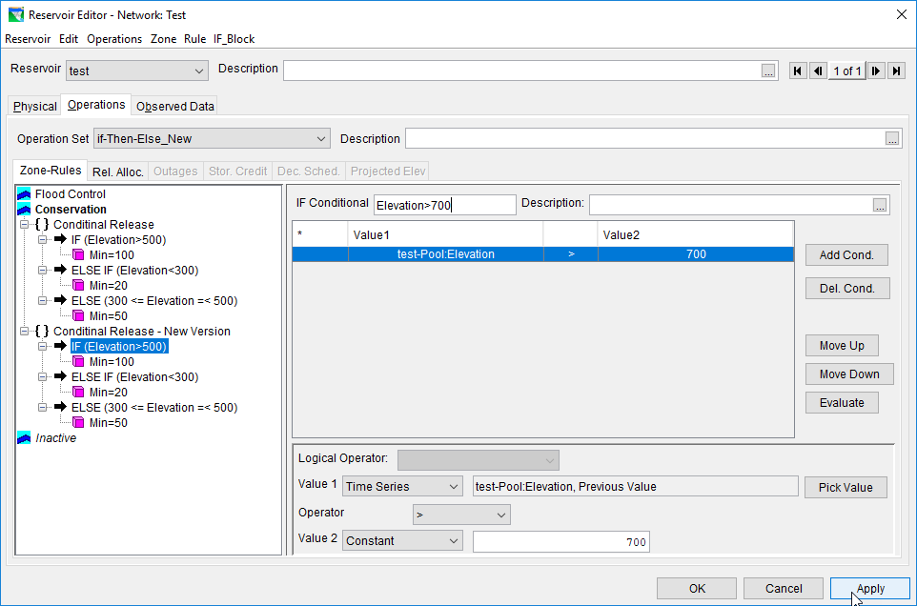
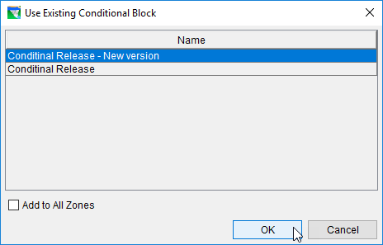
Duplicate IF Blocks, cont’d.

Slide 20
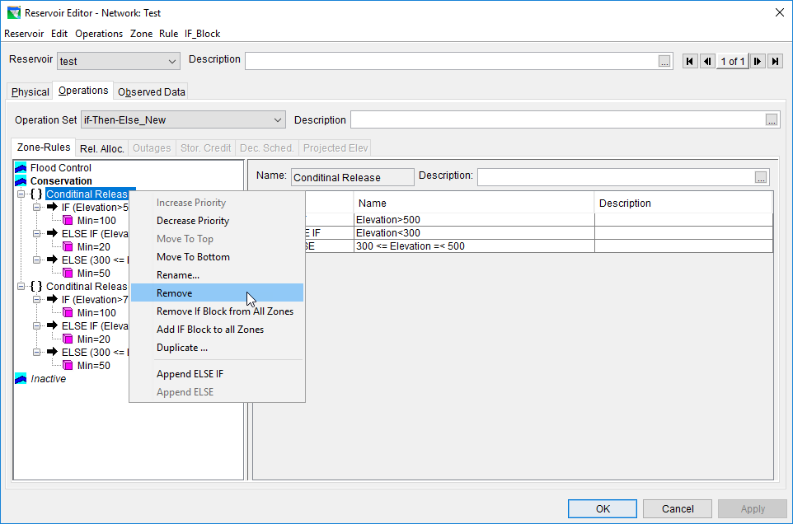
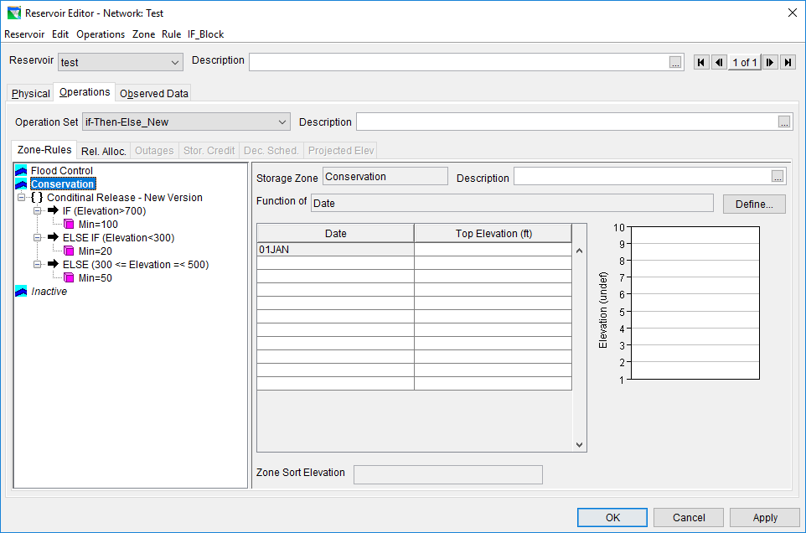
Duplicate IF Blocks, cont’d.

Slide 21
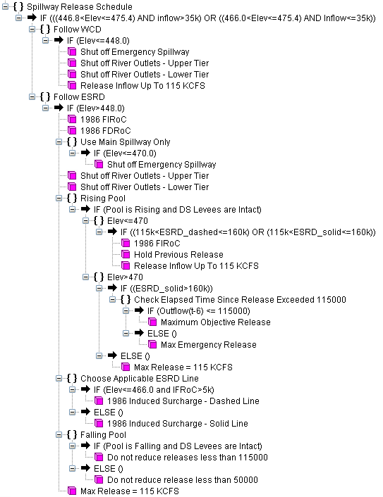
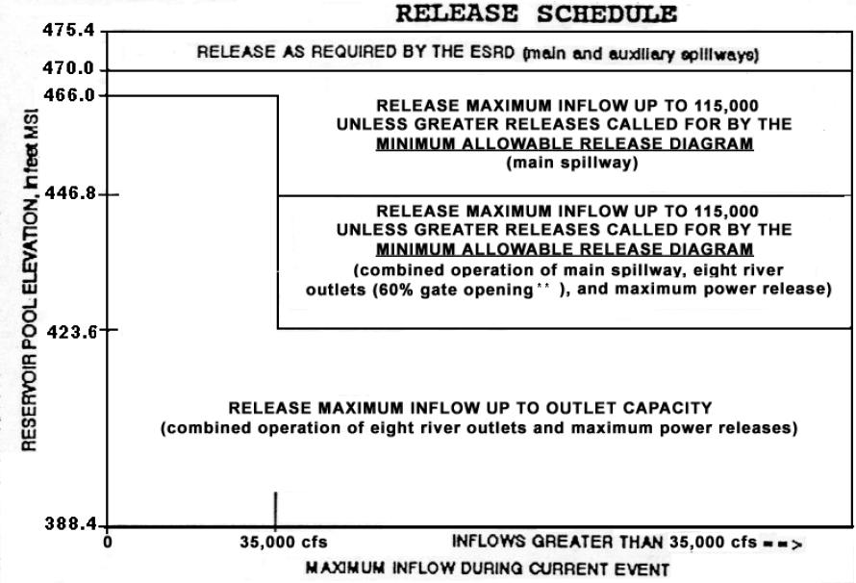
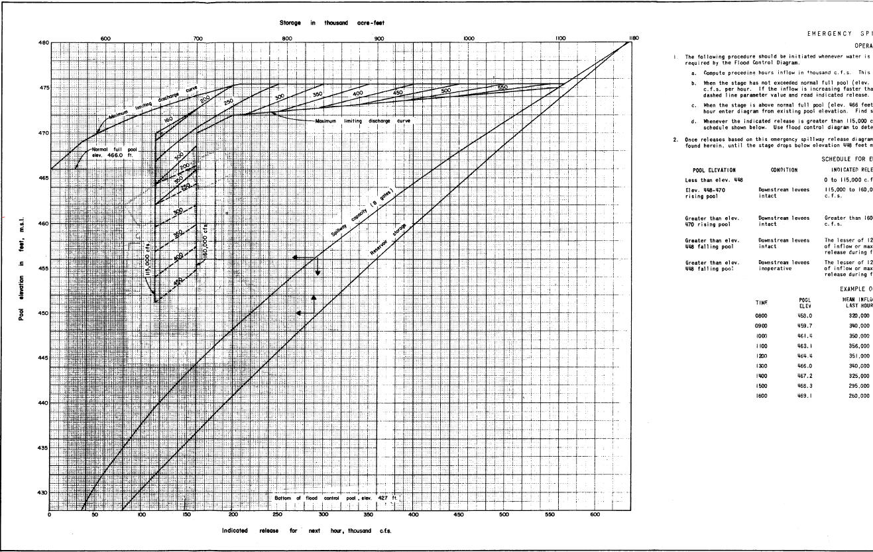
Complex Example

Slide 22
Downstream Control Rules

Slide 23
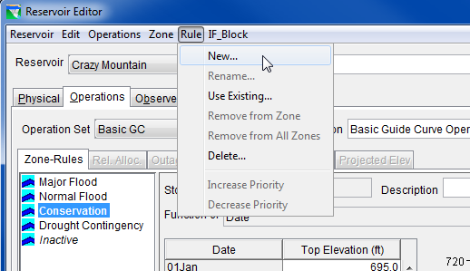
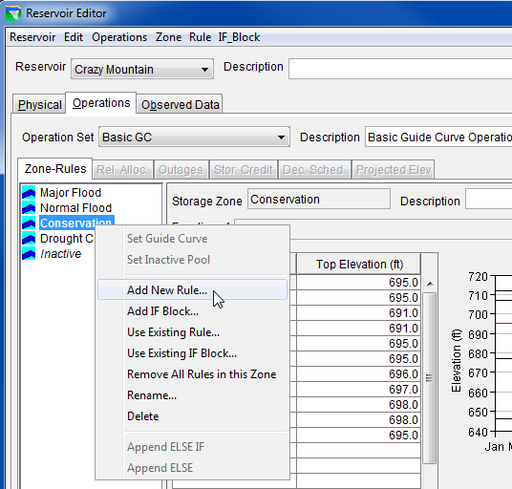
Creating a Downstream Rule…
From the Operations tab of the Reservoir Editor, select a Zone in your current Operation Set
Right click on the zone and select Add New Rule
Or, from the Rule menu, select New.
Notes:
From the Reservoir Editor Operations tab,
…Choose an Operation Set
…Select a zone

Slide 24
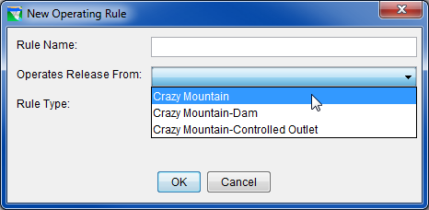
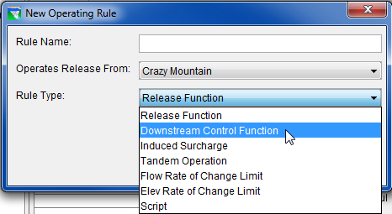
Creating a Downstream Rule…
Select the Reservoir from the “Operates Release From” list.
Select Downstream Control Function from the “Rule Type” list.

Slide 25
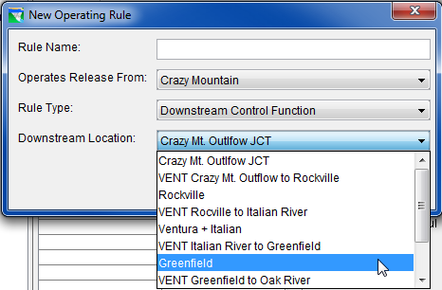
Creating a Downstream Rule…
The New Rule dialog changes - a new list is added…
Select the Downstream Location from the “Downstream Location” list.
Name the rule
Press OK.

Slide 26
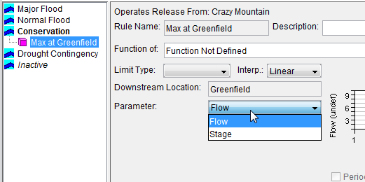
Creating a Downstream Rule…
Define the rule in the same way as for a Release Function rule…
Additional field: Parameter..
Flow
Stage
…if specifying stage, you must enter a flow/stage rating curve at the downstream location

Slide 27
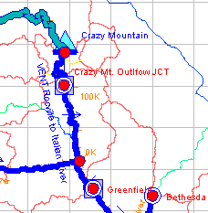
More about… Downstream Control Rules
A grey square appears around each control point
Network Module: if a downstream control rule exists (even if not used)
Simulation Module: if a downstream control is used in the current operation set of the active alternative
A downstream control rule defined at one reservoir can be assigned to other reservoirs upstream of the control point
Select Use Existing from Rule Menu

Slide 28
Prioritizing rules

Slide 29
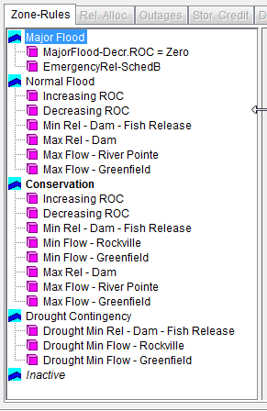
Defining Rule Priority
Rule Priority:
the order in which rules are evaluated and applied to the “allowable range”
In HEC-ResSim, rules appear in each zone of the Operations Tree in order of their priority (highest priority is at the top of the list)
Priority can differ by zone…

Slide 30
Rule Logic - revisited
Rules refine the allowable range of release…
Rule 1:
R > 1,000
Rule 2:
R < 9,000
Rule 3:
F > 12,500 downstream, need R > 10,000
Max physical capacity
above guide curve
allowable range
9000
9000
Release
allowable range
Rule 3 violated, but gets as close as possible
allowable range
below guide curve
1000
1000
0
Notes:
Rule 1 Minimum release of 1000 cfs
Rule 2 Maximum release of 9000 cfs
Rule 3 Minimum downstream flow of 12,500 cfs -> translates to min 10,000 release at reservoir

Slide 31
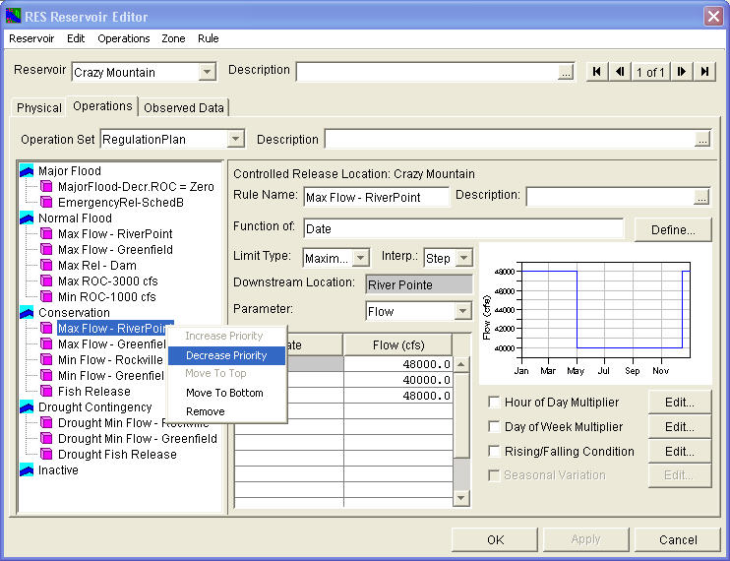
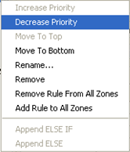
Rule Logic - revisited
What if the rules were re-ordered?
Right-click on rule

Slide 32
Rule Logic - revisited
What if the rules were re-ordered?
Rule 1:
F > 12,500 downstream, need R > 10,000
Rule 2:
R > 1,000
Rule 3:
R < 9,000
Max physical capacity
above guide curve
allowable range
allowable range
10000
10000
10000
allowable range
9000
Release
Rule 3 violated, but gets as close as possible
below guide curve
1000
0
Notes:
Rule 3 is now Rule 1: Minimum downstream flow of 12,500 cfs -> translates to min 10,000 release at reservoir
Rule 2: Minimum release of 1000 cfs
Rule 3: Maximum release of 9000 cfs

Slide 33
Take-home Points
Define the Release Allocation to express how releases will be distributed among outlets
The conditional application of operating rules can be accomplished using IF Blocks
Downstream Control Rules can be used to operate for conditions at a downstream location.
Rules are prioritized based on their position in each zone’s rule stack.

