Slide 1
CAVI Team Modeling

Slide 2
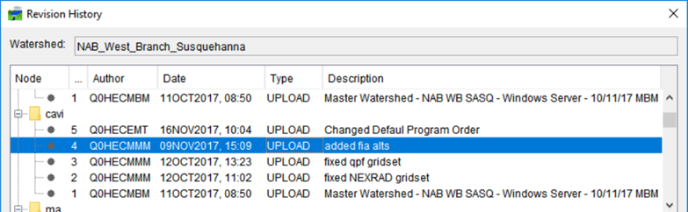
Team Modeling Overview
What is Team Modeling?
  CAVI feature released starting in CWMS 3.1
  Facilitates collaboration between modelers working with the same watersheds and forecasts
  Allows for sharing of CAVI watersheds and forecasts among modeling team members
  Keeps track of revisions, and who made them

Slide 3
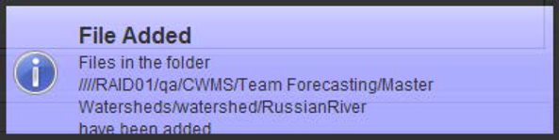
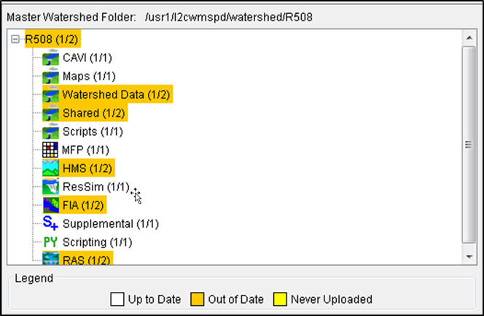
Team Modeling Overview
How it works:
  A local copy of a watershed is designated as a Team Watershed
  The watershed is uploaded to a shared location (windows drive or CWMS server)
  Forecasts for that watershed can also be uploaded as Team Forecasts
  Other team members can download, make revisions, and upload to the Master Watershed or Master Forecast
  Team members always work with a local copy

Slide 4
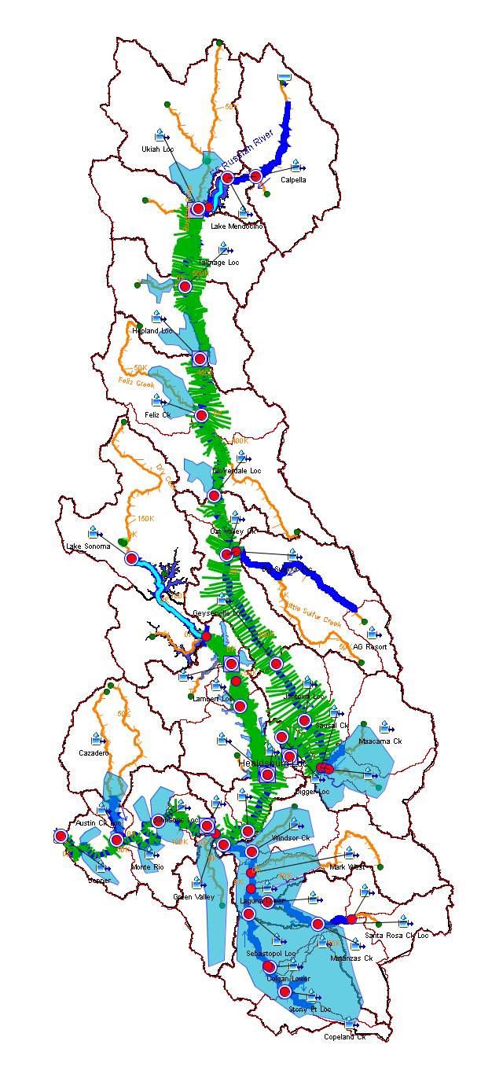
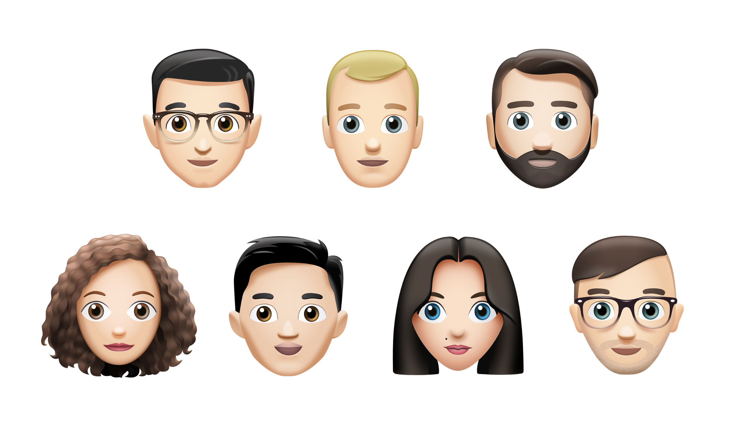
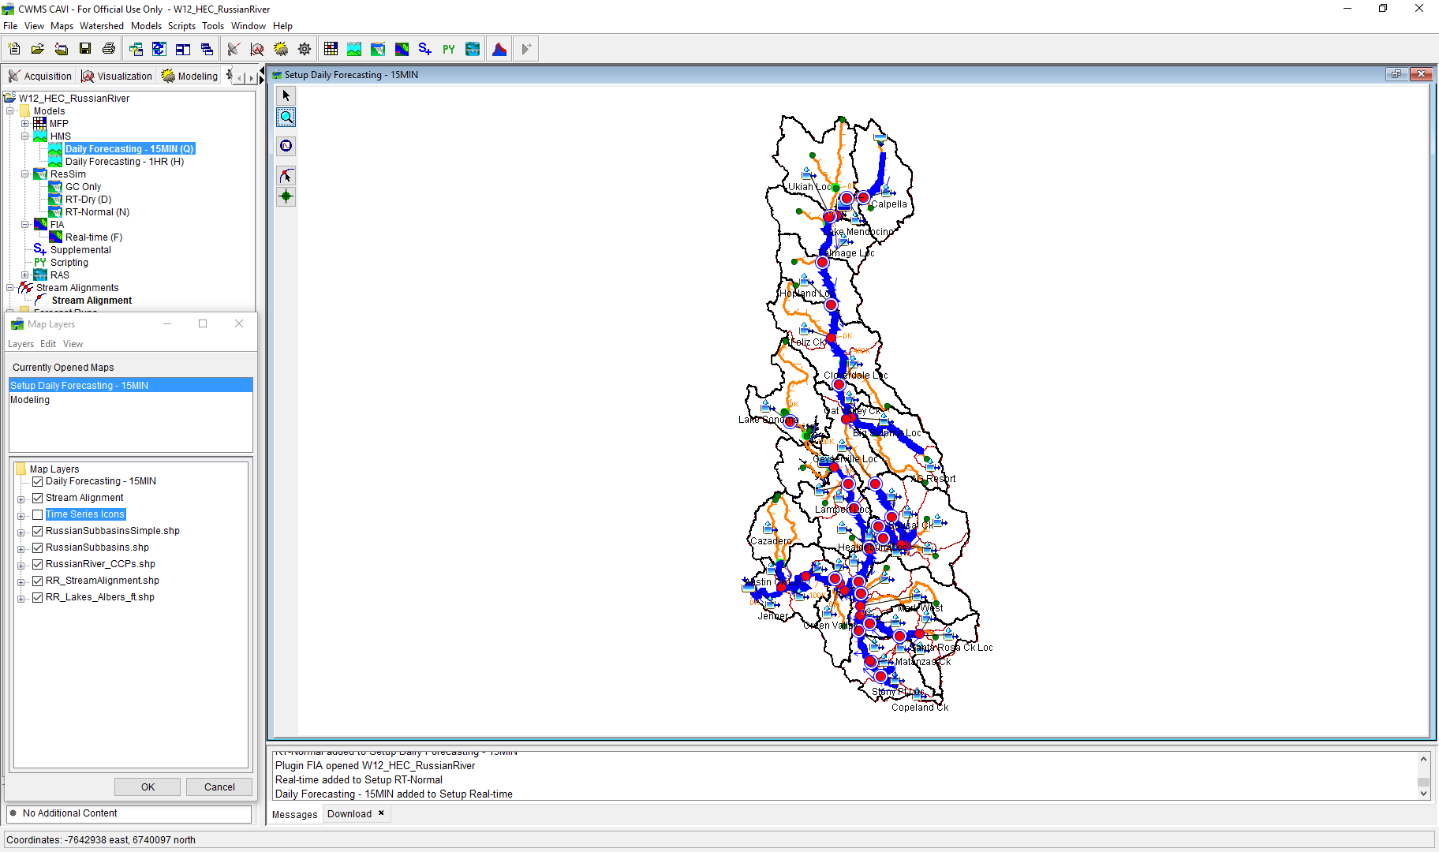





Team Modeling Example
Master Copy

