Slide 1
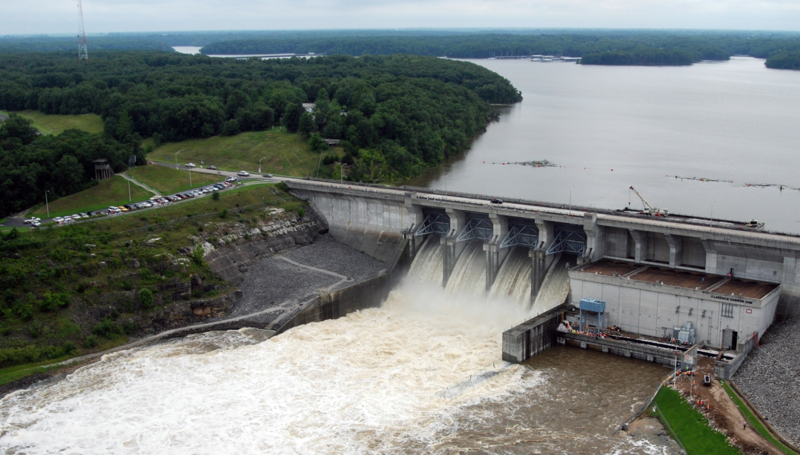
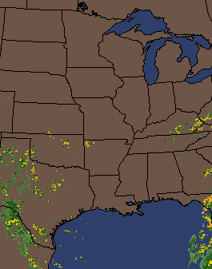
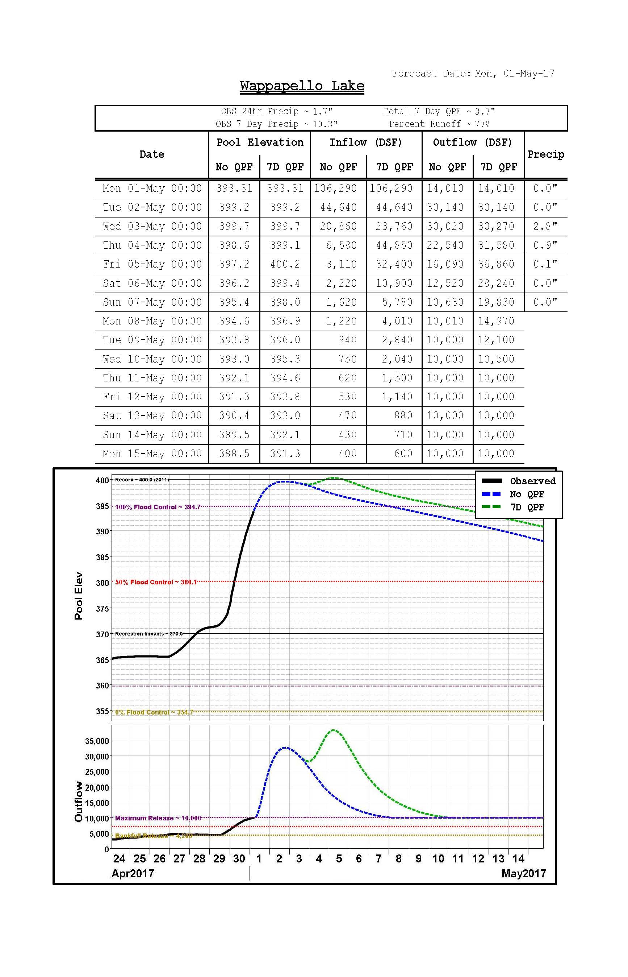
Editing MetVue Alternatives in the cavi
Kat Feingold
Civil Engineer
IWR-HEC
14 Aug 2023

Slide 2
Overview
  Opening the editor
  Setting the Input
  Setting the Output

Slide 3
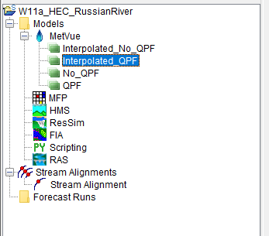

Editing the Metvue Alternative
  From the Setup module, expand the HEC-MetVue node. Right-click on a HEC-MetVue alternative and select Edit MetVue Alternative from the shortcut menu

Slide 4
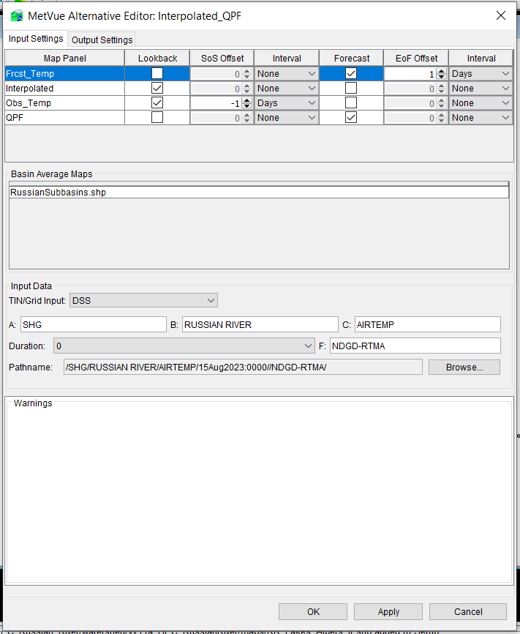
The Input TAb
  The MetVue Alternative Editor dialog will open. Ensure that the Lookback and Forecast checkboxes are correctly set for each of the Map Panels.
    QPE/Observed Temperature should be “Lookback”
    QPF and other forecast data should be “Forecast”
  Sos/EoF offset
    To be able to use HMS Gridded Hamon ET method, one should set the Observed Temperature SoS offset to -1 and the EoF offset of the Forecast temp

Slide 5
The Input TAb
  Under “Basin Average Maps” the Basin Shape File used for the Basin Average should be visible.
    If it is not, this can be fixed in the MetVue module

Slide 6
The Input TAb
  The Tin/Grid Input should be “DSS”
    This is where the input path is displayed
      Ensure that this pathname is correct. Add additional pieces as needed
  Click “Apply”

Slide 7
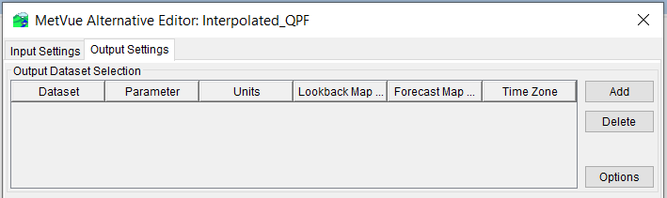
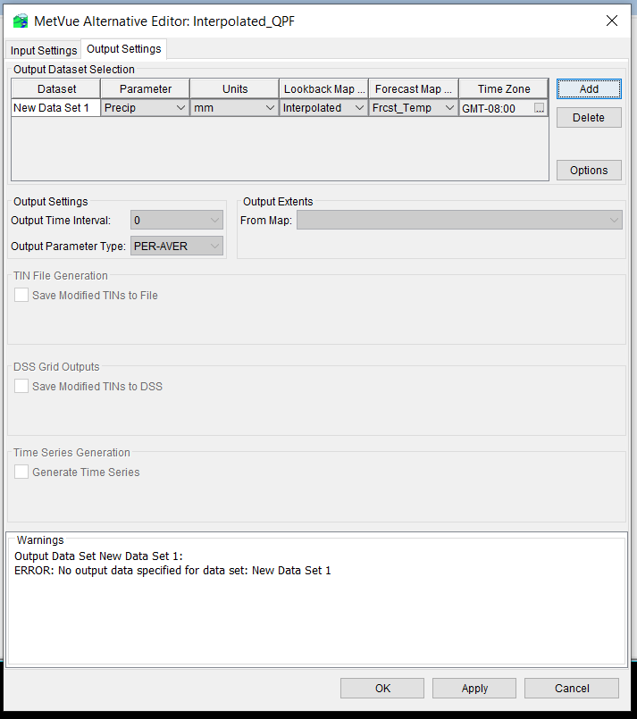
The Output TAb
  Select the “Output Settings “ tab at the top of the window.
  Click “Add”
  A New Data Set will appear
    The next steps will walk though entering the Dataset name and select the Parameter, Lookback Map Panel, and Forecast Map Panel from the dropdown lists

Slide 8
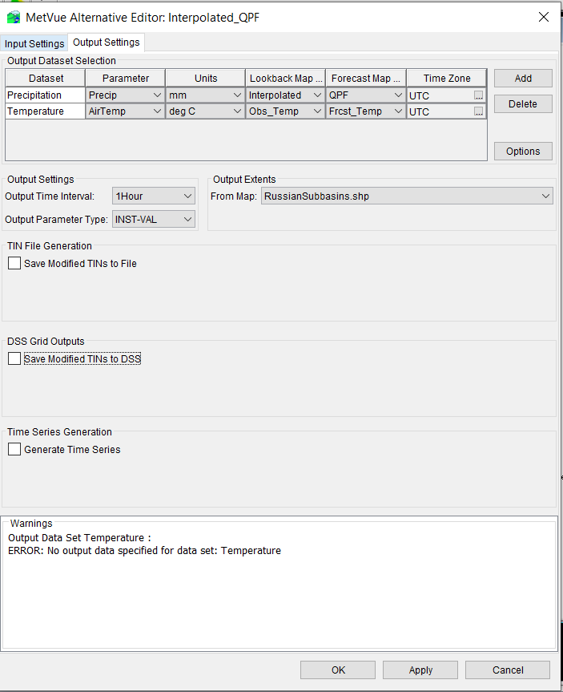
The Output TAb
  Enter the Dataset Name
    For the Precipitation dataset
      Enter “Precipitation” for the Dataset
      Parameter is “Precip”
      Units are “mm”
      Select the “lookback map”
        This was created in the previous tab, if you didn’t add it in Input, it will not be available for Output”
      Select your “forecast Map”; here we use the QPF
      The time zone will be UTC
    For the Temperature dataset
      Enter “Temperature” for the Dataset
      Parameter is “AirTemp”
      Units are “deg C”
      Select the “lookback map”
        This was created in the previous tab, if you didn’t add it in Input, it will not be available for Output”
      Select your “forecast Map”
      The time zone will be UTC

Slide 9
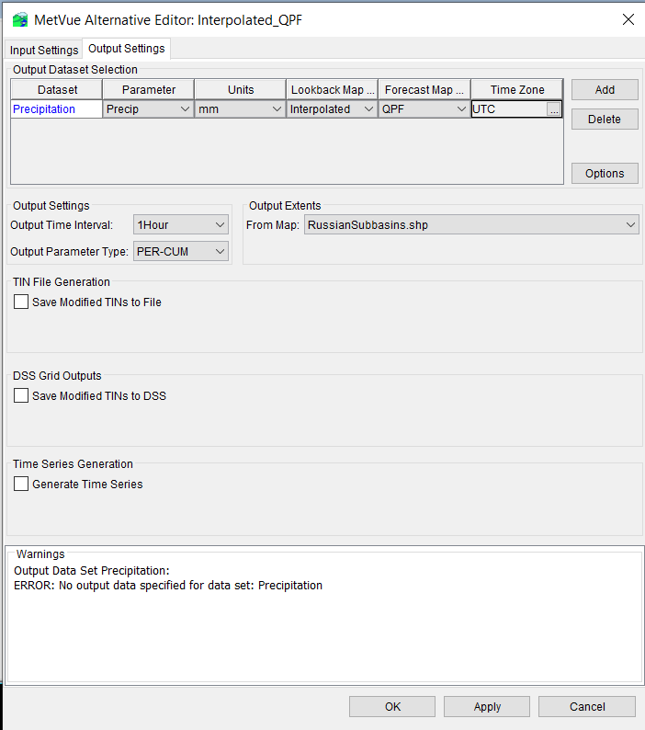
The Output TAb
  Output Time Interval: Choose the appropriate time interval
  Output Parameter Type for Precip should be “PER-CUM”
  Your output extents will be the shape file you associated in MetVue
    If you have more then one, you can use the dropdown to select the correct Shape File.

Slide 10
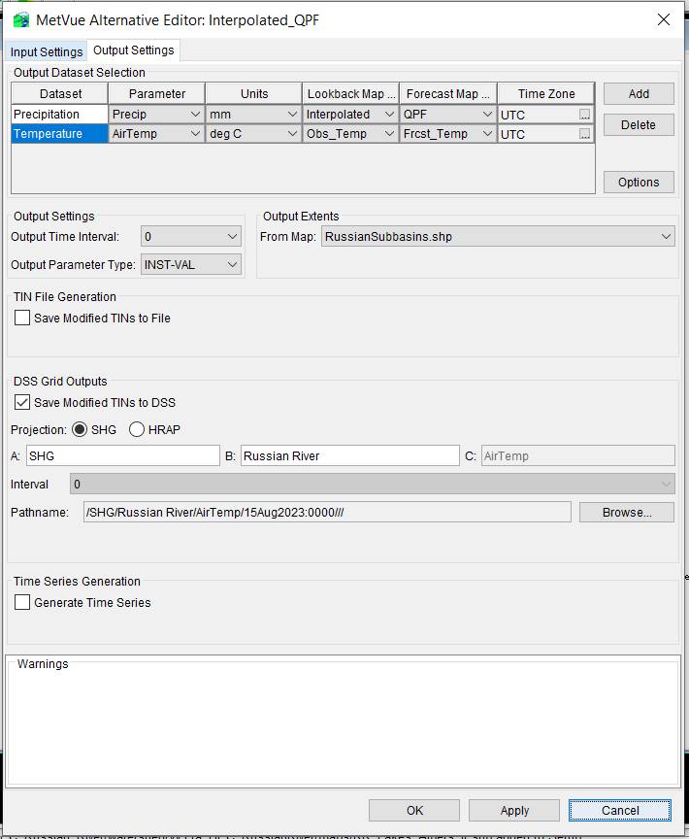
The Output TAb
  Output Time Interval: Choose the appropriate time interval ( 0 is most appropriate for “INST-VAL”
  Output Parameter Type for AirTemp should be “Inst-Val”
  Your output extents will be the shape file you associated in MetVue
    If you have more then one, you can use the dropdown to select the correct Shape File.

Slide 11
The Output TAb
  Set the output dataset options (DSS Grids, Time Series, or both).
  DSS Grid Outputs
    Selecting the “save modified Tines to DSS” will open that section
  Time Series Generation
    This creates a new Timeseries based off these datasets
    Selecting the “Generate Time Series” will open that section (Optional)

Slide 12
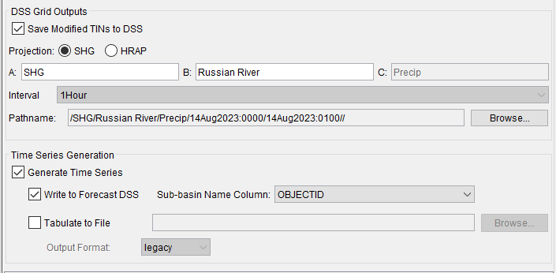
The Output TAb
  DSS Grid Outputs (Required)
    Once selected, the pathname and Parts will auto populate except the “B” part
    Enter your preferred B part ( this will need to either match or be adjusted model linking)
  Time Series Generation (Optional)
    This will also auto populate; selecting “OBJECTID” for Sub-basin Name Column will output with the Sub-basin name identified in the shape file

Slide 13
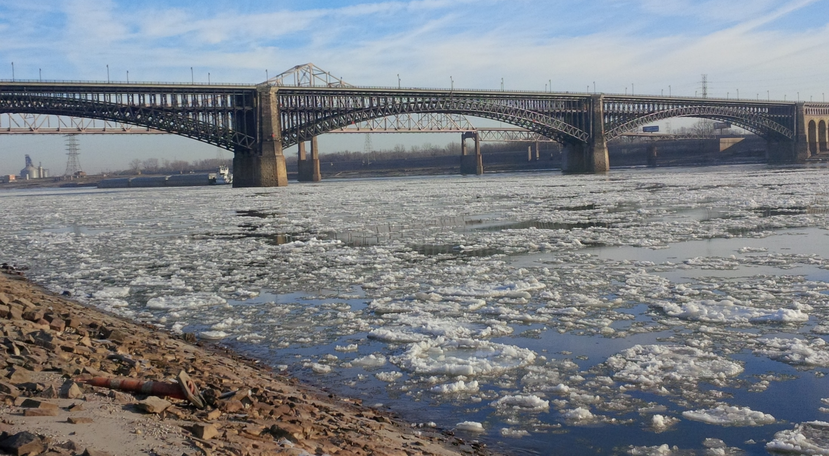
? ? ? Questions ? ? ?

