Slide 1
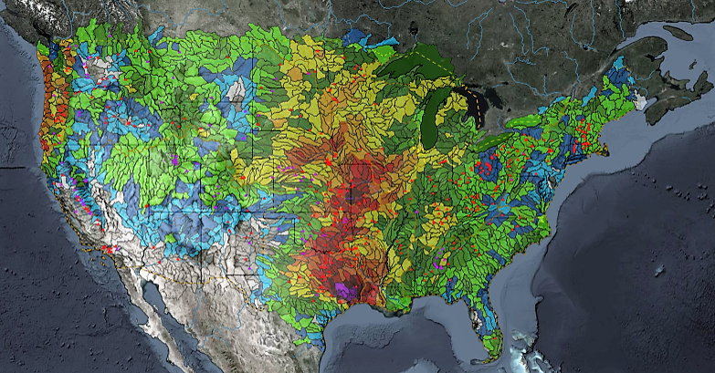
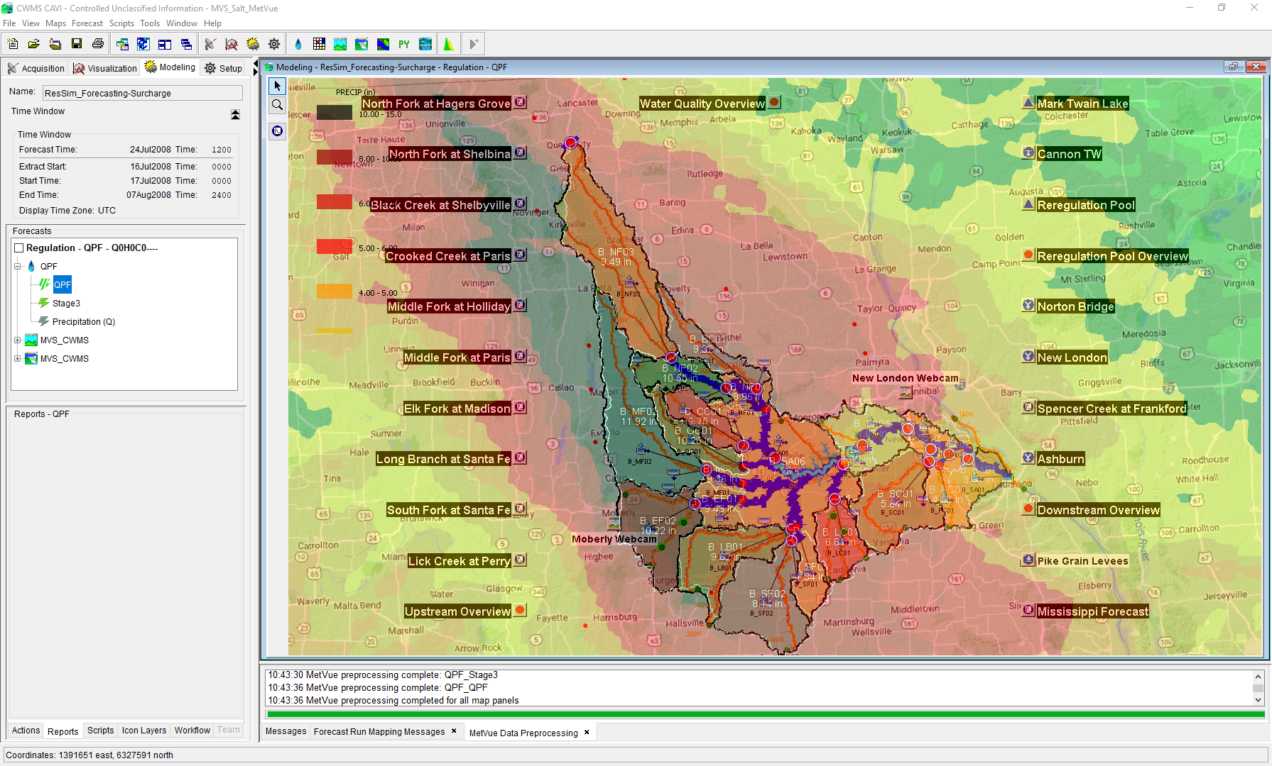
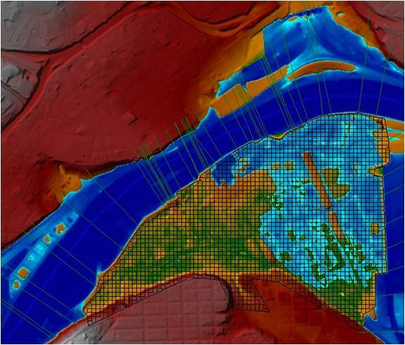
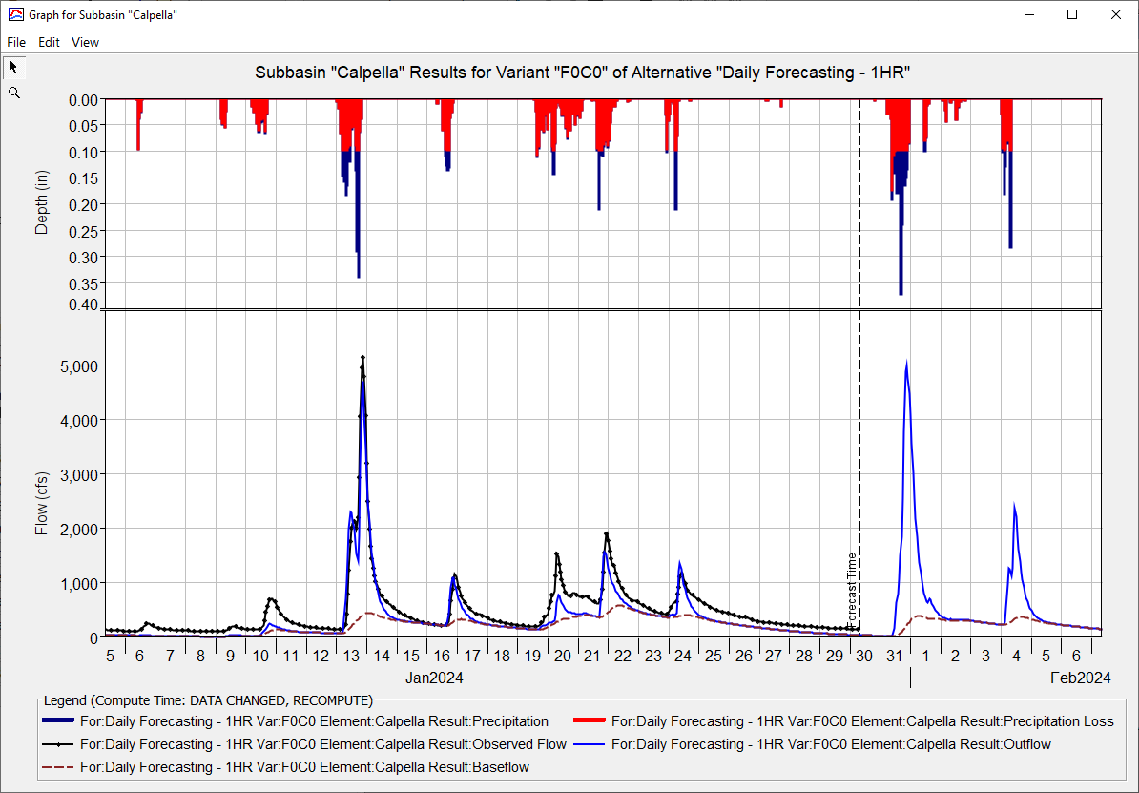
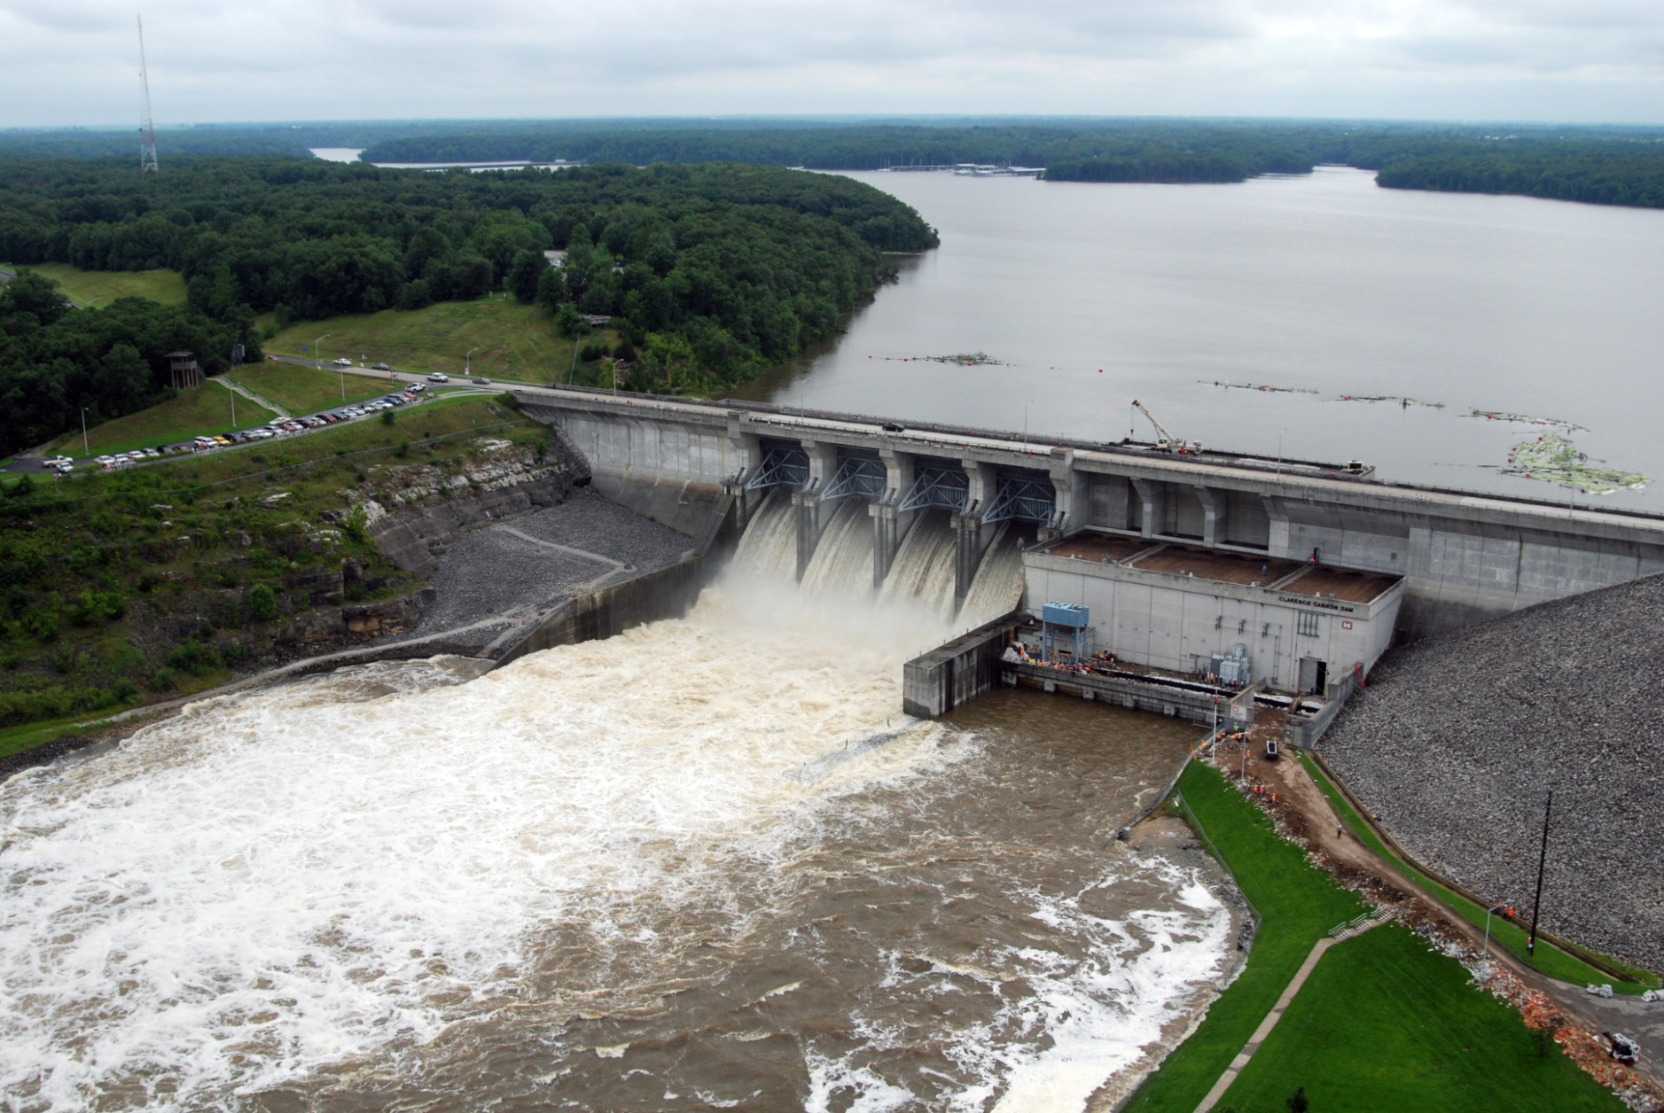
HEC-RAS for CWMS
Andy Richter, P.E., PMP
Hydrologic Engineering Center
CWMS Prospect Course
Notes:
Hello Water Managers,
My name is Andy Richter, part of the Water Management Systems Division at the Hydrologic Engineering Center. I’m going to be covering HEC-RAS for CWMS today.
This presentation is part of a series of recordings that will cover various topics relating to HEC-RAS modeling for CWMS.

Slide 2
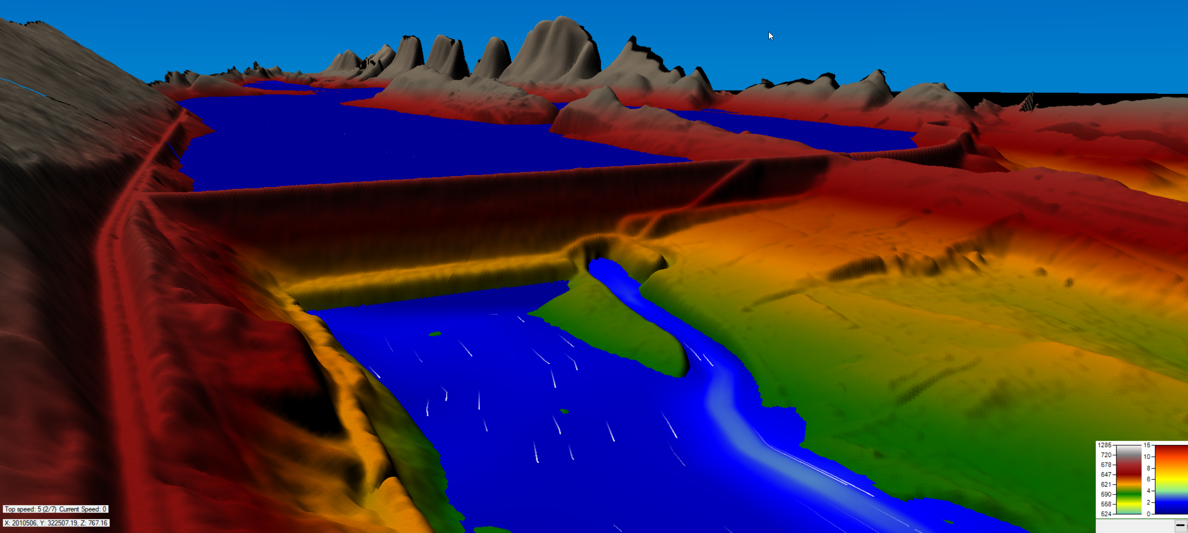
Objective
Identify basic concepts of using HEC-RAS in CWMS
Notes:
The objective for this series of recordings is to identify basic concepts of using HEC-RAS in CWMS. These presentations are intended to broadly cover topics that Water Managers need to know regarding HEC-RAS modeling for real-time forecasting. Let’s get started.

Slide 3
Outline
Purpose of Hydraulic Modeling in CWMS
HEC-RAS Capabilities Overview
HEC-RAS Program Essentials
HEC-RAS Model Development for Real-Time Forecasting
HEC-RAS CAVI Integration
Real-Time Forecasting using HEC-RAS
Notes:
There are six main topics that will be presented in this series. This video will cover two topics: the purpose of Hydraulic Modeling in CWMS and an Overview of HEC-RAS capabilities.

Slide 4





HEC-RAS in sequence
Meteorological Processor (HEC-MetVue)
  Process meteorological data
  Provide input to the hydrologic model
Hydrologic Model (HEC-HMS)
  Transform precip, forecast flows
  Provide input for the reservoir and hydraulics models
Reservoir Simulation Model (HEC-ResSim)
  Determine reservoir system release decisions
  Provide input for the hydraulics model
Hydraulic Model (HEC-RAS)
  Determine stage and flood inundation
  Provide flow input for the flood impact model
Flood Impact Analysis (HEC-FIA)
  Estimate the economic and life loss consequences
  Report where action is required during high stages
Notes:
Before we begin, let’s review the basic model sequence of a CWMS Forecast. In general, when running a forecast, the sequence of a model run will follow this flowchart. Meteorological data will be ingested and processed by HEC-MetVue. That data then becomes the inputs needed to run the HEC-HMS model, which transforms precipitation into runoff. Next in the sequence is the Reservoir Simulation Model, HEC-ResSim. HEC-ResSim receives inputs from the HEC-HMS model and determines reservoir releases within the watershed based on operational rulesets. Next in the sequence is HEC-RAS, the hydraulic model. HEC-RAS can receive inputs from both HEC-HMS and HEC-ResSim. HEC-RAS computes stages within the river network and can be used to develop inundation maps if necessary. Last in our sequence is HEC-FIA, the Flood Impact Analysis model. HEC-FIA receives input data from HEC-RAS in the form of inundation grids. HEC-FIA then computes economic and life loss consequences of the modeled event.
There are other model sequences that can be used within a CWMS watershed, but this diagram demonstrates the most basic flow of data between the models when running a real-time forecast in the CAVI.

Slide 5
Purpose of Hydraulic modeling in CWMS
Notes:
Now let’s talk about the purpose of Hydraulic Modeling in CWMS. Why might YOU need to run an HEC-RAS model when running a real-time forecast?

Slide 6
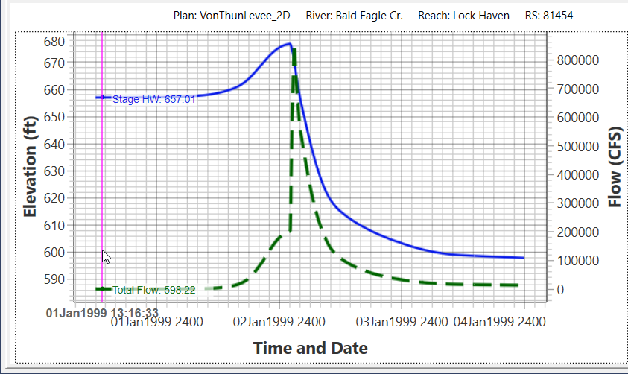
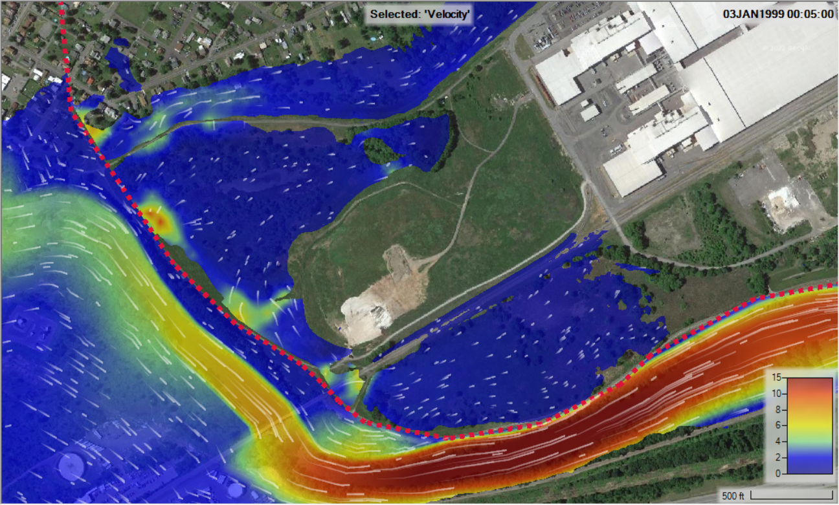
Purpose of hydraulic modeling in CWMS
Predict critical and peak water surface elevations
Predict timing, depth, and extent of potential inundation
Notes:
In the most basic terms, the purpose of hydraulic modeling is to take the runoff flows and compute water surface elevations within the river system. HEC-RAS allows us to predict the timing, depth, and extent of potential inundation within our system.
The figure on the left depicts stage and flow hydrograph outputs, and the figure on the right displays inundation extents. These are two of the most common types of outputs you should review when running an HEC-RAS model within the CAVI.

Slide 7
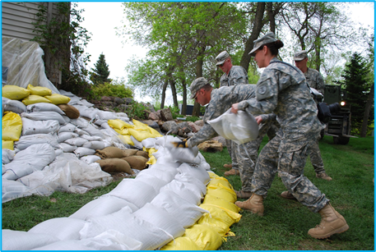
Hydraulic Model Results
HEC-RAS results inform:
  Emergency management decisions
  Flood operations preparedness
  Post-flood impact analyses
When will the levee overtop?
Where are sandbags needed?
Will the road flood?
What areas need to evacuate, and when?
What were the consequences?
Notes:
So what can you do with those results? There are many reasons you or someone from your office may want to review the results of the HEC-RAS model. Those results can help inform emergency management decisions, flood operations preparedness, and post-flood impact analyses.
You might be asked questions similar to those shown here, like “when will the levee overtop?” or “will the road flood?” The model results provide an easy way to answer those questions by visually displaying what might happen within your watershed given the latest forecast.
Ultimately, the results will help determine what actions, if any, need to take place during the event. After the event has passed, the HEC-RAS model can provide inputs to the HEC-FIA model to estimate consequences once the floodwaters recede.

Slide 8
HEC-RAS Capabilities overview
Notes:
Now let’s quickly review some capabilities of HEC-RAS.

Slide 9
HEC-RAS capabilities
1D Steady Flow Hydraulics
  Depth, velocity, and discharge treated as constant with respect to time
  Specify flowrates at all locations, compute stage
  Relies on hydrologic routing
1D Unsteady Flow Hydraulics
  Depth, velocity, and discharge change with respect to time
  Solves for flow and stage
  Computes hydraulic routing
2D Unsteady Flow Hydraulics
  Flow can vary in X and Y direction
  More detailed accounting of forces
https://www.hec.usace.army.mil/confluence/rasdocs
Notes:
There are three main categories of HEC-RAS models: 1-dimensional steady flow hydraulics (click), 1-dimensional unsteady flow hydraulics (click), and 2-dimensional unsteady flow hydraulics (click).
Each category has its upsides and its downsides when it comes to real-time forecasting. In general, the most common type of model you will encounter when running a real-time forecast in CWMS is the 1-dimensional unsteady flow hydraulic model (click). That is not to say you won’t be running the other two types of models, however they are not as common at this point. With the rise in popularity of 2-dimensional modeling, that may change soon.
For more detailed information on HEC-RAS capabilities, I encourage you to review the HEC-RAS documentation available on our website by following the link on the screen. (click)

Slide 10
Questions
Help additional Training
https://usace.dps.mil/sites/KMP-WM/SitePages/Corps-Water-Management-System-(CWMS).aspx
https://www.hec.usace.army.mil/confluence/cwmsdocs
https://discourse.hecdev.net/c/cwms/5
TDL-CELRH-EC-GW-W-USACE CWMS Modeling | General | Microsoft Teams
Notes:
If you have any other questions about our software, need some help, or are looking for additional training; check out these links. They can also be found in the description below. Thank you for your time.

