Slide 1
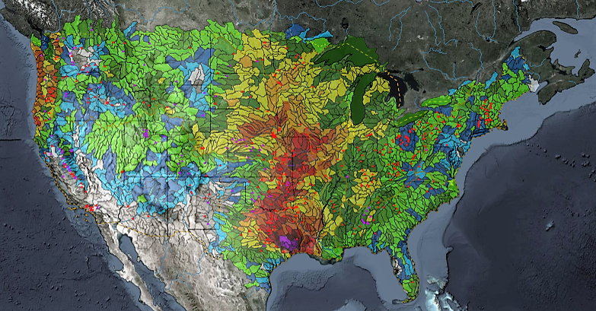
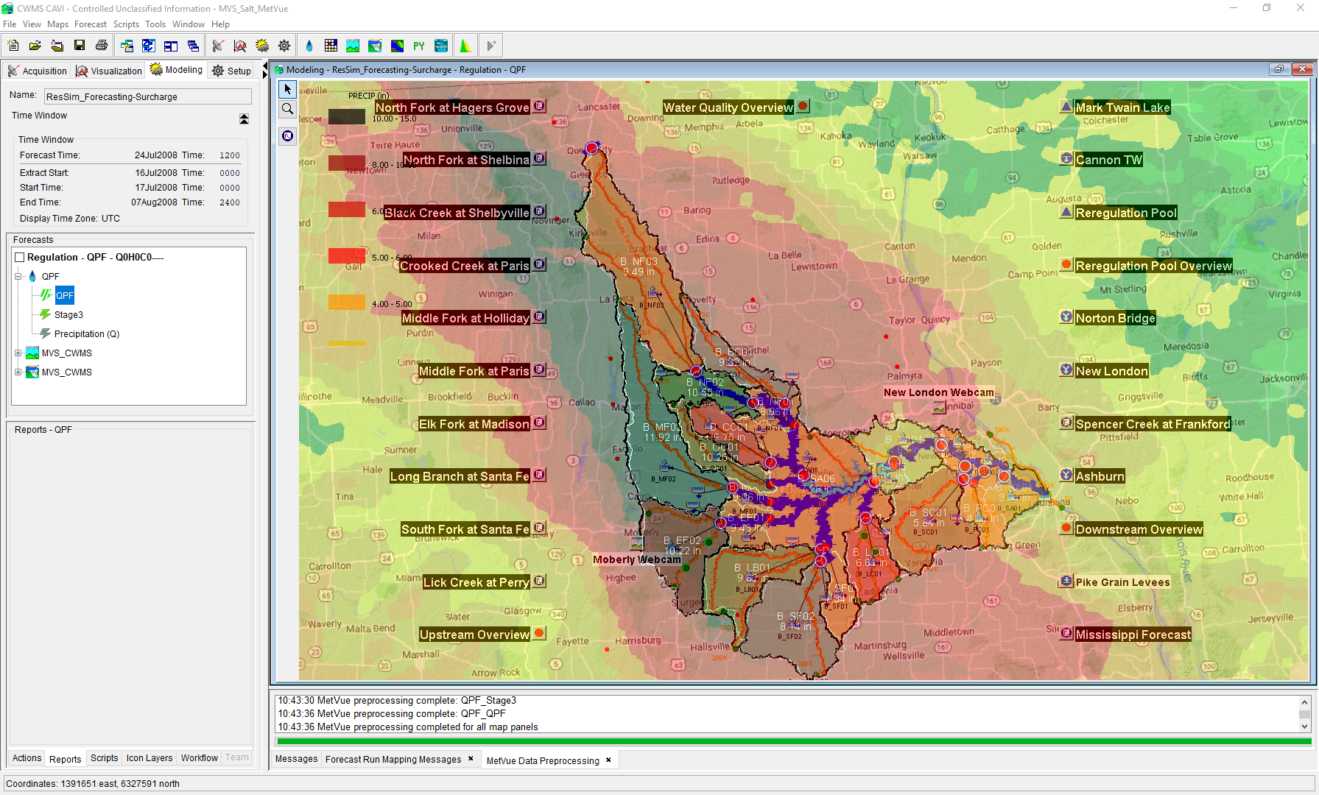
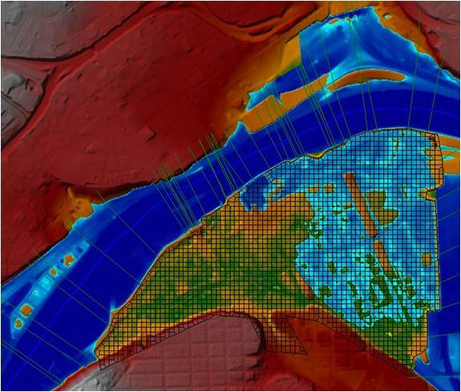
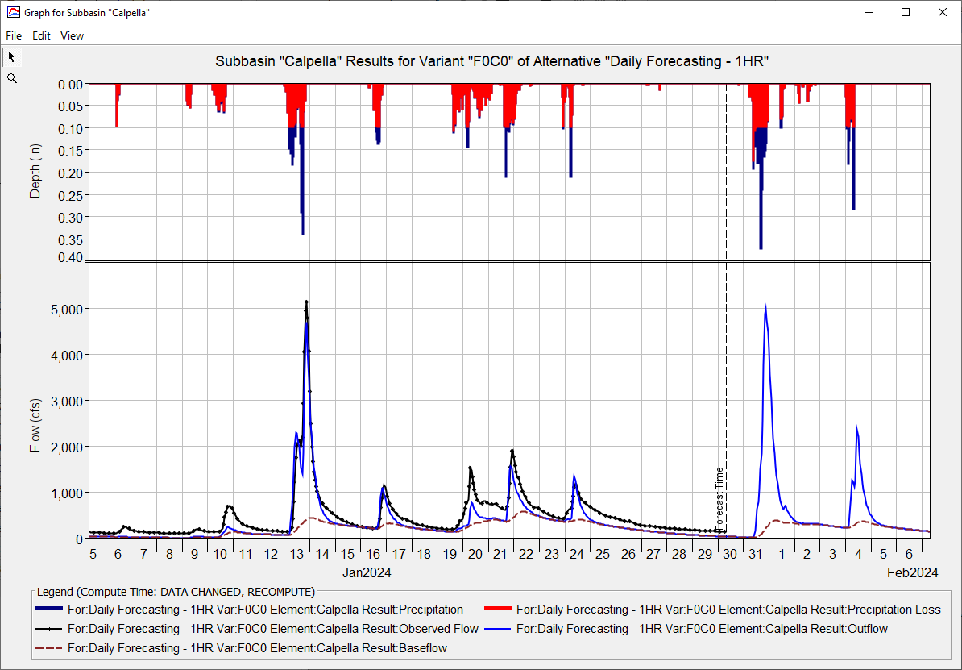
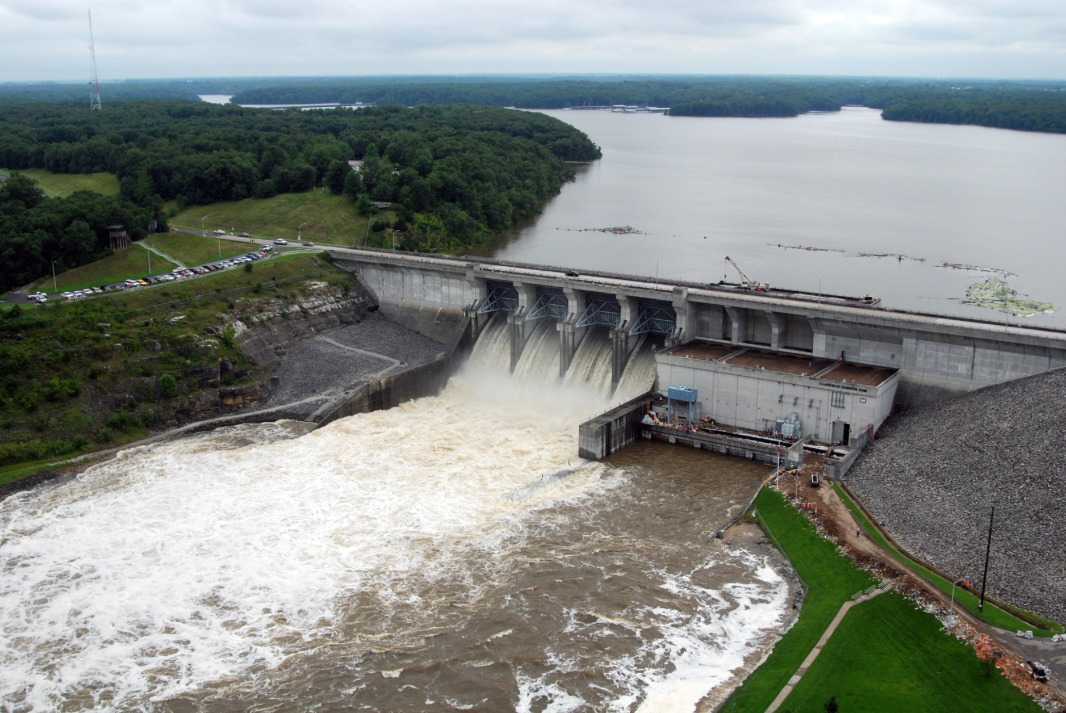
HEC-RAS for CWMS
Andy Richter, P.E., PMP
Hydrologic Engineering Center
CWMS Prospect Course
Notes:
Hello Water Managers,
My name is Andy Richter, part of the Water Management Systems Division at the Hydrologic Engineering Center. I’m going to be covering HEC-RAS for CWMS today.
This presentation is part of a series of recordings that will cover various topics relating to HEC-RAS modeling for CWMS.

Slide 2
Outline
Purpose for Hydraulic Modeling in CWMS
HEC-RAS Capabilities Overview
HEC-RAS Program Essentials
HEC-RAS Model Development for Real-Time Forecasting
HEC-RAS CAVI Integration
Real-Time Forecasting using HEC-RAS
Notes:
There are six main topics that will be presented in this series. Video #1 in this series covered the first two topics. This video will cover HEC-RAS Program Essentials.

Slide 3
HEC-RAS Program Essentials
Notes:
Let’s get started.

Slide 4
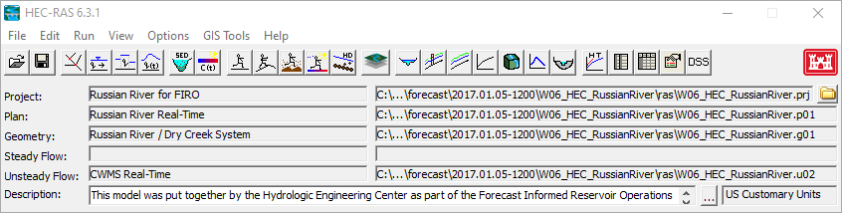





Components of an hec-RAS model
Project: *.prj
Plan: *.p##
Geometry: *.g##
US Flow : *.u##
Notes:
This is the main window you will see when you open an HEC-RAS model. (click)
There are three main components of an HEC-RAS project. The geometry files, the flow files, and the plan files.
The geometry files physically define the river system being analyzed.
The flow files contain boundary conditions for each river reach. In this example, the model is using the unsteady flow option.
The plan files combine one geometry file and one flow file that will be used for the model compute.
You can have any number of plan files, geometry files, and flow files within one HEC-RAS project. Now we will look at each of these components in more detail.

Slide 5
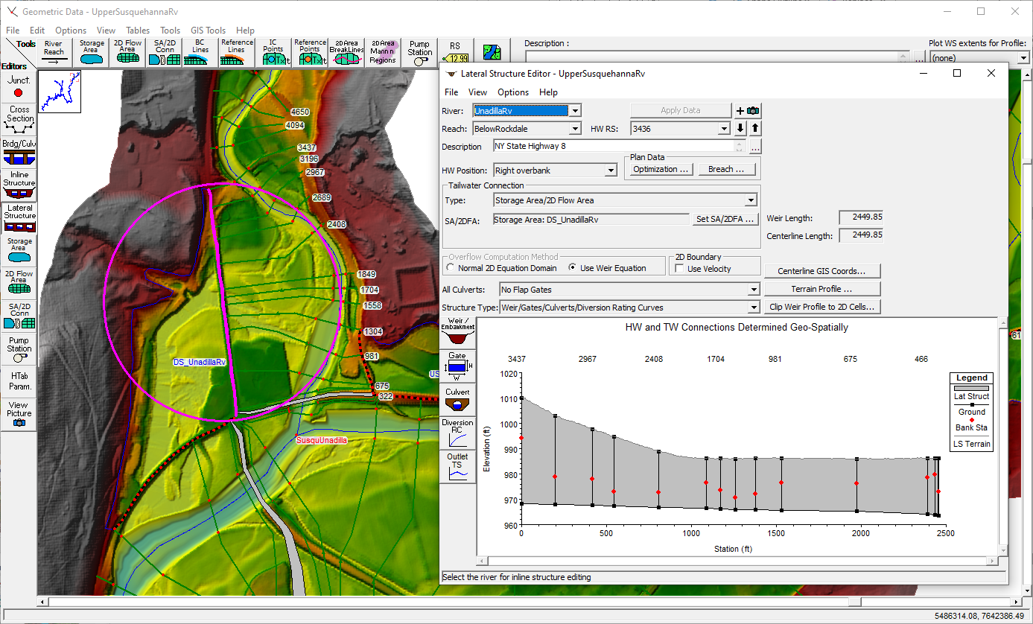
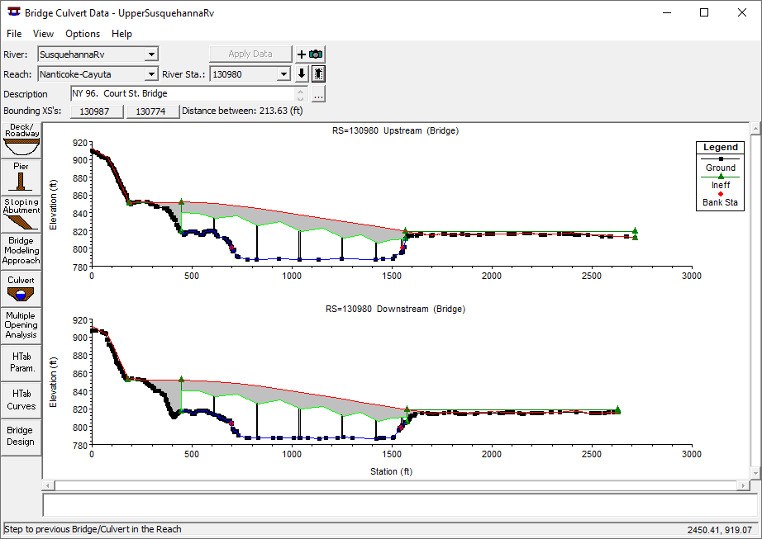
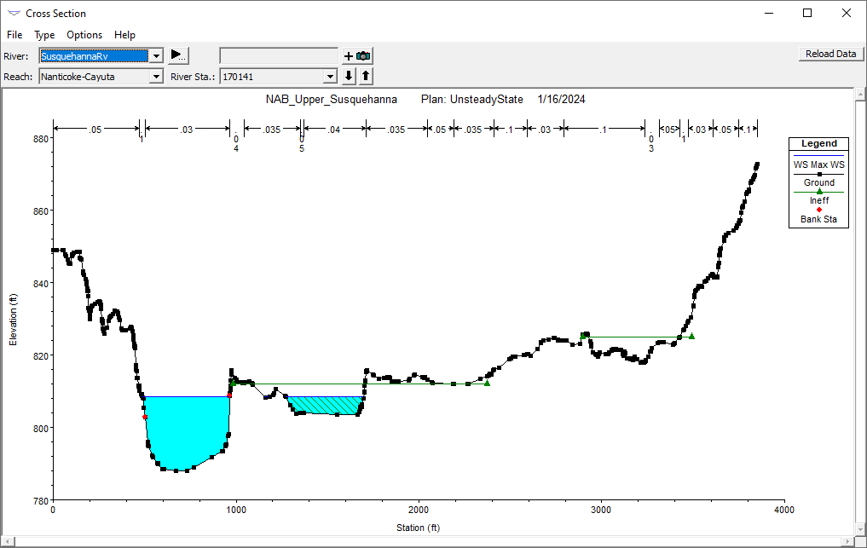
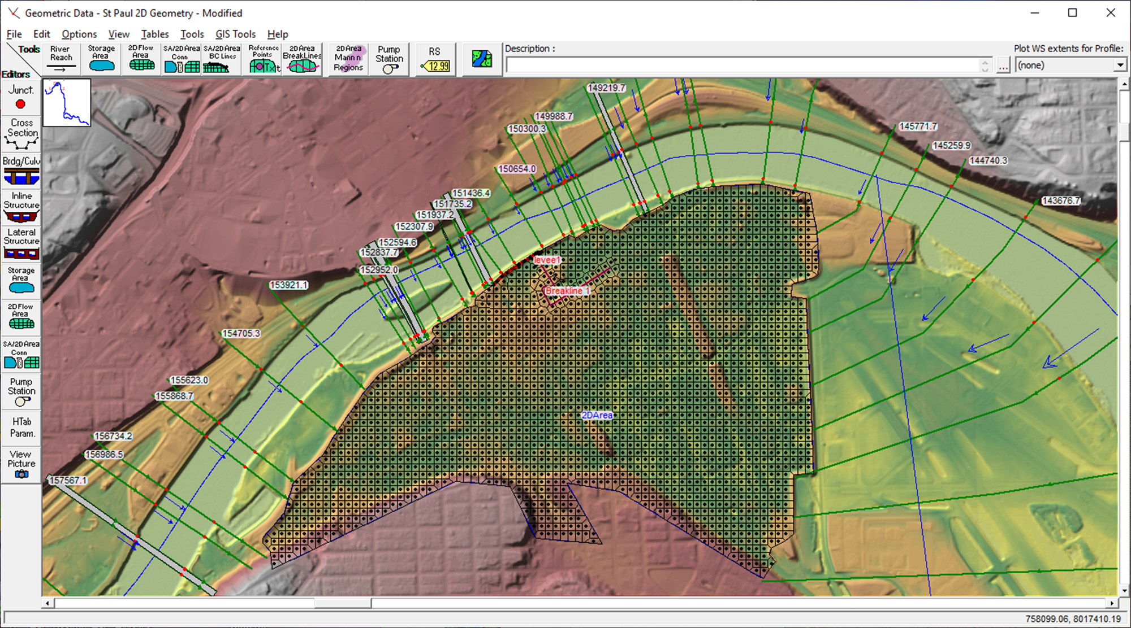
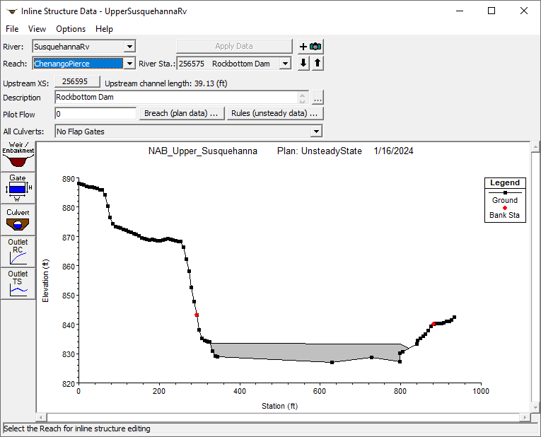
Geometry data
Cross Sections
Bridges and Culverts
Inline Structures (dams, weirs, spillways, etc.)
Lateral Structures (levees, storage area connections, etc.)
1D Storage Areas and 2D Flow Areas
Notes:
The geometry files are the main component of any HEC-RAS model. They can be as simple or as complex as you need them to be. There are many different options available within the geometry editor that allow you to add elements needed to define your river system. (click)
The first element is cross sections. (click) Cross sections represent the geometric boundary of the stream: the channel and floodplain. (click)
(click) Next are bridges and culverts. (click)
(click) Another element you may encounter is inline structures. Inline structures are used to represent dams, weirs, or spillways that fall within the channel and impede flows. (click)
(click) Lateral structures are another element that can be included in your model. (click) These typically represent levees or embankments that separate the main floodplain from off-channel storage. (click)
(click) The last element type that we will cover in this presentation are 1-dimensional storage areas and 2-dimensional flow areas. 1-dimensional storage areas can be sometimes referred to as ‘bathtubs’ because when water enters the storage area, they fill up like a bathtub and have a flat water surface elevation across the entire area. 2-dimensional flow areas are represented by a mesh, as shown in this figure, and allow water to flow through the area depending on the underlying terrain.

Slide 6
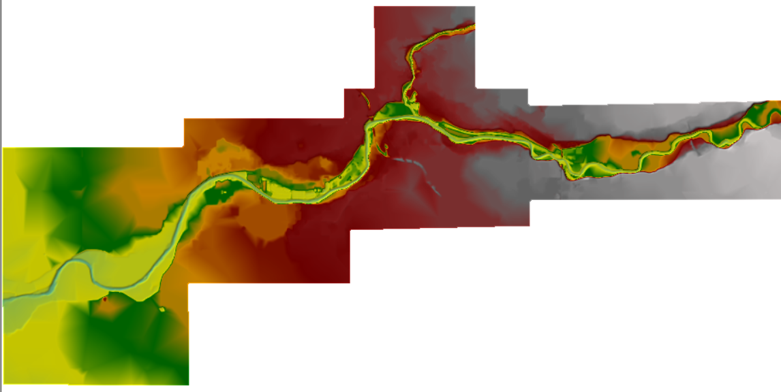
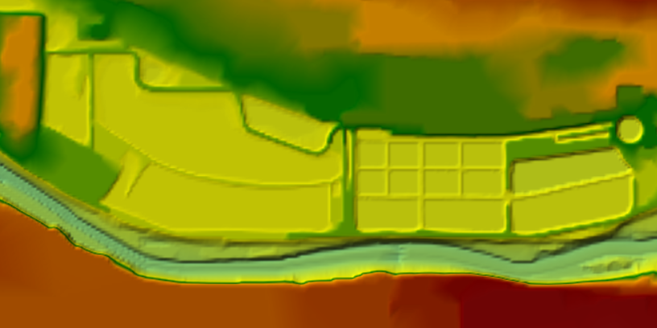
Terrain Data
Used to develop geometry data
  station/elevation data for cross sections, lateral structures, bridges, etc.
  elevation/storage curves for 1D storage areas
  computational mesh for 2D flow areas
Notes:
Terrain Data is an important component of any HEC-RAS model. Terrain data is used to develop the geometry data that we just discussed, such as station and elevation data for cross sections, lateral structures, bridges, and so on. Terrain data is also used to compute elevation storage curves for any 1-dimensional storage areas. It is also used to develop the computational mesh for 2-dimensional flow areas.
You can have multiple terrain datasets within your HEC-RAS model. One terrain may have a very detailed resolution, like a 1-meter grid for example. This detailed data would be good to use when developing the geometry file. You may also want to have a coarser resolution file, such as a 10-meter grid, to use when developing inundation maps. The larger grid cell size keeps the file size of the outputs more reasonable.

Slide 7
Boundary conditions
HEC-RAS needs boundary conditions (stored in the flow files)
  HEC-HMS flows
  HEC-ResSim outflows
  Observed/Forecasted data (tidal gages, NOAA/NWS, etc.)
  Output from other CWMS HEC-RAS models
  Rating Curves
  Normal Depth
Notes:
HEC-RAS models can’t run without boundary conditions. We need to tell the model where the water is entering the system, how much is entering (or leaving) and when. This information is entered in the flow files.
For CWMS models, the two primary inputs for our HEC-RAS models are going to be outputs from HEC-HMS and HEC-ResSim. Remember that HEC-HMS provides runoff flows into the river system, while HEC-ResSim provides releases from any reservoirs within the watershed that are being modeled.
Your model may also include other types of boundary conditions, such as observed or forecasted data from tidal gages, outputs from other CWMS HEC-RAS models, rating curves, or normal depth slopes.

Slide 8
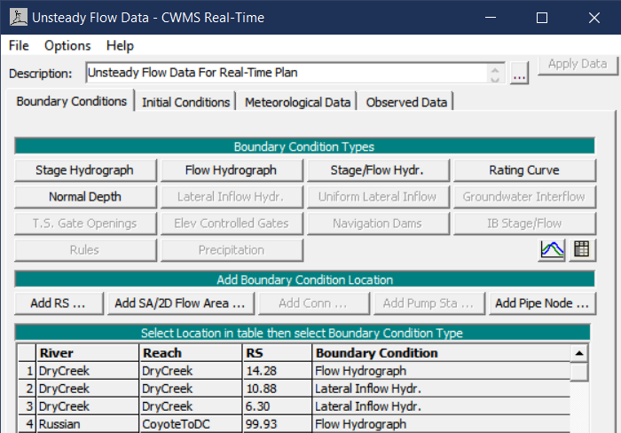
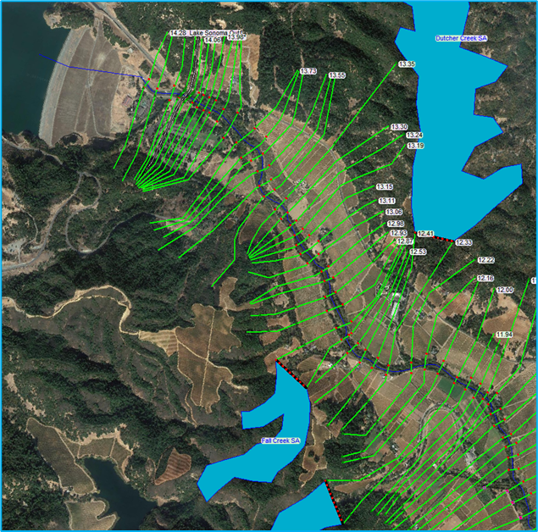
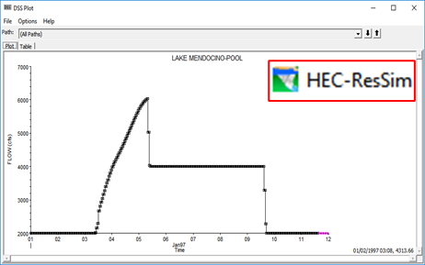
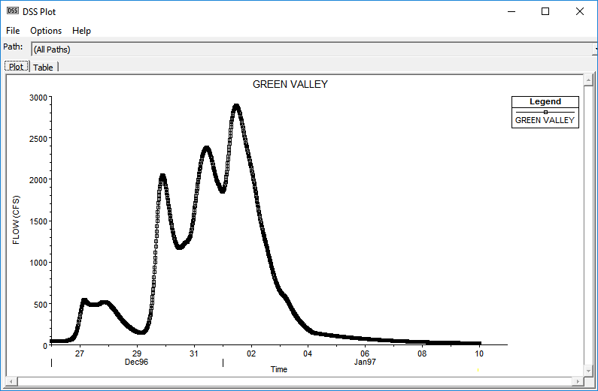
Inflow hydrographs
Notes:
This image is an example of the Unsteady Flow Data Editor that you can find within HEC-RAS. This is where you define the boundary conditions needed to run your HEC-RAS model. (click)
The image on the right depicts our HEC-RAS model geometry. As you can see in the upper left corner of the image, there is a reservoir that is discharging into our system. This output would come from the HEC-ResSim model (click).
We also have HEC-HMS outputs from subbasins that enter the river at various places downstream of our reservoir, as shown here. (click)

Slide 9
Plan file
The Plan File controls the simulation
Combines a Geometry File with a Flow File
Sets the Time Window
Defines the Computation Options and Output Options
Becomes the HEC-RAS Model Alternative when imported into the CAVI
Notes:
Now that we’ve talked about geometry files and flow files, let’s talk about the third major component of an HEC-RAS model, the plan file. (click)
In broad terms, the plan file controls the simulation. (click)
It combines one geometry file with one flow file (click), sets the time window (click), defines computation and output options (click), and most importantly for CWMS users, becomes the HEC-RAS model alternative when imported into the CAVI.

Slide 10
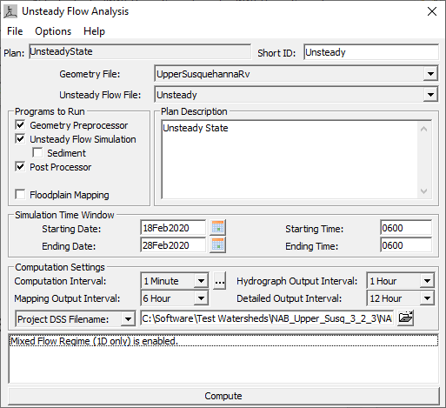
Plan File
Notes:
This is an example of an unsteady flow plan.
(Click) This portion of the dialog defines which geometry file and which flow file will be used for the simulation. You can choose which files to use by selecting a file from the available options in the drop-down list.
(click) Here is the simulation time window. For CWMS forecasts, this data will be replaced with the start and end time for the forecast when a new forecast is created in the CAVI.
(click) These are the computation settings for the plan. You will choose the time step, or computation interval, for the run. In this example, it is set to 1 minute. You will also set the time intervals for various outputs. These settings have been preset when the models were developed, so you should not have to adjust them when running a forecast.

Slide 11
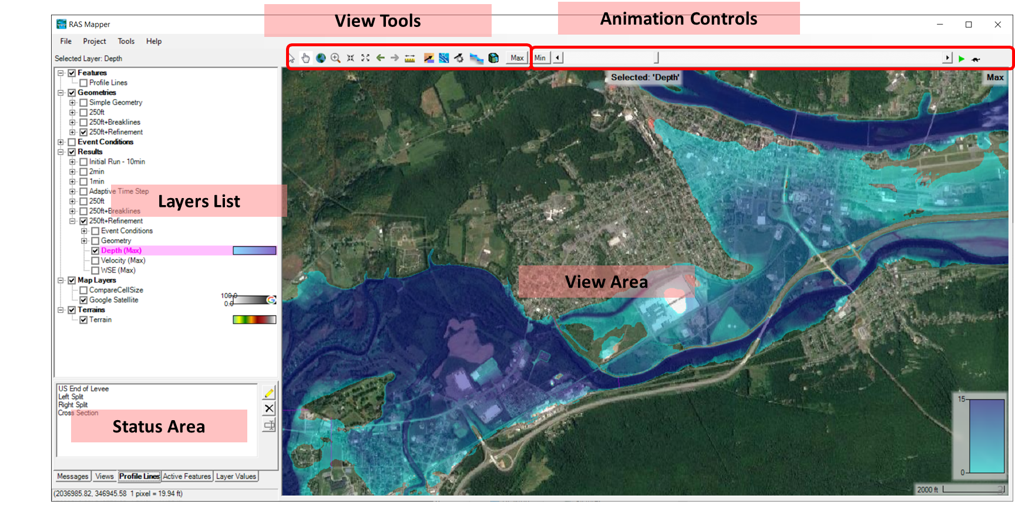
HEC-RAS Mapper
Notes:
One other major component of the HEC-RAS software package is RAS Mapper. This can be used to develop a new HEC-RAS model, view model output and compare results, and develop inundation mapping products.
For CWMS users, most of the time you spend using RAS Mapper will be to develop inundation maps. Once a run has successfully computed, you can display GIS outputs, such as the inundation depth grid, to determine what areas of the floodplain will be flooded and how deep the water will potentially get.
You can animate outputs to see how the inundation changes over time if you are running an unsteady flow model. This can help determine when areas will start to flood, or when the floodwaters might start to recede. It is a great tool to use when demonstrating to others in your office the results of your forecast.

Slide 12
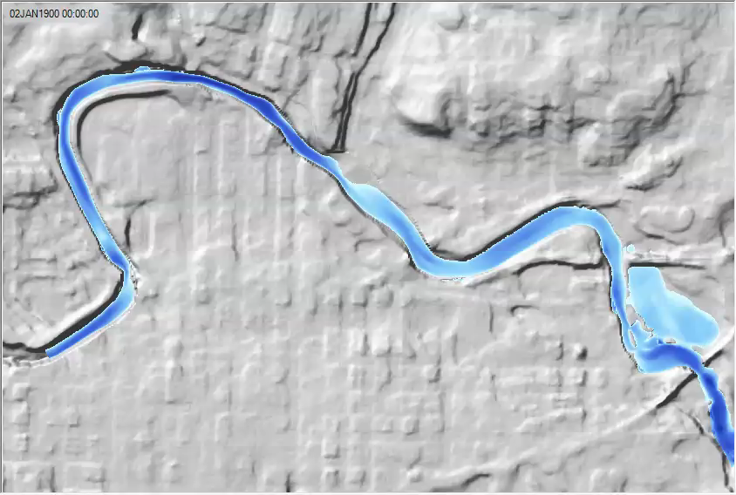
Dynamic Maps - animations
Notes:
Here is an example of an animation created using RAS Mapper.
You can see the floodwaters start to inundate the floodplain. As we zoom in, notice the depths begin to increase in the overbank areas. The grid shown on the screen indicates this model has a 2-dimensional flow area.
These types of animations can be helpful when trying to relay information to emergency managers, first responders, or others helping during the event.

Slide 13
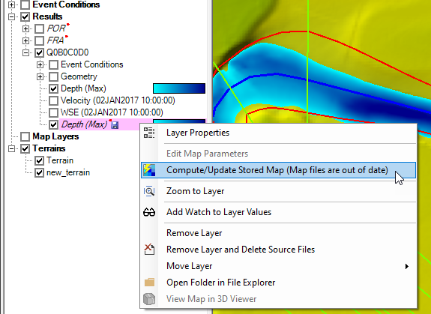
Stored maps
Export results to GeoTiff raster file on disc
Allows HEC-RAS to pass results to other applications
  GIS for inundation maps
  HEC-FIA for consequences or flood damages reduced
Notes:
The video animations are a great way to share information to others in your office, but if we want to share information from HEC-RAS to other models, such as HEC-FIA, then we need to create stored maps.
Stored maps are results that are exported as geotiff raster files and saved on disc. This allows us to get the computational results from HEC-RAS and either make a map using GIS products or run HEC-FIA to compute consequences.

Slide 14
Questions
Help additional Training
https://usace.dps.mil/sites/KMP-WM/SitePages/Corps-Water-Management-System-(CWMS).aspx
https://www.hec.usace.army.mil/confluence/cwmsdocs
https://discourse.hecdev.net/c/cwms/5
TDL-CELRH-EC-GW-W-USACE CWMS Modeling | General | Microsoft Teams
Notes:
If you have any other questions about our software, need some help, or are looking for additional training; check out these links. They can also be found in the description below. Thank you for your time.

