Slide 1
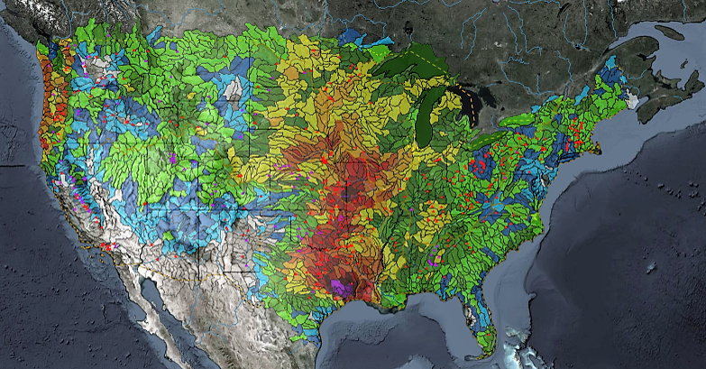
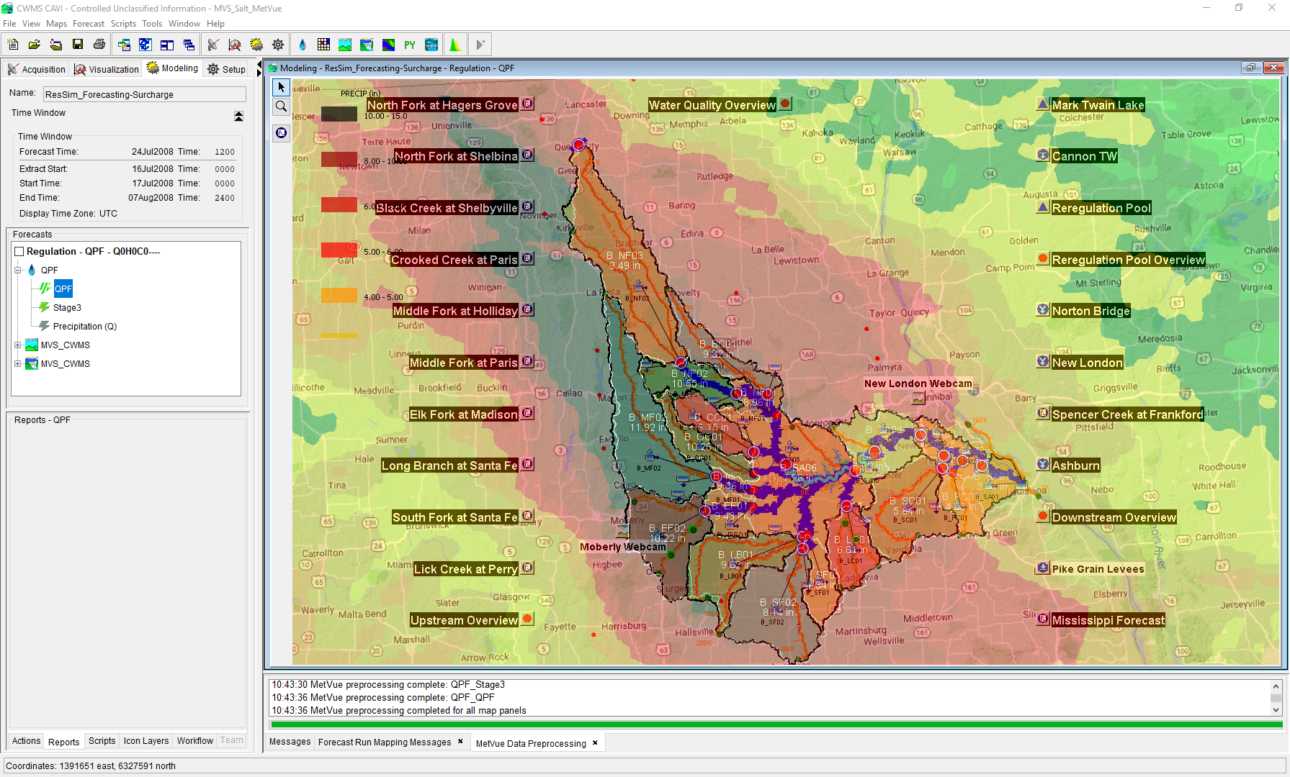
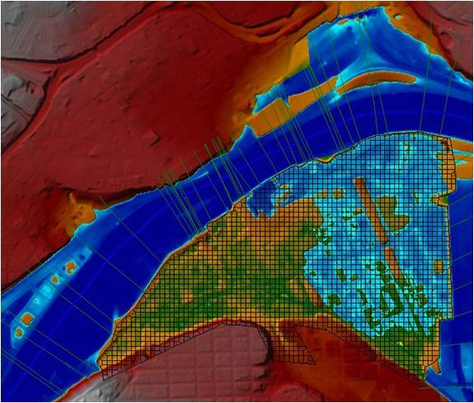
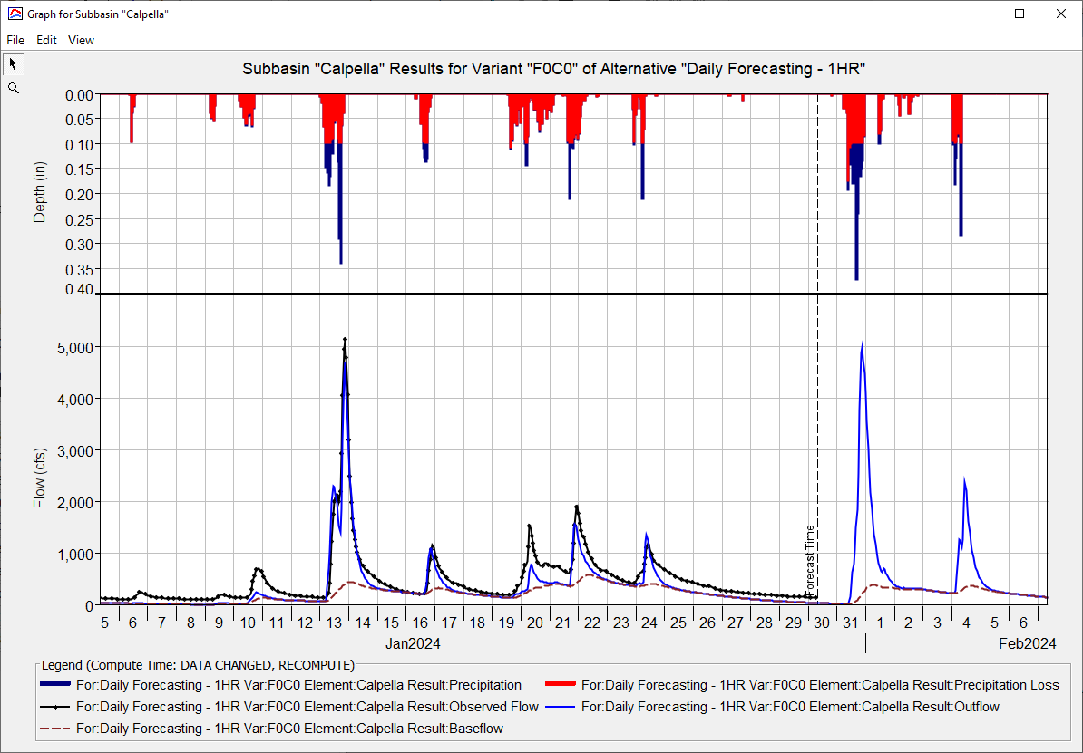
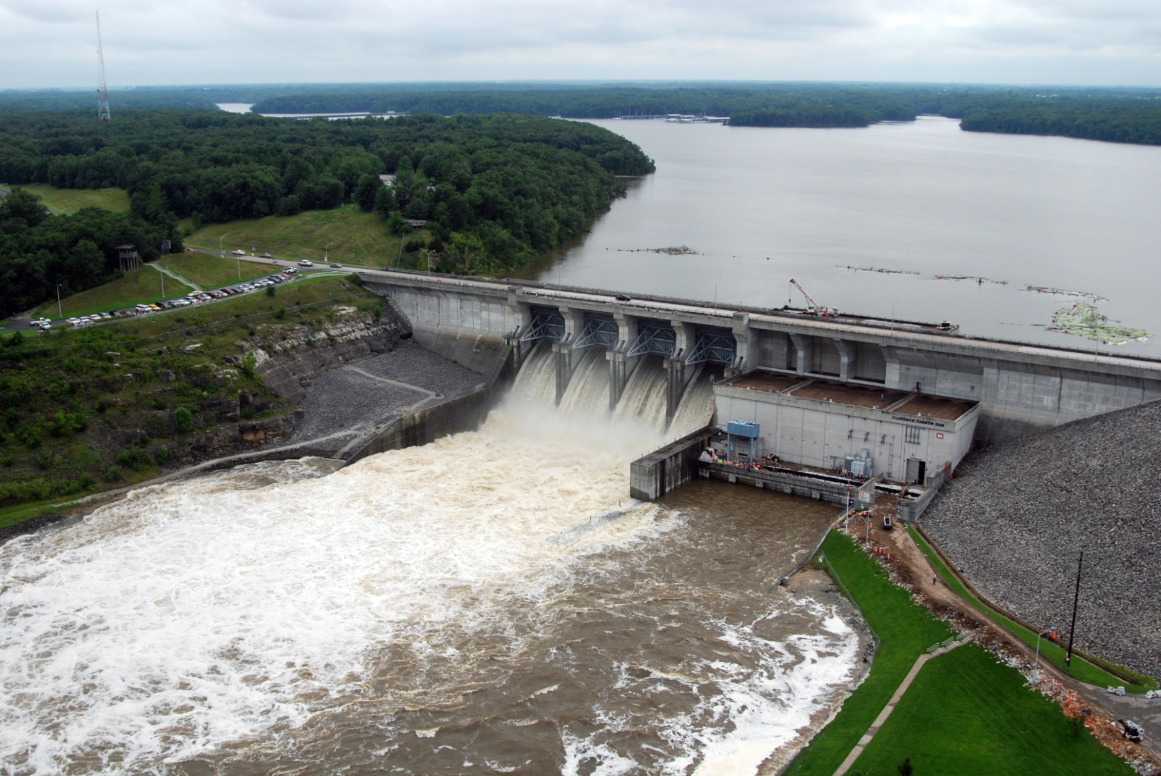
HEC-RAS for CWMS
Andy Richter, P.E., PMP
Hydrologic Engineering Center
CWMS Prospect Course
Notes:
Hello Water Managers,
My name is Andy Richter, part of the Water Management Systems Division at the Hydrologic Engineering Center. I’m going to be covering HEC-RAS for CWMS today.
This presentation is part of a series of recordings that will cover various topics relating to HEC-RAS modeling for CWMS.

Slide 2
Outline
Purpose for Hydraulic Modeling in CWMS
HEC-RAS Capabilities Overview
HEC-RAS Program Essentials
HEC-RAS Model Development for Real-Time Forecasting
HEC-RAS CAVI Integration
Real-Time Forecasting using HEC-RAS
Notes:
There are six main topics that will be presented in this series. Previous videos have covered the first three topics. This video will cover HEC-RAS Model Development for Real-Time Forecasting.

Slide 3
Model development for real-time forecasting
Notes:
Let’s get started.

Slide 4
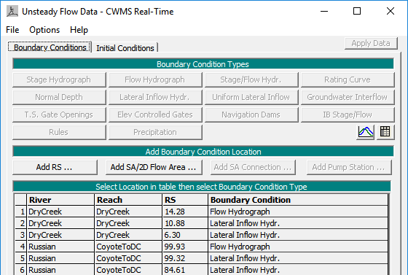
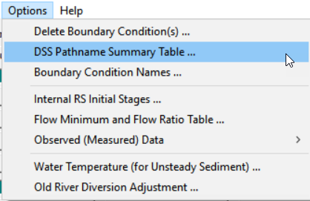
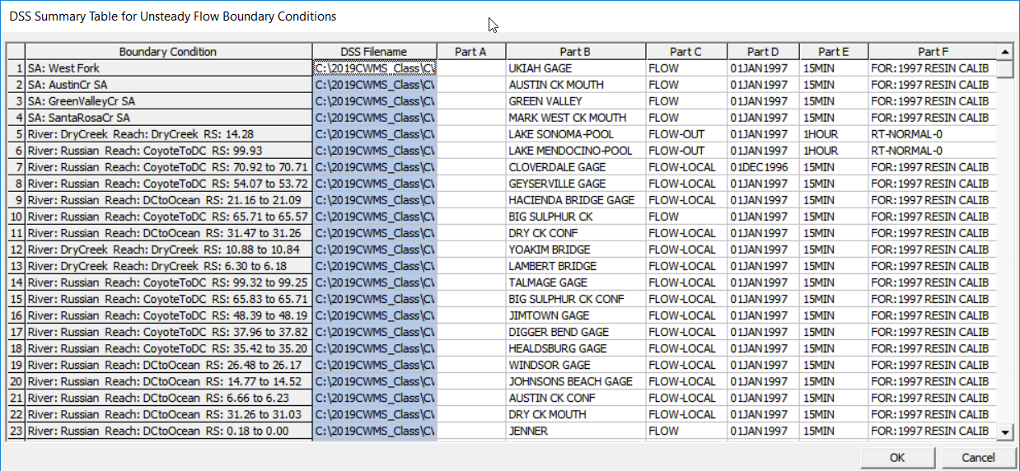
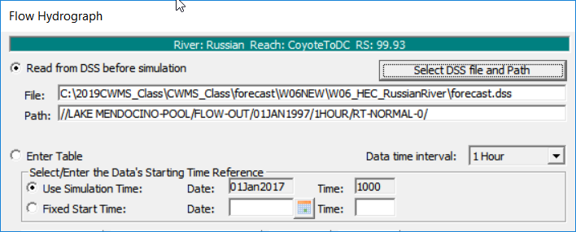
Boundary conditions within HEC-RAS
Notes:
Once the geometry setup is complete, you should work with the HEC-HMS and HEC-ResSim modelers to ensure that all necessary model outputs are included as model inputs to the HEC-RAS model. (click) This work is first completed within the Flow Files inside of the HEC-RAS model.
(click) The DSS Pathname Summary Table is a good way (click) to review all the boundary conditions that you set up within the model, ensuring that the pathnames correctly match the required outputs from HEC-HMS and HEC-ResSim.

Slide 5
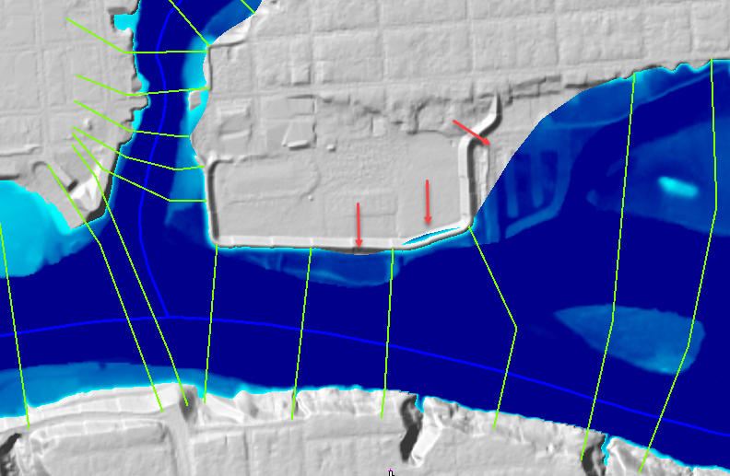
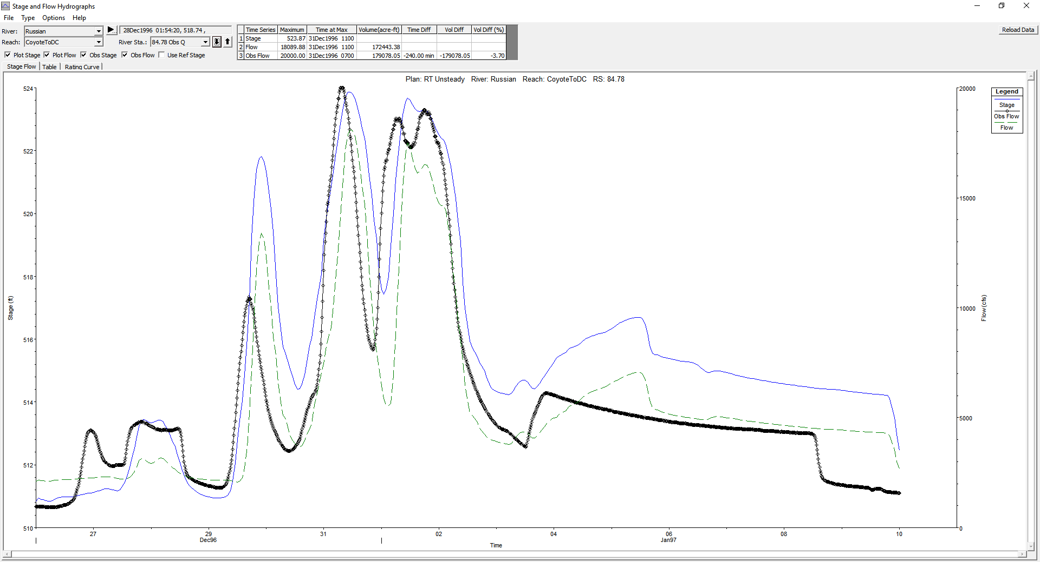
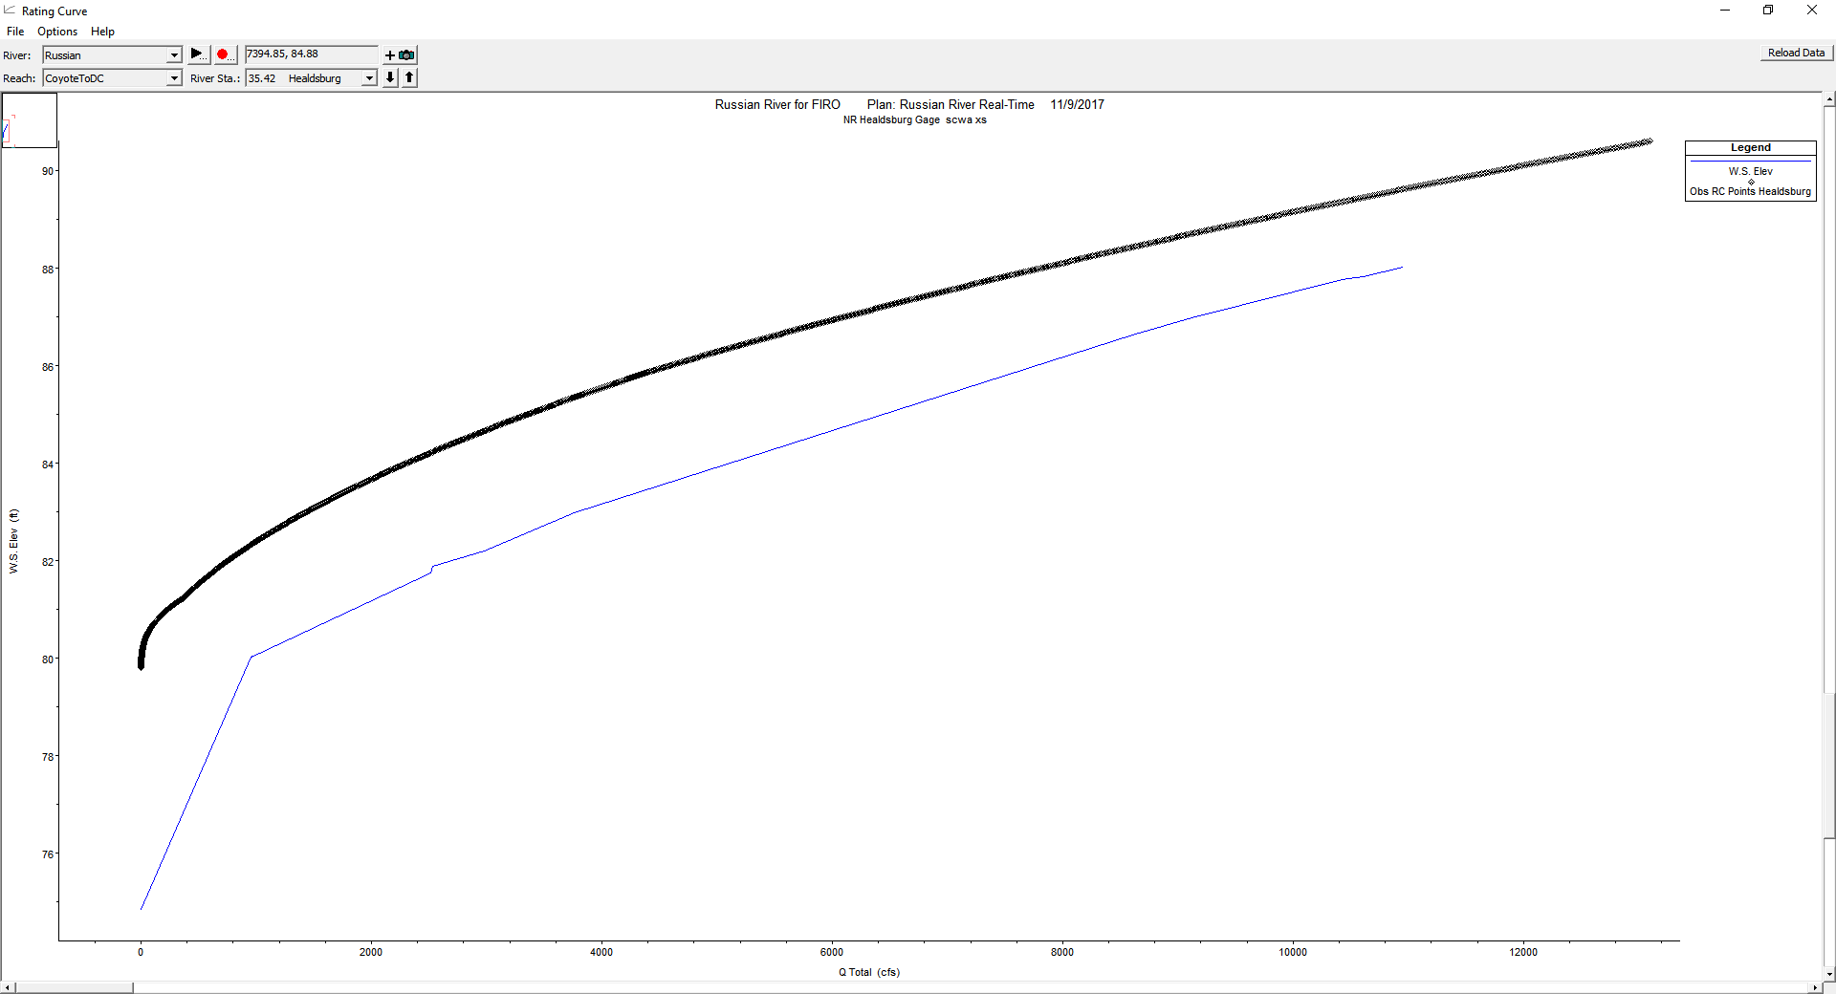
Model Calibration
Calibrate model to historic events
  Observed Stages/Flows
  Rating Curves
  Adjusting model parameters (Manning’s “n” values, ineffective flow areas, etc.)
Use HEC-RAS Mapper
  Compare model output to aerial photography
  Look for problems with inundated areas (abrupt cutoffs, missing areas, etc.)
Notes:
Now that the boundary conditions have been established, you can move on to model calibration. This is a significant task when developing an HEC-RAS model. It is an essential step when developing a new model. You should be calibrating the model to ensure that the model outputs are matching observed data (click) such as gage recordings of stages and flows or (click) computed rating curves. To calibrate the model, (click) you will need to adjust model parameters such as the Manning’s N values, until your model results match observed data.
(Click) At the same time, you should also inspect model outputs in HEC-RAS Mapper to verify that the outputs look sound. (click) One important step is to look for problem areas where the inundation is getting cut off or is missing. Corrections to the model geometry may be required to fix these issues with mapping.

Slide 6
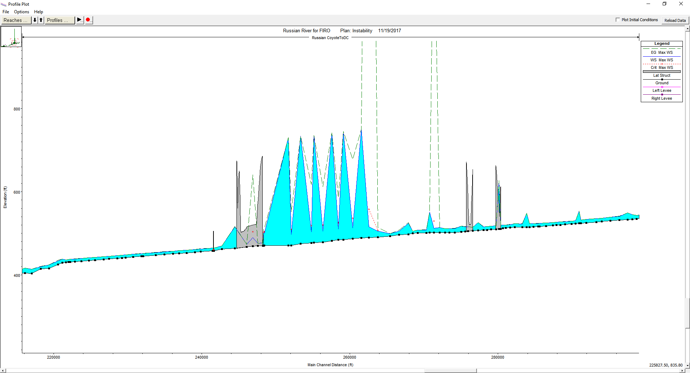
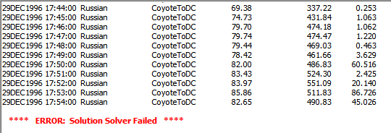
Stress testing
Why stress test our models?
  Ensure model stability at a variety of conditions
    High Flows
    Low Flows
    Levee Breaches
Notes:
During development, you should stress test your HEC-RAS model. (click) This ensures that the model is stable at a variety of flow conditions, such as high flows, low flows, and even levee breaches.
If the models are appropriately stress tested, then they should be more reliable during a wide range of flow conditions that may be experienced during an event.
(click) Instabilities can be seen when viewing model outputs, such as this profile plot, (click) or when reviewing the computational messages from the run

Slide 7
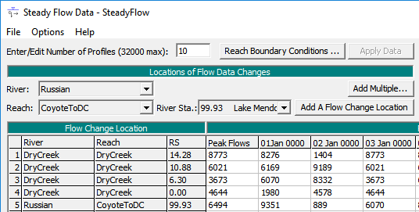
Steady Flow Plan
Create a steady flow plan that can be used as a backup to the unsteady flow plan*
Consider steady flow limitations
not applicable when model has 2D elements
Notes:
It was recommended that CWMS modelers develop a steady flow plan as a backup, if the unsteady plan was intended to be the primary option when running the HEC-RAS model. This backup was intended to be used in case the unsteady plan failed or crashed during a forecast run.
One thing to note, models that include 2-dimensional flow areas cannot be run with a steady flow plan.

Slide 8
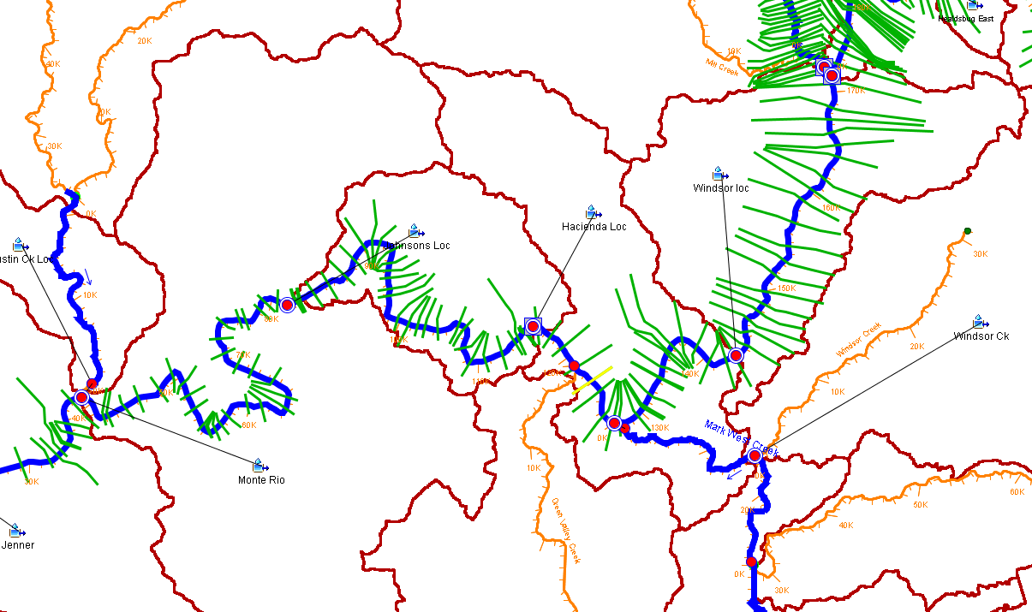
Linking boundary Conditions in CAVI
Location/Parameter
Notes:
Once the HEC-RAS modeler has completed development in HEC-RAS, they will work with the HEC-HMS and HEC-ResSim team members to link the correct outputs as inputs to HEC-RAS within the CAVI.
(click through) In this example, we have several HEC-HMS outflows that need to be entered as inflows to our HEC-RAS model. If all is set correctly, the CAVI should automatically connect the datasets to the correct locations. It is good practice to verify that the model linking has been set correctly inside of your CAVI watershed, though.

Slide 9
Questions
Help additional Training
https://usace.dps.mil/sites/KMP-WM/SitePages/Corps-Water-Management-System-(CWMS).aspx
https://www.hec.usace.army.mil/confluence/cwmsdocs
https://discourse.hecdev.net/c/cwms/5
TDL-CELRH-EC-GW-W-USACE CWMS Modeling | General | Microsoft Teams
Notes:
If you have any other questions about our software, need some help, or are looking for additional training; check out these links. They can also be found in the description below. Thank you for your time.

