Slide 1
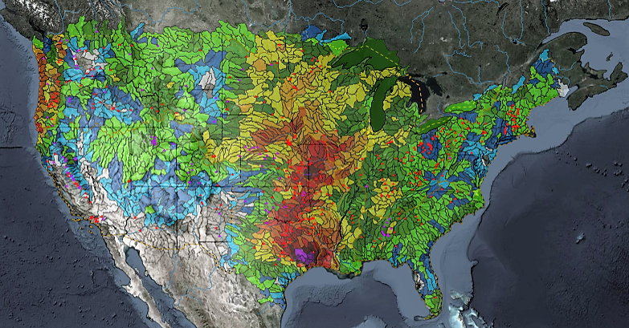
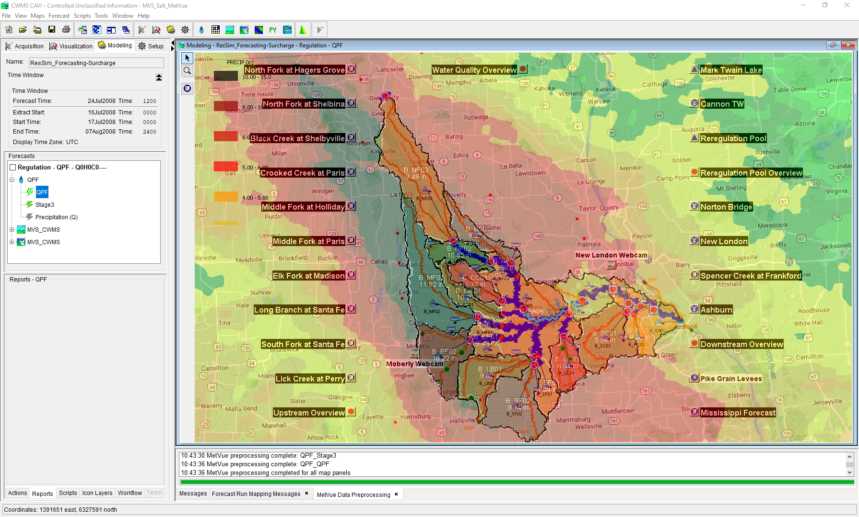
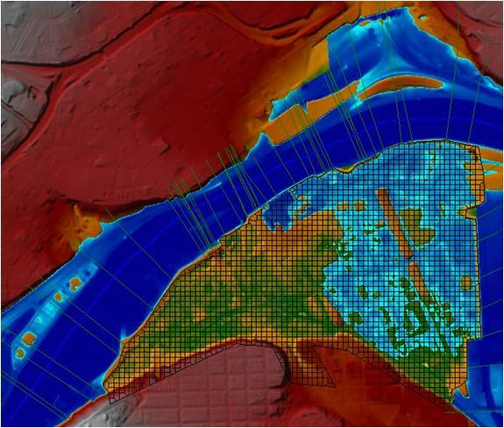
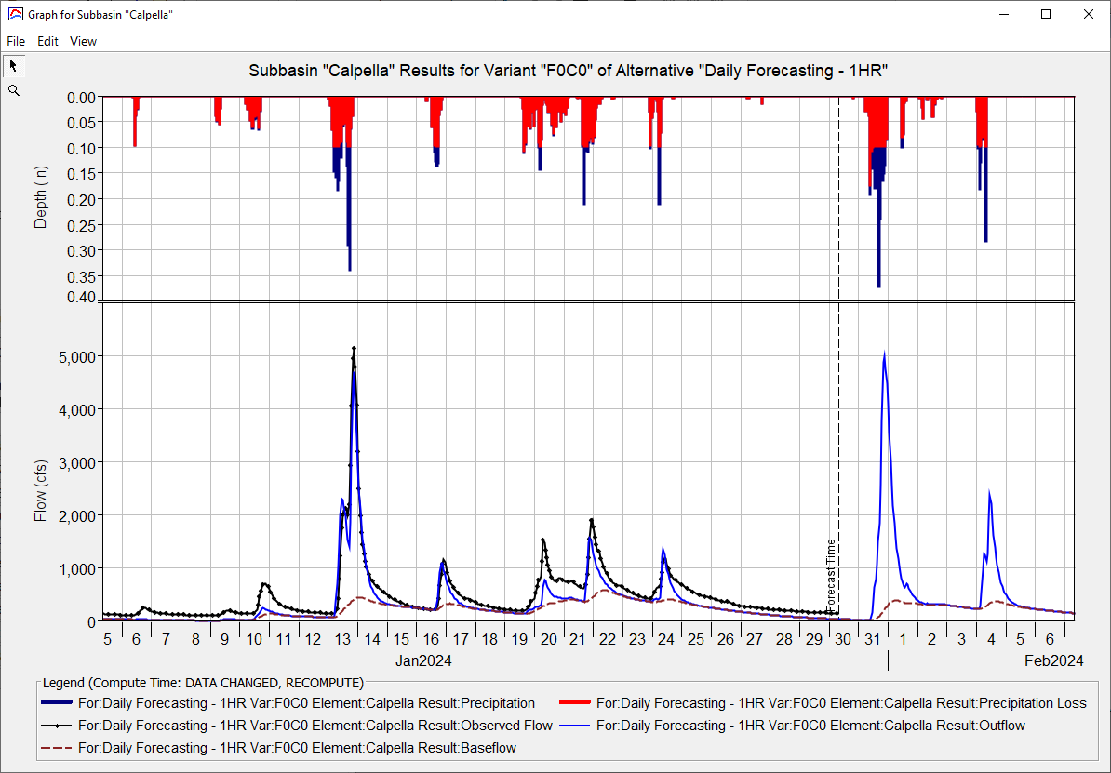
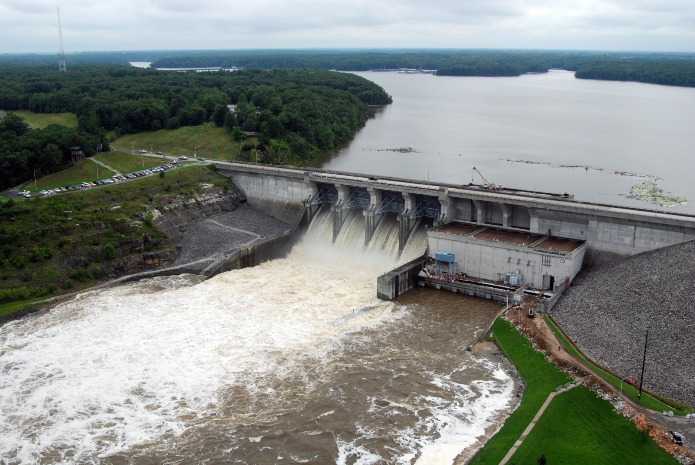
HEC-RAS for CWMS
Andy Richter, P.E., PMP
Hydrologic Engineering Center
CWMS Prospect Course
Notes:
Hello Water Managers,
My name is Andy Richter, part of the Water Management Systems Division at the Hydrologic Engineering Center. I’m going to be covering HEC-RAS for CWMS today.
This presentation is part of a series of recordings that will cover various topics relating to HEC-RAS modeling for CWMS.

Slide 2
Outline
Purpose for Hydraulic Modeling in CWMS
HEC-RAS Capabilities Overview
HEC-RAS Program Essentials
HEC-RAS Model Development for Real-Time Forecasting
HEC-RAS CAVI Integration
Real-Time Forecasting using HEC-RAS
Notes:
There are six main topics that will be presented in this series. Previous videos have covered the first four topics. This video will cover HEC-RAS CAVI Integration.

Slide 3
HEC-RAS CAVI Integration
Notes:
Let’s get started.

Slide 4
CAVI integration steps
Import HEC-RAS Project
Configure HEC-RAS Mapper
  Copy additional data (terrain and local HEC-DSS data)
  Create saved depth grid map
Run standalone simulation from base model (Setup Tab)
Verify Model Linking in CAVI
Notes:
There are four main steps when integrating an HEC-RAS model into the CAVI.
(Click) The first step is to import the HEC-RAS project.
(click) The second step is to configure HEC-RAS Mapper.
(click) The third step is to run the base model standalone from within the setup tab.
(click) The last step is to verify model linking inside of the CAVI.

Slide 5
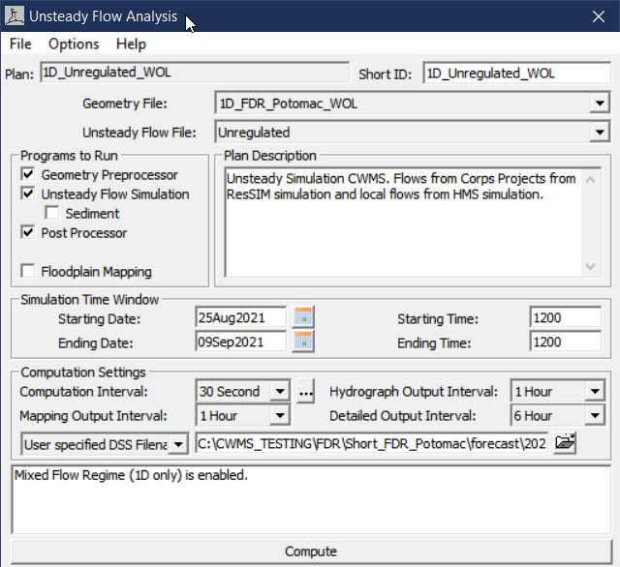
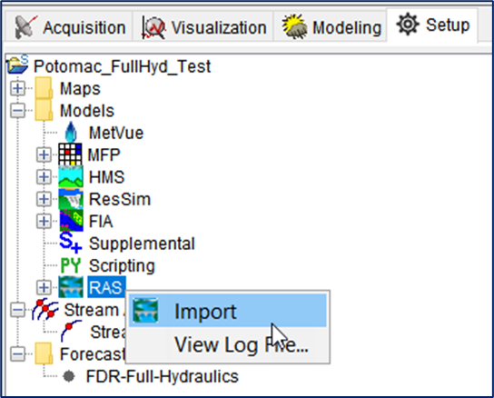
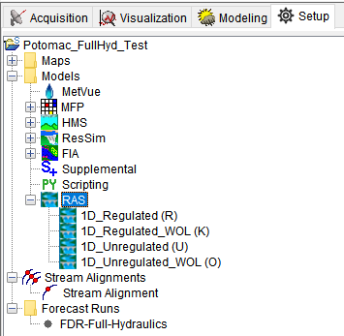
Import HEC-RAS model
Only ONE HEC-RAS Project can be imported
HEC-RAS plans become CAVI alternatives
Notes:
The first step in this process is to import the model into the CAVI. (click) It is important to note that only one HEC-RAS project can be imported into a CAVI watershed.
(click) Each of the plans inside of the HEC-RAS model become alternatives when imported into the CAVI. (click)

Slide 6
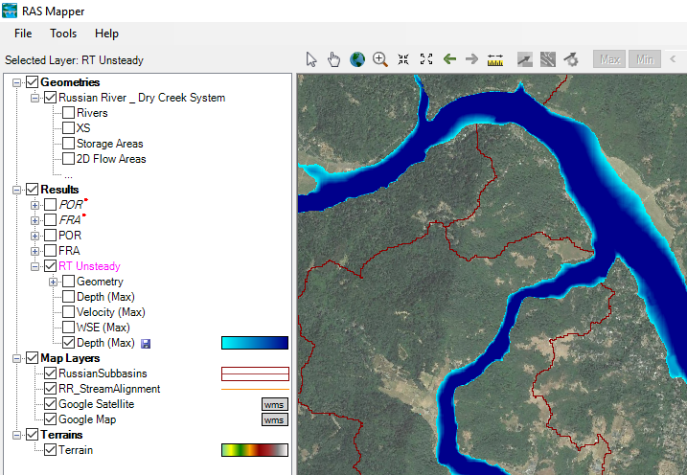
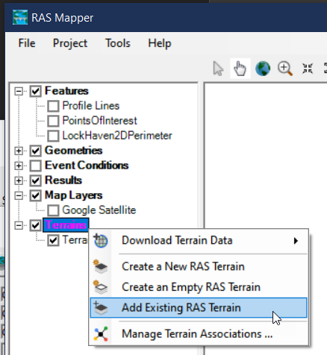
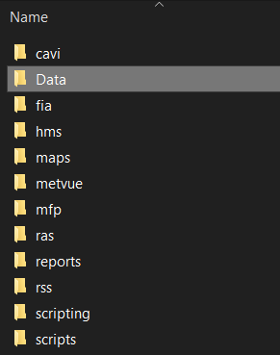
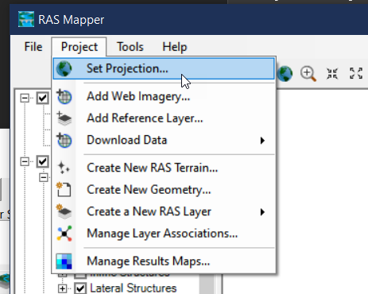
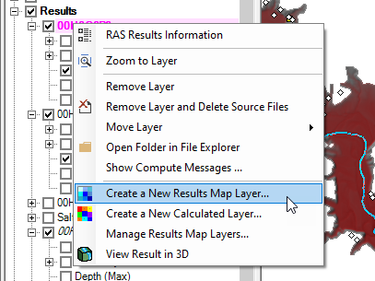
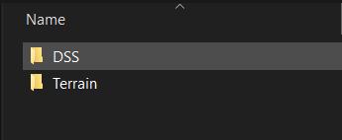
Configure HEC-RAS Mapper
HEC-RAS Mapper needs more data than the CAVI import provides
  Terrain data
  Projection file
Copy data into the watershed directory
Create Saved Map
Notes:
The next step in this process is to configure HEC-RAS Mapper. (click)
It needs more data than the model import into the CAVI watershed provides, such as the terrain data (click), and the projection file (click).
You will need to copy that data from the original HEC-RAS model file directory into the watershed directory. (click)
At this point, you will need to create saved maps – and remember those are outputs that will be generated and saved to disc so that they can be passed to HEC-FIA or used to develop inundation maps.

Slide 7
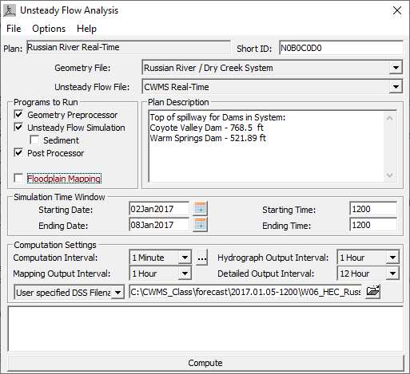
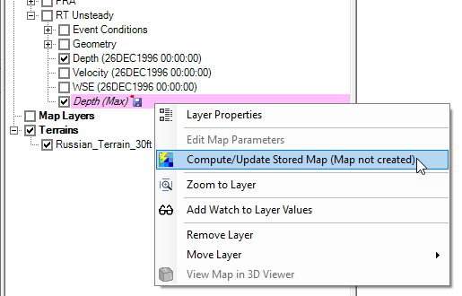
Run standalone HEC-RAS Simulation
Compute HEC-RAS model in Base Directory
Generate Saved Map
Essential for HEC-RAS to HEC-FIA model linking
Notes:
The next step is to run a standalone HEC-RAS model simulation. (click) This should be done within the base watershed directory.
(Click) During this step, you will need to generate a saved map. (click) This step is necessary to ensure the model linking between HEC-RAS and HEC-FIA is correct and functions properly within the CAVI.

Slide 8
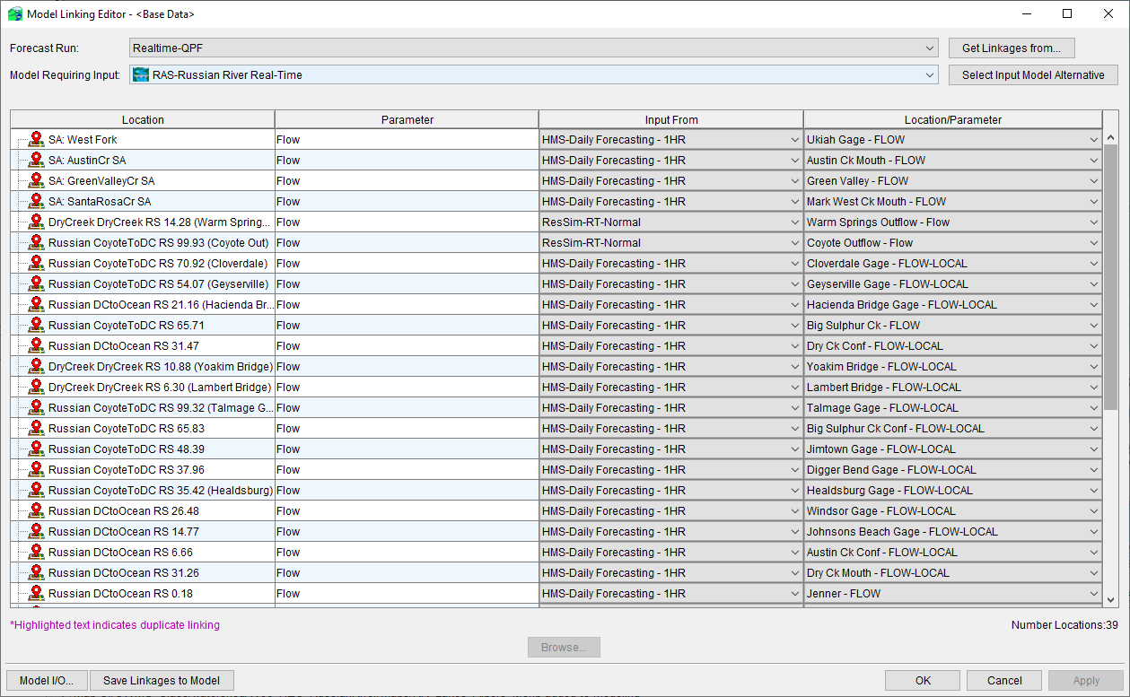
Verify model linking in CAvi
Notes:
The last step in this process is to verify the model linking inside of the CAVI. This should be done within the Setup Tab so that the model linking for the base model is correct, which ensures that any forecasts created will inherit the correct linkages.

Slide 9
Questions
Help additional Training
https://usace.dps.mil/sites/KMP-WM/SitePages/Corps-Water-Management-System-(CWMS).aspx
https://www.hec.usace.army.mil/confluence/cwmsdocs
https://discourse.hecdev.net/c/cwms/5
TDL-CELRH-EC-GW-W-USACE CWMS Modeling | General | Microsoft Teams
Notes:
If you have any other questions about our software, need some help, or are looking for additional training; check out these links. They can also be found in the description below. Thank you for your time.

