Slide 1
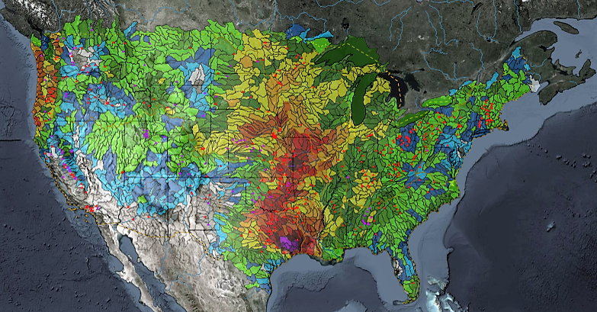
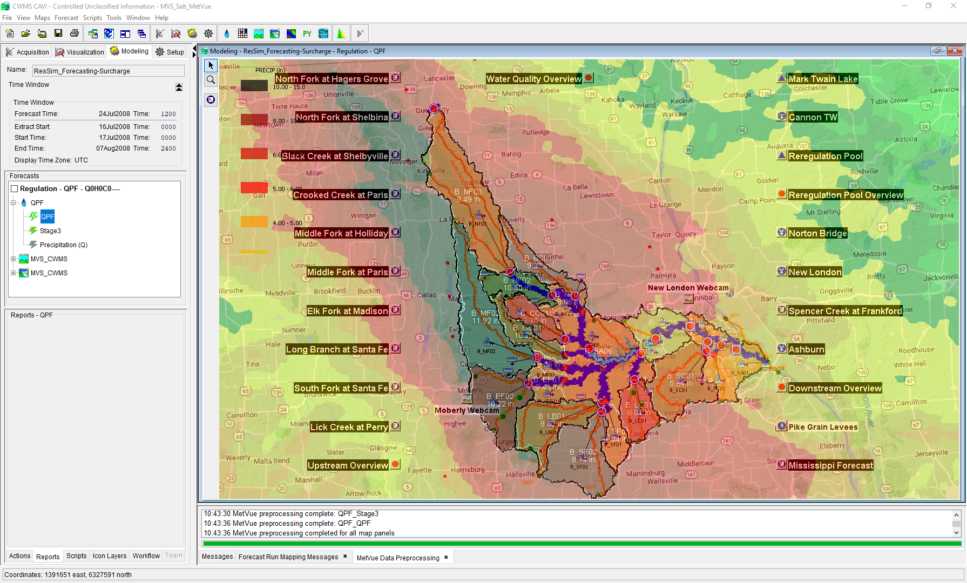
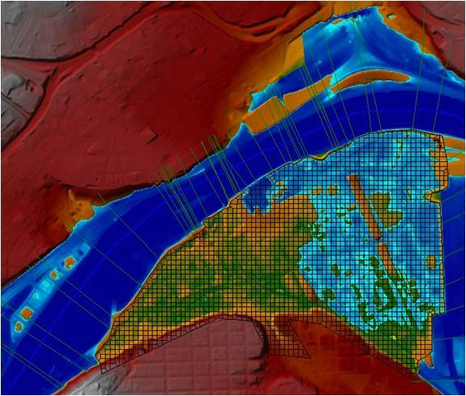
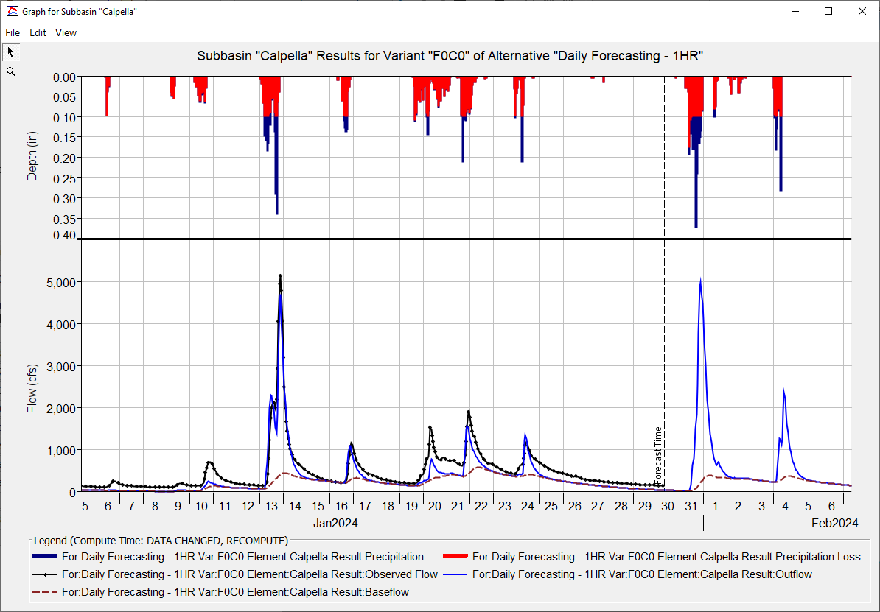
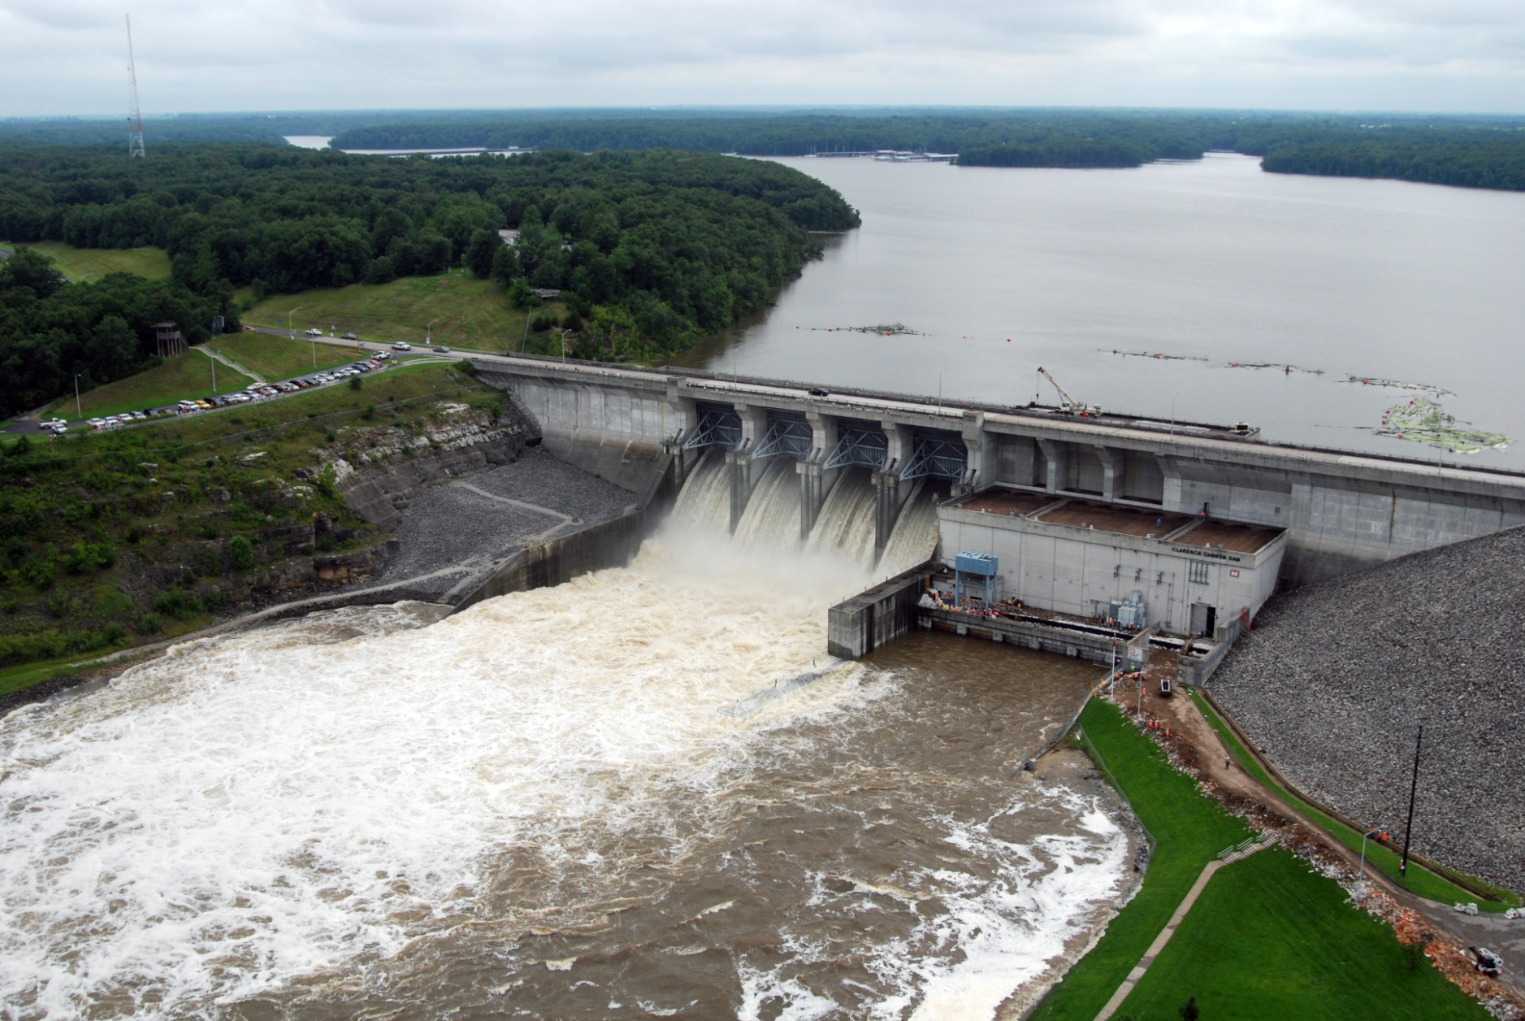
ST. Louis District CWMS Implementation
Russell Errett, P.E.
Hydrologic Engineering Center
CWMS Prospect Course

Slide 2
Overview
  St. Louis District Overview
  Review of CWMS Implementation within the St. Louis District
  Application of CWMS with the St. Louis District
    Examples of CWMS usage
    Evaluation of performance of CWMS vs Legacy

Slide 3
Data Viewing and Editing

Slide 4
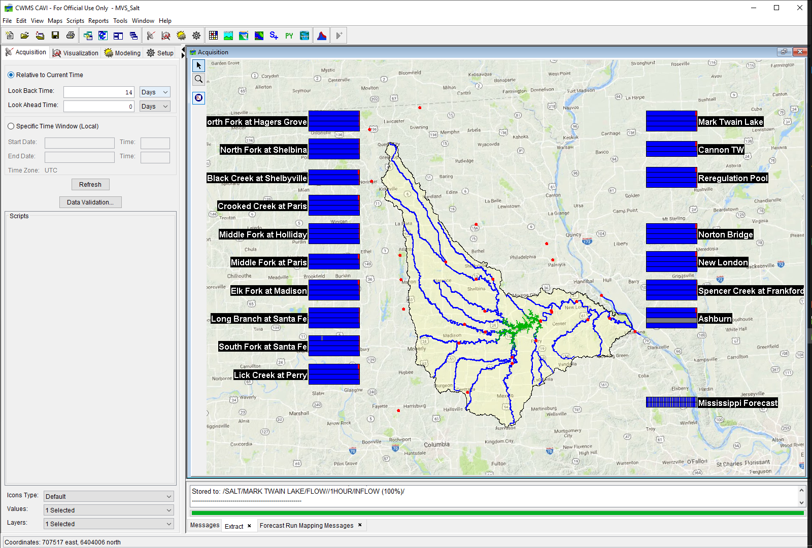
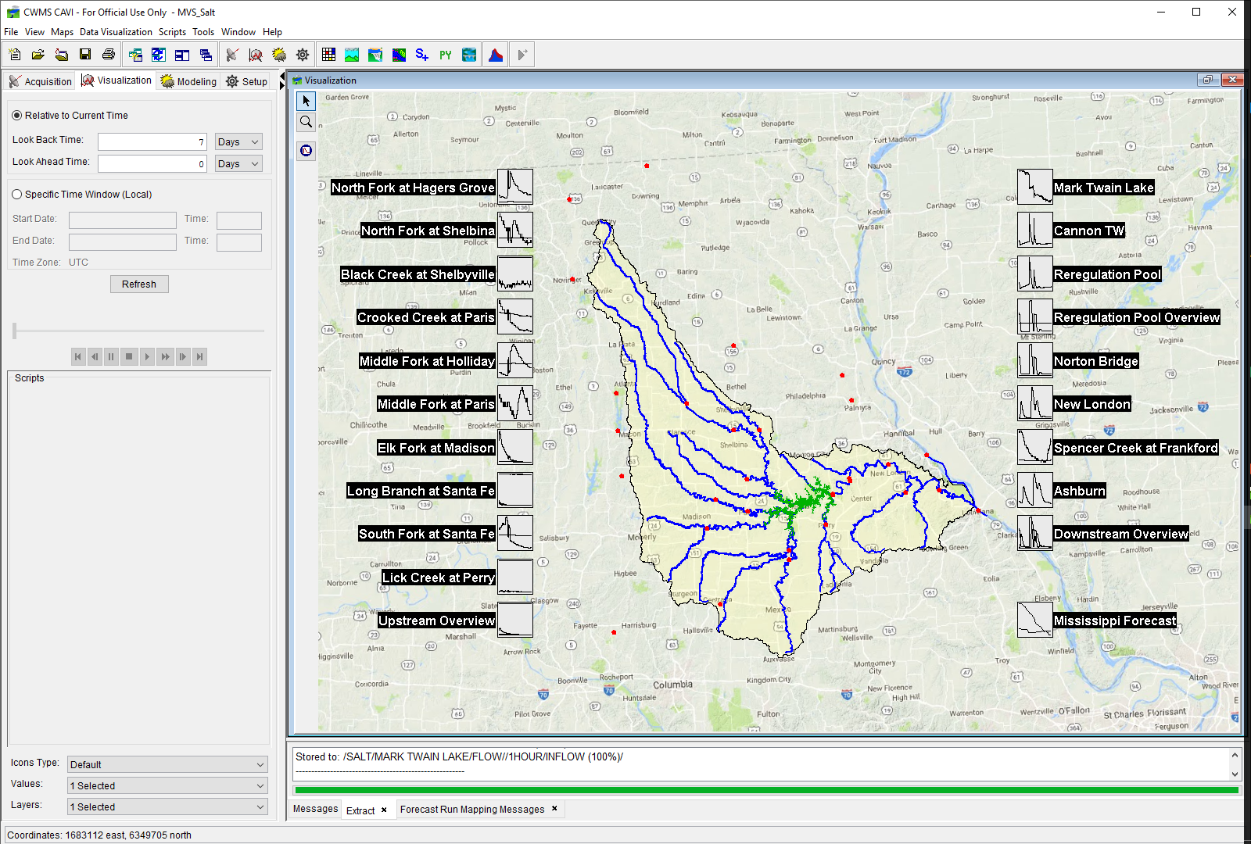
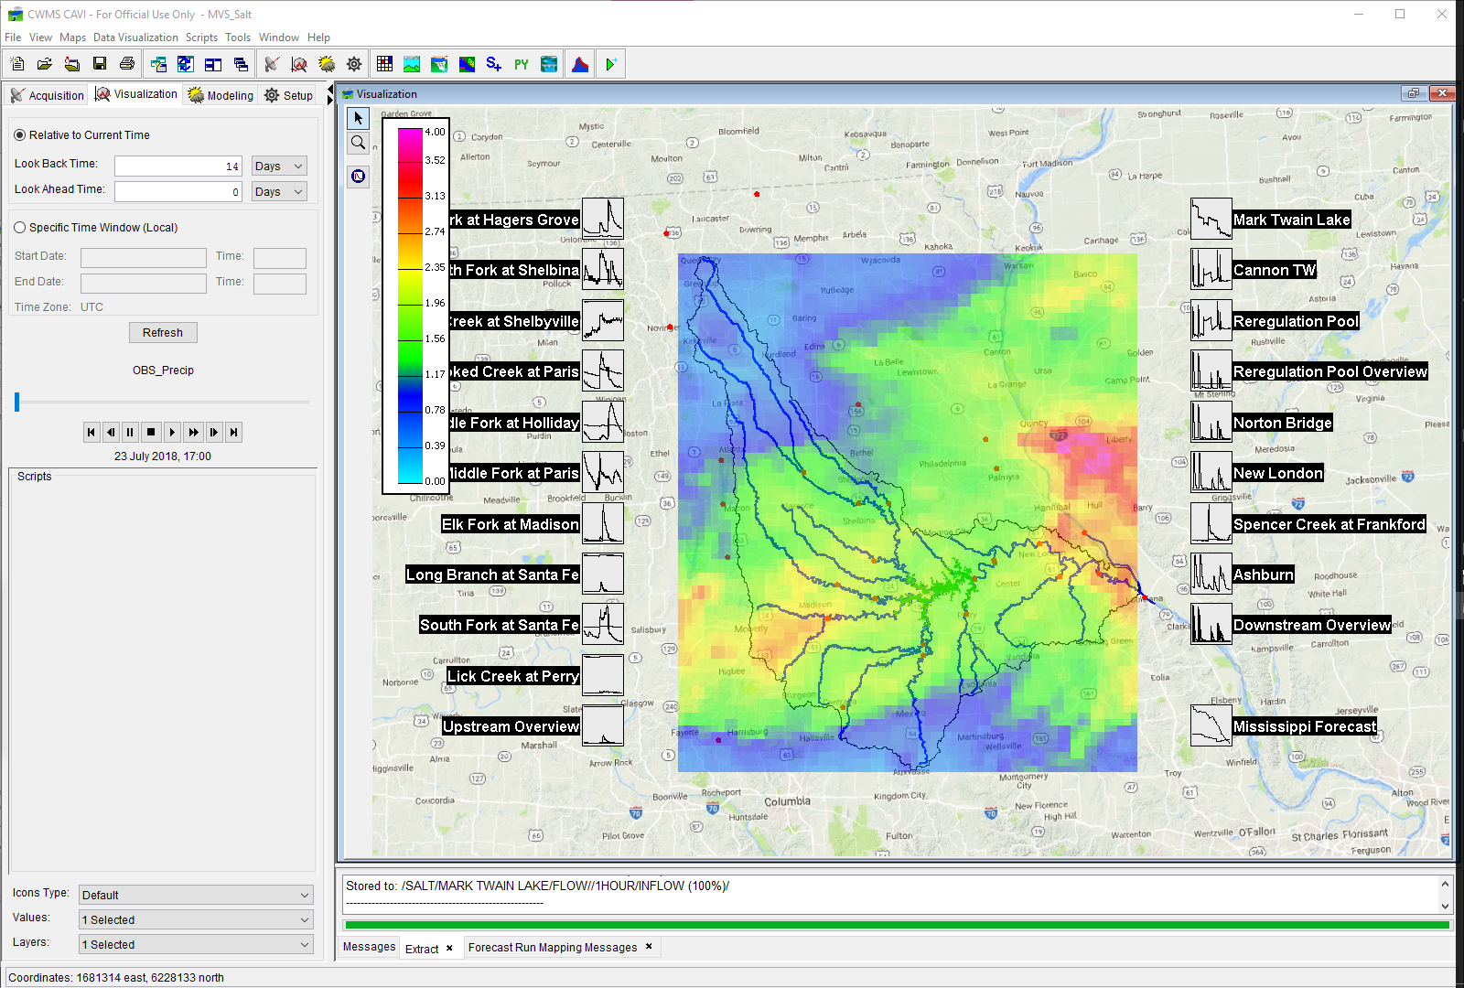
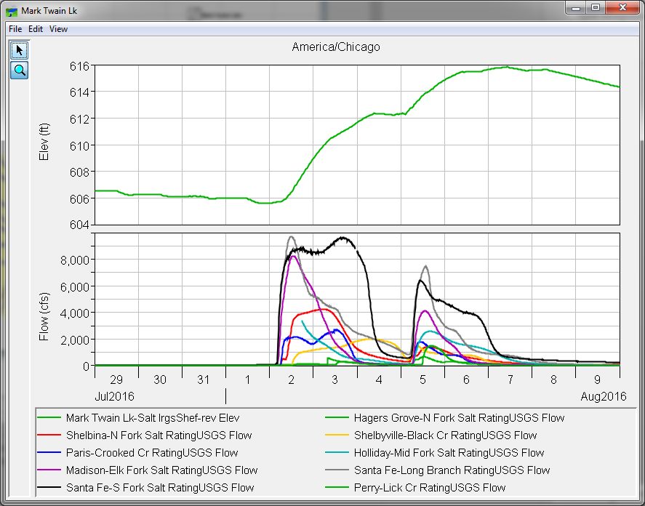
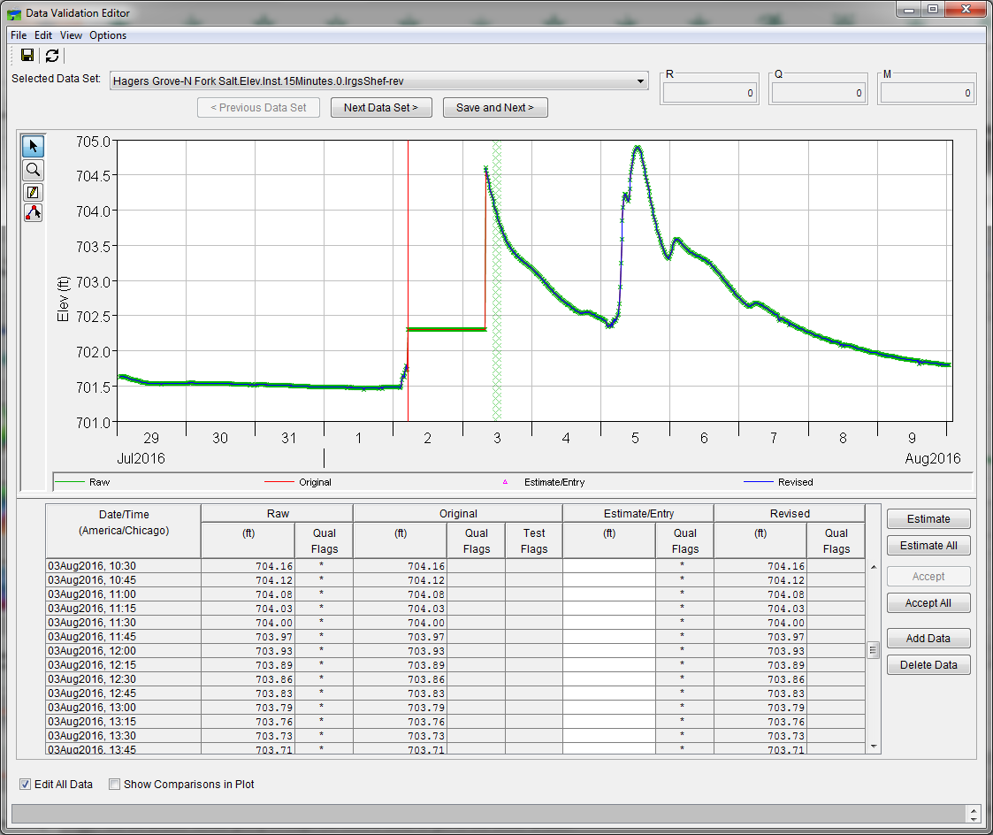
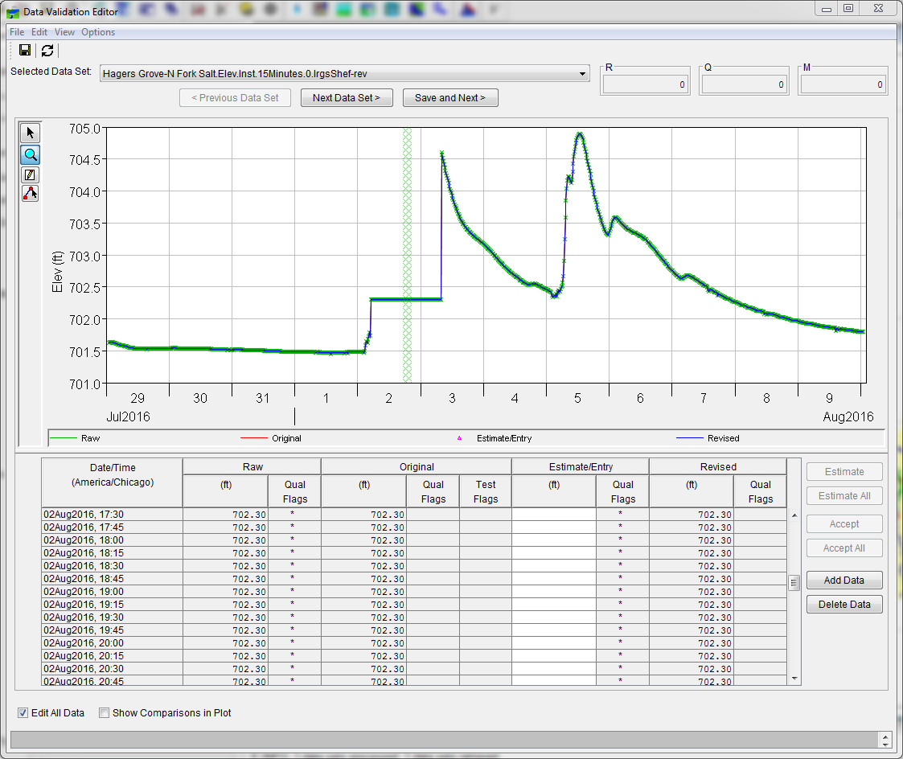
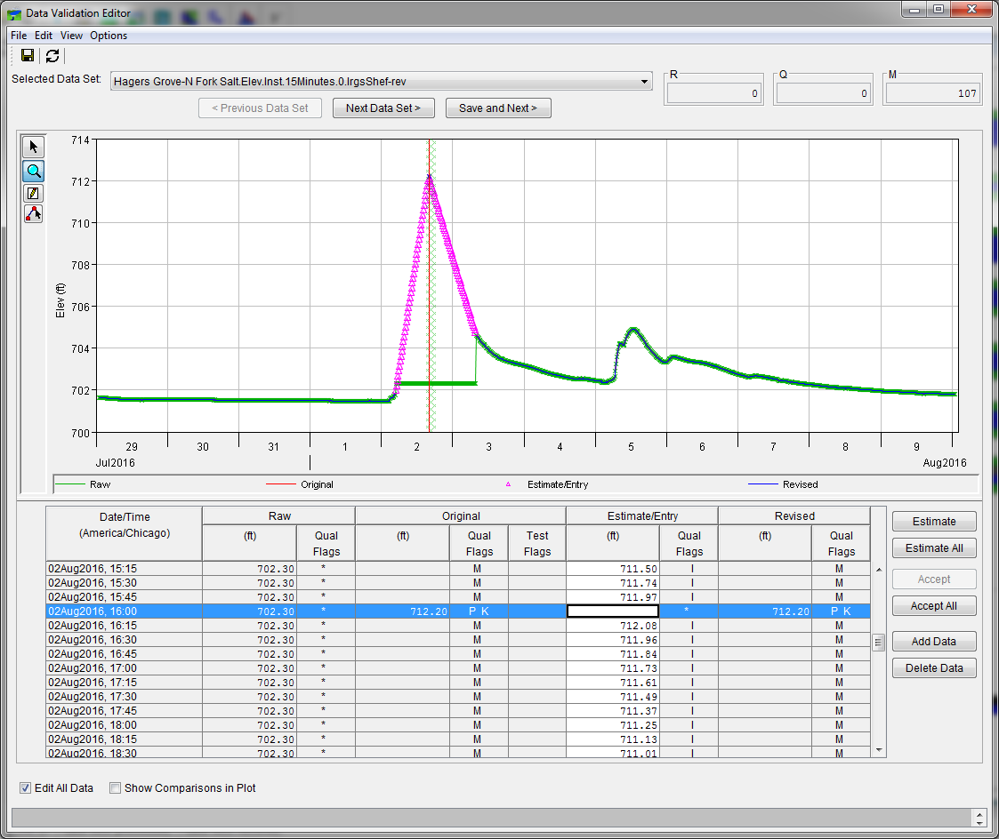
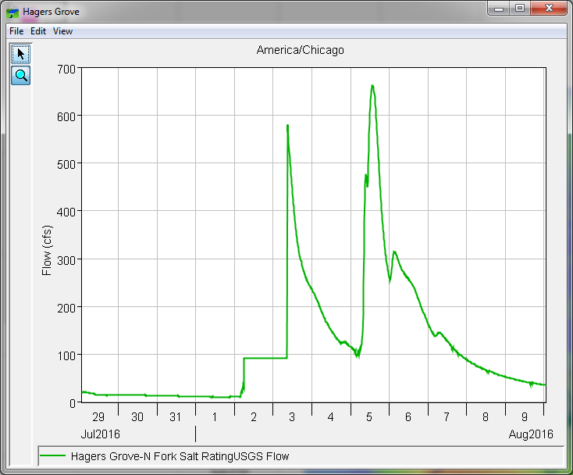
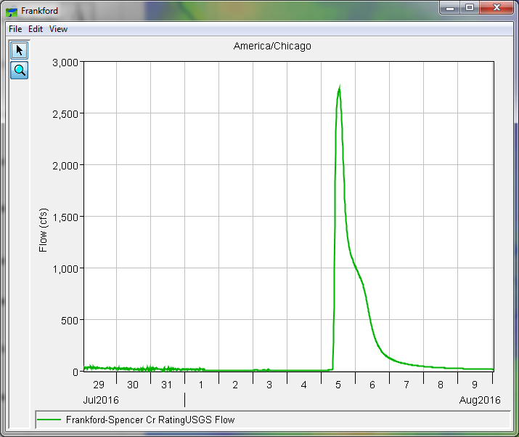
Data Viewing and Editing
Notes:
Intro: The more clicks it takes for a Water Manager to get to the answer, the less likely they are to use it. Meaning, if it takes 10 clicks to get to a good answer, but 2 to get to an OK answer, then they will likely use the OK answer versus going through the extra 8 clicks to get to the better answer.

Slide 5
Questions
Help additional Training
https://usace.dps.mil/sites/KMP-WM/SitePages/Corps-Water-Management-System-(CWMS).aspx
https://www.hec.usace.army.mil/confluence/cwmsdocs
https://discourse.hecdev.net/c/cwms/5
TDL-CELRH-EC-GW-W-USACE CWMS Modeling | General | Microsoft Teams

