Slide 1
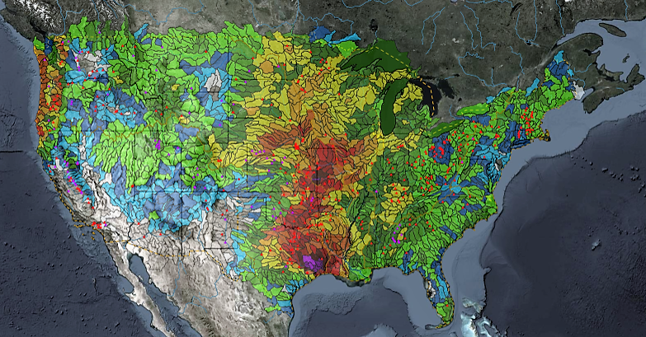
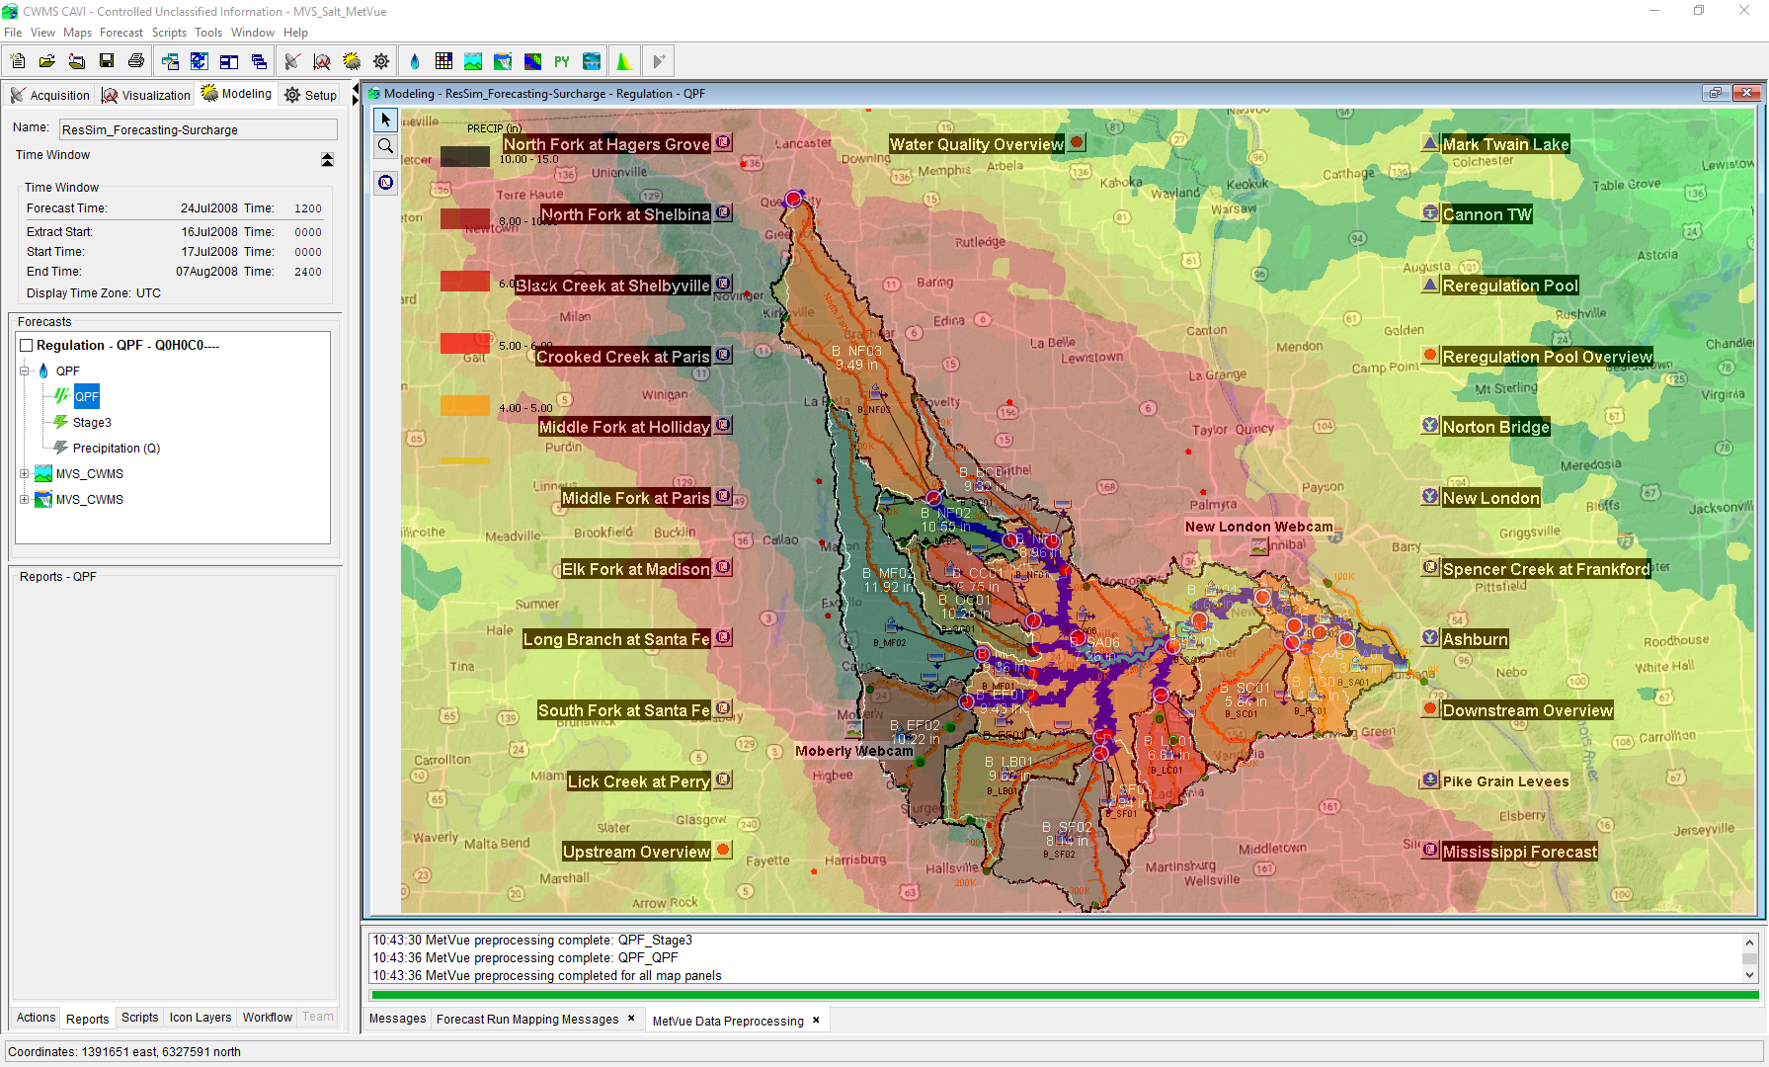

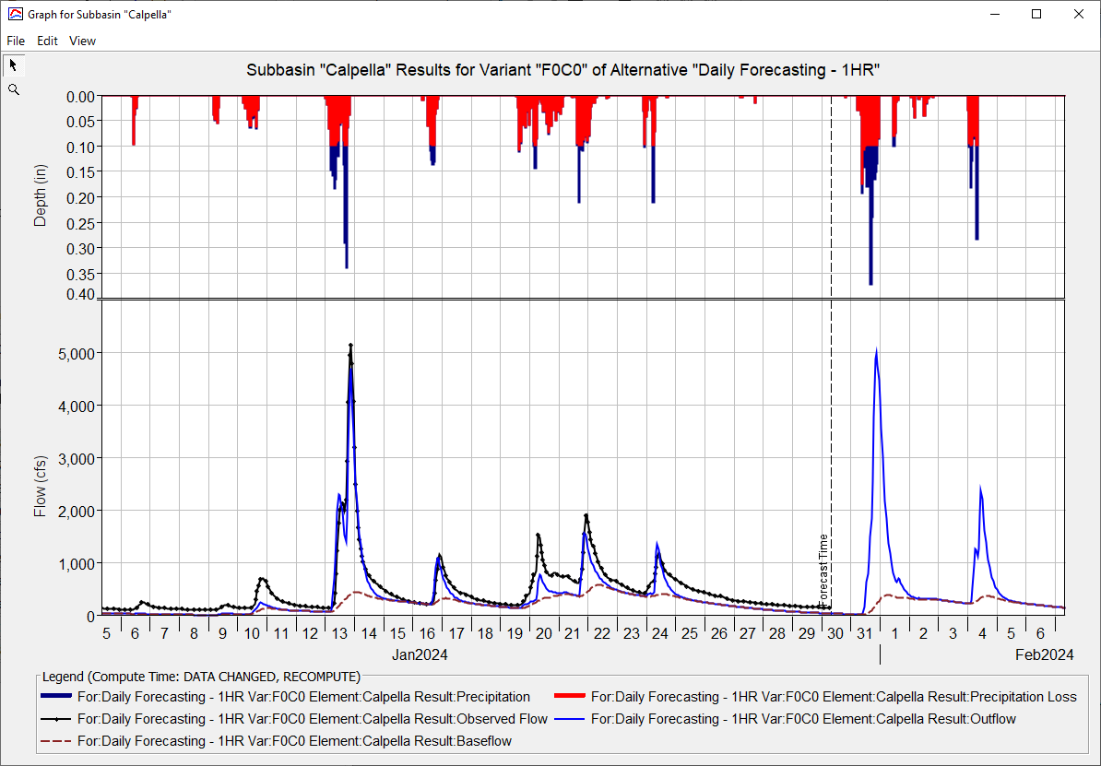
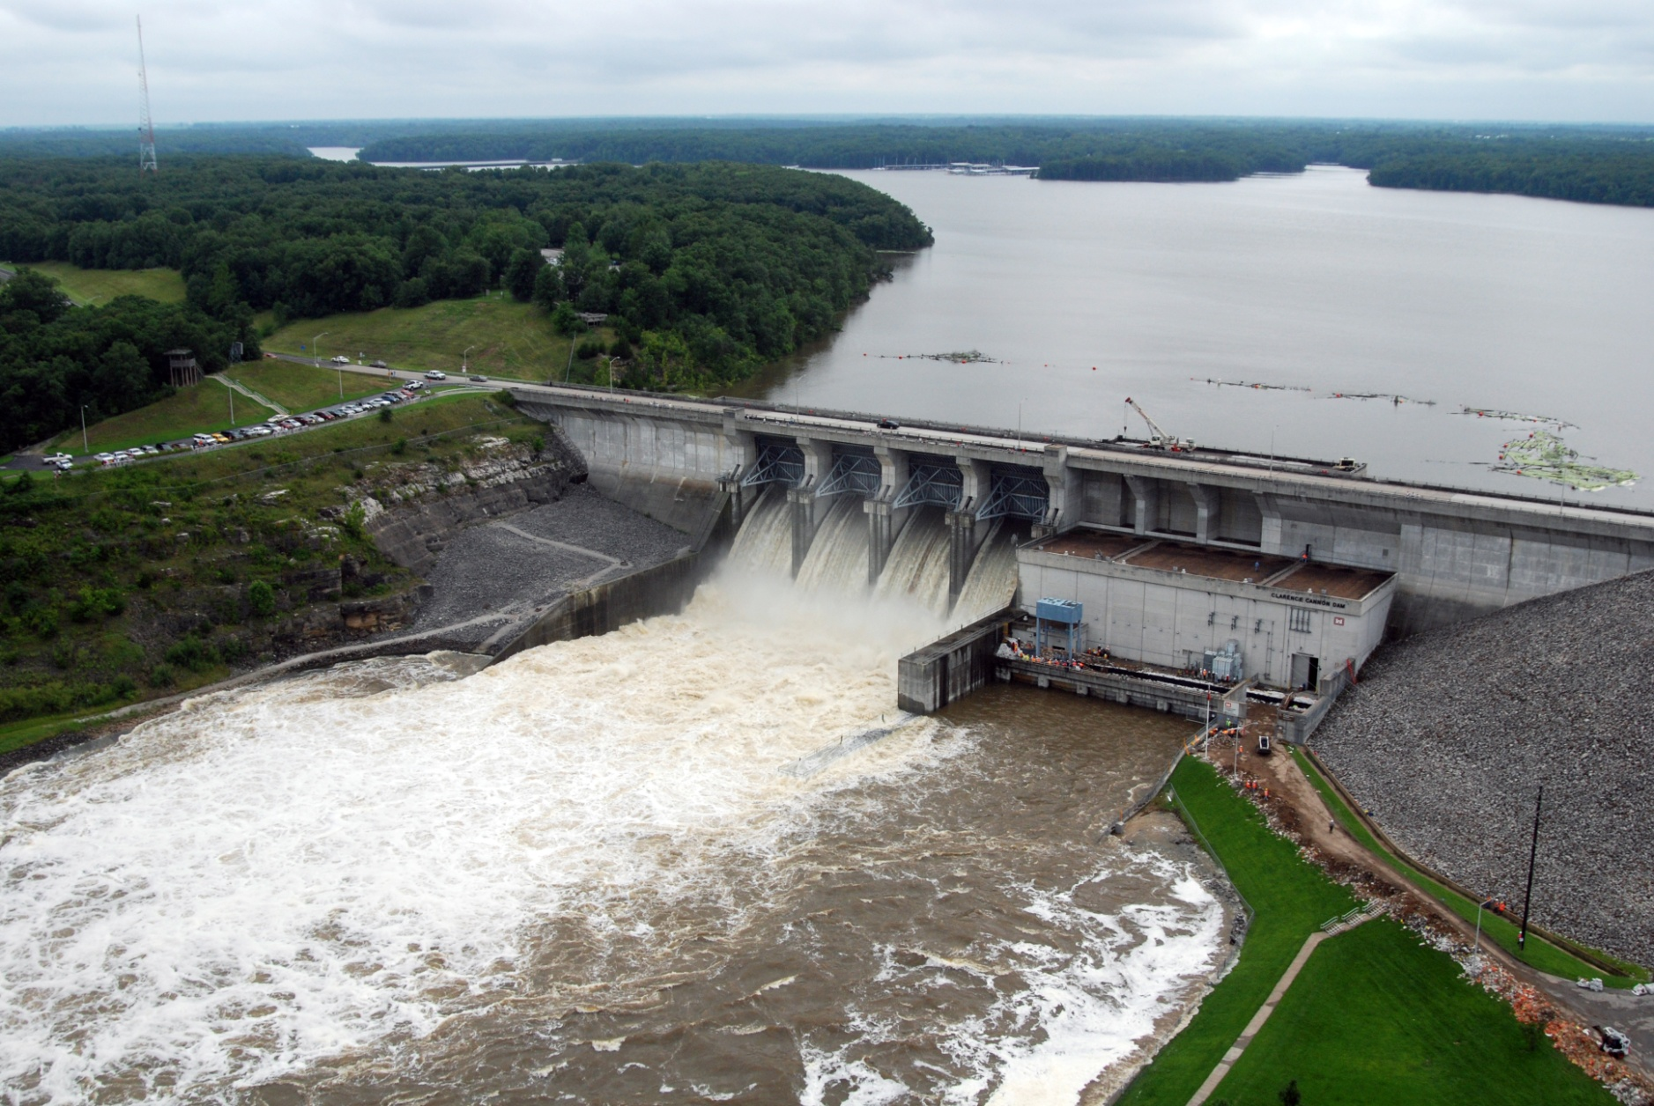
HEC-HMS Real-Time Hydrologic Modeling
Matt Fleming, P.E.
Hydrologic Engineering Center
CWMS Prospect Course

Slide 2
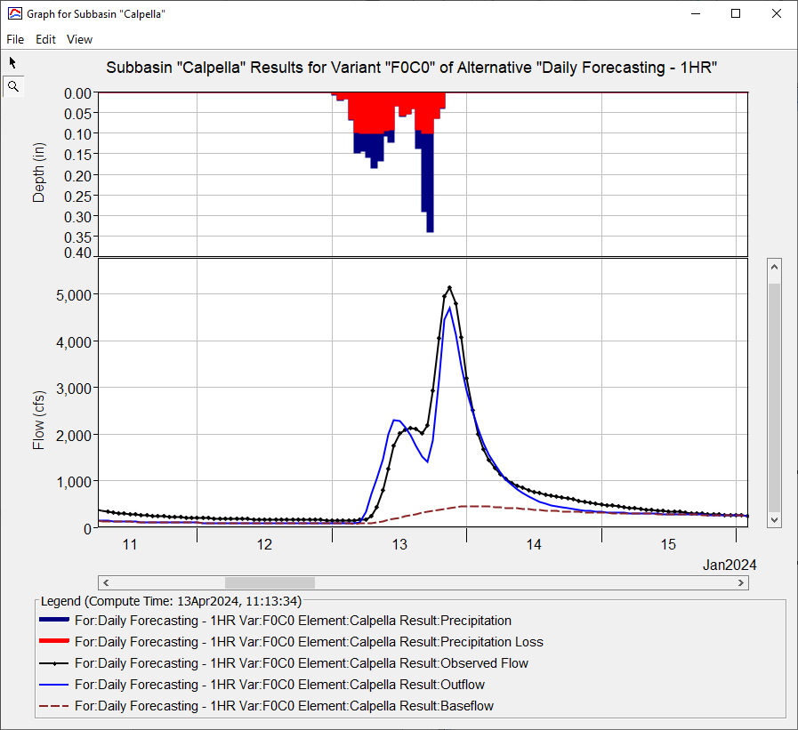
Objectives
  Learn about HEC-HMS modeling options that should be used in real-time forecasting
  Identify key parameters for hydrologic forecast simulation

Slide 3
Overview
  HEC-HMS Modeling Options
    Meteorologic Model
      Precipitation, Temperature, and ET
    Basin Model
      Discretization, Snow, Loss, Transform, Baseflow, Reach Routing, and Reservoir
  Key Parameters for Real-Time Forecasting

Slide 4





HEC-HMS in sequence
Meteorological Processor (HEC-MetVue)
  Process meteorological data
  Provide input to the hydrologic model
Hydrologic Model (HEC-HMS)
  Transform precipitation, forecast flows
  Provide input for the reservoir and hydraulics models
Reservoir Simulation Model (HEC-ResSim)
  Determine reservoir system release decisions
  Provide input for the hydraulics model
Hydraulic Model (HEC-RAS)
  Determine stage and flood inundation
  Provide flow input for the flood impact model
Flood Impact Analysis (HEC-FIA)
  Estimate the economic and life loss consequences
  Report where action is required during high stages

Slide 5
HEC-HMS Modeling Options – Meteorologic Model

Slide 6
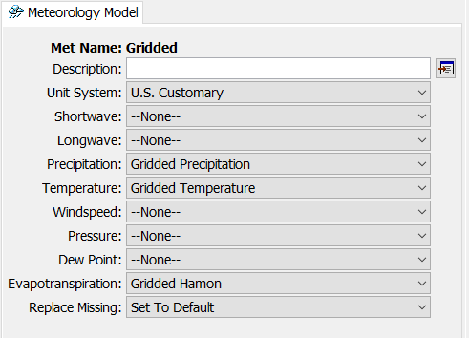
Meteorologic Model
Prepares boundary conditions for hydrologic processes in the basin model
  Precipitation – needed for snow and infiltration
  Temperature – needed for snow and potential ET
  Potential ET – needed for actual ET
Set missing inputs to “default” (e.g. zero)
  Temperature must be defined for all time steps

Slide 7
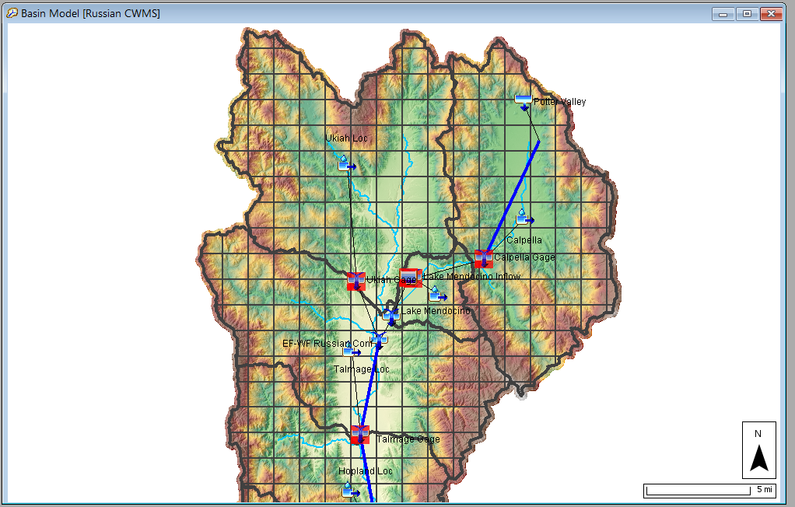
Which Meteorologic options should I use?
Precipitation (required)
  Gridded (question if needed)
  Interpolated (with bias grid)
  Specified Hyetograph (from MetVue)
Temperature (only required for snow and some ET methods)
  Gridded
  Interpolated (with elevation grid and lapse rate)
  Specified Gage
ET
  Monthly Average
  Gridded/Non-Gridded Hamon

Slide 8
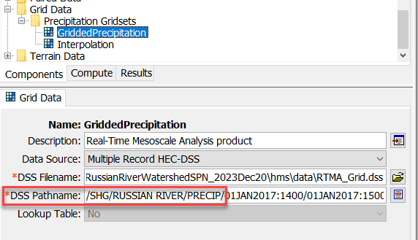
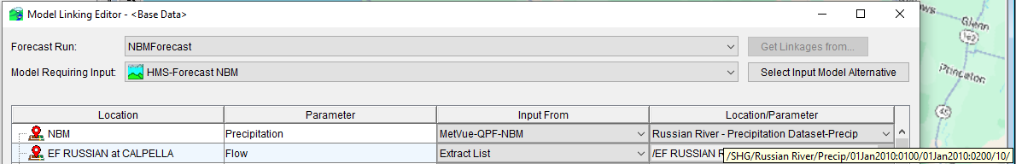
Grid Set Definition
Set Grid Source for Precipitation
  Why “Multiple Record HEC-DSS” for the Data Source?
  Use consistent pathname parts between MetVue and HMS
Make different grid sets for different precipitation sources
  Historic + Forecast 1
  Historic + Forecast 2
CAVI model linking replaces F-Part pathname using MetVue Key

Slide 9
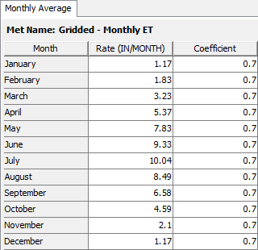
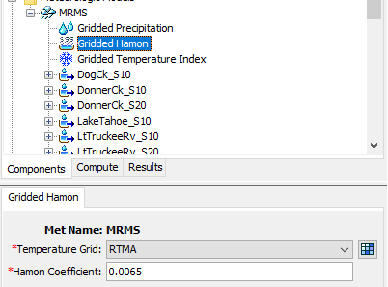
Evapotranspiration (ET)
Monthly ET
  Requires you to link meteorologic and basin models (there are pitfalls)
  Global parameter table for quick parameter definition
  Not accurate for specific events, close enough and fast computation
Gridded Hamon
  Requires gridded temperature, cannot be missing
  Older software versions require temperature one day before and after simulation window

Slide 10
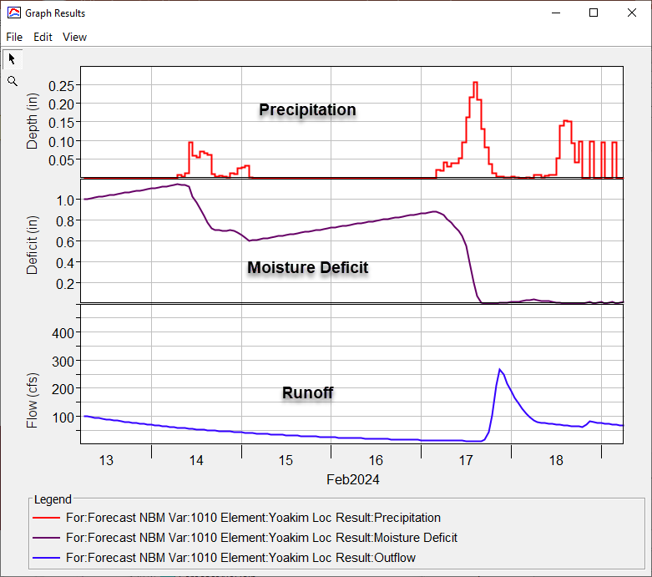
Evapotranspiration (ET)

Slide 11
HEC-HMS Modeling Options - Basin Model

Slide 12
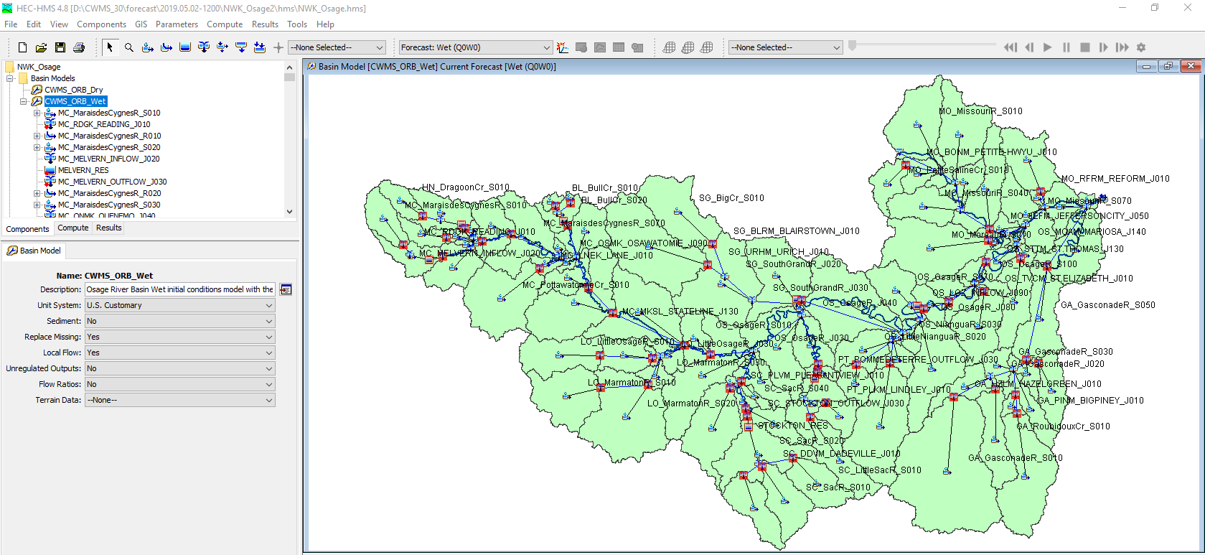
Example Basin Model

Slide 13
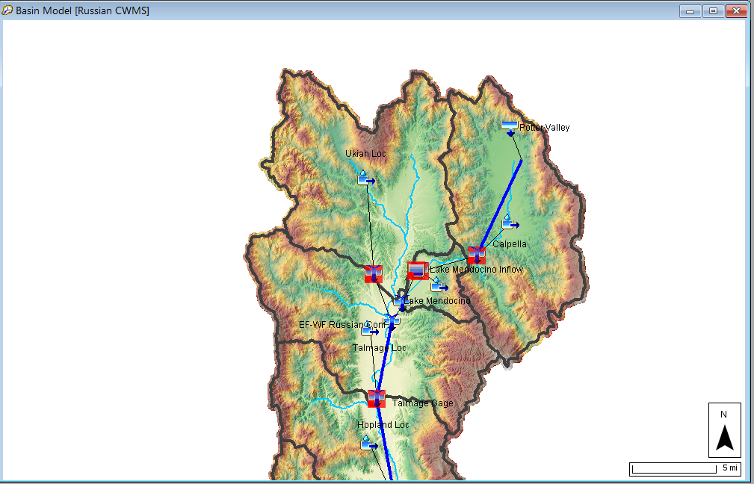
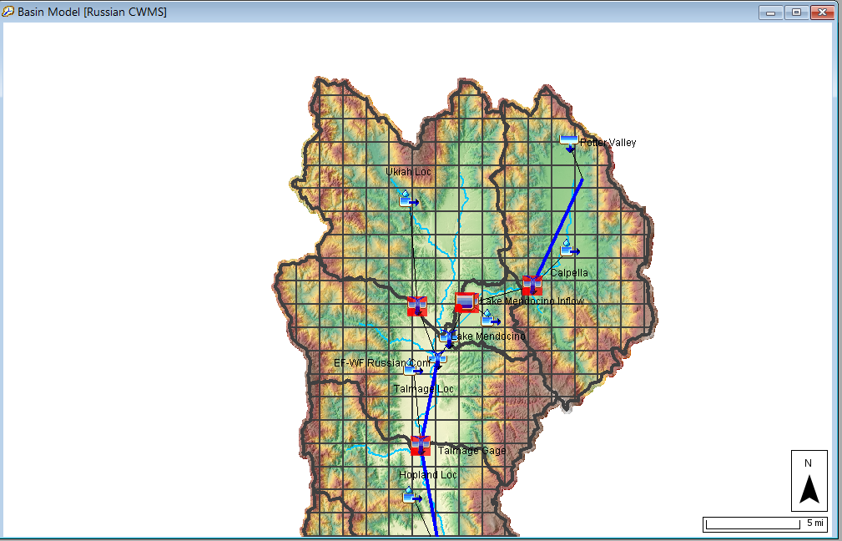
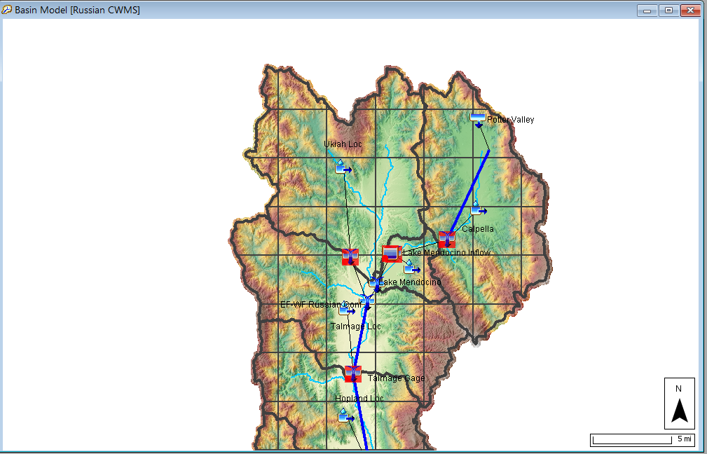
Discretization
Subbasin Average
2000 Meter Grid
5000 Meter Grid

Slide 14
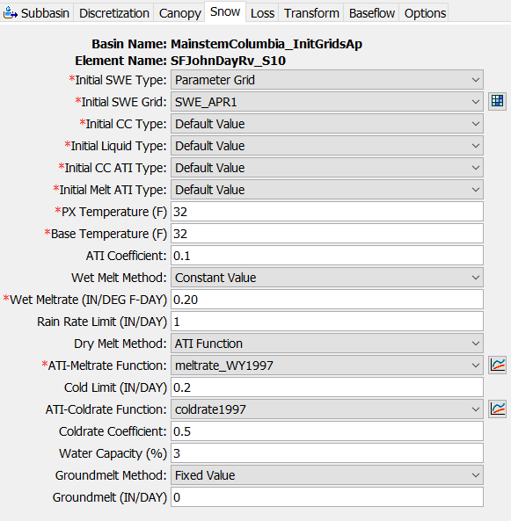
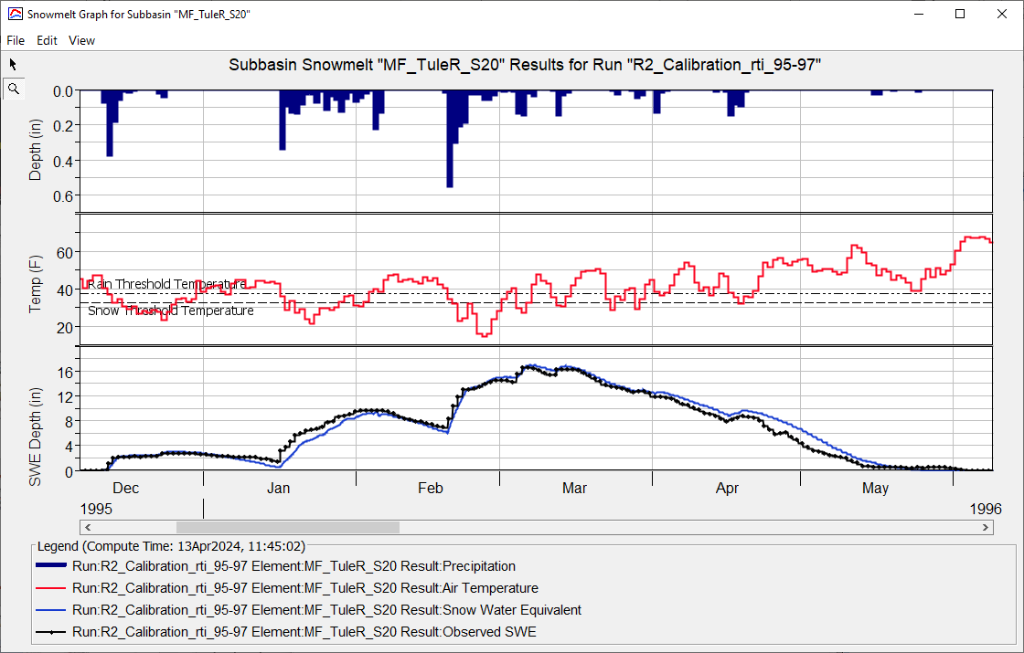
Snow
Initialize Snow States using grids or default values
Px Temp: 30 – 37 Deg F
Wet Meltrate: 0.05-0.25 in/F-day

Slide 15
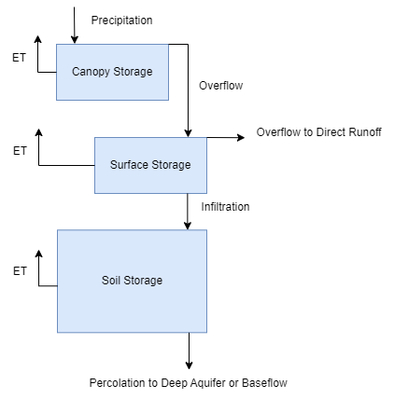
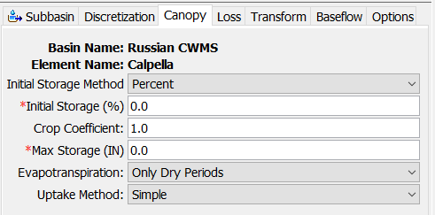
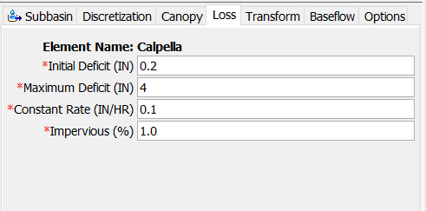
Subbasin Loss/Excess
Simple Canopy + Deficit and Constant
Canopy Storage
Soil Moisture Deficit

Slide 16
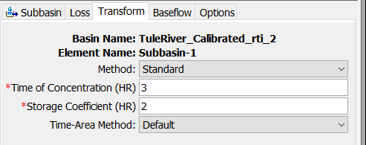
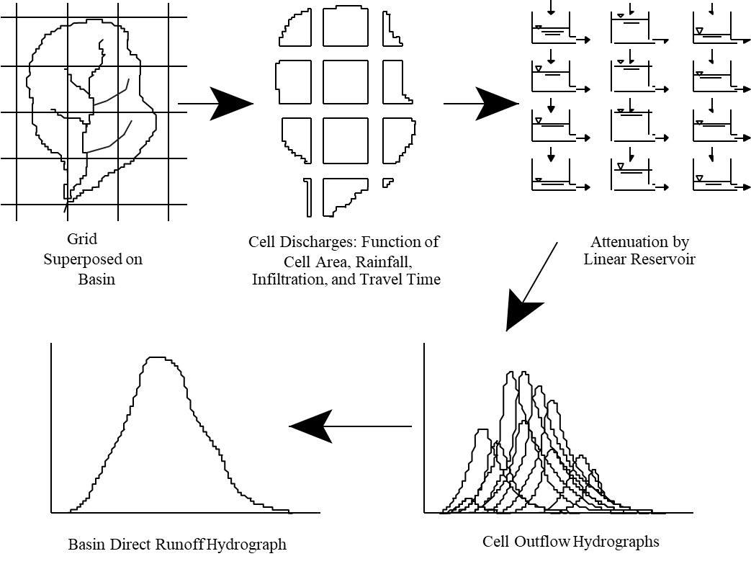
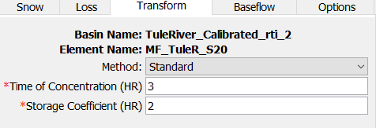
Subbasin Transform
Clark
ModClark and Clark
ModClark

Slide 17
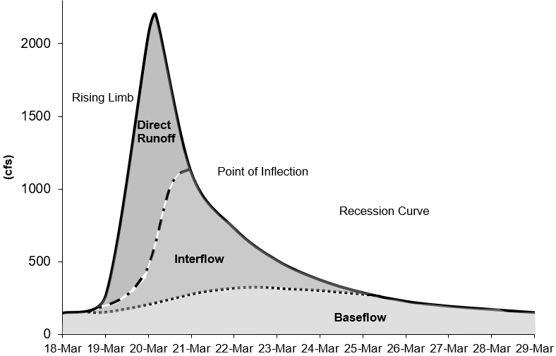
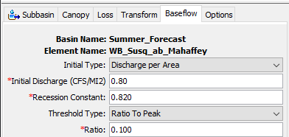
Subbasin Baseflow
Recession Baseflow

Slide 18
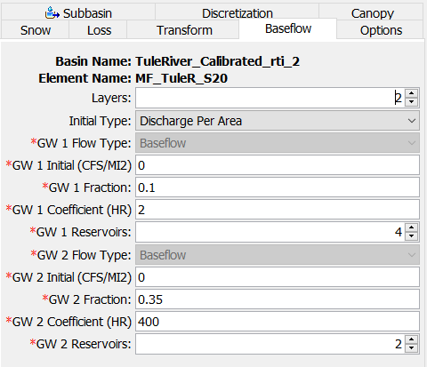
Subbasin Baseflow
Linear Reservoir Baseflow
Interflow - Linear Reservoir
Baseflow - Linear Reservoir

Slide 19
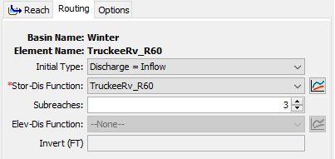
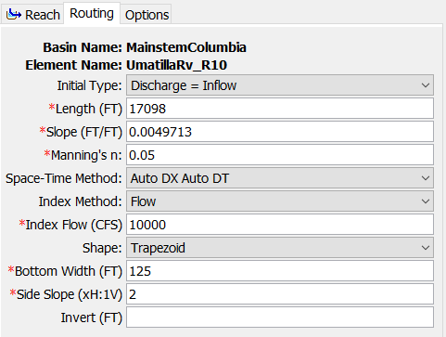
Reach Routing Methods
Routing methods:
  Variable Lag and K
    Relationship between Flow, Lag, and Attenuation
  Modified Puls
    Storage-Discharge relationship developed using steady flow HEC-RAS models
  Muskingum
    Static relationship between Lag and Attenuation
  Muskingum-Cunge
    Most computation burdensome method

Slide 20
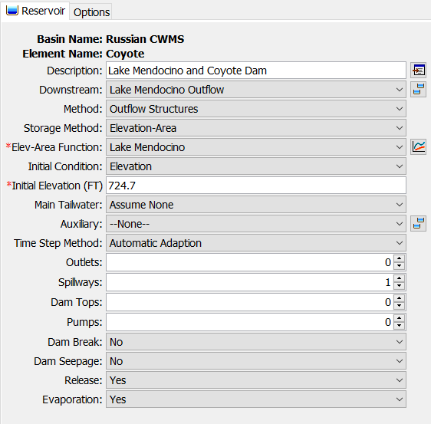
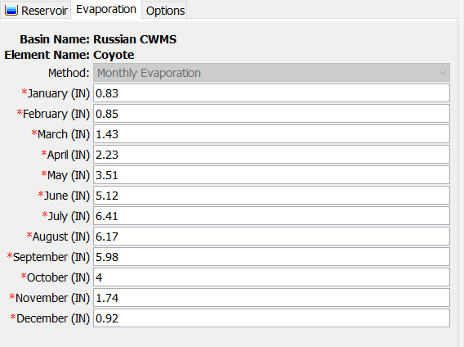
Reservoirs
Four reservoir routing methods - Outflow Curve, Outflow Structures, Rule-Based Operations, and Specified Release

Slide 21
Key Parameters For Real Time Forecasting
Notes:
Observed Flows
Calibration
Computation Points

Slide 22
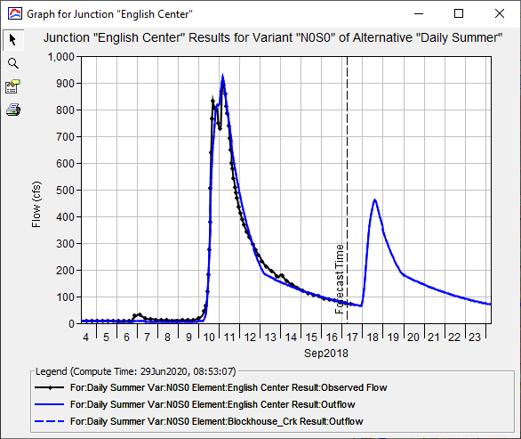
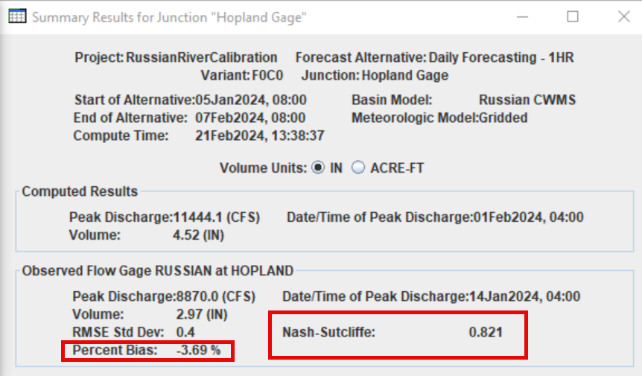
Observed Flows in HEC-HMS
Observed Flow
Computed Flow

Slide 23
Which Model Parameters Should I adjust?
Every Forecast
Occasionally
Initial Conditions
  Initial SWE / Cold Content
  Initial Moisture Deficit
  Initial Baseflow
  Initial Reservoir Elevation/Storage
Process Parameters
  PX Temperature
  Wet Meltrate
  Constant Loss Rate
  Recession Baseflow – ratio to peak
  Recession Baseflow – recession constant
  Linear Reservoir Baseflow – GW 1 Fraction (seasonally consistent)
  Linear Reservoir Baseflow – GW 2 Fraction (seasonally consistent)
Process Parameters
  Dry Meltrate Function (long term simulation)
  ModClark/Clark TC and R
  Reach Routing
    Mod Puls number of subreaches
    Muskingum K and X
    Muskingum Cunge n and energy slope
  Canopy Crop Coefficient
  ET Coefficient or Monthly Adjustment Factor

Slide 24
Questions
Help additional Training
https://usace.dps.mil/sites/KMP-WM/SitePages/Corps-Water-Management-System-(CWMS).aspx
https://www.hec.usace.army.mil/confluence/cwmsdocs
https://discourse.hecdev.net/c/cwms/5
TDL-CELRH-EC-GW-W-USACE CWMS Modeling | General | Microsoft Teams
“Just keep CWMS’ing”

