Slide 1
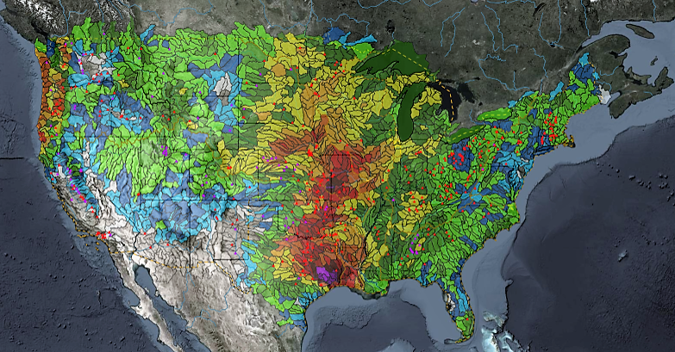
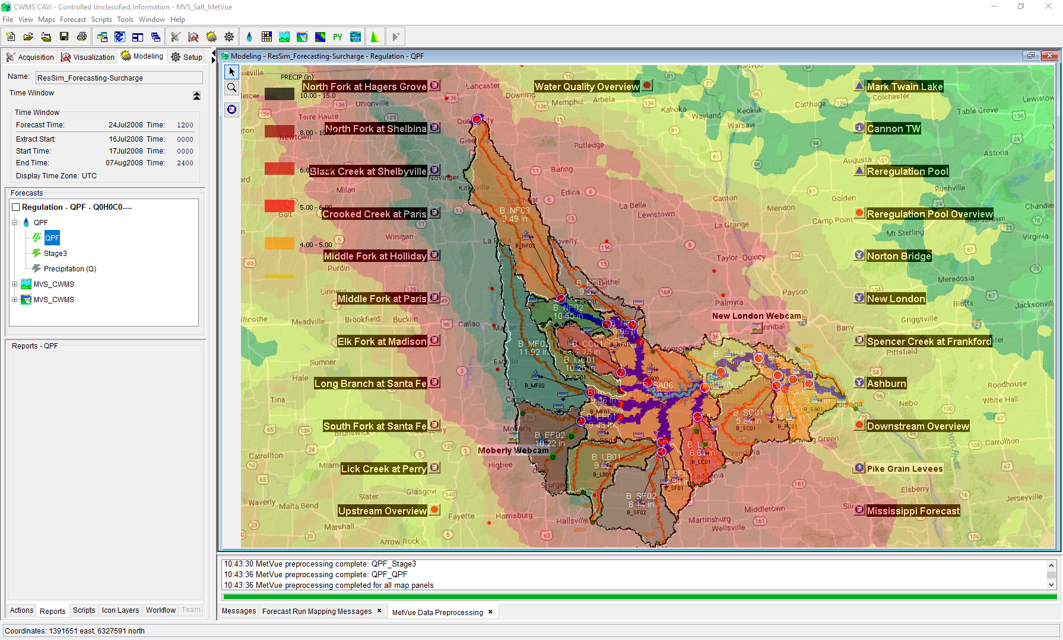

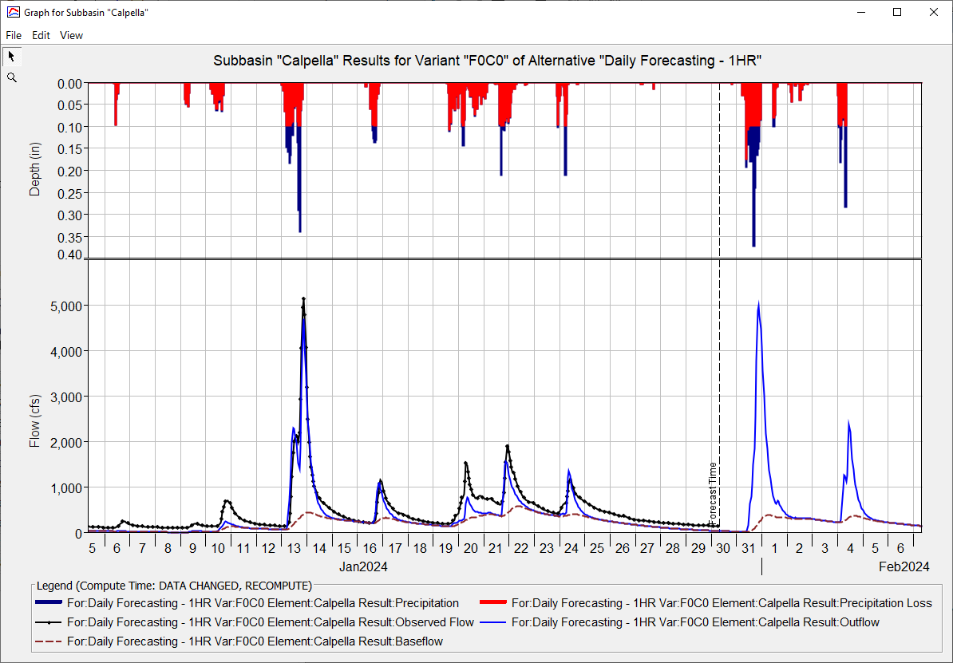
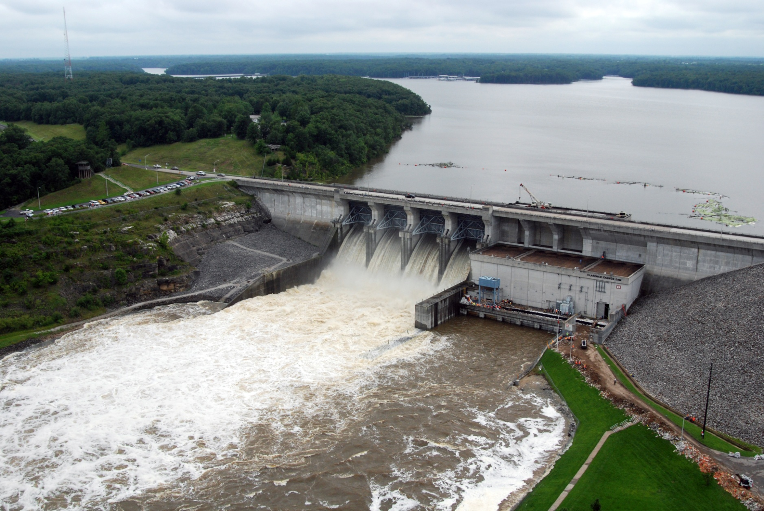
HEC-RAS for CWMS
Andy Richter, P.E., PMP
Hydrologic Engineering Center
CWMS Prospect Course

Slide 2
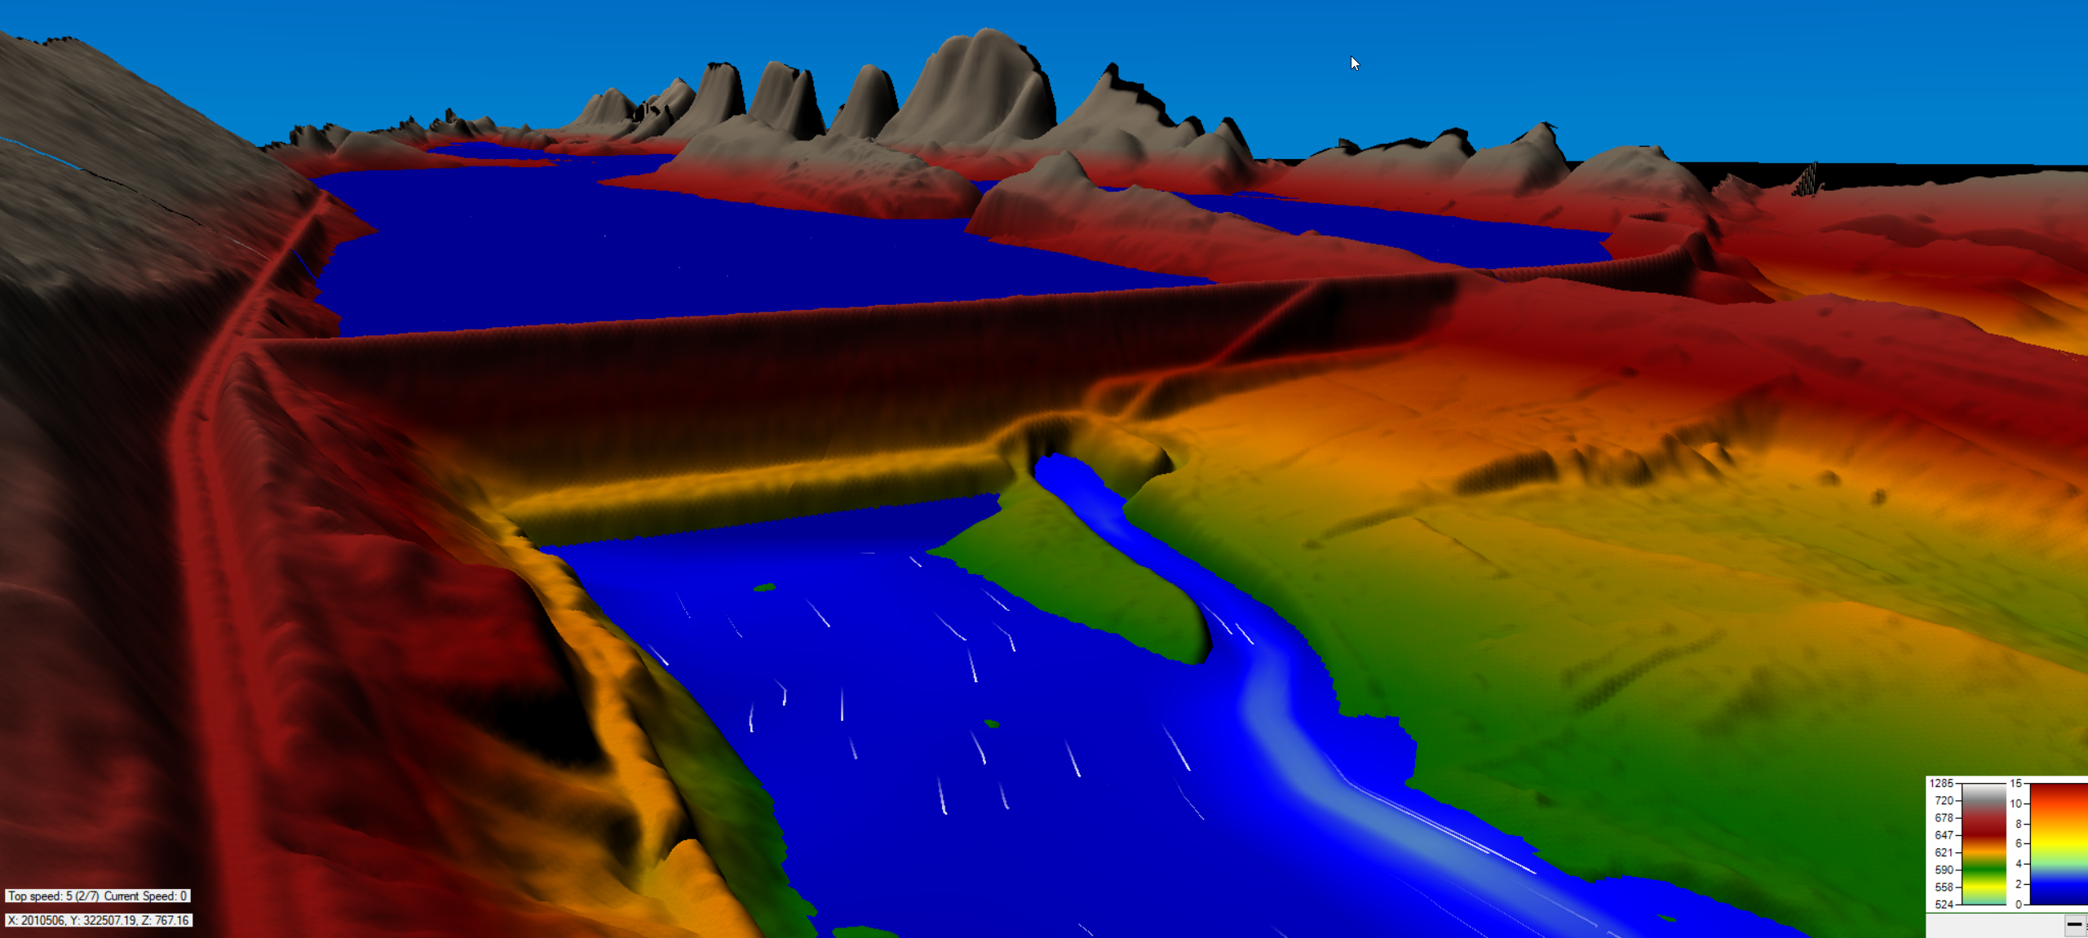
Objective
Identify basic concepts of using HEC-RAS in CWMS

Slide 3
Outline
Purpose of Hydraulic Modeling in CWMS
HEC-RAS Capabilities Overview
HEC-RAS Program Essentials
HEC-RAS Model Development for Real-Time Forecasting
HEC-RAS CAVI Integration
Real-Time Forecasting using HEC-RAS

Slide 4





HEC-RAS in sequence
Meteorological Processor (HEC-MetVue)
Process meteorological data
Provide input to the hydrologic model
Hydrologic Model (HEC-HMS)
Transform precip, forecast flows
Provide input for the reservoir and hydraulics models
Reservoir Simulation Model (HEC-ResSim)
Determine reservoir system release decisions
Provide input for the hydraulics model
Hydraulic Model (HEC-RAS)
Determine stage and flood inundation
Provide flow input for the flood impact model
Flood Impact Analysis (HEC-FIA)
Estimate the economic and life loss consequences
Report where action is required during high stages

Slide 5
Purpose of Hydraulic modeling in CWMS

Slide 6
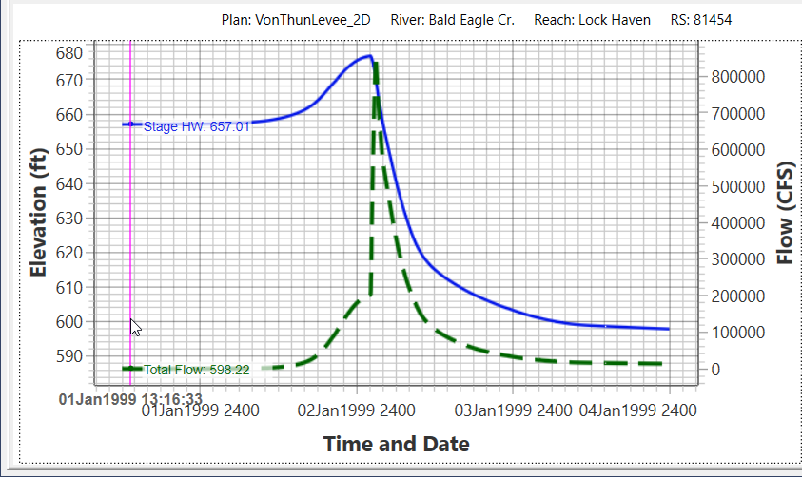
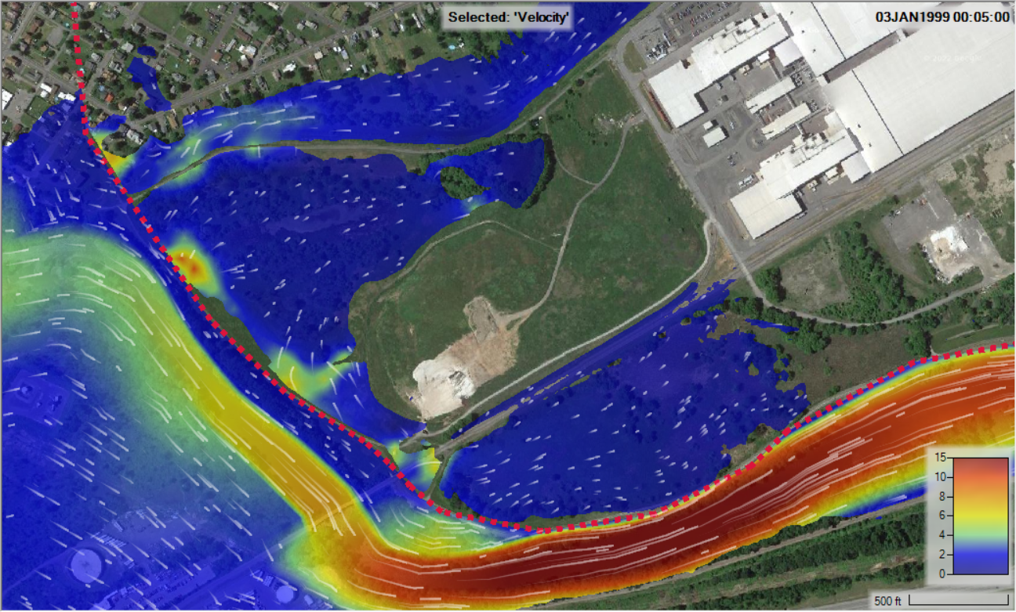
Purpose of hydraulic modeling in CWMS
Predict critical and peak water surface elevations
Predict timing, depth, and extent of potential inundation

Slide 7
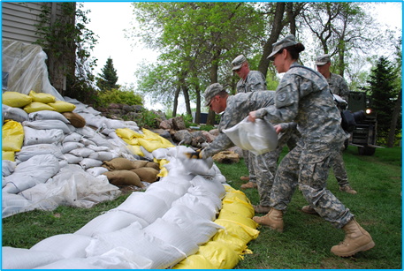
Hydraulic Model Results
HEC-RAS results inform:
Emergency management decisions
Flood operations preparedness
Post-flood impact analyses
When will the levee overtop?
Where are sandbags needed?
Will the road flood?
What areas need to evacuate, and when?
What were the consequences?

Slide 8
HEC-RAS Capabilities overview

Slide 9
HEC-RAS capabilities
1D Steady Flow Hydraulics
Depth, velocity, and discharge treated as constant with respect to time
Specify flowrates at all locations, compute stage
Relies on hydrologic routing
1D Unsteady Flow Hydraulics
Depth, velocity, and discharge change with respect to time
Solves for flow and stage
Computes hydraulic routing
2D Unsteady Flow Hydraulics
Flow can vary in X and Y direction
More detailed accounting of forces
https://www.hec.usace.army.mil/confluence/rasdocs

Slide 10
HEC-RAS Program Essentials

Slide 11
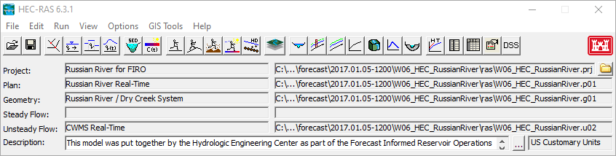





Components of an hec-RAS model
Project: *.prj
Plan: *.p##
Geometry: *.g##
US Flow : *.u##

Slide 12
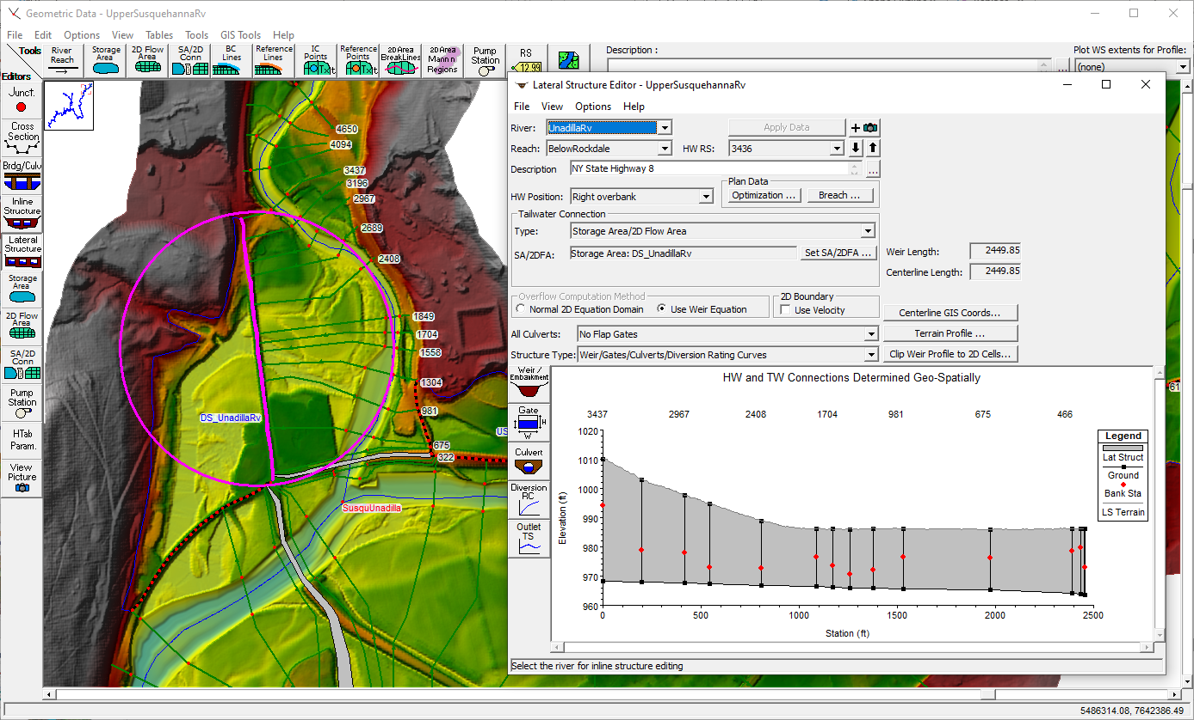
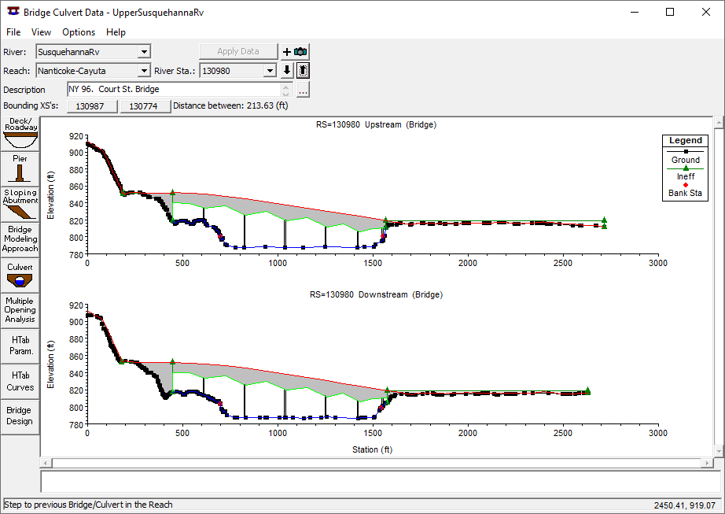
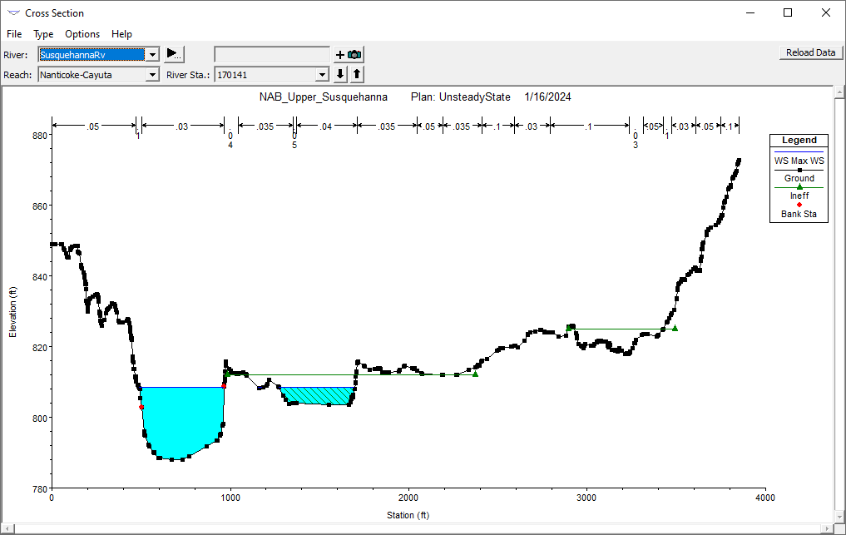
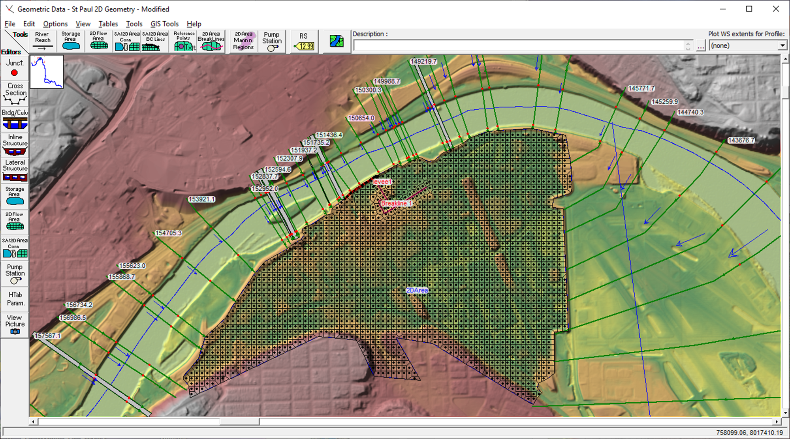
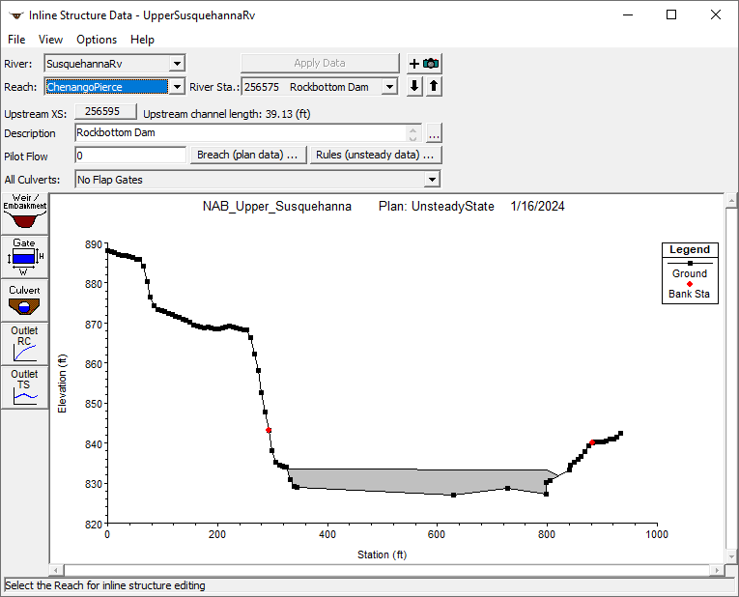
Geometry data
Cross Sections
Bridges and Culverts
Inline Structures (dams, weirs, spillways, etc.)
Lateral Structures (levees, storage area connections, etc.)
1D Storage Areas and 2D Flow Areas

Slide 13
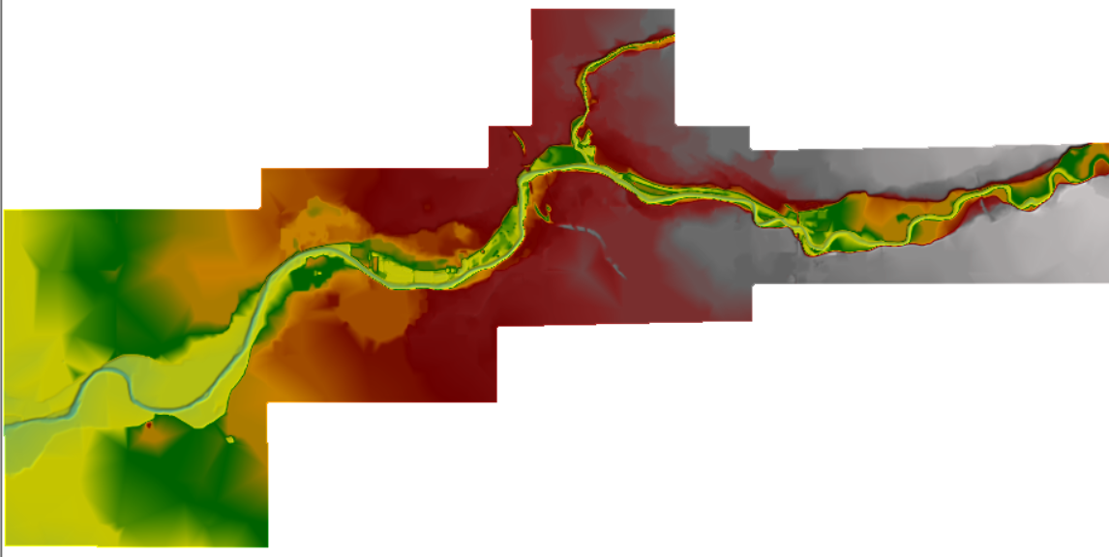
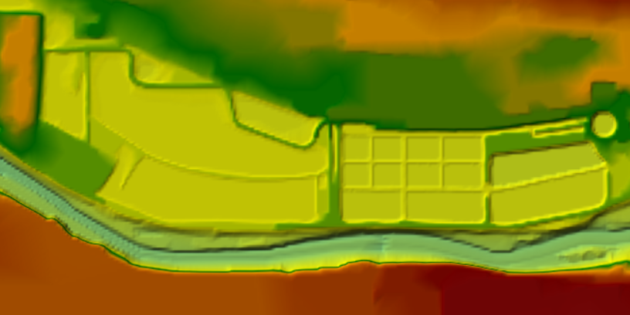
Terrain Data
Used to develop geometry data
station/elevation data for cross sections, lateral structures, bridges, etc.
elevation/storage curves for 1D storage areas
computational mesh for 2D flow areas

Slide 14
Boundary conditions
HEC-RAS needs boundary conditions (stored in the flow files)
HEC-HMS flows
HEC-ResSim outflows
Observed/Forecasted data (tidal gages, NOAA/NWS, etc.)
Output from other CWMS HEC-RAS models
Rating Curves
Normal Depth

Slide 15
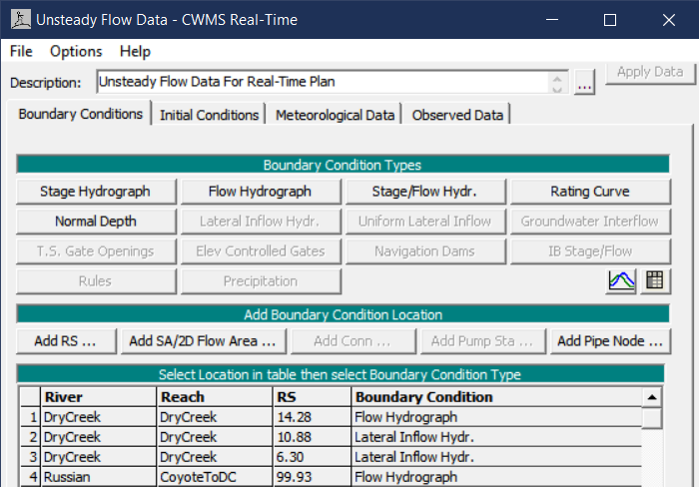
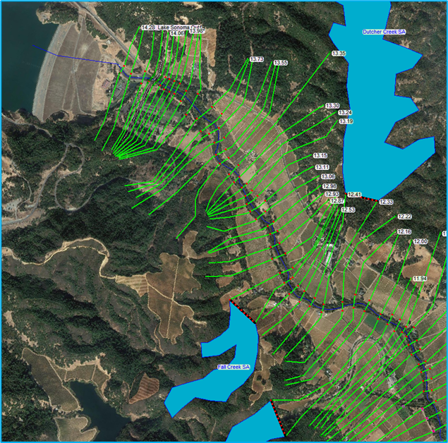
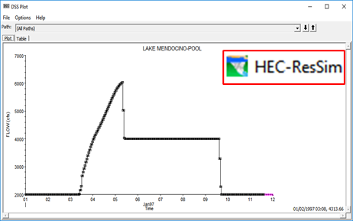
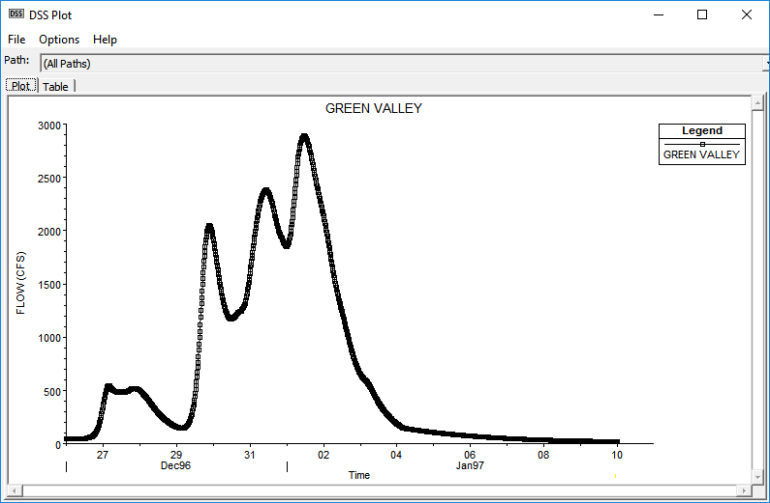
Inflow hydrographs

Slide 16
Plan file
The Plan File controls the simulation
Combines a Geometry File with a Flow File
Sets the Time Window
Defines the Computation Options and Output Options
Becomes the HEC-RAS Model Alternative when imported into the CAVI

Slide 17
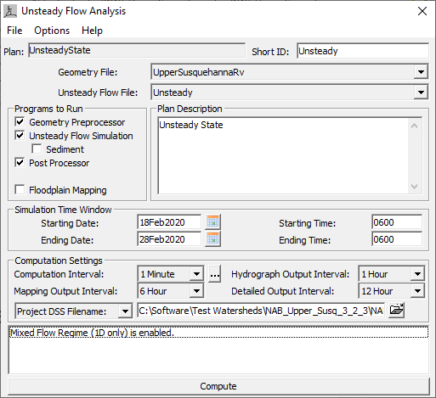
Plan File

Slide 18
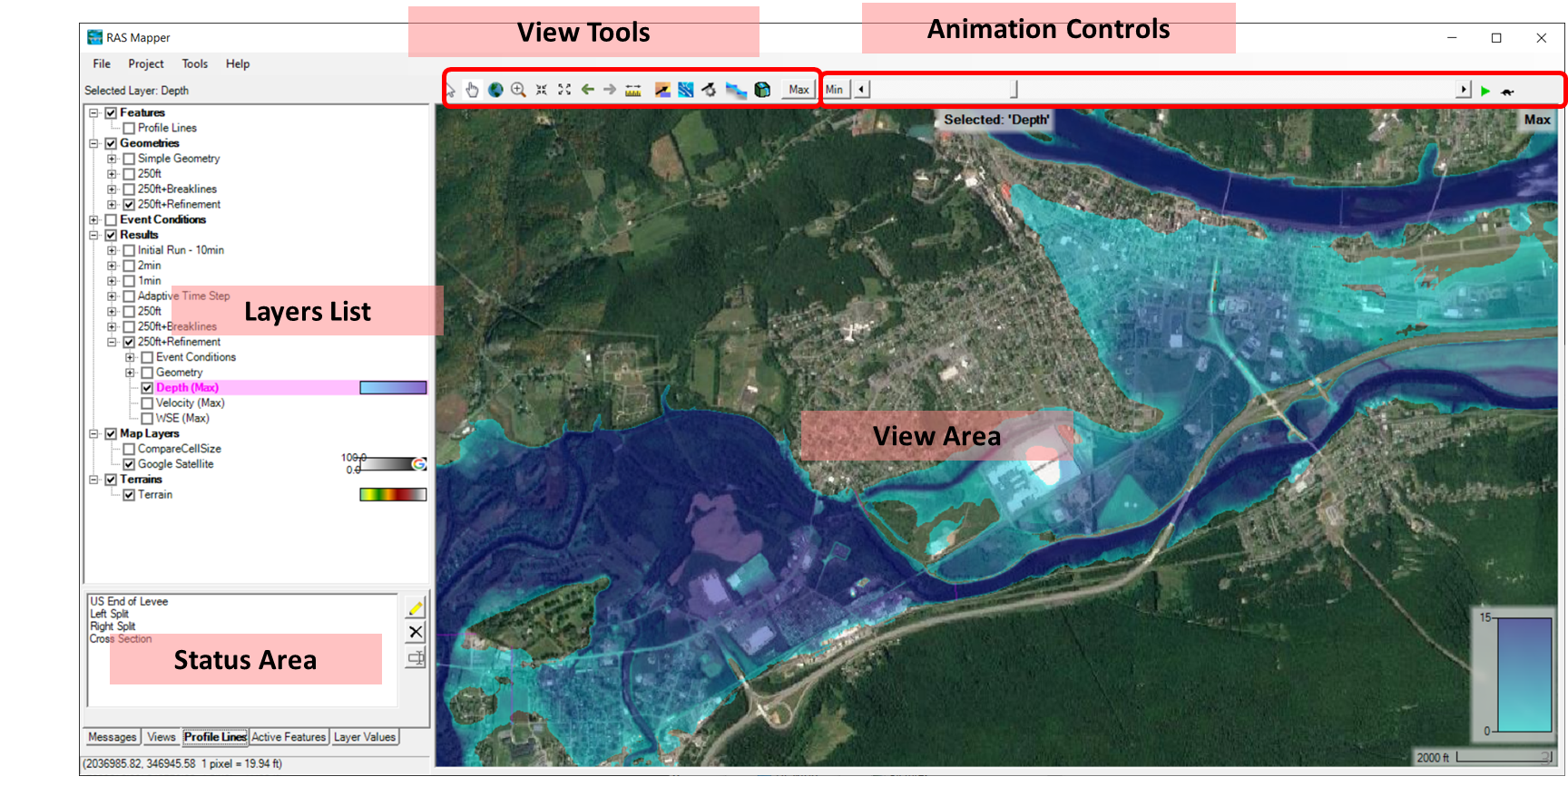
HEC-RAS Mapper

Slide 19
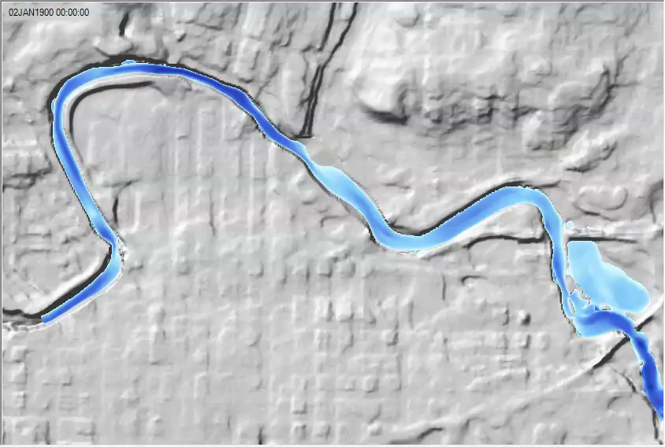
Dynamic Maps - animations

Slide 20
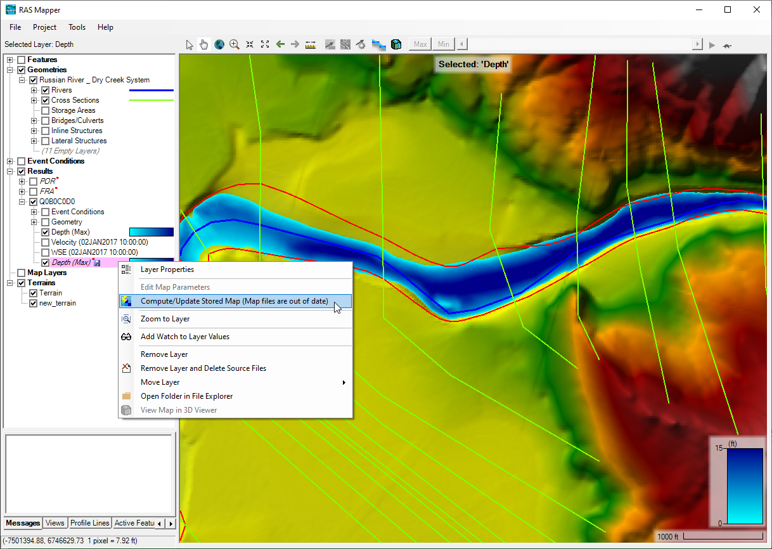
Stored maps
Export results to GeoTiff raster file on disc
Allows HEC-RAS to pass results to other applications
GIS for inundation maps
HEC-FIA for consequences or flood damages reduced

Slide 21
Model development for real-time forecasting

Slide 22
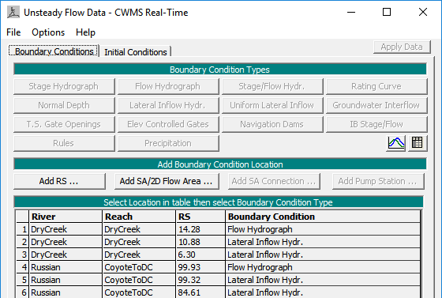
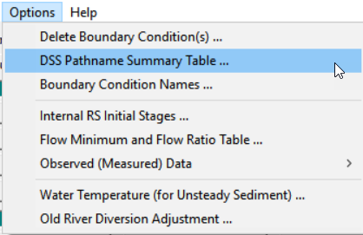
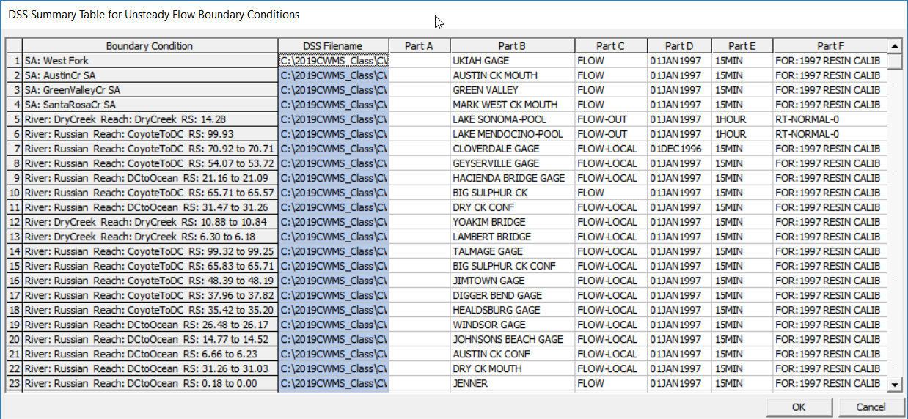
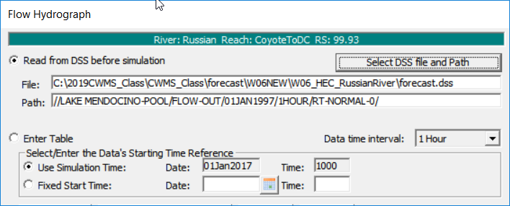
Boundary conditions within HEC-RAS

Slide 23
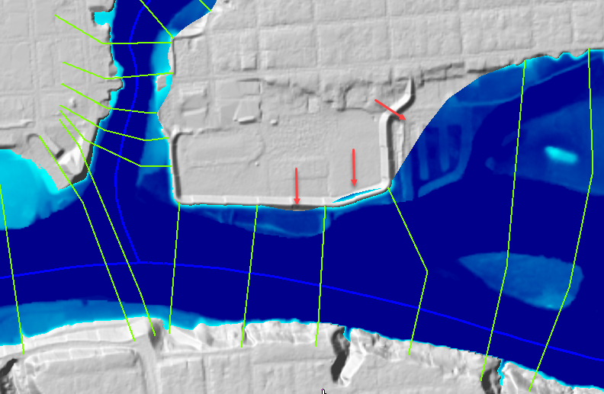
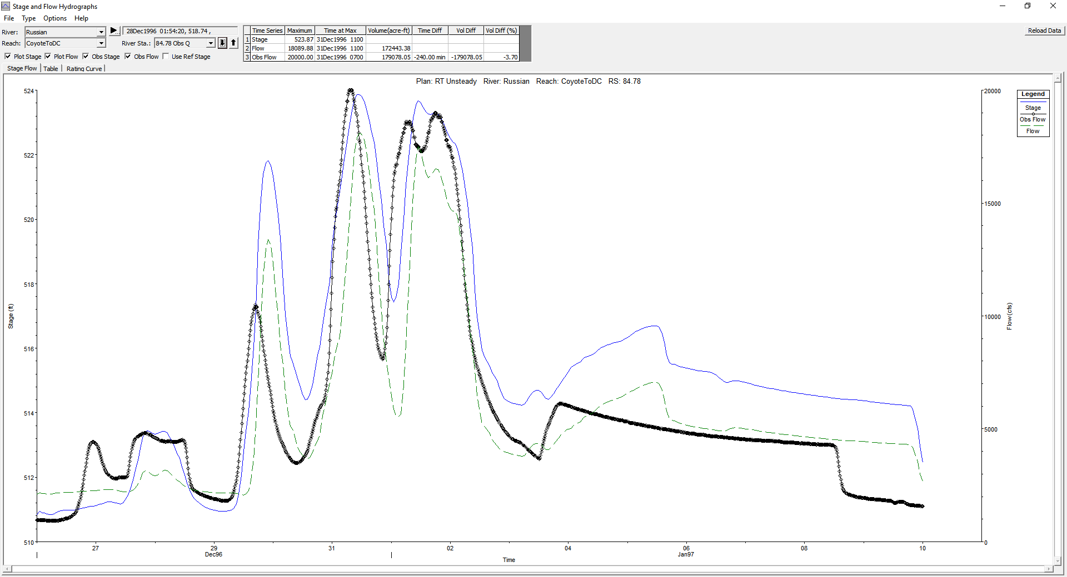
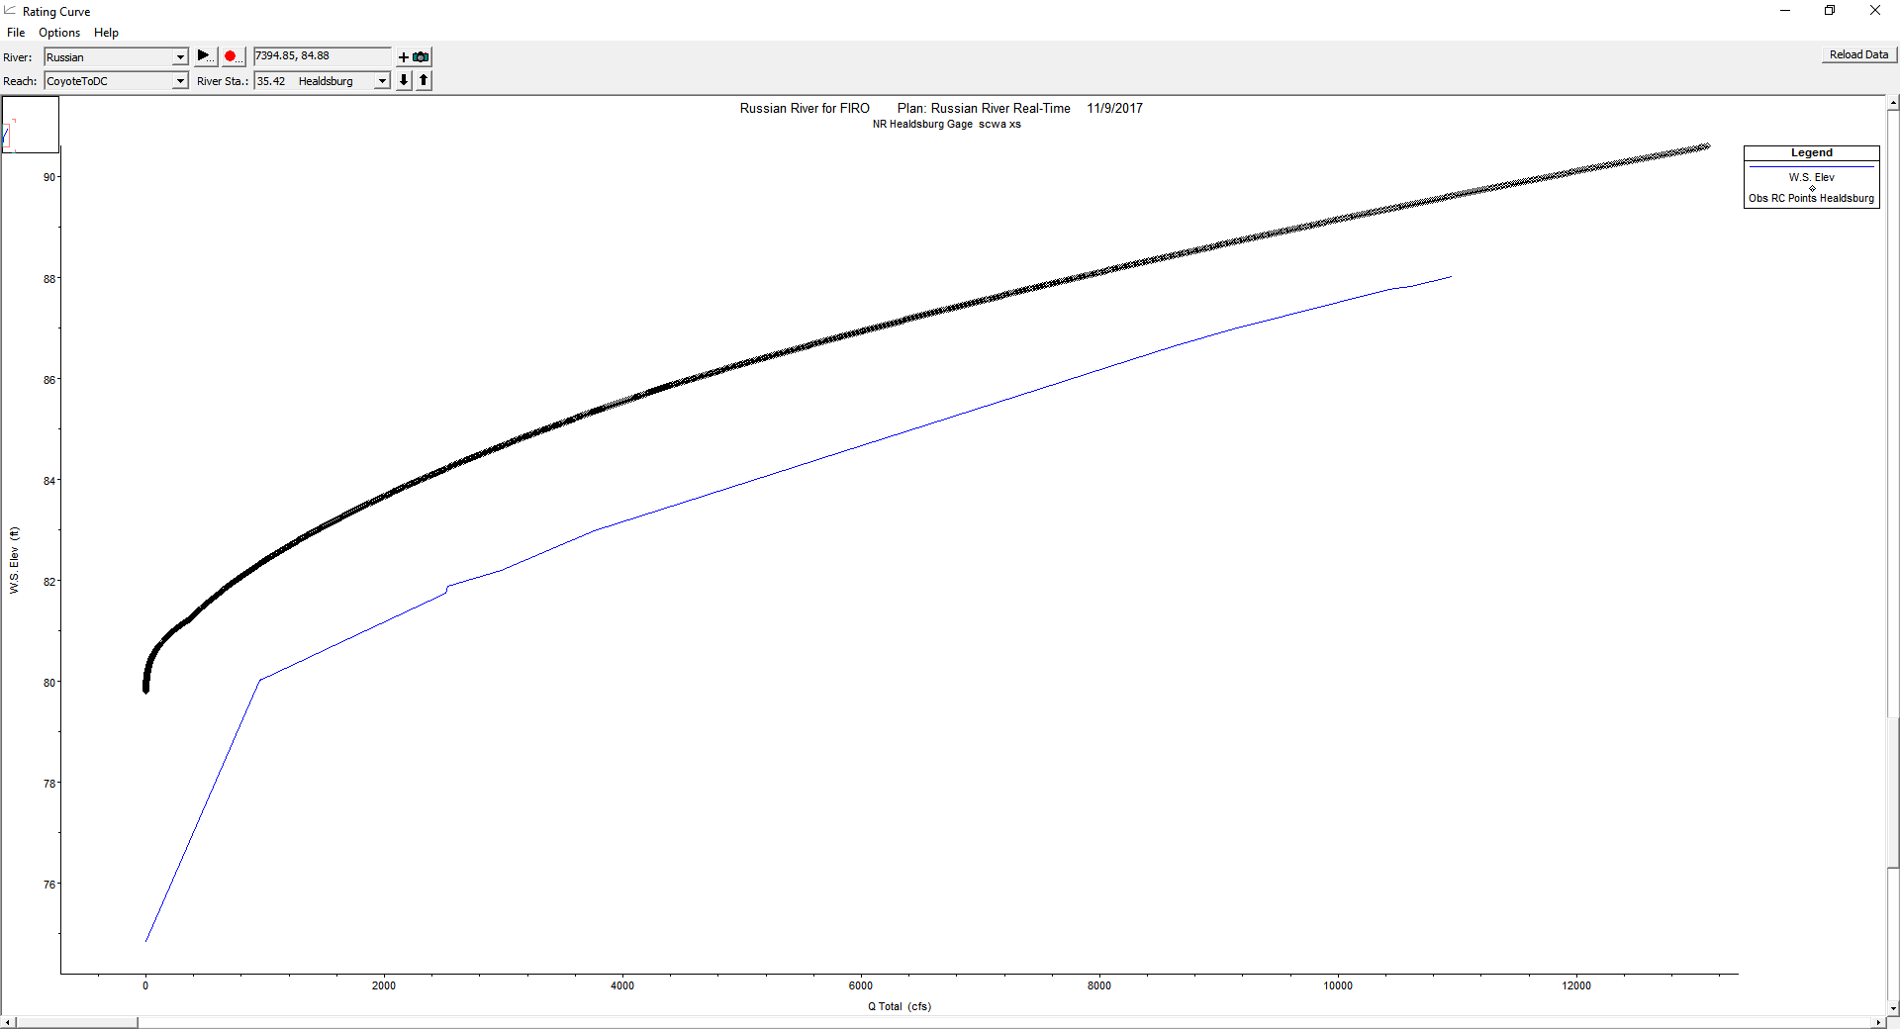
Model Calibration
Calibrate model to historic events
Observed Stages/Flows
Rating Curves
Adjusting model parameters (Manning’s “n” values, ineffective flow areas, etc.)
Use HEC-RAS Mapper
Compare model output to aerial photography
Look for problems with inundated areas (abrupt cutoffs, missing areas, etc.)

Slide 24
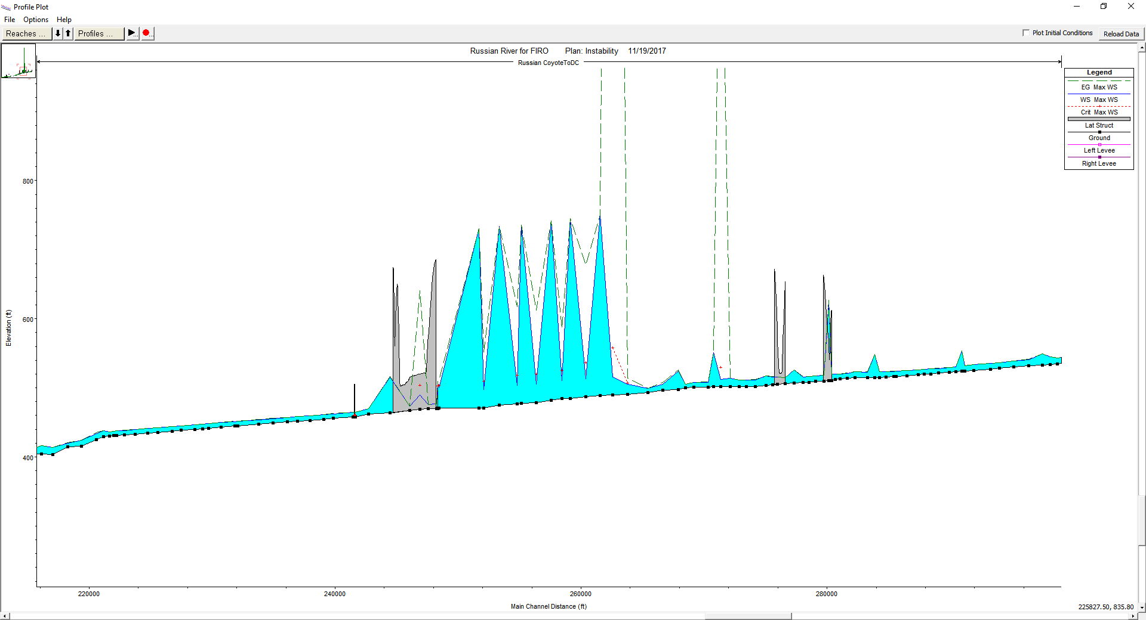
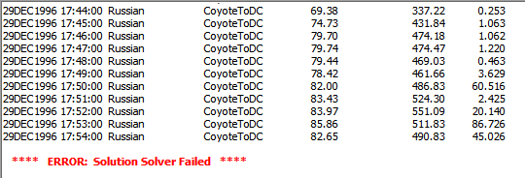
Stress testing
Why stress test our models?
Ensure model stability at a variety of conditions
High Flows
Low Flows
Levee Breaches

Slide 25
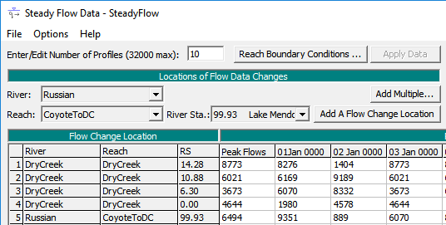
Steady Flow Plan
Create a steady flow plan that can be used as a backup to the unsteady flow plan*
Consider steady flow limitations
not applicable when model has 2D elements

Slide 26
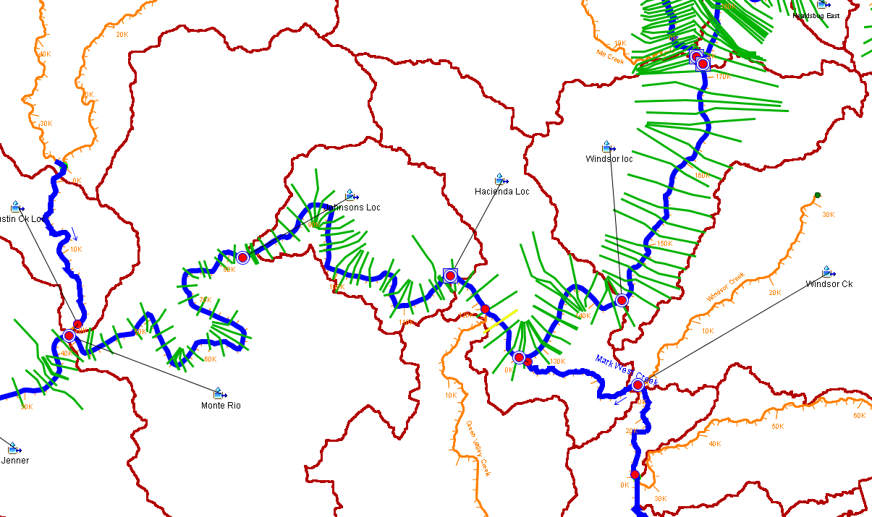
Linking boundary Conditions in CAVI
Location/Parameter

Slide 27
HEC-RAS CAVI Integration

Slide 28
CAVI integration steps
Import HEC-RAS Project
Configure HEC-RAS Mapper
Copy additional data (terrain and local HEC-DSS data)
Create saved depth grid map
Run standalone simulation from base model (Setup Tab)
Verify Model Linking in CAVI

Slide 29
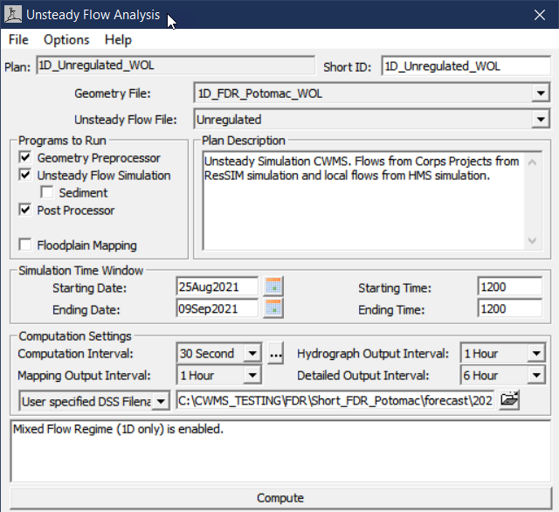
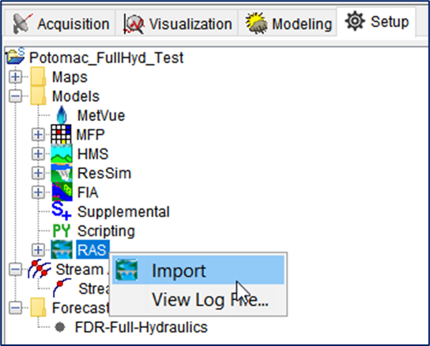
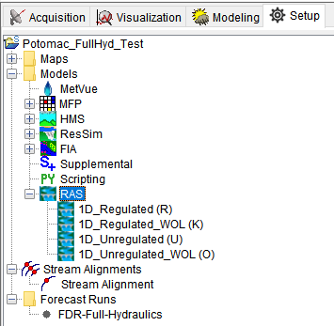
Import HEC-RAS model
Only ONE HEC-RAS Project can be imported
HEC-RAS plans become CAVI alternatives

Slide 30
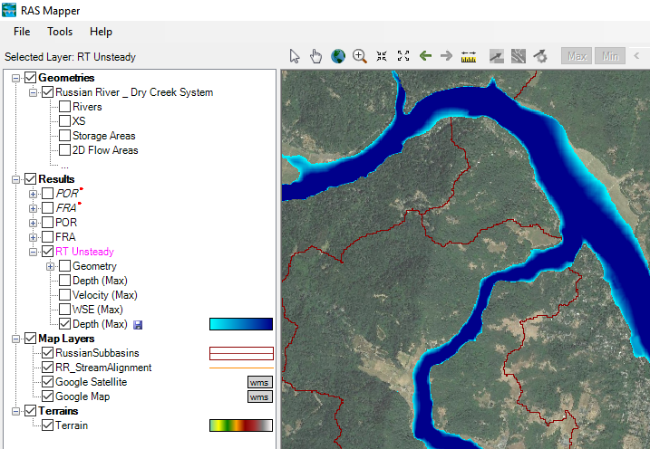
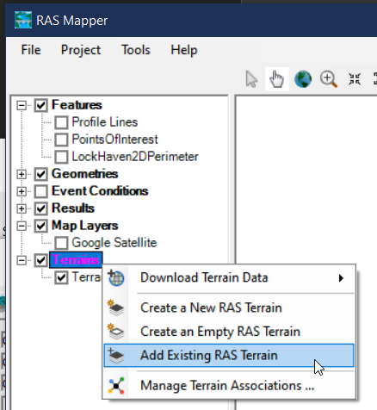
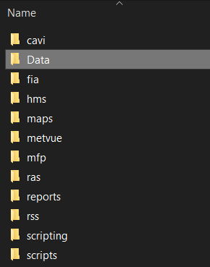
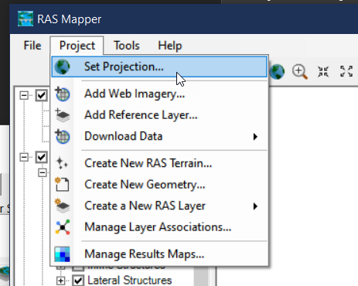
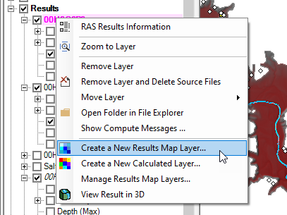
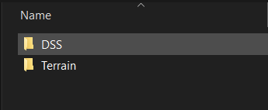
Configure HEC-RAS Mapper
HEC-RAS Mapper needs more data than the CAVI import provides
Terrain data
Projection file
Copy data into the watershed directory
Create Saved Map

Slide 31
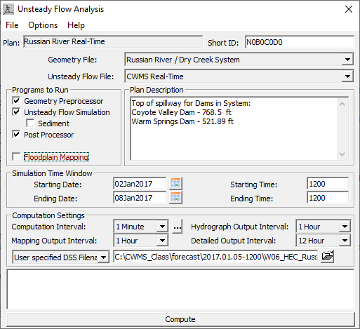
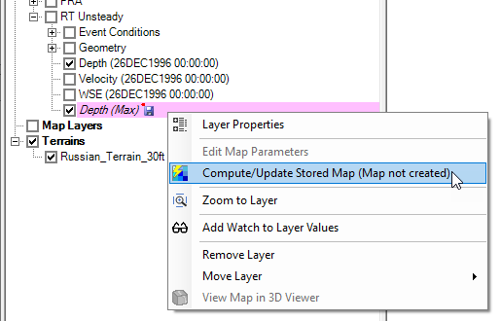
Run standalone HEC-RAS Simulation
Compute HEC-RAS model in Base Directory
Generate Saved Map
Essential for HEC-RAS to HEC-FIA model linking

Slide 32
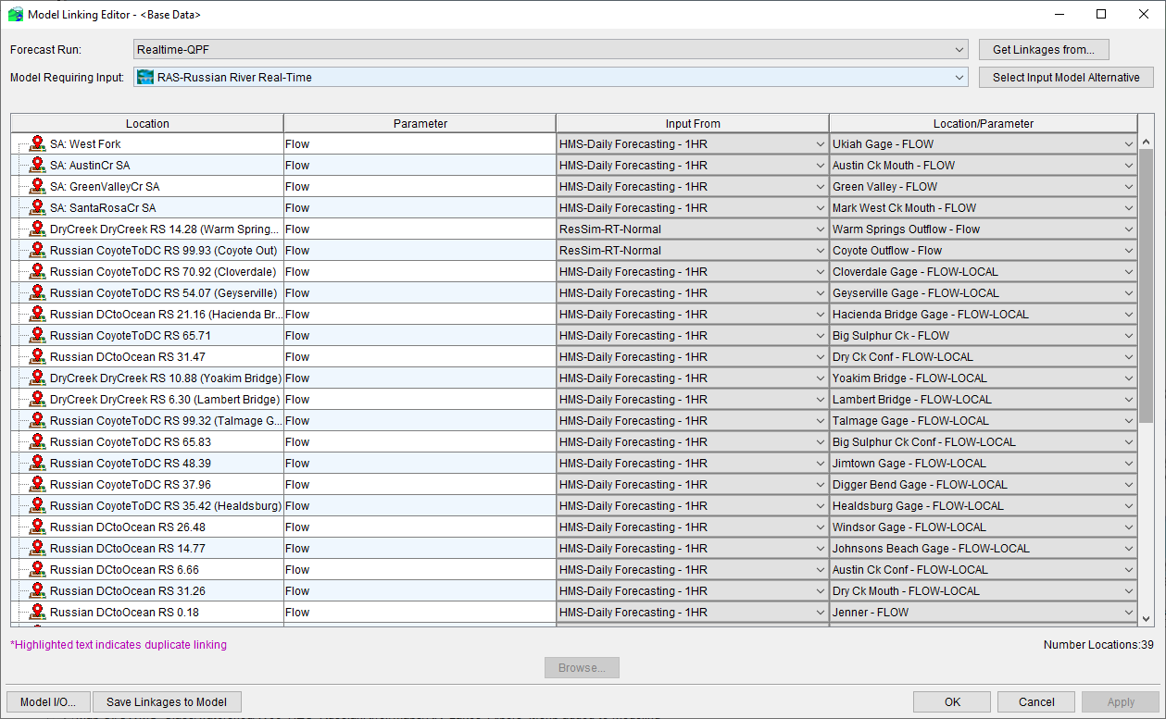
Verify model linking in CAvi

Slide 33
Real-Time Forecasting using HEC-RAS

Slide 34
Running a forecast
Check incoming data
Run HEC-MetVue, HEC-HMS, and HEC-ResSim alternatives
Adjust/calibrate until you are “happy”
Run HEC-RAS
Review results
Calibrate
Generate depth grids (if needed)

Slide 35
HEC-RAS Calibration Process
Run HEC-RAS model alternative
Compare results with observed data (flow and stage)
Adjust model parameters
Manning’s “n” values
Ineffective flow areas
Repeat
RUN
COMPARE
ADJUST

Slide 36
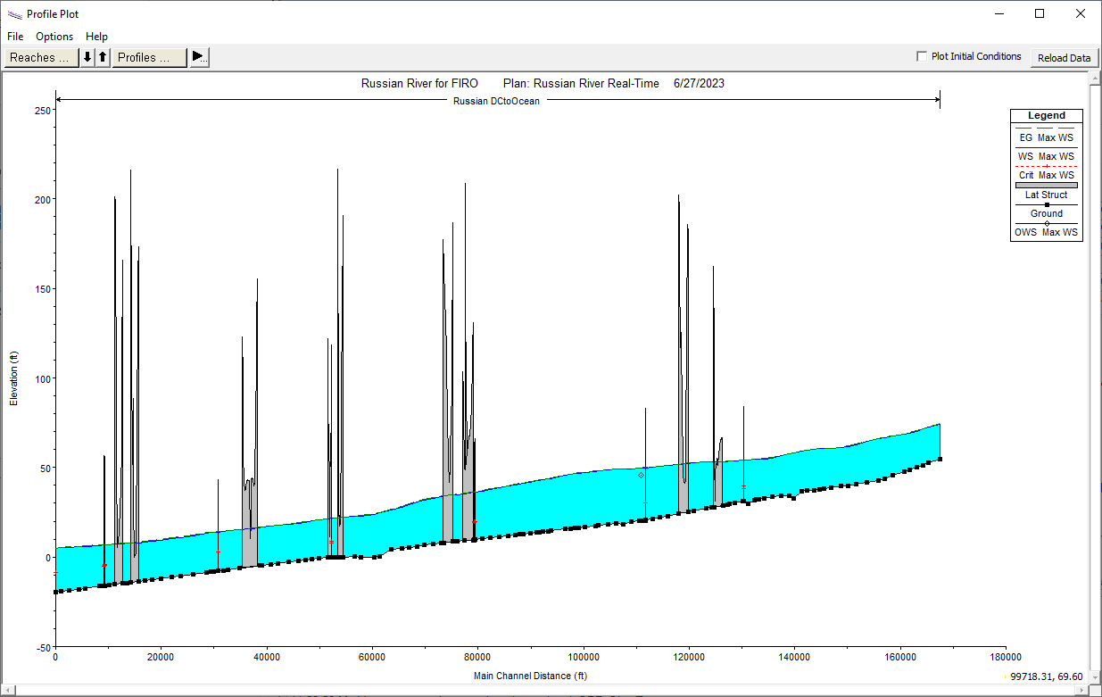
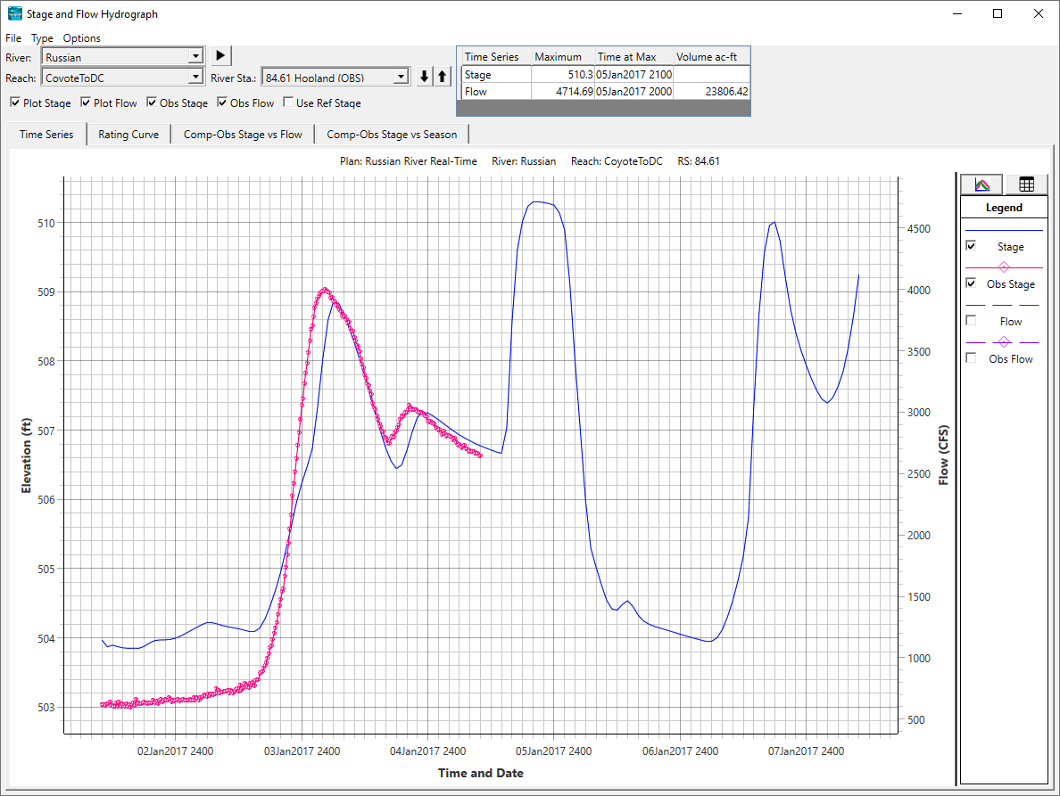
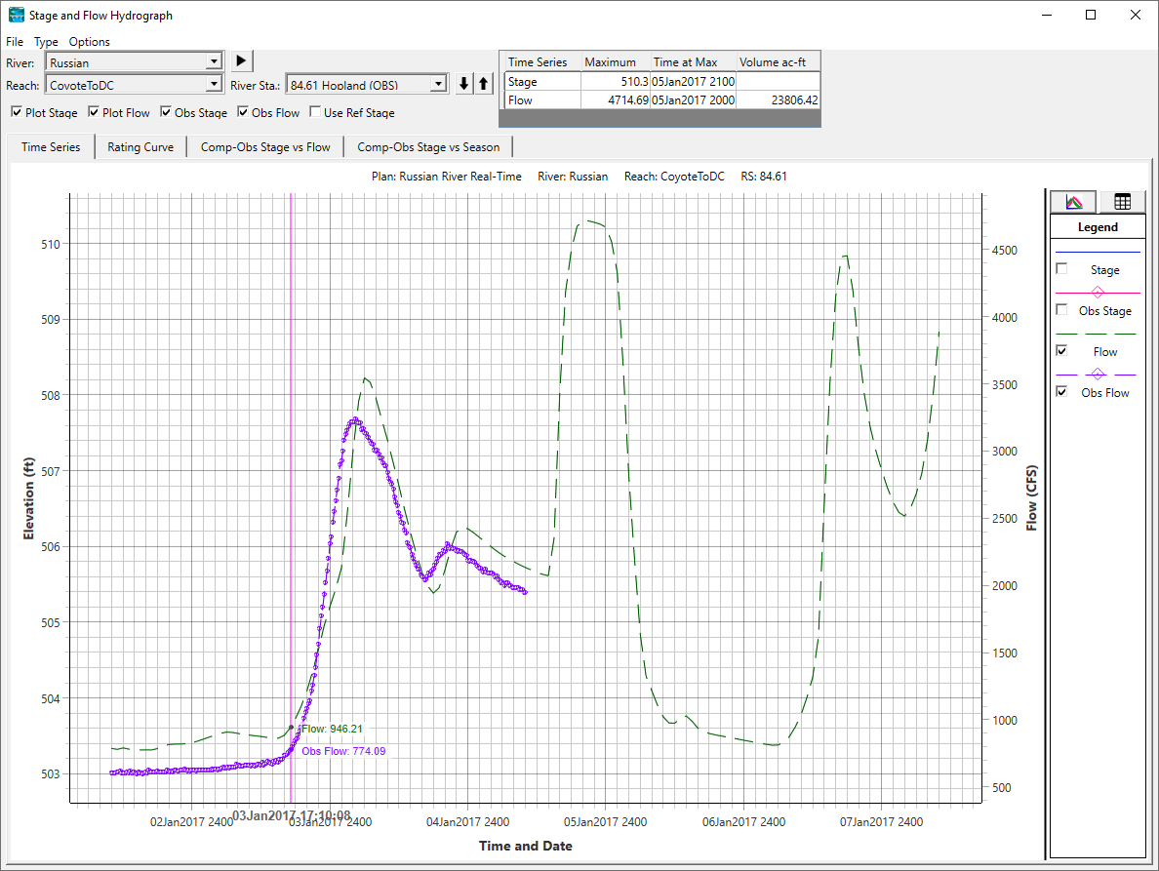
Comparing model Results to observed
Use Stage and Flow hydrograph plots to compare model outputs to observed data
Use Profile plots to review overall shape of water surface (look for anomalies)

Slide 37


Adjusting model parameters

Slide 38

Adjusting model parameters
Set up Flow Roughness Factors for sections of your model around observed data locations
Similar approach to Zones for HEC-HMS
Good way to quickly adjust Manning’s “n” values within large sections of your model
Still need to check and fully calibrate your model a few times a year (especially if the factors start diverging)

Slide 39
Validating Results
You should review results prior to creating an inundation map
Common Instability Locations
Bridges
Junctions
Inline Structures
Slope Changes/Steep Reaches

Slide 40

Inundation mapping best practices
Run HEC-RAS, check results & calibrate, then generate saved map
Do not check the “Floodplain Mapping” box in the Unsteady Flow Analysis Options
Get in the habit of checking the results before publishing the maps

Slide 41
Questions Help additional Training
https://usace.dps.mil/sites/KMP-WM/SitePages/Corps-Water-Management-System-(CWMS).aspx
https://www.hec.usace.army.mil/confluence/cwmsdocs
https://discourse.hecdev.net/c/cwms/5
TDL-CELRH-EC-GW-W-USACE CWMS Modeling | General | Microsoft Teams

