Slide 1
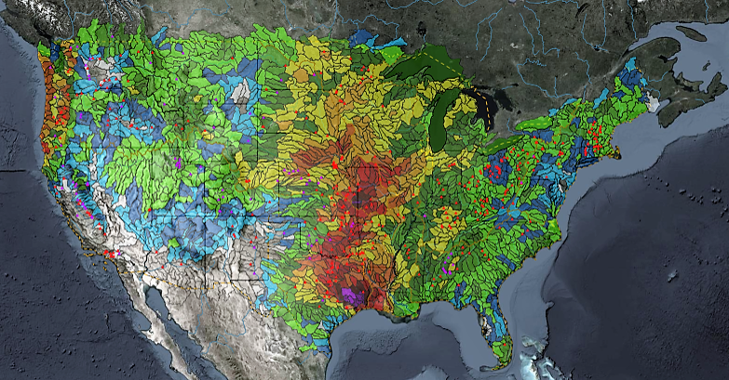
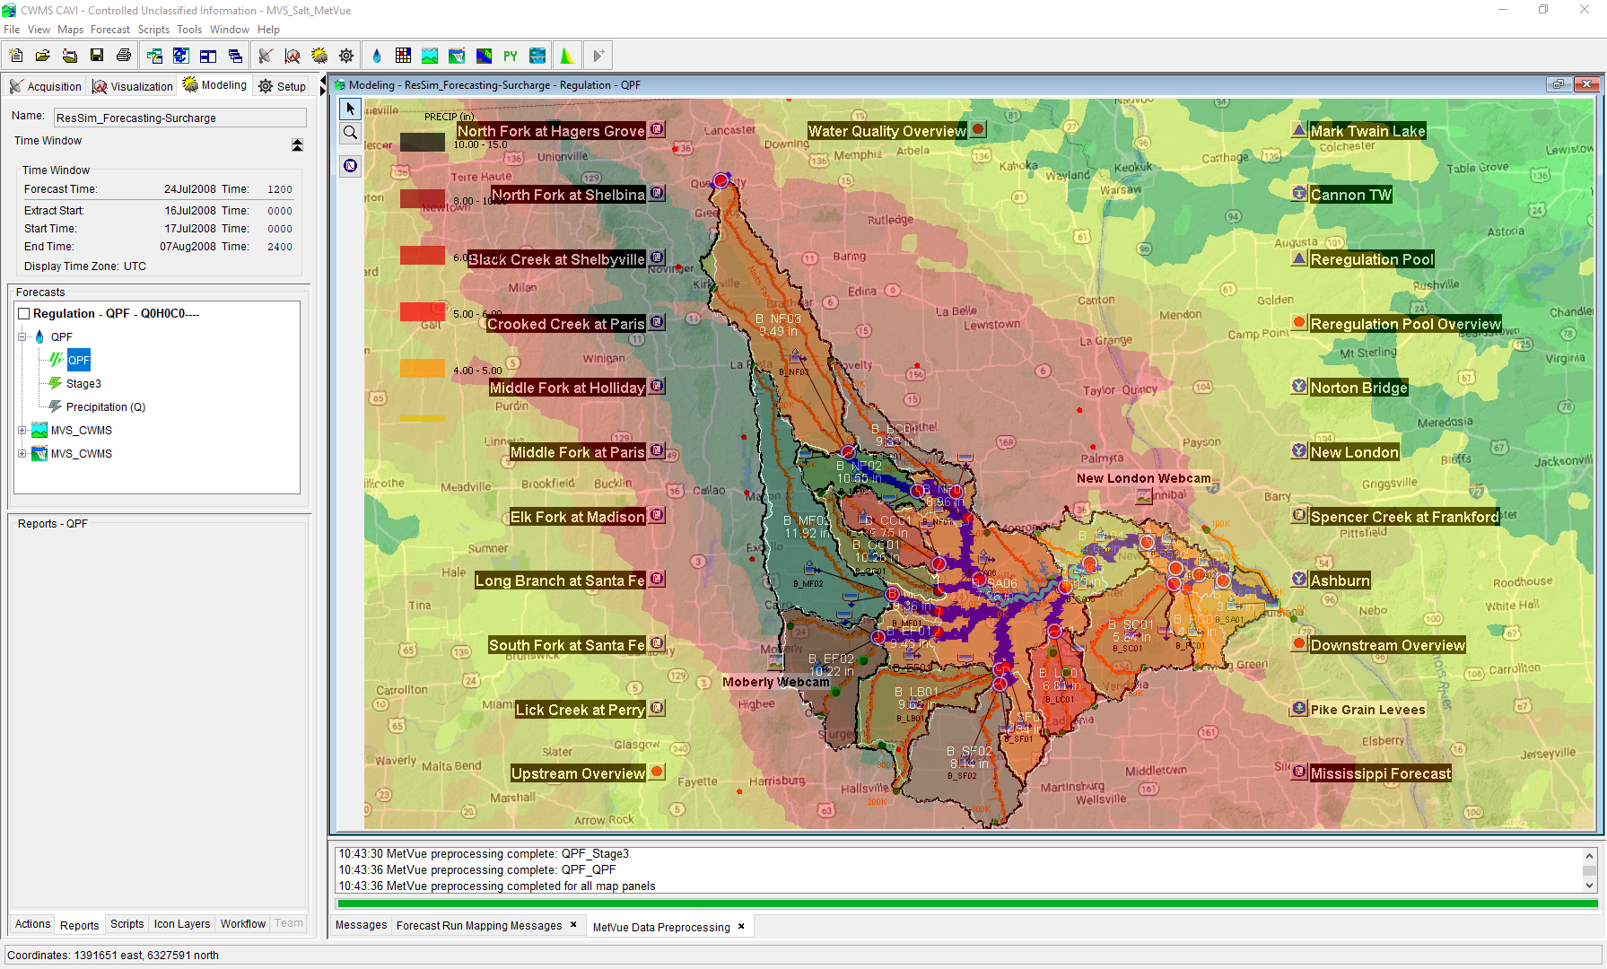

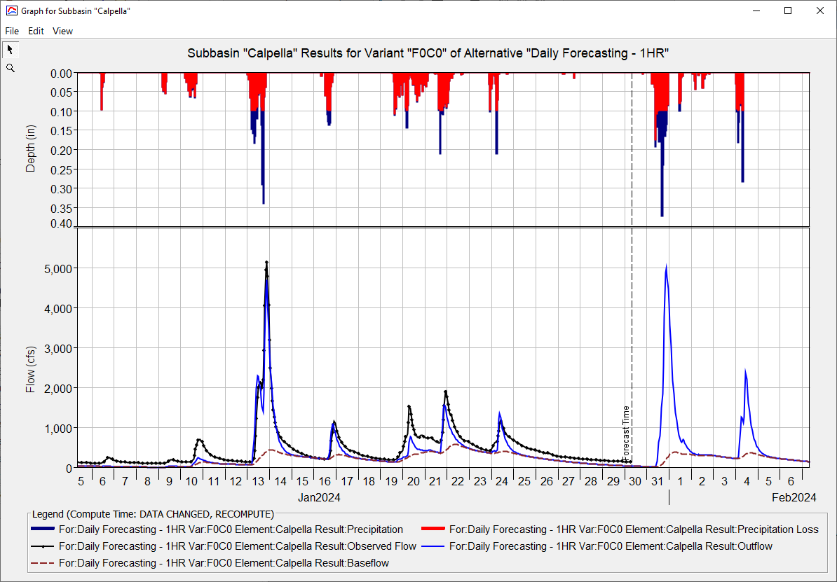
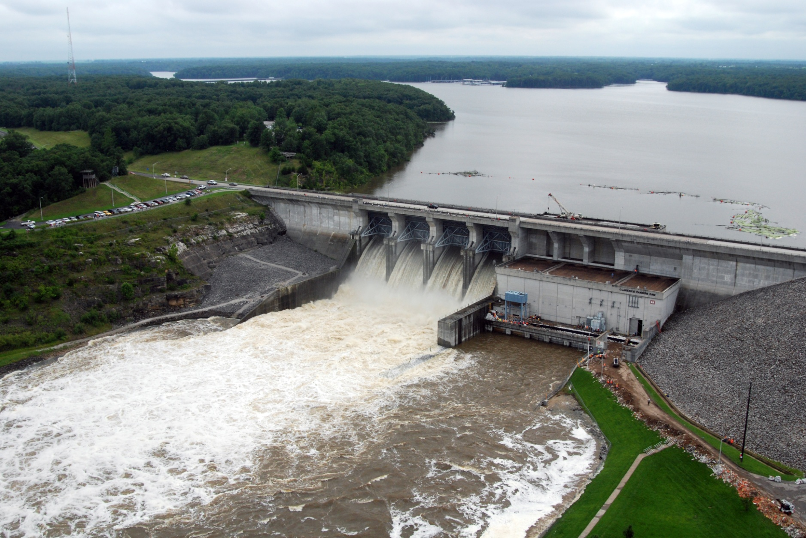
HEC-HMS Real-Time Hydrologic Modeling
Matt Fleming, P.E.
Hydrologic Engineering Center
CWMS Prospect Course
Overview

Slide 2
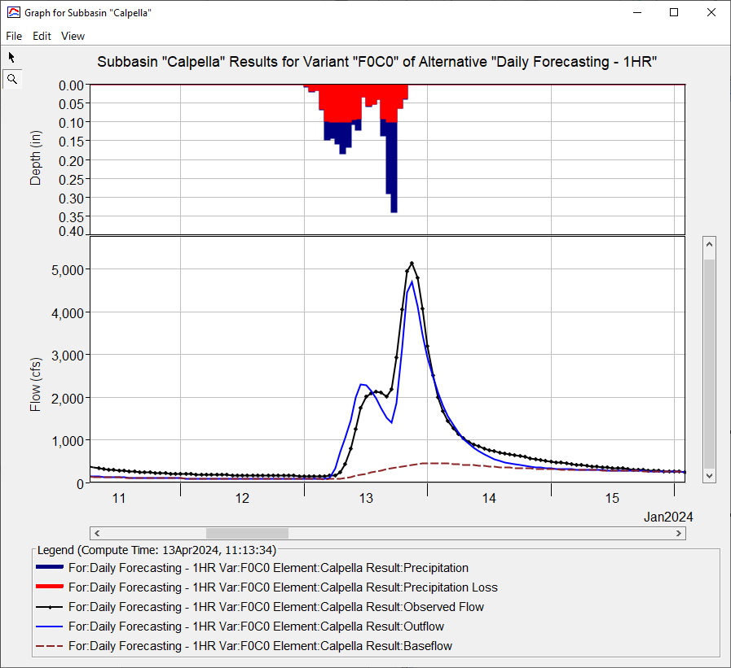
Objectives
Learn about HEC-HMS modeling options that should be used in real-time forecasting
Identify key parameters for hydrologic forecast simulation

Slide 3
Overview
HEC-HMS Modeling Options
Meteorologic Model
Precipitation, Temperature, and ET
Basin Model
Discretization, Snow, Loss, Transform, Baseflow, Reach Routing, and Reservoir
Key Parameters for Real-Time Forecasting

Slide 4





HEC-HMS in sequence
Meteorological Processor (HEC-MetVue)
Process meteorological data
Provide input to the hydrologic model
Hydrologic Model (HEC-HMS)
Transform precipitation, forecast flows
Provide input for the reservoir and hydraulics models
Reservoir Simulation Model (HEC-ResSim)
Determine reservoir system release decisions
Provide input for the hydraulics model
Hydraulic Model (HEC-RAS)
Determine stage and flood inundation
Provide flow input for the flood impact model
Flood Impact Analysis (HEC-FIA)
Estimate the economic and life loss consequences
Report where action is required during high stages

Slide 5
Questions Help additional Training
https://usace.dps.mil/sites/KMP-WM/SitePages/Corps-Water-Management-System-(CWMS).aspx
https://www.hec.usace.army.mil/confluence/cwmsdocs
https://discourse.hecdev.net/c/cwms/5
TDL-CELRH-EC-GW-W-USACE CWMS Modeling | General | Microsoft Teams
“Just keep CWMS’ing”

