Slide 1
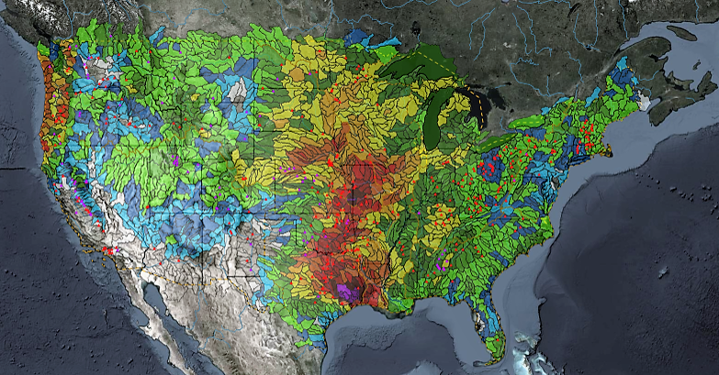
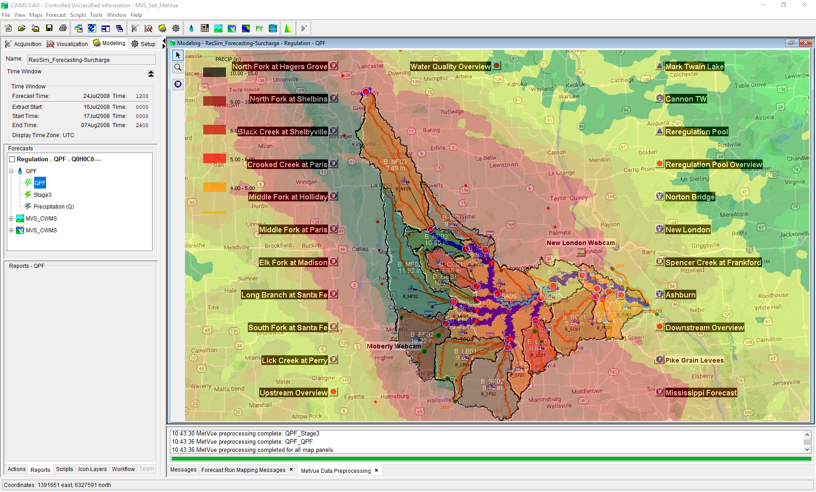

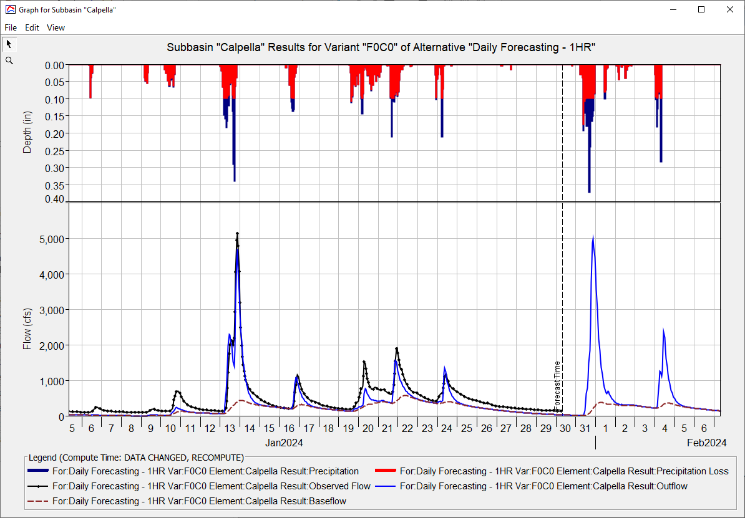
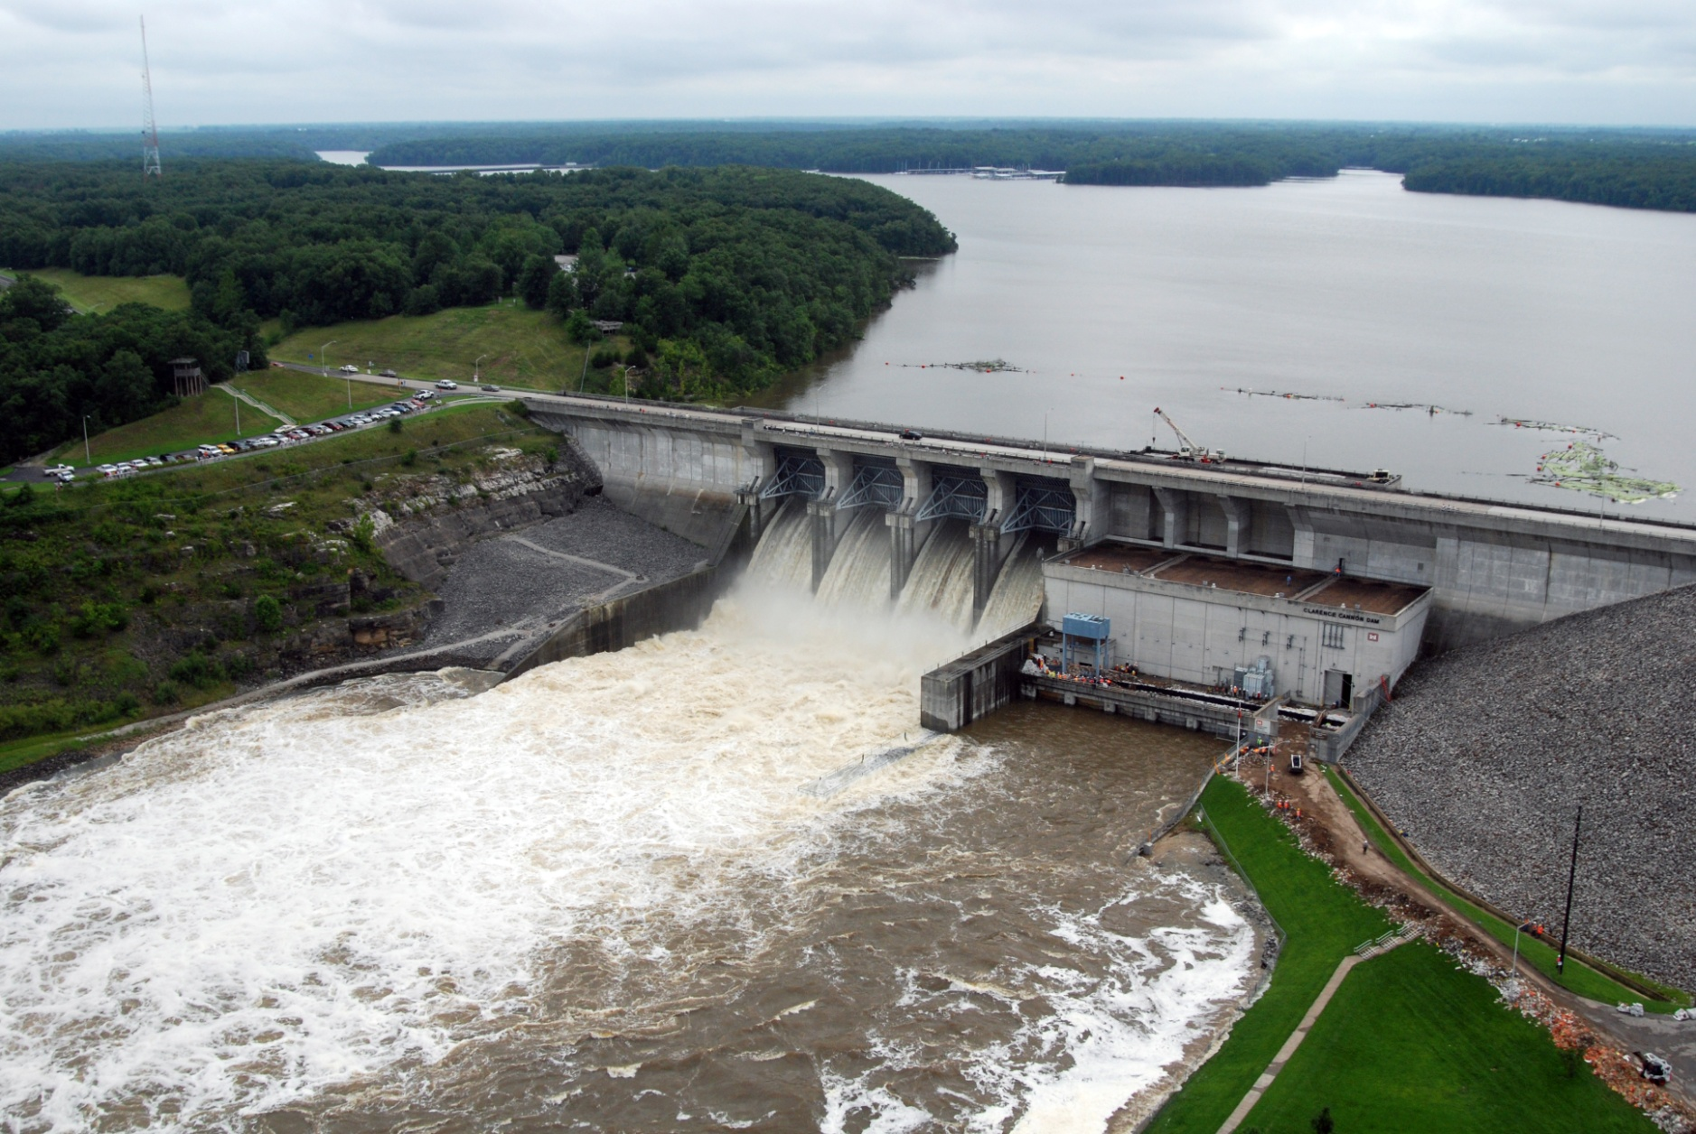
HEC-HMS Real-Time Hydrologic Modeling
Matt Fleming, P.E.
Hydrologic Engineering Center
CWMS Prospect Course
Meteorologic Model

Slide 2
Overview
  HEC-HMS Modeling Options
    Meteorologic Model
      Precipitation, Temperature, and ET
    Basin Model
      Discretization, Snow, Loss, Transform, Baseflow, Reach Routing, and Reservoir
  Key Parameters for Real-Time Forecasting

Slide 3
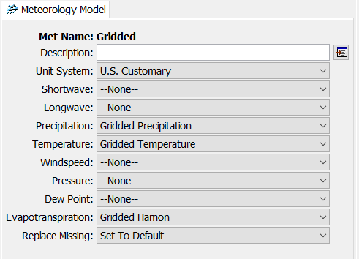
Meteorologic Model
Prepares boundary conditions for hydrologic processes in the basin model
  Precipitation – needed for snow and infiltration
  Temperature – needed for snow and potential ET
  Potential ET – needed for actual ET
Set missing inputs to “default” (e.g. zero)
  Temperature must be defined for all time steps

Slide 4
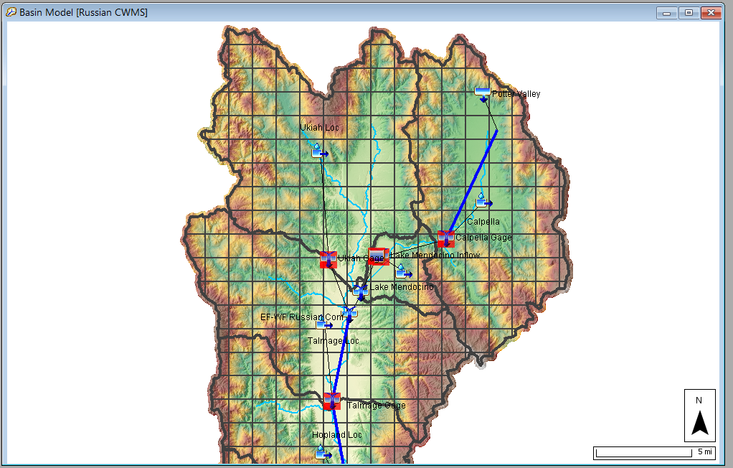
Which Meteorologic options should I use?
Precipitation (required)
  Gridded (question if needed)
  Interpolated (with bias grid)
  Specified Hyetograph (from MetVue)
Temperature (only required for snow and some ET methods)
  Gridded
  Interpolated (with elevation grid and lapse rate)
  Specified Gage
ET
  Monthly Average
  Gridded/Non-Gridded Hamon

Slide 5
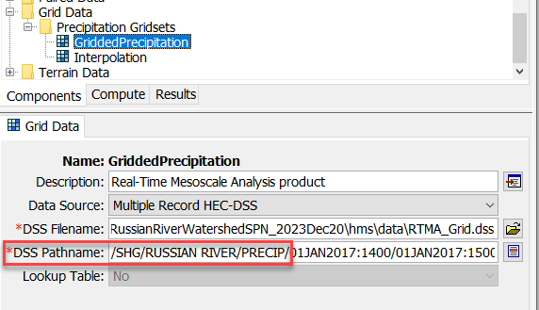
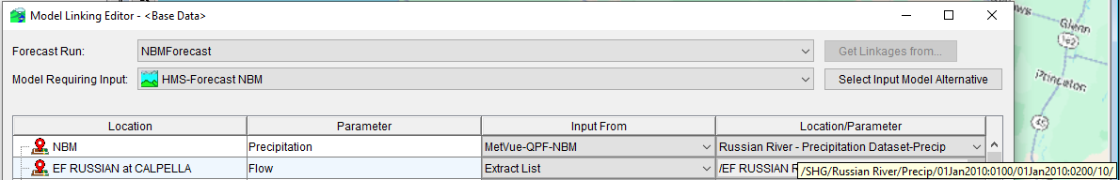
Grid Set Definition
Set Grid Source for Precipitation
  Why “Multiple Record HEC-DSS” for the Data Source?
  Use consistent pathname parts between MetVue and HMS
Make different grid sets for different precipitation sources
  Historic + Forecast 1
  Historic + Forecast 2
CAVI model linking replaces F-Part pathname using MetVue Key

Slide 6
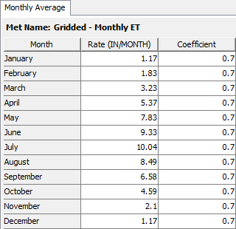
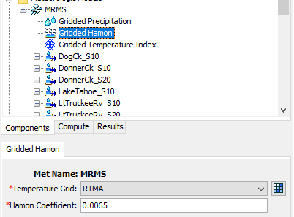
Evapotranspiration (ET)
Monthly ET
  Requires you to link meteorologic and basin models (there are pitfalls)
  Global parameter table for quick parameter definition
  Not accurate for specific events, close enough and fast computation
Gridded Hamon
  Requires gridded temperature, cannot be missing
  Older software versions require temperature one day before and after simulation window

Slide 7
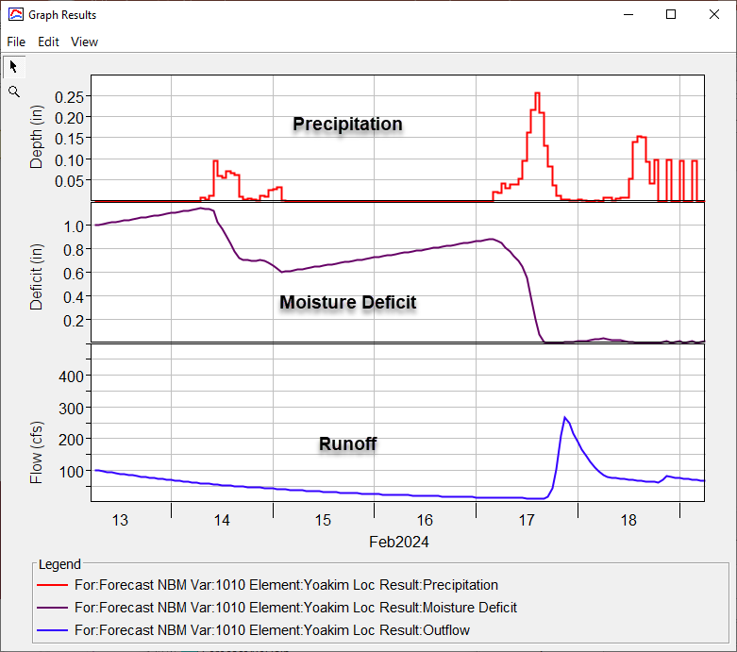
Evapotranspiration (ET)

Slide 8
Questions
Help additional Training
https://usace.dps.mil/sites/KMP-WM/SitePages/Corps-Water-Management-System-(CWMS).aspx
https://www.hec.usace.army.mil/confluence/cwmsdocs
https://discourse.hecdev.net/c/cwms/5
TDL-CELRH-EC-GW-W-USACE CWMS Modeling | General | Microsoft Teams
“Just keep CWMS’ing”

