Slide 1
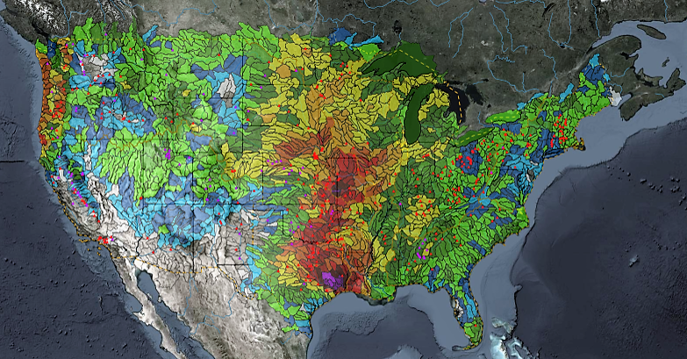
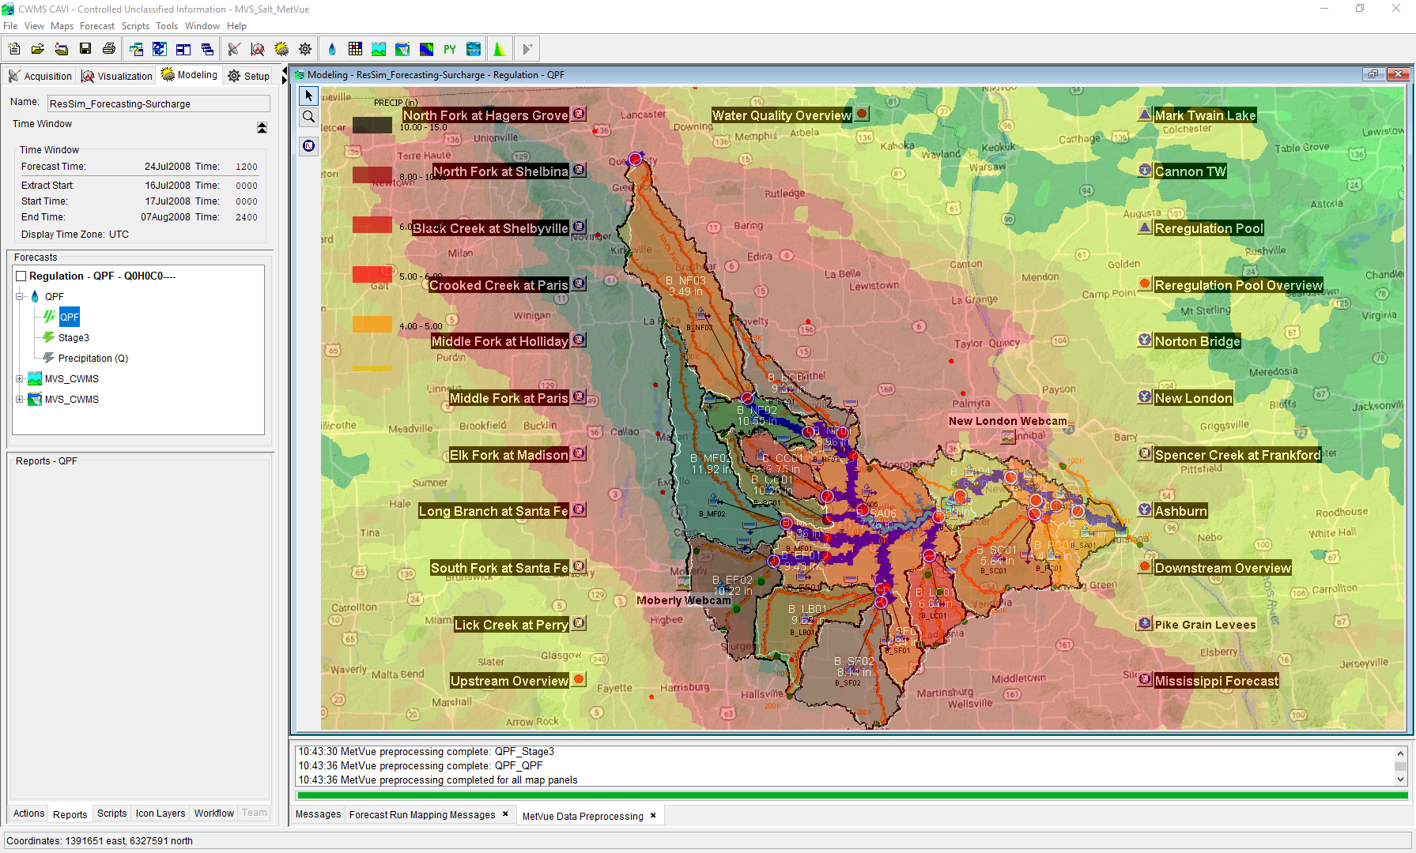

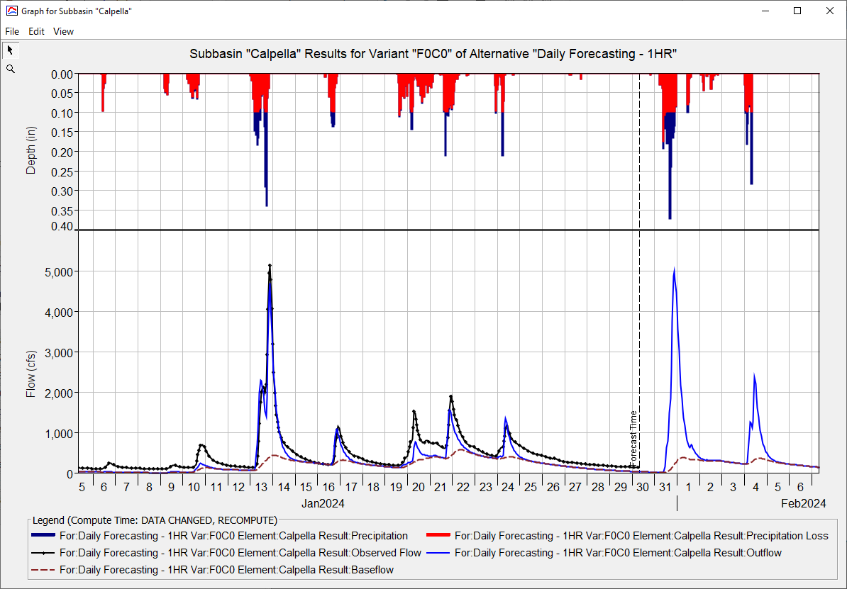
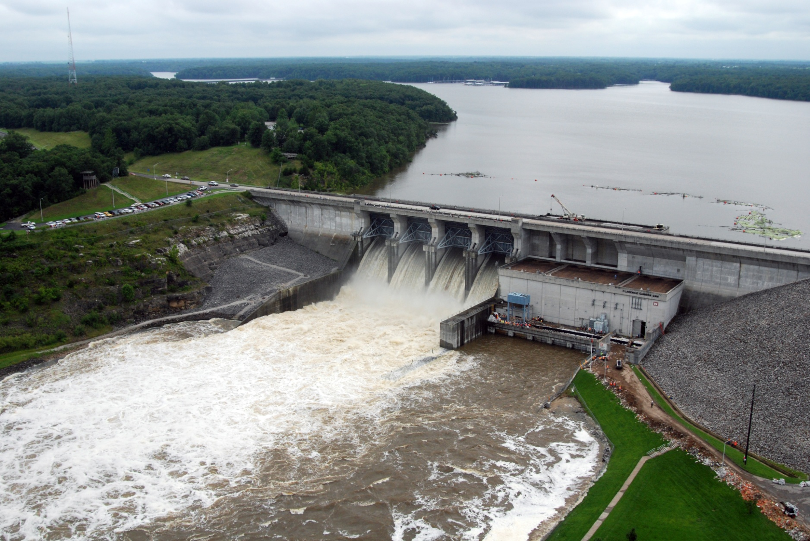
HEC-HMS Real-Time Hydrologic Modeling
Matt Fleming, P.E.
Hydrologic Engineering Center
CWMS Prospect Course
Basin Model

Slide 2
Overview
HEC-HMS Modeling Options
Meteorologic Model
Precipitation, Temperature, and ET
Basin Model
Discretization, Snow, Loss, Transform, Baseflow, Reach Routing, and Reservoir
Key Parameters for Real-Time Forecasting

Slide 3
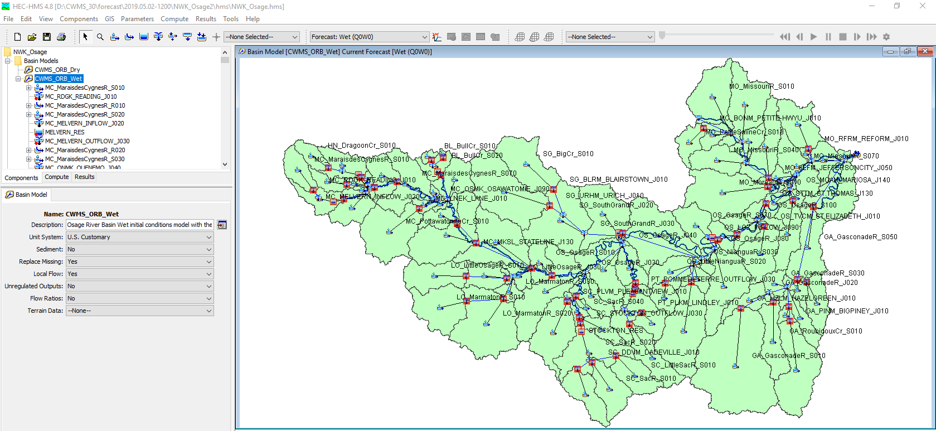
Example Basin Model

Slide 4
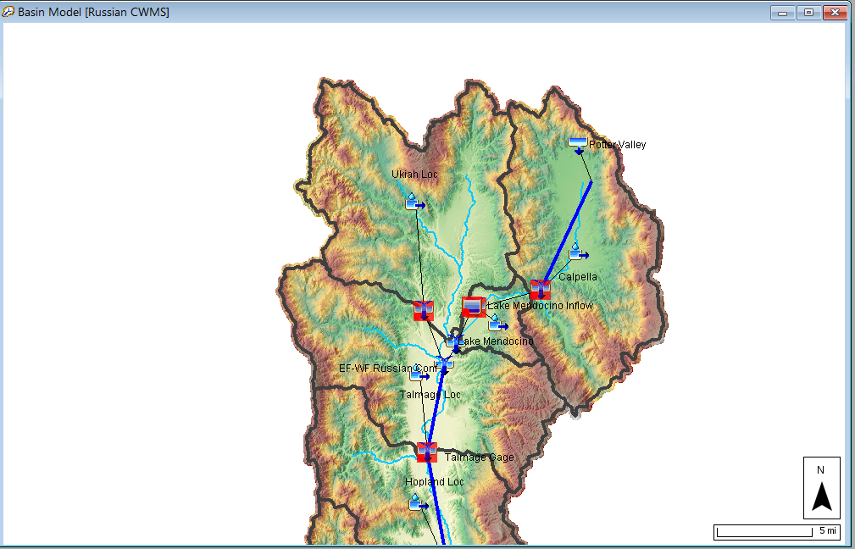
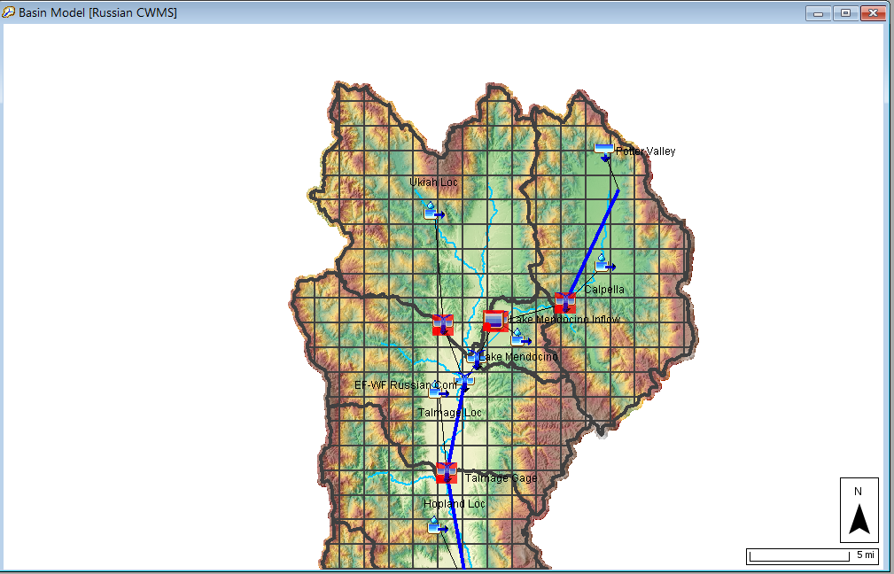
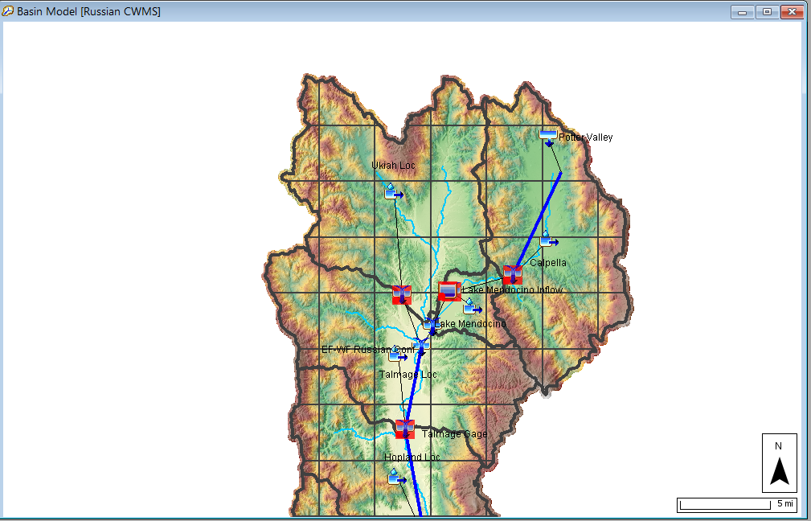
Discretization
Subbasin Average
2000 Meter Grid
5000 Meter Grid

Slide 5
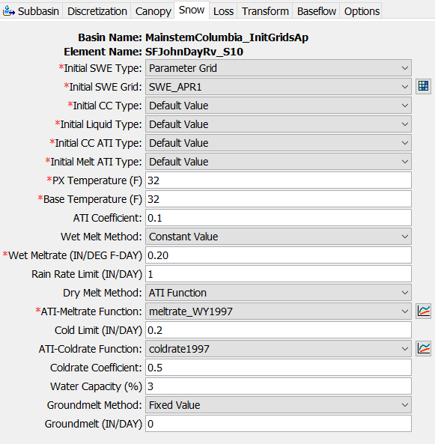
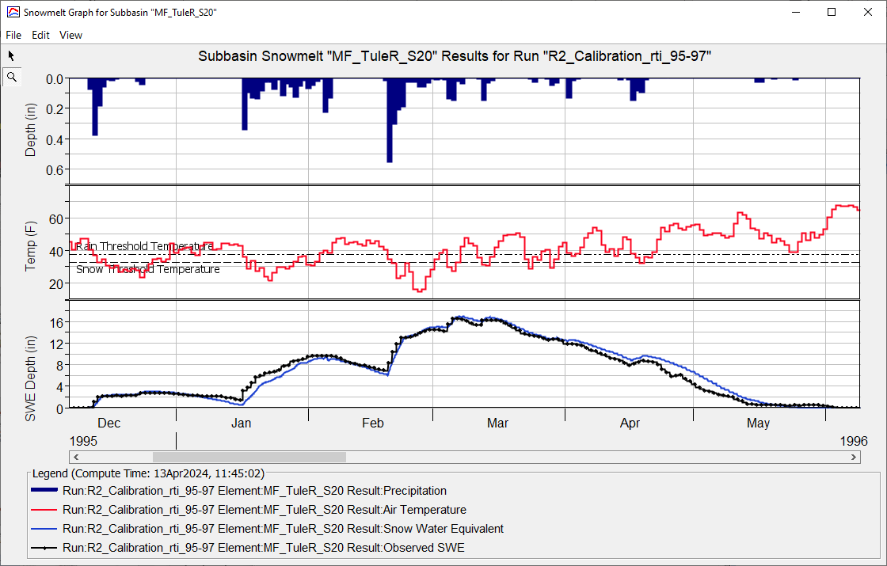
Snow
Initialize Snow States using grids or default values
Px Temp: 30 – 37 Deg F
Wet Meltrate: 0.05-0.25 in/F-day

Slide 6
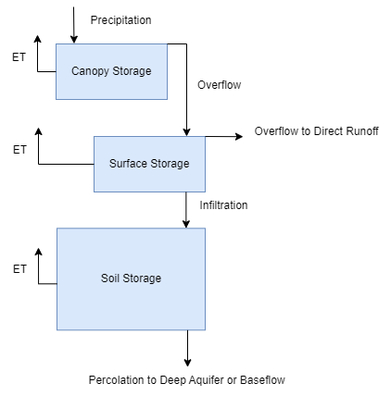
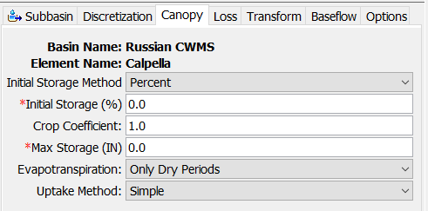
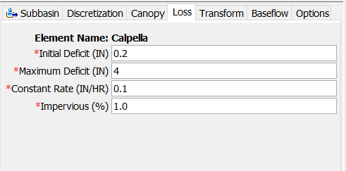
Subbasin Loss/Excess
Simple Canopy + Deficit and Constant
Canopy Storage
Soil Moisture Deficit

Slide 7
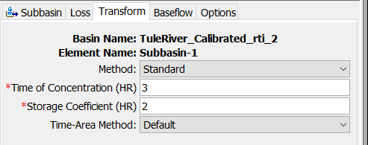
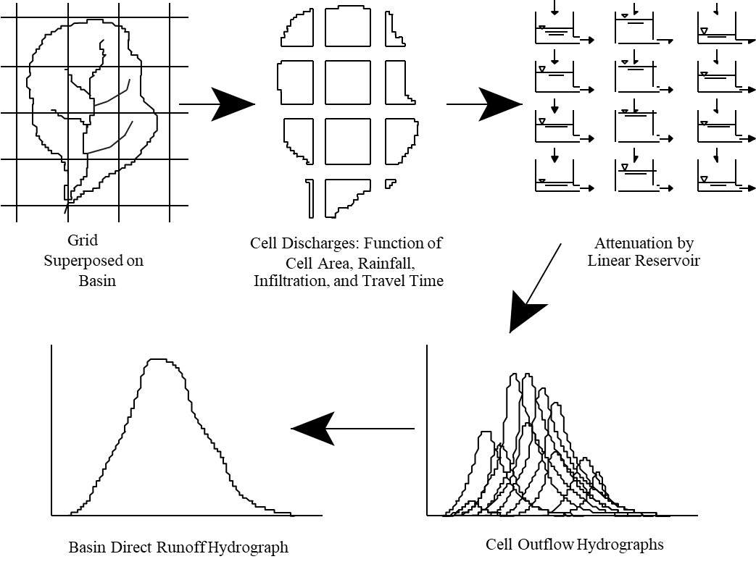
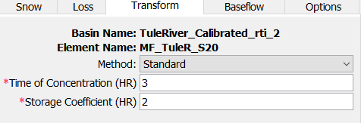
Subbasin Transform
Clark
ModClark and Clark
ModClark

Slide 8
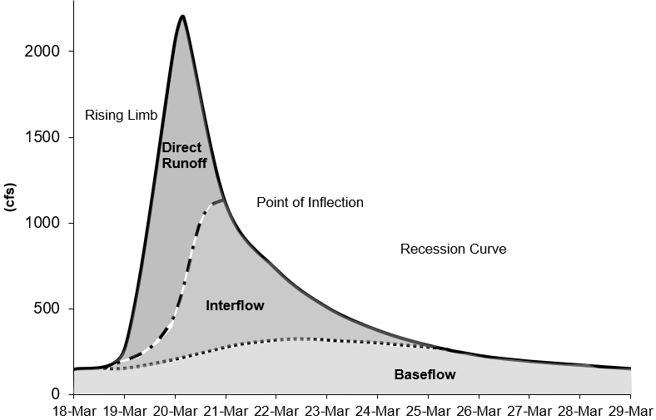
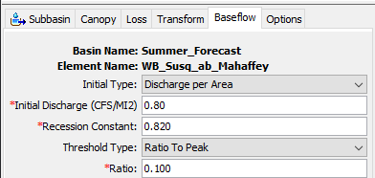
Subbasin Baseflow
Recession Baseflow

Slide 9
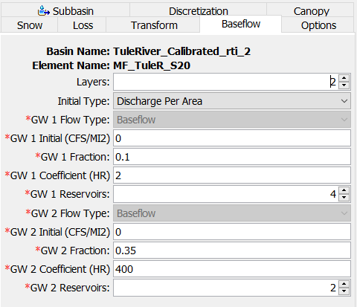
Subbasin Baseflow
Linear Reservoir Baseflow
Interflow - Linear Reservoir
Baseflow - Linear Reservoir

Slide 10
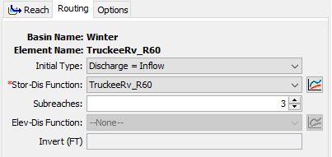
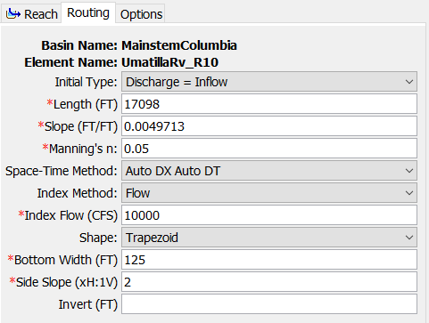
Reach Routing Methods
Routing methods:
Variable Lag and K
Relationship between Flow, Lag, and Attenuation
Modified Puls
Storage-Discharge relationship developed using steady flow HEC-RAS models
Muskingum
Static relationship between Lag and Attenuation
Muskingum-Cunge
Most computation burdensome method

Slide 11
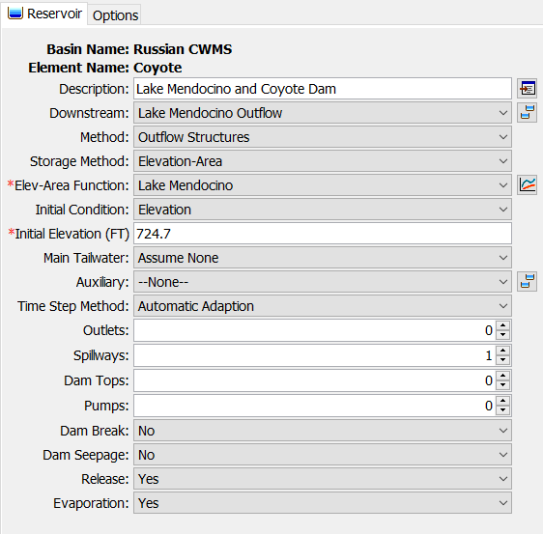
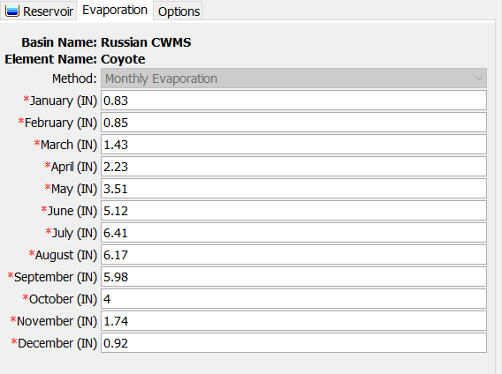
Reservoirs
Four reservoir routing methods - Outflow Curve, Outflow Structures, Rule-Based Operations, and Specified Release

Slide 12
Questions Help additional Training
https://usace.dps.mil/sites/KMP-WM/SitePages/Corps-Water-Management-System-(CWMS).aspx
https://www.hec.usace.army.mil/confluence/cwmsdocs
https://discourse.hecdev.net/c/cwms/5
TDL-CELRH-EC-GW-W-USACE CWMS Modeling | General | Microsoft Teams
“Just keep CWMS’ing”

