Slide 1
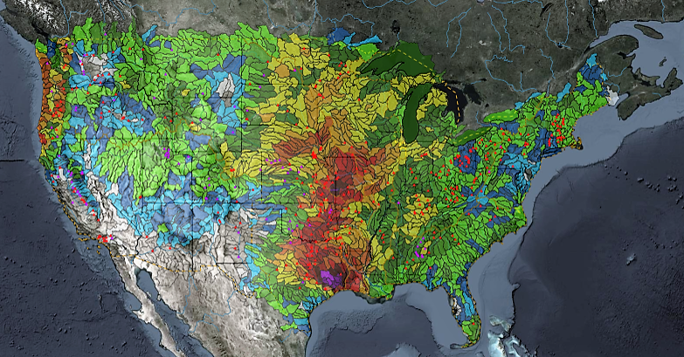
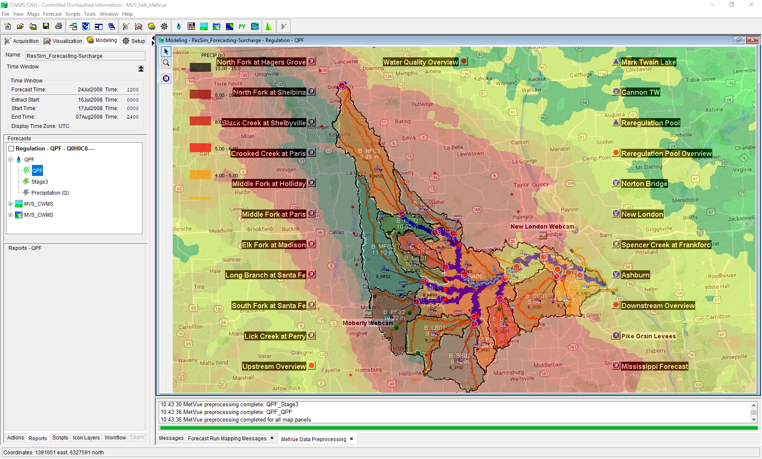

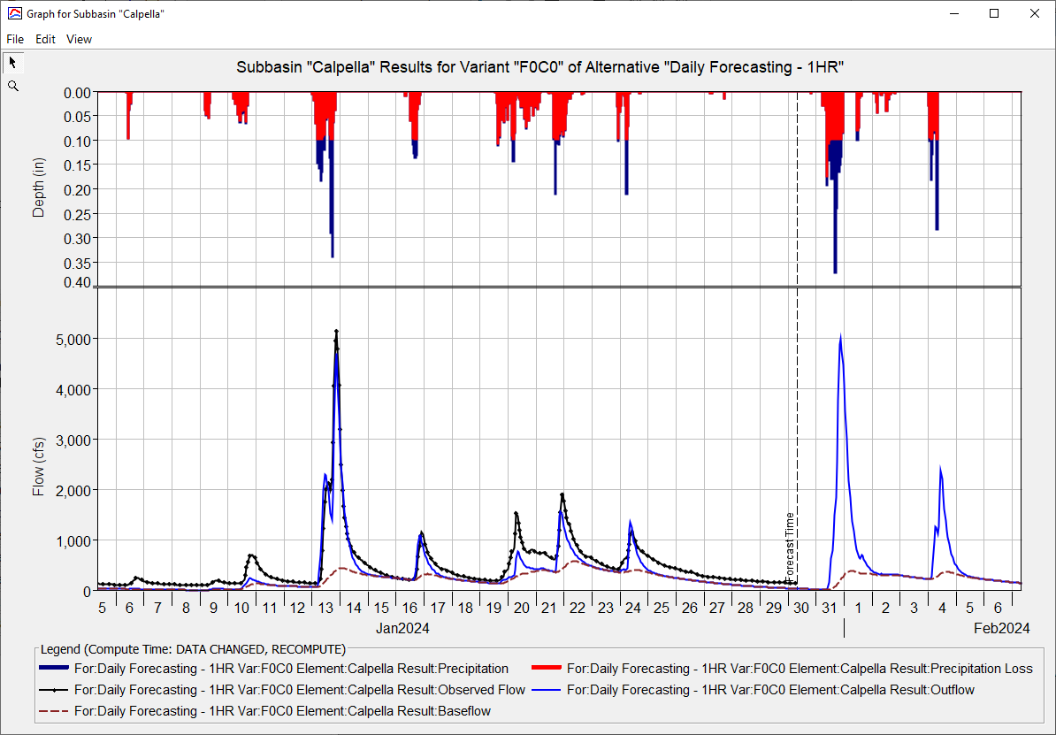
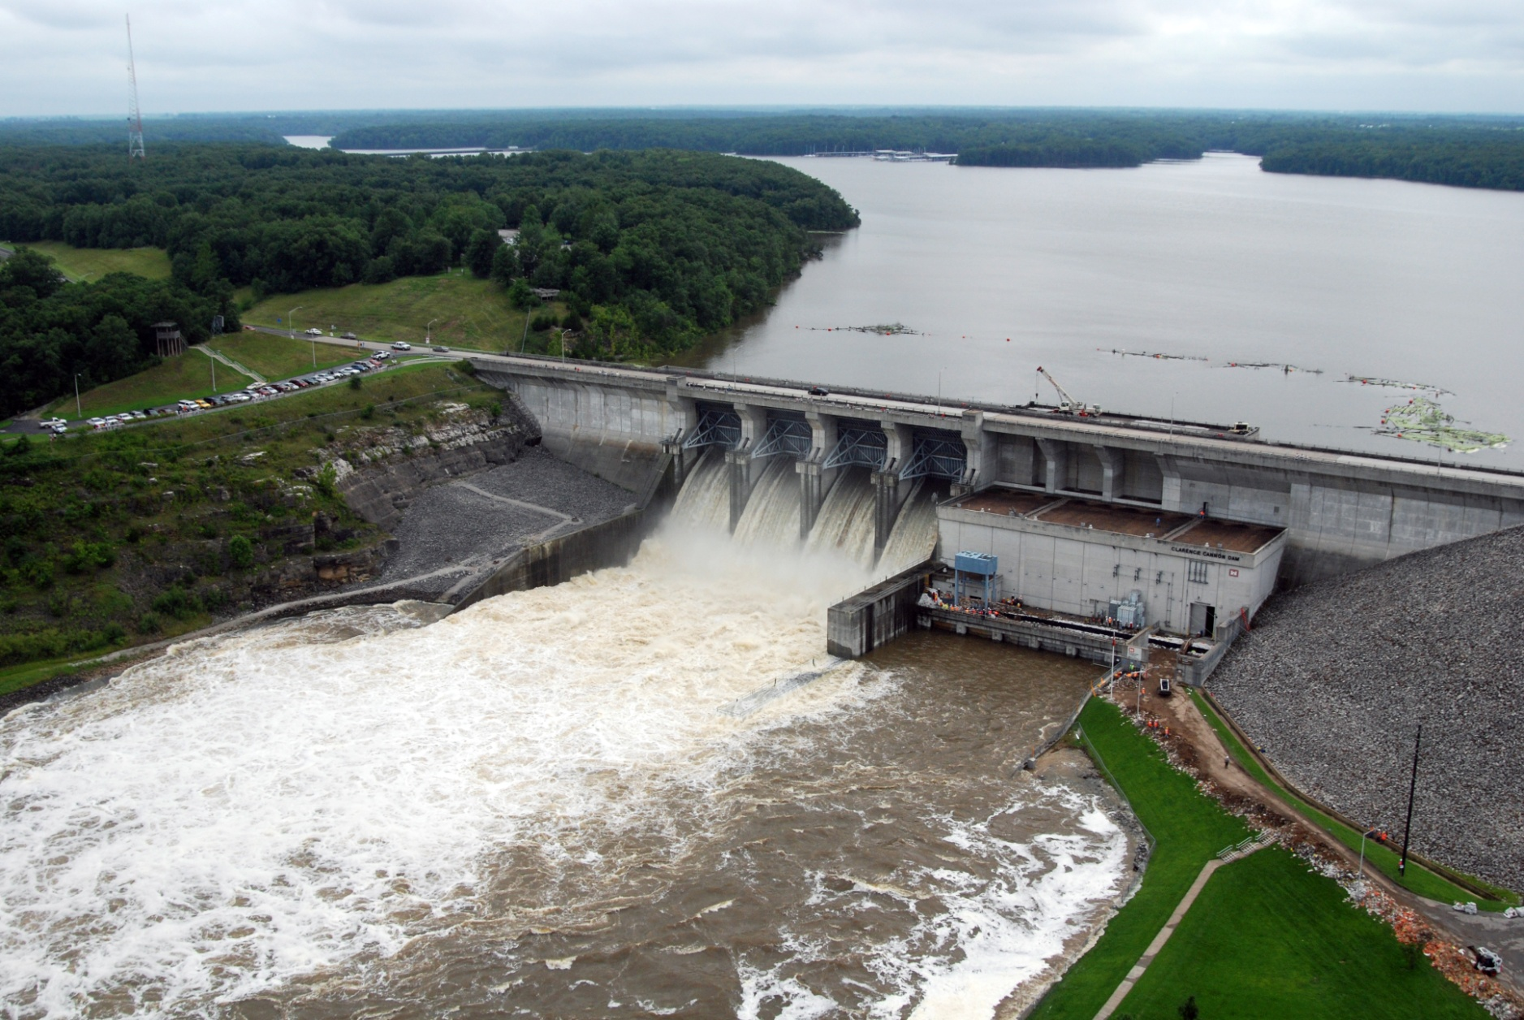
HEC-HMS Real-Time Hydrologic Modeling
Matt Fleming, P.E.
Hydrologic Engineering Center
CWMS Prospect Course
Key Parameters for Real-Time Forecasting

Slide 2
Overview
HEC-HMS Modeling Options
Meteorologic Model
Precipitation, Temperature, and ET
Basin Model
Discretization, Snow, Loss, Transform, Baseflow, Reach Routing, and Reservoir
Key Parameters for Real-Time Forecasting

Slide 3
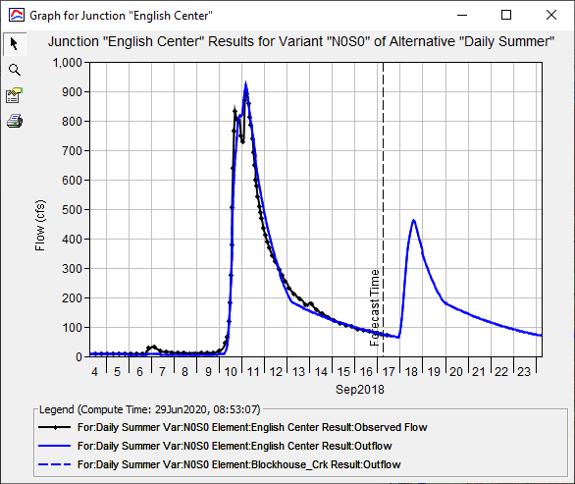
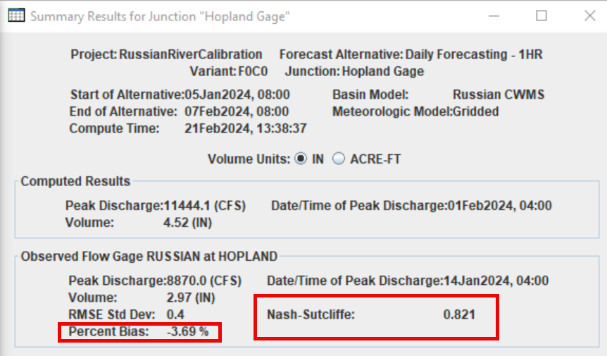
Observed Flows in HEC-HMS
Observed Flow
Computed Flow

Slide 4
Which Model Parameters Should I adjust?
Every Forecast
Occasionally
Initial Conditions
Initial SWE / Cold Content
Initial Moisture Deficit
Initial Baseflow
Initial Reservoir Elevation/Storage
Process Parameters
PX Temperature
Wet Meltrate
Constant Loss Rate
Recession Baseflow – ratio to peak
Recession Baseflow – recession constant
Linear Reservoir Baseflow – GW 1 Fraction (seasonally consistent)
Linear Reservoir Baseflow – GW 2 Fraction (seasonally consistent)
Process Parameters
Dry Meltrate Function (long term simulation)
ModClark/Clark TC and R
Reach Routing
Mod Puls number of subreaches
Muskingum K and X
Muskingum Cunge n and energy slope
Canopy Crop Coefficient
ET Coefficient or Monthly Adjustment Factor

Slide 5
Questions Help additional Training
https://usace.dps.mil/sites/KMP-WM/SitePages/Corps-Water-Management-System-(CWMS).aspx
https://www.hec.usace.army.mil/confluence/cwmsdocs
https://discourse.hecdev.net/c/cwms/5
TDL-CELRH-EC-GW-W-USACE CWMS Modeling | General | Microsoft Teams
“Just keep CWMS’ing”

