Slide 1
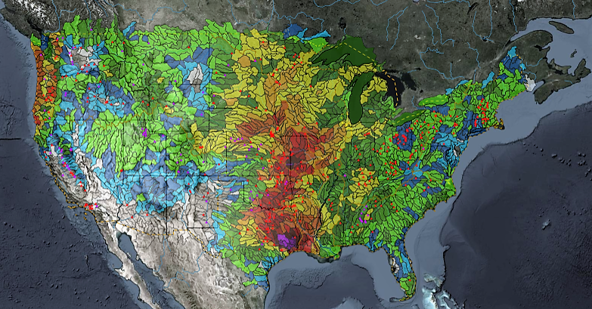
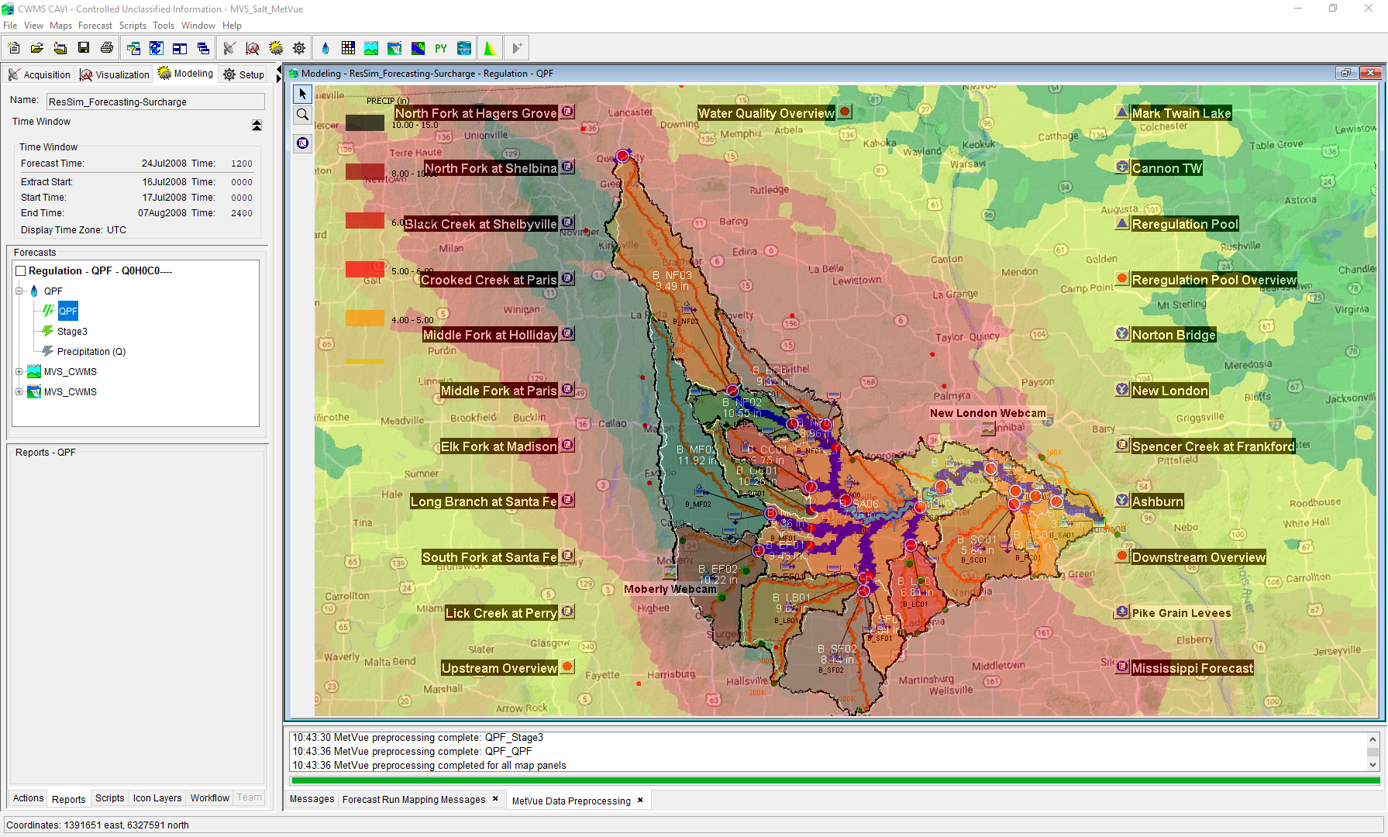

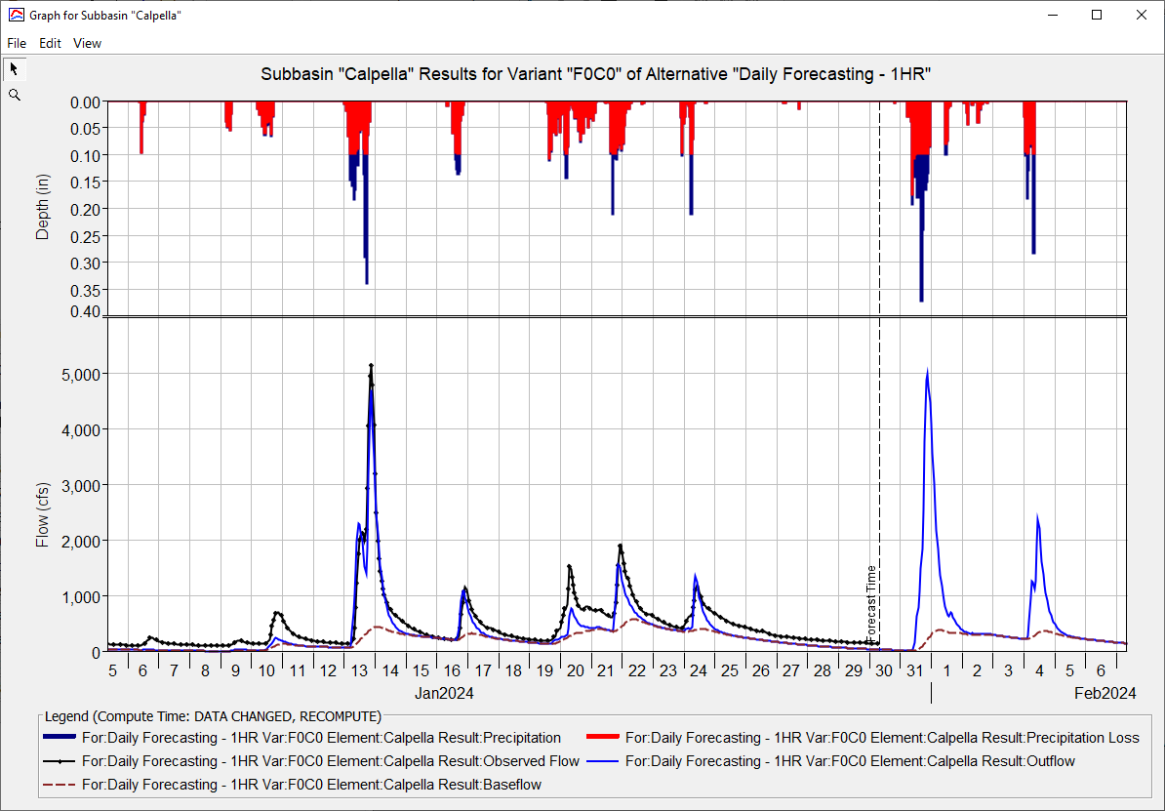
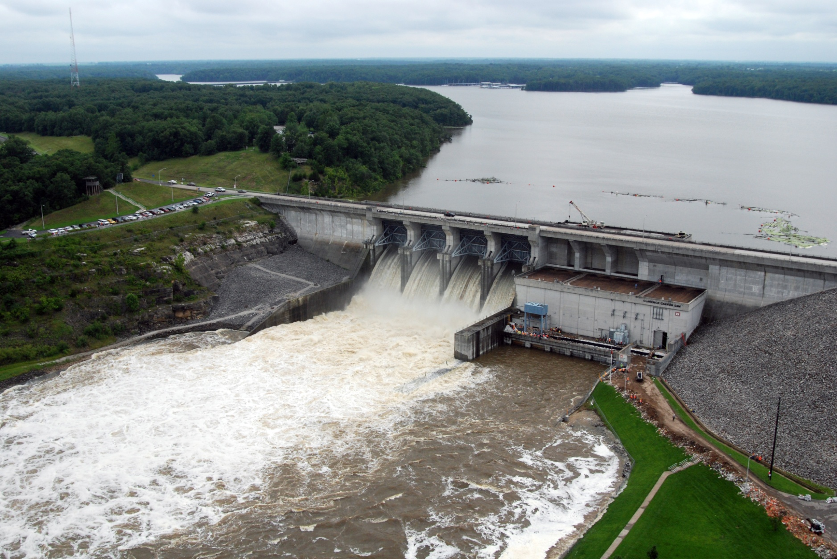
HEC-ResSim in CWMS
Russell Errett, P.E.
Hydrologic Engineering Center
CWMS Prospect Course

Slide 2
Overview
Learn basic concepts of using HEC-ResSim in CWMS for making real-time reservoir operation decisions
Introduction to HEC-ResSim
What is ResSim?
What can ResSim do?
Why do we want it in CWMS?
Integrating an HEC-ResSim model into CWMS
A brief review of importing, linking, etc.
Using HEC-ResSim for Real-Time Decision Making
Data Considerations
How real-time modeling differs from planning studies
Regulation Schedule/Plan
The OSI

Slide 3
Introduction to HEC-ResSim

Slide 4
What is HEC-ResSim?
HEC-ResSim is a software program designed for simulating the operations of one or more reservoirs in a river system for a variety of operational goals and constraints.
Notes:
Introduction to ResSim
What is ResSim?
HEC-ResSim is a software program designed for simulating the operations of one or more reservoirs in a river system for a variety of operational goals and constraints.
The acronym “ResSim” stands for Reservoir Simulation.
ResSim is designed for modeling reservoir operations. It can handle one reservoir or many.
It can handle at-site operations or system operations.
And, because it is rule-based, it can handle multiple objectives at once.
ResSim simulates the reservoir operations timestep by timestep.
It is NOT an optimization model, so it doesn’t look at the whole time window and try to determine an “optimal” release plan.

Slide 5
What can HEC-ResSim do?
It can determine the releases of one or more reservoirs for an observed, synthetic, or predicted flow event using a defined operation scheme and/or a prescribed release schedule.
It uses mass-balance computations to determine the resulting pool elevation and storage for each reservoir.
It can route and combine inflows and the determined releases through the modeled river system using hydrologic routing.
Notes:
Introduction to ResSim
What can ResSim do?
ResSim performs a variety of computations for determining reservoir operations
It can determine the releases of one or more reservoirs for an observed, synthetic, or predicted flow event using a defined operation scheme and/or a prescribed release schedule.
It uses mass-balance computations to determine the resulting pool elevation and storage for each reservoir.
It can route and combine inflows and the determine flows through the modeled river system using hydrologic routing.
More Informally…
ResSim makes release decisions on a time-step by time-step basis
It uses a rule-based operation scheme to make the release decisions -or-
It uses a prescribed release schedule (release overrides)
It computes the ending pool elevation and storage, time-step by time-step
It routes and combines flows through the river network.
It uses hydrologic routing (as opposed to hydraulic routing)
Although not as physically accurate as hydraulic routing, it is faster and provides needed information for many operational decisions

Slide 6
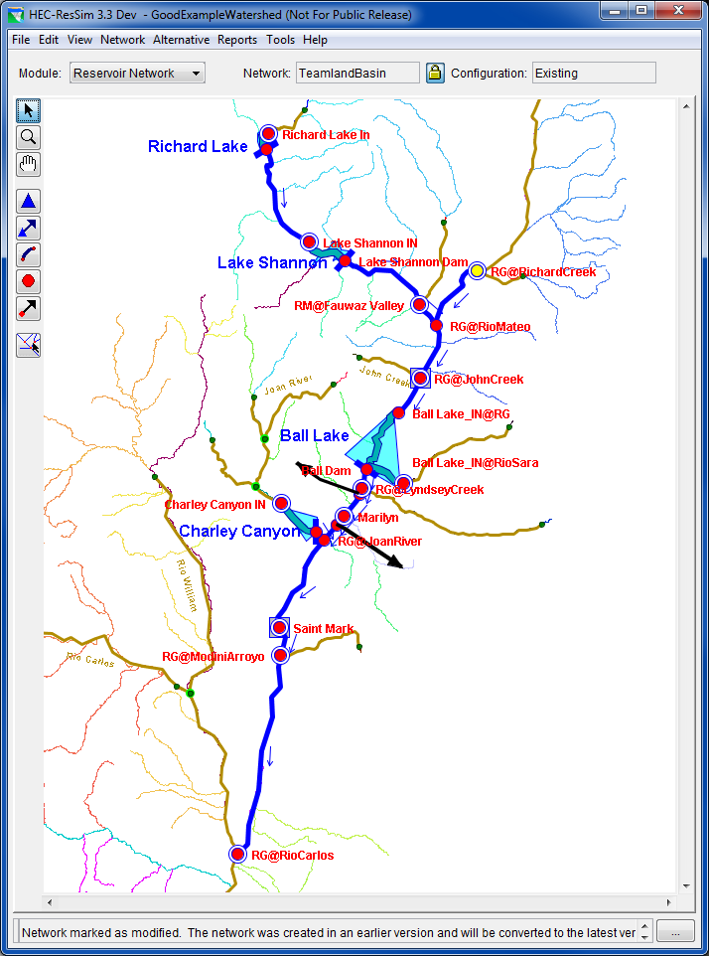
The Reservoir Network
The HEC-ResSim schematic…
Reservoirs
Pool Definition
Hierarchical Outlet Structure
Operation Plans
Junctions/Control Points
Inflows
Outflow
Stage lookup
Routing Reaches & Diversions
Provide Connectivity
Hydrologic Routing
Notes:
Introduction to ResSim
Reservoir Networks
The ResSim Schematic…
ResSim’s Reservoir Network – is the key element of the ResSim model. It describes the model schematic and contains the physical and operational data for each model element of the schematic, including:
Reservoirs
Reservoir pool and outlet definitions
Reservoir Operation Plans (the rules, zones, allocation, etc)
Junctions
Inflows - Inflows into the river system are identified at the Junctions.
Outflow - Junctions sum up inflows to produce a single outflow
Stage Lookup - Junctions can also be provide a rating curve for looking up Stage from the computed Flow.
Routing Reaches and Diversions
Provide Connectivity
Hydrologic Routing
Routing reaches and diversions move water through the river network (from one junction to the next) using hydrologic routing.
Diversions take water away from a junction in the network… and may optionally return it elsewhere in the network.
This slide includes a screen shot of the Model Schematic from the ResSim Network Module. Describe the visual clues included in the map schematic…
Inflow, Control Points, Diversion arrowheads (connectivity)

Slide 7
Rule-Based Reservoir Operations
Guide-Curve
A Seasonal or Variable Target Pool Elevation
Basic Guide Curve Operation
“Within physical limits, get the reservoir pool elevation to guide curve as fast as possible.”
Operating Zones
Divide the storage pool into operational zones.
A prioritized set of rules within each zone limits or overrides basic guide curve operation.
Notes:
Introduction to ResSim
Rule-based Reservoir Operations
The ResSim operation scheme is defined by 4 fundamental elements:
A Guide-Curve
A seasonal or Variable Target Pool Elevation
the target pool elevation (or storage) throughout the year – thus, a curve (or annually repeating pattern)
Basic Guide Curve Operation
“Within physical limits, get the reservoir pool elevation to guide curve as fast as possible.”
i.e., get to the target pool elevation and stay there
Operating Zones
Divide the storage pool into operational zones.
A prioritized set of rules within each zone limits the basic guide curve operation
Different layers of the reservoir pool (storage) have different operating objectives. The guide curve naturally divides the pool into two primary zones – Flood Control and Conservation (reserved space vs reserved water).
The different operating objectives are represented by different sets of operating rules placed in each zone…

Slide 8
Rule-Based Reservoir Operations
The Rules
Release Function – local (at-site) objectives
Downstream Control Function – downstream objectives
Rates of Change – on release or elevation
Induced Surcharge - Emergency Gate Regulation
Hydropower – local and system
Pump Schedule
Tandem
Prescribed Release
User-Scripted
Notes:
Introduction to ResSim
Rule-based Reservoir Operations
Rules
ResSim has a variety of predefined rule types including:
Complex Local & Downstream Flow Objectives
Release or Pool Elevation Rates of Change
Emergency Gate Regulation (Induced Surcharge)
Local and System Hydropower Requirements
Pump Schedule
Parallel and Tandem Reservoir Systems
Prescribed Release
User-Scripted release objectives

Slide 9
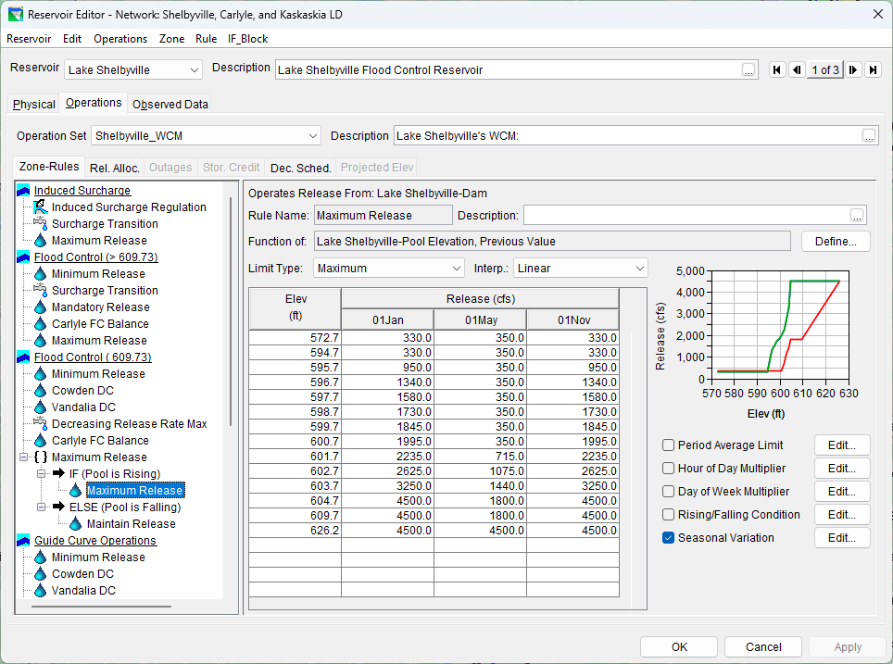
Reservoir Editor
Notes:
Introduction to ResSim
ResSim’s Reservoir Editor – Operations tab
This slide is a screen shot of the Reservoir Editor, Operations tab, Zone-Rules subtab. Describe the features of this tab…
Zone-Rules tree
Bold zone is the guide curve
Italic zone is the Inactive Zone (a special zone below which the reservoir cannot “operationally” release water)
The Edit Pane – changes with the selection in the tree
The Menus – change with the selection of the Major Tab
The other subtabs – additional modifiers on the operations

Slide 10
Alternatives
Reservoir Network Selection
Run Control
Alternative Type , Compute Timestep, Compute Options
Operations
Operation set per Reservoir, System Storage Balance
Lookback
Starting Conditions – Pool Elevation, Releases
Time Series
Local Inflows, Lookback Time Series, External Variables
Notes:
Introduction to ResSim
ResSim Alternatives
Reservoir Network Selection
Alternatives …are based on a Reservoir Network. And include:
Run Control data
Alternative Type – Standard, Ensemble, Monte Carlo, etc.
Compute Timestep – 5min to 1 day, 1 hour is typical for real-time
Compute Options – instantaneous vs period average, plus unreg and holdouts.
Operations
(Select an) Operation set per Reservoir
(Select a) Storage Balance plan per Reservoir System
Lookback - aka…Initial Conditions
Elevation or Storage
Releases per outlet, Diversion flow, state variables.
Each conditions can be defined with a Constant or Time Series.
In Real-time modeling, use of Time Series for these Initial Conditions wherever you have real-time observed data in the database
Time Series
Local Inflows
Lookback Time Series
External Variables needed for the operations

Slide 11
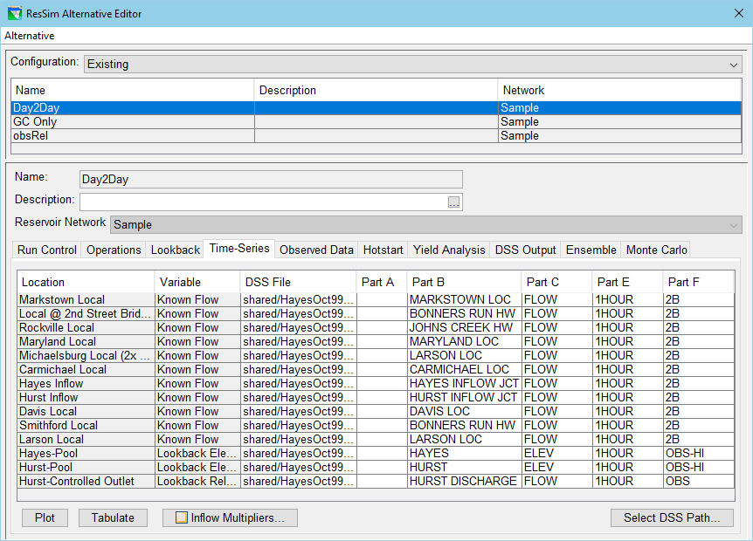
Alternative Editor
Notes:
Introduction to ResSim
ResSim’s Alternative Editor
This slide shows a screen shot of the ResSim Alternative editor at the Time-Series tab. Describe the features of this tab…
Upper panel: Existing Alternative list – includes the Reservoir Network identification, which it is the foundation of the alternative
Lower Panel: The selected alternative “editor” made up of several tabs for specifying the various aspects of the alternative. The first four are the most important:
Run Control
Operations
Lookback
Time-Series
Although each of the tabs are important, the Time-Series tab has some aspects worth noting:
The time series list includes several different types of required input based on the information specified in the network and on the Operations and Lookback tabs. These include:
Known Flows
Lookback Elevation, Lookback Release
Input Time Series
Others… (Lookback Diversion, Input Evap,…)
Inflow Multipliers button – for increasing or decreasing the inflows globally or one by one.

Slide 12
Simulation and Analysis
Simulation
a specified Time Window
a set of alternatives to analyze
Analysis Tools
Context-sensitive Plots
Release Decision Report
Summary Reports
Customized Plots
User-defined Reports
HEC-DSSVue
The Operations Support Interface (OSI)
Notes:
Introduction to ResSim
Simulation and Analysis
To compute and analyze the results of an alternative, the user must create a “simulation” (A ResSim concept) or “forecast” (the equivalent in CWMS).
A Simulation or Forecast is specified by:
a Time Window
a set of alternatives to be computed and analyzed.
Once an alternative has been computed, a variety of tools are available to analyze the results
Analysis Tools
Context-sensitive Plots
Release Decision Report
Summary Reports
Customized Plots
User-defined Reports
HEC-DSSVue/CWMSVue

Slide 13
HEC-ResSim’s Major Features
Graphical System Schematic, tightly integrated with CWMS (and HEC-WAT)
Hierarchical Outlet Structure
Diversions and Diverted Outlets
Release Allocation – Outlet Prioritization
Zone-Based Prioritized Operation Rule Set
Compute Intervals: 5min – 1day
Customizable Plots and Reports
Induced Surcharge Operation
Scheduled Local & System Hydropower
Tandem and Parallel System Operations
Pump-back Storage Operation
Conditional (If-then-else) Rule Activation
User-Scripted Rules & State Variables
Customizable Operations Support Interface (OSI)
Notes:
Introduction to ResSim
ResSim’s Major Features allow users to model a wide variety of situations
Graphical System Schematic, tightly integrated with CWMS. Includes an active schematic that provides access to model editors and output, from both ResSim and the CWMS
Hierarchical Outlet Structure. The benefits and limitations of this feature include:
Ability to separate power releases from spillway or sluice gate releases
Inability to operate to gates settings, ResSim is presently all about flow
Diversions and Diverted Outlets.
Diversions are from the river
Diverted outlets are from the (reservoir) pool.
Diversions are single minded. In other models, when using diversions at a reservoir, they take water away before the reservoir can decide what to do with it. Diverted outlets allow the modeler to prioritize and determine the pool diversions with the other reservoir releases.
Release Allocation – Outlet Prioritization
When the rules don’t care where the water is released from, the release allocation can take over.
Zone-Based Prioritized Operation Rule Set
The operation rules are specified per reservoir “zone”. This allows the rules/objectives to change depending on how full (or empty) the reservoir is.
Compute Interval Range: 5min – 1day
Typical intervals for real-time operation are 1hr, 6hr, or 1day. But really flashy systems may need 15 min or less. 6hr may be used when the operations are coordinated with the Weather Service forecast (which is usually published on a 6hr interval)
Customizable Plots and Reports
A standard set of plots and reports are available.
But, the standard plots allow the user to customize what they want to see and then save their custom plot configuration for later use as a “User Plot”
And, a report builder is available for creating customized tables of output in a generalized report format.

Slide 14
HEC-ResSim’s Role in CWMS
Simulate Real-Time Reservoir Operations
Much of a water manager’s function is to operate the district’s reservoirs. CWMS is intended to support that effort.
CWMS, therefore, needed a modernized and integrated reservoir simulation model.
To meet that need, HEC-ResSim was developed in parallel with CWMS and its design requirements were strongly influenced by the water management community.
A good HEC-ResSim model for CWMS should provide the water manager a good first guess to use when determining the upcoming release schedule for their reservoirs.
Notes:
Introduction to ResSim
ResSim’s Major Features allow users to model a wide variety of situations
Graphical System Schematic, tightly integrated with CWMS. Includes an active schematic that provides access to model editors and output, from both ResSim and the CWMS
Hierarchical Outlet Structure. The benefits and limitations of this feature include:
Ability to separate power releases from spillway or sluice gate releases
Inability to operate to gates settings, ResSim is presently all about flow
Diversions and Diverted Outlets.
Diversions are from the river
Diverted outlets are from the (reservoir) pool.
Diversions are single minded. In other models, when using diversions at a reservoir, they take water away before the reservoir can decide what to do with it. Diverted outlets allow the modeler to prioritize and determine the pool diversions with the other reservoir releases.
Release Allocation – Outlet Prioritization
When the rules don’t care where the water is released from, the release allocation can take over.
Zone-Based Prioritized Operation Rule Set
The operation rules are specified per reservoir “zone”. This allows the rules/objectives to change depending on how full (or empty) the reservoir is.
Compute Interval Range: 5min – 1day
Typical intervals for real-time operation are 1hr, 6hr, or 1day. But really flashy systems may need 15 min or less. 6hr may be used when the operations are coordinated with the Weather Service forecast (which is usually published on a 6hr interval)
Customizable Plots and Reports
A standard set of plots and reports are available.
But, the standard plots allow the user to customize what they want to see and then save their custom plot configuration for later use as a “User Plot”
And, a report builder is available for creating customized tables of output in a generalized report format.

Slide 15
Integrating an HEC-ResSim model into CWMS

Slide 16
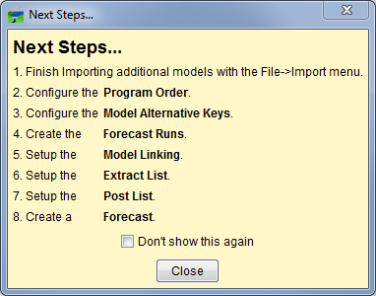
Watershed Setup - A Process…
Notes:
Integrating a ResSim model into CWMS
Watershed Setup – A Process
This slide shows the Next Steps dialog. This dialog is displayed by the CAVI after you (first) create a new watershed. It is a reminder of the steps you need to take to assemble a watershed for use in CWMS…
Import any additional models
Define the Program Order
Note: steps 1 & 2 are swappable. It may be more logical to specify the program order before importing the models.
Assign Key Letters
Create a Forecast Run. Assemble the model alternatives into a sequence. Only “lettered” alternatives can be used
Model Linking. Establish the data flow between the models
Configure the Extract Groups. Create the extract groups so that the data needed by your models will be available for the compute
Setup your Post Lists decide what you want to store back to the database from your forecasts. Complete this after models are up and running smoothly
Create a Forecast. The forecast will exercise the extract. Test the data and model linking by computing, correct any problems, retest…
Save. Talk about saving here, even though the illustration doesn’t…
Save to Base – either the forecast run or the individual models. This will ensure that any changes you made to get the forecast running are available for the next forecast.

Slide 17
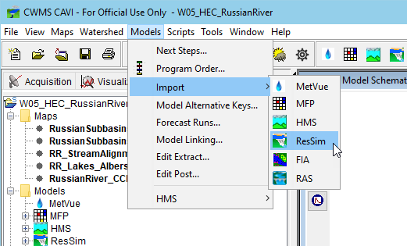
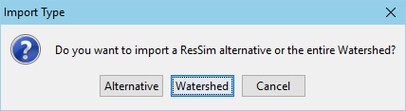
Importing Models
Notes:
Integrating a ResSim model into CWMS
Importing Models
This slide shows the Models menu from the CAVI, the submenu under import, and the query dialog you will see when you select ResSim to import.
Models Menu, Import… Each model in the Program Order should be in the imported if available, but… If ResSim is going to be used, Import the ResSim model FIRST.
a ResSim watershed and a CWMS watershed share a common framework. Because of this, a CWMS watershed can (and should) be created from a ResSim watershed
When a ResSim watershed is imported, the CWMS watershed gets the ResSim watershed’s maps, stream alignment, and configuration information as well as the ResSim model data – networks, alternatives, & simulations
When Importing a ResSim model, you will be asked if you want to import just an alternative or a whole watershed.
If the CWMS watershed does not yet have a ResSim model, pick Watershed.
If you have already imported a ResSim watershed but want to add a new alternative or update an existing one from the original source watershed, pick Alternative.
“from the original watershed” should be stressed here. This is because there are a number of foundational aspects of the watershed that should be consistent between the existing CWMS watershed and the ResSim watershed you are importing from. These include the configurations and a variety of overlapping files – especially networks.

Slide 18
Importing… Watershed versus Alternative
Watershed
Alternative
Everything from the watershed is brought in – no questions asked…
Stream Alignment
Configurations & Elements
Networks
Alternatives
Simulations
Maps
HEC-DSS Files
More
Only the Alternative and its network files are brought in
No Stream Alignment
No Configurations & Elements
A valid stream alignment must already exist in the watershed
Importer tries to place network elements on the correct streams…
…and tries to tie them to existing configuration elements.
Notes:
Integrating a ResSim model into CWMS
Importing Watershed vs Alternative
Watershed – everything is brought in from the standard folders of the watershed, no questions asked. This includes the:
Stream Alignment
Configurations and Schematic Elements (not so sure about this one..)
Reservoir Networks
Alternatives
Simulations.
Maps
Shared folder – DSS files.
HOWEVER, any additional folders you’ve added to the watershed may not be imported (copied) into the CWMS watershed so review new watershed carefully.
Alternative – only the files associated with the alternative and its network are imported (copied) into the CWMS watershed.
No Stream Alignment
No Configurations
The Alternative Importer tries to associate all network elements to their streams so a valid stream alignment must already be in the watershed.
The importer also tries to associate the network with its configuration, so if the configurations are not already in the watershed, the links to the configuration elements will be broken; this is not a problem for CWMS, but may be of concern if the CWMS watershed is later used as the basis for a study model.

Slide 19
Revising a ResSim Alternative for CWMS
Revise Lookback settings (Use Observed Data):
For each reservoir…
Set Lookback Elevation to Time Series
Set Lookback Release to Time Series
If time series do not exist for every outlet
Set ONE Controlled Outlet to Time Series
Set all other outlets to Constant - Set those constants to zero
If time series does not exist or are not reliable for pool elevation and/or outflow, advanced options exist to estimate one or both variables
Lookback Elevation:
Set to Guide Curve
Function of Release (needs an initial pool elevation to start)
Start with Constant
Start with Time Series
Start with Guide Curve
Lookback Release
Function of Elevation
Notes:
Integrating a ResSim Model into CWMS
Revising a ResSim Alternative for use in CWMS – Use Observed Data
(before or after import, this is what you should consider to make the alternative appropriate for real-time use).
But – we aware – in CWMS 3.x, ResSim alternatives can continue to be used in standalone, so some of your changes could affect how the alternative works in standalone.
Revise the Lookback settings:
The lookback settings are the Initial Conditions for your reservoirs. You should use current observed data for your real-time model.
For each reservoir…
Set Elevation to Time Series
Set ONE outlet to Time Series
Set all other outlets to Constant - Set those constants to zero
Note – there are lots of caveats to these last two instructions. What are some of them?
Controlled outlet – gates, spillway, power plant
Observed total flow vs observed individual flow – is there a gage? Is the observed estimated?
Uncontrolled outlets

Slide 20
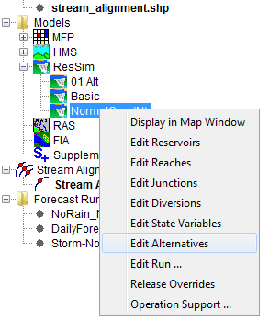
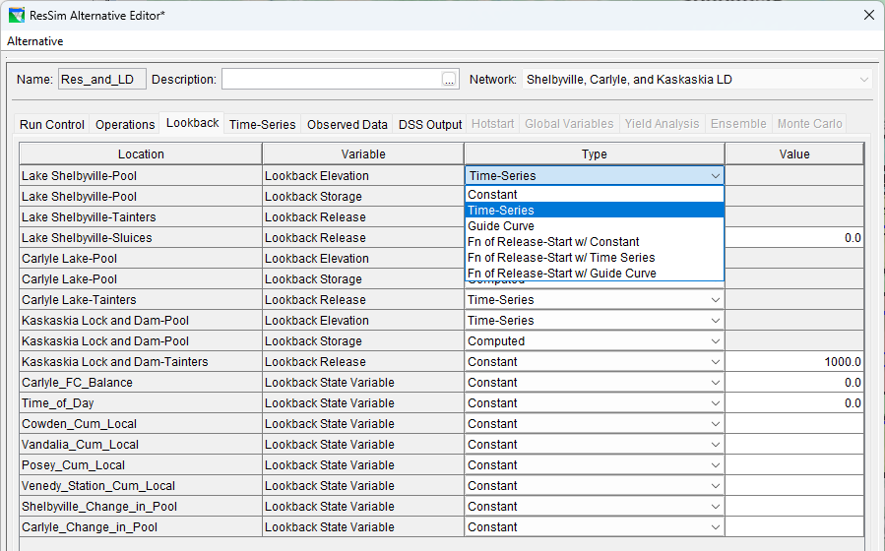
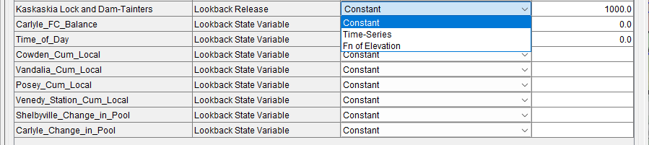
Revising an Alternative for CWMS
Notes:
Integrating a ResSim Model into CWMS
Revising a ResSim Alternative for use in CWMS, continued
This slide contains 2 screen shots:
one of the context menu from the Alternative in the CAVI setup tab’s model tree
one of the Lookback Tab of the Alternative Editor
If the ResSim modeler created the watershed for use in CWMS, then the alternatives may already be “ready to go”. Check ‘em anyway. To do so,
right click on the ResSim alternative in the models tree and select Edit Alternatives…
The ResSim alternative editor for the selected alternative will open. Go to the Lookback Tab.
Make sure that for each reservoir, the reservoir pool elevation (or storage) and the release from at least one outlet are set to Time Series.
Set the other outlet releases to zero (0.0)
Explain WHY these entries should be set to Time Series and discuss data availability.
Explain how constant vs time-series affects the real-time regulator. Talk about the exceptions.

Slide 21
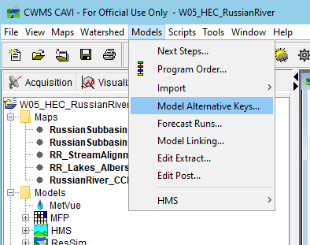
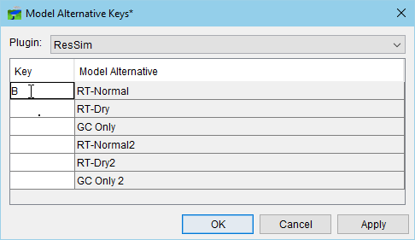
Assigning Model alternative Keys
Notes:
Integrating a ResSim Model into CWMS
Assigning Key Letters
A “key” must assigned to each alternative that is going to be used in a CWMS forecast run
It must be an single alpha-numeric character: A-Z and 0-9
Not case sensitive
Each character can only be used once per model but can be reused by another model. E.g., Both HMS and ResSim could have alts with the key “B”
The forecast run assembles a “key string” from the individual alternatives’ keys that were selected to form the run
Each alternative’s substring of the run’s key string is used to label the F-Part of the DSS pathname of each output record that they produce at compute time.

Slide 22
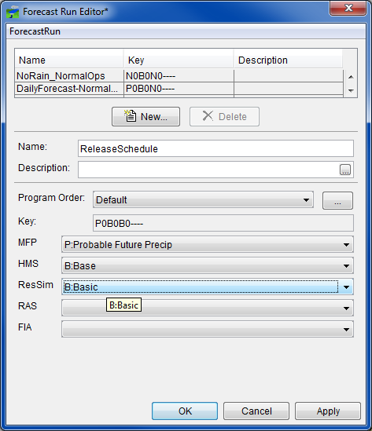
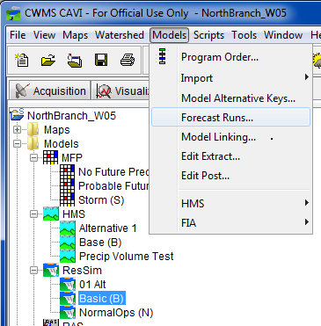
Creating Forecast Runs
Notes:
Integrating a ResSim Model into CWMS
Creating Forecast Runs
this slide contains 2 screen shots:
one of the Models menu from the from the Modeling Tab of the CAVI
one of the Forecast Run Editor
Explain the following…
To Create a Forecast Run Open the Forecast Run Editor from the Models menu (select Forecast Runs…)
Click New.
Give the new forecast run a Name. Be descriptive, but not too long
Select the model alternatives
Click Apply or OK.
Not all models of the program sequence must be “filled in” with an alternative; you can decide which models you want to include or not include in a particular forecast run.
For example you may just want a RAS/FIA forecast run to use only during flood events. This run might use data from other forecast runs. This would ensure you not running them unnecessarily in a daily forecast
Another example could be to leave out HMS and MFP because you only want to use flows from the local RFC for ResSim’s inflows.

Slide 23
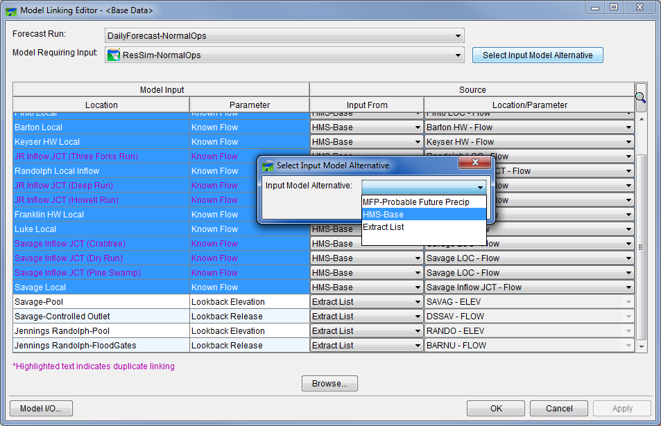
Model Linking
Extract vs Model Input
Known Flow
More than likely is linked to HMS
Could be extract if RFC flows are used
The Know Flow time series must cover the entire simulation time window (lookback and forecast)
Lookback Elevation and Release
More than likely is linked to Extract
Only needs to cover the lookback time window
Notes:
Integrating a ResSim Model into CWMS
Model Linking.
This slide illustrates the Model Linking Editor. The model being linked is ResSim, the “Known Flow” rows are highlighted and the “Select Input Model Alternative but has been selected so that the dropdown dialog is shown
Be careful – the list of input that ResSim generates is in sections…
The local inflows, then the Lookback and Operations’ Input Time Series, then the Observed data. All listed inputs are required EXCEPT the observed.
Set the “Input From” and set the source for each row of required input
The first several rows of the list are the inflows (“Known Flow” is ResSim’s parameter name for inflow data).
You should select these rows as a group,
then click on the “Select Input Model Alternative” button.
A small dialog with a dropdown list will appear
Select the model in the sequence that will be producing the inflows for your ResSim model then press Ok.
This data is usually produced (for the whole time window of the forecast or simulation) by HMS (a rainfall runoff model) which precedes ResSim in the CWMS program order.
The NOAA-NWS RFC may be producing the forecasted inflows for your forecast run. In this condition, there is no preceding model that generates them, so “Input From” should be set to Extract List.
When you perform a “mass” linking this way, another small dialog will appear that asks if you are sure you want to “link” all those rows to the selected alternative. Unless you accidently picked the wrong model alternative, click Yes.
The other is a portion of the table in the model linking editor…

Slide 24
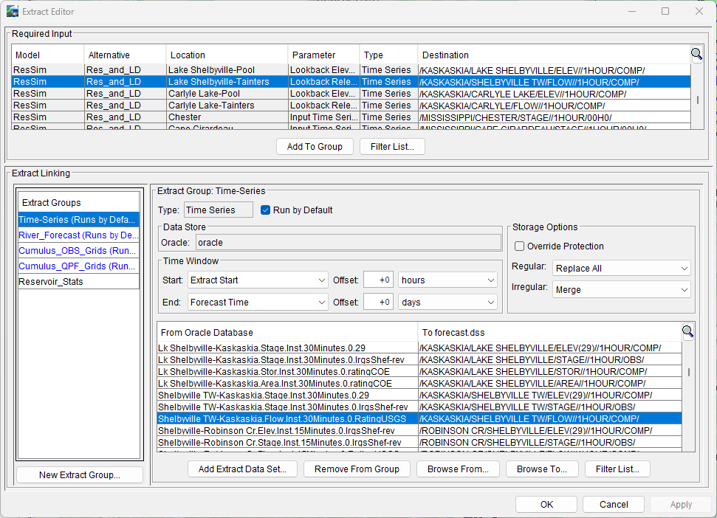
Configuring the Extract
Notes:
Integrating a ResSim Model into CWMS
Configuring the Extract
This slide is a screen shot of the Extract Editor
Focus on the ResSim “required inputs”: Lookback Data! And maybe operational info…
Discuss time step, time window, and data type.
Time series, grids
15 min data vs hourly or daily
Instantaneous versus period average
Explain how this affects which group a given record should be added to.
Interpolation
Extract Offsets

Slide 25
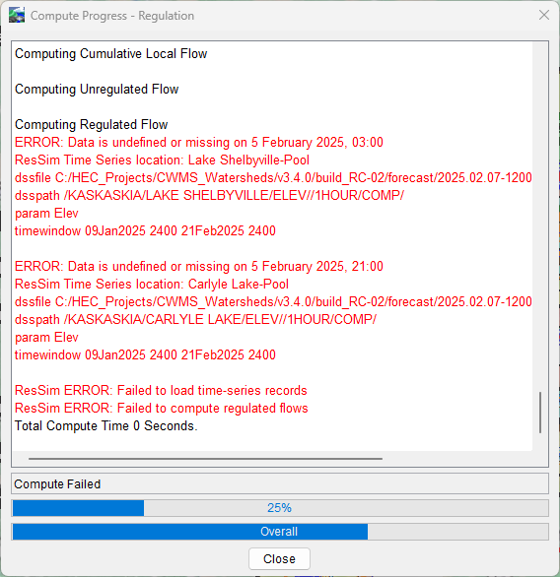
Compute
Progress Dialog
Watch for messages
Red Text are ERRORs
Yellow/Orange Text are Warnings
Black Text is informational
Most Errors are caused by the input data
Fill in missing data
Link to a different data source
Adjust the extract time window, add offset.
Re-Run the Extract
Notes:
Integrating a ResSim Model into CWMS
Compute, Continued
Watch the Compute Progress Dialog. When Done (success or failure)…
Spend some time reading the messages in the Compute Progress Dialog
(usually) Red Text are ERRORs – a red message usually indicates a problem that halts the compute. The problem must be resolved before you can get a complete compute.
Yellow/Orange Text are Warnings - understand the warnings – these usually won’t stop the compute but your results may be questionable
Black Text is informational - become familiar with the messages, there’s important “progress” information in there
Look for more information generated by the compute in:
Message Box of the CAVI, Compute Log, Console Log, Model Server Log
Most Errors are caused by the input data
Analyze and Correct Any Errors
For Example “known release TS empty or invalid”
means: a time series record is empty, missing, or has “validity” flags raised. And…”known release”.. What’s that? A Lookback release? Or a local flow?
But look deeper… at the messages around the error messages.
See if you are being told which model element the TS is for.
Do you know where ResSim is in its compute process? (Init, cumloc, unreg, reg, holdouts?)
Is there a time window message or a date and time in the message?
If so, check the message’s time info against the compute time window in the control panel (and at the beginning of the Progress dialog’s ResSim messages) Use DSSVue to check if the time-series record exists in the forecast.dss file and if it does, check if there’s missing data.

Slide 26
Using HEC-ResSim for Real-Time Decision making

Slide 27
Real-Time Modeling Procedure
Review Data
Check status of the data streams and the basin’s gages
Familiarize yourself with current basin conditions and weather forecast
Review the current and forecasted precipitation (and snow?) grids
Identify an appropriate forecast time window – esp. lookback and forecast times
Notes:
ResSim for Real Time Decision Making
Real Time Modeling Procedure
Review Data
Check Status of the data streams and the basin’s gages
Familiarize yourself with Current Basin Conditions and Weather Forecast
Review the current and forecasted precip (and snow?) grids
Identify an appropriate forecast time window – esp lookback and forecast times

Slide 28
Real-Time Modeling Procedure
Review Current Data
Identify an appropriate forecast time window
Create a Forecast
Use the time window you identified
Recommend including at least two Forecast Runs
No Future Precipitation
Expected (Probable) and/or Possible Future Precipitation
Add additional offsets to the Time Window, if needed
Compute all runs through HEC-ResSim
Notes:
ResSim for Real Time Decision Making
Real Time Modeling Procedure - continued
Review Data
Check Status of the data streams and the basin’s gages
Familiarize yourself with Current Basin Conditions and Weather Forecast
Review the current and forecasted precip (and snow?) grids
Identify an appropriate forecast time window – esp lookback and forecast times
Create a Forecast
Use the time window you identified
Include at least two Forecast Runs
No Future Precip
Expected (Probable) and/or Possible Future Precip
Add additional offsets to the Time Window, if needed
Compute all runs through ResSim

Slide 29
Real-Time Modeling Procedure
For each Forecast Run, Analyze the Reservoir Operations
Review Standard and Custom Plots, Reports, OSI
Make modifications to the HEC-ResSim model as needed to develop an appropriate Release Schedule
Release Overrides - OSI
Rule and/or Zone adjustments
Physical Parameter updates
Save to Base
If changes made are needed for future forecast runs
Rule and/or Zone adjustments
Physical Parameter updates
Notes:
ResSim for Real Time Decision Making
Real Time Modeling Procedure, continued.
For each Forecast Run, Analyze the Reservoir Operations
Review Standard and Custom Plots, Reports, OSI
Make modifications as needed to develop an appropriate Release Schedule
Release Overrides
Rule and/or Zone adjustments
Physical Parameter updates
Save – To – Base!
At this point, saving is selective – do I or don’t I?
Go over what gets saved for ResSim – Everything related to the Alternative ( including the overrides?)

Slide 30
Tools for Analyzing Results
Active Schematic
Standard Plots & the Release Decision Report
Element Specific
Found on context menu from schematic elements
Standard Reports
Summary Reports – by Element Type, Some Statistics
Found on the Reports tab when you’ve selected a HEC-ResSim alternative in the Forecast runs tree
CWMS-Vue/HEC-DSSVue
Access to more detailed ResSim output
Filter by F part…
Notes:
ResSim for Real Time Decision Making
Tools for Analyzing ResSim Results…
Active Schematic
Standard Plots & the Release Decision Report
Element Specific
Found on shortcut (right click) menu from schematic elements
Standard Reports
Summary Reports – Flows per Element Type, Some Statistics
Found on the Reports tab when you’ve selected a ResSim alternative in the Forecast runs tree
CWMSVue/DSSVue
Access to more detailed ResSim output
Filter by F part

Slide 31
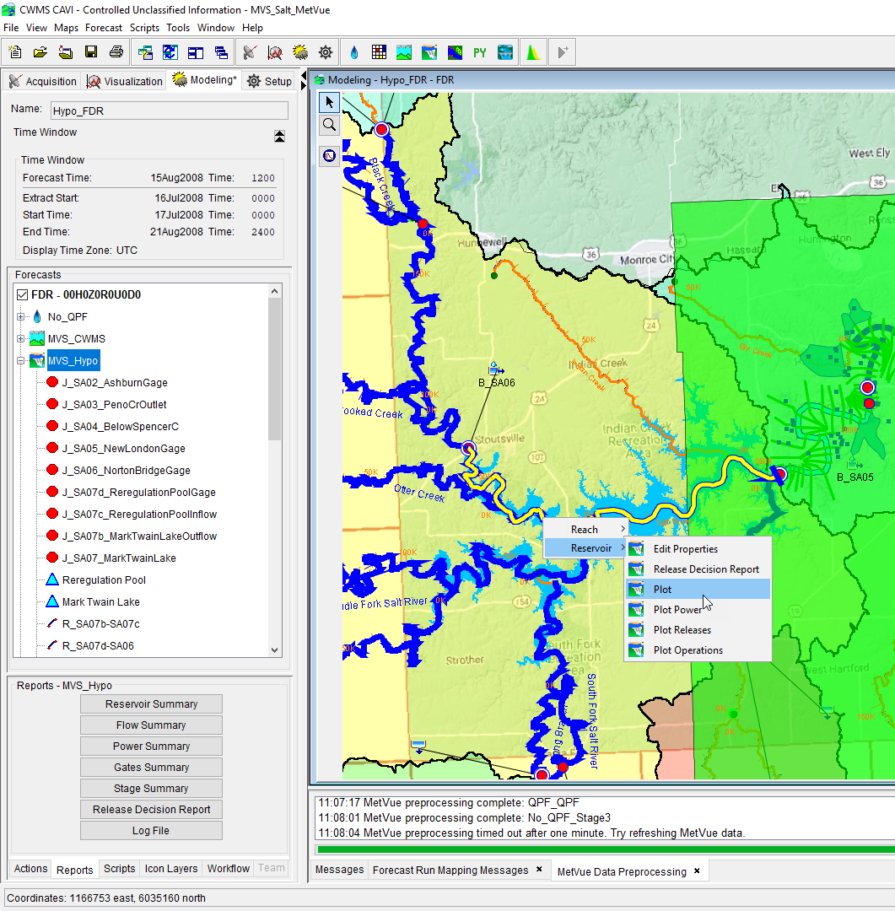
Viewing Results
Output is available from:
Forecast Run Alternative modeling tree
Reports Tab below modeling tree
From the modeling schematic in the CAVI Modeling map window
Opening the specific model from the standalone application
Or opening the forecast.dss file via CWMS-Vue and sorting the results based upon the model results F-Part
View Results

Slide 32
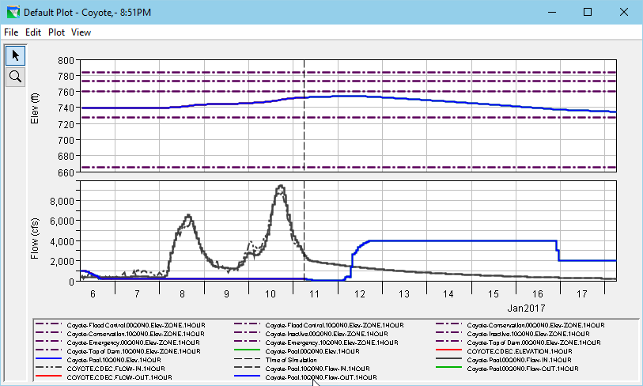
The Standard Reservoir Plot
Notes:
ResSim for Real Time Decision Making
The Standard Reservoir Plot
This slide is a screen shot of a standard Reservoir plot. Describe how the plot is arranged (and how to interpret it.)
In the upper viewport, the computed elevation of the selected reservoir and its operating zones are plotted
In the lower viewport, the computed inflow and outflow from the reservoir (pool) are plotted.
Other common option for reviewing results
tabulating from the default plots – File menu
customizing the plot – Edit and Plot menus
Remind them about the CWMS graphics lecture and workshop on Wednesday

Slide 33
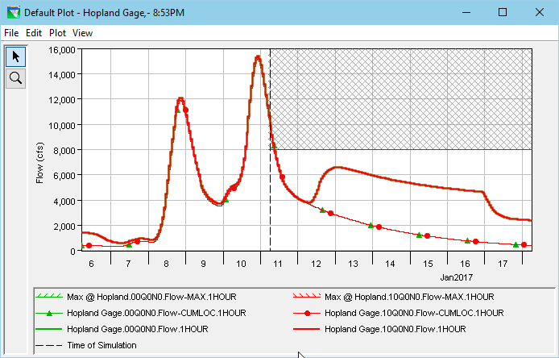
The Standard Junction Plot
Notes:
ResSim for Real Time Decision Making
The Standard Junction Plot
This slide is a screen shot of a standard Junction plot. Describe how the plot is arranged (and how to interpret it.) Point out how to read the plot, emphasize…
The Junction’s (out)Flow
Limiting Rules
Flow-Cumloc

Slide 34
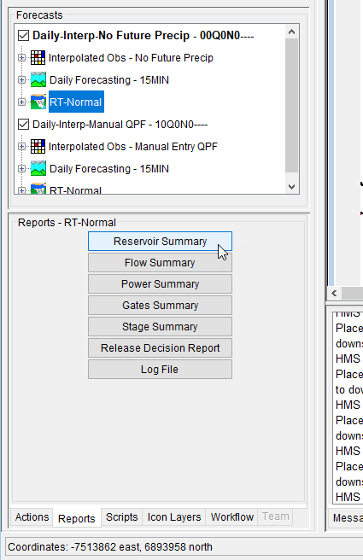
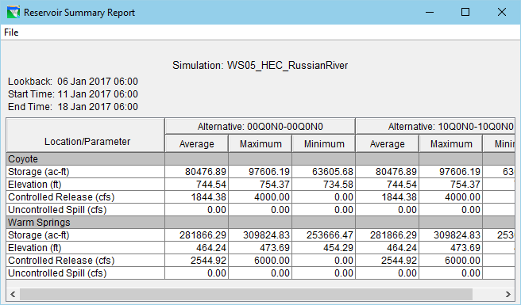
The Reports Tab
Notes:
ResSim for Real Time Decision Making
The Reports Tab
This slide is has two screen shots:
One of the Forecast Control Panel (run tree and subtabs, with the Reports Tab selected)
One of the Reservoir Summary Report
Point out the sub-tabs of the Forecast Control Panel
Explain that some are context sensitive to the selection in the Runs Tree
For ResSim, the Reports tab contains links to ResSim’s Summary Reports

Slide 35
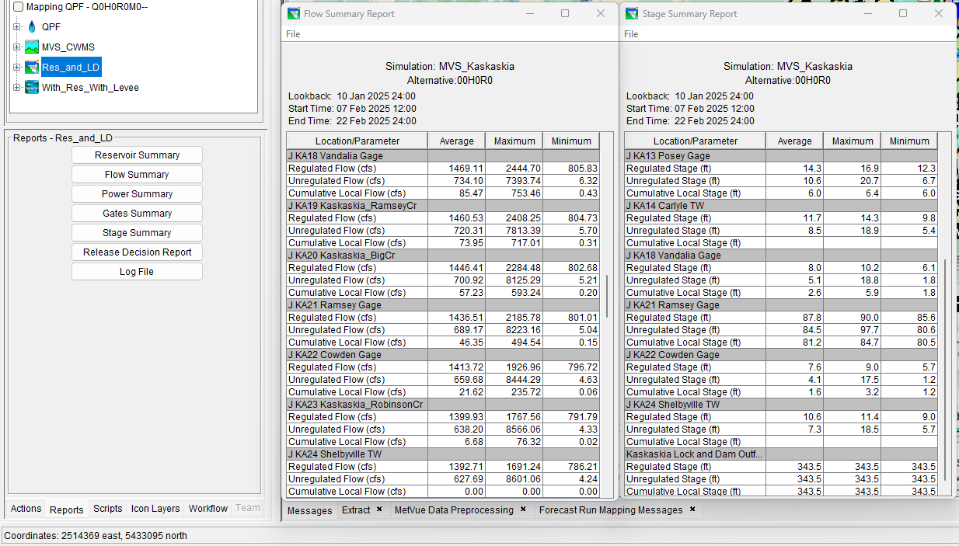
The Reports Tab
Summary Reports:
Reservoir Summary report is available for any network with a reservoir
Flow Summary report is available for any ResSim network
Power Summary report requires a hydropower house to be associated to a reservoir
Gates Summary Report is available if gates curves have been defined in the Physical Properties
Stage Summary report is available for junctions with stage-discharge rating curves defined
Notes:
ResSim for Real Time Decision Making
The Reports Tab
This slide is has two screen shots:
One of the Forecast Control Panel (run tree and subtabs, with the Reports Tab selected)
One of the Reservoir Summary Report
Point out the sub-tabs of the Forecast Control Panel
Explain that some are context sensitive to the selection in the Runs Tree
For ResSim, the Reports tab contains links to ResSim’s Summary Reports

Slide 36
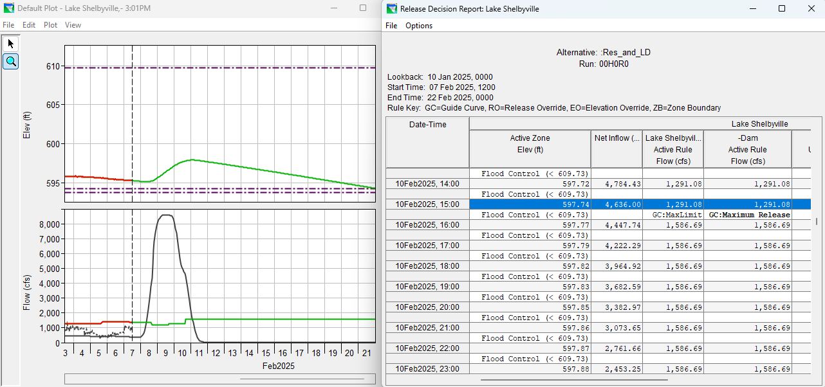
The Release Decision Report
Notes:
ResSim for Real Time Decision Making
The Release Decision Report is designed to tell you what led to the release decisions at each timestep.
This slide is a screen shot of the Release Decision Report. Describe how the report is arranged (and how to interpret it.)
The start of the report = time of forecast
The two lines/rows per timestep
One row for what it did
And one for why it did it
The columns for zone, elevation, and each level of the outlet hierarch
The bold vs std text – explain that bold text indicates a user specified rule
The codes – like GC to be Guide Curve Operation, MinLim, PhysMaxCap

Slide 37
Release Overrides

Slide 38
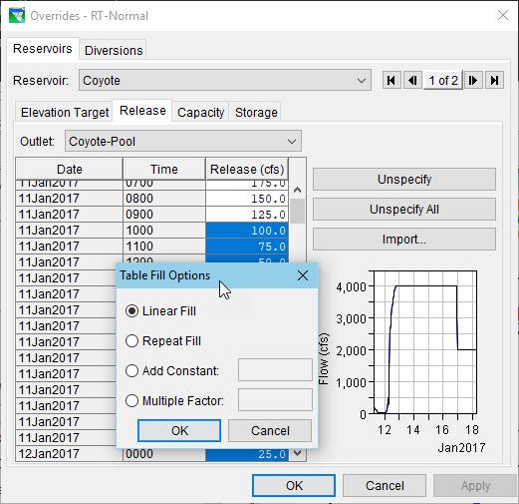
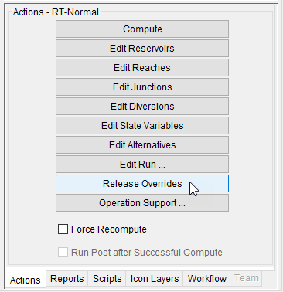
Release Overrides
Notes:
ResSim for Real Time Decision Making
This slide contains a screen shot of the CAVI’s Actions tab and another of the ResSim Overrides Editor.
Release Overrides allow the user to specify an exact operation constrained only by physical capacity (I.e., the rules, zones, and guide curve are ignored for the time step at which you have specified the overrides)
Why override the Releases?
Mimic gate settings
Evaluate influence of a NOT by the book release schedule
The rules “aren’t cutting it”.
Trials vs Alternatives –
Acknowledge that CWMS 3.0 cannot do trials
Suggest possibility of a “base” alternative, and one or more to tinker with
Process of defining overrides
COMPUTE (if you haven’t already)
Hand enter new values
Enter value in selected cell, select range, fill-repeat
Enter value in first and last cell of a range, fill-linear
Use a Fill-Factor or Fill–add Constant option for a range
Ok & RECOMPUTE

Slide 39
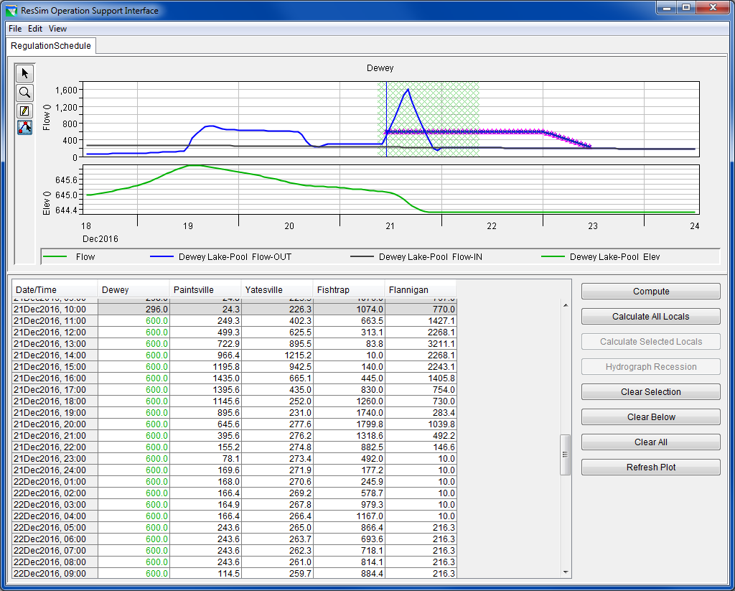
Operations Support Interface (OSI)
Notes:
ResSim for Real Time Decision Making
Operations Support Interface (OSI)
This slide shows a screen shot a fully setup OSI…
The OSI is a fully configurable interface for building your own Release Overrides Editor – It is more like a ‘dashboard’ for defining your regulation schedule.
Select the ResSim alternative in a Forecast. Launch the OSI from the Action buttons.
If the OSI is blank, add a Tab from the Edit menu
Add a Variable – this is the “variable” you are overriding, like a Reservoir Release.
Give it a Name and Description, and Set the Element Type - Reservoir
Select the Element and Select the Variable (Type) – Release, Press OK
Click on a value in the column that was added for your variable in the OSI’s table. Notice what happens to the plot in the upper part of the OSI
Edit your Variable
Add Additional relevant Time Series to be displayed in plot
Add a Max Target for your Variable.
Press OK. Click to another variable’s column and then back to this one or Click Refresh Plot. Notice what happens to the plot.
Enter an override of a reservoir release
Use the graphical editing tool (the 4th one) and draw in your override or enter the override values in the table. (You end drawing by right-clicking on your last point)
Press Compute to see the results of the overrides you entered
Consider adding a second tab to show the elevation (and stage) at key control points in the watershed.
A separate handout is available that covers these steps. Hand it out or go over it if you can’t do a demo.

Slide 40
OSI – Operations Support Interface
Configured by the User
Intended for:
Developing Overrides
Tabs are for organizing variables
Variables are for editing or displaying data
Reservoir Overrides
Computed Results

Slide 41
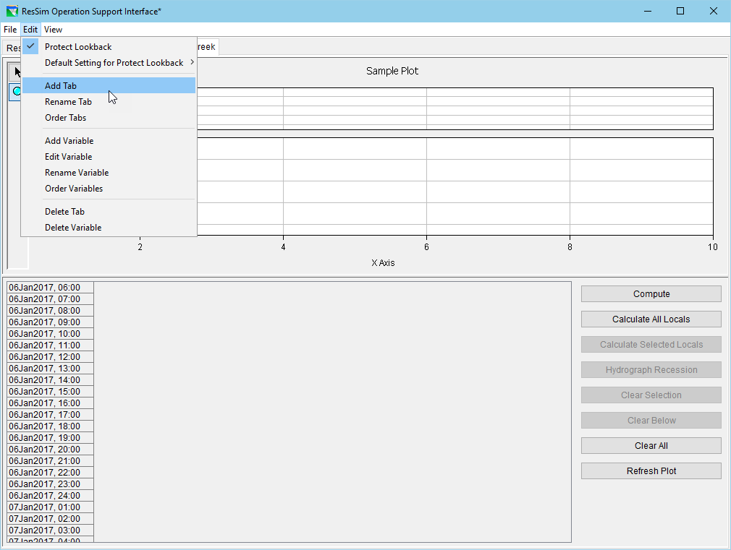
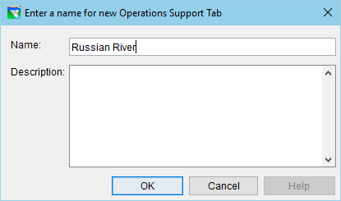
OSI – Adding a Tab

Slide 42
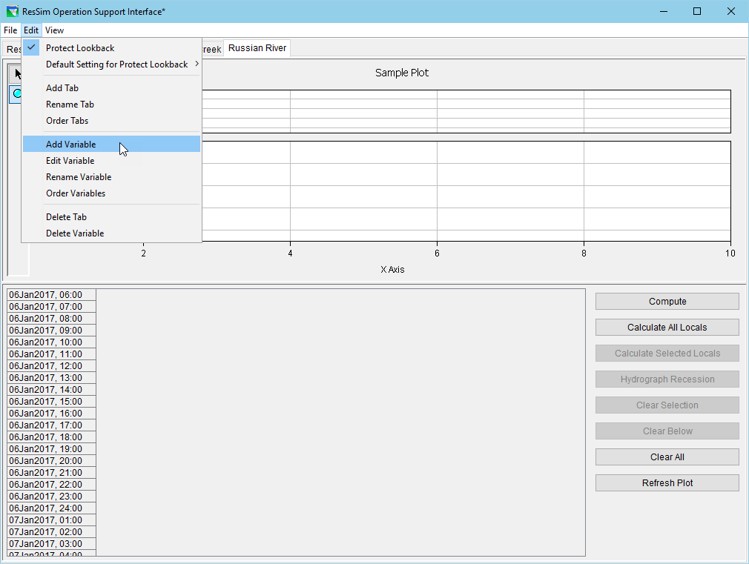
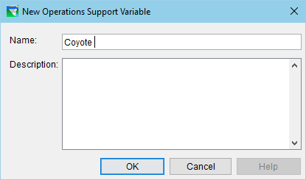
OSI – Adding a Variable

Slide 43
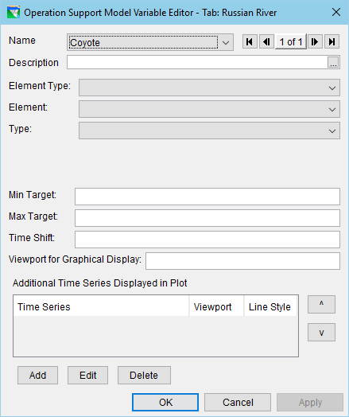
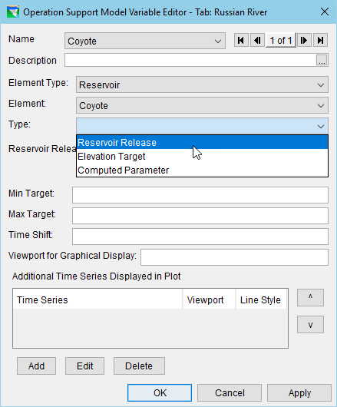
OSI – Setting up the Variable

Slide 44
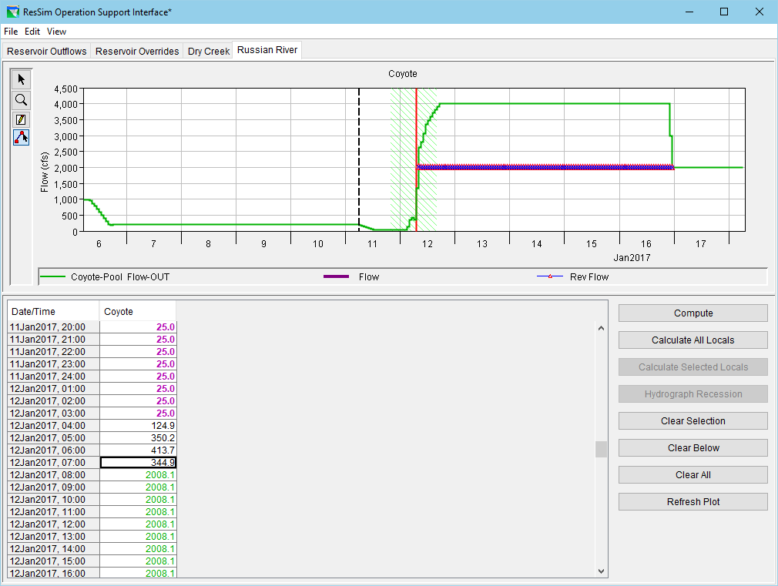
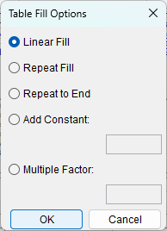
OSI – Entering Overrides

Slide 45
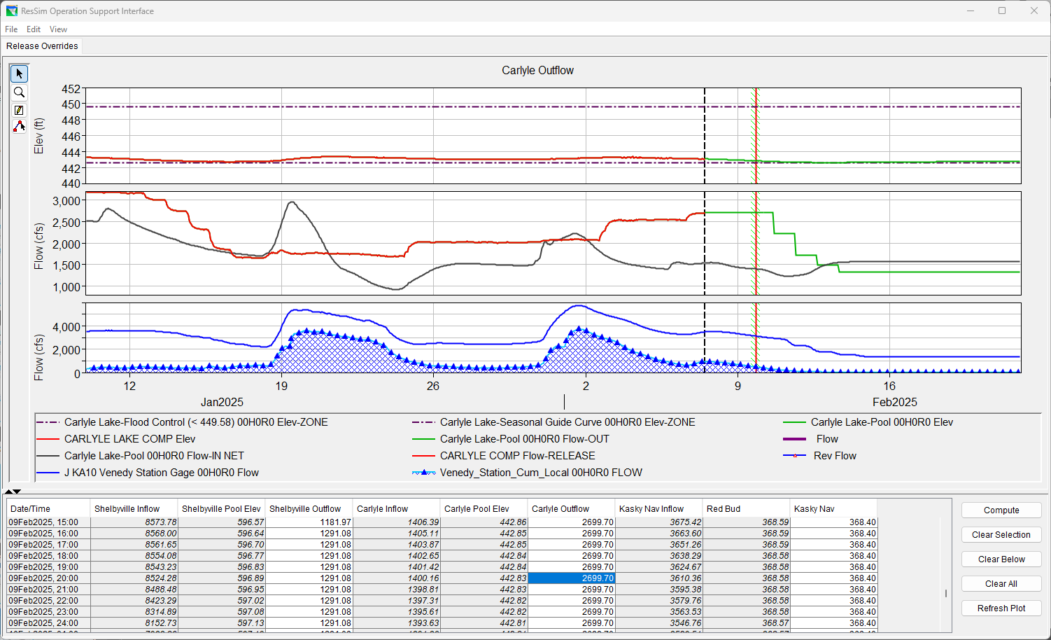
OSI – Configuration Examples

Slide 46
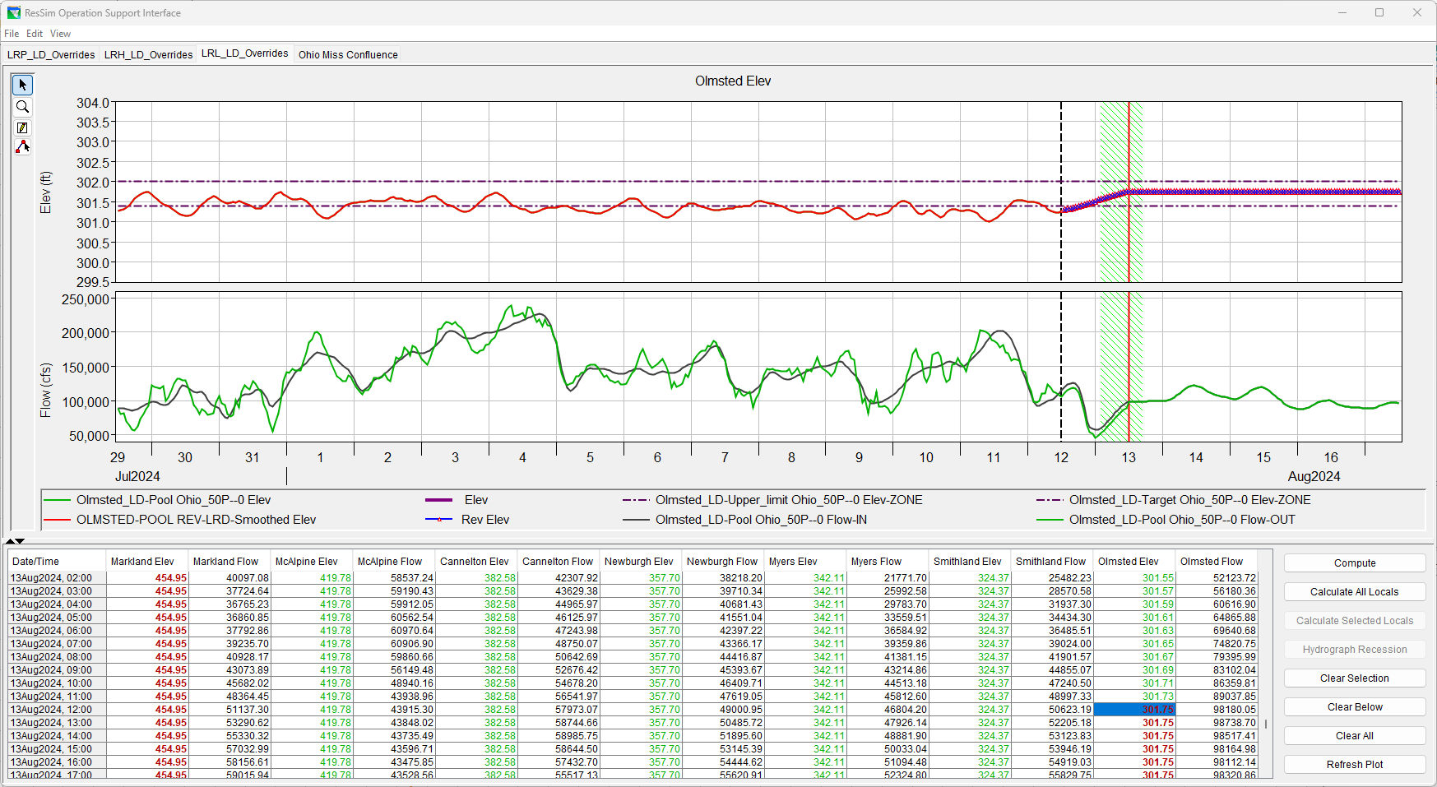
OSI – Configuration Examples

Slide 47
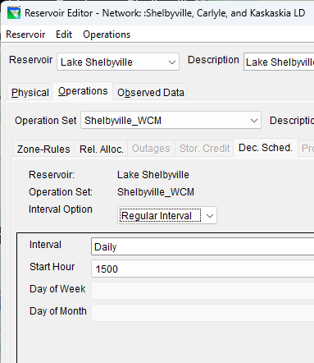
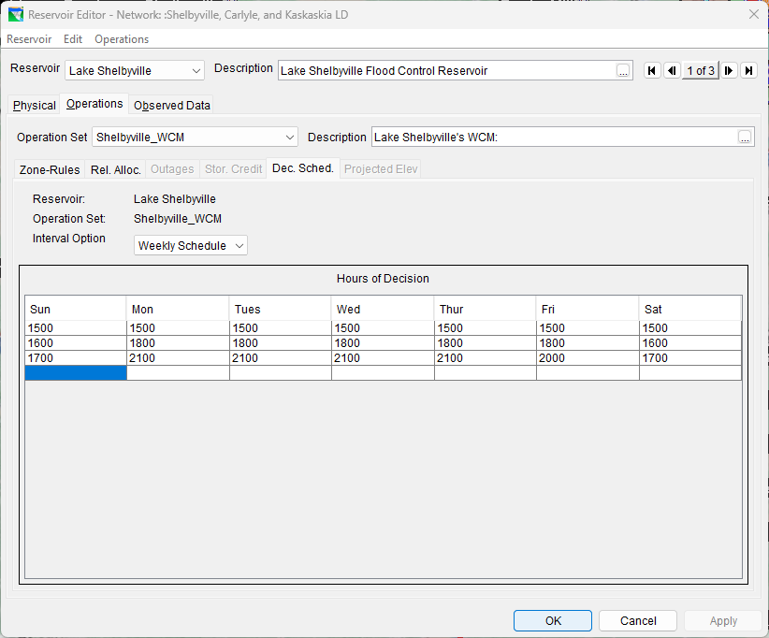
Capabilities & Limitations
Gates & Gate Operations
Time Series of Gate Openings (with gate curves)
Flows are what the program wants to be at the end of the timestep, not some reasonable gate setting for an ordered gate usage
Time Step
Decision Interval
Each Time-Step (default)
Regular Interval
1hr, 6hr, Daily, etc.
Weekly Schedule
Set the times of day based
upon the day of week
when changes can occur
Notes:
ResSim Capabilities & Limitations
Gates & Gate Operations
Time Series of Gate Openings (with gate curves)
Flows are what the program wants to be at at the end of the timestep, not some reasonable gate setting for an ordered gate usage
Time Step
New Decision each Time-Step
Decision Interval, limited…
Others?

Slide 48
Summary
HEC-ResSim is the integrated reservoir simulation model included in the CAVI’s suite of real-time decision support tools.
HEC-ResSim Model Integration includes…
Revising the ResSim Alternatives’ Lookback settings
Establishing the model linking to HMS results and observed data
Configuring the Extract groups
Using HEC-ResSim for Real-time Decision Support involves…
Analyzing the model’s releases
Performing “What-if” analysis
Developing a realistic release schedule
Testing and revising your schedule
Notes:
Summary
ResSim is the integrated reservoir simulation model included in the CAVI’s suite of real-time decision support tools.
ResSim Model Integration includes…
Revising the ResSim Alternatives’ Lookback settings
Establishing the model linking to HMS results and observed data
Configuring the Extract groups
Using ResSim for Real-time Decision Support involves…
Analyzing the model’s releases
Performing “What-if” analysis
Developing a realistic release schedule
Testing and revising your schedule

Slide 49
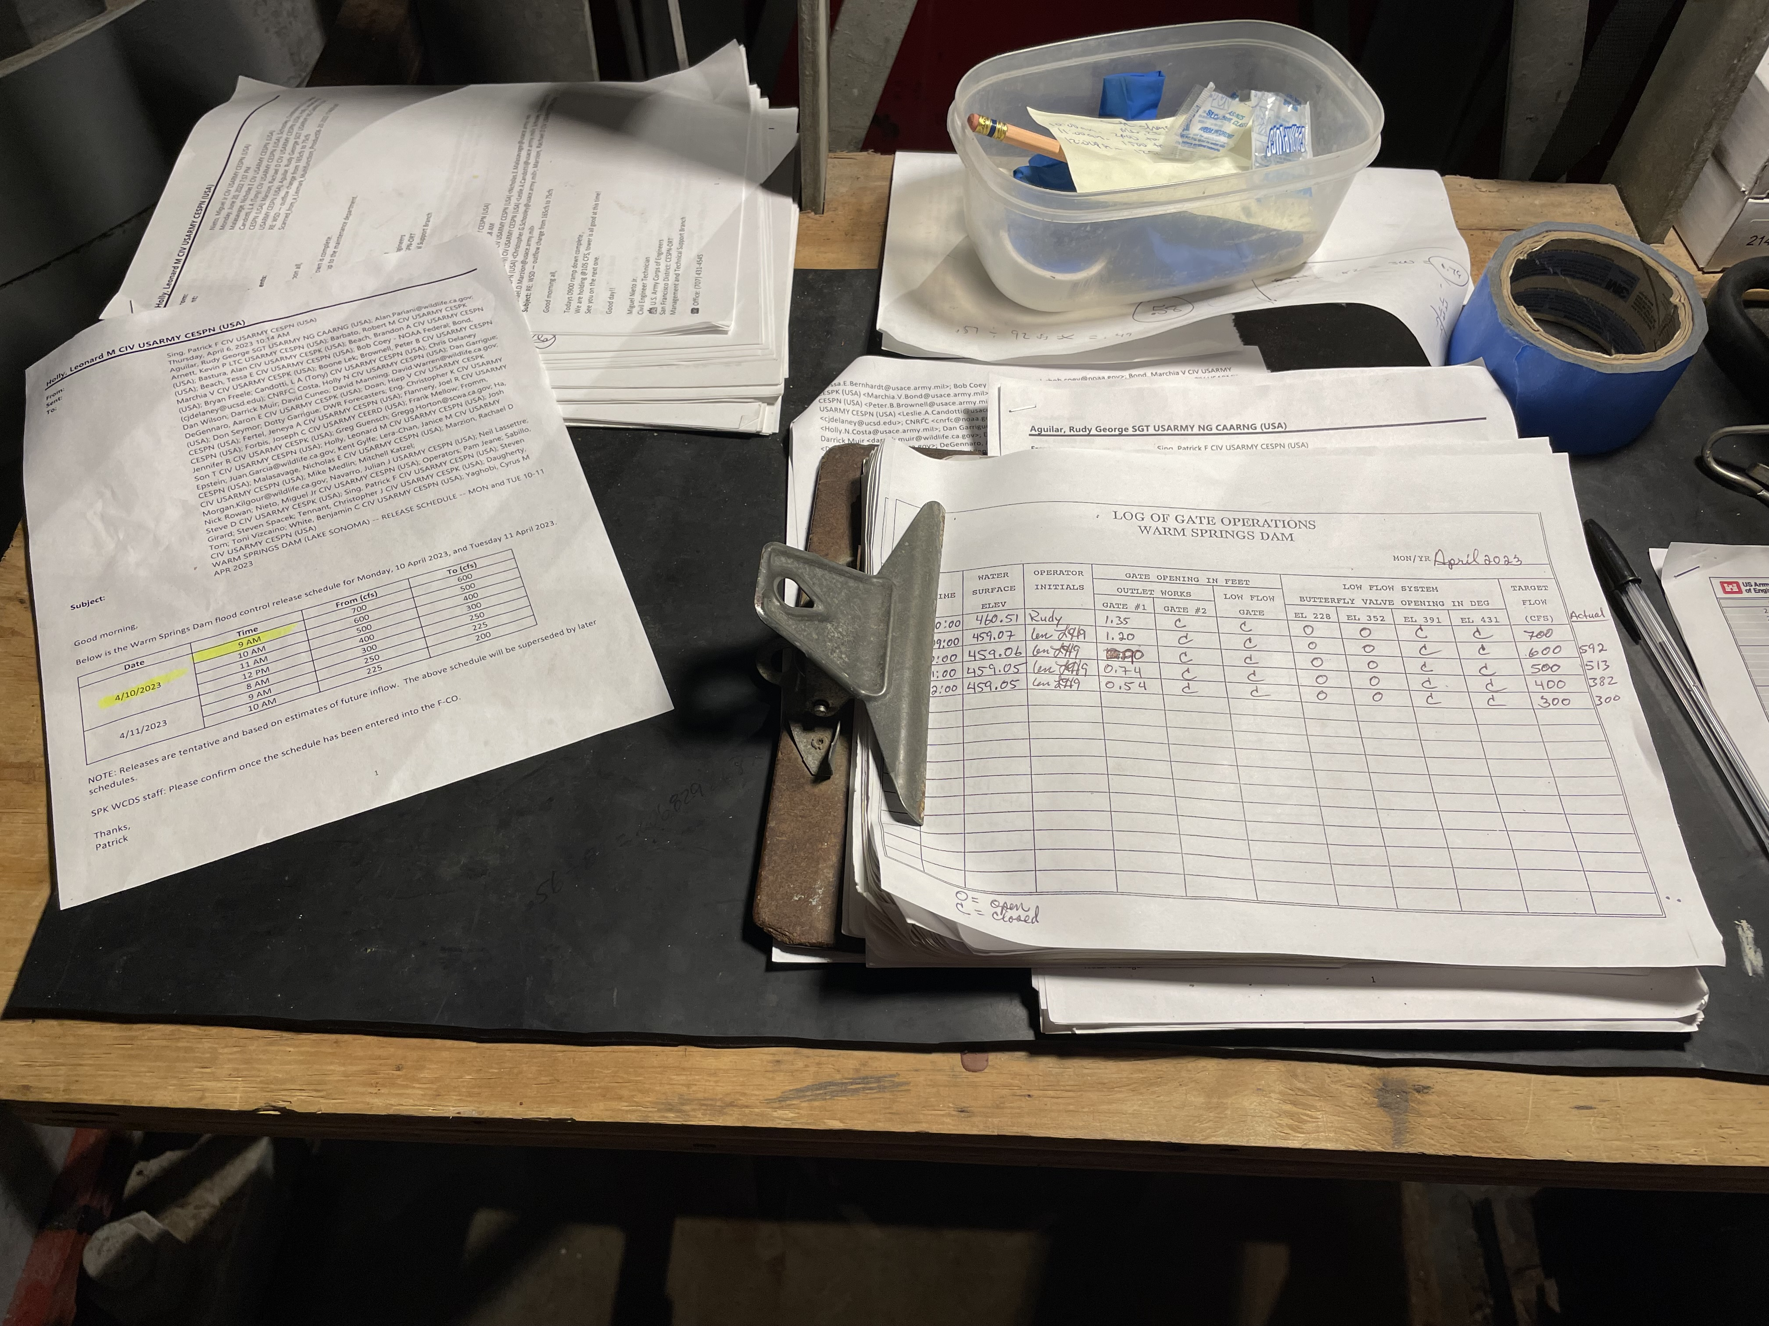
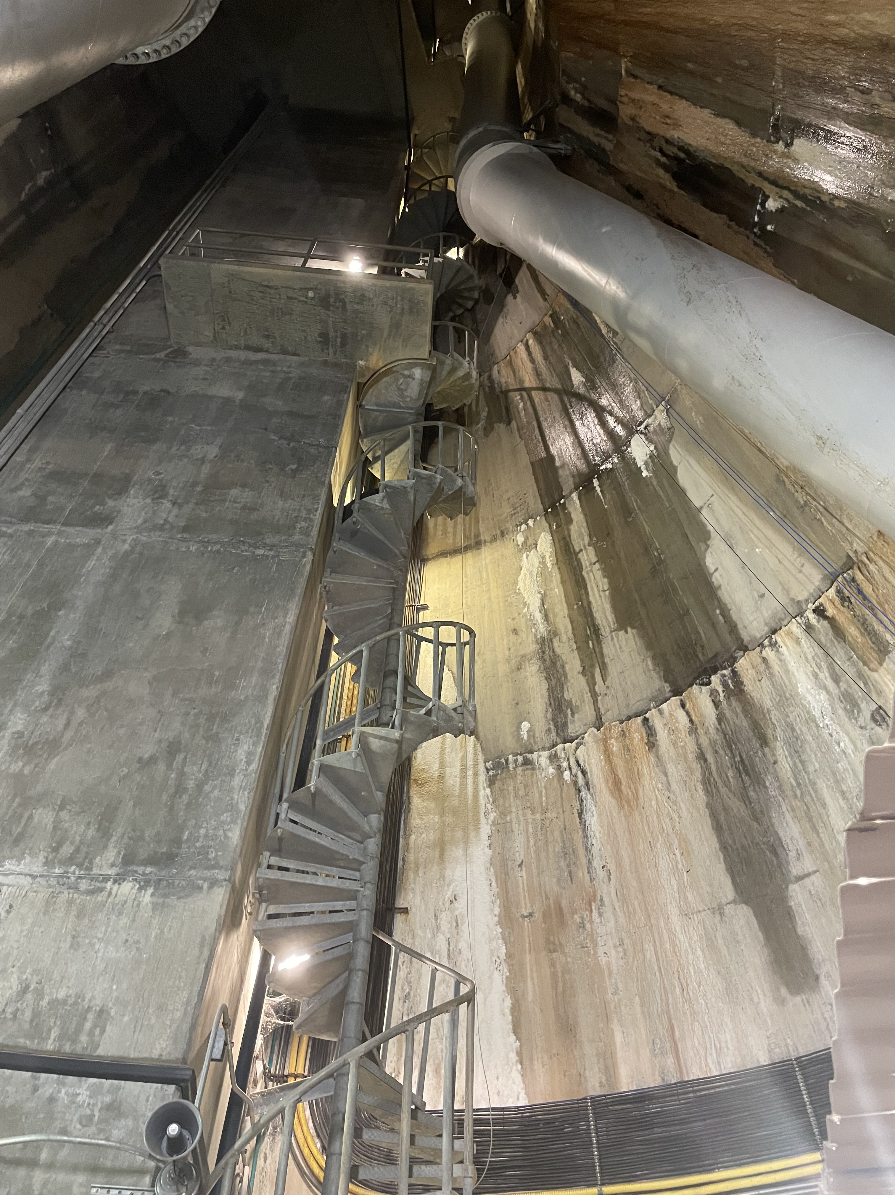
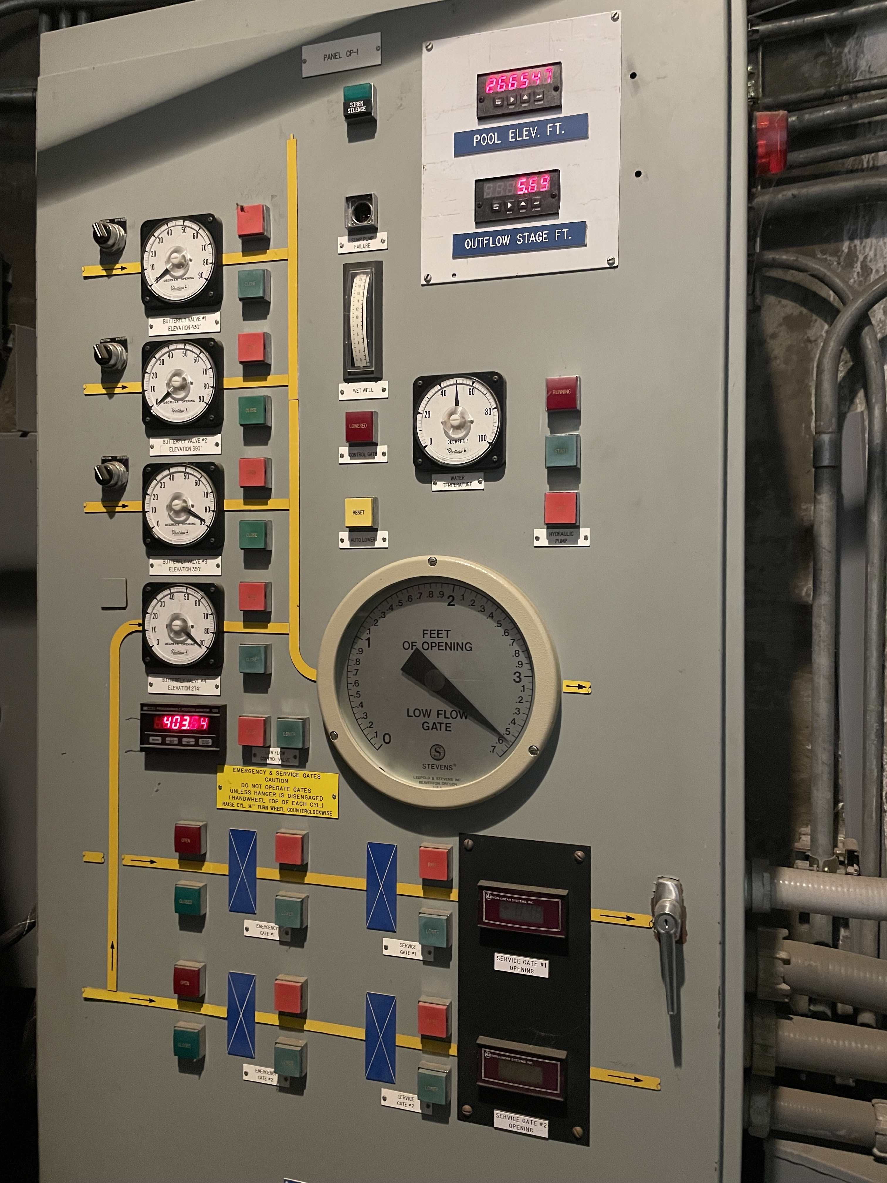
? ? ? Questions ? ? ?
Notes:
Lake Sonoma outflow change instructions and stairwell to get down to where gate changes are made.

