Slide 1
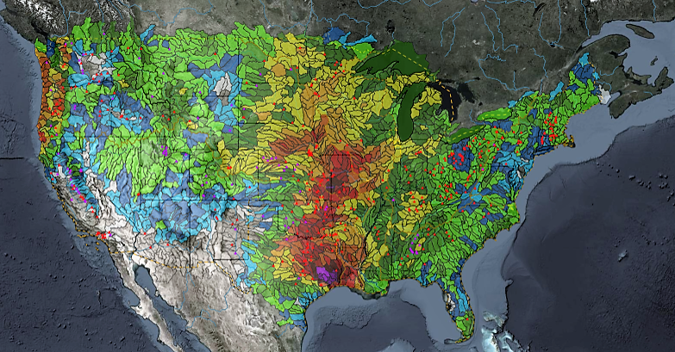
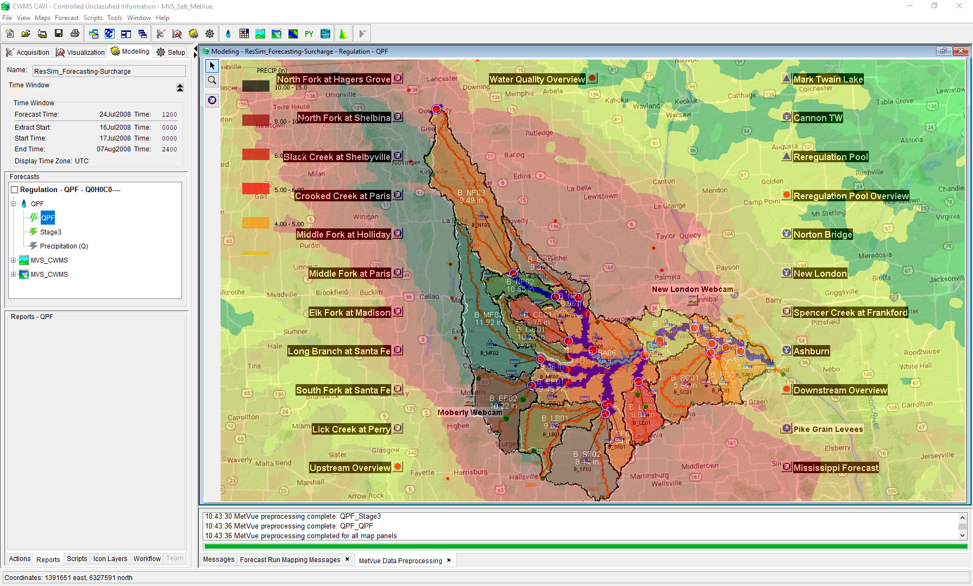

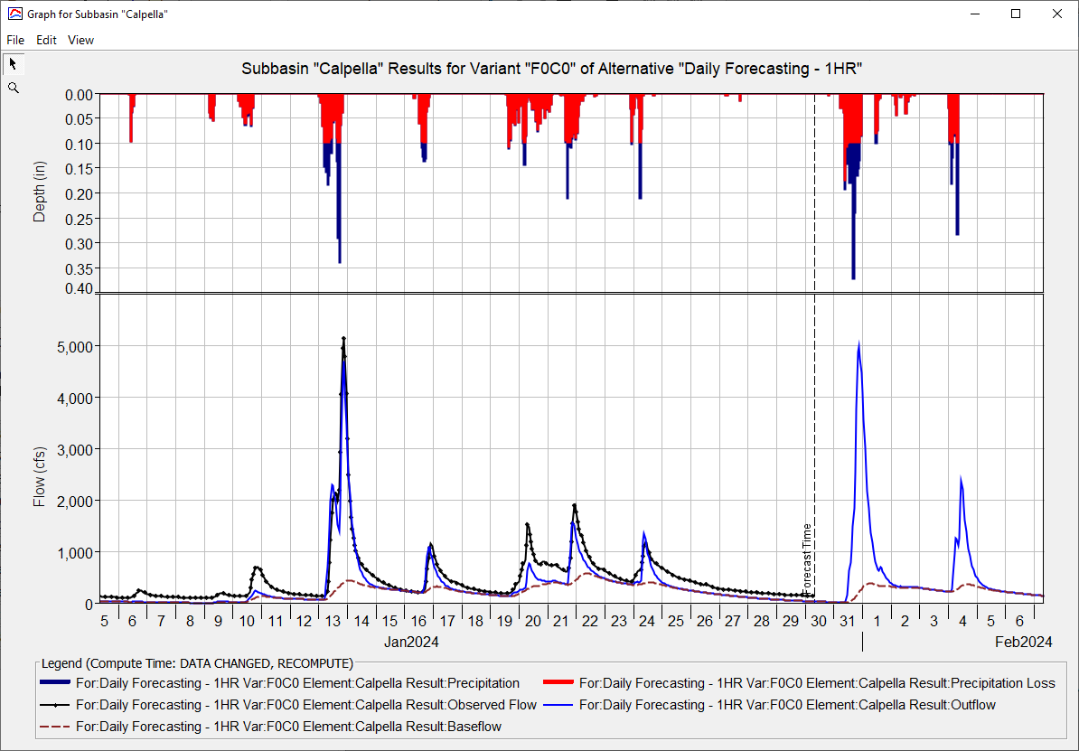
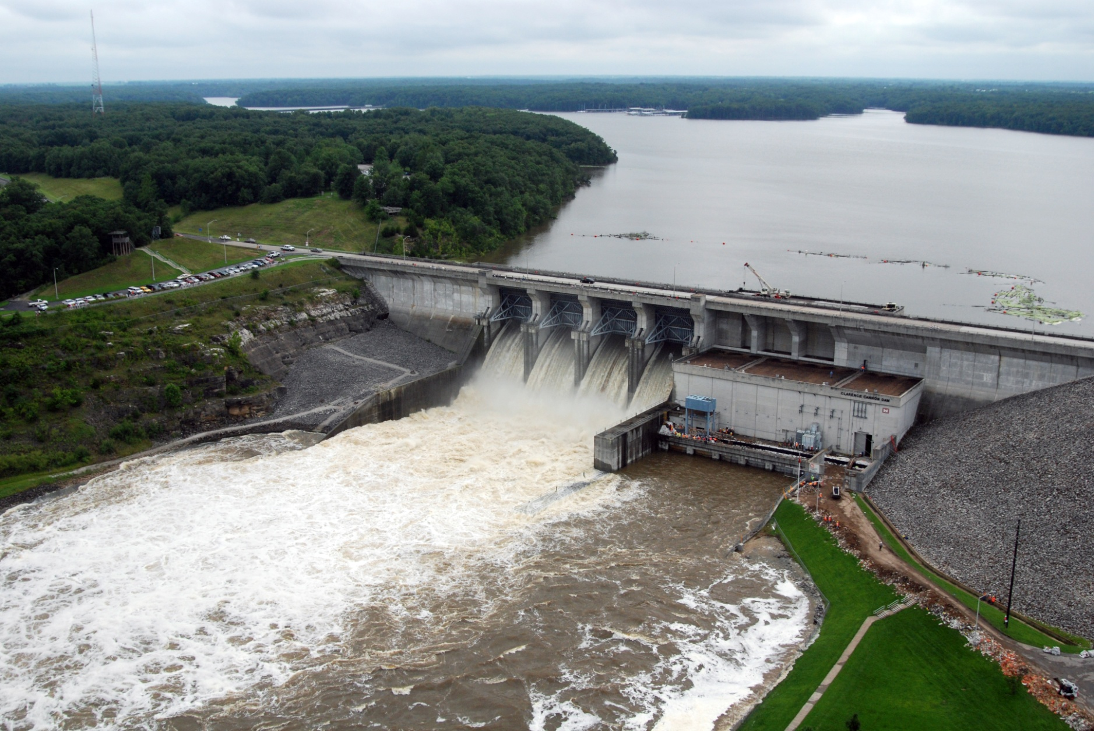
HEC-RAS for CWMS
Andy Richter, P.E., PMP
Hydrologic Engineering Center
CWMS Prospect Course
Notes:
Hello Water Managers,
My name is Andy Richter, part of the Water Management Systems Division at the Hydrologic Engineering Center. I’m going to be covering HEC-RAS for CWMS today.
This presentation is part of a series of recordings that will cover various topics relating to HEC-RAS modeling for CWMS.

Slide 2
Outline
Purpose for Hydraulic Modeling in CWMS
HEC-RAS Capabilities Overview
HEC-RAS Program Essentials
HEC-RAS Model Development for Real-Time Forecasting
HEC-RAS CAVI Integration
Real-Time Forecasting using HEC-RAS
Notes:
There are six main topics that will be presented in this series. Previous videos have covered the first five topics. This video will cover Rea-Time Forecasting using HEC-RAS.

Slide 3
Real-Time Forecasting using HEC-RAS
Notes:
Let’s get started.

Slide 4
Running a forecast
Check incoming data
Run HEC-MetVue, HEC-HMS, and HEC-ResSim alternatives
Adjust/calibrate until you are “happy”
Run HEC-RAS
Review results
Calibrate
Generate depth grids (if needed)
Notes:
When running a forecast in CWMS, these are the steps you will generally follow. First, you must check incoming data to ensure that any required inputs to your models are available and look reasonable.
The next step is to run all the models within your forecast that precede HEC-RAS, which may be HEC-MetVue, HEC-HMS, and HEC-ResSim. The model outputs should be checked and the models calibrated until you are happy with the results.
Next, you will run your HEC-RAS model alternative, review the results, calibrate if the model output does not match observed data, and generate depth grids if they are needed.

Slide 5
HEC-RAS Calibration Process
Run HEC-RAS model alternative
Compare results with observed data (flow and stage)
Adjust model parameters
Manning’s “n” values
Ineffective flow areas
Repeat
RUN
COMPARE
ADJUST
Notes:
The most important, and often most overlooked, portion of running HEC-RAS inside of a CWMS forecast is the calibration process. (click) The first step in this process is running the HEC-RAS model alternative. (click) You should always review the model results and compare them with observed data to ensure your model is performing adequately and providing data that is reasonable. (click) If the model results do not match up with observed data, you should begin adjusting model parameters and (click) repeating the process of running the model and comparing the results with observed data until the two converge.

Slide 6
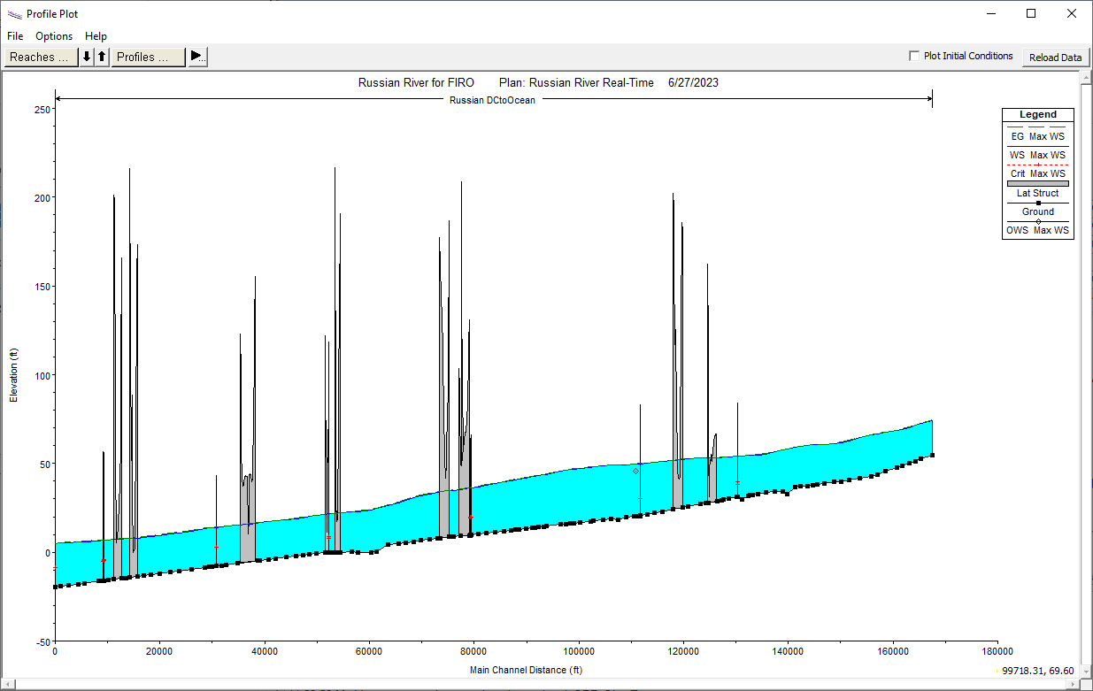
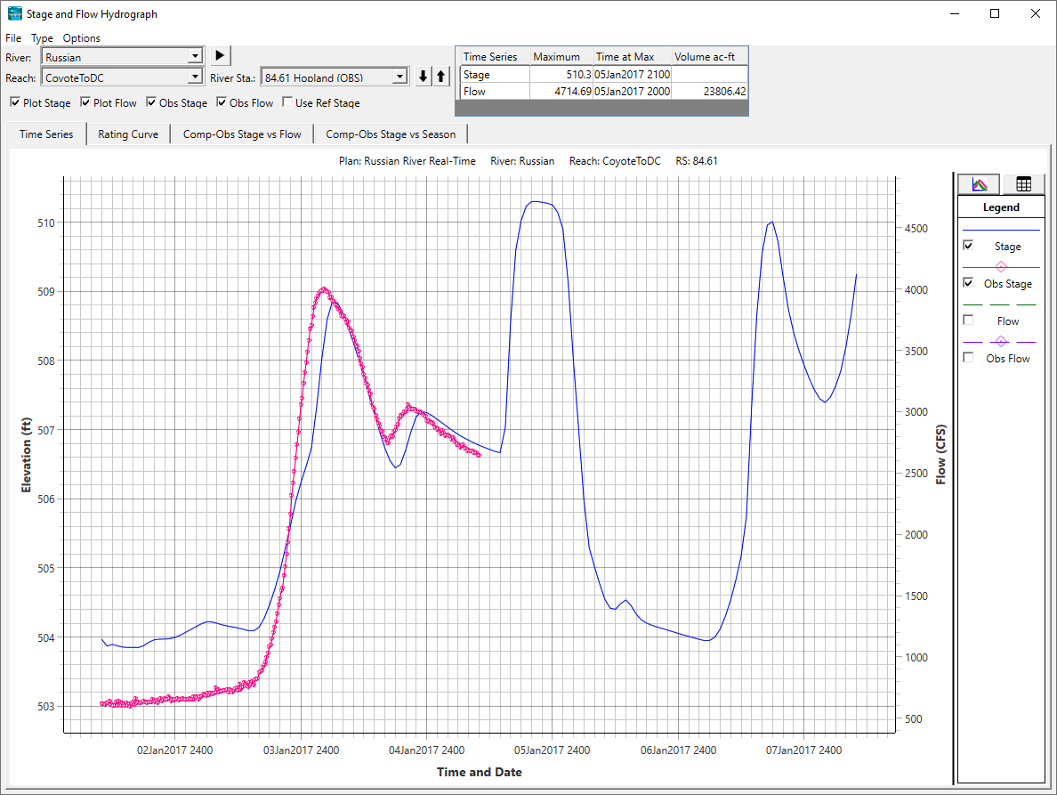
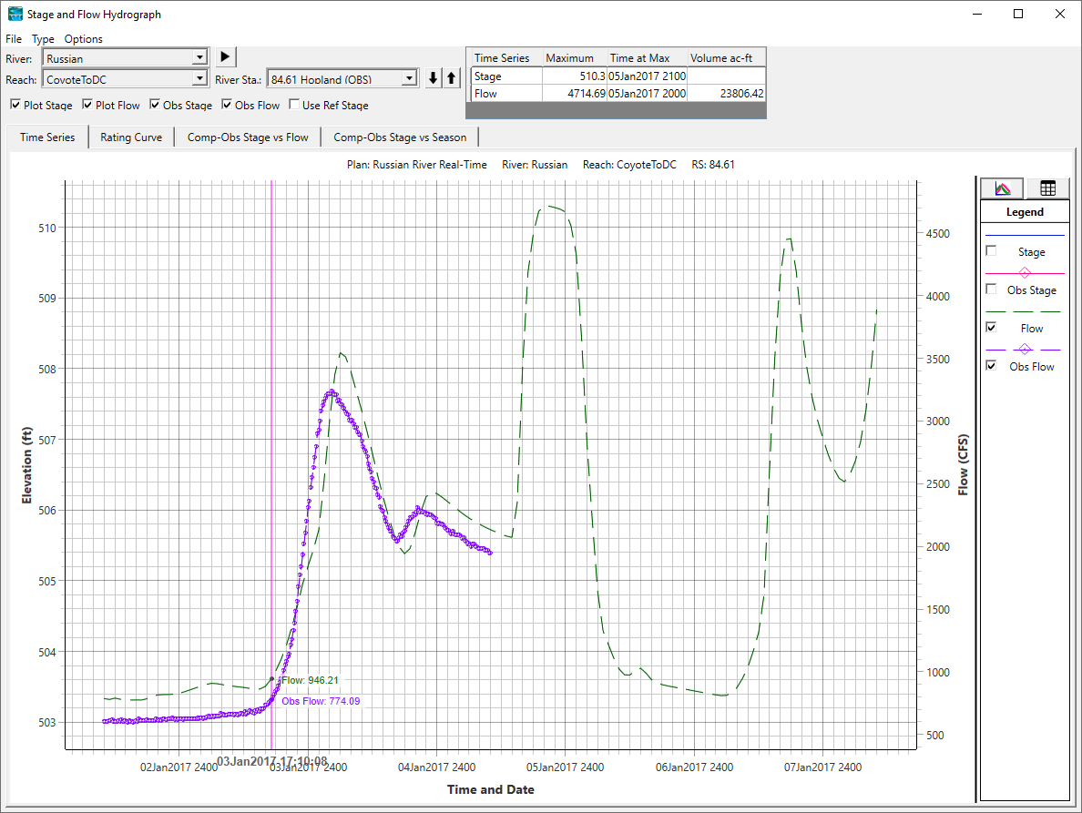
Comparing model Results to observed
Use Stage and Flow hydrograph plots to compare model outputs to observed data
Use Profile plots to review overall shape of water surface (look for anomalies)
Notes:
How do you compare model results to observed data? HEC-RAS provides many ways to view results, but there are a few that you should focus on when running a CWMS forecast.
(click) The first place you should look is at the stage and flow hydrographs at locations with gages that provide observed data. (click) These plots will help you identify what parameter adjustments are needed within the model to get a better fit between the computed results and observed datasets.
(click) Another important place to look is at the profile plots for each of your model reaches. (click) HEC-RAS will plot observed data as points within your reach, but the most important thing you should be looking for are anomalies (spikes or dips in the water surface profiles). Any anomalies indicate that the model is not producing reasonable results and all efforts should be taken to adjust the model until those anomalies disappear.

Slide 7
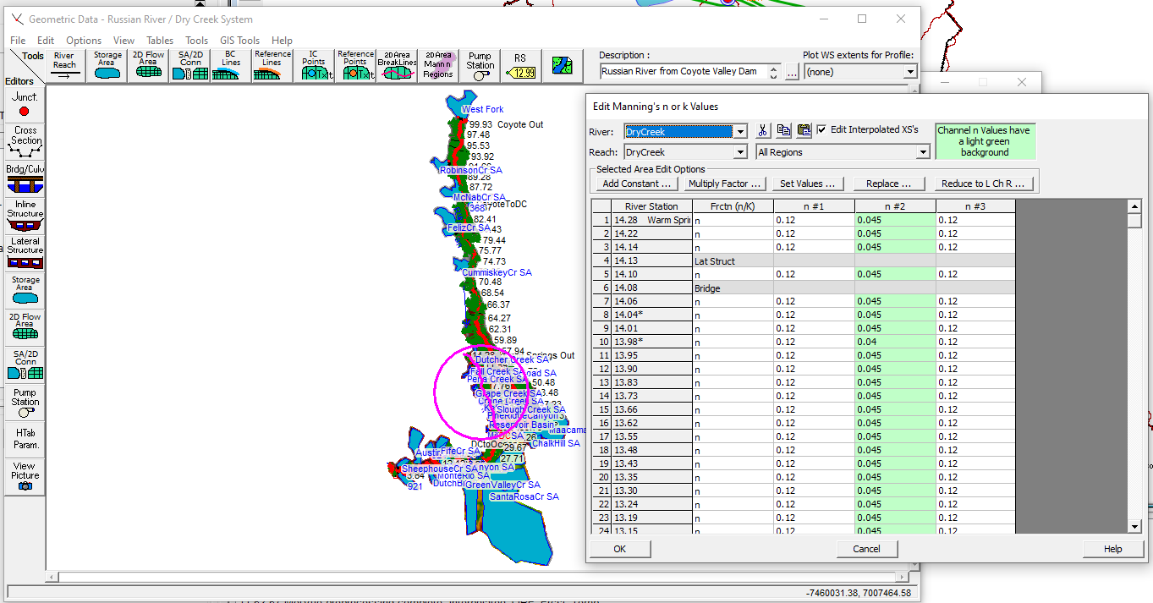
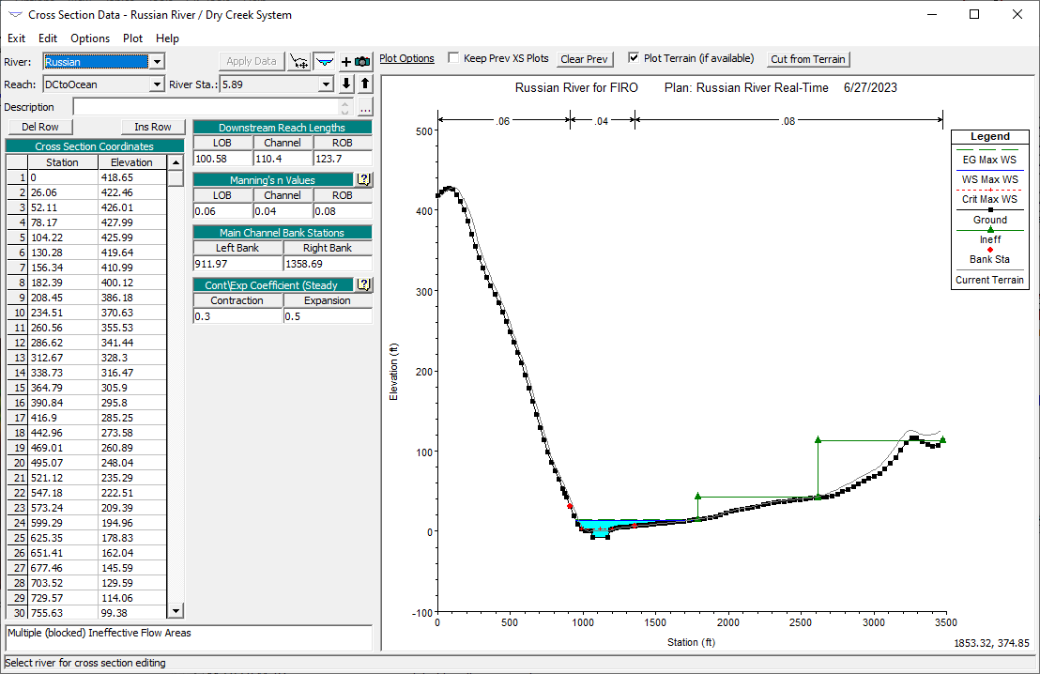
Adjusting model parameters
Notes:
There are several ways to adjust model parameters within the HEC-RAS model when calibrating.
One way is to open the geometry and begin adjusting Manning’s N Values or ineffective flow areas at each cross section. This is how models are developed and initially calibrated, (click) but this is not an efficient way to calibrate when running a forecast in CWMS.

Slide 8
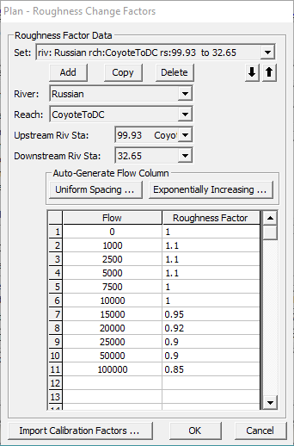
Adjusting model parameters
Set up Flow Roughness Factors for sections of your model around observed data locations
Similar approach to Zones for HEC-HMS
Good way to quickly adjust Manning’s “n” values within large sections of your model
Still need to check and fully calibrate your model a few times a year (especially if the factors start diverging)
Notes:
Instead, we recommend setting up flow roughness factors inside of your Plan files.
This is similar to the approach in HEC-HMS that uses zones to calibrate the model.
This option allows you to adjust roughness coefficients with changes in flow. This feature is very useful for calibrating an unsteady flow model for flows that range from low to high. Roughness generally decreases with increases in flow and depth, and this is especially true on larger river systems. This feature allows the user to adjust the roughness coefficients up or down in order to get a better match of observed data. By viewing the hydrograph plots as we reviewed on the previous slide, you can determine which roughness factors to adjust depending on how the model is reacting at various flow values.
We recommend that you check and fully calibrate your model by adjusting base values instead of the roughness factors at least once a year, especially if the factors start diverging.

Slide 9
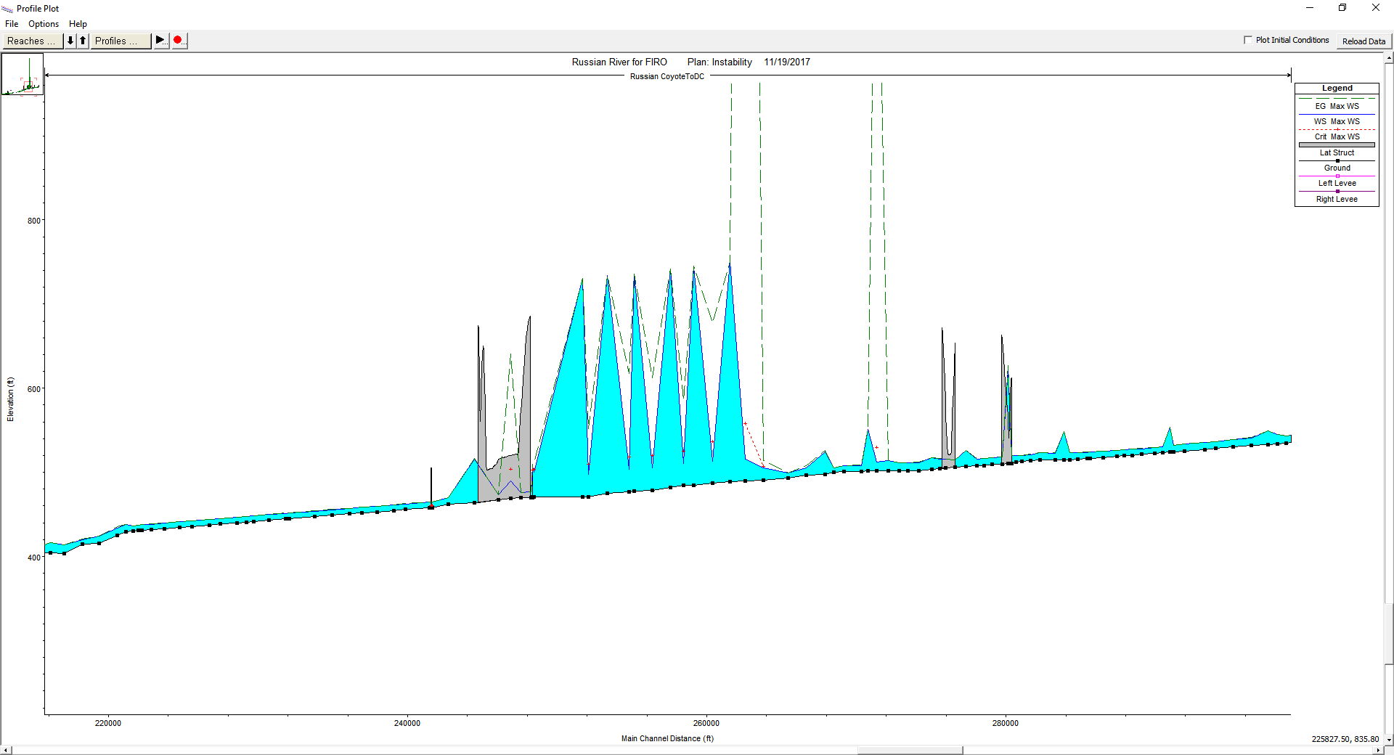
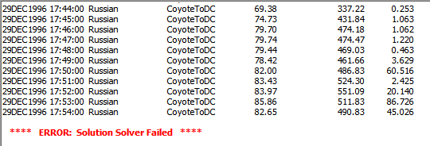
Validating Results
You should review results prior to creating an inundation map
Common Instability Locations
Bridges
Junctions
Inline Structures
Slope Changes/Steep Reaches
Notes:
Now that you have calibrated your model, you should perform one last check to validate your results (click) especially if you need to create an inundation map.
(click) Pay special attention to locations within your model that may cause instabilities, such as bridges, junctions, inline structures, and steep reaches.
(click) As noted previously, reviewing the profile plots for all of the reaches in the model will help identify any locations that need adjustment. If you see spikes in the water surface profile, as shown in the plot on the screen, you should review the model at that location and adjust parameters until those spikes are eliminated.
(click) You should also review the runtime messages for any warnings or errors. This can help you determine locations within the model that need further refinement.

Slide 10
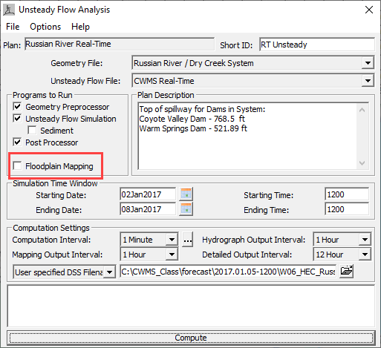
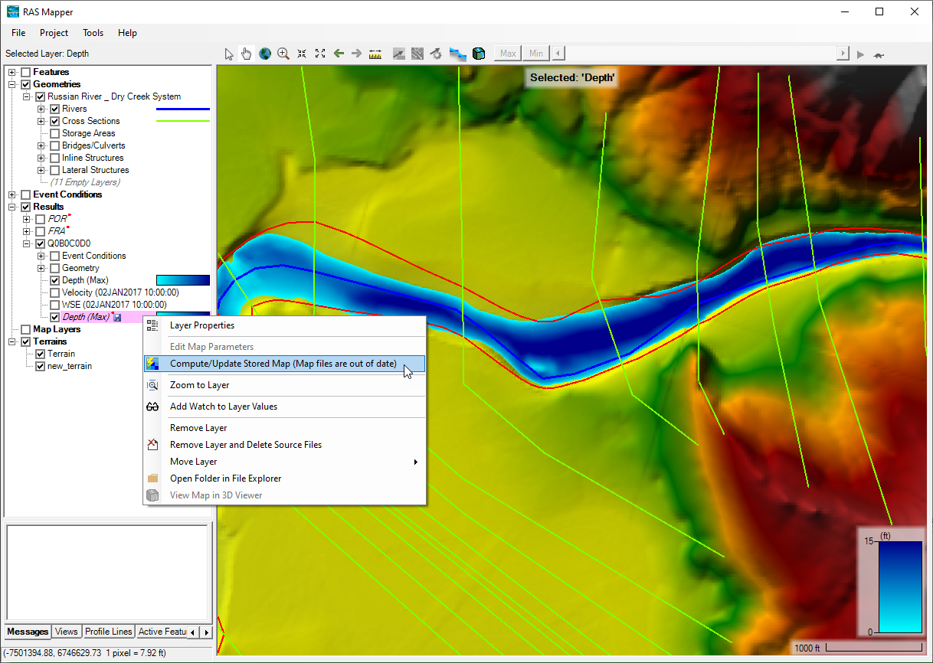
Inundation mapping best practices
Run HEC-RAS, check results & calibrate, then generate saved map
Do not check the “Floodplain Mapping” box in the Unsteady Flow Analysis Options
Get in the habit of checking the results before publishing the maps
Notes:
(click) Now that we have calibrated our models, we are ready to develop an inundation map. (click) Right-clicking on the stored depth grid within HEC-RAS Mapper allows you to generate the map and save it to disc. (click)
One thing that I want to stress is the importance of not generating the saved map without checking results first. (click) We recommend not checking the box next to the Floodplain Mapping option within the Unsteady Flow Plan, so that you are required to create the map manually from HEC-RAS Mapper. (click) This will get you into the habit of reviewing results prior to creating the inundation map.

Slide 11
Questions Help additional Training
https://usace.dps.mil/sites/KMP-WM/SitePages/Corps-Water-Management-System-(CWMS).aspx
https://www.hec.usace.army.mil/confluence/cwmsdocs
https://discourse.hecdev.net/c/cwms/5
TDL-CELRH-EC-GW-W-USACE CWMS Modeling | General | Microsoft Teams
Notes:
If you have any other questions about our software, need some help, or are looking for additional training; check out these links. They can also be found in the description below. Thank you for your time.

