Slide 1
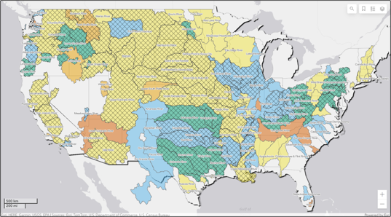

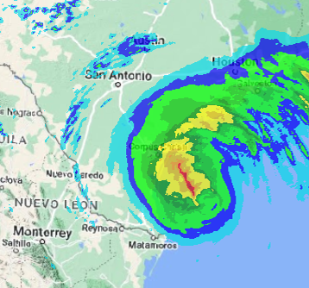
Corps water management system (CWMS) overview
Fauwaz Hanbali
Hydrologic Engineering Center
CWMS Prospect Course
Notes:
CWMS Overview

Slide 2

Overview
Water Management in USACE
Corps Water Management System (CWMS)
CWMS National Implementation Program
Summary and Resources
Notes:
Overview
Water Management in USACE
Corps Water Management System (CWMS)
National CWMS Implementation Program
Summary and Conclusion

Slide 3
USACE Water Management Mission
Notes:
CWMS Overview

Slide 4
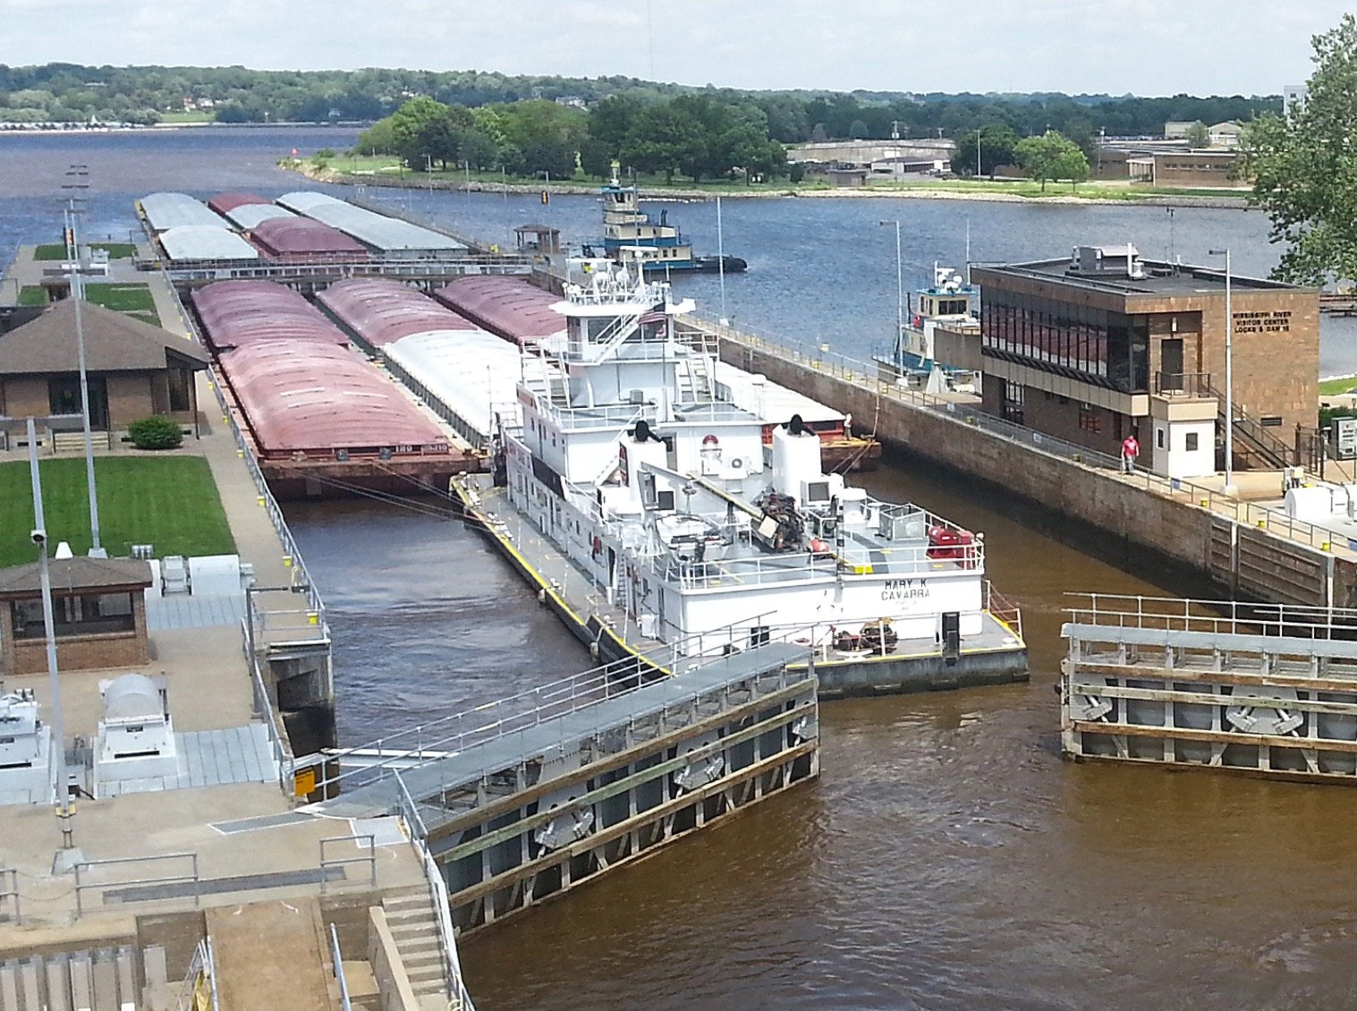
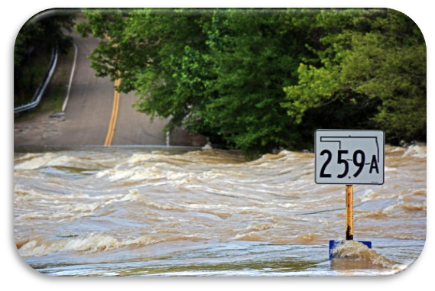

Usace water management mission
Collect, process, store, analyze and disseminate water resources data
Continuously monitor conditions in our systems (precipitation, temperature, flow, stage, melt)
Make daily operations decisions on over 600 USACE reservoirs
Flood Risk Reduction
Navigation
Hydropower
Water Supply
Environment

Slide 5
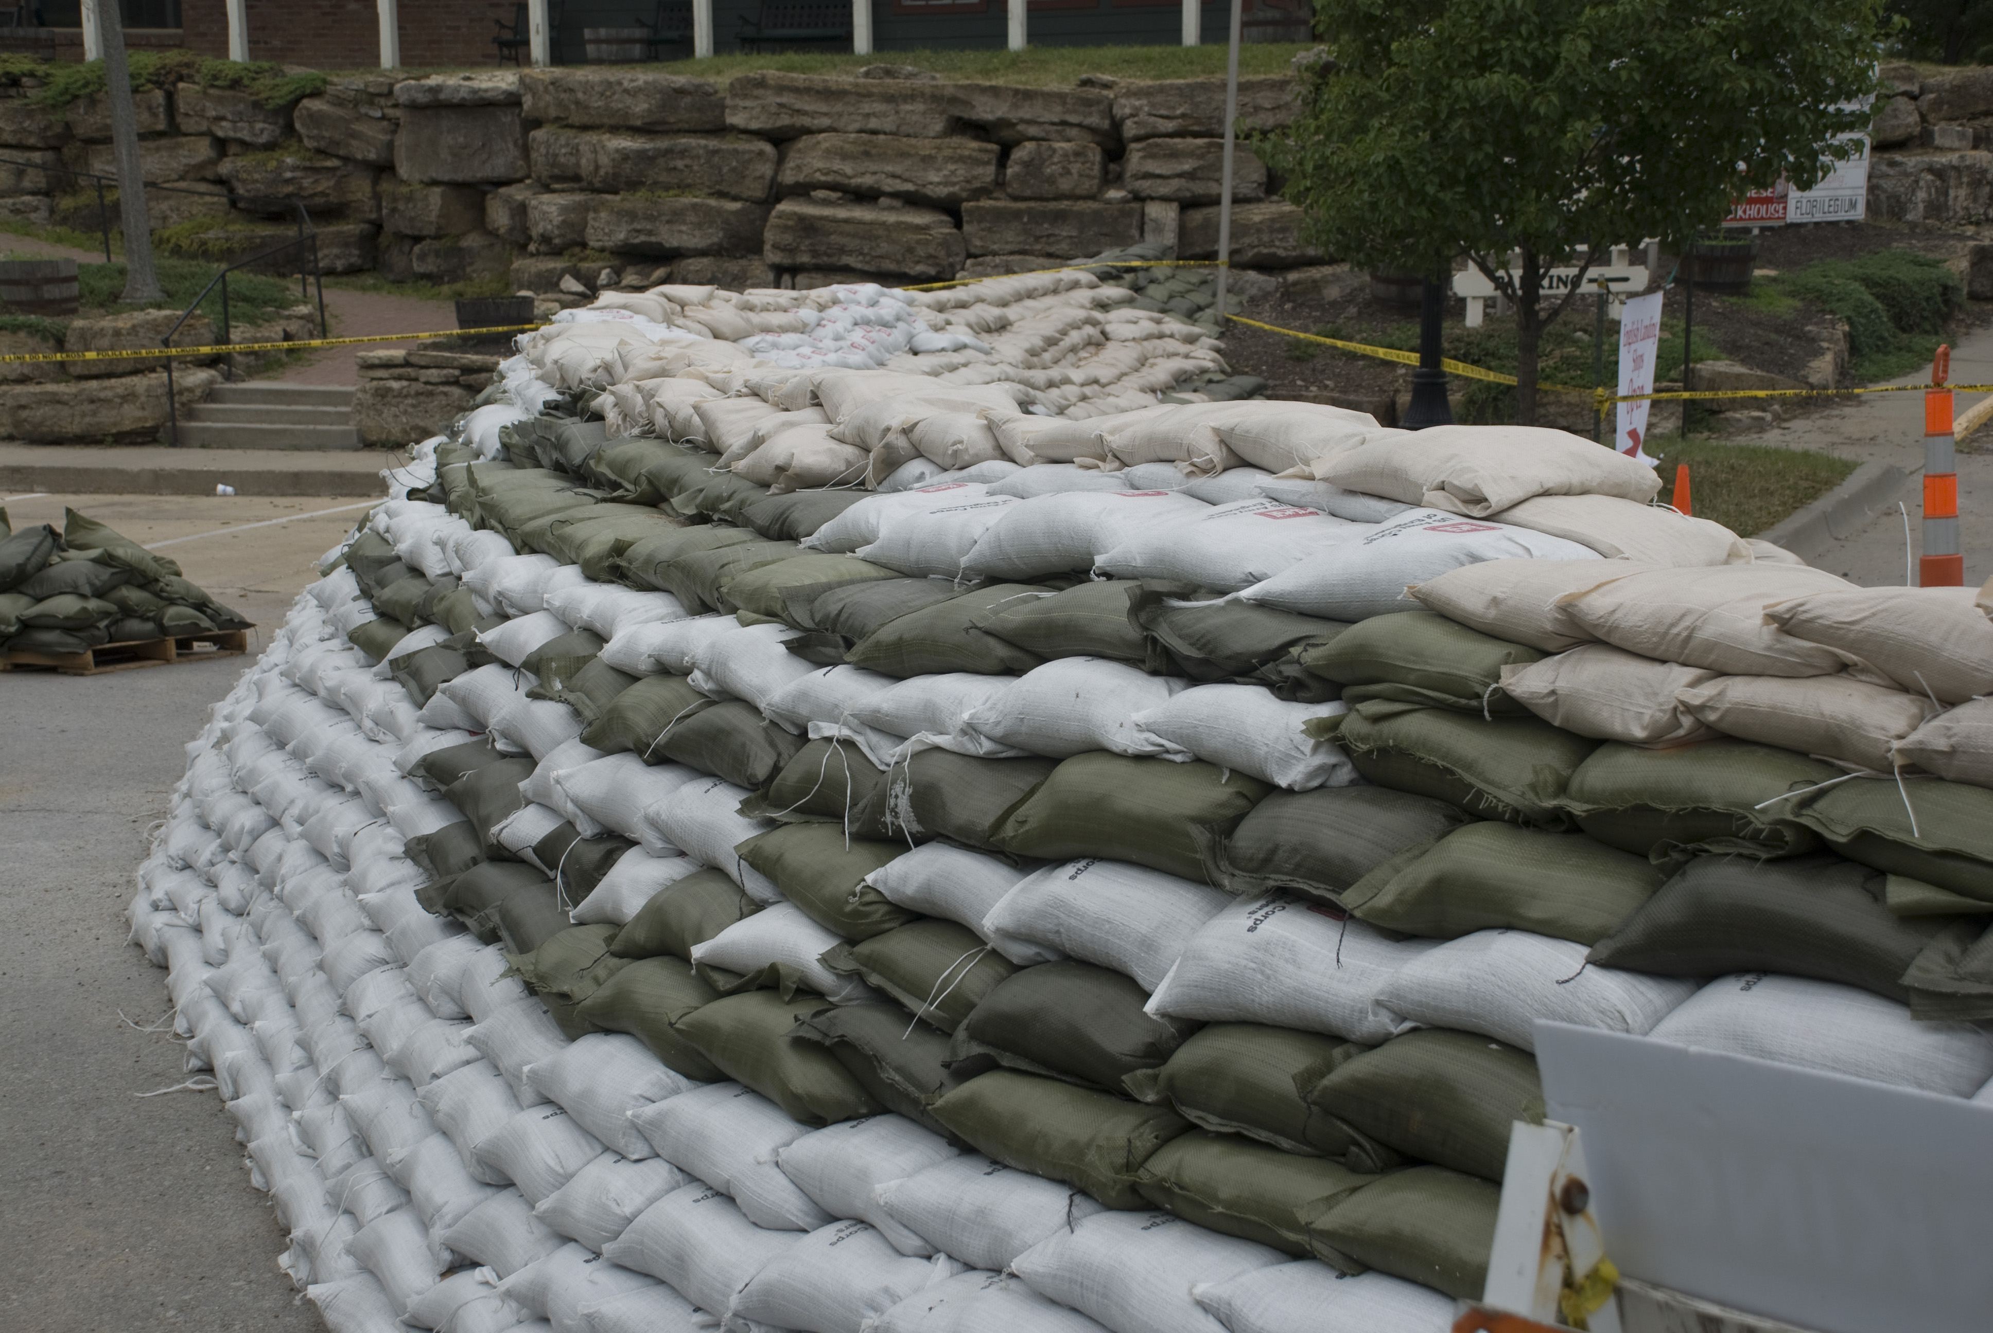
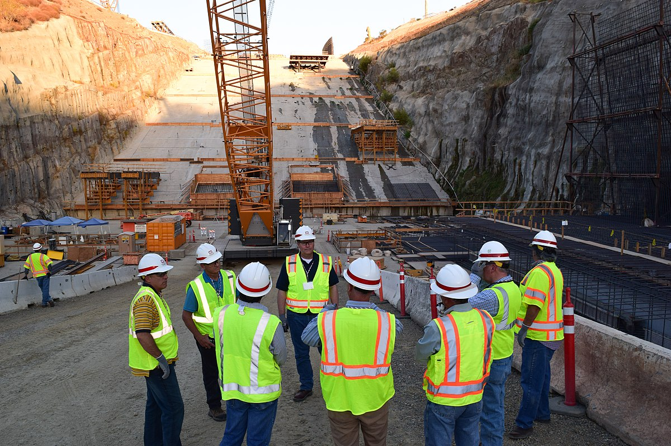
Usace water management mission
Support other USACE missions:
Preparedness: Emergency and disaster response
Planning: Systems based water resources approach
Dam/Levee Safety: Risk informed decision making

Slide 6

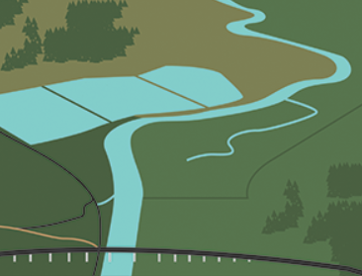



Importance of the water management mission
Water Management is a Mission Critical element within the Corps
Increases public safety
Benefits the economy
Increases public quality of life
Protects and restores the environment
Notes:
III. Presentation
USACE Role in Water Management
We are Stewards of our Nation’s Water (Water Management) Resources
Water Management is a Mission Critical element within the Corps.
Improves the public’s quality of life and safety
Benefits the nations economy
We are required to collect, process, store, analyze and disseminate water resource data.
We directly support daily decisions at all 600+ Corps Reservoirs.
These decisions, which are based on approved water control manuals and plans, directly impact most of the Corps business lines.
We are also required to manage the flood storage of other federal, state and private dams during times of flooding. We must constantly monitor rain, snow, snow melt, lake levels and river levels.
During Non-Flood time We must constantly make operation decisions to maintain navigation, generate hydropower and manage low flow and drought conditions.

Slide 7
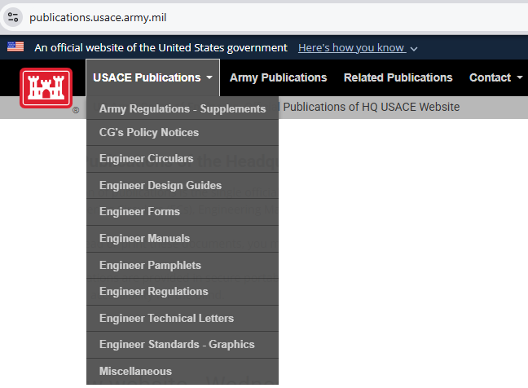
USACE Water Management Strategy and Policy
Strategic Vision: USACE Actions for Change: Comprehensive Systems Approaches that include sustainable solutions
Legislation: WRDA 1997 Sec. Army provide public access to USACE Water Resources Data
Civil Works Initiatives: Planning Transformation
Corps Policy on Water Control
ER 200-1-5
ER 1110-2-240
EM 1110-2-3600
Notes:
USACE Role in Water Management
USACE Strategy for System/Watershed Requirements
Corps Policy
ER 1105-2-100, Planning Guidance Notebook, 22 April 2000, requires systems approaches, "The planning process shall address the Nation’s water resources needs in a systems context…”
ER 1105-2-409, Planning in a Collaborative Environment, 31 May 2005, provides revised procedures for conducting Corps water resources planning, "Collaboration is the keystone of the Corps watershed approach…”
EC 1110-2-6067, USACE Process for the National Flood Insurance Program (NFIP) Levee System Evaluation, 31 August 2010,
Strategic vision: USACE Actions for Change
required comprehensive systems approaches that include integrated sustainable solutions and decisions are risk-informed.
Legislation: WRDA 1997 Sec. Army provide public access to USACE Water Resources Data.
Civil Works Initiatives: Planning Transformation:
CWMS is the tool to meet the Water Management Mission
Is a modernized AIS set of Water Management tools designed to meet USACE initiatives, the WM mission, and any legislative or legal requirements.
B. Corps Policy on Water Control
Engineering Regulation ER 1110-2-240, Water Control Management
Engineering Manual EM 1110-2-3600, Management of Water Control System
Engineering Regulation ER 1110-2-8156, Preparation of Water Control Manuals
Environmental Operating Principals ER 200-1-5.

Slide 8
Corps Water management System (CWMS)
Notes:
CWMS Overview

Slide 9
Corps Water Management System (CWMS)
CWMS is the tool to help water managers meet the mission
An Automated Information System (AIS) to collect, process, and store real-time data
A suite of modeling tools to run real-time forecast simulations and help achieve a wide range of reservoir authorized purposes
Designed to meet USACE initiatives, the WM mission, and other legislative requirements

Slide 10


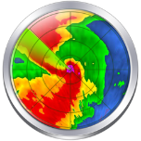
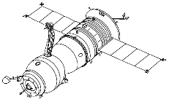



Corps water management system (CWMS)
CWMS Database
Met Data
RTS Modeling & Water Management Decisions
Data Dissemination
Observed Data
Instructions
Notes:
Explain the process
Explain that the piece we will be focusing on is RTS
CWMS Overview

Slide 11
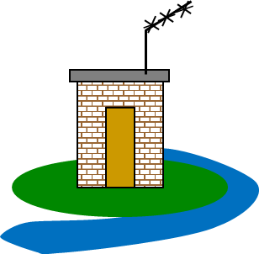
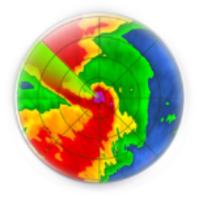
Real-time data acquisition
CWMS Server/Database
Collect
Decode
Transform
Validate
Make corrections
Use data for monitoring and forecasting
Notes:
Components of CWMS
Data Acquisition
Collect: record and transmit (line of sight to satellite to receiving dish to CWMS server (database)
Decode into usable format
Transform decoded data
Validate transformed data
Make corrections
Monitoring and Forecasting

Slide 12
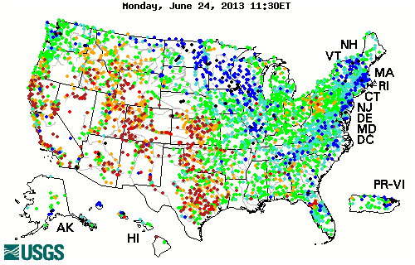
Station data
Stream gauging data used for water management
USGS provides USACE data for 2500 stations
Notes:
Components of CWMS
Common Data Acquired
Real-Time Data
Stream gauging data used for water management
USGS provides USACE data for 2500 stations

Slide 13
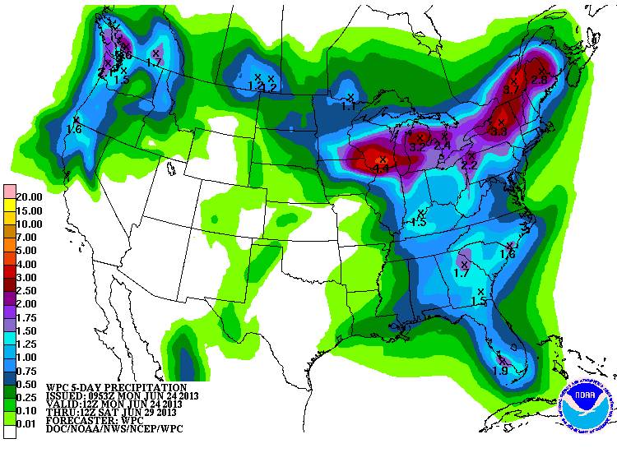
Observed & forecast met data
NOAA/NWS Support:
Quantitative Precipitation Estimates (QPEs)
Provides Quantitative Forecast Precipitation (QPFs)
RFCs provide river stage/flow forecasts
Notes:
Components of CWMS
Common Data Acquired
Forecasted Data
Provides Precipitation Quantitative Estimates (QPE)
Provides Precipitation Quantitative Forecast (QPF) for various durations such as 24, 48, and 72 hours
RFCs (River Forecast Centers) provide river stage forecasts

Slide 14
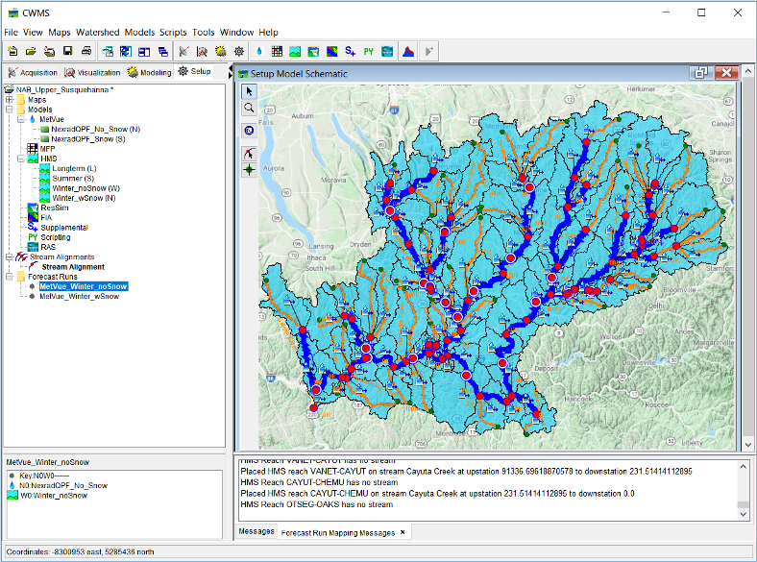

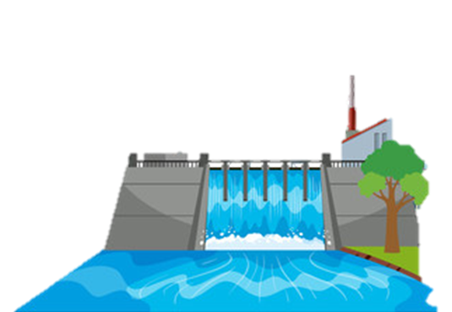
HEC-RTS
Hydrologic Engineering Center (HEC) Real-Time Simulation (RTS)
The CWMS suite of modeling software with integrated real-time data
Data
Instructions

Slide 15





CWMS Modeling Tools
Meteorology
Reservoir Operations
Consequences
Hydrology
Hydraulics
Notes:
USACE Role in Water Management
Corps of Engineers Water Management System
CWMS Package
The CWMS release package consists of a database (software and hardware) and a suite of models
The database consists of software for data acquisition, visualization and dissemination
The model suite consists of HEC-MetVue, HEC-HMS, HEC-ResSim, HEC-RAS, and HEC-FIA
Real time data and weather forecasts are used with the models to generate streamflow forecasts and make release decisions

Slide 16
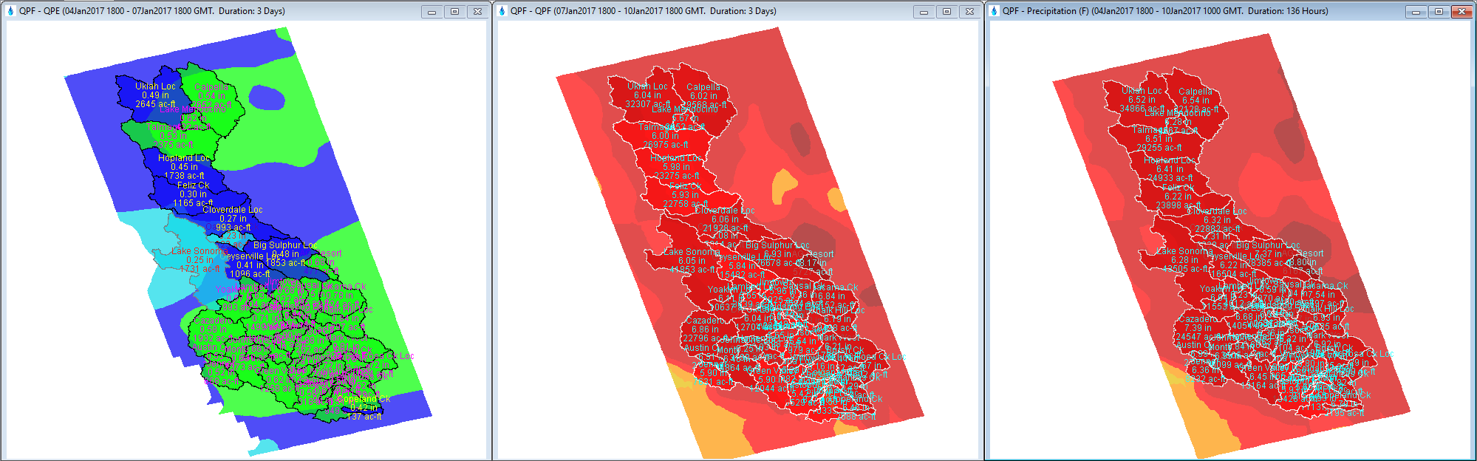


Meteorological Scenarios: HEC-MetVue
Processes and Combines Observed and Forecast Meteorological Datasets
Precipitation, Temperature, and more
Allows for:
Observed Dataset Corrections
Forecast Dataset Adjustments for additional “What-If” Scenarios
Observed
Precipitation
Forecast
Precipitation
Combined
Precipitation

Slide 17
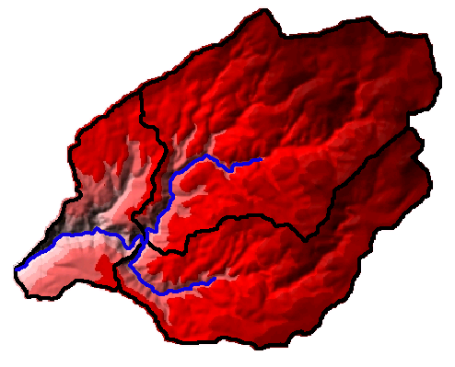
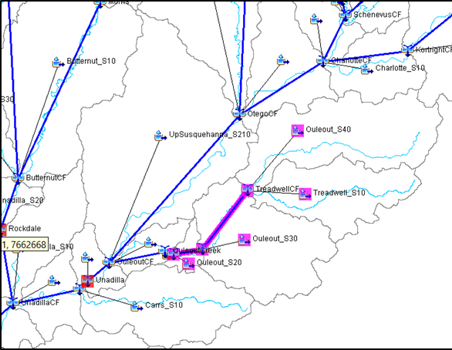
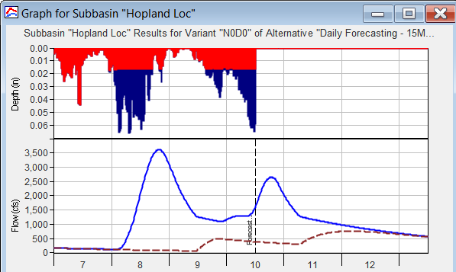
Hydrologic Modeling: HEC-HMS
Compute runoff and uncontrolled flows given input meteorological data
Predict inflows to reservoirs, and local-flows downstream of reservoirs
Model output used as input to reservoir operations and hydraulics models
Notes:
Components of CWMS
Hydrologic Modeling: Precipitation (HEC-HMS)
Utilize GIS functionality for developing watershed input.
Digital terrain model
sub-basin delineation and drainage network
development of a grid cell file

Slide 18
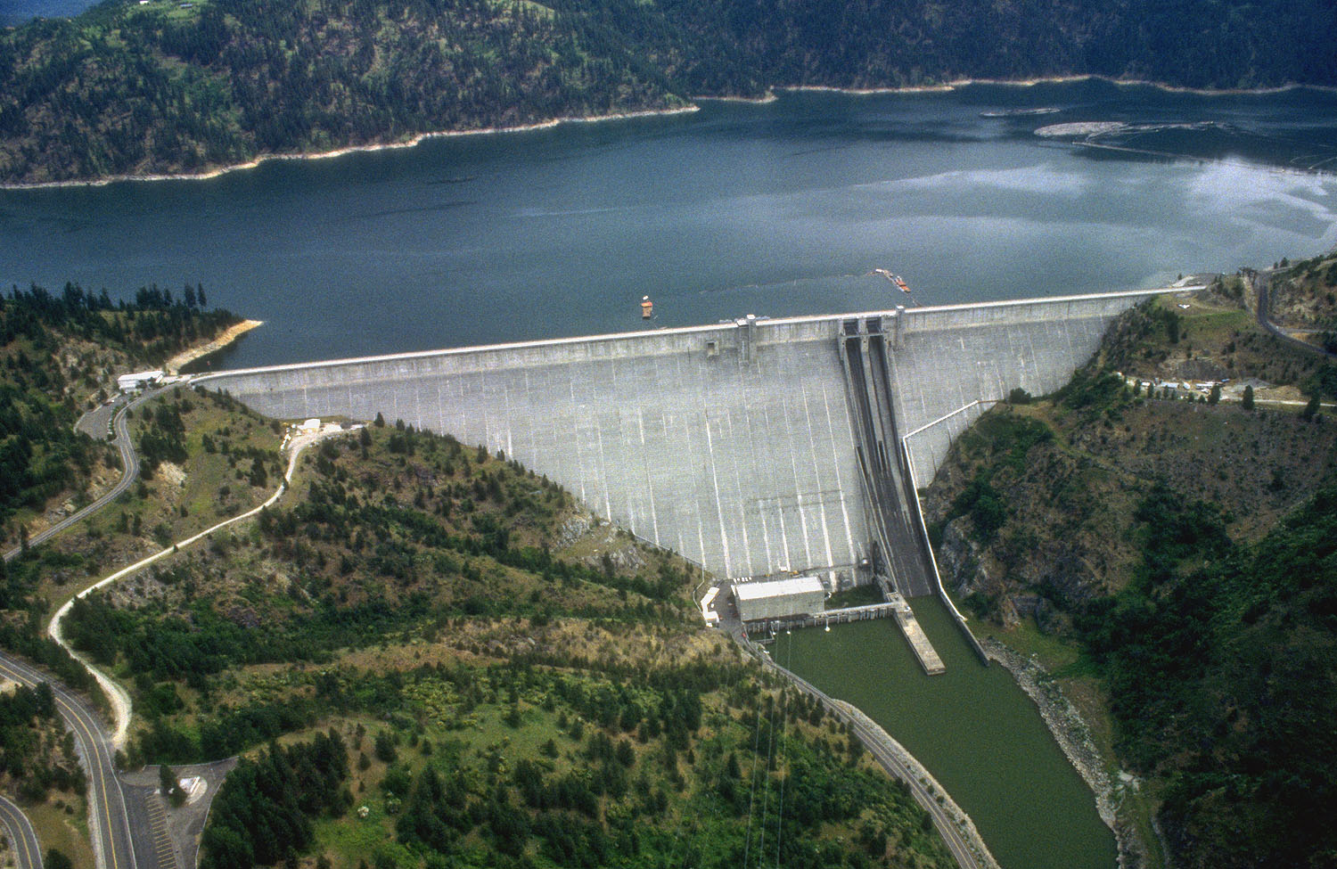
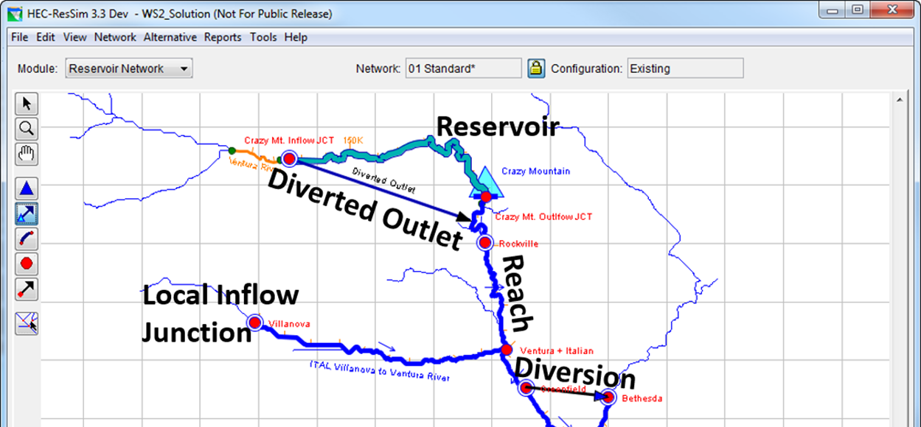
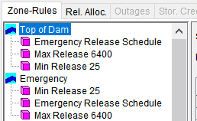
Reservoir Operations: HEC-ResSim
Given stream flows and water control rules, simulate reservoir operations
Override operations to test operating plan scenarios
Model output used as input to hydraulics and consequences models
Notes:
Components of CWMS
Reservoir Operations
Given streamflows and water control plans (reservoir operating rules) for a river basin simulate reservoir operations and computes downstream hydrographs
Streamflows are observed and forecasted
Streamflows include reservoir inflow and downstream local hydrographs
Model (reservoir) output (regulated hydrographs) are used as input to hydraulic and flood inundation (consequence) models and impacts are evaluated

Slide 19
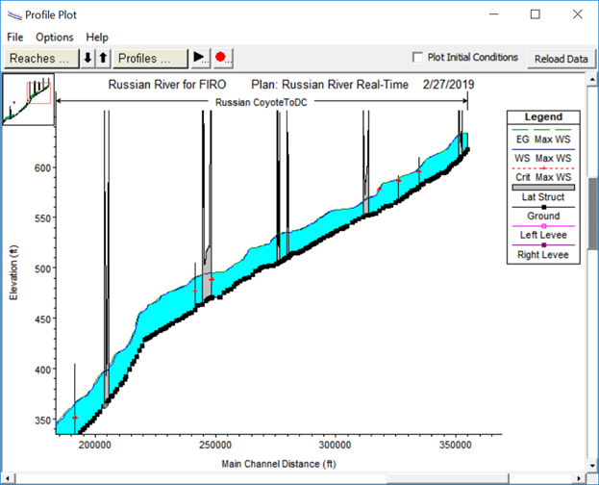
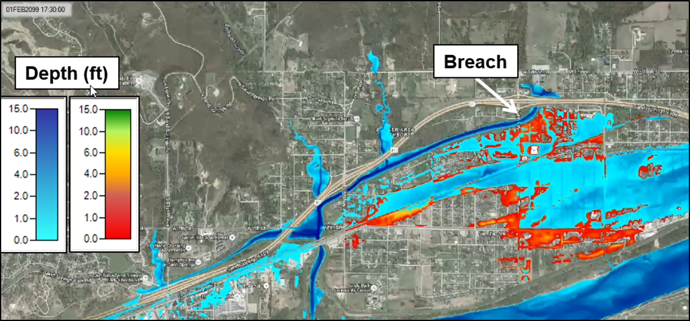
River Hydraulics: HEC-RAS
Given flow hydrographs, compute water surface profiles
Predict resultant water surface elevations and inundation areas for events
Produce inundation maps
Model output used as input to consequences models
Notes:
Components of CWMS
River Hydraulics
HEC-RAS Hydraulic Modeling Software
Steady-flow or unsteady-flow analysis; 1-D and 2-D, water quality, sediment
Channel friction adjusted through the CAVI and NMI (Native Model Interface)
Given reservoir model hydrographs, computes water surface profiles and stage hydrographs
Also computes river velocities, stages, and inundated areas given streamflow and river/floodplain geometry and hydraulic characteristics (river hydraulics).
19

Slide 20
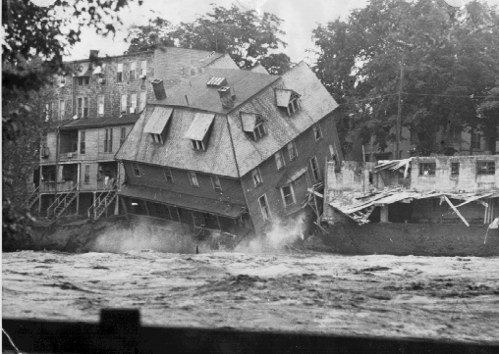
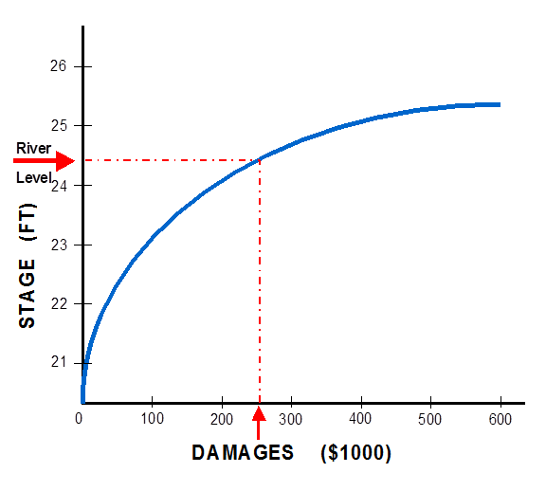
Consequences: HEC-FIA
HEC-FIA (Flood Impact Analysis) identifies the consequences from a flood event
Given river stages and damage data, computes damages to structures and estimates life loss
Computes project benefits
Response tables provide a list and of actions to take during an event, based on forecasted stages
Notes:
Components of CWMS
Consequence Analysis: HEC-FIA
HEC-FIA (Flood Impact Analysis) identifies the consequences from a single event
Accepts model output from HEC-ResSim and HEC-RAS
Given river stages and damage data, computes damages to structures and other contents of the floodplain (including agricultural)
Computes damages and benefits between different scenarios, including with and without project conditions
Estimates Life Loss
Commonly used FIA components
"Action tables" provide a list and time of actions to take during an event, based on forecasted

Slide 21
CWMS Modeling: Putting it all together
Real-time hydrometeorological data
Weather forecasts
Models for various forecast alternatives (scenarios) are calibrated based on real time conditions
Forecast alternatives for a variety of scenarios are simulated and evaluated for decision making purposes
Notes:
USACE Role in Water Management
Corps of Engineers Water Management System
CWMS Modeling: Putting it all together
Real time hydrometeorological data like rain, streamflow, temperature, snow water equivalent are acquired, validated, and transformed
Weather forecasts (scenarios) for rain and temperature are input into CWMS
Models for various forecast alternatives (scenarios) are calibrated based on real time conditions
Typically use one week of observed data and evaluate results two weeks into the future.
What models are needed? hydrologic, reservoir, hydraulic and flood inundation models?
Forecast alternatives for a variety of scenarios are simulated and evaluated for decision making purposes
No rain (rain on the ground)
QPF’s or multiples of QPF
Historical events
Specified Reservoir operations
Levee failures

Slide 22
CWMS National implementation Plan
Notes:
CWMS Overview

Slide 23
CWMS National Implementation Plan
Joint effort by MMC and HEC to strengthen water management capabilities of USACE
Aims to develop CWMS models and databases for USACE Districts across the nations
201 watersheds ranging in size from 50 to 100,000+ sq. mi.
Total of 2,250,000+ sq. mi.
Implement CWMS models into daily water management processes at district offices
Consistent approach across the nation
Notes:
National CWMS Implementation
It is an investment in the Corps
Supports Transformation of Civil Works, Preparing for Tomorrow, and Reducing Disaster Risks
$124 million 10 year program depending on level of funding
Working on basins in all 7 continental divisions.
141 USACE personnel worked on CWMS including 109 modelers, 14 economist, and 18 GIS specialists.

Slide 24
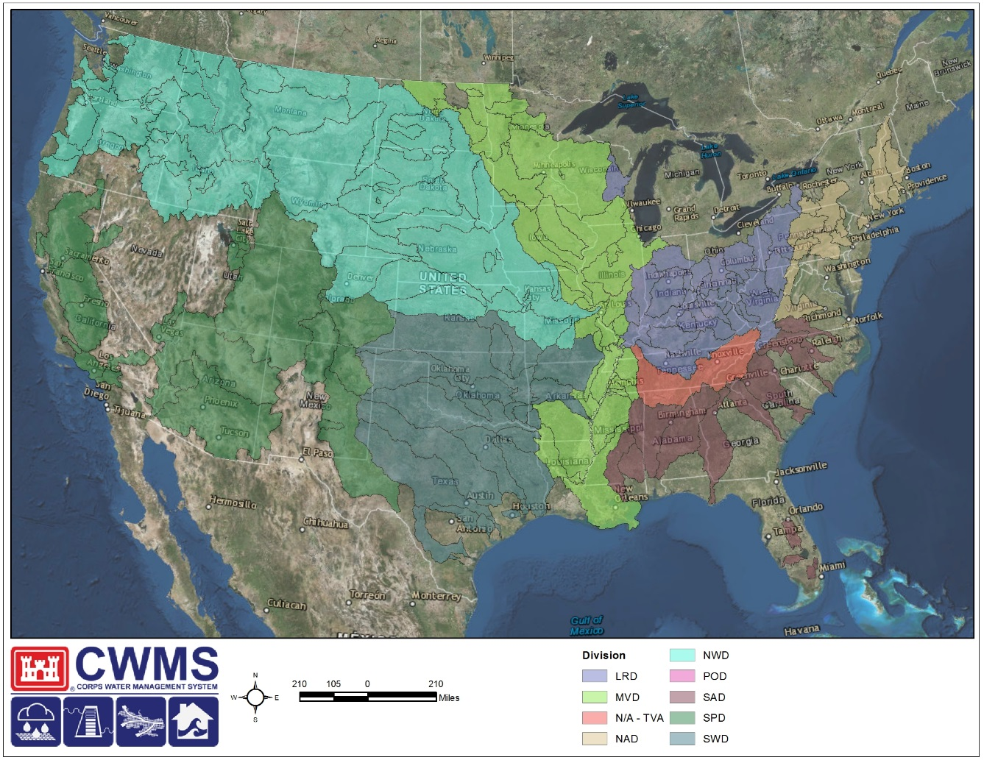
CWMS National Implementation Plan
$124 million 10-year+ program (2012-2026)
Build out of CWMS basin models in all 7 continental divisions and Alaska
Around 200 USACE personnel per year worked on CWMS implementation including engineers, economist, and GIS specialists
Notes:
The Corps Water Management System has been developed by HEC in an effort to streamline data collection, data validation, and data usage within hydrologic, reservoir simulation, hydraulic, and consequence models.
The CWMS Nationwide Implementation was started as an effort to fully integrate the CWMS platform within all watersheds for which there is a USACE interest. The total number of watersheds of interest exceeds 200 and range in size between 50 sq miles and 100,000+ sq miles. In total, 2.25 million sq miles falls under this umbrella.
Starting in 2012, two watersheds were used as part of a pilot program whereby models were constructed, data streams were established, and all products were integrated in a seamless fashion.
Since those first two successful implementations, CWMS has been implemented within an additional 190+ watersheds across the United States.
CWMS Overview

Slide 25
100% CWMS IMPLEMENTATION
An office with water management responsibility MUST have Corps Water Management System (CWMS) models developed and be fully capable to run the full suite of models (complete with meteorological and reservoir scenarios) to completion with consequences and inundation mapping being produced.
The office MUST regularly exercise the models to ensure they are sufficient in their operation/use/application and have an exercised Continuity of Operations Plan (COOP) in-place.
CWMS models MUST replace legacy systems since CWMS is the USACE standard across the enterprise.
It is expected that CWMS models will be used for daily operational planning in determining appropriate operational actions for reservoir operation.
It is not expected that consequence modeling and mapping be produced on a daily basis, but would need to be readily available in times of need or when requested.
Notes:
CWMS Overview

Slide 26
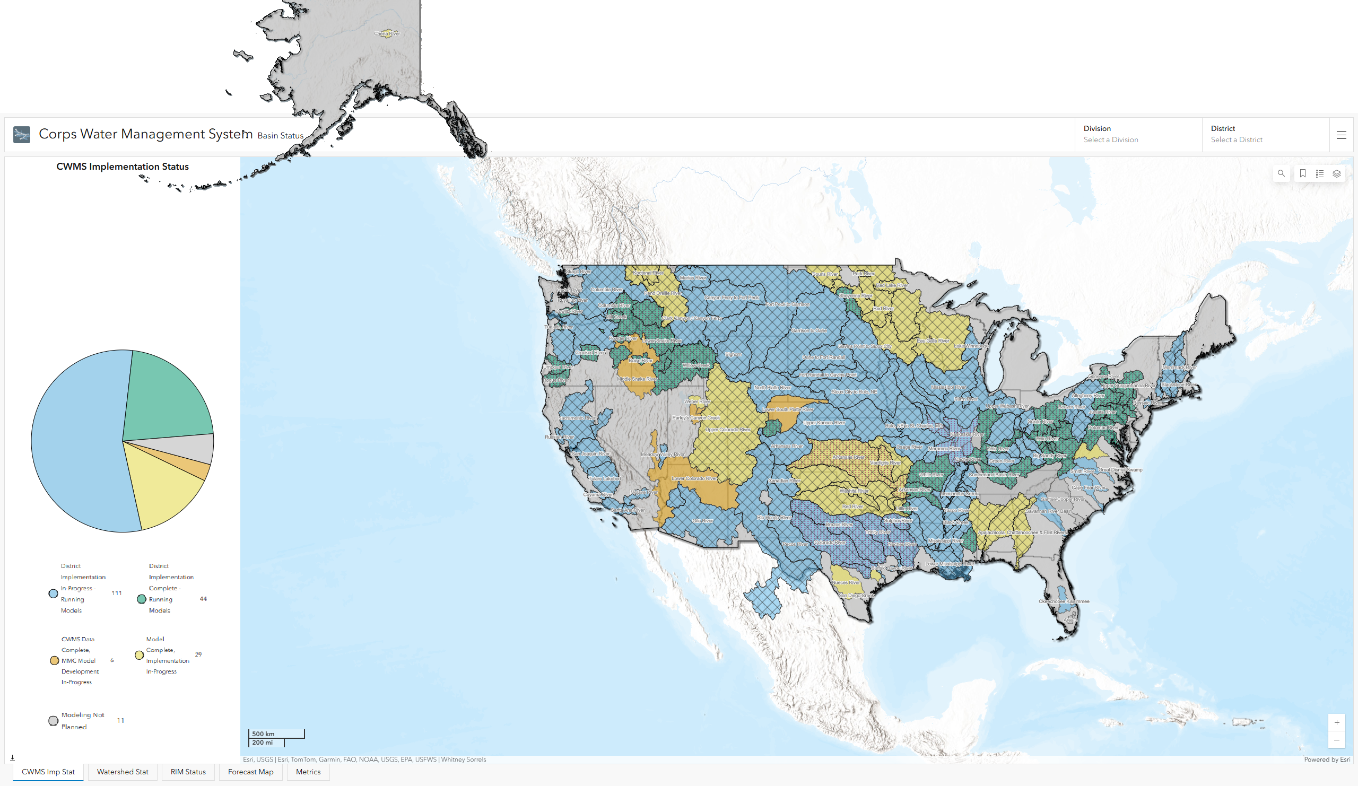
CWMS Implementation Map
Notes:
National CWMS Implementation (Status as of January 2025)

Slide 27

CWMS Beyond Water Management
Dam Safety
DSAC
Risk Assessments
EAP Maps
IRRMP
Transform Civil Works
CIPR
Consequence Assessment Studies
Consequence-Based Top Screen
Security Risk Assessments
Prepare for Tomorrow
Levee Safety
LSAC
Risk Assessments
EAP Maps
Water Management
Operating Plans
Project Operation
Inundation Maps
What if Scenarios
Planning
Planning Transformation
Watershed based budgeting
Watershed based analysis
UOC/FRM
Enhance Disaster Preparation
Strengthen interagency Support
Flood Risk Benefits
Risk Transference
Reduce Disaster Risks
Notes:
National CWMS Implementation
Who does CWMS implementation support?
Transform Civil Works
CIPR, Dam Safety
Prepare for Tomorrow
Levee Safety, Planning
Reduce Disaster Risks
Water Management
UOC/FRM

Slide 28
Summary and Resources
Notes:
CWMS Overview

Slide 29
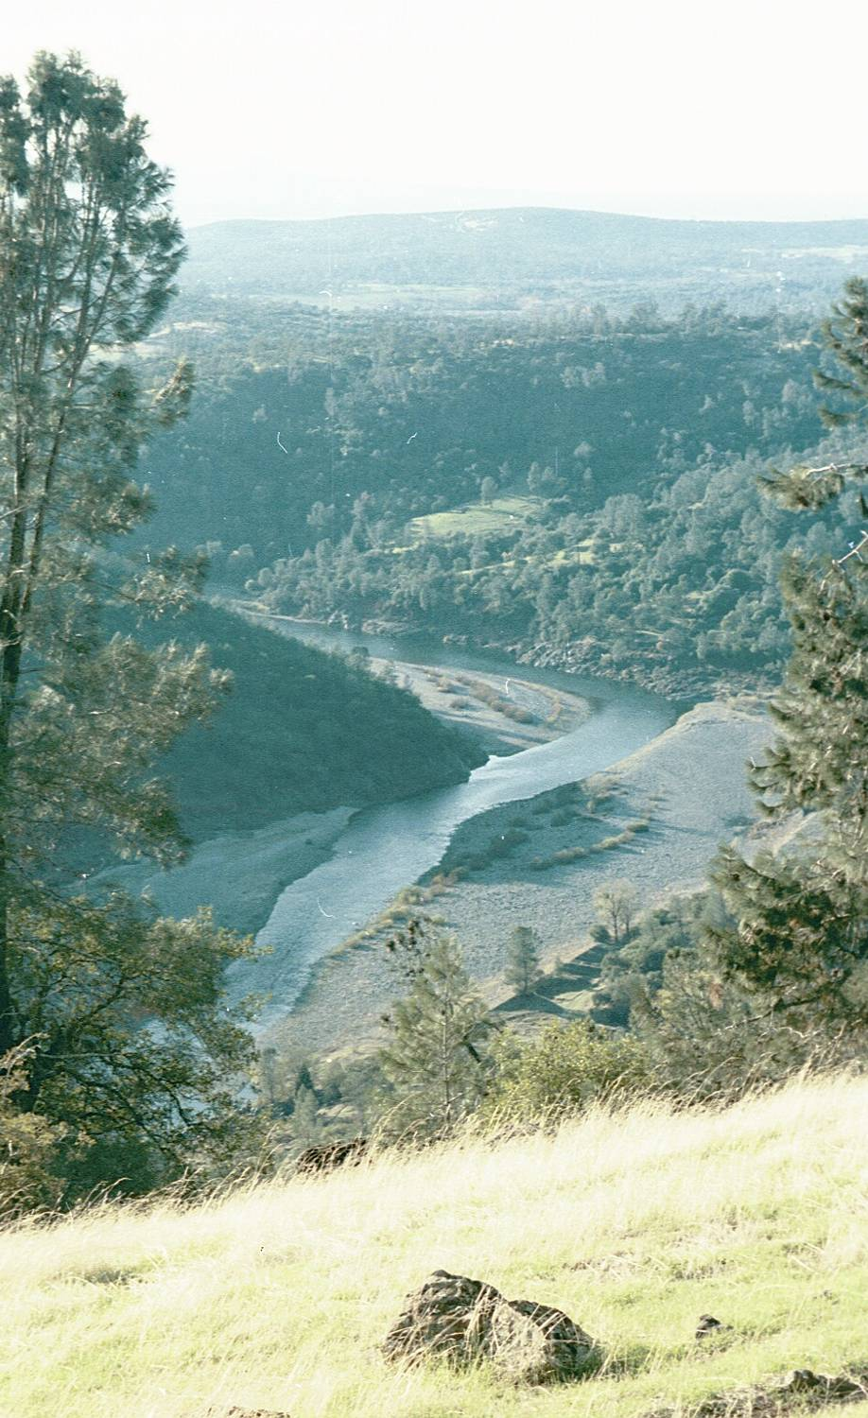
Summary
CWMS is a basin wide comprehensive and integrated system for real time water management
Strong data management capabilities
A full range of hydrologic/hydraulic modeling software
Capability to evaluate operational decisions and compare the impact of various "what if?" scenarios
Comprehensive Training, Manuals and Full Technical Support
Notes:
Conclusion
CWMS is a basin wide comprehensive and integrated system for real time water management
Strong data management capabilities
A full range of hydrologic/hydraulic modeling software
Capability to evaluate operational decisions and compare the impact of various "what if?" scenarios
Comprehensive Training, Manuals and Full Technical Support

Slide 30
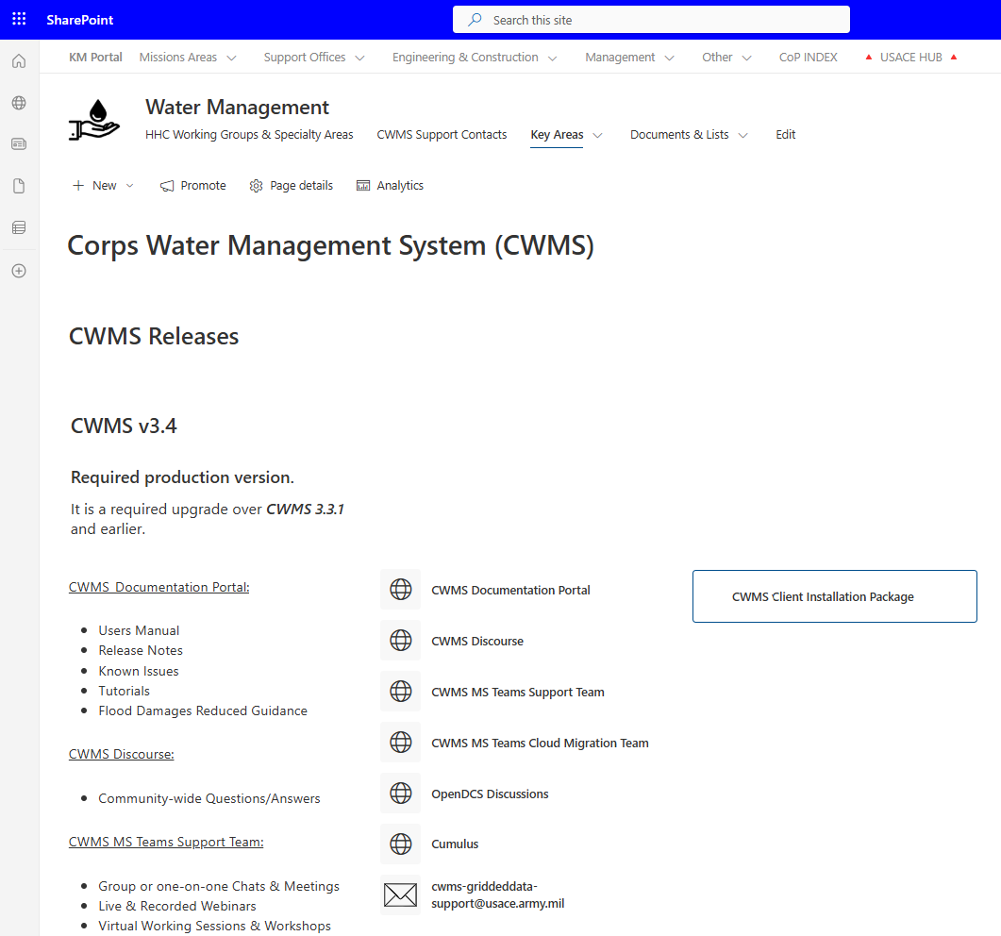
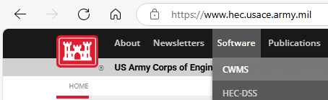
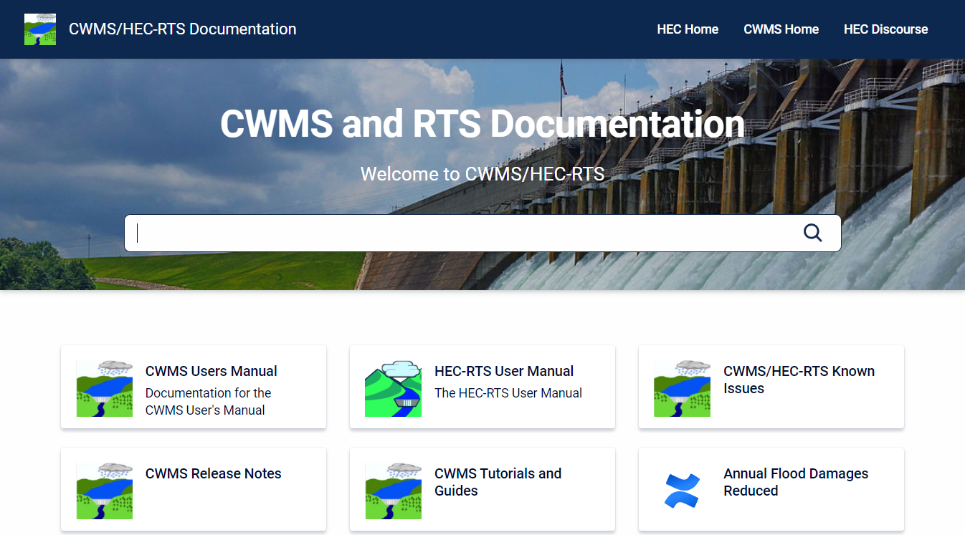
CWMS INFO
CWMS Documentation Portal
Users Manual, Release Notes, Training, and More
Accessible from Sharepoint & the HEC Website
CWMS 3.4.0 Installation
Database schema upgrade scheduled with all offices
Client Software package available in Sharepoint
Notes:
CWMS Overview

Slide 31
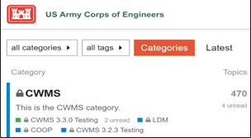
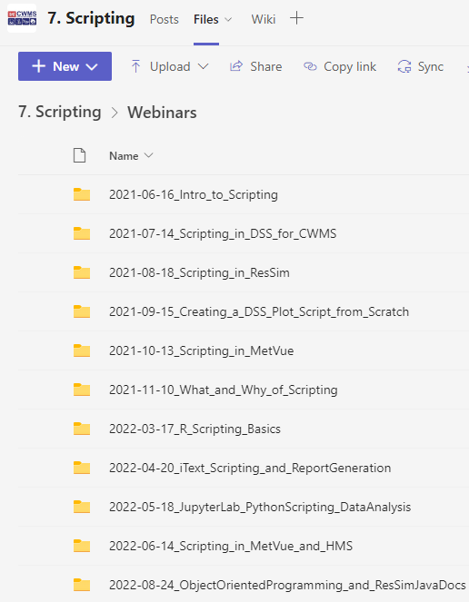
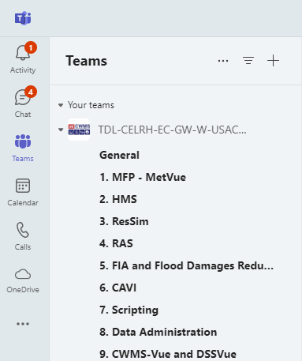
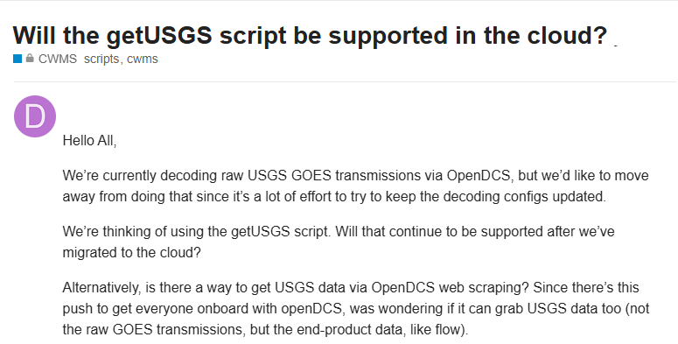
CWMS Discourse & MS Teams
CWMS Discourse
MS Teams
Primary CWMS support platform
Community-wide questions/answers
Group or one-on-one Chats & Meetings
Live & Recorded Webinars
Virtual Working Sessions & Workshops
In-person Workshop Materials Archives
Notes:
CWMS Overview

Slide 32
Questions Help additional Training
https://usace.dps.mil/sites/KMP-WM/SitePages/Corps-Water-Management-System-(CWMS).aspx
https://www.hec.usace.army.mil/confluence/cwmsdocs
https://discourse.hecdev.net/c/cwms/5
TDL-CELRH-EC-GW-W-USACE CWMS Modeling | General | Microsoft Teams
Notes:
CWMS Overview

