Slide 1
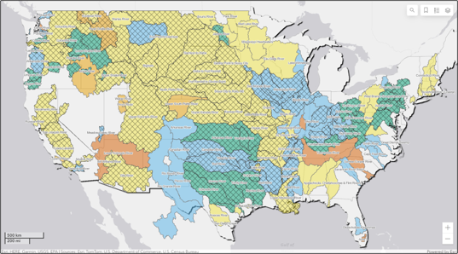

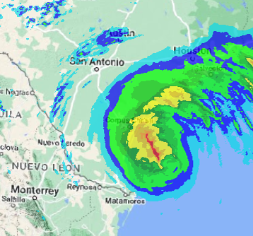
Corps water management system (CWMS) overview
Part A – Water Management Mission Intro
Fauwaz Hanbali
Hydrologic Engineering Center
CWMS Prospect Course
Notes:
1
CWMS Overview

Slide 2

Overview
Water Management in USACE
Corps Water Management System (CWMS)
CWMS National Implementation Program
Summary and Resources
Water Management in USACE
Corps Water Management System (CWMS)
CWMS National Implementation Program
Summary and Resources
Notes:
Overview
Water Management in USACE
Corps Water Management System (CWMS)
National CWMS Implementation Program
Summary and Conclusion

Slide 3
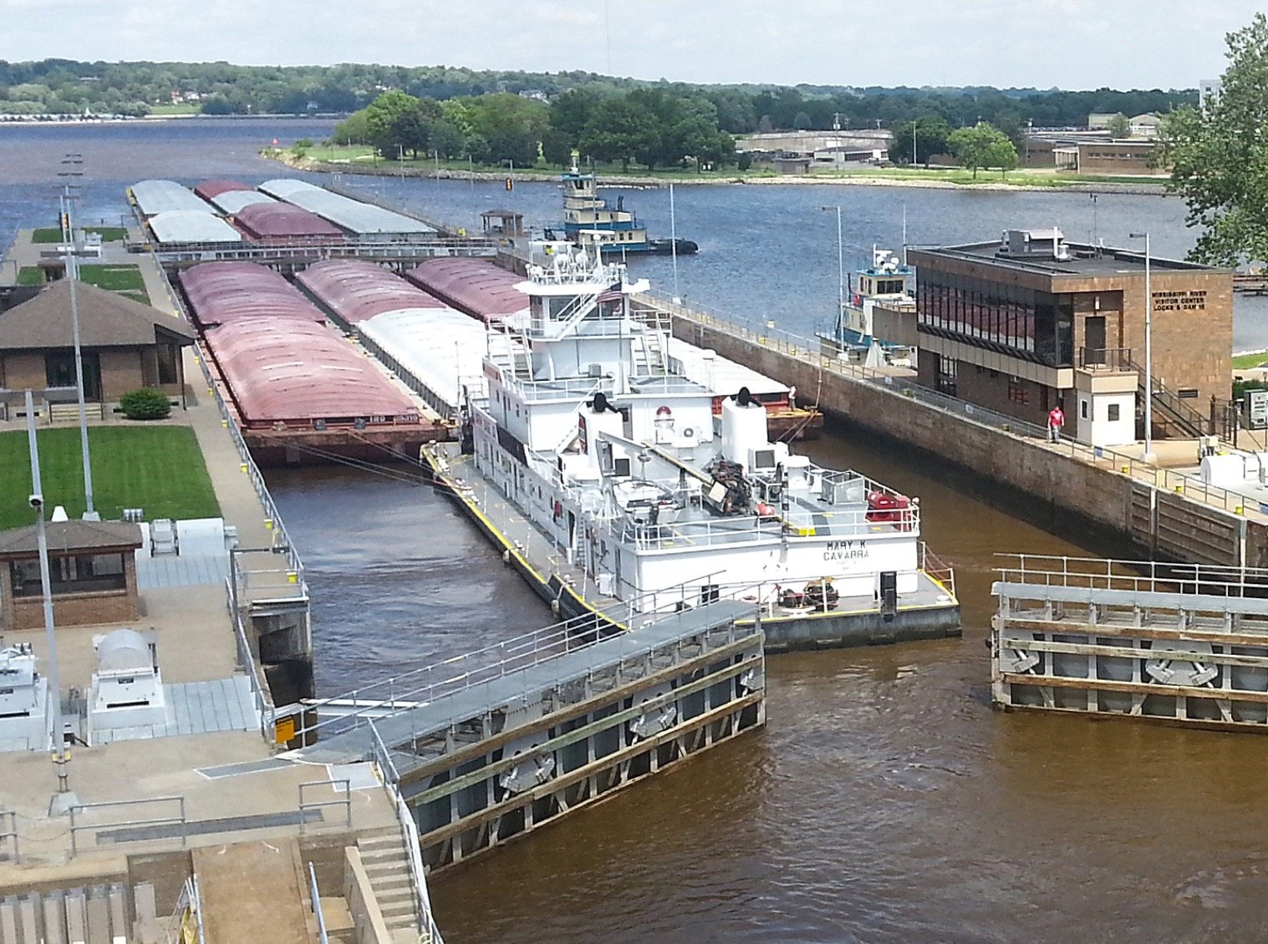
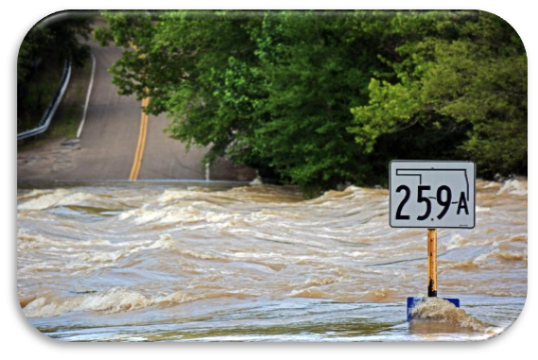
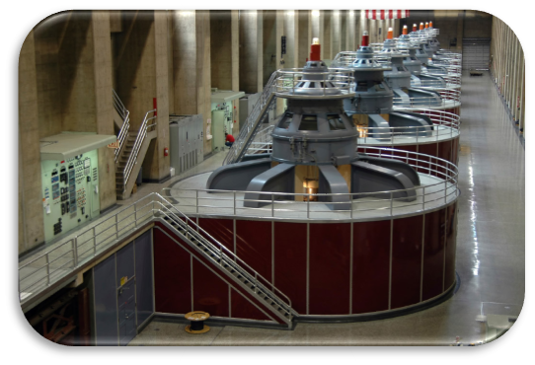
Usace water management mission
Collect, process, store, analyze and disseminate water resources data
Continuously monitor conditions in our systems (precipitation, temperature, flow, stage, melt)
Make daily operations decisions on over 600 USACE reservoirs
    Flood Risk Reduction
    Navigation
    Hydropower
    Water Supply
    Environment

Slide 4
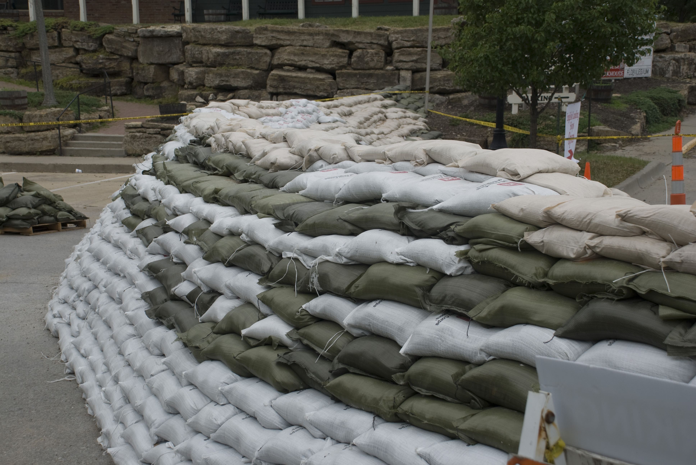
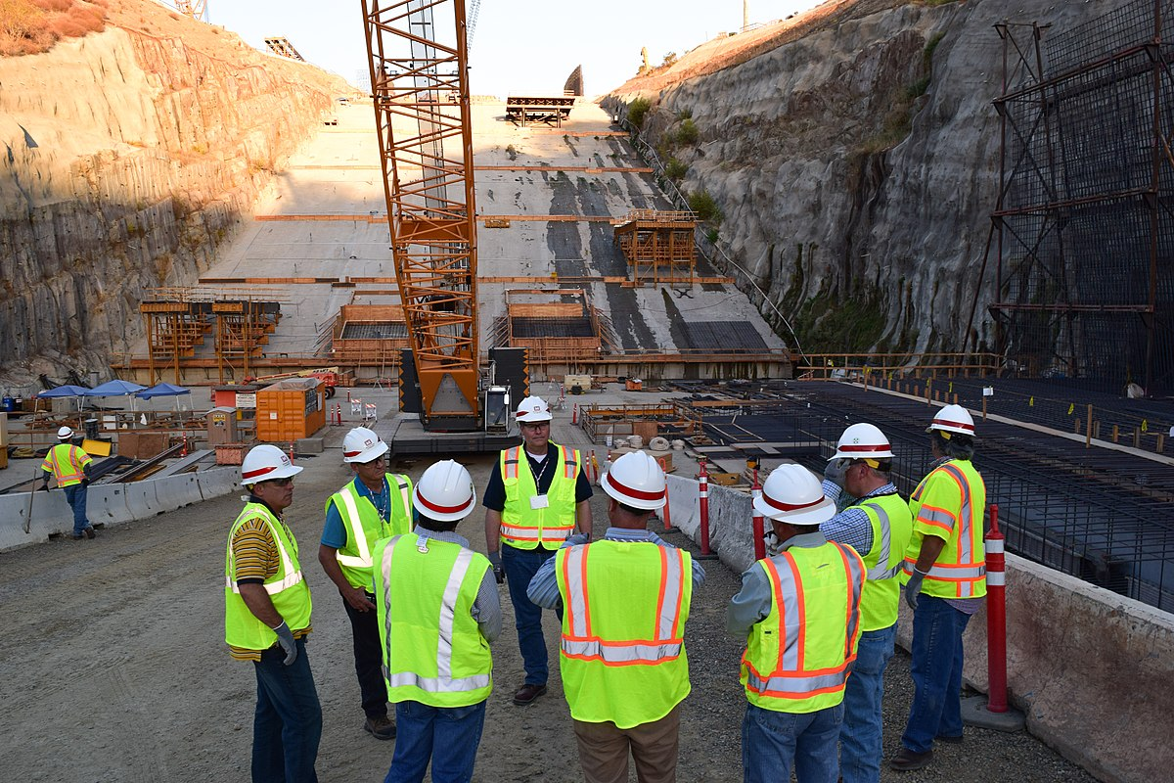
Usace water management mission
Support other USACE missions:
    Preparedness: Emergency and disaster response
    Planning: Systems based water resources approach
    Dam/Levee Safety: Risk informed decision making

Slide 5

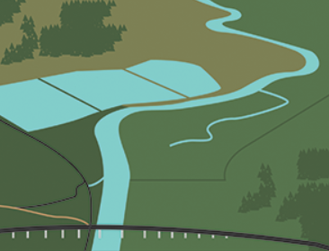



Importance of the water management mission
Water Management is a Mission Critical element within the Corps
  Increases public safety
  Benefits the economy
  Increases public quality of life
  Protects and restores the environment
Notes:
III. Presentation
USACE Role in Water Management
We are Stewards of our Nation’s Water (Water Management) Resources
Water Management is a Mission Critical element within the Corps.
Improves the public’s quality of life and safety
Benefits the nations economy
We are required to collect, process, store, analyze and disseminate water resource data.
We directly support daily decisions at all 600+ Corps Reservoirs.
These decisions, which are based on approved water control manuals and plans, directly impact most of the Corps business lines.
We are also required to manage the flood storage of other federal, state and private dams during times of flooding. We must constantly monitor rain, snow, snow melt, lake levels and river levels.
During Non-Flood time We must constantly make operation decisions to maintain navigation, generate hydropower and manage low flow and drought conditions.

Slide 6
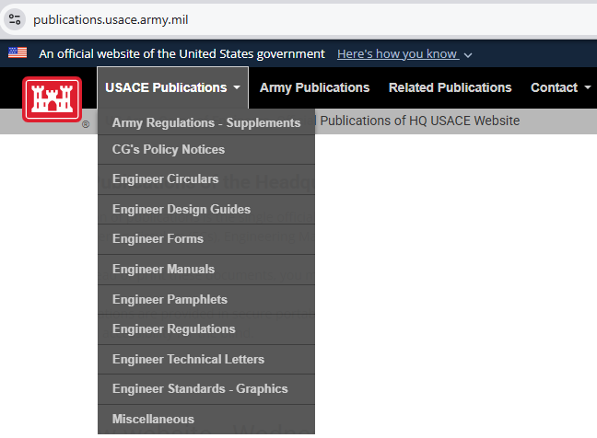
USACE Water Management
Strategy and Policy
Strategic Vision: USACE Actions for Change: Comprehensive Systems Approaches that include sustainable solutions
Legislation: WRDA 1997 Sec. Army provide public access to USACE Water Resources Data
Civil Works Initiatives: Planning Transformation
Corps Policy on Water Control
  ER 200-1-5
  ER 1110-2-240
  EM 1110-2-3600
Notes:
USACE Role in Water Management
USACE Strategy for System/Watershed Requirements
Corps Policy
ER 1105-2-100, Planning Guidance Notebook, 22 April 2000, requires systems approaches, "The planning process shall address the Nation’s water resources needs in a systems context…”
ER 1105-2-409, Planning in a Collaborative Environment, 31 May 2005, provides revised procedures for conducting Corps water resources planning, "Collaboration is the keystone of the Corps watershed approach…”
EC 1110-2-6067, USACE Process for the National Flood Insurance Program (NFIP) Levee System Evaluation, 31 August 2010,
Strategic vision: USACE Actions for Change
required comprehensive systems approaches that include integrated sustainable solutions and decisions are risk-informed.
Legislation: WRDA 1997 Sec. Army provide public access to USACE Water Resources Data.
Civil Works Initiatives: Planning Transformation:
CWMS is the tool to meet the Water Management Mission
Is a modernized AIS set of Water Management tools designed to meet USACE initiatives, the WM mission, and any legislative or legal requirements.
B. Corps Policy on Water Control
Engineering Regulation ER 1110-2-240, Water Control Management
Engineering Manual EM 1110-2-3600, Management of Water Control System
Engineering Regulation ER 1110-2-8156, Preparation of Water Control Manuals
Environmental Operating Principals ER 200-1-5.

Slide 7
Questions
Help additional Training
https://usace.dps.mil/sites/KMP-WM/SitePages/Corps-Water-Management-System-(CWMS).aspx
https://www.hec.usace.army.mil/confluence/cwmsdocs
https://discourse.hecdev.net/c/cwms/5
TDL-CELRH-EC-GW-W-USACE CWMS Modeling | General | Microsoft Teams
Notes:
7
CWMS Overview

