Slide 1
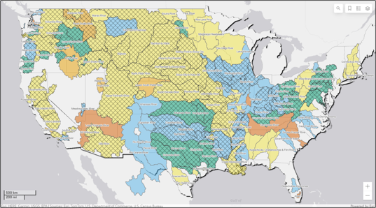

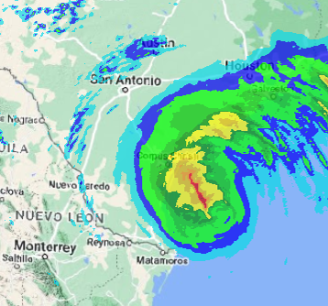
Corps water management system (CWMS) overview
Part B – CWMS Introduction
Fauwaz Hanbali
Hydrologic Engineering Center
CWMS Prospect Course
Notes:
CWMS Overview

Slide 2

Overview
Water Management in USACE
Corps Water Management System (CWMS)
CWMS National Implementation Program
Summary and Resources
Notes:
Overview
Water Management in USACE
Corps Water Management System (CWMS)
National CWMS Implementation Program
Summary and Conclusion

Slide 3
Corps Water Management System (CWMS)
CWMS is the tool to help water managers meet the mission
An Automated Information System (AIS) to collect, process, and store real-time data
A suite of modeling tools to run real-time forecast simulations and help achieve a wide range of reservoir authorized purposes
Designed to meet USACE initiatives, the WM mission, and other legislative requirements

Slide 4


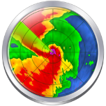
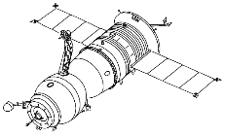

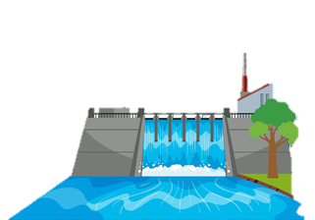

Corps water management system (CWMS)
CWMS Database
Met Data
RTS Modeling & Water Management Decisions
Data Dissemination
Observed Data
Instructions
Notes:
Explain the process
Explain that the piece we will be focusing on is RTS
CWMS Overview

Slide 5
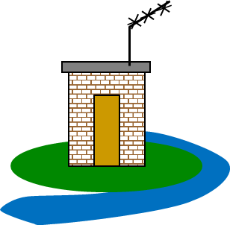
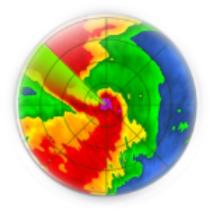
Real-time data acquisition
CWMS Server/Database
Collect
Decode
Transform
Validate
Make corrections
Use data for monitoring and forecasting
Notes:
Components of CWMS
Data Acquisition
Collect: record and transmit (line of sight to satellite to receiving dish to CWMS server (database)
Decode into usable format
Transform decoded data
Validate transformed data
Make corrections
Monitoring and Forecasting

Slide 6
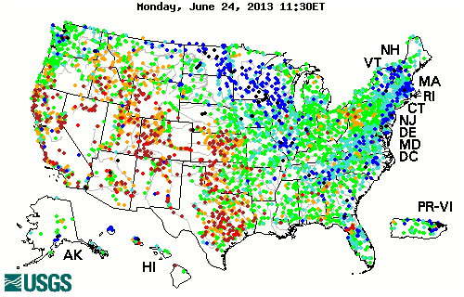
Station data
Stream gauging data used for water management
USGS provides USACE data for 2500 stations
Notes:
Components of CWMS
Common Data Acquired
Real-Time Data
Stream gauging data used for water management
USGS provides USACE data for 2500 stations

Slide 7
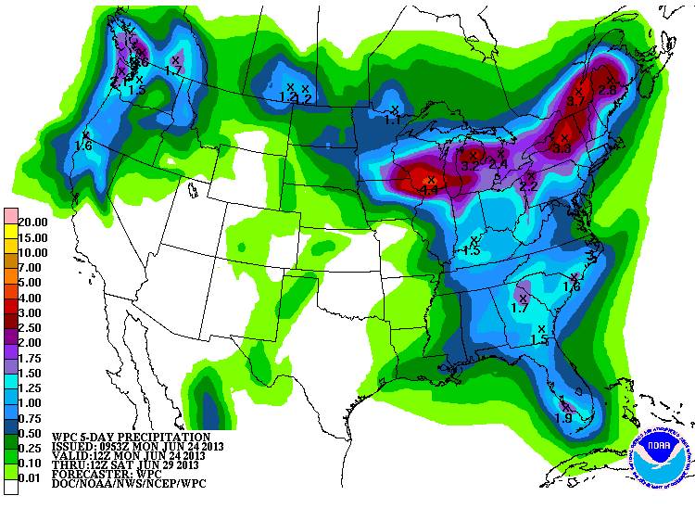
Observed & forecast met data
NOAA/NWS Support:
Quantitative Precipitation Estimates (QPEs)
Provides Quantitative Forecast Precipitation (QPFs)
RFCs provide river stage/flow forecasts
Notes:
Components of CWMS
Common Data Acquired
Forecasted Data
Provides Precipitation Quantitative Estimates (QPE)
Provides Precipitation Quantitative Forecast (QPF) for various durations such as 24, 48, and 72 hours
RFCs (River Forecast Centers) provide river stage forecasts

Slide 8
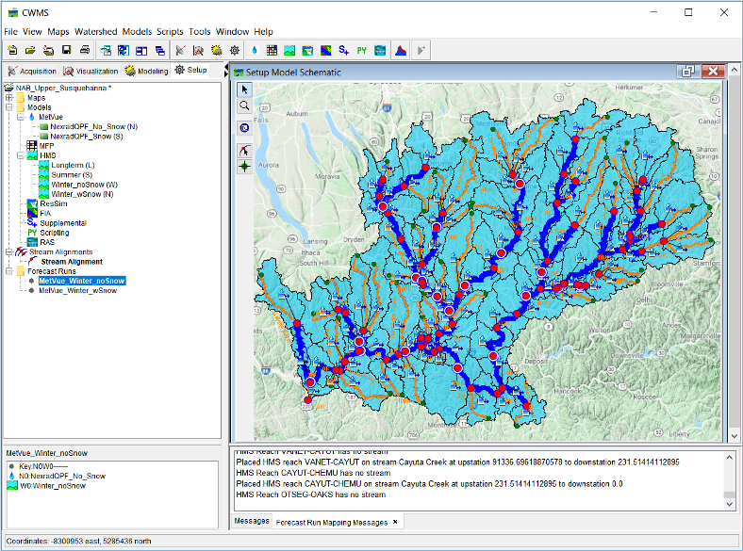

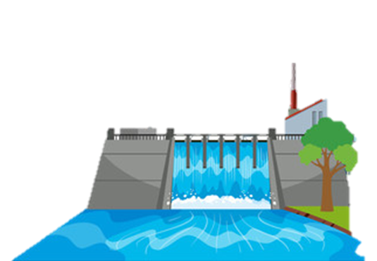
HEC-RTS
Hydrologic Engineering Center (HEC) Real-Time Simulation (RTS)
The CWMS suite of modeling software with integrated real-time data
Data
Instructions

Slide 9





CWMS Modeling Tools
Meteorology
Reservoir Operations
Consequences
Hydrology
Hydraulics
Notes:
USACE Role in Water Management
Corps of Engineers Water Management System
CWMS Package
The CWMS release package consists of a database (software and hardware) and a suite of models
The database consists of software for data acquisition, visualization and dissemination
The model suite consists of HEC-MetVue, HEC-HMS, HEC-ResSim, HEC-RAS, and HEC-FIA
Real time data and weather forecasts are used with the models to generate streamflow forecasts and make release decisions

Slide 10
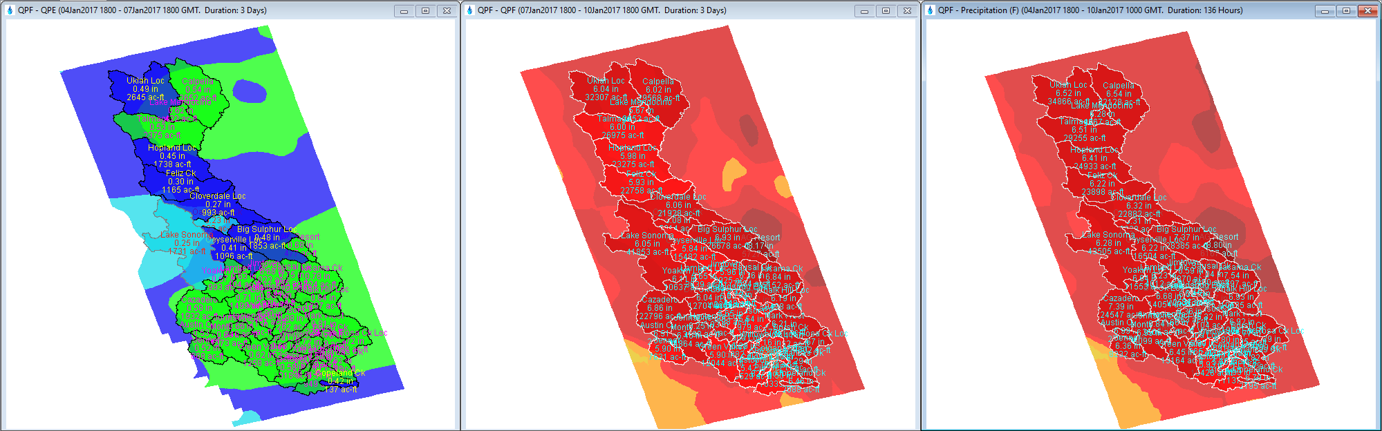


Meteorological Scenarios: HEC-MetVue
Processes and Combines Observed and Forecast Meteorological Datasets
Precipitation, Temperature, and more
Allows for:
Observed Dataset Corrections
Forecast Dataset Adjustments for additional “What-If” Scenarios
Observed
Precipitation
Forecast
Precipitation
Combined
Precipitation

Slide 11
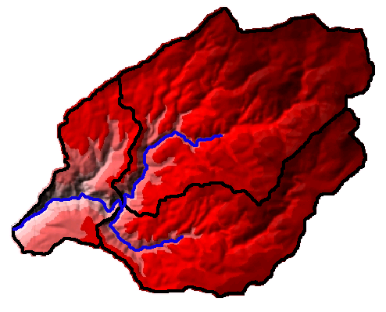
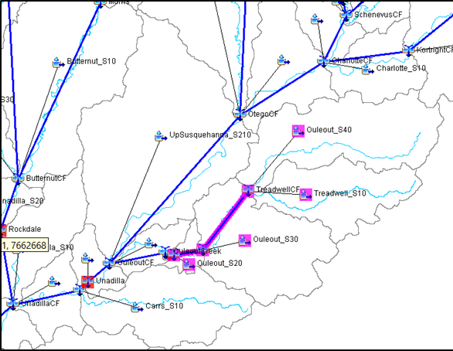
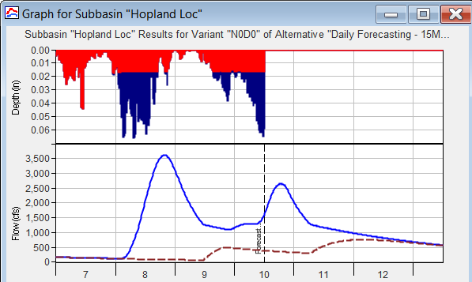
Hydrologic Modeling: HEC-HMS
Compute runoff and uncontrolled flows given input meteorological data
Predict inflows to reservoirs, and local-flows downstream of reservoirs
Model output used as input to reservoir operations and hydraulics models
Notes:
Components of CWMS
Hydrologic Modeling: Precipitation (HEC-HMS)
Utilize GIS functionality for developing watershed input.
Digital terrain model
sub-basin delineation and drainage network
development of a grid cell file

Slide 12
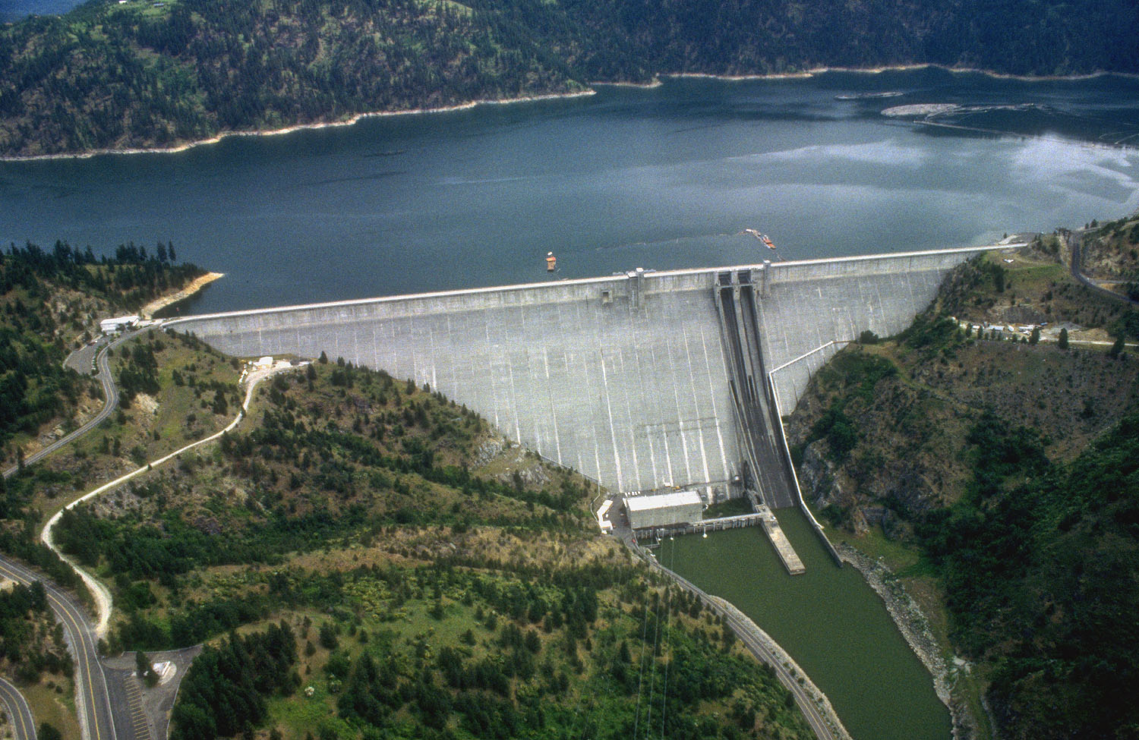
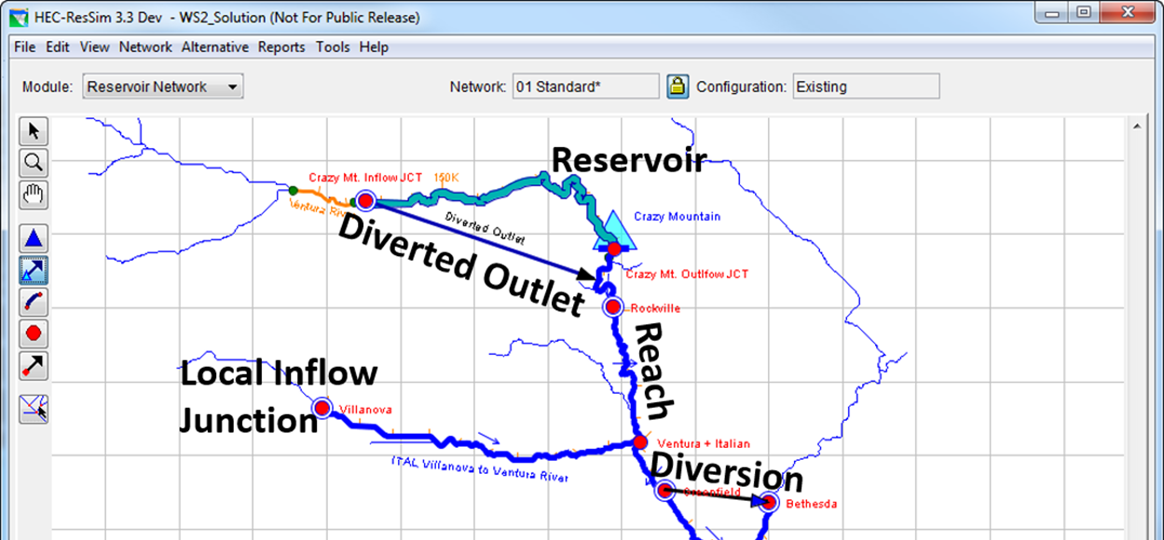
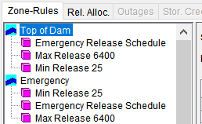
Reservoir Operations: HEC-ResSim
Given stream flows and water control rules, simulate reservoir operations
Override operations to test operating plan scenarios
Model output used as input to hydraulics and consequences models
Notes:
Components of CWMS
Reservoir Operations
Given streamflows and water control plans (reservoir operating rules) for a river basin simulate reservoir operations and computes downstream hydrographs
Streamflows are observed and forecasted
Streamflows include reservoir inflow and downstream local hydrographs
Model (reservoir) output (regulated hydrographs) are used as input to hydraulic and flood inundation (consequence) models and impacts are evaluated

Slide 13
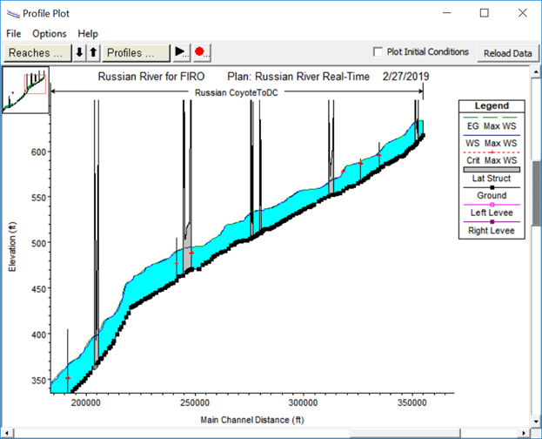
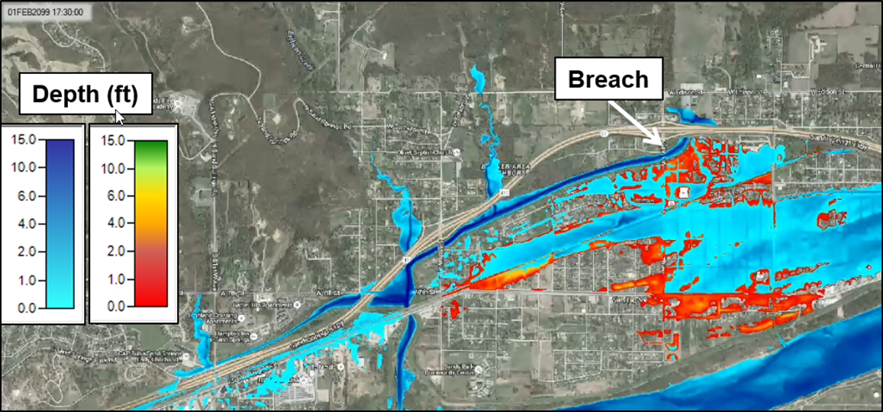
River Hydraulics: HEC-RAS
Given flow hydrographs, compute water surface profiles
Predict resultant water surface elevations and inundation areas for events
Produce inundation maps
Model output used as input to consequences models
Notes:
Components of CWMS
River Hydraulics
HEC-RAS Hydraulic Modeling Software
Steady-flow or unsteady-flow analysis; 1-D and 2-D, water quality, sediment
Channel friction adjusted through the CAVI and NMI (Native Model Interface)
Given reservoir model hydrographs, computes water surface profiles and stage hydrographs
Also computes river velocities, stages, and inundated areas given streamflow and river/floodplain geometry and hydraulic characteristics (river hydraulics).
13

Slide 14
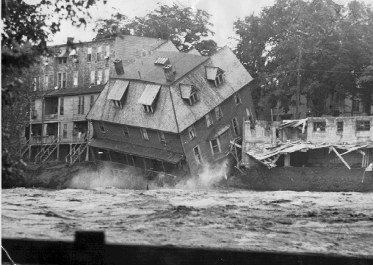
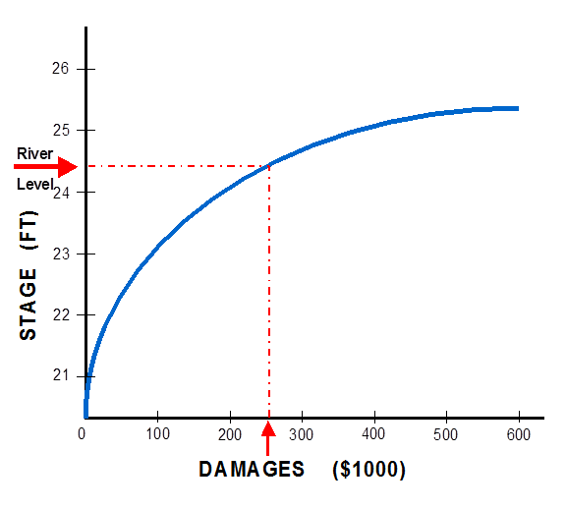
Consequences: HEC-FIA
HEC-FIA (Flood Impact Analysis) identifies the consequences from a flood event
Given river stages and damage data, computes damages to structures and estimates life loss
Computes project benefits
Response tables provide a list and of actions to take during an event, based on forecasted stages
Notes:
Components of CWMS
Consequence Analysis: HEC-FIA
HEC-FIA (Flood Impact Analysis) identifies the consequences from a single event
Accepts model output from HEC-ResSim and HEC-RAS
Given river stages and damage data, computes damages to structures and other contents of the floodplain (including agricultural)
Computes damages and benefits between different scenarios, including with and without project conditions
Estimates Life Loss
Commonly used FIA components
"Action tables" provide a list and time of actions to take during an event, based on forecasted

Slide 15
CWMS Modeling: Putting it all together
Real-time hydrometeorological data
Weather forecasts
Models for various forecast alternatives (scenarios) are calibrated based on real time conditions
Forecast alternatives for a variety of scenarios are simulated and evaluated for decision making purposes
Notes:
USACE Role in Water Management
Corps of Engineers Water Management System
CWMS Modeling: Putting it all together
Real time hydrometeorological data like rain, streamflow, temperature, snow water equivalent are acquired, validated, and transformed
Weather forecasts (scenarios) for rain and temperature are input into CWMS
Models for various forecast alternatives (scenarios) are calibrated based on real time conditions
Typically use one week of observed data and evaluate results two weeks into the future.
What models are needed? hydrologic, reservoir, hydraulic and flood inundation models?
Forecast alternatives for a variety of scenarios are simulated and evaluated for decision making purposes
No rain (rain on the ground)
QPF’s or multiples of QPF
Historical events
Specified Reservoir operations
Levee failures

Slide 16
Questions Help additional Training
https://usace.dps.mil/sites/KMP-WM/SitePages/Corps-Water-Management-System-(CWMS).aspx
https://www.hec.usace.army.mil/confluence/cwmsdocs
https://discourse.hecdev.net/c/cwms/5
TDL-CELRH-EC-GW-W-USACE CWMS Modeling | General | Microsoft Teams
Notes:
CWMS Overview

