Slide 1
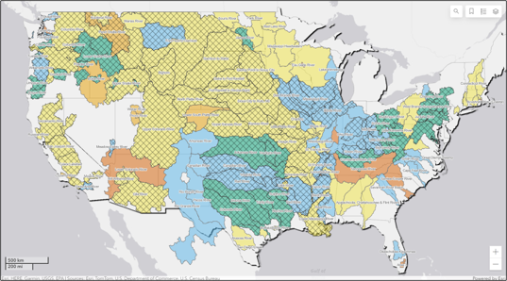

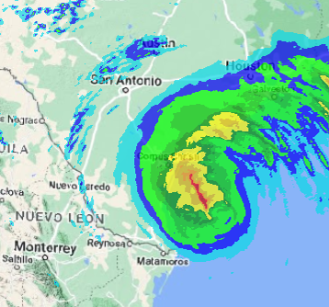
Corps water management system (CWMS) overview
Part C – CWMS National Implementation
Fauwaz Hanbali
Hydrologic Engineering Center
CWMS Prospect Course
Notes:
CWMS Overview

Slide 2

Overview
Water Management in USACE
Corps Water Management System (CWMS)
CWMS National Implementation Program
Summary and Resources
Notes:
Overview
Water Management in USACE
Corps Water Management System (CWMS)
National CWMS Implementation Program
Summary and Conclusion

Slide 3
CWMS National Implementation Plan
Joint effort by MMC and HEC to strengthen water management capabilities of USACE
Aims to develop CWMS models and databases for USACE Districts across the nations
201 watersheds ranging in size from 50 to 100,000+ sq. mi.
Total of 2,250,000+ sq. mi.
Implement CWMS models into daily water management processes at district offices
Consistent approach across the nation
Notes:
National CWMS Implementation
It is an investment in the Corps
Supports Transformation of Civil Works, Preparing for Tomorrow, and Reducing Disaster Risks
$124 million 10 year program depending on level of funding
Working on basins in all 7 continental divisions.
141 USACE personnel worked on CWMS including 109 modelers, 14 economist, and 18 GIS specialists.

Slide 4
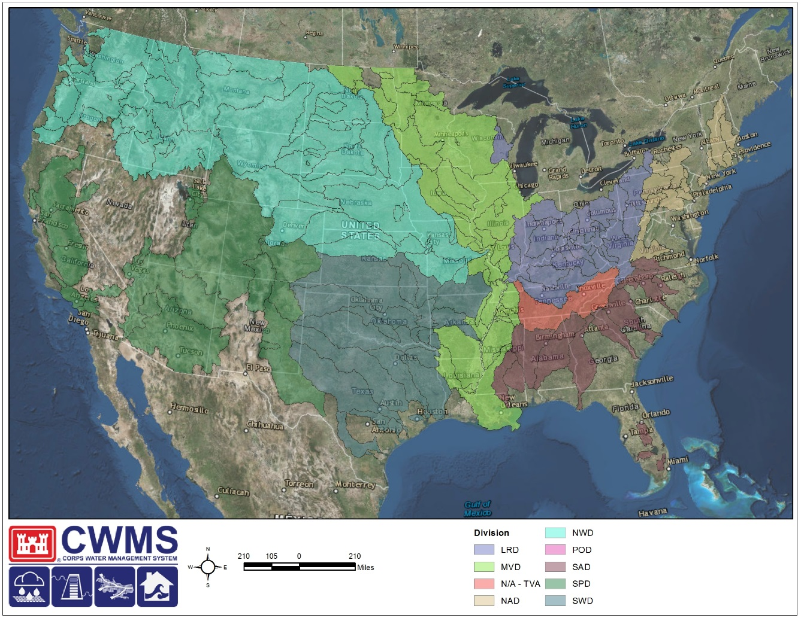
CWMS National Implementation Plan
$124 million 10-year+ program (2012-2026)
Build out of CWMS basin models in all 7 continental divisions and Alaska
Around 200 USACE personnel per year worked on CWMS implementation including engineers, economist, and GIS specialists
Notes:
The Corps Water Management System has been developed by HEC in an effort to streamline data collection, data validation, and data usage within hydrologic, reservoir simulation, hydraulic, and consequence models.
The CWMS Nationwide Implementation was started as an effort to fully integrate the CWMS platform within all watersheds for which there is a USACE interest. The total number of watersheds of interest exceeds 200 and range in size between 50 sq miles and 100,000+ sq miles. In total, 2.25 million sq miles falls under this umbrella.
Starting in 2012, two watersheds were used as part of a pilot program whereby models were constructed, data streams were established, and all products were integrated in a seamless fashion.
Since those first two successful implementations, CWMS has been implemented within an additional 190+ watersheds across the United States.
CWMS Overview

Slide 5
100% CWMS IMPLEMENTATION
An office with water management responsibility MUST have Corps Water Management System (CWMS) models developed and be fully capable to run the full suite of models (complete with meteorological and reservoir scenarios) to completion with consequences and inundation mapping being produced.
The office MUST regularly exercise the models to ensure they are sufficient in their operation/use/application and have an exercised Continuity of Operations Plan (COOP) in-place.
CWMS models MUST replace legacy systems since CWMS is the USACE standard across the enterprise.
It is expected that CWMS models will be used for daily operational planning in determining appropriate operational actions for reservoir operation.
It is not expected that consequence modeling and mapping be produced on a daily basis, but would need to be readily available in times of need or when requested.
Notes:
CWMS Overview

Slide 6
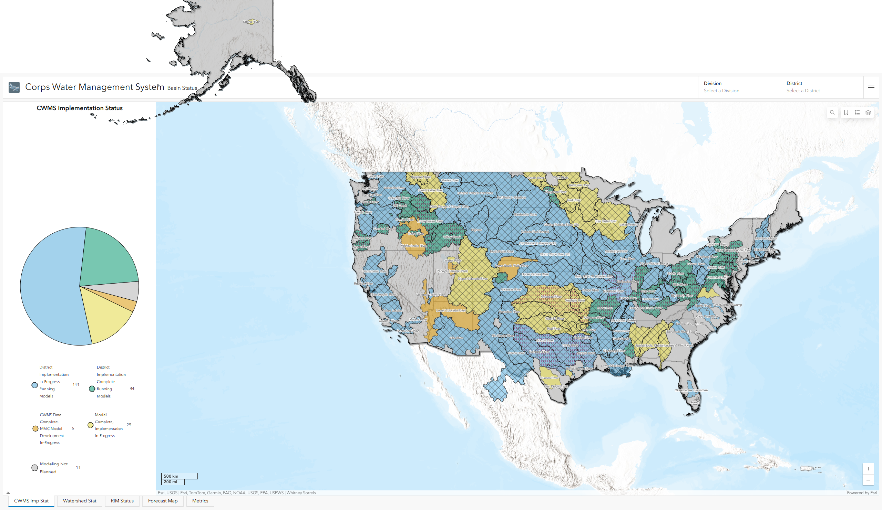
CWMS Implementation Map
Notes:
National CWMS Implementation (Status as of January 2025)

Slide 7
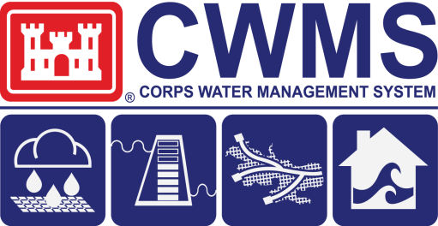
CWMS Beyond Water Management
Dam Safety
DSAC
Risk Assessments
EAP Maps
IRRMP
Transform Civil Works
CIPR
Consequence Assessment Studies
Consequence-Based Top Screen
Security Risk Assessments
Prepare for Tomorrow
Levee Safety
LSAC
Risk Assessments
EAP Maps
Water Management
Operating Plans
Project Operation
Inundation Maps
What if Scenarios
Planning
Planning Transformation
Watershed based budgeting
Watershed based analysis
UOC/FRM
Enhance Disaster Preparation
Strengthen interagency Support
Flood Risk Benefits
Risk Transference
Reduce Disaster Risks
Notes:
National CWMS Implementation
Who does CWMS implementation support?
Transform Civil Works
CIPR, Dam Safety
Prepare for Tomorrow
Levee Safety, Planning
Reduce Disaster Risks
Water Management
UOC/FRM

Slide 8
Questions Help additional Training
https://usace.dps.mil/sites/KMP-WM/SitePages/Corps-Water-Management-System-(CWMS).aspx
https://www.hec.usace.army.mil/confluence/cwmsdocs
https://discourse.hecdev.net/c/cwms/5
TDL-CELRH-EC-GW-W-USACE CWMS Modeling | General | Microsoft Teams
Notes:
CWMS Overview

