Slide 1
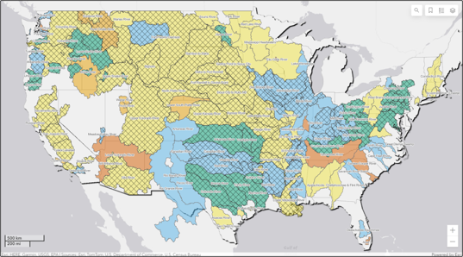

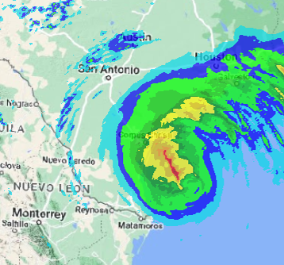
Corps water management system (CWMS) overview
Part D – Summary and resources
Fauwaz Hanbali
Hydrologic Engineering Center
CWMS Prospect Course
Notes:
CWMS Overview

Slide 2

Overview
Water Management in USACE
Corps Water Management System (CWMS)
CWMS National Implementation Program
Summary and Resources
Notes:
Overview
Water Management in USACE
Corps Water Management System (CWMS)
National CWMS Implementation Program
Summary and Conclusion

Slide 3
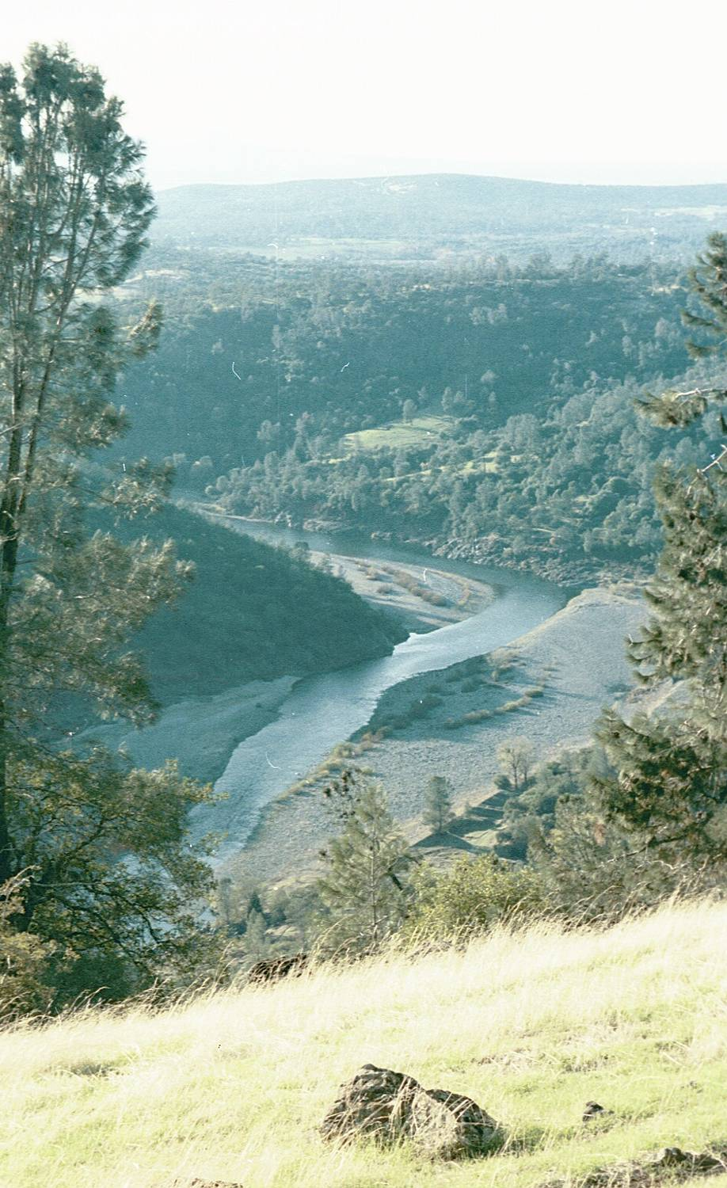
Summary
CWMS is a basin wide comprehensive and integrated system for real time water management
Strong data management capabilities
A full range of hydrologic/hydraulic modeling software
Capability to evaluate operational decisions and compare the impact of various "what if?" scenarios
Comprehensive Training, Manuals and Full Technical Support
Notes:
Conclusion
CWMS is a basin wide comprehensive and integrated system for real time water management
Strong data management capabilities
A full range of hydrologic/hydraulic modeling software
Capability to evaluate operational decisions and compare the impact of various "what if?" scenarios
Comprehensive Training, Manuals and Full Technical Support

Slide 4
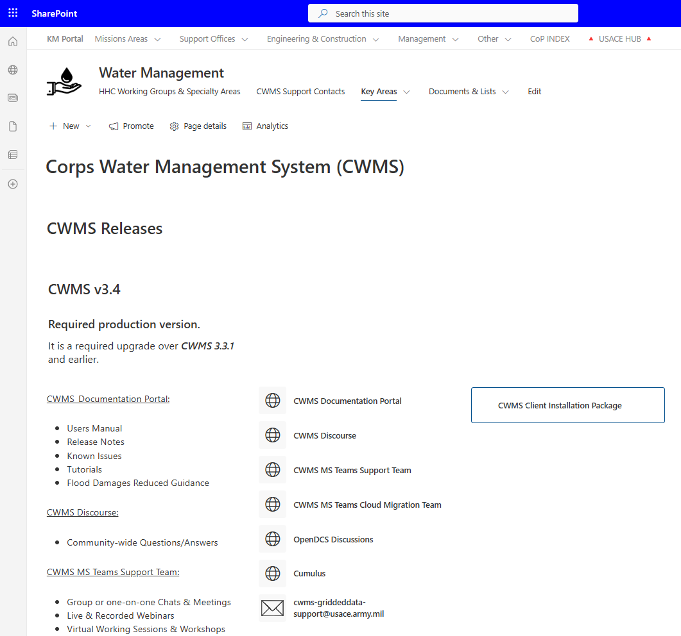
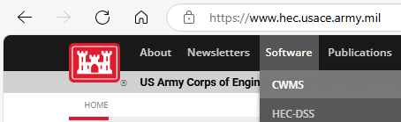
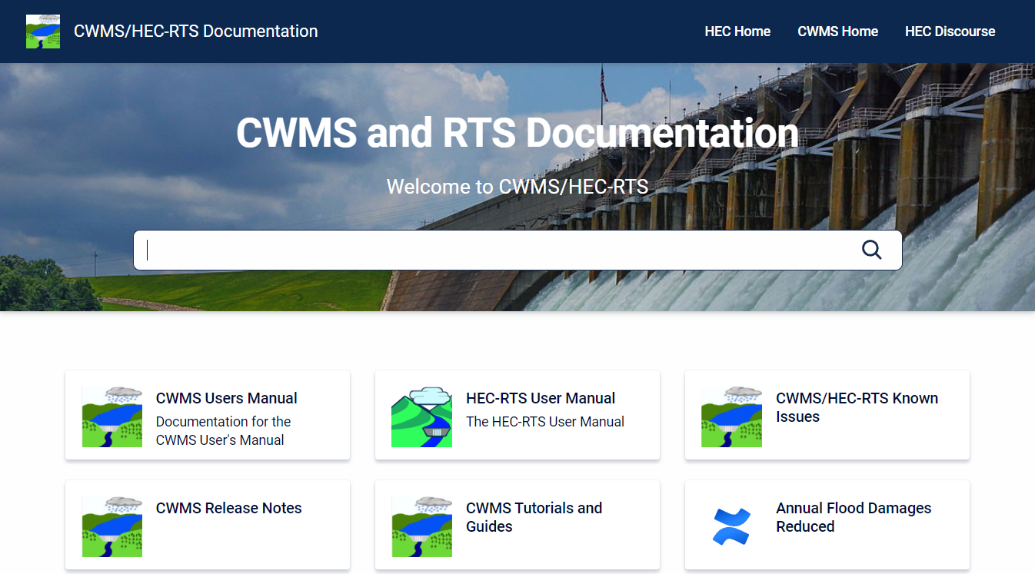
CWMS INFO
CWMS Documentation Portal
  Users Manual, Release Notes, Training, and More
  Accessible from Sharepoint & the HEC Website
CWMS 3.4.0 Installation
  Database schema upgrade scheduled with all offices
  Client Software package available in Sharepoint
Notes:
CWMS Overview

Slide 5
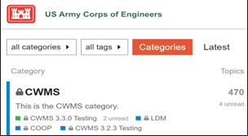
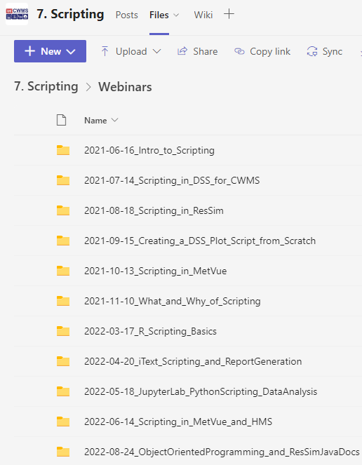
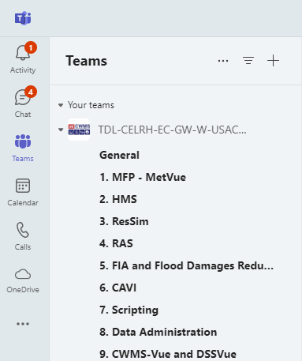
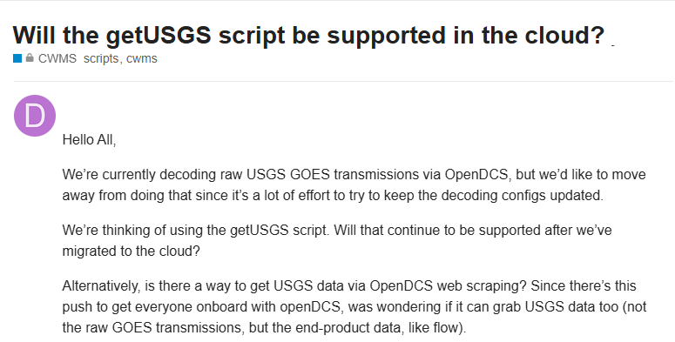
CWMS Discourse & MS Teams
CWMS Discourse
MS Teams
  Primary CWMS support platform
  Community-wide questions/answers
  Group or one-on-one Chats & Meetings
  Live & Recorded Webinars
  Virtual Working Sessions & Workshops
  In-person Workshop Materials Archives
Notes:
CWMS Overview

Slide 6
Questions
Help additional Training
https://usace.dps.mil/sites/KMP-WM/SitePages/Corps-Water-Management-System-(CWMS).aspx
https://www.hec.usace.army.mil/confluence/cwmsdocs
https://discourse.hecdev.net/c/cwms/5
TDL-CELRH-EC-GW-W-USACE CWMS Modeling | General | Microsoft Teams
Notes:
CWMS Overview

