Slide 1
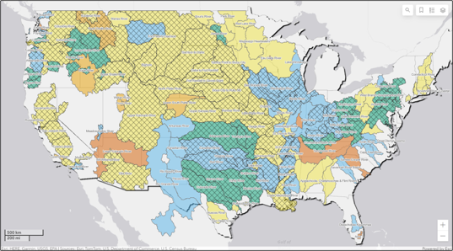

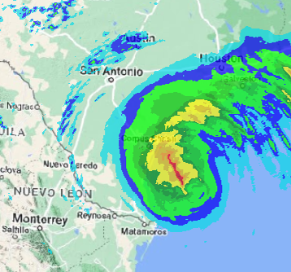
HEC-MetVue overview
Part A – Program Interface
Fauwaz Hanbali
Hydrologic Engineering Center
CWMS Prospect Course

Slide 2

Overview
HEC-MetVue Program Interface
HEC-MetVue Key Features Orientation
HEC-MetVue Interactive and Automated Data Processing and Analysis
HEC-MetVue in CWMS
HEC-MetVue Program Interface
HEC-MetVue Key Features Orientation
HEC-MetVue Interactive and Automated Data Processing and Analysis
HEC-MetVue in CWMS
HEC-MetVue

Slide 3
HEC-METVUE
Meteorological Visualization Utility Engine

Slide 4
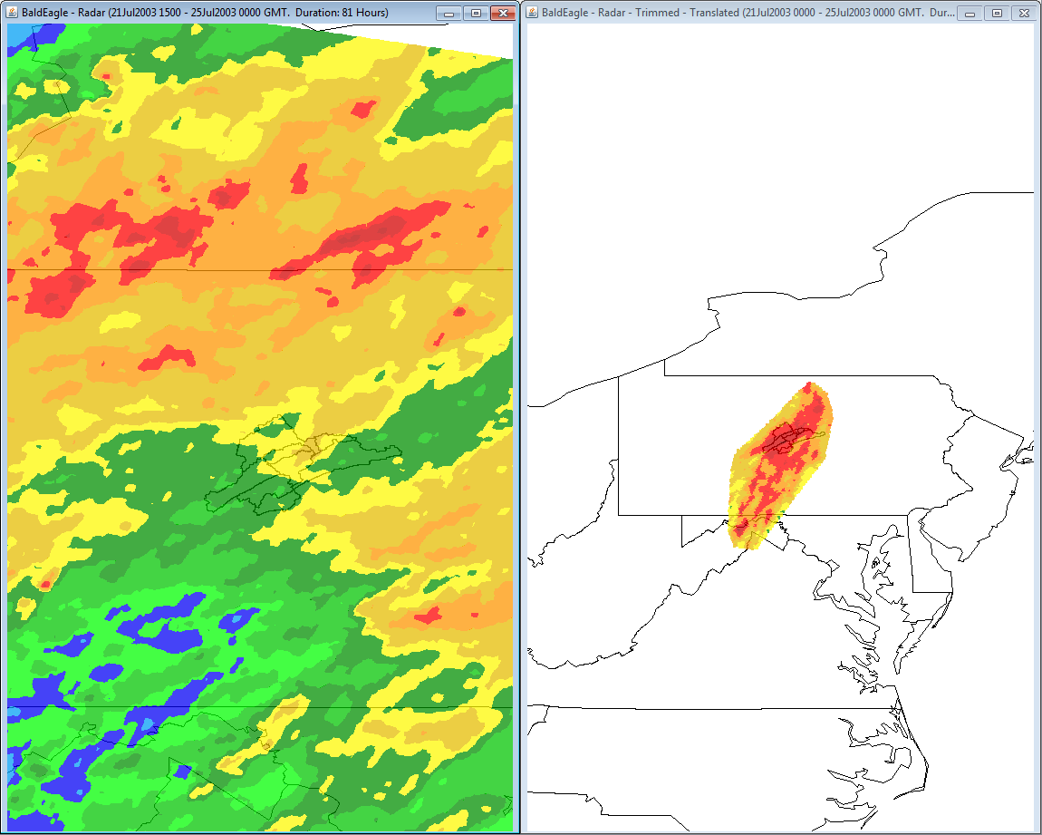
Map Window Features
Visualization Layers
  Contour, Basin Avg., TIN Mesh, Point Measurement, & Gage Interpolation Layers
Interactive zoom:
  Encompass Data or background map extents
  Previous zoom levels
Map Panel tiling and zoom level syncing
Mouse tracking (point coordinate & value)

Slide 5
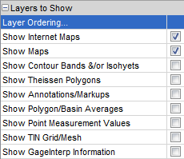
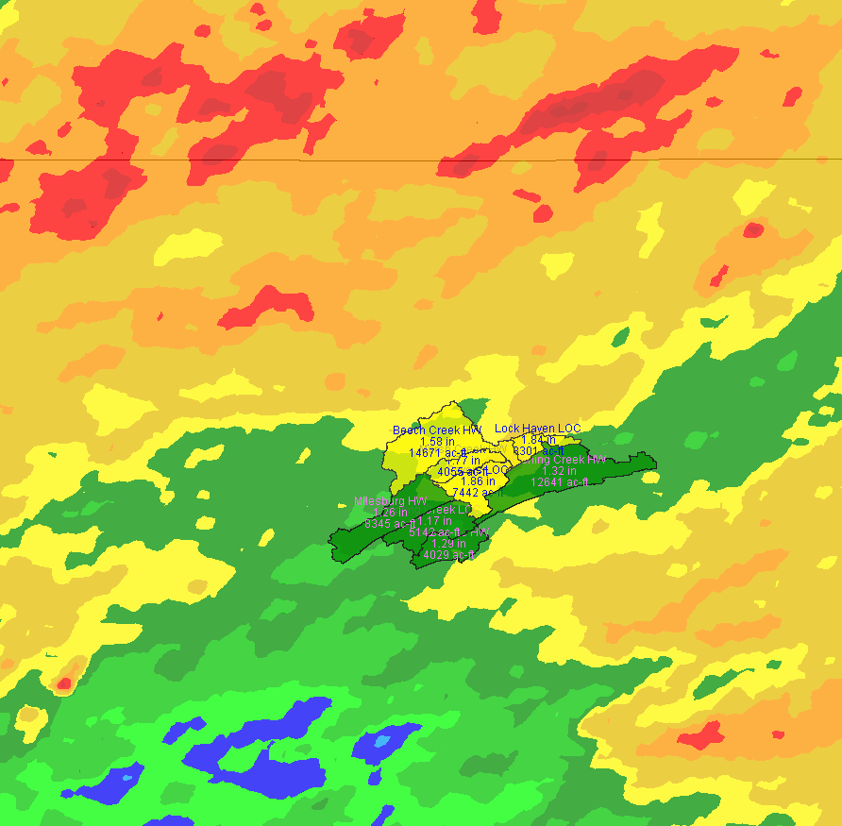
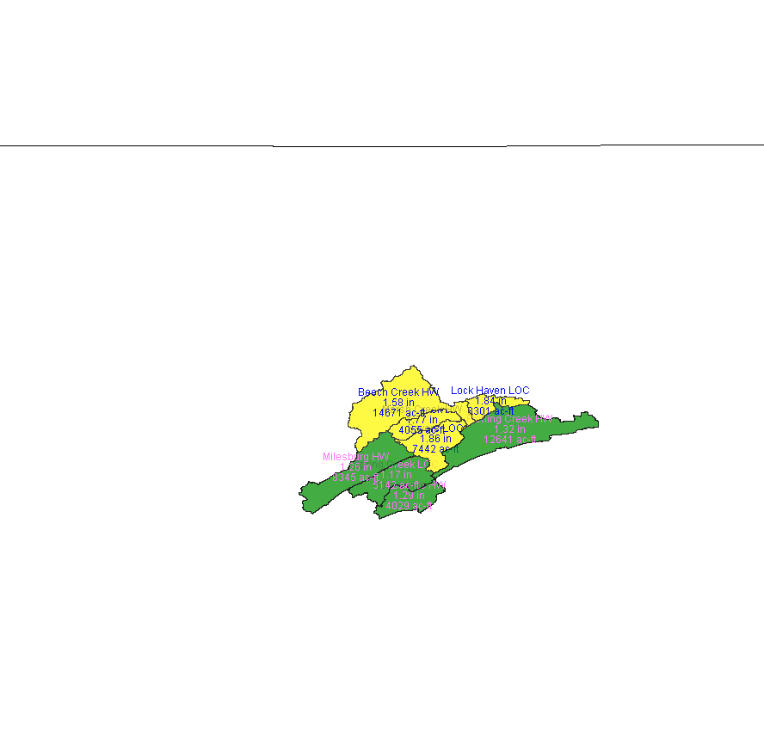

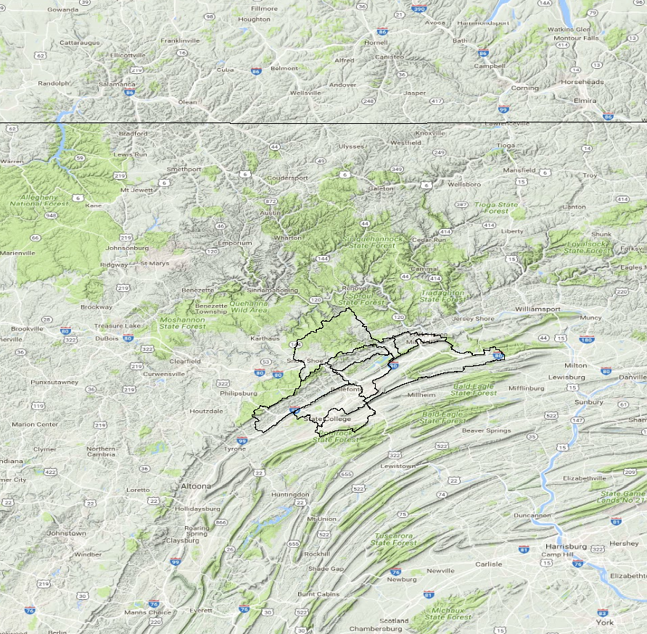
Layer Visualization Options
Contour Layer
Basin Average Layer
TIN Layer
Web Map Layer

Slide 6
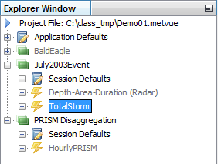
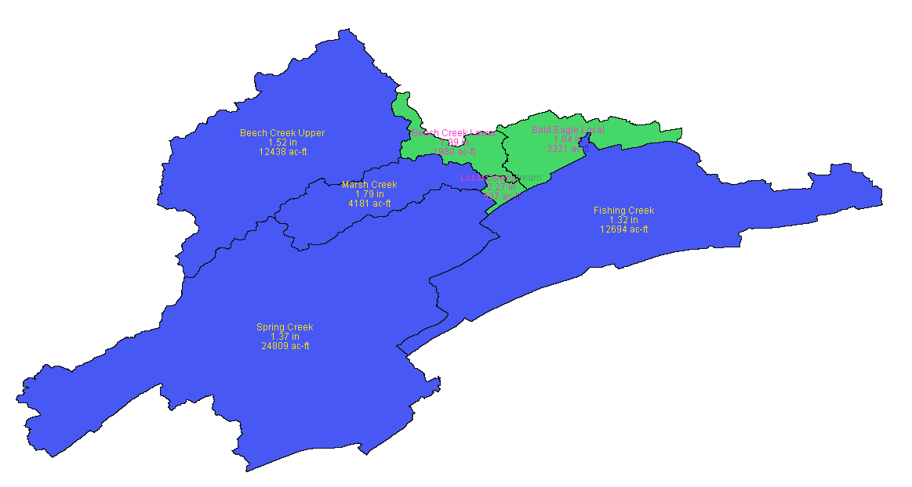
HEC-MetVue File & Data Management
A Project File (*.metvue) is in XML format and contains project configuration and settings information
A Session is the work area for the user to organize work units (Map Windows)
A Map Window is the work unit that contains the information the user views and edits
Session
Session
Map Window

Slide 7
Questions
Help additional Training
https://usace.dps.mil/sites/KMP-WM/SitePages/Corps-Water-Management-System-(CWMS).aspx
https://www.hec.usace.army.mil/confluence/cwmsdocs
https://discourse.hecdev.net/c/cwms/5
TDL-CELRH-EC-GW-W-USACE CWMS Modeling | General | Microsoft Teams

